Slide 1


UNIVERSIDAD AUTÓNOMA DEL ESTADO DE MÉXICO
FACULTAD DE LENGUAS
LICENCIATURA EN LENGUAS
ANÁLISIS LITERARIO EN INGLÉS
LITERATURA MEDIEVAL
PROFESORA: CELENE GARCÍA ÁVILA
SEMESTRE 2018 B

Slide 2
BEOWULF
General aspects

Slide 3
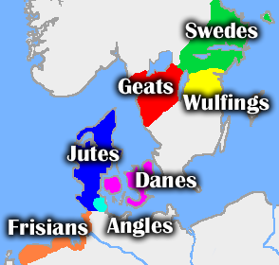
Tribes
Notes:
Mapa de las tribus que aparecen en la historia.

Slide 4
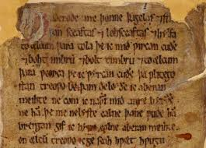
SURVIVING MANUSCRIPT
It has come down to us in a single manuscript, MS. Cotton Vitellius A.XV.
This MS. is kept in the British Museum
The epic poem was trascribed into West Saxon dialect at the end of the tenth century.
It is belived to have been composed in the eighth century
Notes:
En esta lamina se presenta la información y la imagen del único manuscrito de Beowulf.

Slide 5
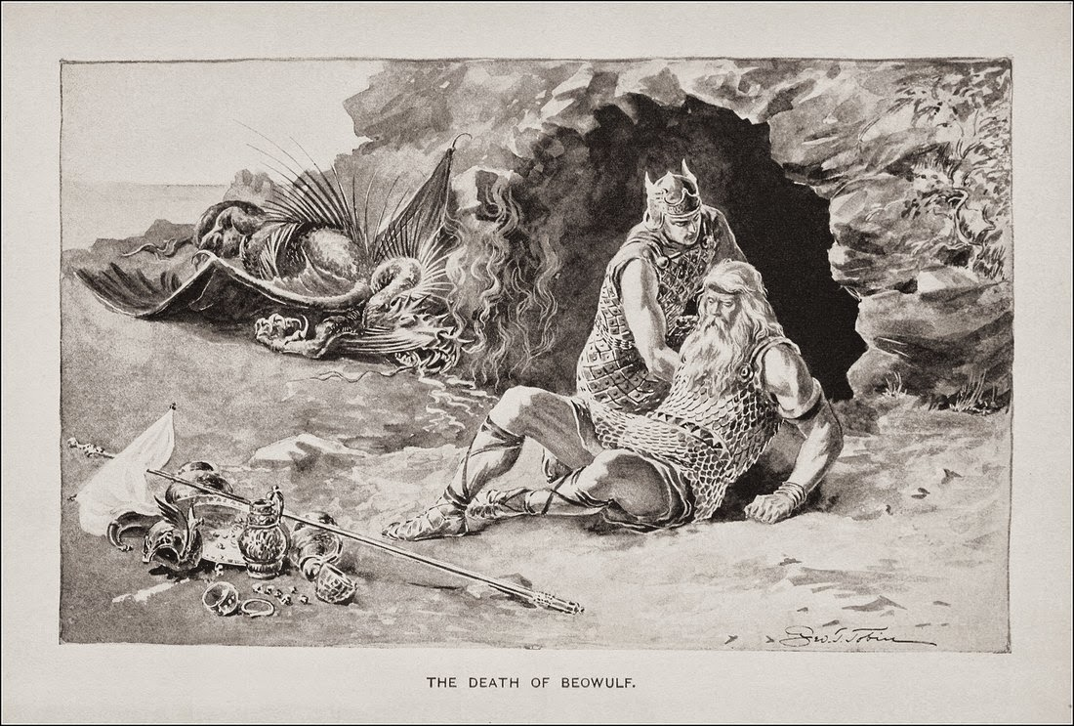
It is Anonymous
It was not given the title Beowulf until 1805
It wasn’t printed until 1815
It was admired inthe nith century by King Alfred among others
Notes:
En esta lámina se presentan datos generales del manuscrito y se agrega una imagen representativa de la posible muerte del padre de Beowulf.

Slide 6
The unique MS. Survived the fire of 1731, which destroyed or damaged much of the library of Sir Robert Cotton (1571-1631)
Some of the text was already lost when the Icelandic schoolar G.J. Thorkelin came to make the trascriptions, which were completed in 1787.
The text is divided into 43 fits or sections with line-endings and, less frequently, half-line endings indicated by punctuation.
Modern editors have arranged the text in verse.
However no evidence of date and place of composition is conclusive.
Notes:
Descripción de los cambios estructurales en Beowulf desde su publicación hasta ahora.

Slide 7
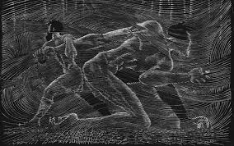
Multicultural influences
Beowulf absorbed all sorts of European polyglot influences:
The Germanic roots of the poem’s Anglo-Saxon language
The Scandinavian roots of its narrative.
The epic poem depicts a Britain tied to the continent.
There are pagan traditions mingled with later Christian religious practices
Local legends of the Danes and Swedes are also preserved.
Notes:
Datos generales la multiculturalidad que se pueden encontrar en el manuscrito de Beowulf.

Slide 8
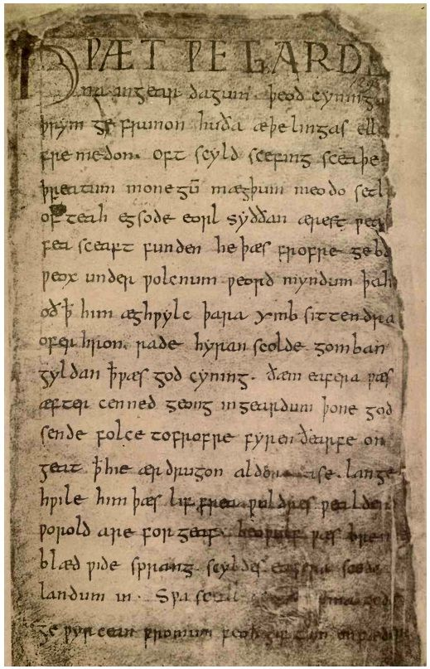
Notes:
Manuscrito original de Beowulf.

Slide 9
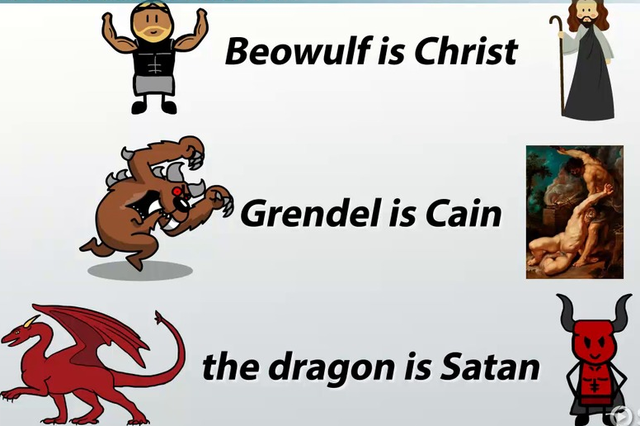
Alusions to christianity
Cain
The giants
The Devil (“old enemy”, “the enemy of mankind”)
664 important differences between the Celtic church and the Roman church were settled in the Synod of Whitby, so Christianity was the dominant religión in the country, but bishops kept on insisting to prescribe penance for those who practiced pagan rites.
Notes:
En esta lámina se muestran alusiones encontradas a Beowulf referentes a la religión cristiana.

Slide 10
Sir thomas malory
Le Morte D’Arthur

Slide 11
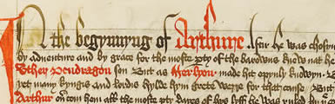
The winchester manuscript
Thomas Malory's 'Le Morte D’Arthur‘
British Library Add. MS 59678, f.35
Copyright © The British Library Board
This sole surviving manuscript copy is known as the Winchester manuscript) of Thomas Malory’s version of the legends of King Arthur and his knights; it was made within a decade of the author’s death in 1471.
Notes:
El manuscrito Winchester es el único sobreviviente. La imagen es del manuscrito real.

Slide 12
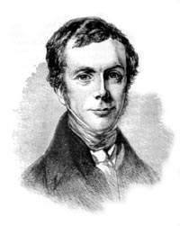
Malory was a ‘knight prisoner’
His identity is not certain. He is generally believed to have been the Sir Thomas Malory who inherited the estates of Newbold Revel in Warwickshire and Winwick in Northamptonshire in 1434, aged around 24 years.
Malory led the unremarkable life of a country gentleman, attending to his judicial and social responsibilities as lord of the manor until 1450 when, for unknown reasons, he turned to a life of crime.
Notes:
Esta información es variada porque no se sabe la identidad de Malory, por lo que se hablará de diferentes personajes con el mismo nombre.
La imagen es del posible Malory que escribió Le Morte D’Artur.

Slide 13
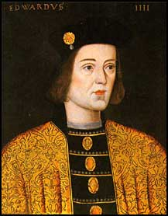
A “Thomas Malorie (or Malarie), knight” was excluded from four general pardons granted by Edward IV to the Lancastrians in 1468 and 1470. This Malorie, who may have been Malory of Newbold Revell, was probably the author of Le Morte Darthur.
Malory of Newbold Revell served in the train of Richard Beauchamp, earl of Warwick, at the siege of Calais.
Was knight of the shire in 1445; and died on March 14, 1471.
Notes:
Esta información es sobre el posible autor de Le Morte d’Arthur. La imagen es de Edward IV quién excluyó a Malory.

Slide 14
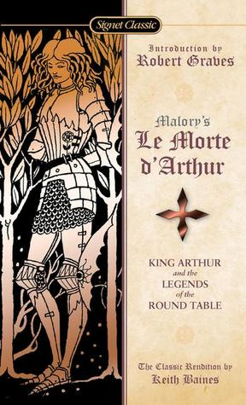
In the colophon to Le Morte D’Arthur the author, calling himself “Syr Thomas Maleore knyght,”
Malory was jailed on various occasions during the period 1450–60, but it is not recorded that he was in prison about 1470, when the colophon was written.
Notes:
En esta diapositiva se habla del Malory autor de Le Morte d’Arthur y cómo solía hacerse llamar a sí mismo.
La imagen es de la portada de dicho libro.

Slide 15
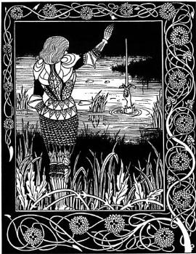
Malory of Newbold Revell served in the train of Richard Beauchamp, earl of Warwick, at the siege of Calais.
Notes:
Más información acerca de la vida Malory , autor de Le Morte d’Arthur.
La imagen es una representación de los caballeros que aparecían en dicho libro.

Slide 16
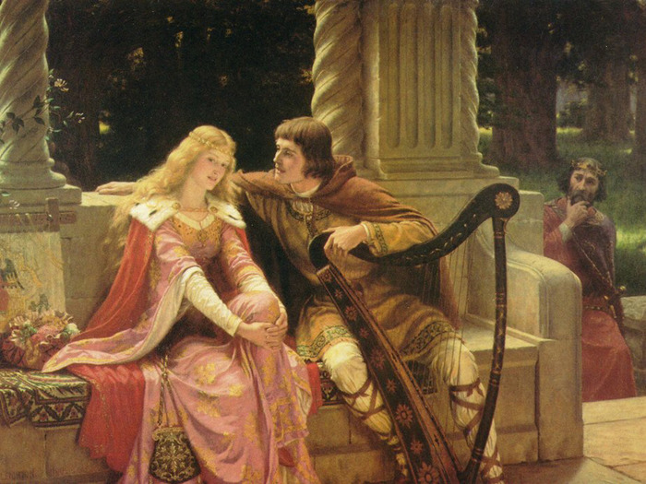
Malory’s romance is a glorification of chivalric values and of King Arthur, the British King, at one and the same time.
The only manuscript discovered in 1934, lags its beginning and its end and is not Malorys autograph.
Notes:
En esta diapositiva se parecía una representación del amor cortés en aquella época y sobre el cuál Malory solía escribir de forma enaltecedora.
El amor cortés consistía en mostrar ek amor hacia el ser querido de forma noble y siendo un caballero en el caso de los hombres, y corresponder con tiernas y delicadas muestras de amor correspondido por parte de las mujeres.

Slide 17
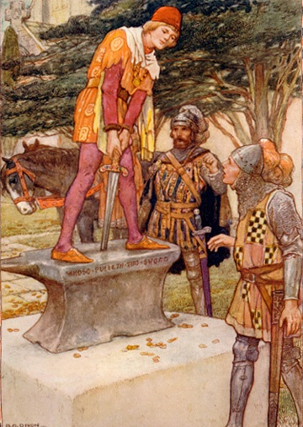
Morte Darthur
The selections given below are two of the best known in Malory’s book: how Arthur became King by pulling out the sword from the stone and how he met his death.
Both display Malory’s superb narrative skill and the care and composure of his literary idom.
Notes:
Se mencionan los dos momentos más representativos dentro de la historia de Malory, así como las principales características en su forma de escribir.

Slide 18
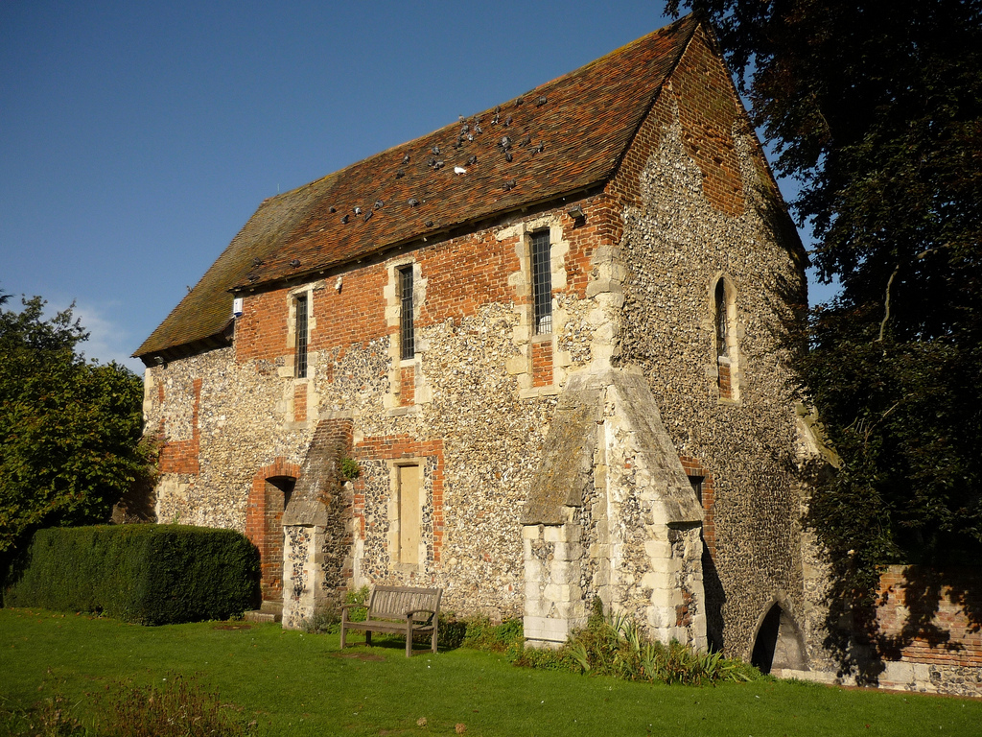
He was buried in the Chapel of St. Francis at Grey Friars, near Newgate
Notes:
Chapel of St. Francis at Grey Friars.

Slide 19
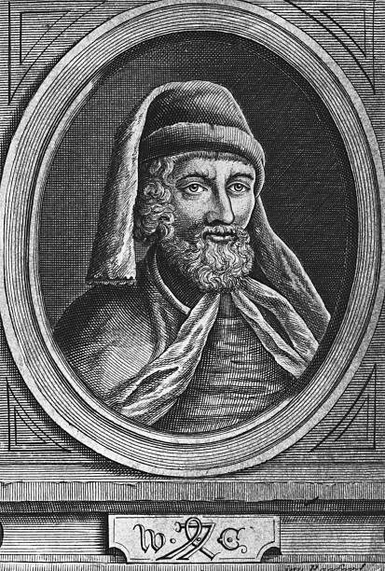
Malory completed Le Morte Darthur about 1470; it was printed by William Caxton in 1485.
Notes:
Imagen de William Caxton

Slide 20
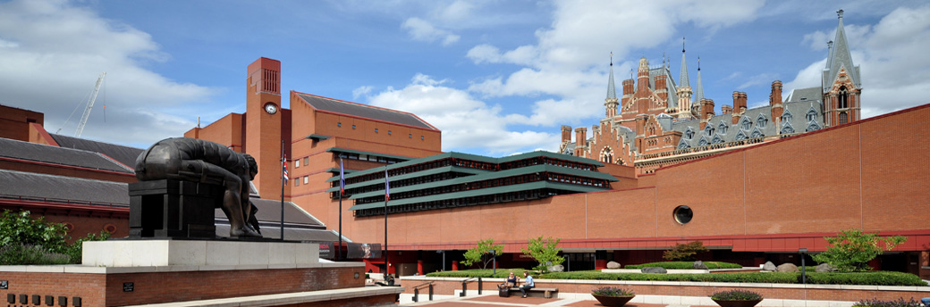
The only extant manuscript that predates Caxton’s edition is in the British Library, London.
Notes:
British Library.

Slide 21
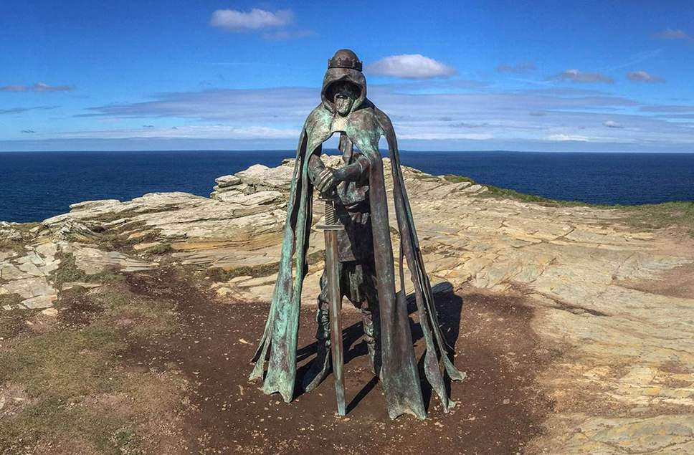
The village and nearby Tintagel Castle are associated with the legends surrounding King Arthur.
Notes:
Estatua de Rey Arturo en Tintagel.

Slide 22
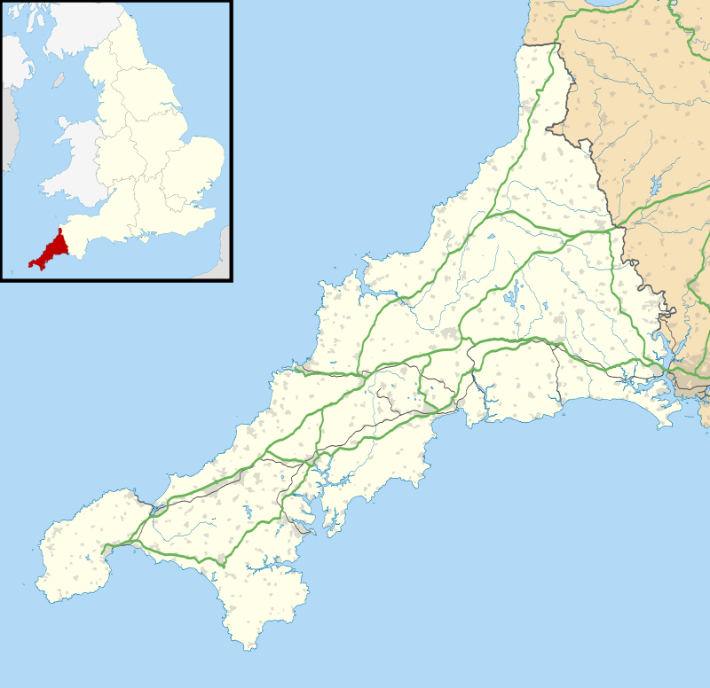
Tintagel or Trevena is a civil parish and village situated on the Atlantic coast of Cornwall, England, United Kingdom.
Notes:
Ubicación de Tintagel en el mapa.

Slide 23
Geoffrey Chaucer
The Merchant’s Tail

Slide 24
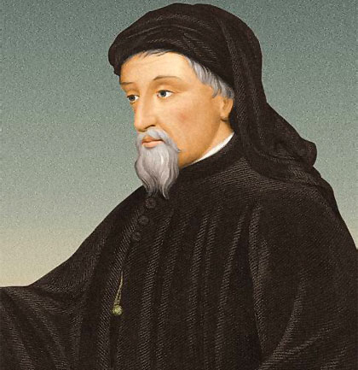
He was born into a well-to-do burgeois family, in London, about 1343.
His father was a wine merchant, a memeber of the growing number of men in the comercial centers of England, specially in London, who were beginning to exert a powerful effect on the structure of English society.
They were somewhere in between: the beginning of the English middle class.
Notes:
Breve descripción de los primeros años de Chaucer junto a su familia en Inglaterra.

Slide 25
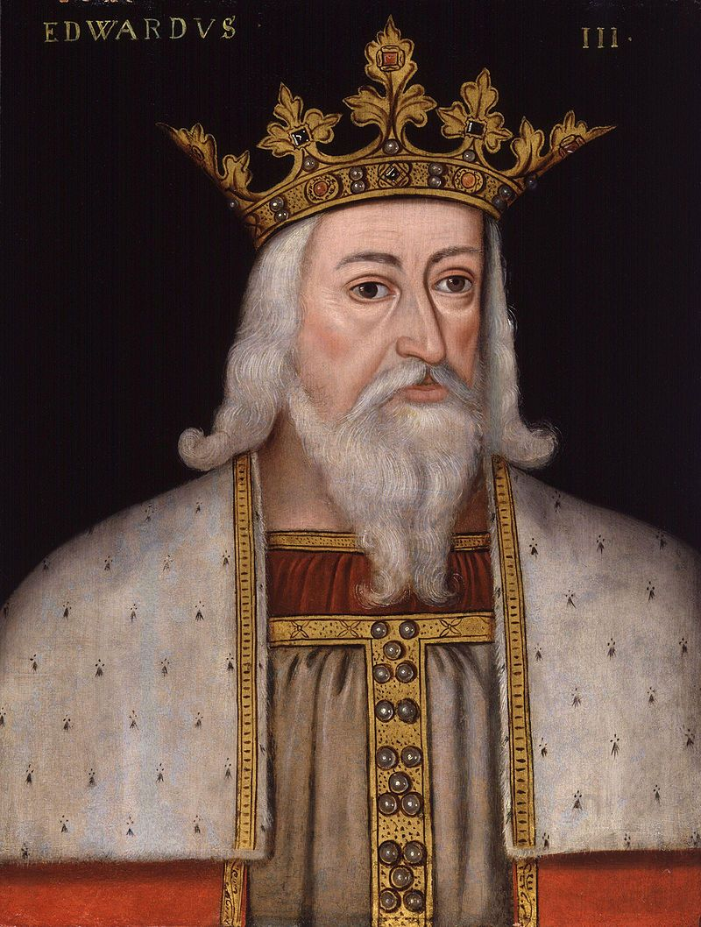
In his early teens, Chaucer was made a page in the household of one of England’s most considerable noblemen, Prince Lionel, third son of King Edward III, and later Duke of Clarence.
The connections he made there must have served him well in later life and we know that his talent kept him in asociation with memebers of the aristocracy.
Notes:
Logros importantes en la vida de Chaucer como adolescente. Esto le abrió muchas puertas en sociedad.

Slide 26
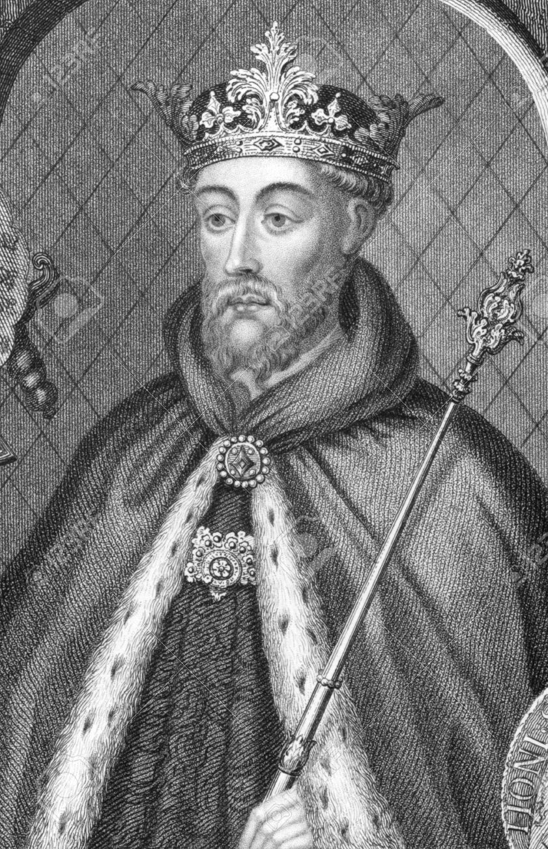
His first great patron was John of Gaunt, fifth son of the King and the most powerful noble in England, who might also have been his friend.
From the successive kings, Edward III, Richard II and Henry IV, Chaucer recieved offices, grants of money, and other privileges for his services in various capacities.
He married well; is wife Philippa was a memeber of the houholds of both Queen Philippa and of the thirth wife of John of Gaunt, and it was probably the daughter of a knight.
Notes:
En esta diapositiva se menciona cómo es que Chaucer fue subiendo de categoría social al trabajar con figuras importantes de la burguesía y realeza. También se añade un pequeño comentario sobre su esposa y cómo es que ella también era parte del grupo de personajes ingleses importantes.

Slide 27
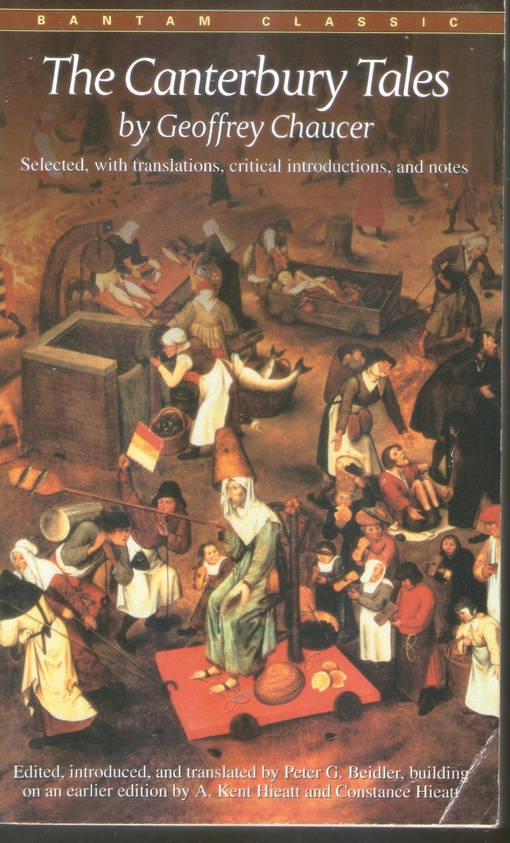
The Canterbury tales
Cronologicaly, the tales are his final achievement, though it looks as if he had long before worked out drafts of some of the stories which he propose to use (the “tragedies” of the Monk’s Tale, the Second Nun’s Tale of St. Cecilia, an early versión of the Knight’s Tale – for the plot of which he was again indebted to Boccaccio)
In terms of asrtistry the Tales represent the pick of his gigantic and vaired talent, his fullest and most mature production.
Notes:
Presentación de la obra más importante de Chaucer, The Canterburry Tales.

Slide 28
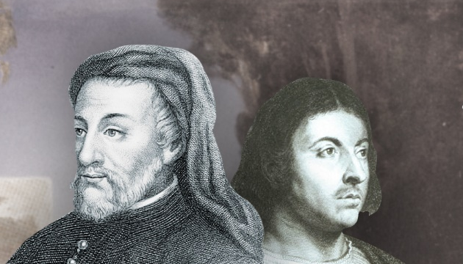
The Tales are certainly the expression of Chaucer’s fully matured genious; yet even if he had never written them he will have done enough to make it clear that he has no superios as an English poet except Shakespeare.
He dwarfs his contemporaries – and the poets of the next hundred and fifty years- in the same way as Shakespeare dwarfs his.
Notes:
Aquí se muestra un pequeño y general análisis de la forma de escritura de Chaucer así como la relación que guarda con Shakespeare.

Slide 29
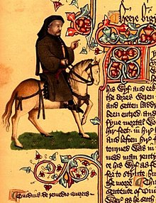
There were many respects in which Chaucer shared European preoccupations, one of the most important being the counscious artistry of his verse.
As with any great poet, this is partly a matter for which instinct most account. But it is also partly a matter of self-awareness in the handling of subject and verse, so as to produce the máximum effect of “sentence and solas”: profit and delight.
One means of doing this was to intimate the ancient poets to show one self truly worthy to be in their company, inheritor of the poetic.}
Notes:
En esta diapositiva se mencionan algunos de los aspectos más importantes de la literatura de Chaucer.

Slide 30
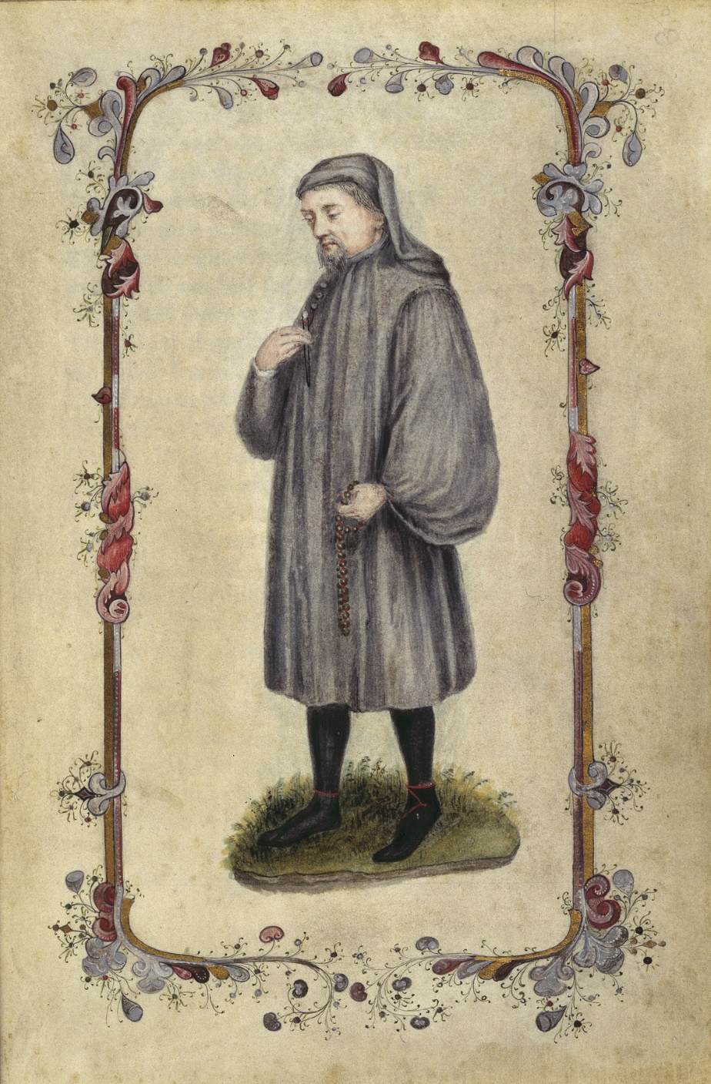
Chaucer’s English
Chaucer gave both prestige and currency to the English spoken in London at his time but this was not the only dialect of the language in which Works of literature were composed during the fourteenth century.
Chaucer, along with John Gower and other London authors of the fourteenth century, took the English of London just at a time when it was beginign to assert itself as the major dialect and carried it farther along the road.
Their use of it represents the true begining of modern standard English.
Notes:
Aquí se mencionas las características del inglés utilizado por Chaucer en su literatura y cómo esto representó el inicio de la literatura moderna.

Slide 31
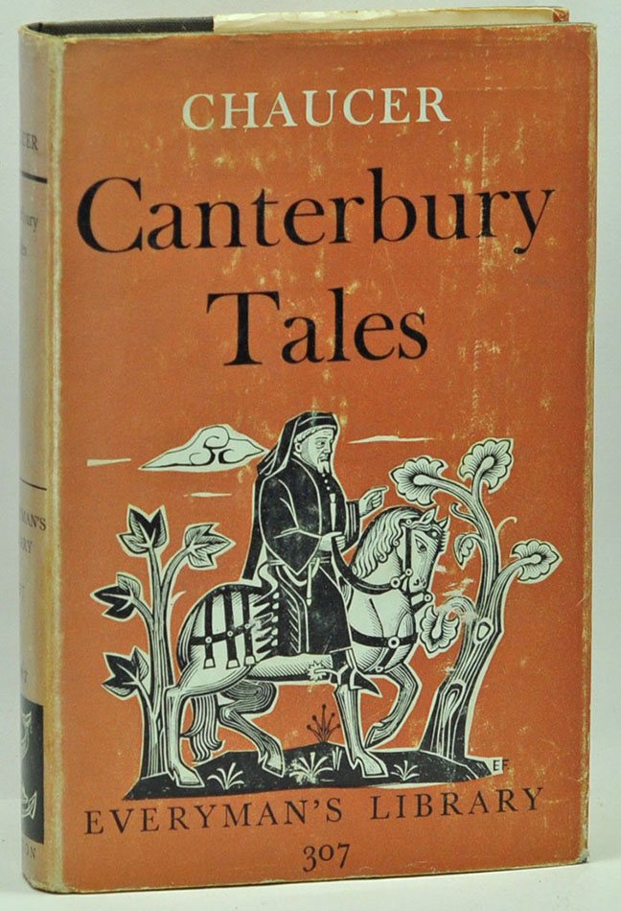
The best way to understand Chaucer is to read him aloud.
Reading aloud minimizes the difficulties of understanding Chaucer, which lie in the different meanings of much of his vocabulary and the subtlety of his poetry.
Notes:
Pequeños tips para lograr comprender la literatura de Chaucer a fin de disfrutar plenamente sus historias.

Slide 32
References
J.B. Trapp. (1973). The Oxford Anthology of English Literature Vol. I. London: Oxford University Press. Pp 119-129
J.B. Trapp. (1973). The Oxford Anthology of English Literature Vol. I. London: Oxford University Press. Pp 444-447

