Slide 1

Facultad de Contaduría y Administración
Unidad de Aprendizaje: Inglés C1
Licenciatura informática administrativa
(Modalidad Presencial y a distancia)
Título: connecting ideas
SOLO VISIÓN PROYECTABLE
AUTORA:ROSA LILIANA CORDERO NAVA

Slide 2
Language and pronunciation
Unit of Competence B:Understanding factual academic articles and presenting the summary with main points.
El presente material educativo (Sólo visión proyectable) está diseñado para el desarrollo de los objetivos de las habilidades de Lenguaje y Comunicación (Language and Pronunciation) de la Unidad de Competencia B del Nivel de Inglés C1 de la Dirección de Aprendizaje de Lenguas.

Slide 3
Objetivos
Types of clues: finding definition of and unknown word in a texts by a synonym, an antonym, an explanation.
Discourse markers to link ideas: however, nonetheless, moreover, furthermore, therefore, as a result, etc.
Signal words: before, after, since, while, whether, also, too, etc.
Phrasal verbs: point out, look over, look up, think over, carry out, pick up.
Linking words of the sentences.
Stress patterns with phrasal verbs.

Slide 4
Guión explicativo
El presente material educativo está diseñado para el desarrollo de los objetivos de Language and pronunciation de la Unidad de Competencia B del Nivel de Inglés C1 de la DAL.
El vocabulario y algunas ideas para los ejemplos expuestos fueron adaptados (sólo con propósitos académicos) de dos artículos relacionados con la temática de Negocios en México; es por ello, que en los ejemplos y las actividades sugeridas en su mayoría contienen vocabulario técnico del área de Negocios.
Se recomienda tener conexión a Internet para visitar los vínculos de las palabras y practicar su pronunciación. Es importante que el estudiante escuche la pronunciación cuantas veces lo crea necesario y de ser posible en algún dispositivo grabe con su voz la pronunciación de cada palabra, esto le generará un aprendizaje más significativo.
También se recomienda que los estudiantes creen sus propios ejemplos con el vocabulario sugerido o con sus propias ideas y así contextualizar y consolidar el vocabulario nuevo.

Slide 5


Guión explicativo
Icono de audio: al dar clic se desplegará un diccionario en Internet con la pronunciación
Icono de actividad de expresión oral: se recomienda en parejas o de forma individual generar un ejemplo nuevo con el vocabulario sugerido o con sus propias ideas.

Slide 6
Guión explicativo
El presente material educativo se puede utilizar en:
Aula de clase: conversaciones en parejas, equipos o como material para toda la clase en forma de presentación.
Centro de Autoacceso: Asesorías individuales o grupales para practicar el lenguaje y pronunciación.
Inglés C1 a distancia: Para asesorías a distancia, ya sea de grabación en voz, chat en vivo, material de referencia, o para la asignación de una actividad de practica de lenguaje, pronunciación, redacción y expresión oral.

Slide 7
Contenido
El presente material se divide en cuatro secciones:
Finding a definition
Discourse markers
Signal words
Phrasal verbs

Slide 8
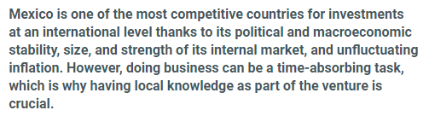
F i n d i n g a d e f i n i t i o n
When reading a text ,it is important to understand the main idea of a sentence or paragraph.
When you face an unknown word try :
Analyze what it is before and after
Look for discourse markers
Look for signal words
Find synonyms or antonyms
With these ideas you will understand better, the main idea.

Slide 9

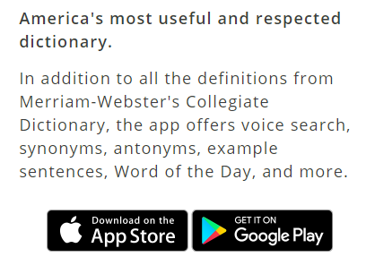
A suggested dictionary
URL https://www.Merriam-webster.Com/
The dictionary by merriam-webster is America's most trusted online dictionary for English word definitions, meanings, and pronunciation.
It’s easy to use and you can use it on your computer, tablet or cell phone

Slide 10
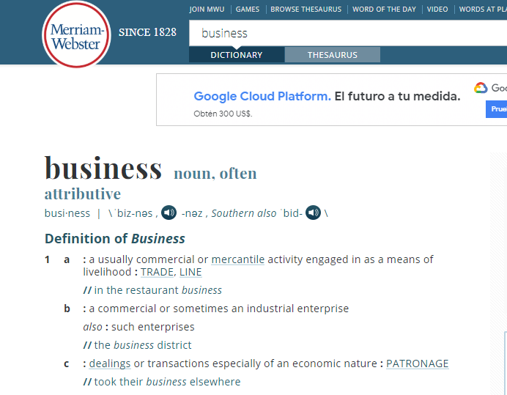
Finding s new definition
Listen to the pronunciation
Business
Check different definitions with examples
A usually commercial or mercantile activity engaged in as means of livelihood
Example: in the restaurant business
Identify if it the word is: a noun, verb, preposition, adverb, etc.

Slide 11
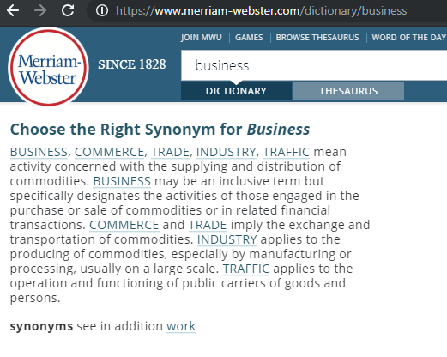
SYNONYMS
A wide range of synonyms:
Commerce
Trade
Industry
traffic
Synonyms can be used to avoid repetition when speaking or writing

Slide 12
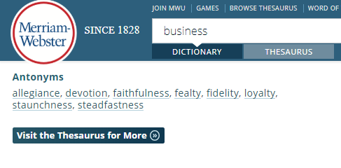
ANTONYM
A wide range of antonyms:
Allegiance
Devotion
Faithfulness
Fealty
Fidelity
Loyalty
Staunchness
Steadfastness
Antonyms are opposites that can be helpful to have a variety of vocabulary

Slide 13
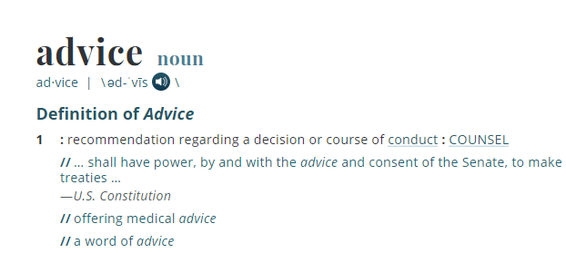
EXCERCISE
Go the DICTIONARY and look up the following words:
Advice
Applicant
Budget
Headquarters
Subsidiary
Account
Goods
Purchase
ACTIVITY
Read the explanation
Listen to the pronunciation
Repeat as many time as possible
Identify synonyms and antonyms

Slide 14
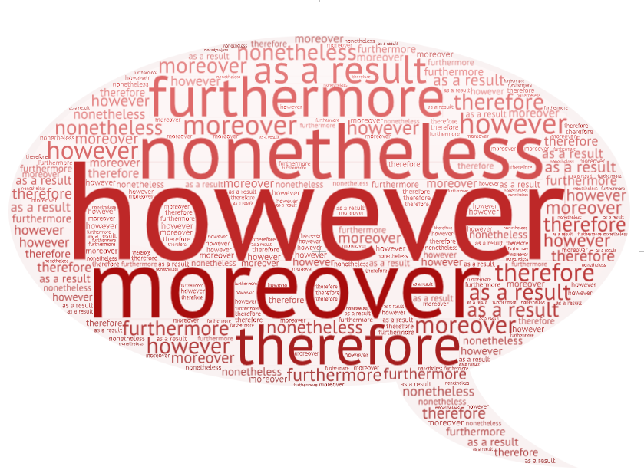
D i s c o u r s e m a r k e r s
Discourse markers are words or phrases that help to connect, organize and manage what a person says or writes.

Slide 15
HOWEVER
Example:
Mexico is an excellent country to start a small business enterprise, however, it is necessary to follow several procedures to save time and avoid future problems.
HOWEVER
(click here to hear the pronunciation)
Definition
In whatever manner or way
To whatever degree or extend
In spite of that: on the other hand
How in the world
Activity: Try saying an example using However with the following ideas:
Mexican Social Security Institute
Electricity
Registering property
Getting credit

Slide 16
NONETHELESS
Example:
Paying taxes is a laborious process in Mexico, nonetheless there are only six payments to be made.
NONETHELESS
(click here to hear the pronunciation)
Definition
NEVERTHELESS
In spite of what just been said
Activity: Try saying an example using nonetheless with the following ideas:
Tax legislation
Foreign companies
Invoice
supplier

Slide 17
MOREOVER
Example:
Mexico has free trade agreements with 46 countries, moreover, it has become a global manufacturing base with economies in North and South america
MOREOVER
(click here to hear the pronunciation)
Definition
In addition to what has been said: BESIDES
Activity: Try saying an example using moreover with the following ideas:
Strategic location
Consumption centers
policies
trade

Slide 18
FURTHERMORE
Example:
Mexico is an excellent country to start a small business enterprise, furthermore, it is necessary to follow several procedures to save time and avoid future problems.
FURTHERMORE
(click here to hear the pronunciation)
Definition
In whatever manner or way
To whatever degree or extend
In spite of that: on the other hand
How in the world
Activity: Try saying an example using furthermore with the following ideas:
Mexican Social Security Institute
Electricity
Registering property
Getting credit

Slide 19
THEREFORE
Example:
Having local knowledge of the investment environment and good information on the taxation framework can therefore be an asset for any overseas venture.
THEREFORE
(click here to hear the pronunciation)
Definition
For that reason: consequently
Because of that
On that ground
Activity: Try saying an example using Therefore with the following ideas:
Legal information
Accounting information
Domestic economy

Slide 20
AS A RESULT
Example:
Mexican government has made improvements to its infrastructure. As a result, it now stands as the 15th largest economy.
As a result
(click here to hear the pronunciation)
Definition
Because of something
Often +of
Activity: Try saying an example using As a result with the following ideas:
Transportation
Energy
telecommunications

Slide 21

S i g n a l w o r d s
Signal words help to show the connection between ideas. It can be comparison, contrast, cause, effect, problem and solution.

Slide 22
BEFORE
Example:
Before Mexico signed the NAFTA agreement, there were a lot of talks about negotiations which are still in revision due to political factors.
BEFORE
(click here to hear the pronunciation)
Definition
Conjunction
Earlier than the time that
Sooner or quicker than
So that… do not
Until the time that
Activity: Try saying an example using before with the following ideas:
Agreements
Trade
Goods
Import and export

Slide 23
A F T E R
Example:
After Mexico signed the NAFTA agreement, it has been proved that the workforce has been growing fast.
A F T E R
(click here to hear the pronunciation)
Definition
Conjunction
Subsequentely to the time when
Activity: Try saying an example using After with the following ideas:
Canada
Materials
Economy
Challenges.

Slide 24
S I N C E
Example:
Since 1996 US, Mexico and Canada have been working together importing and exporting their products.
SINCE
(click here to hear the pronunciation)
Definition
Conjunction
At a time in the past after or later than
In view of the fact that
Activity: Try saying an example using since with the following ideas:
Trump administration
Obama administration
Peña Nieto admisnitration

Slide 25
W H I L E
Example:
Mexico has been reforming its financial regulations while, other countries haven’t change a lot their main financial regulations.
W H I L E
(click here to hear the pronunciation)
Definition
Conjunction
During the time that
As long as
When on the other hand
Activity: Try saying an example using while with the following ideas:
Financial reform
Structuring process

Slide 26
W h e t h e r
Example:
At the end of this political period Mexicans will determine whether there will be a good financial future for the country.
W H E T H E R
(click here to hear the pronunciation)
Definition
Conjunction
Used as a function Word usually with correlative or or with or whether to indicate
An indirect question involving stated or implied alternatives.
Activity: Try saying an example using whether with the following ideas:
Foreign investment
Credits
investors

Slide 27
P h r a s a l V e r b s
Phrasal verb is a phrase that combines a verb with a preposition or adverb or both and that functions as a verb whose meaning is different from the combined meanings of the individual words.
verb
+
preposition

Slide 28

POINT OUT
Example:
Mexican President Peña Nieto pointed out in his last government report that the percentage of employment has increased considerably.
POINT OUT
(click here to hear the pronunciation)
Definition
To direct someone’s attentions to (someone or something) by pointing
To talk about or mentions (something that one thinks is important)
Activity: Try saying an example using point out with the following ideas:
Small business
Client
unemployment

Slide 29

LOOK OVER
Example:
The students of Public Administration are looking over the first local government report in order to give a detailed report.
LOOK OVER
(click here to hear the pronunciation)
Definition
To inspect or examine especially in a cursory ways
Activity: Try saying an example using look over with the following ideas:
A specific article
A final exam

Slide 30
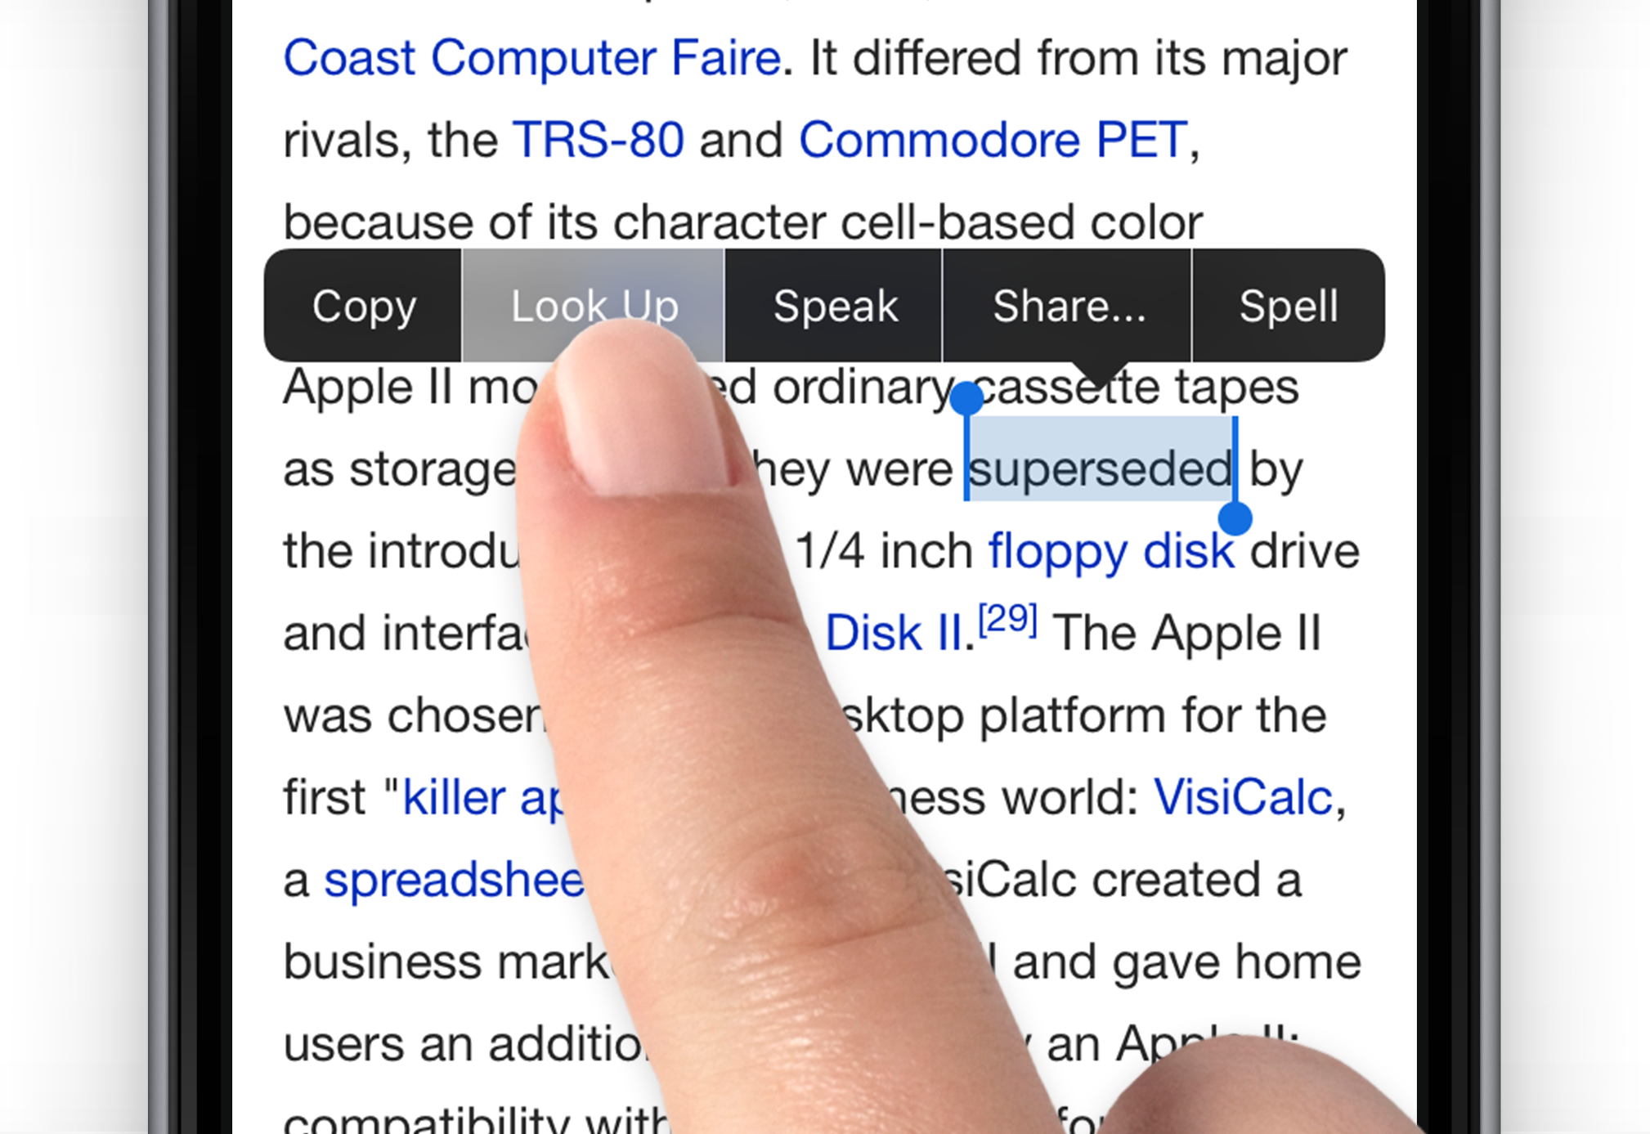
L O O K U P
Example:
To learn more vocabulary always try to look up the synonyms and antonyms of a new word.
LOOK UP
(click here to hear the pronunciation)
Definition
To search for in or as if in a reference work
To seek out especially for a brief visit
Activity: Try saying an example using look up with the following ideas:
A figure in a list
The etymology root

Slide 31
THINK OVER
Example:
The commission will think over if the proposal is reasonable.
THINK OVER
(click here to hear the pronunciation)
Definition
To think about (something) for a period of time especially in an effort to understand or make a decision about it
Activity: Try saying an example using think over with the following ideas:
An offer
An idea
A decision

Slide 32
CARRY OUT
Example:
The president said he carried out all his proposals before finishing his period.
CARRY OUT
(click here to hear the pronunciation)
Definition
To bring to a successful issue: complete and accomplish
To put into execution
To continue to an end or stopping point
Activity: Try saying an example using carry out with the following ideas:
Research
Marketing study

Slide 33

P I C K U P
Example:
The CEO of an important company picked up a severe illness when he went on business to a foreign country.
PICK UP
(click here to hear the pronunciation)
Definition
To take hold of and lift up
To gather together: COLLECT
To take (passengers or freight) into a vehicle
Activity: Try saying an example using pick up with the following ideas:
A friend
An object
flue

Slide 34

References
Cambridge Dictionary (2018)https://dictionary.cambridge.org/es/gramatica/gramatica-britanica/discourse-markers/discourse-markers-so-right-okay
Cambridge Dictionary Grammar (2018) https://dictionary.cambridge.org/es/gramatica/gramatica-britanica/discourse-markers/discourse-markers-so-right-okay
Close relationship brings benefits for US companies doing business in Mexico (June, 2018) https://www.tmf-group.com/en/news-insights/articles/2018/june/us-companies-business-in-mexico/
Cloud word of slide 13 was created with https://wordart.com/
Collins Dictionary English-English (2018) https://www.collinsdictionary.com/register
Elbaun S. N. (2016) 6th Edition Grammar in context 3 Cengage Learning
Images were taken from google images (used for academic purposes only) from https://images.google.com/
Merriam-Webster Dictionary English-English (2018) https://www.merriam-webster.com/
Top challenges of doing business in Mexico (March 2018) https://www.tmf-group.com/en/news-insights/articles/top-challenges/doing-business-in-mexico/

