Slide 1


UNIVERSIDAD AUTÓNOMA
DEL ESTADO DE MÉXICO
Plantel “Lic. Adolfo López Mateos” de la escuela preparatoria.
TÍTULO: Modulo II. Vida diaria: Hábitos y rutinas.
Tema 2. Hábitos y rutinas.
PROGRAMA EDUCATIVO: INGLÉS 1.
NIVEL EDUCATIVO DONDE SE IMPARTE: Medio Superior de la UAEMÉx.
SEMESTRE: SEGUNDO Semestre
CBU: 2015
Responsable de elaboración:
L.L.I. ERIKA MARIA LOREDO GALICIA.
PROFESOR DE ASIGNATURA DE INGLÉS

Slide 2
Guion explicativo para el empleo del material, con relación a los objetivos y contenidos del curso
La asignatura de inglés 1 del campo disciplinar de la Comunicación ubicándose en el segundo semestre con el propósito general de:
Emplea el idioma inglés de forma sencilla a través de expresiones cotidianas y representaciones lingüísticas básicas asociadas al contexto cultural y social en el que se desenvuelve, para satisfacer sus necesidades inmediatas de interacción, supervivencia o de relación con su entorno.
El curso se compone de 4 módulos:
El primer módulo hace referencia a su información personal y hace una introducción de los temas básicos del idioma. El módulo dos se enfoca en su vida diaria: hábitos y rutinas, el módulo tres se basa en su entorno: casa, escuela y ciudad. Y por último el cuarto se basa en cómo la cómo es el estudiante y cómo son las personas que lo rodean.

Slide 3
Este material esta basado en el tema 2 del Modulo II y tiene como próposito:
Construye de forma oral y escrita, un texto simple y coherente, sobre su familia, hábitos y rutinas, así como la frecuencia con que las realiza.
Por lo que las presentes diapositivas se centran en el desarrollo de la identificación de verbos y estructura de oraciones en presente simple, con verbos con los que los estudiantes se encuentran familiarizados, es un material de autoestudio. Las respuestas correctas se observan cuando se da la transición de las diapositivas y se le va dando CLIC en la respuesta más apropiada para el estudiante. Al dar CLIC aparece una imagen que indica si la respuesta es correcta o no. La presentación contiene hipervínculos.

Slide 4
Competencias
Competencia de la dimensión (perfil de egreso)
COMPETENCIA DISCIPLINAR
Comunicación. Básica
10 Identifica e interpreta la idea general y posible desarrollo de un mensaje oral o escrito en una segunda lengua, recurriendo a conocimientos previos, elementos no verbales y contexto cultural.
11. Se comunica en una lengua extranjera mediante un discurso lógico, oral o escrito, congruente con la situación comunicativa.
Extendida
9. Trasmite mensajes en una segunda lengua o lengua extranjera atendiéndolas características de contextos socioculturales diferentes.
COMPETENCIA GENÉRICA
4 Escucha, interpreta y emite mensajes pertinentes en distintos contextos mediante la utilización de medios, códigos y herramientas apropiados.
4.4 Se comunica en una segunda lengua en situaciones cotidianas.
7. Aprende por iniciativa e interés propio a lo largo de la vida.
7.1 Define metas y da seguimiento a sus procesos de construcción de conocimiento.
10. Mantiene una actitud respetuosa hacia la interculturalidad y la diversidad de creencias, valores, ideas y prácticas sociales.
10.2 Dialoga y aprende de personas con distintos puntos de vista y tradiciones culturales mediante la ubicación de sus propias circunstancias en un contexto más amplio.

Slide 5
Módulo 2
TEMA 2 | Vida diaria: Hábitos y rutinas.
Uso de la lengua | Simple Present (affirmative and negative forms, Yes or No questions and Wh- questions).
Vocabulario | Routine Verbs (get up, take a shower, go to school, do homework, have breakfast/lunch/dinner, surf the net, go to bed, do exercise, etcetera). Periodos del día (morning, afternoon, evening, night).

Slide 6

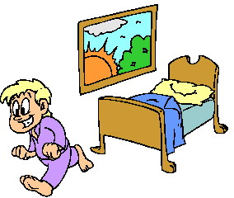
ROUTINE VERBS
Get up

Slide 7
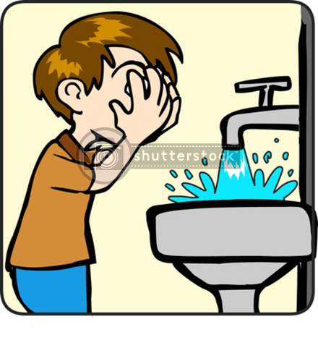
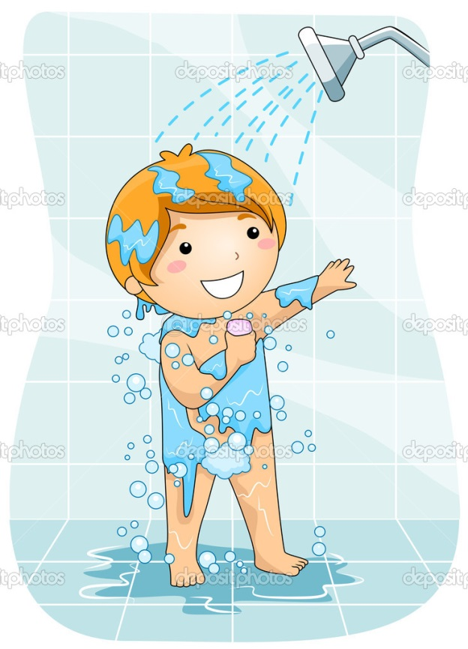
Wash your face
Take a shower

Slide 8
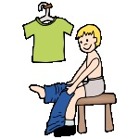
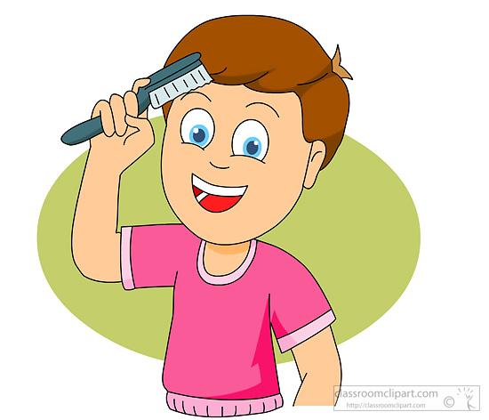
Get dressed
Brush your hair.

Slide 9
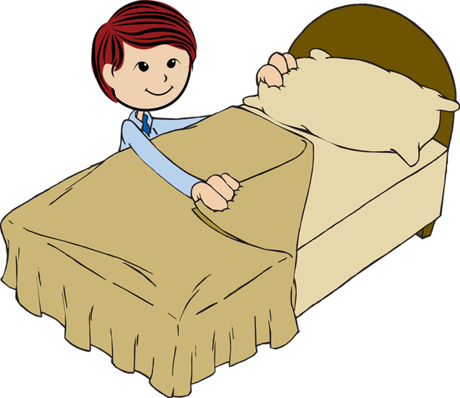
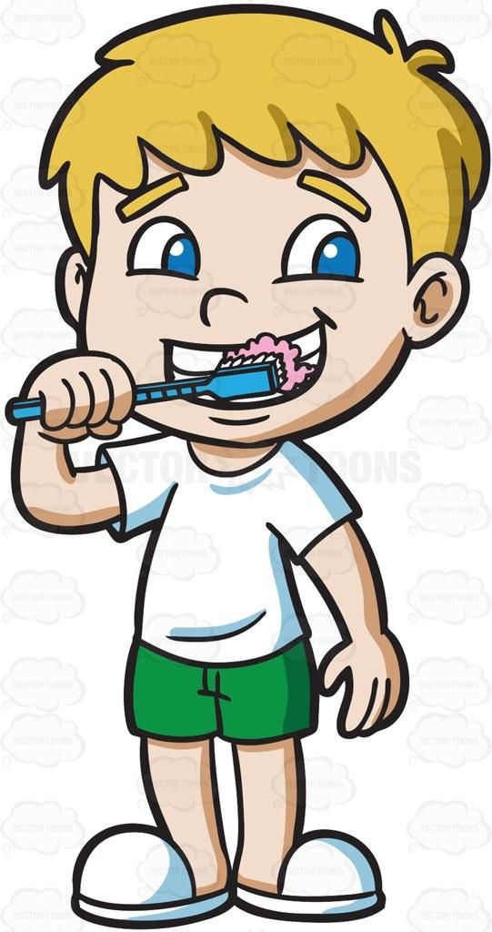
Make your bed
Brush your teeth

Slide 10
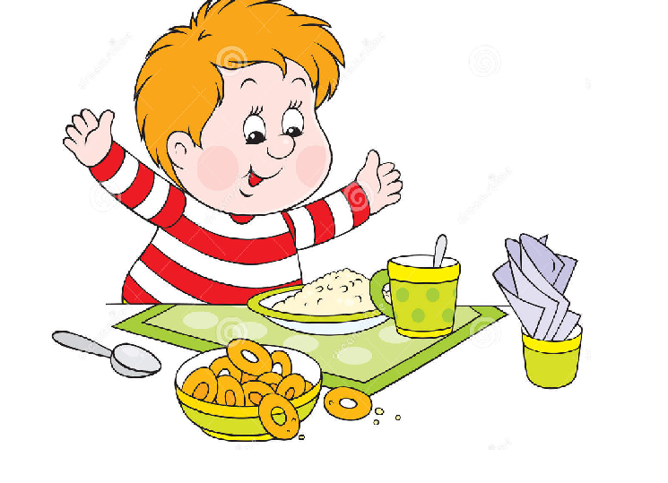
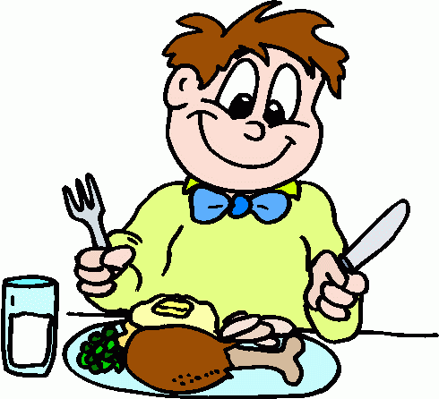
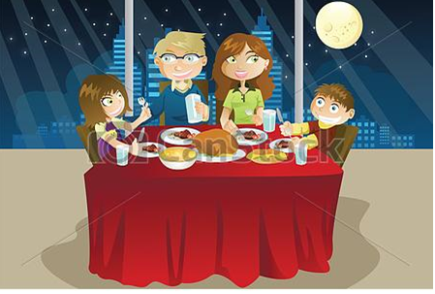
Eat breakfast before 10 a.m.
Eat lunch after noon.
Eat dinner after 6 pm.

Slide 11
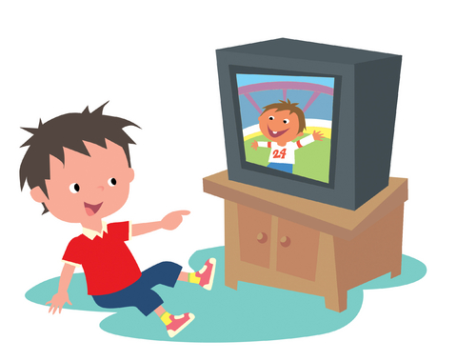

Watch T.V.
Listen to music

Slide 12
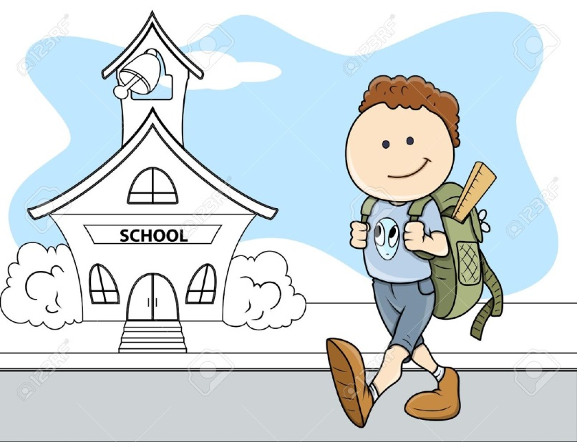
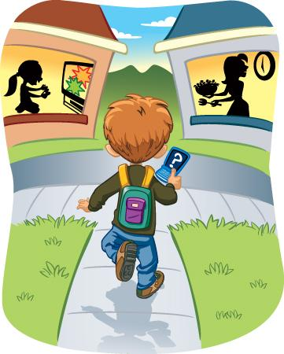
Go to school
Go home

Slide 13
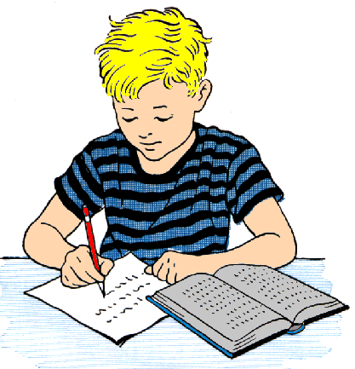
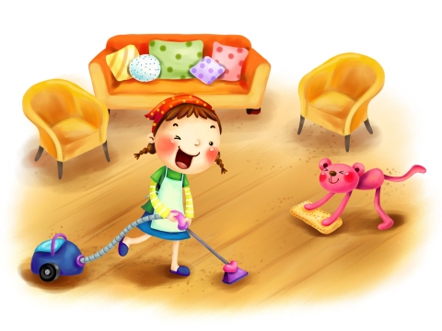
Do homework
Do housework

Slide 14
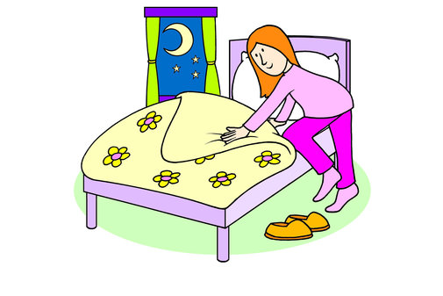
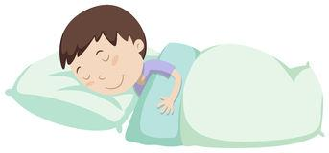
Go to bed
Go to sleep

Slide 15
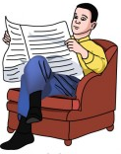
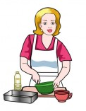
Read the newspaper
Make breakfast / lunch or dinner.

Slide 16
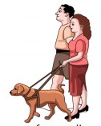

Go for a walk
Go shopping

Slide 17
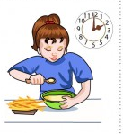
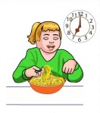
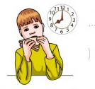
Practice 1
Click on the correct verb according to the picture.
1. Have dinner.

Slide 18

Terrific!!

Slide 19

You are wrong!!

Slide 20
2. Have breakfast .

Slide 21


Slide 22


Slide 23
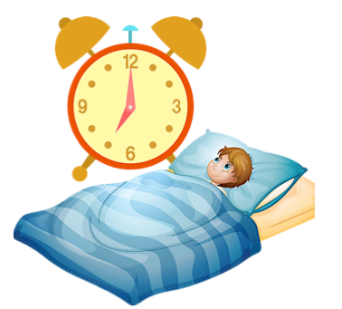
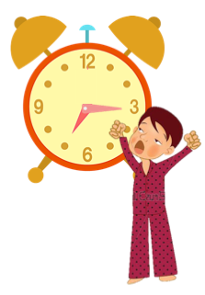
3. Get up .

Slide 24


Slide 25
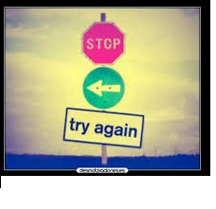

Slide 26
4. Wake up .

Slide 27


Slide 28


Slide 29
5. Do housework.

Slide 30


Slide 31


Slide 32
Present simple
Habits
Permanent actions
Uses
Routines
For timetables

Slide 33
GRAMMAR STRUCTURE

Slide 34
PRESENT SIMPLE: AFFIRMATIVE SENTENCES
Subject | Verb + complement.
I | read books.
You | sing pop songs.
We | play handball.
They | speak Japanese
Subject | Verb + complement.
He | reads books.
She | sings pop songs.
It | jumps very high.
Exception: Verbs ending in O / X / S / CH/ SH add - ES E.g. Do- does, fix – fixes, pass – passes, watch- watches, push – pushes.
Verbs ending in consonant + y add -IES e.g. study – studies, cry – cries, fly – flies.

Slide 35
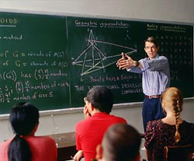
PRACTICE 2.
Click on the correct answer.
a) start
b) starts
c) startes
1. My Math class _________ at 10:40

Slide 36

Try again!!

Slide 38
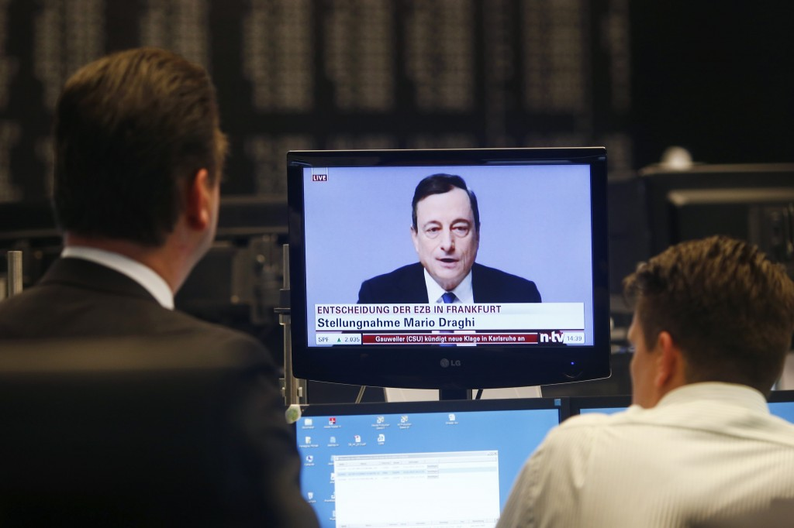
a) watchs
b) watches
c) watch
2. They __________ the news at 10 pm

Slide 39
You are wrong!!

Slide 40
Terrific!!

Slide 41
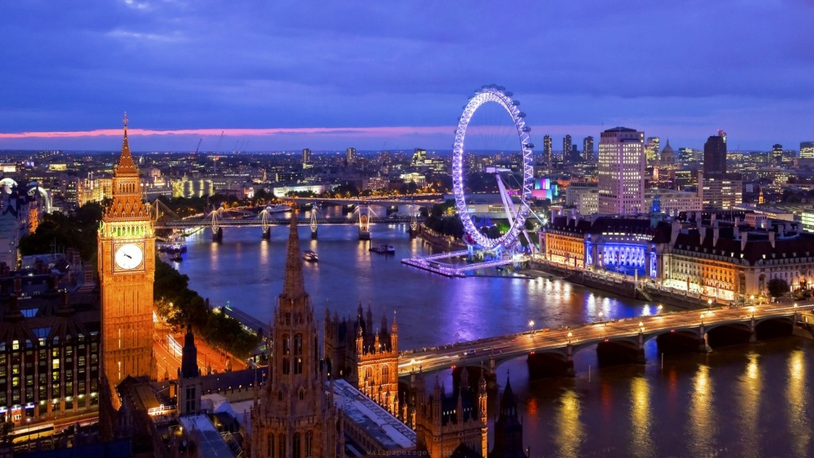
a) live
b) lives
c) living
3. My friend Mike ___________ with his parents in London.

Slide 42

EXCELLENT!!!!

Slide 43

TRY AGAIN!!

Slide 44
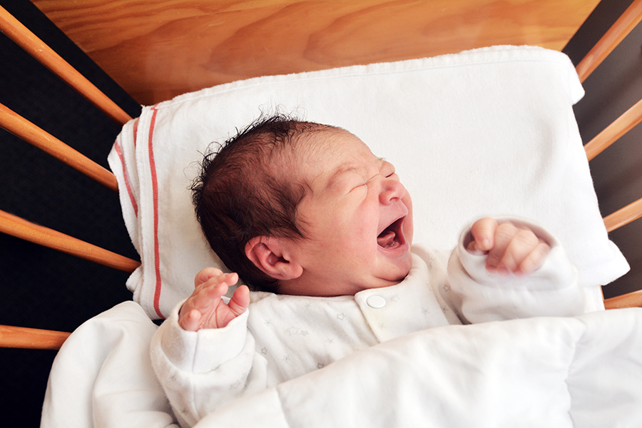
a) cry
b) cries
c) cryies
4. My baby ________ when he is hungry.

Slide 45

Well done!!!!

Slide 46

TRY AGAIN!!

Slide 47
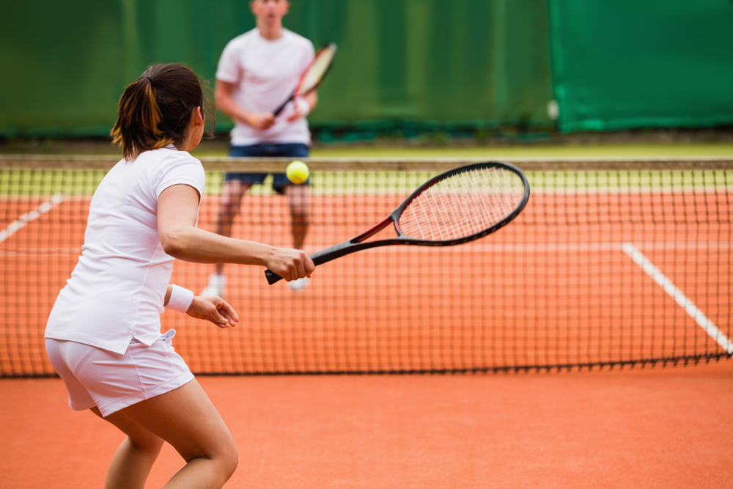
a) play
b) plays
c) playing
5. My brother and I ____________ tennis on Sunday.

Slide 48

VERY GOOD!!!

Slide 49

TRY AGAIN!!

Slide 50
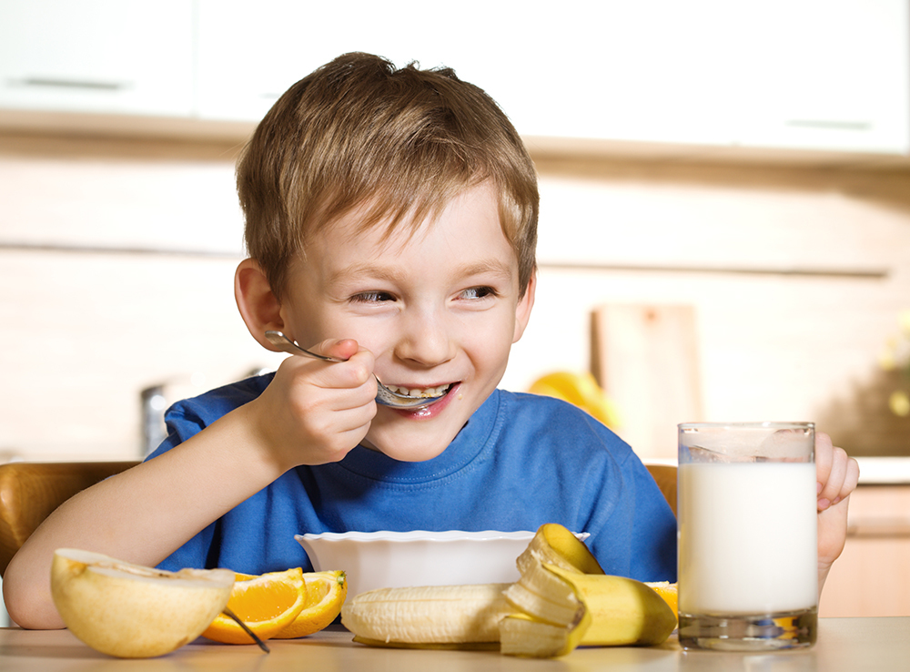
a) eat
b) eats
c) eates
6. My brother _______ breakfast at 7 a.m.

Slide 51


Slide 52


Slide 53

a) go
b) goes
c) gos
7. My friends _________ shopping on weekend.

Slide 54


Slide 55

Try again!!!

Slide 56
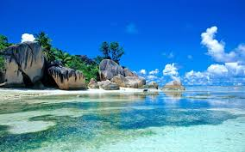
a) read
b) reads
c) reades
8. My mother _______ a book twice a week.

Slide 59
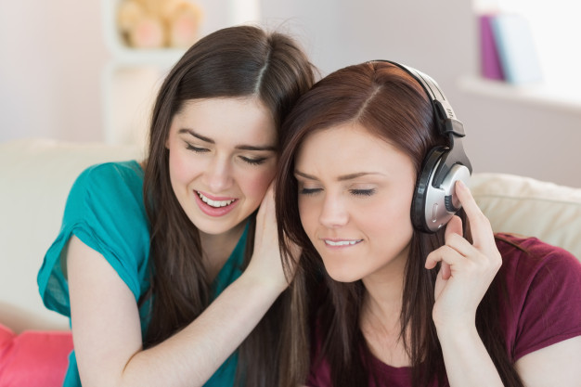
a) listens
b) listen
c) listenes
9. My friend and I __________ to music at home.

Slide 60


Slide 61


Slide 62
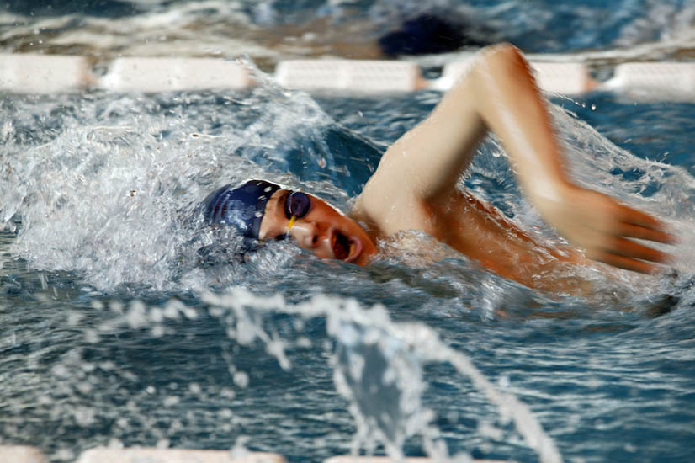
a) swim
b) swims
c) swimes
10. Mark ________ in the Olympic pool.

Slide 63


Slide 64


Slide 65
PRESENT SIMPLE: NEGATIVE STRUCTURE
SUBJECT
DON’T (I, YOU, WE, THEY)
DOESN’T (HE, SHE, IT)
VERB + COMPLEMENT
EXAMPLES:
He doesn’t eat in the office.
You don’t go to the cinema on Friday.
It doesn’t rain much.

Slide 66

PRACTICE 3.
Click on the correct answer.
a) doesn’t
b) don’t
c) do not
1. Anna _________ study for her exam.

Slide 67
Try again!!

Slide 69
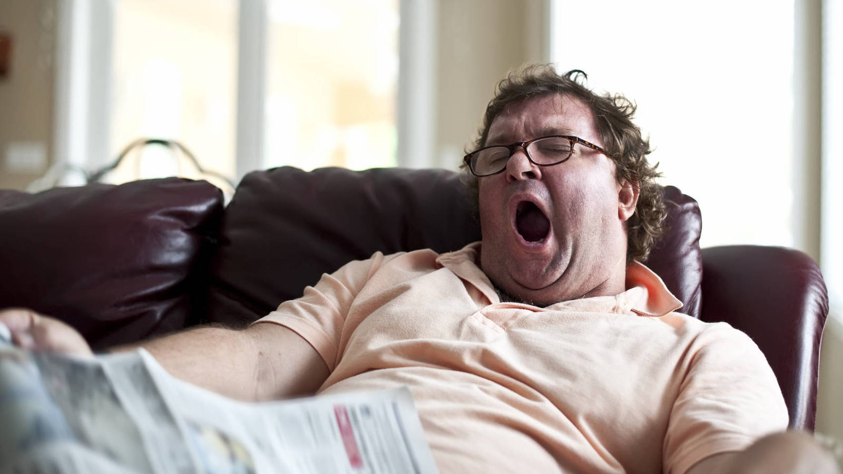
a) doesn’t do
b) don’t do
c) doesn’t
2. He __________ exercise.

Slide 70
You are wrong!!

Slide 71
Terrific!!

Slide 72
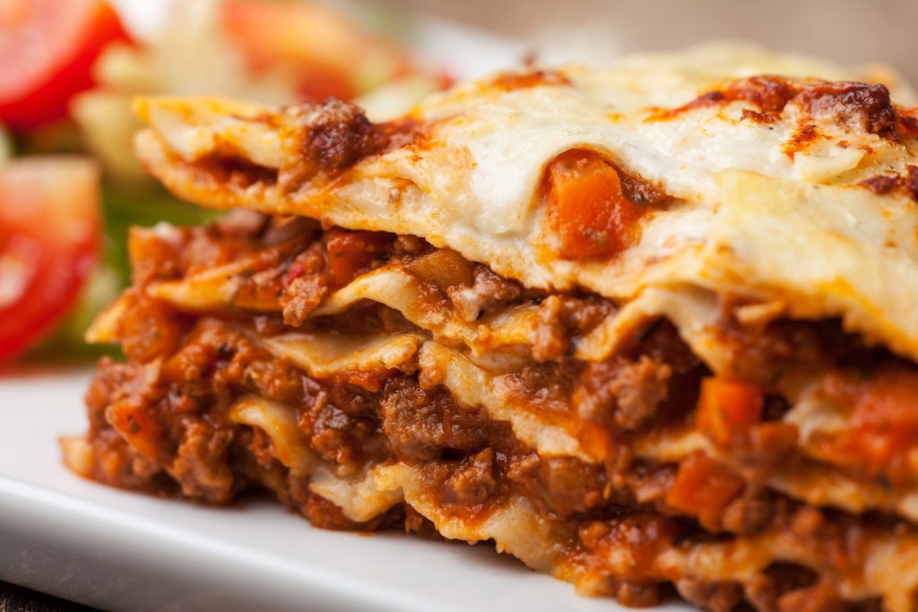
a) doesn’t play
b) doesn’t cook
c) doesn’t drink
3. My mother _______ lasagne, she prefers to buy it.

Slide 73
EXCELLENT!!!!

Slide 74
TRY AGAIN!!

Slide 75

a) doesn’t play
b) doesn’t eat
c) doesn’t drink
4. My father _______ coffee because it’s bad for his health.

Slide 76
Well done!!!!

Slide 77
TRY AGAIN!!

Slide 78

a) don’t smoke
b) doesn’t smoke
c) don’t smoking
5. My mother and I __________ . We hate the cigarettes. It’s awful for our health.

Slide 79
VERY GOOD!!!

Slide 80
TRY AGAIN!!

Slide 81
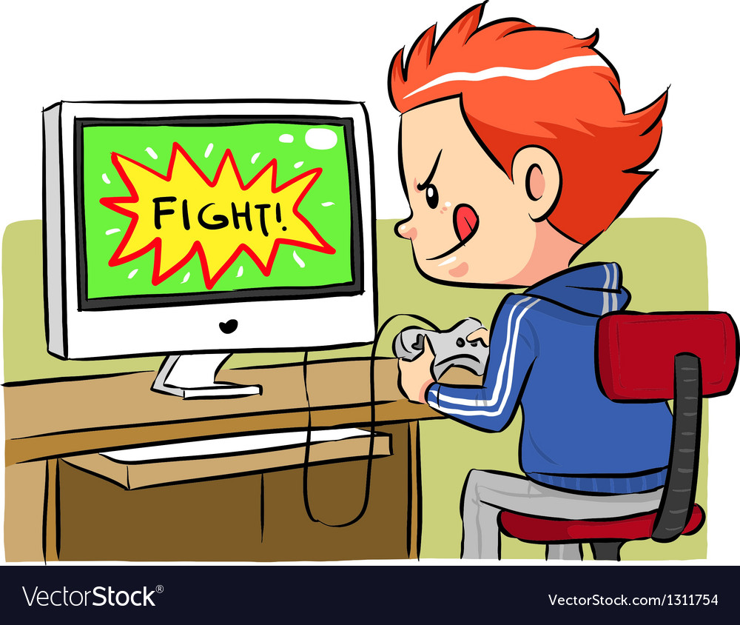
a) doesn’t
b) don’t
6. He ____________ play computer games on weekdays.

Slide 84
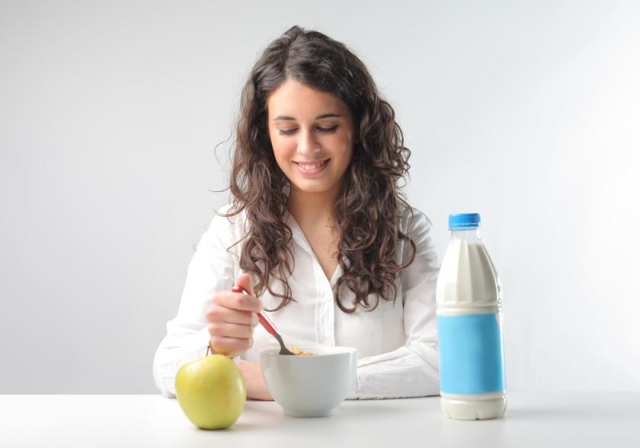
a) don’t
b) doesn’t
c) hasn’t
7. Elisa _______ have breakfast with her family.

Slide 86
Try again!!!

Slide 87
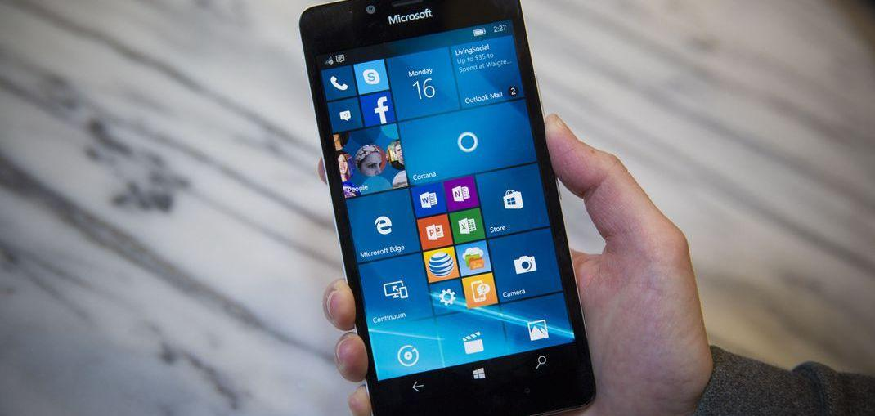
a) doesn’t
b) don’t
c) isn’t
8. My best friend __________ phone me after school.

Slide 90
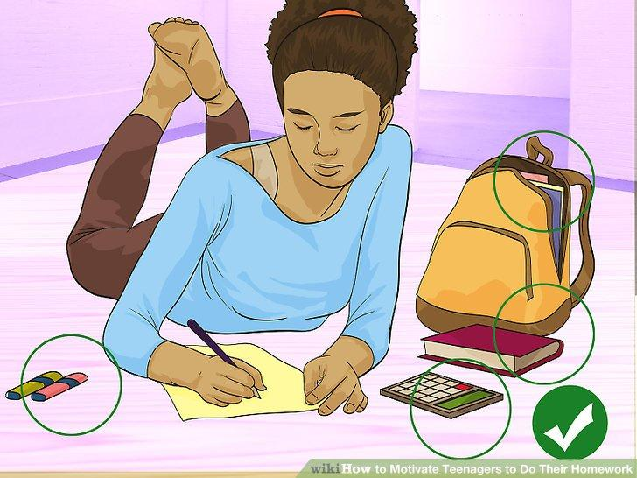
a) don’t do
b) don’t make
c) don’t
9. I _________ my homework on weekend.

Slide 93
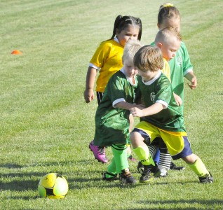
a) don’t
b) doesn’t
10. Marcos and his brother ________ play soccer in the morning.

Slide 96
QUESTIONS AND SHORT ANSWERS
  DO
  DOES
AUXILIAR
  YOU, WE, THEY
  HE / SHE / IT
SUBJECT
  PLAY SOCCER ON WEDNESDAY?
  WORK ON WEEKENDS?
VERB
  YES, I / WE / THEY DO. / NO, I / WE / THEY DON’T.
  YES, HE, SHE, IT DOES. / NO, HE / SHE / IT DOESN’T
ANSWER

Slide 97
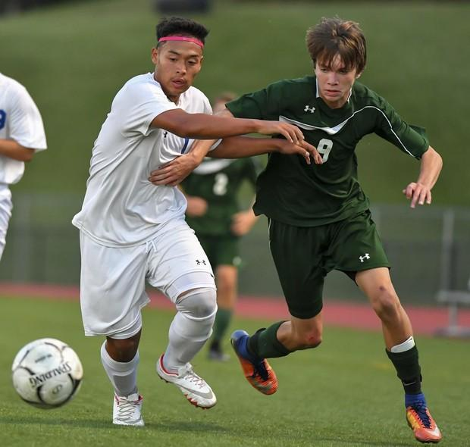
QUESTIONS.
Click on the correct word.
a) Do
b) Does
1. __________ you play soccer? Yes, I play soccer on weekend.

Slide 98
Try again!!

Slide 100
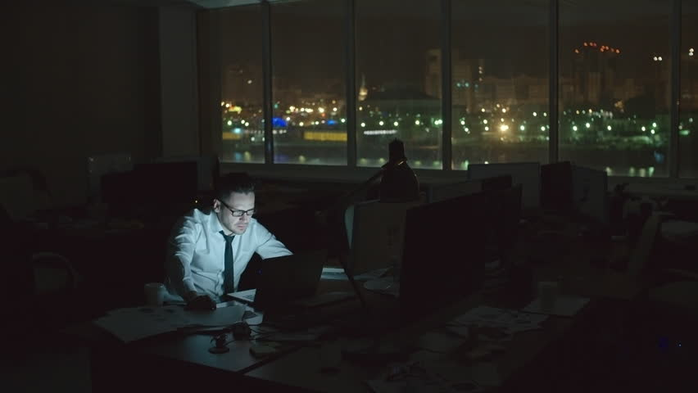
a) Do
b) Does
2. _______ your dad work at night? Yes, he does.

Slide 101
You are wrong!!

Slide 102
Terrific!!

Slide 103

a) Do
b) Does
3. ______ your best friend speak japanese? Yes, he does.

Slide 104
EXCELLENT!!!!

Slide 105
TRY AGAIN!!

Slide 106
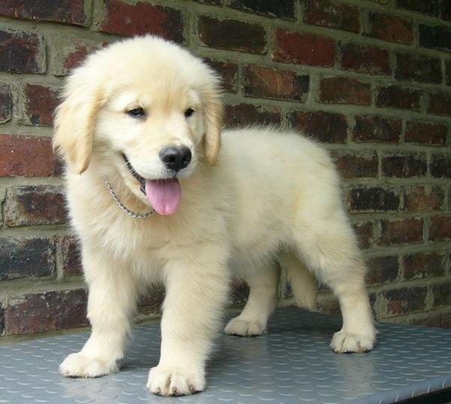
a) Do
b) Does
4. ________ Fido eat fish? No, it doesn’t.

Slide 107
Well done!!!!

Slide 108
TRY AGAIN!!

Slide 109
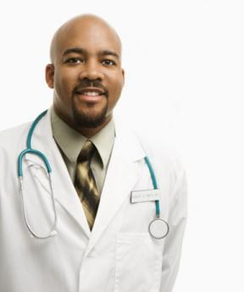
a) Do
b) Does
5. _______ the doctor work in a hospital? Yes, he does.

Slide 110
VERY GOOD!!!

Slide 111
TRY AGAIN!!

Slide 112
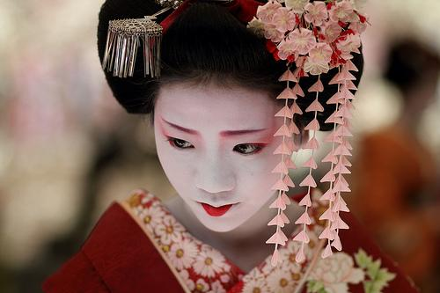
a) Do
b) Does
6. _______ she speak Portuguese?
No, she doesn’t

Slide 115

a) Do
b) Does
7. _______ they study at weekends? No, they don’t.

Slide 117
Try again!!!

Slide 118
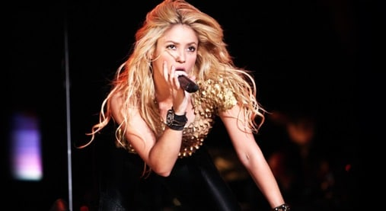
a) Does
b) Do
8. _________ Shakira sing in Spanish? Yes, she does.

Slide 121
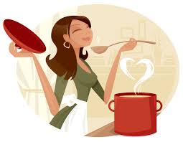
a) Does
b) Do
9. ______ your mother cook dinner?
Yes, she does.

Slide 124
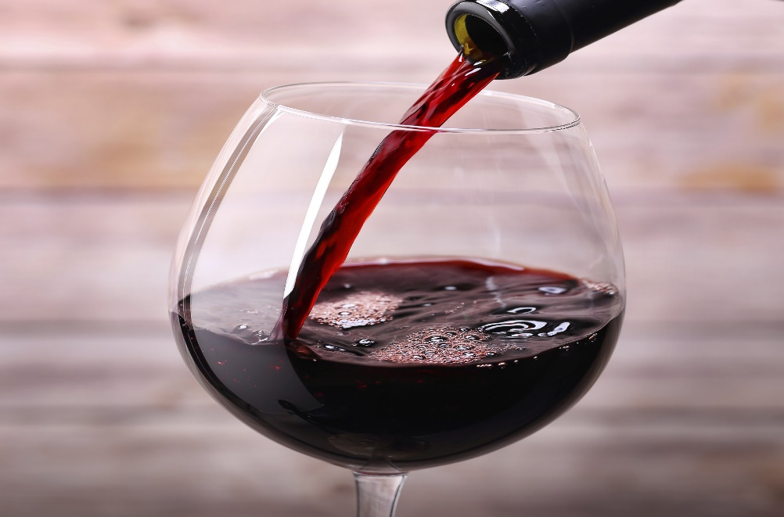
a) Do
b) Does
_______ you drink red wine?
No, I don’t.

Slide 127
WH QUESTIONS
  PEOPLE
  Who do you live with? I live with my parents.
WHO
  PLACES
  Where do you study? I study in UAEMex.
WHERE
  TIME / DATES
  When does she do her homework? She does her homework in the afternoon.
WHEN
  THINGS
  What do you eat for breakfast? I eat eggs and a milkshake.
WHAT

Slide 128
  MANNER
  HOW do you travel to school?
  I travel to school by bus.
HOW
  Which do you prefer: the yellow one or the red one? I prefer the red one.
WHICH
  POSSESSION.
  WHOSE? It’s Lucy’s.
WHOSE

Slide 129

Click on the correct question word.
a) Where
b) When
c) How
_____________ do you play soccer?
I play soccer in the afternoon.

Slide 130


Slide 131


Slide 132

a) Where
b) When
c) How
2. _________ do you read a book? In a library.

Slide 133


Slide 134


Slide 135

a) When
b) What
c) How
3. ________ do you relax on weekend?
I listen to music.

Slide 136


Slide 137


Slide 138

a) Which
b) When
c) Where
4. _______ sport do you practice: basketball or tennis?
I play basketball

Slide 139
VERY GOOD!!!

Slide 140
TRY AGAIN!!

Slide 141

a) When
b) Which
c) What
5. _______ do you do in your free time?
I watch TV.

Slide 144

a) When
b) What
c) How
6. _______ do you go to school?
I go to school by bus.

Slide 146
Try again!!!

Slide 147
a) What
b) Which
c) When
7. _____ kind of music do you like?
I like pop music.

Slide 150

a) When
b) Where
c) What
8. ______ do you go running?
I go running in the park.

Slide 153
a) Where
b) When
c) What
9. _______ do you want to drink?
I want to drink red wine.

Slide 156

a) When
b) Where
c) What
10. ______ do you go running?
I go running in the morning.

Slide 159
TIME EXPRESSIONS IN PRESENT
ON
IN
EVERY
AT
Monday
the morning
the afternoon
the evening
noon
night
midnight
every day
every month
every year
weekend
July
August
7:00 pm
8:00 am
May 15th
ONCE / TWICE / THREE TIMES
an hour, a day, a week, a month, a year,

Slide 160


Slide 161

PRACTICE 5.
Click on the correct answer.
a) in
b) on
c) at
1. I go to sleep ______ midnight.

Slide 162
Try again!!

Slide 164

a) in
b) on
c) at
2. She usually visits her grandmother ____ weekend.

Slide 165
You are wrong!!

Slide 166
Terrific!!

Slide 167

a) in
b) on
c) at
3. My mother’s birthday is _____ November 6th.

Slide 168
EXCELLENT!!!!

Slide 169
TRY AGAIN!!

Slide 170

a) on
b) in
c) at
4. My family and I go on vacation ____ July.

Slide 171
Well done!!!!

Slide 172
TRY AGAIN!!

Slide 173

a) on
b) at
c) in
5. My mother goes to the supermarket ____ the afternoon.

Slide 174
VERY GOOD!!!

Slide 175
TRY AGAIN!!

Slide 176

a) every
b) at
c) in
6. I play soccer _________ day.

Slide 179

a) on
b) in
c) at
7. I go to the gym _____ Friday night.

Slide 181
Try again!!!

Slide 182

a) in
b) on
c) at
8. I have dinner with my family ____ 7:00 p.m.

Slide 185

a) in
b) on
c) at
9. I have lunch with my friends _____ noon.

Slide 188

a) every
b) in
c) at
10. I have exams _____ month.

Slide 191

ADVERBS OF FREQUENCY.

Slide 192
PRACTICE 6.
Click on the correct answer.
1. What sentence is correct?
A) Mark does always his homework.
B) Mark always does his homework.

Slide 193
Try again!!

Slide 195
2. What sentence is correct?
a) They are never late for school.
b) They never are late for school.

Slide 196
You are wrong!!

Slide 197
Terrific!!

Slide 198
3. What sentence is correct?
a) Mary sometimes goes to the gym at noon.
b) Mary goes sometimes to the gym at noon.

Slide 199
EXCELLENT!!!!

Slide 200
TRY AGAIN!!

Slide 201
4. What sentence is correct?
a) He goes often on picnics with his friends.
b) He often goes on picnics with his friends.

Slide 202
Well done!!!!

Slide 203
TRY AGAIN!!

Slide 204
5. What sentence is correct?
a) We go dancing usually on Monday.
b) We usually go dancing on Monday.

Slide 205
VERY GOOD!!!

Slide 206
TRY AGAIN!!

Slide 207
6. What sentence is correct?
a) Carol always does her homework at 5pm.
b) Carol does her homework always at 5pm.

Slide 210
7. What sentence is correct?
a) Ben and Jane rarely eat in the school.
b) Ben and Jane eat in the school rarely.

Slide 212
Try again!!!

Slide 213
8. What sentence is correct?
a) It’s often cold in March.
b) It’s cold often in March.
c) It often is cold in March.

Slide 216
9. What sentence is correct?
a) He always arrives late for work.
b) He arrives late for work always.

Slide 219
10. What sentence is correct?
a) Mirna is usually early for school.
b) Mirna usually is early for school.

Slide 222


