Slide 1


UNIVERSIDAD AUTÓNOMA DEL ESTADO DE MÉXICO
PLANTEL “LIC ADOLFO LOPÉZ MATEOS” DE LA ESCUELA PREPARATORIA
Asignatura: INGLES ll
Módulo II
Nombre del módulo : Estilos de vida saludables.
Elaborado por:
Susana Sánchez Bastida
Material didáctico solo visión proyectables

Slide 2
Propósito general
Emplea el idioma inglés para satisfacer sus necesidades inmediatas de interacción, supervivencia y de relación con su entorno inmediato, de forma simple, por medio de expresiones cotidianas, frases comunes, familiares y representaciones lingüísticas asociadas al contexto cultural y social.

Slide 3
Proósito de la unidad de aprendizaje de inglés II
Interactúa en el idioma inglés de forma oral y escrita, en situaciones sociales o académicas relacionadas con áreas de experiencia que le son relevantes, toma decisiones, realiza ofrecimientos, promesas y predicciones generales; expresa planes e intenciones, posibilidades, prohibiciones y necesidades. De igual modo establece condiciones, y asume las consecuencias de sus acciones, dando sugerencias y recomendaciones.

Slide 4
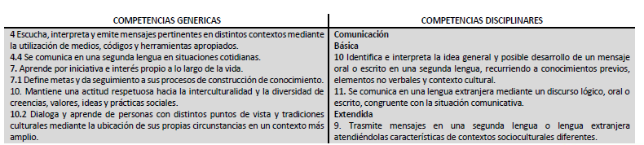
COMPETENCIAS

Slide 5
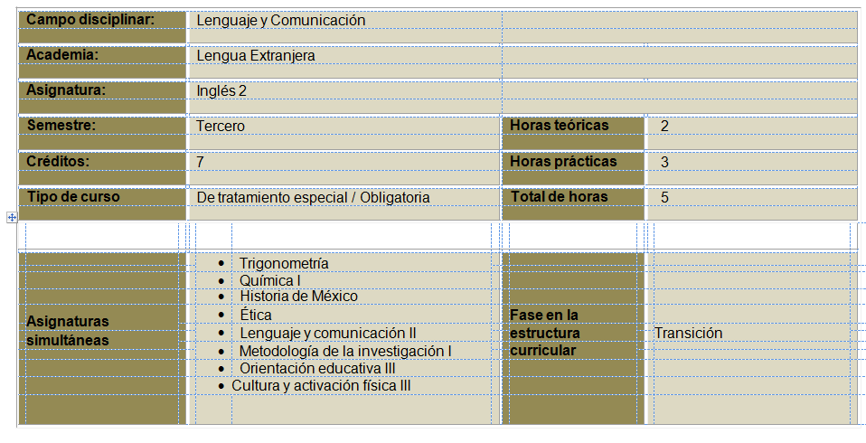

Slide 6
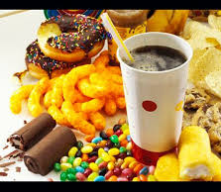
She told me to get some junk food

Slide 7
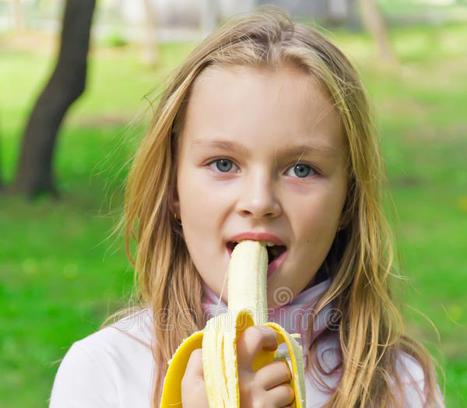
She usually eats bananas in the morning.

Slide 8
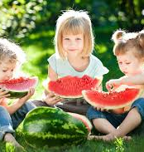
The children are vegan.

Slide 9
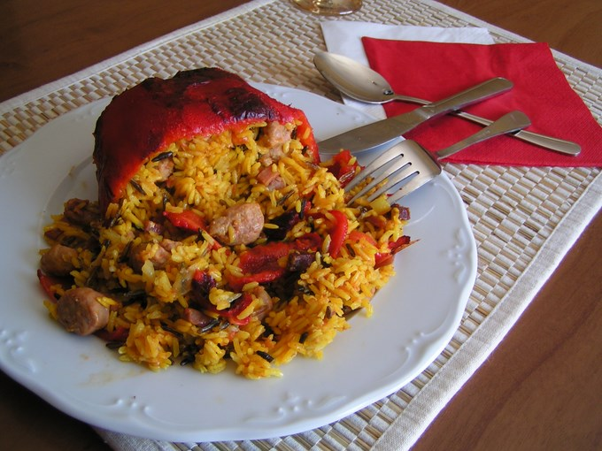
I love beef with rice and peppers.

Slide 10
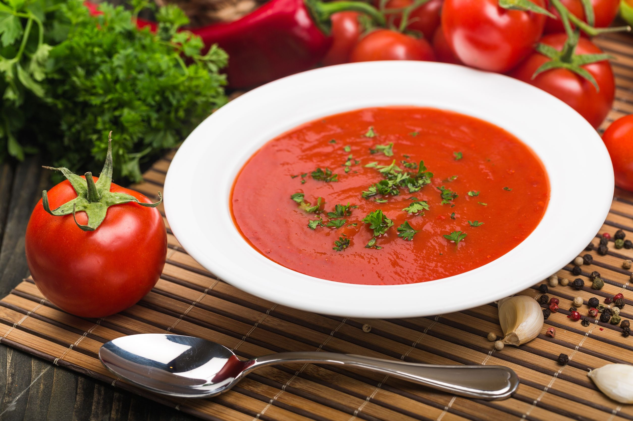
There are some tomatoes for soup.

Slide 11
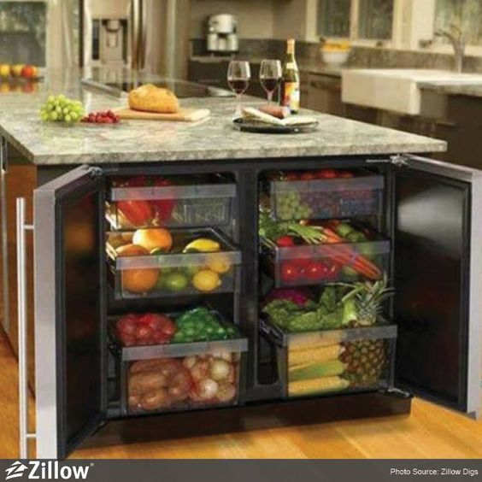
There are some fruits and vegetables in the kitchen.

Slide 12
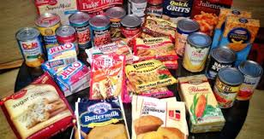
She usually eats processed products.

Slide 13
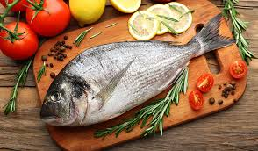
The fish and seafood are healthy.

Slide 14
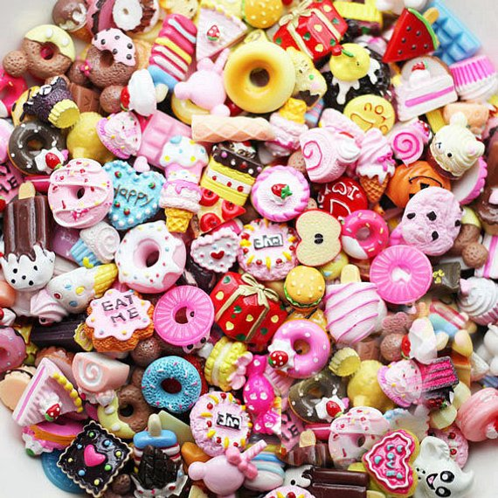
Sweet food is very dangerous.

Slide 15
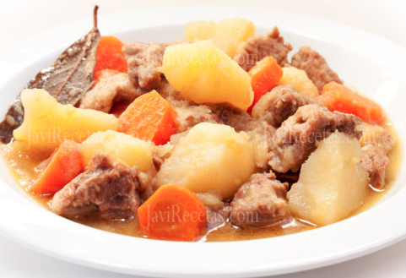
We are eating some meat with potatoes and carrots.

Slide 16
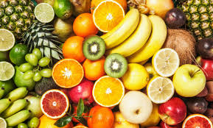
You should eat some fruit are healthy.

Slide 17
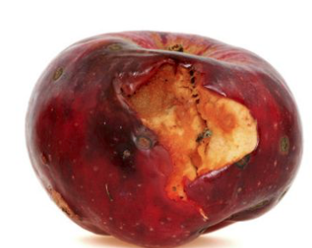
My best friend shouldn't eat that apple.

Slide 18
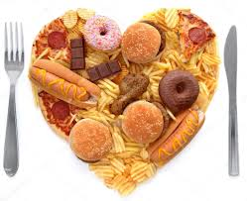
I shouldn't eat unhealthy food.

Slide 19
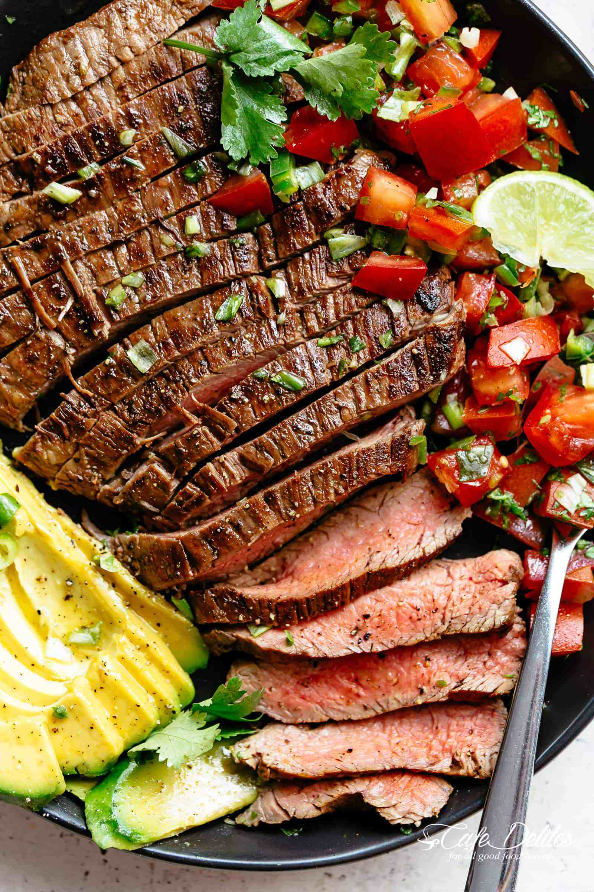
There isn't any beef.

Slide 20
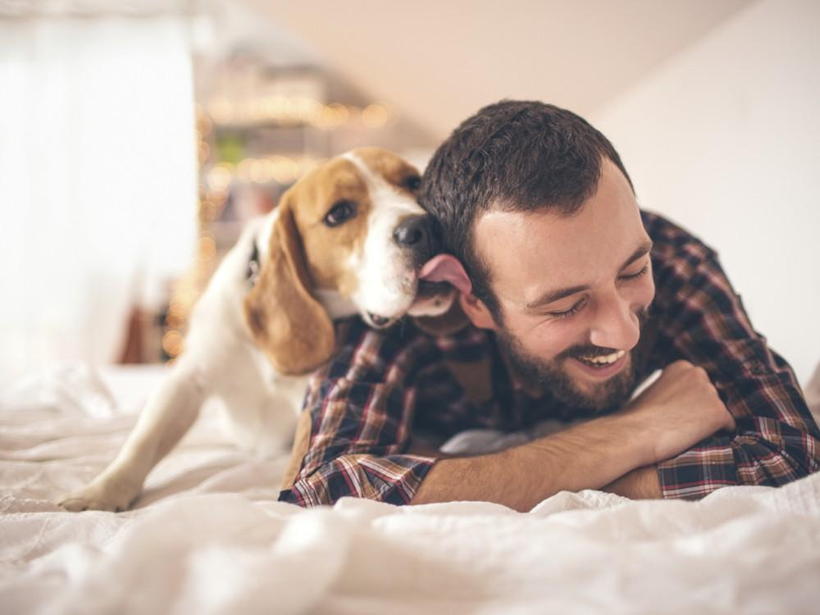
I don't have any pets.

Slide 21
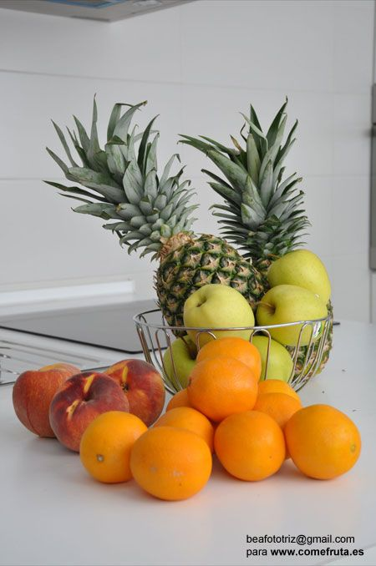
There aren't any pineapples.

Slide 22
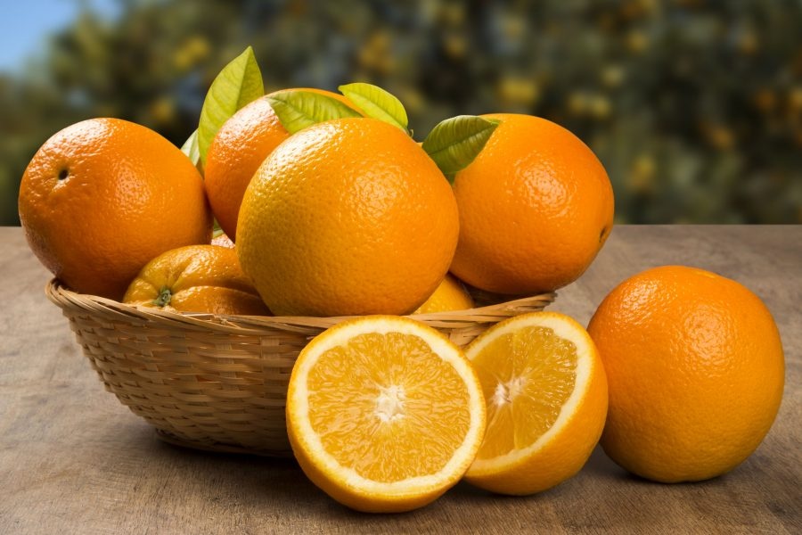
Are there any oranges?

Slide 23
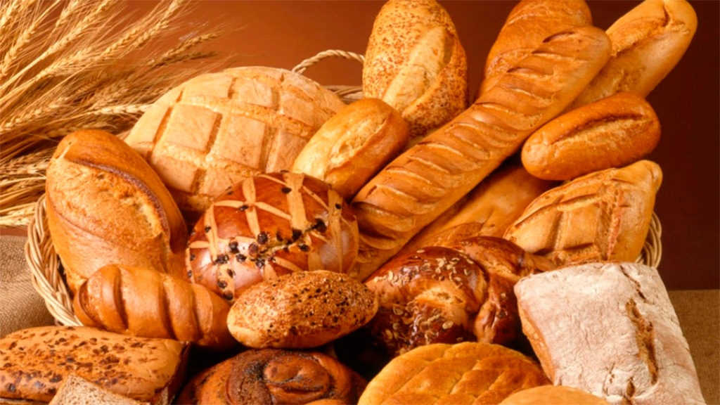
There's some bread.

Slide 24
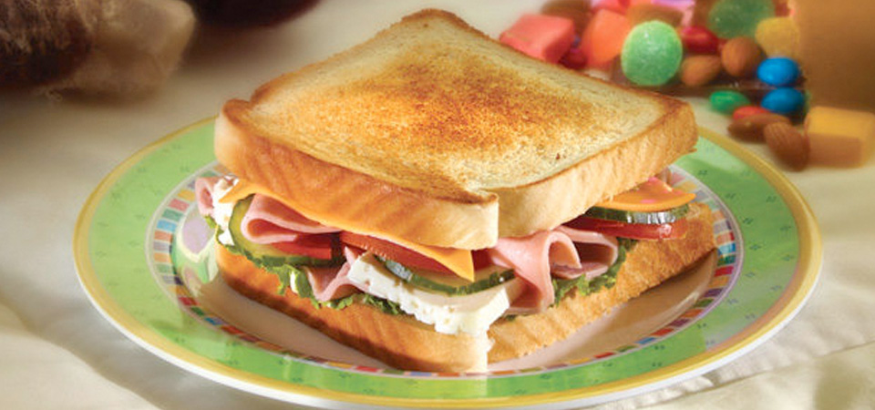
Let's make some sandwiches.

Slide 25
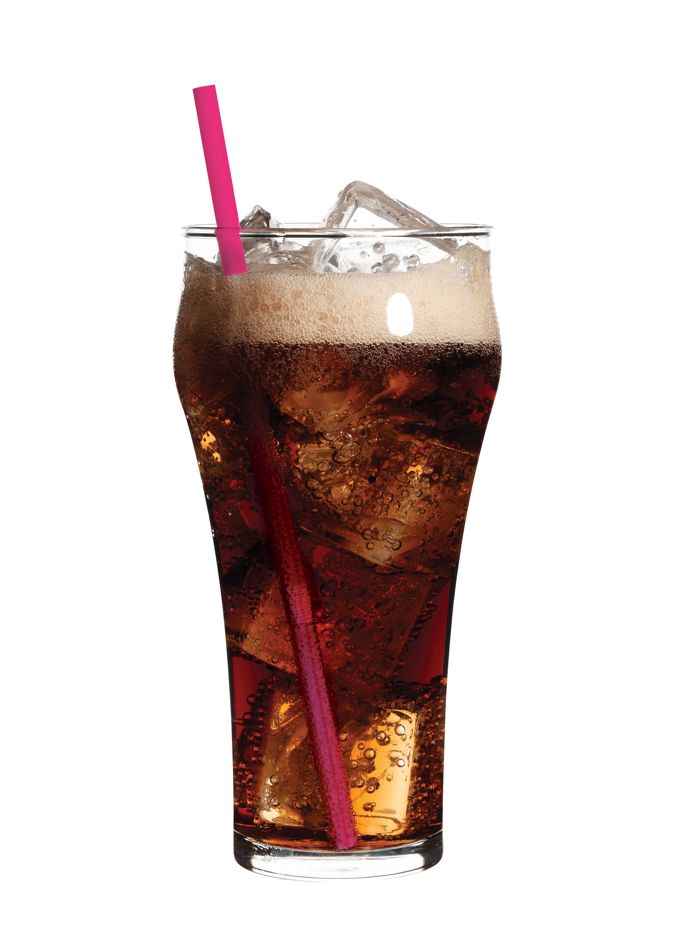
Is there any soda in the house?

Slide 26
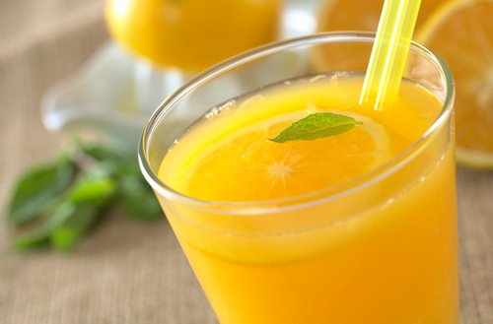
Is there any orange juice?

Slide 27
How many onions are there?

Slide 28
You shouldn't have a big meal just before bed.

Slide 29
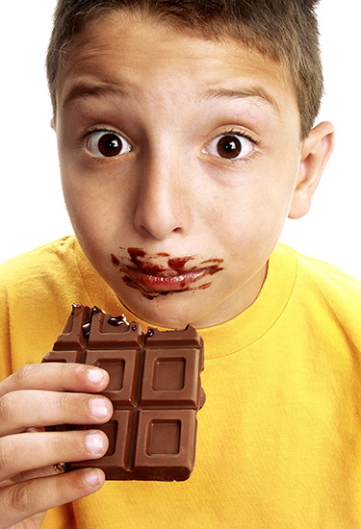
How many chocolates do you eat every week?

Slide 30
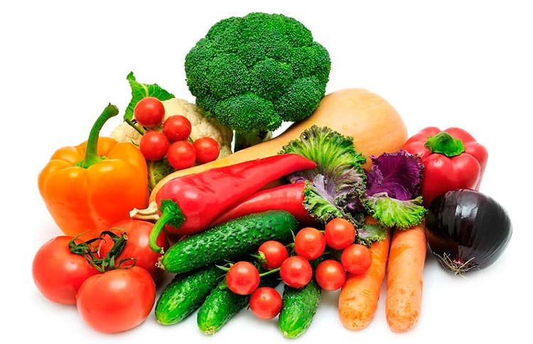
I don't like some vegetables.

Slide 31
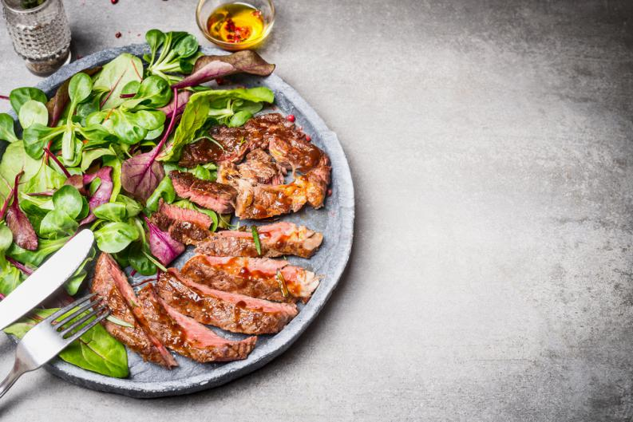
My mom should make meat with salad.

Slide 32
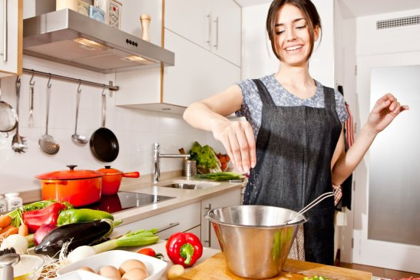
I should prepare the food.

Slide 33
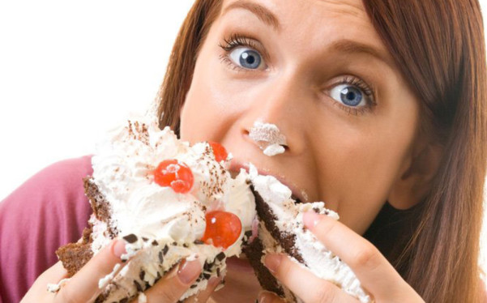
You shouldn't eat cake.

Slide 34
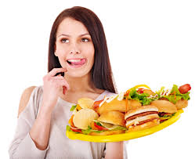
Some food is against the rules of my balanced diet.

Slide 35
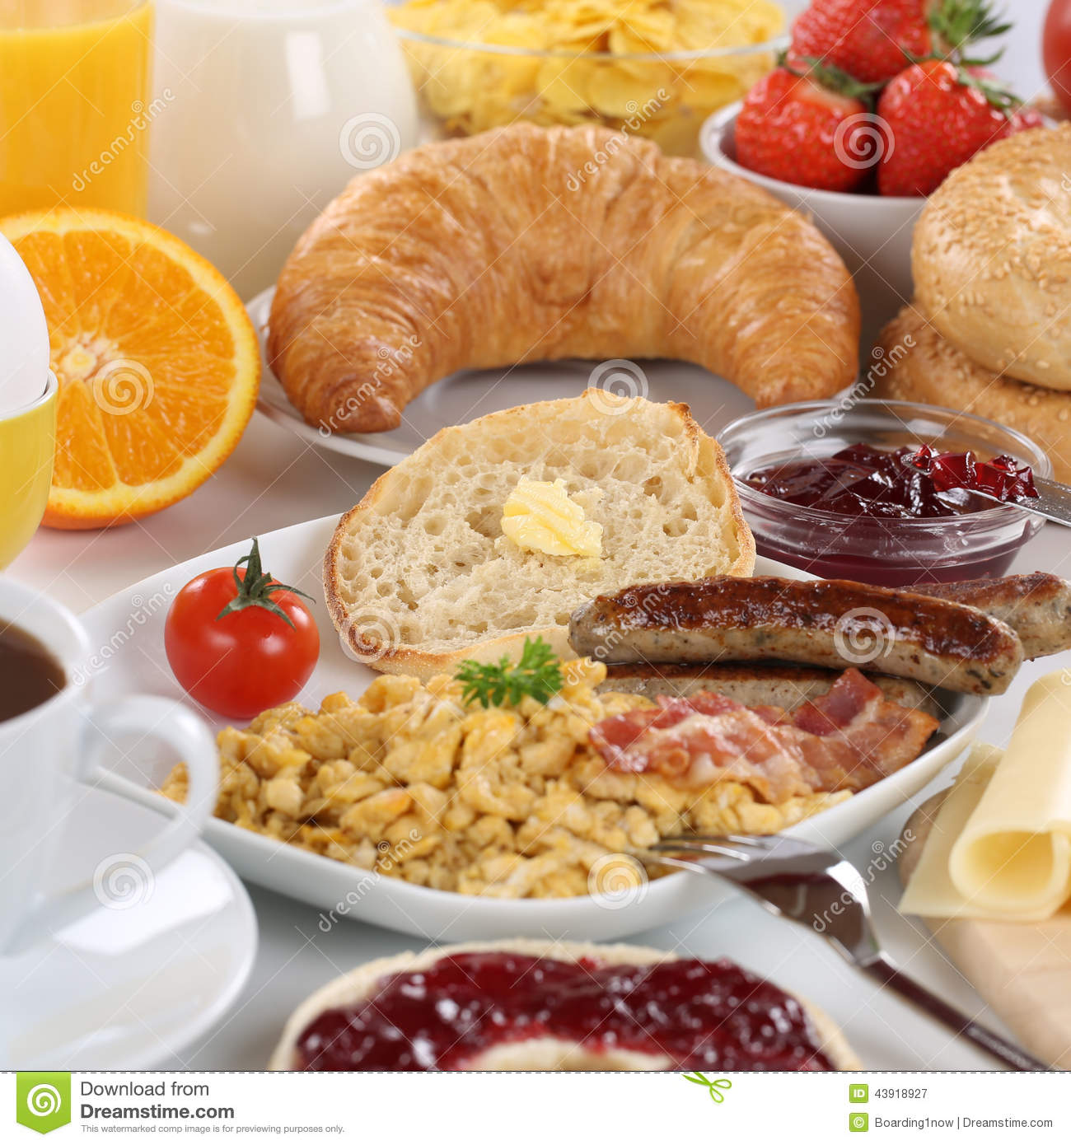
I shouldn't eat big breakfat.

Slide 36
Bibliografía básica
Solutions. elementary workbook / 2 ed. (incluye cd, ISBN: 9780194552813, Autor: Paul a.falla
Imágenes : google images

