Slide 1


UNIVERSIDAD AUTÓNOMA DEL ESTADO DE MÉXICO
PLANTEL “LIC ADOLFO LOPÉZ MATEOS” DE LA ESCUELA PREPARATORIA
Asignatura: INGLES 4
Módulo I
Nombre del módulo : Sharing experiences and telling when they happened.
Elaborado por:
Susana Sánchez Bastida
Material didáctico solo visión proyectables

Slide 2
Propósito general
Interactúa en el idioma inglés de forma oral y escrita, en situaciones sociales o académicas relacionadas con áreas de experiencia que le son relevantes, toma decisiones, realiza ofrecimientos, promesas y predicciones generales; expresa planes e intenciones, posibilidades, prohibiciones y necesidades. De igual modo establece condiciones, y asume las consecuencias de sus acciones, dando sugerencias y recomendaciones.

Slide 3
Propósito de la asignatura inglés 4
Interactúa en el idioma inglés de forma oral y escrita, en situaciones sociales o académicas relacionadas con áreas de experiencia que le son relevantes, toma decisiones, realiza ofrecimientos, promesas y predicciones generales; expresa planes e intenciones, posibilidades, prohibiciones y necesidades. De igual modo establece condiciones, y asume las consecuencias de sus acciones, dando sugerencias y recomendaciones.

Slide 4
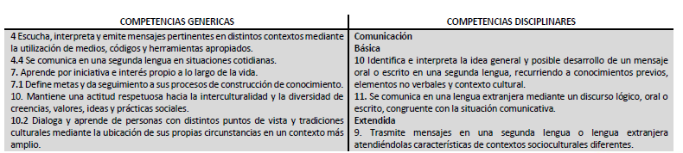
Competencias

Slide 5
Lesson 5-6

Slide 6
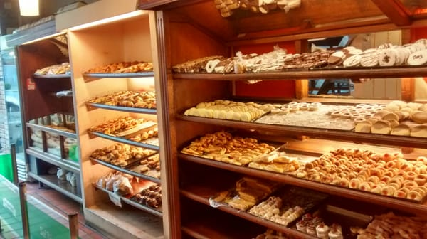
Baker´s
you can buy some bread in a bakers

Slide 7
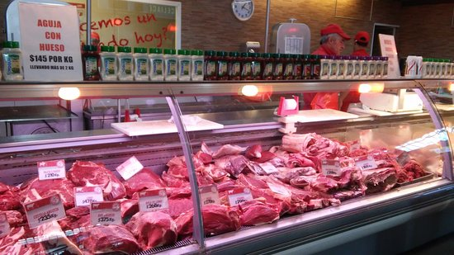
Butcher´s
I bought some meat at the butcher´s yesterday.

Slide 8
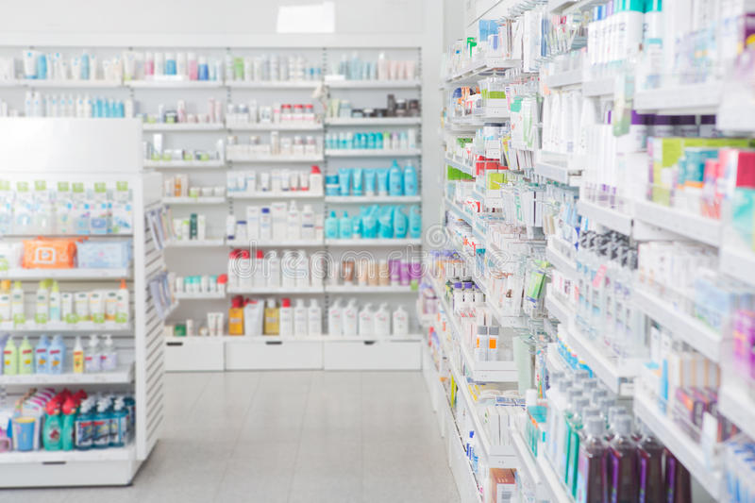
Chemist´s
Yesterday I went to the chemist´s for my medicine

Slide 9
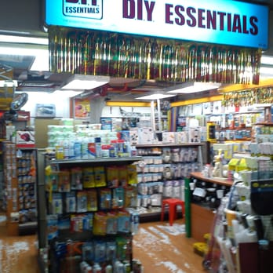
DIY STORE
In home depot you have to do the things yourself

Slide 10
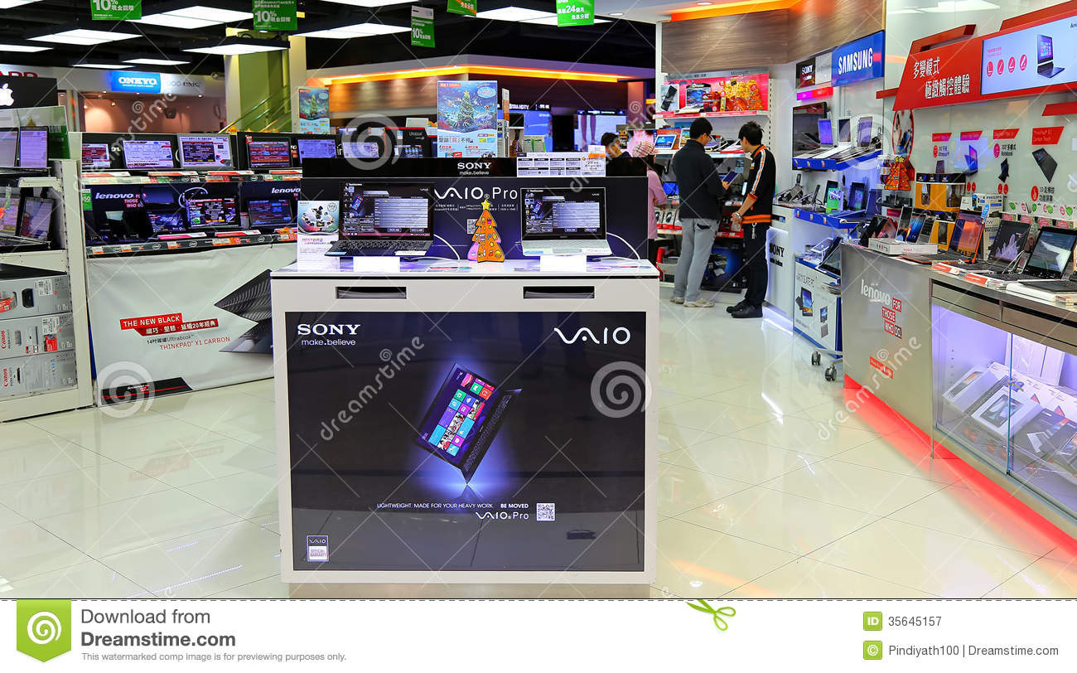
Electrical store
I´m going to change my livingroom lamps, I´ll go to a electrical store to buy the new ones.

Slide 11
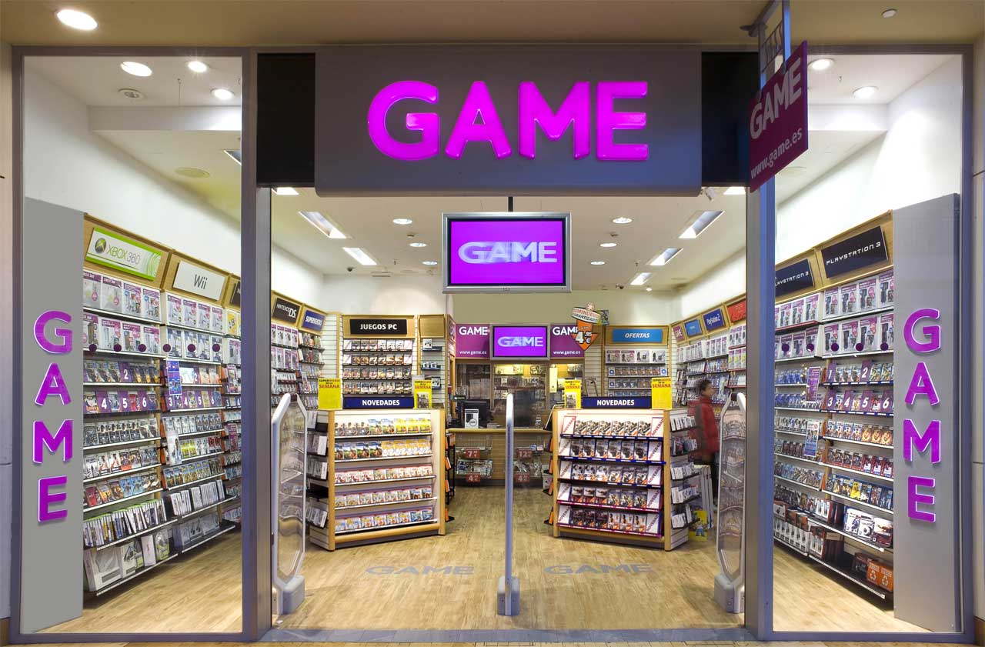
Entertaiment store
I want to rent a movie in the entertaiment store.

Slide 12
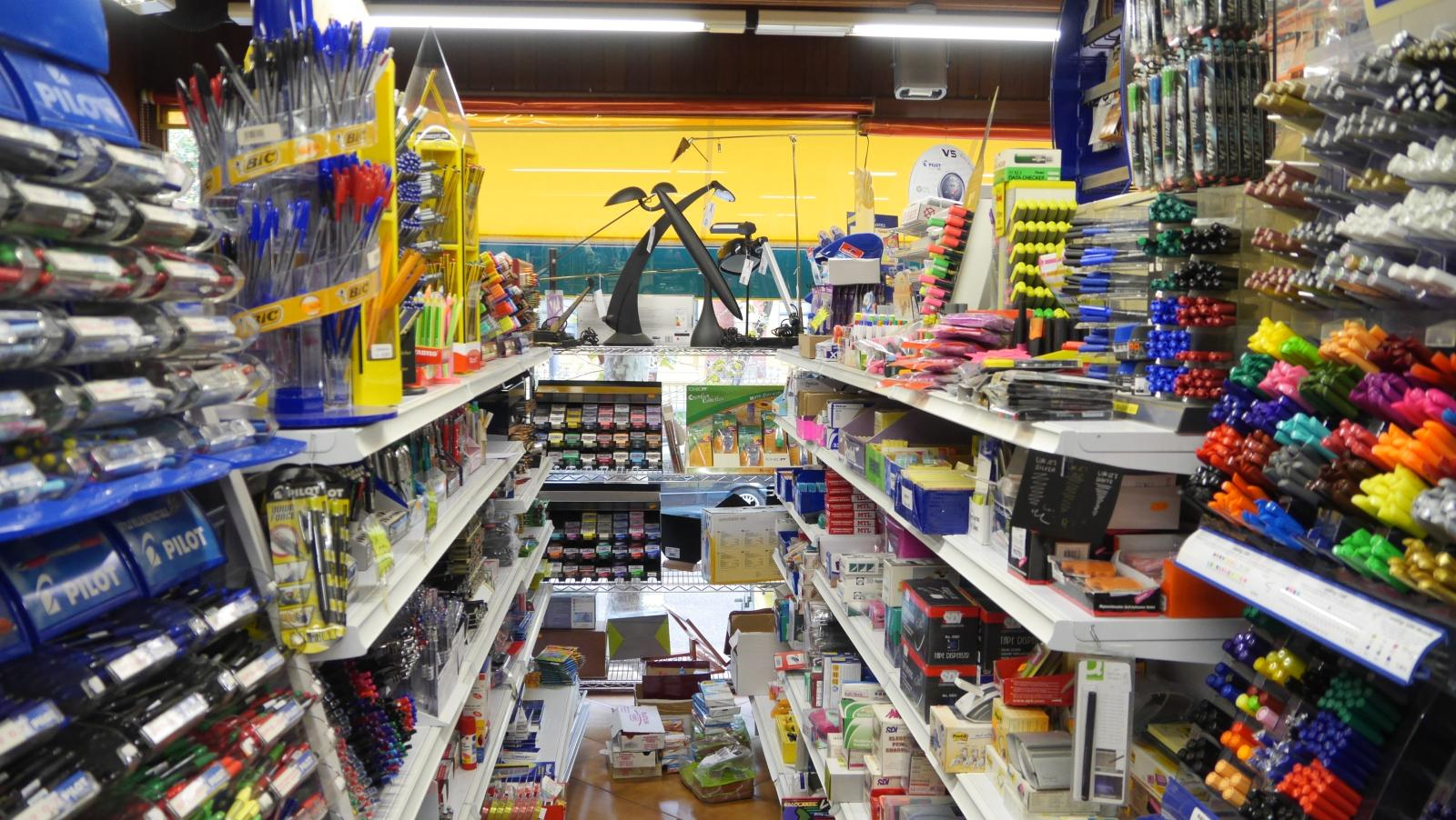
Estate agent´s
In the estate agent´s you find the essential for the school.

Slide 13
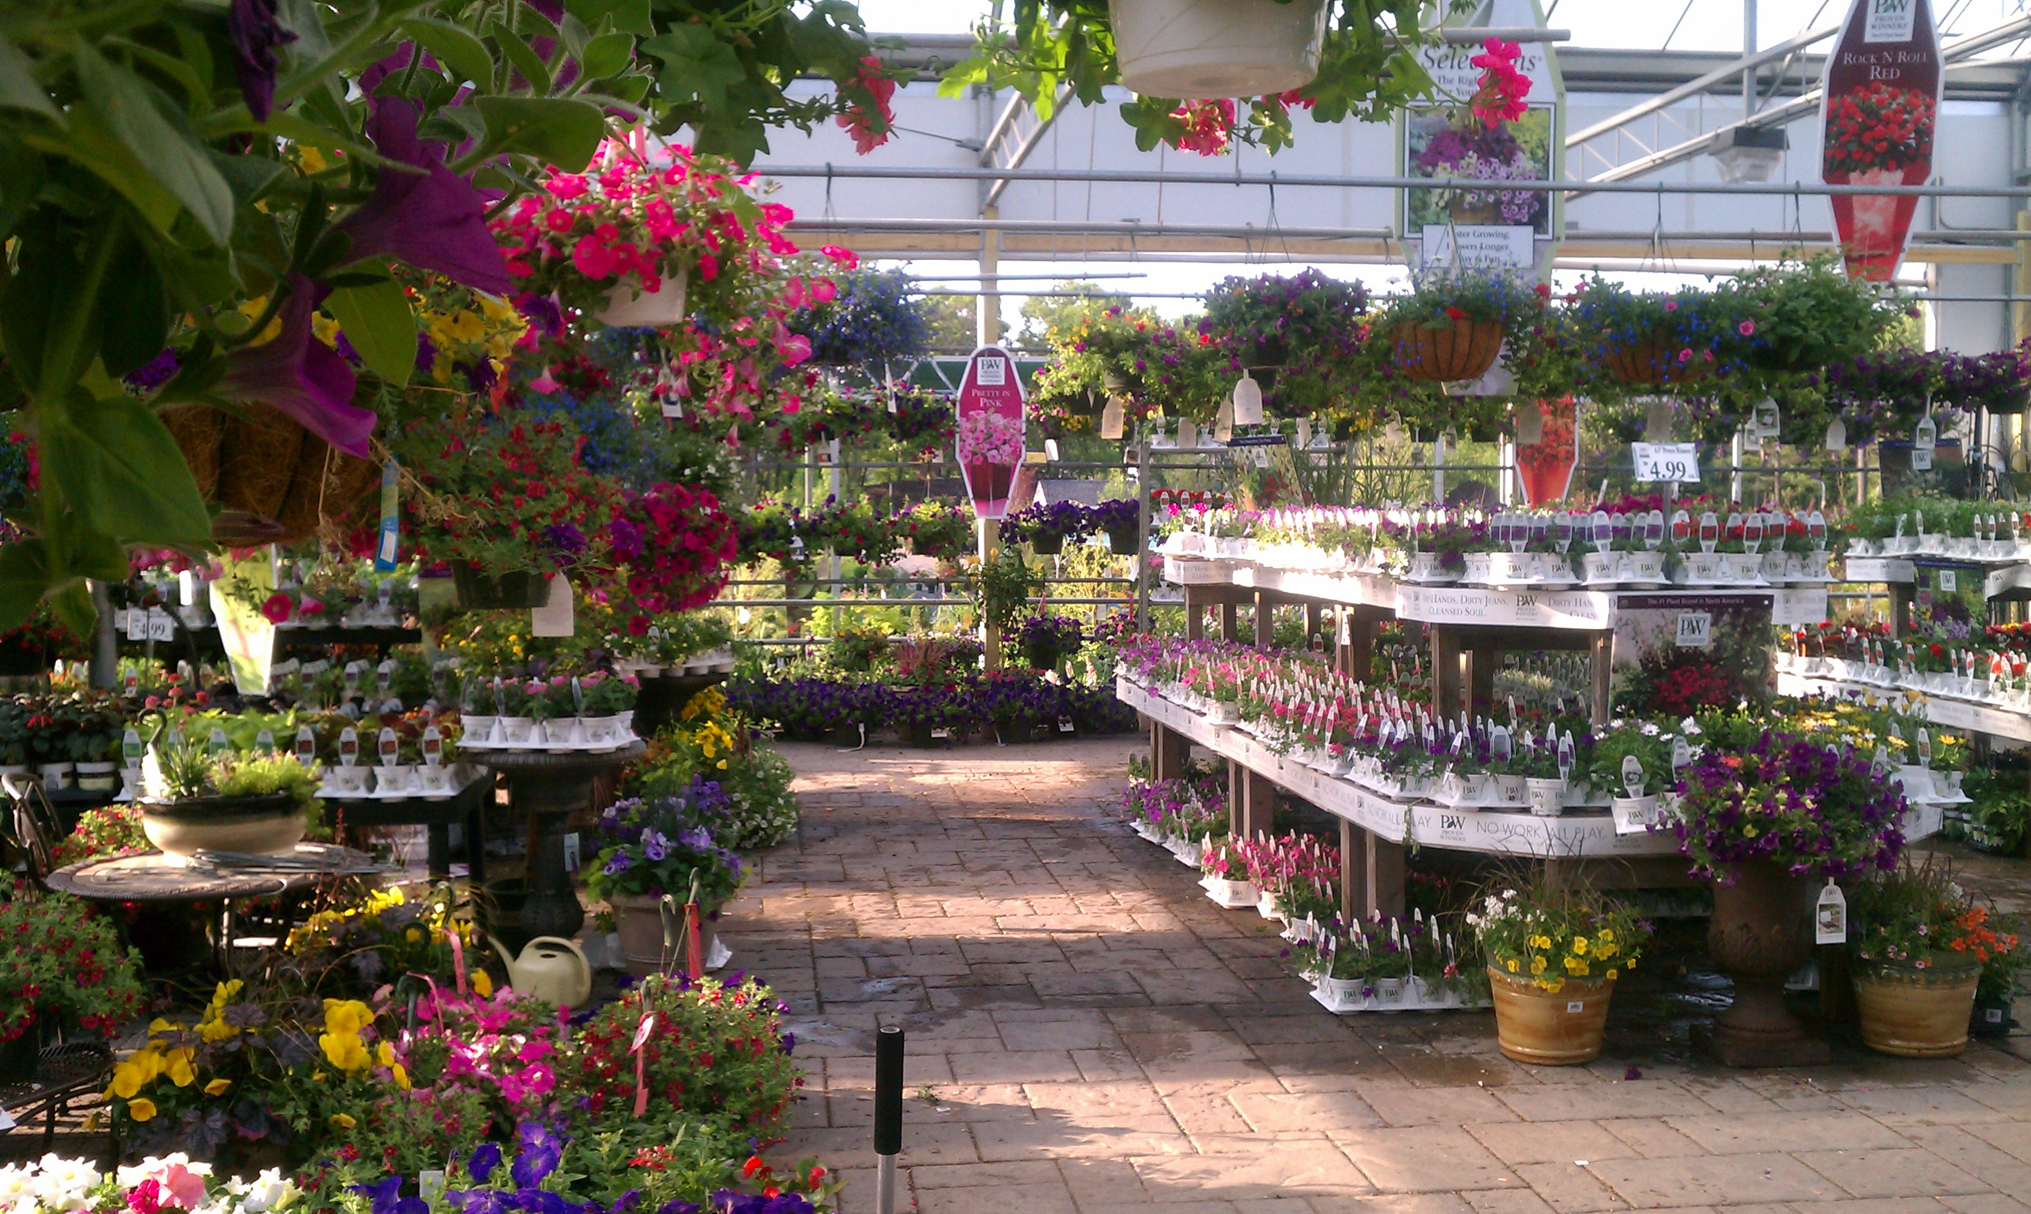
Garden center
Yesterday I accompanied my mom to the garden center to buy roses for the living room.

Slide 14
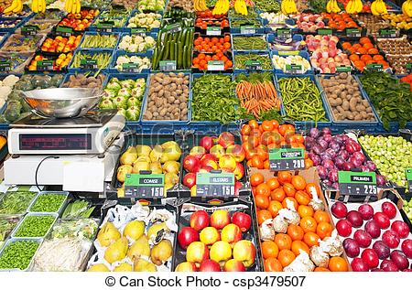
greengrocer´s.
My mom always goes to the grocery store to prepare food,

Slide 15
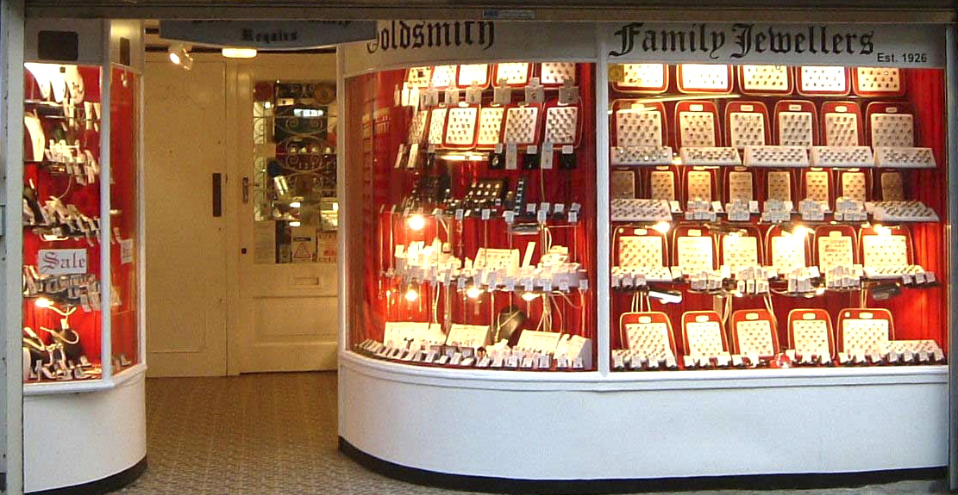
jeweller´s
I'm going to the jeweler´s to buy a watch.

Slide 16
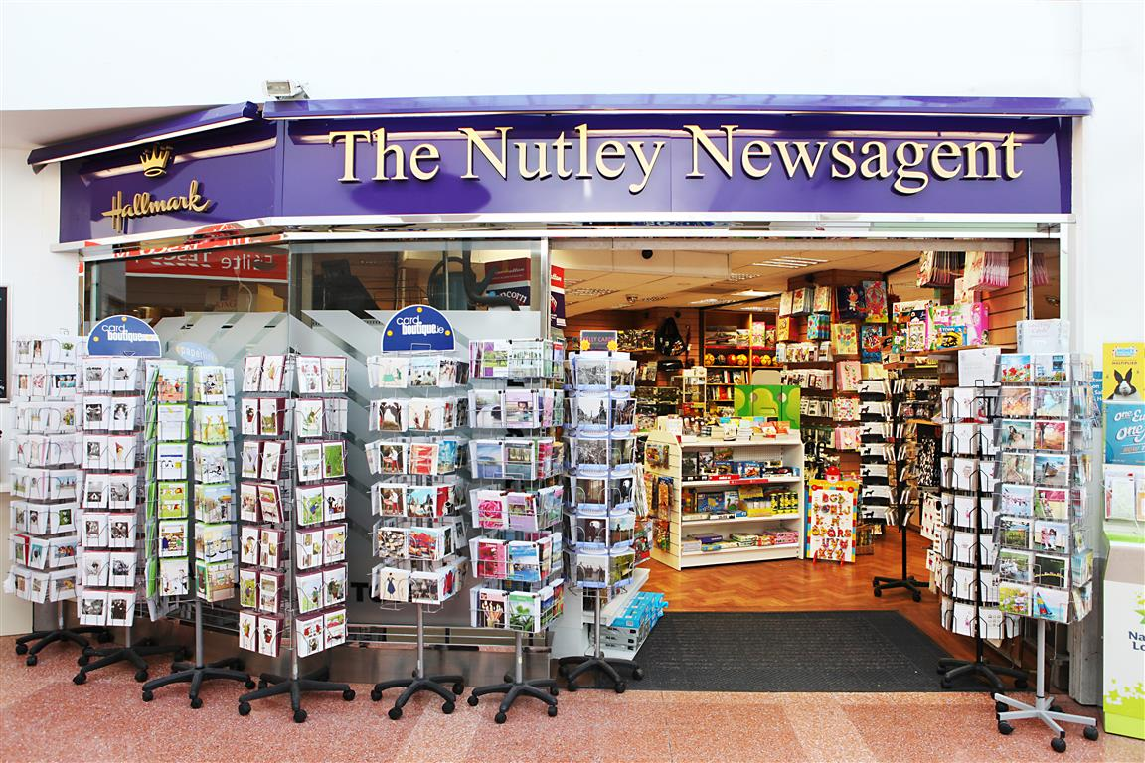
NEWSAGENT´S
my uncle goes every day to buy the newspaper.

Slide 17
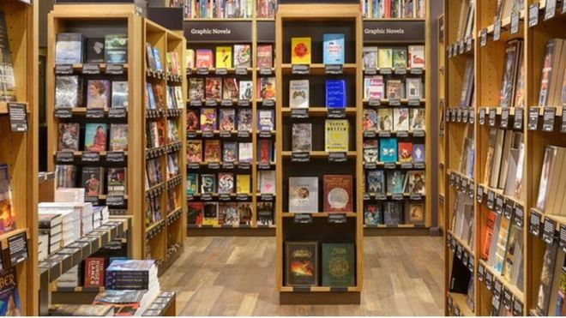
BOOKSHOP
Last week I went to the bookshop for some philosophy books.

Slide 18
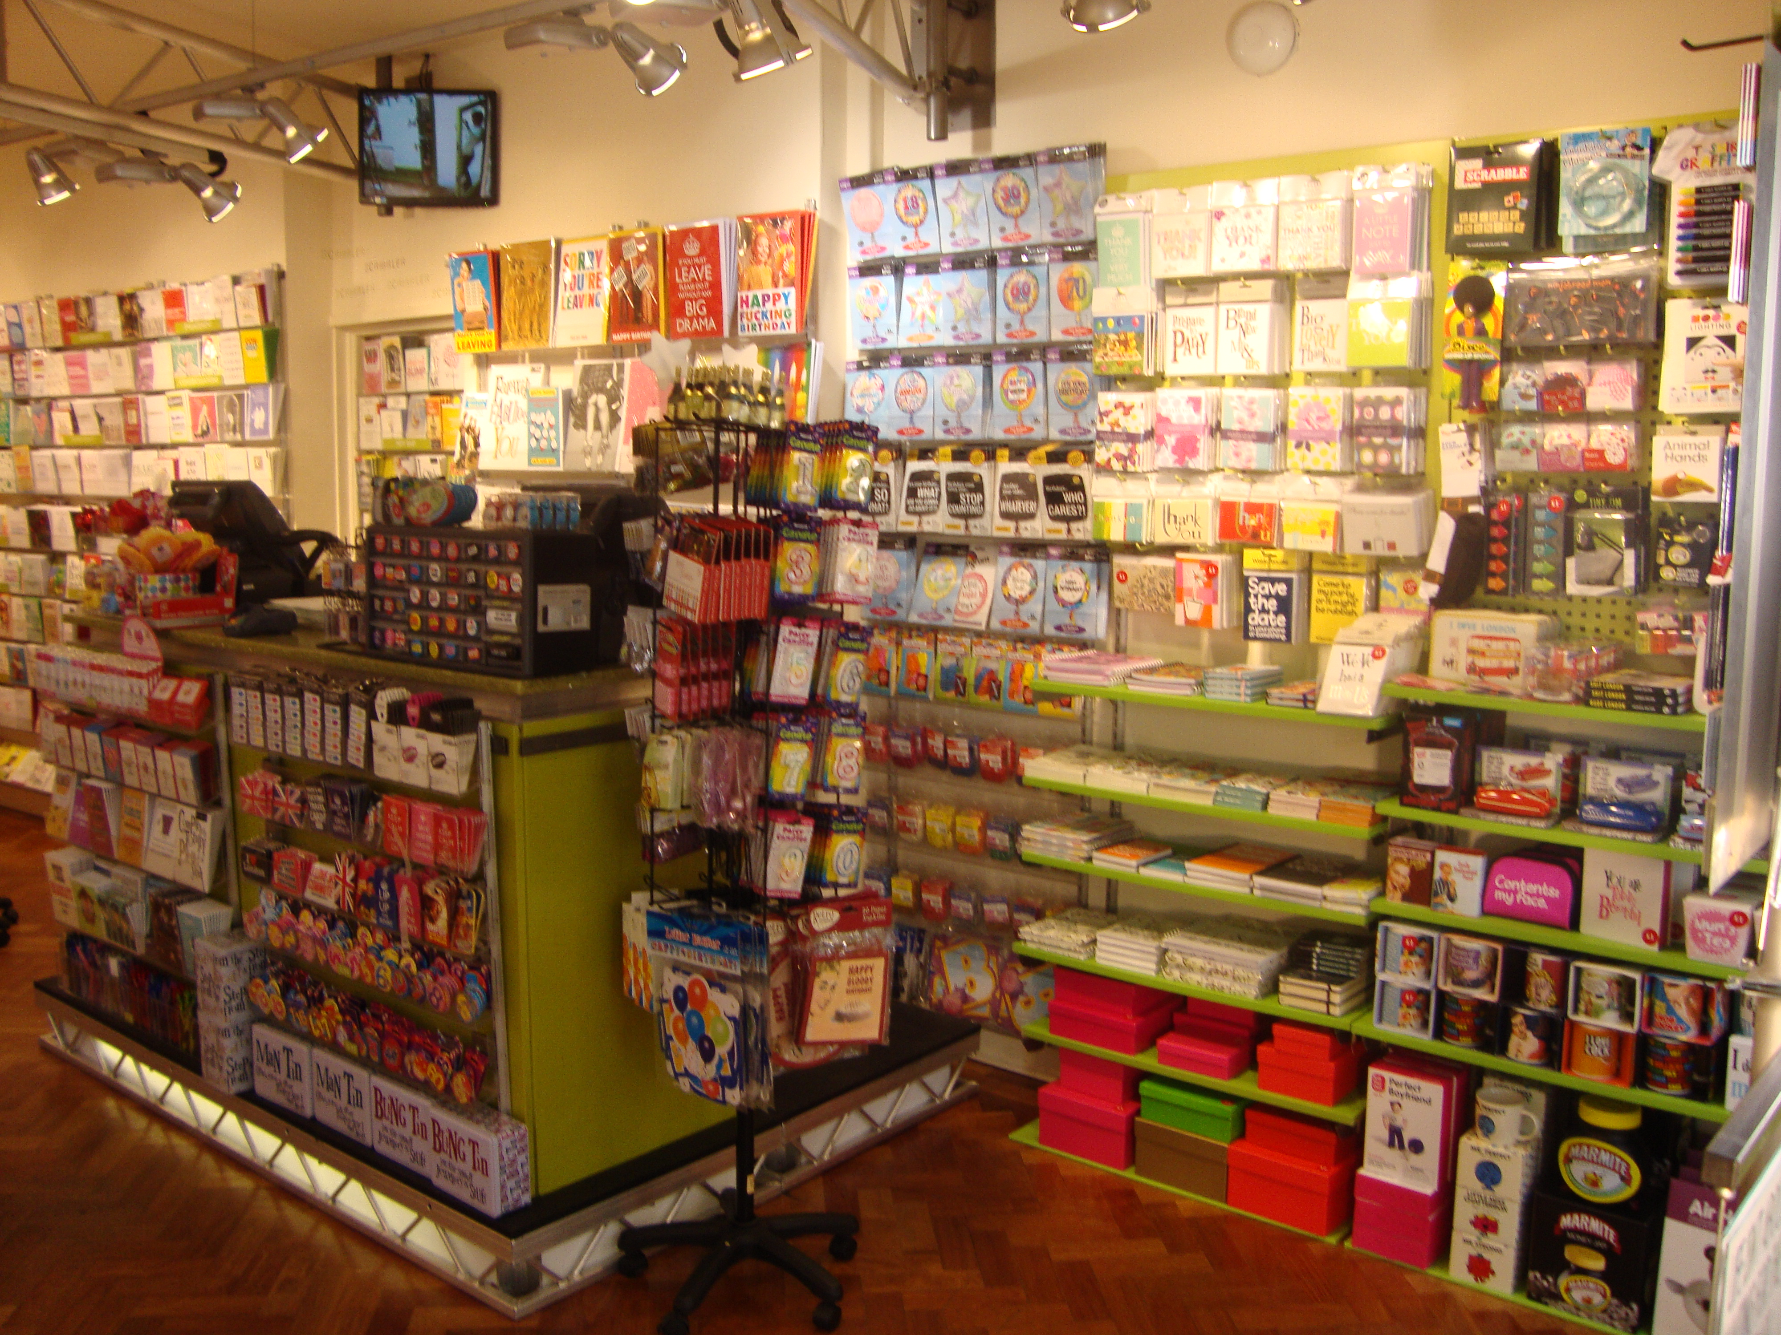
card shop
I have to go to the card shop to buy a letter of congratulations to my friend.

Slide 19
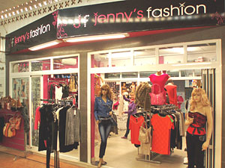
clothes shop
I like go to the clothes shop every weekend

Slide 20
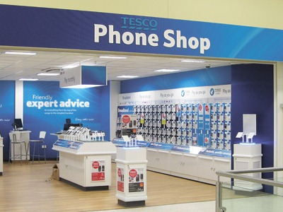
mobile phone store
I'm going to go the next month to the mobile phone store to buy a new one

Slide 21
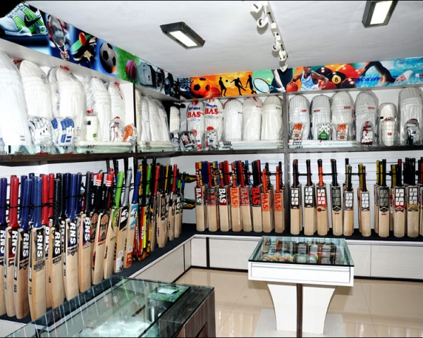
sports shop.
I recently went to buy some clothes at the sports shop

Slide 22
“USE OF ELECTRONIC DEVICES”

Slide 23
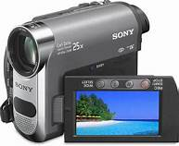
camcorder
I saw your camcorder in the classroom, go for it.

Slide 24
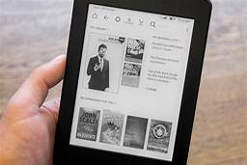
ebook reader
I love the ebook reader because I can hear it when I´m taking a shower or when I´m going to sleep.

Slide 25
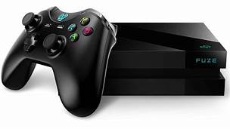
game console
I had a game console, in which I could play after finishing my homework.

Slide 26
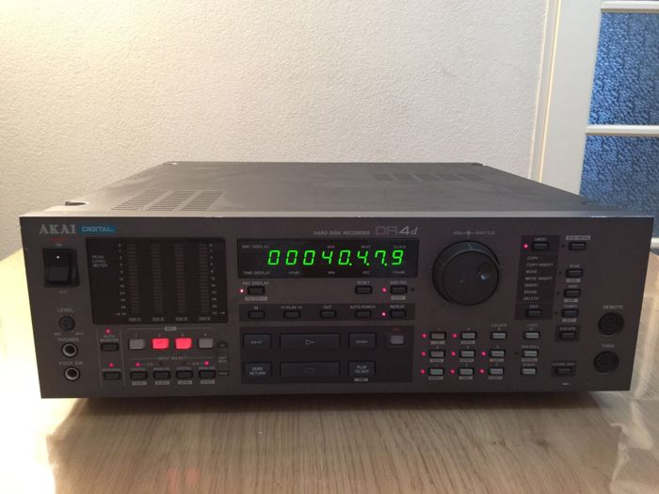
hard disk recorder
I lost my dad´s hard disk recorder yesterday at school, he´s gona kill me.

Slide 27
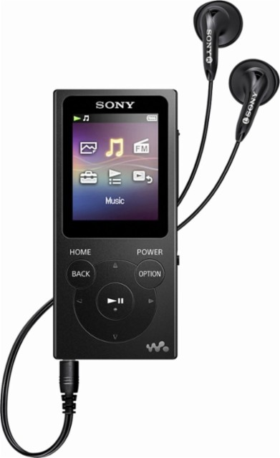
MP3 player
In my Mp3 player, I could listen to the songs that I like the most.

Slide 28
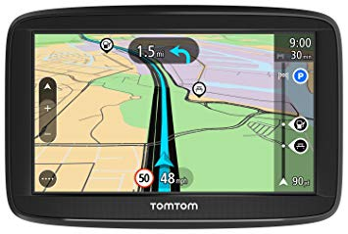
satnav
The satnav is really usefull because we can go to many places that we don´t know with it.

Slide 29
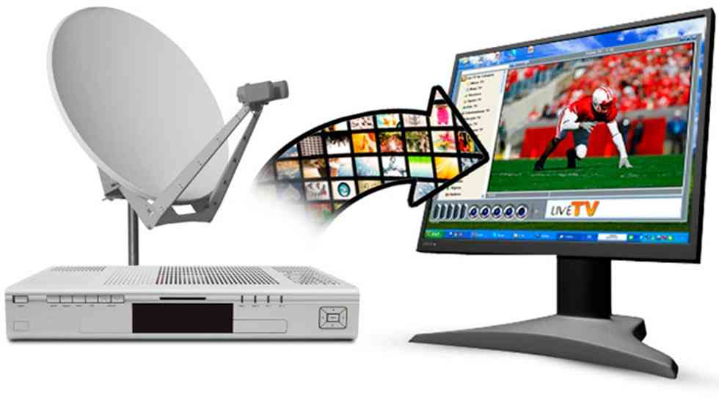
Satellite TV
I had a television, in which I could watch my favorite shows and I received a satellite signal.

Slide 30
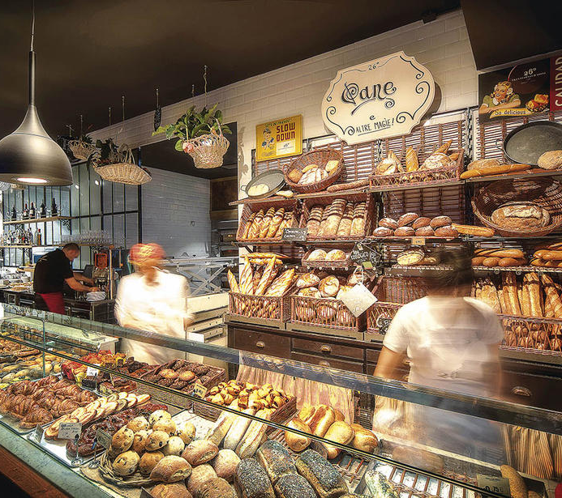
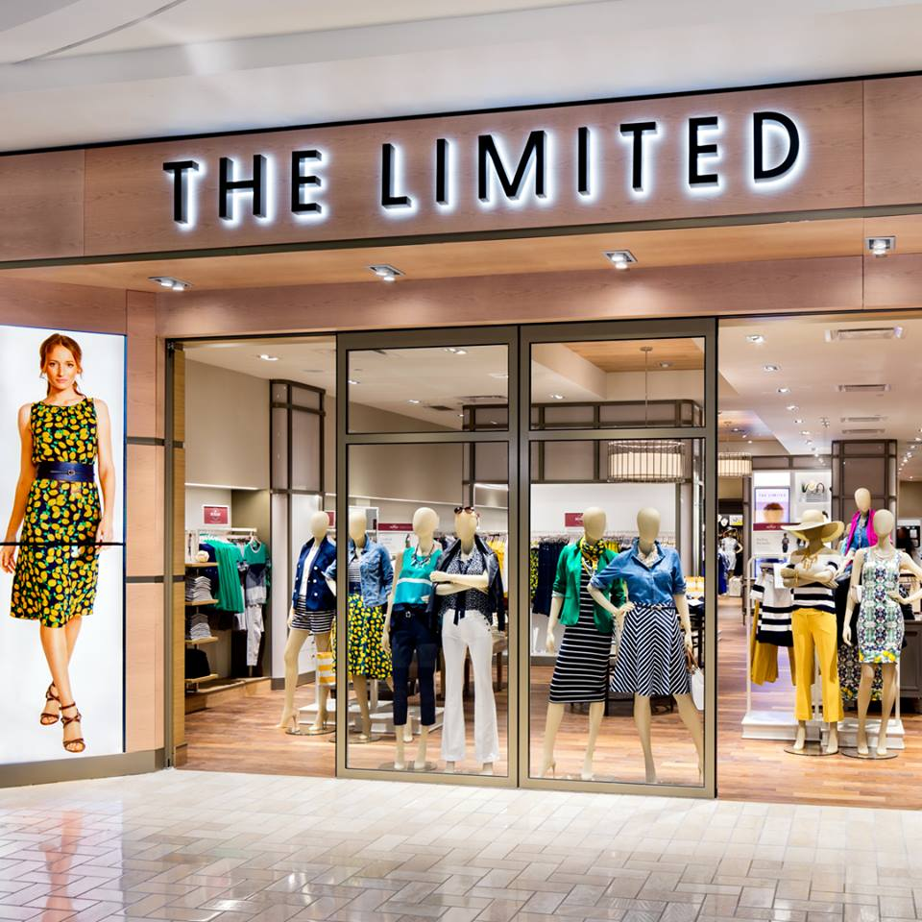
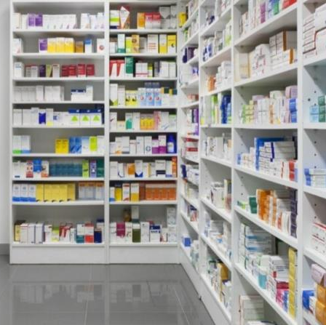
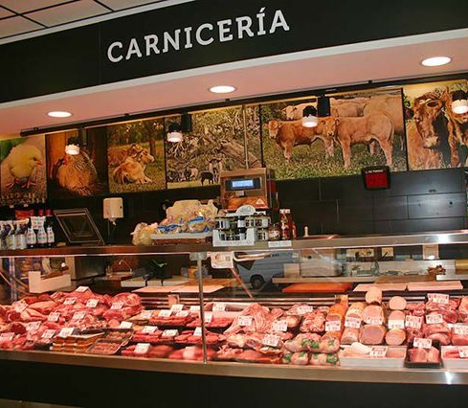
Vocabulary
Let´s go to the new shops in town, I heard they´re great.
That Baker´s is really famous, we should buy in there.
The butcher´s next to my house is close, I don´t know what to do.
I went to the chemist´s and the receptionist was rude.
I want to remodel my house, I should go to a DIY store.
I´m going to change my livingroom lamps, I´ll go to a electrical store to buy the new ones.
I don´t know what to do on Friday, maybe I´ll go to an entertainment store to buy a movie.

Slide 31
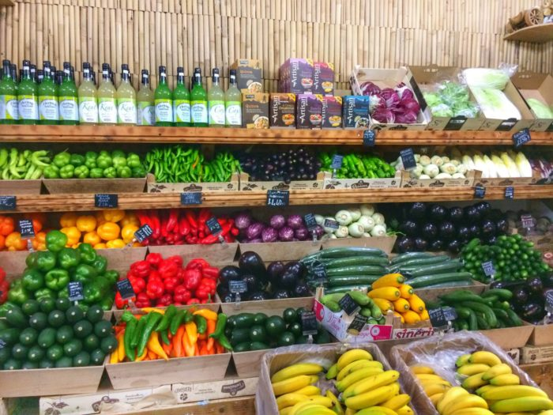
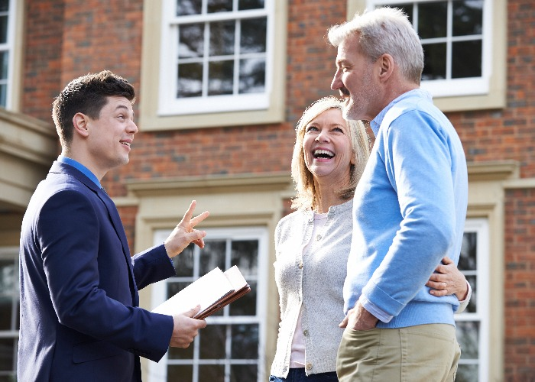
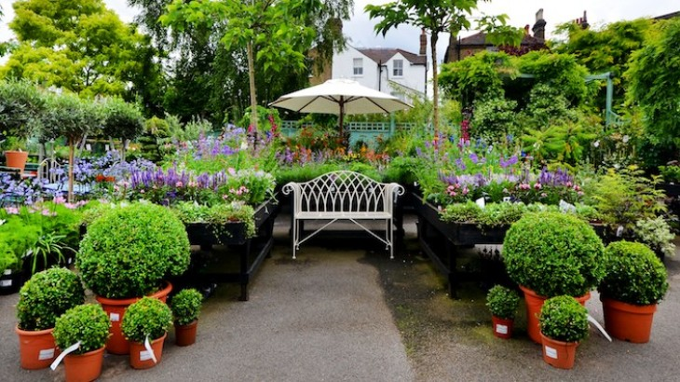
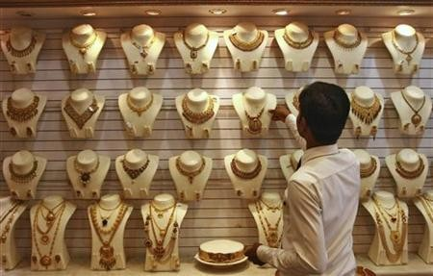
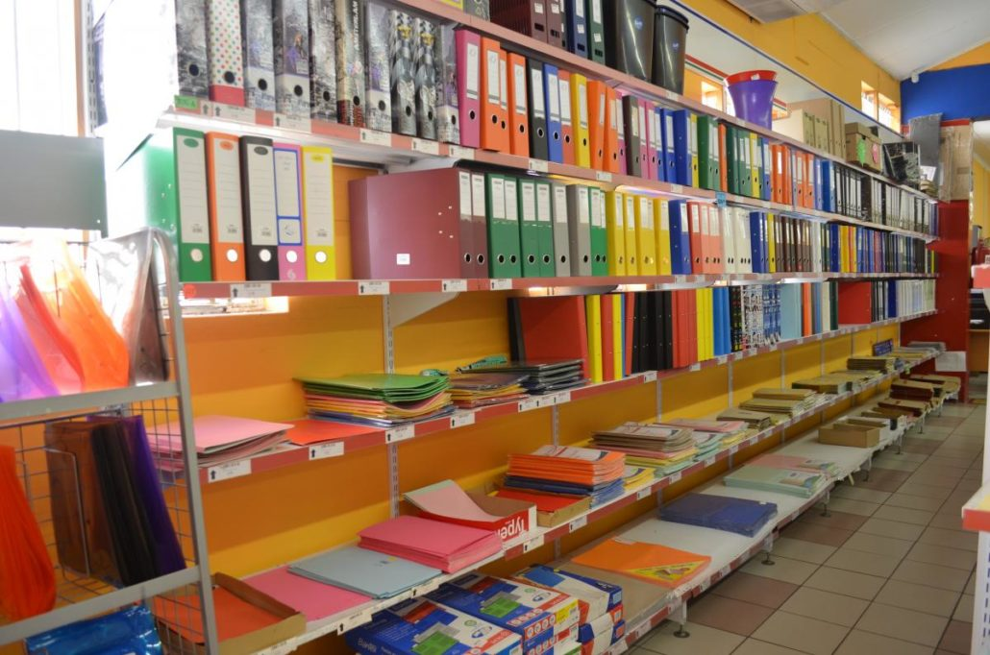
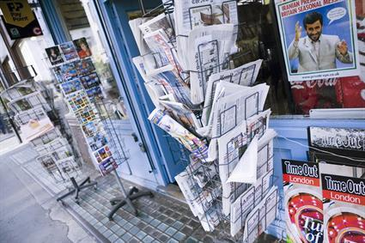
I´m going to buy a new house, i should read the estate agent´s.
I want some trees on my garden, I´ll go to the garden centre to pick my favorites.
I buy vegetables in my cousin´s greengrocer´s.
I saw a beautiful ring in the jeweller´s this morning. I´ll buy it.
I wanna know where the accident was, can we stop in the newsagent´s?
You should buy your son´s stuffs i the new stationer´s near my house, the prices are amazing.

Slide 32
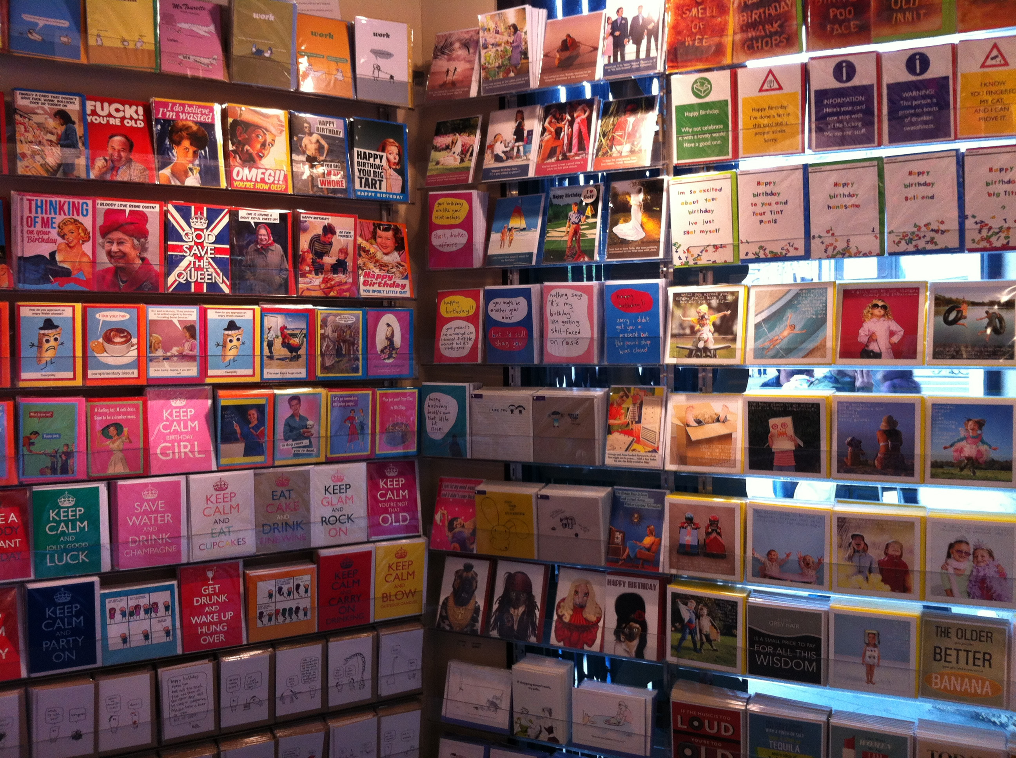
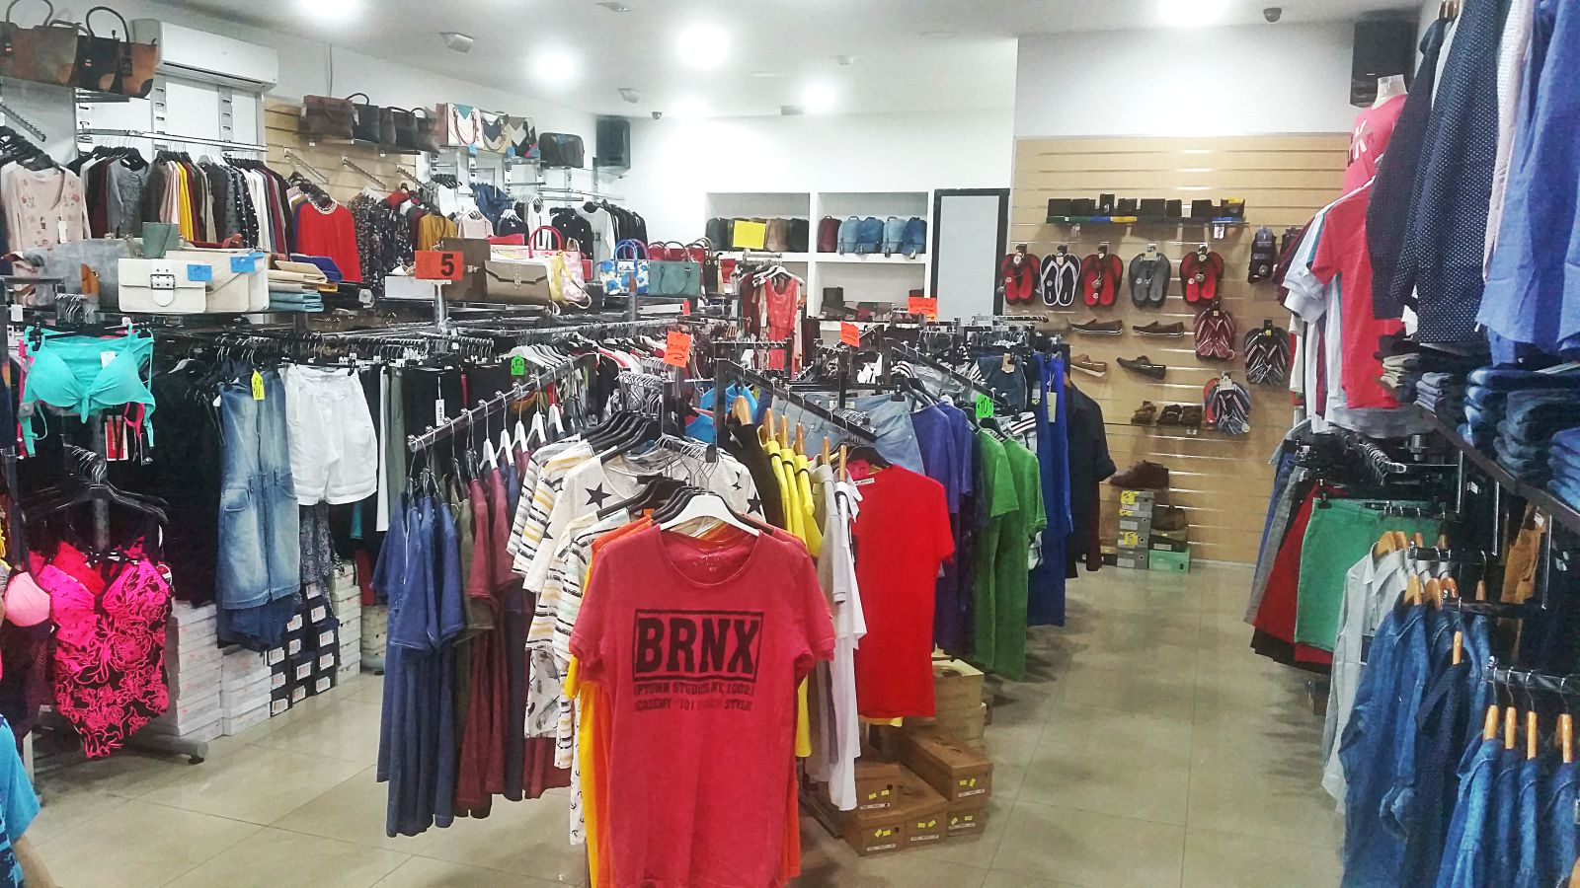
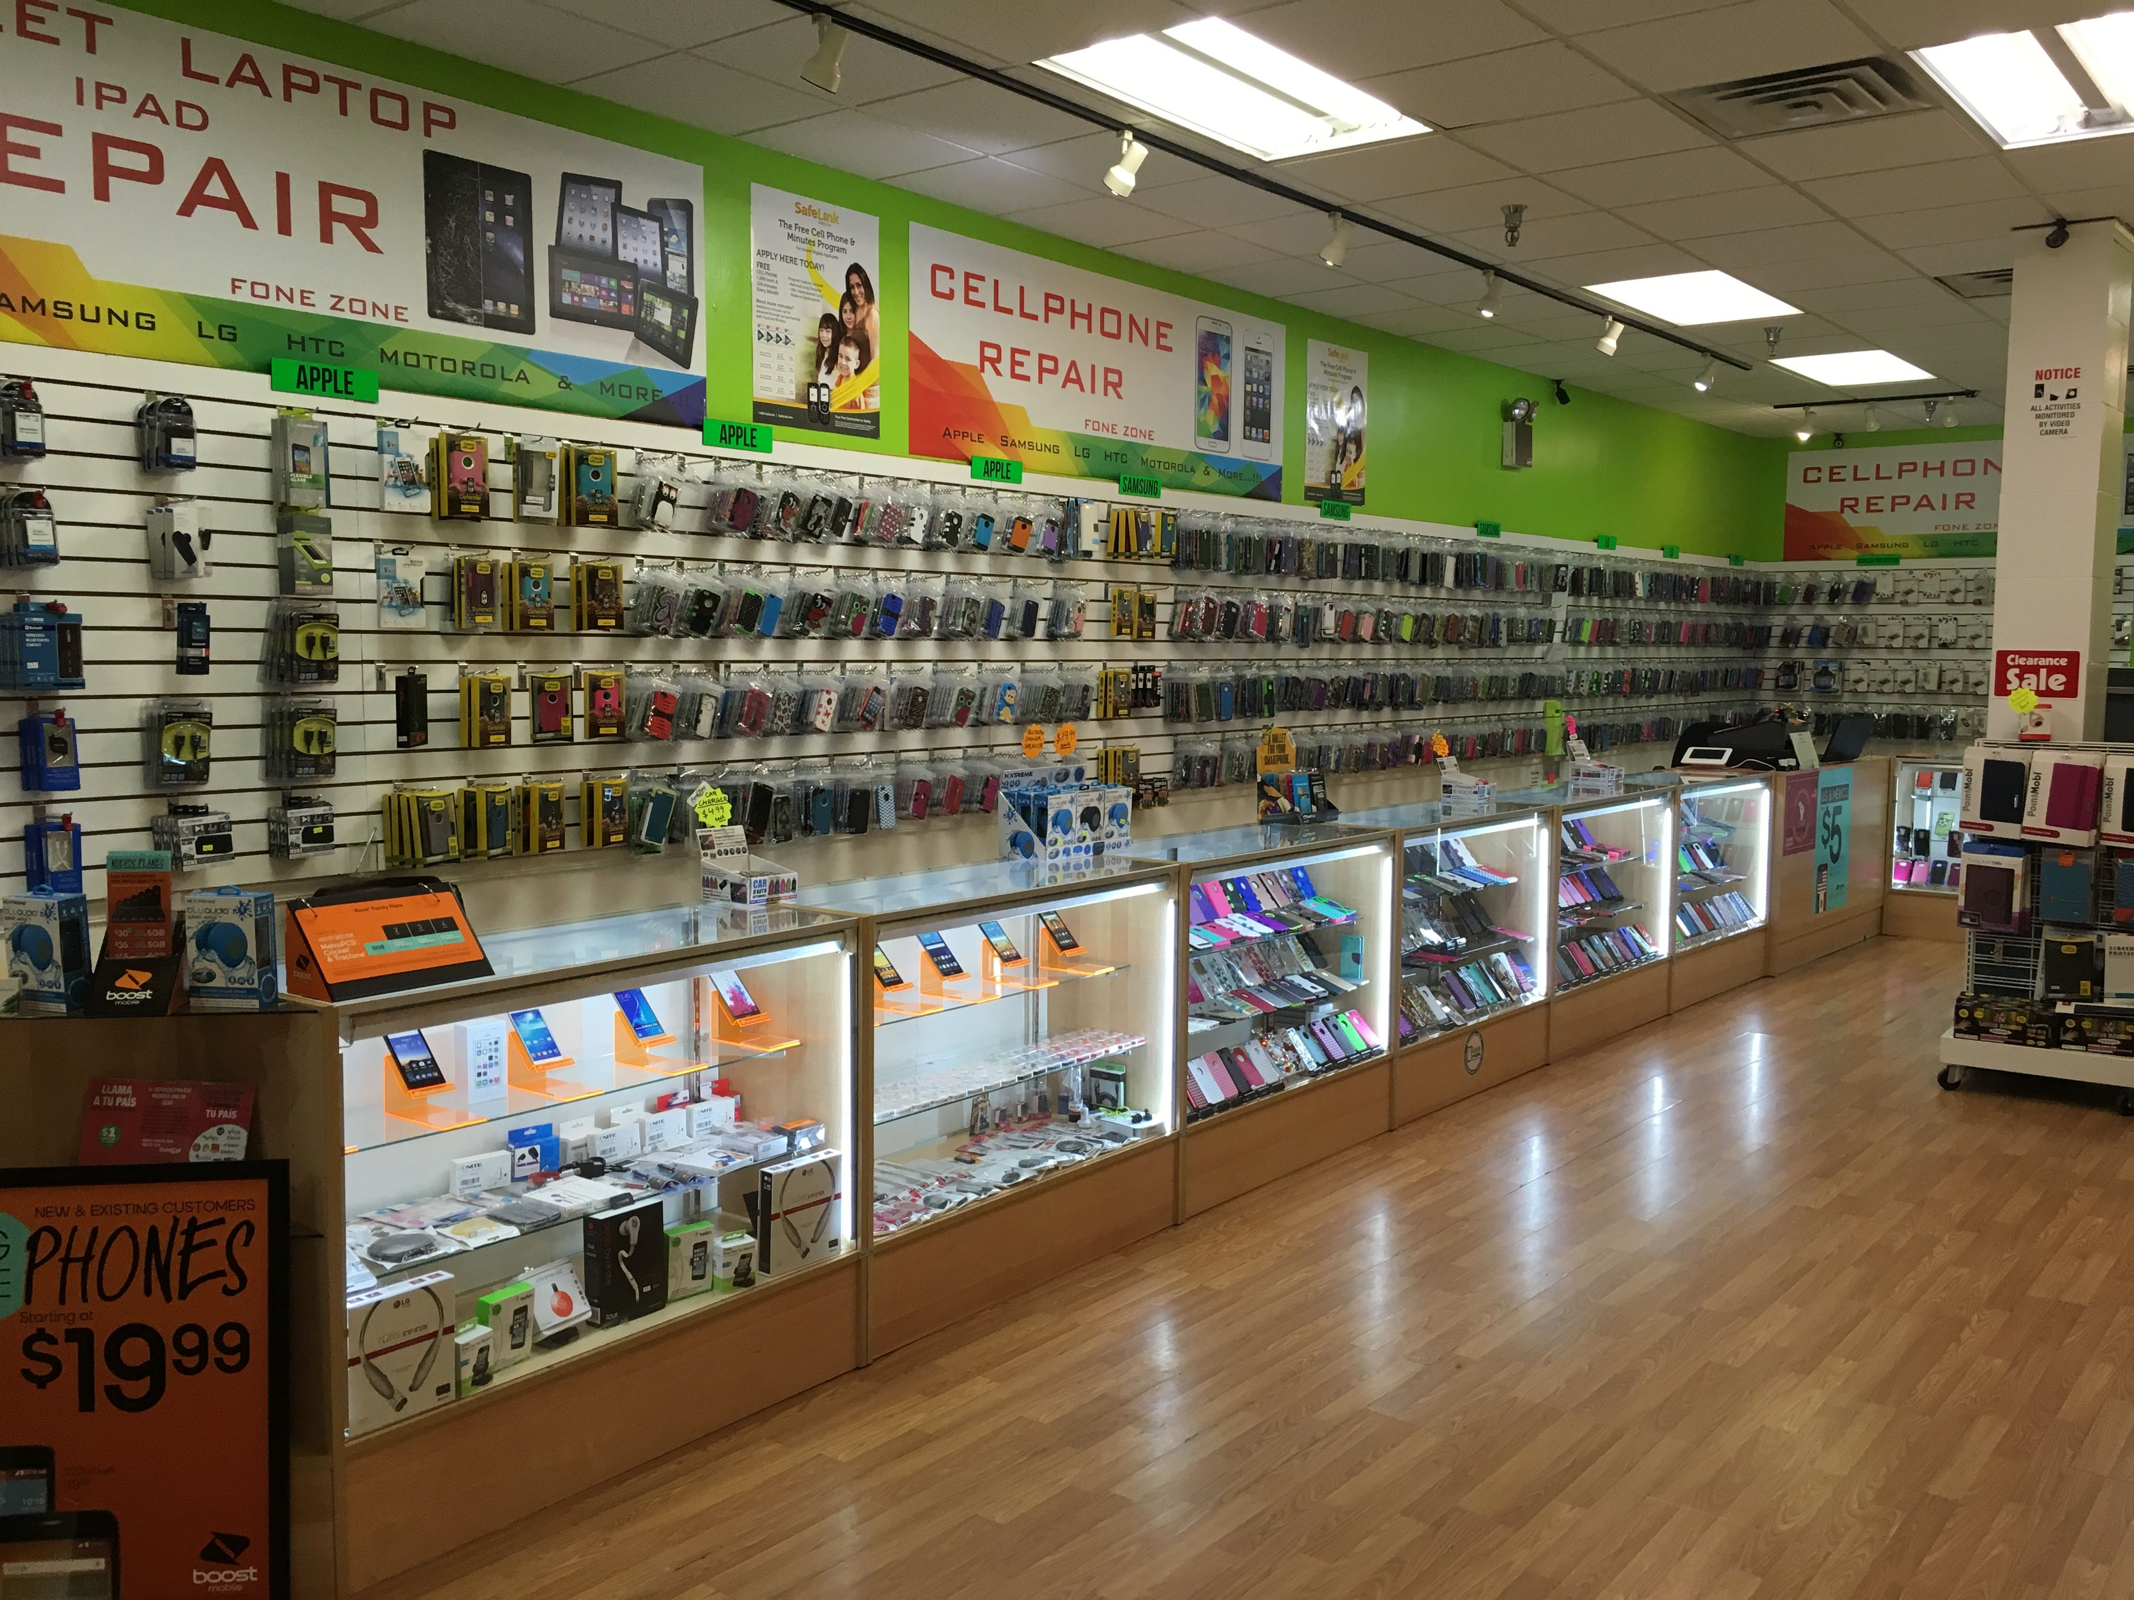
I´ll buy Laura Esquivel´s new book on the bookshop.
You can go to a card shop to buy a a birthday card for Melanie.
That dress is really beautiful, in which clothes shop did you buy it?
My phone is broken, maybe I´ll go to a mobile phone store to fix it.
If you want a new racket, you should go to a sports shop.
The perfect gift for your nephew is in the toy shop next to the cinema.

Slide 33
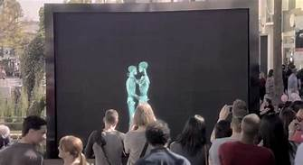
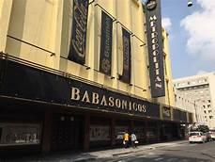
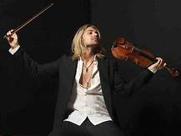
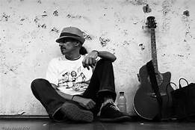
That artist is amazing, the play was a success because of him.
All the audience was surprised with all the acting thing.
The audition must be hard to pass.
My brother plays his guitar on the Street, he´s a busker.
There is a place where you can go and play your instruments, I think is a venue.

Slide 34

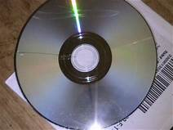
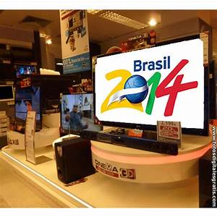
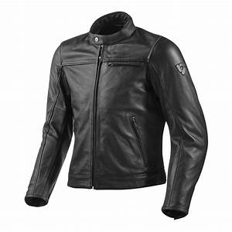
The store has a 20% of discount on sale, let´s buy a lot of things, the bids are shocking.
The purchase was a success.
It was a great bargain until the banknotes arrived.
The DVD That I bought is scratched.
My jacket has a hole under the armpit.
Your new television is really big, where did you buy it?

Slide 35
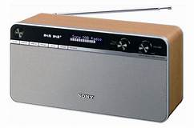
I saw your camcorder in the classroom, go for it.
I lost my digital radio when I went to the beach on vacation.
My dad gave it to me a digital photo frame as my birthday present.
I love the ebook reader because I can hear it when I´m taking a shower or when I´m going to sleep.
My mom sold our game console because we spend much time playing videogames.

Slide 36
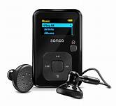
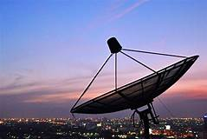
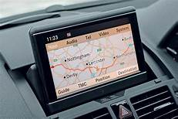
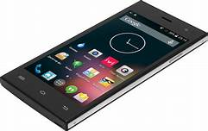
I lost my dad´s hard disk recorder yesterday at school, he´s gona kill me.
This MP3 player is really lightweight, is it yours?
The teacher has my notebook.
The satnav is really usefull because we can go to many places that we don´t know with it.
Satellite TV has a lot of interesting programs like the Discovery Channel.
My mom bought me a new smartphone, is amazing, and dad gave me a Tablet.

Slide 37
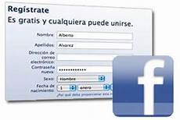


I created a Facebook account
I log on and my Friends told me to post a profile picture.
I updated the profile and upload many messages to my close Friends
I deactivate the account because it was kind of boring.

Slide 38




The car that my uncle bought is very fancy.
Sorry but I can´t today, I´ll met with some friends in a café.
I would like to play basketball with your dad tomorrow.
I'm glad you came to the movies with me.

Slide 39




I can´t make coffee, my coffee machine is broken.
I bring popcorn , put them in the microwave.
Your pants are still in the washing machine.
Put your palette in the freezer, before it melts.
To make french bread, you need a toaster

Slide 40
Bibliografía básica
Solutions. Preintermediate ed. (incluye cd, ISBN: 9780194552813, Autor: Paul a.falla
Imágenes : google images

