Slide 1


UNIVERSIDAD AUTÓNOMA DEL ESTADO DE MÉXICO
PLANTEL “LIC ADOLFO LOPÉZ MATEOS” DE LA ESCUELA PREPARATORIA
Asignatura: INGLES II
Módulo V
Nombre del módulo : Estilos de vida saludables.
Elaborado por:
Susana Sánchez Bastida
Material didáctico solo visión proyectables: Places , towns and cities

Slide 2
Propósito general
Emplea el idioma inglés para satisfacer sus necesidades inmediatas de interacción, supervivencia y de relación con su entorno inmediato, de forma simple, por medio de expresiones cotidianas, frases comunes, familiares y representaciones lingüísticas asociadas al contexto cultural y social.

Slide 3
Propósito de la unidad de aprendizaje de inglés II
Interactúa en el idioma inglés de forma oral y escrita, en situaciones sociales o académicas relacionadas con áreas de experiencia que le son relevantes, toma decisiones, realiza ofrecimientos, promesas y predicciones generales; expresa planes e intenciones, posibilidades, prohibiciones y necesidades. De igual modo establece condiciones, y asume las consecuencias de sus acciones, dando sugerencias y recomendaciones.

Slide 4
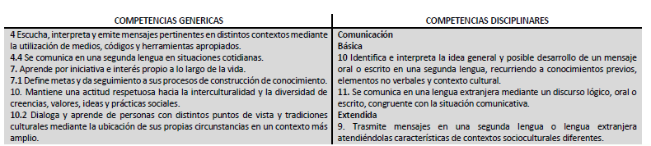
COMPETENCIAS

Slide 5
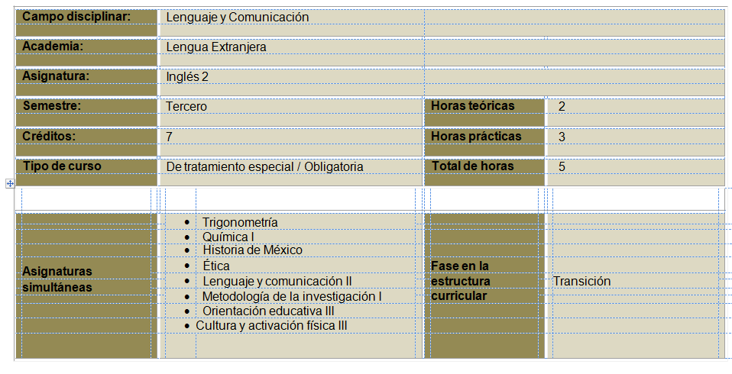

Slide 6
Places towns and cities

Slide 7
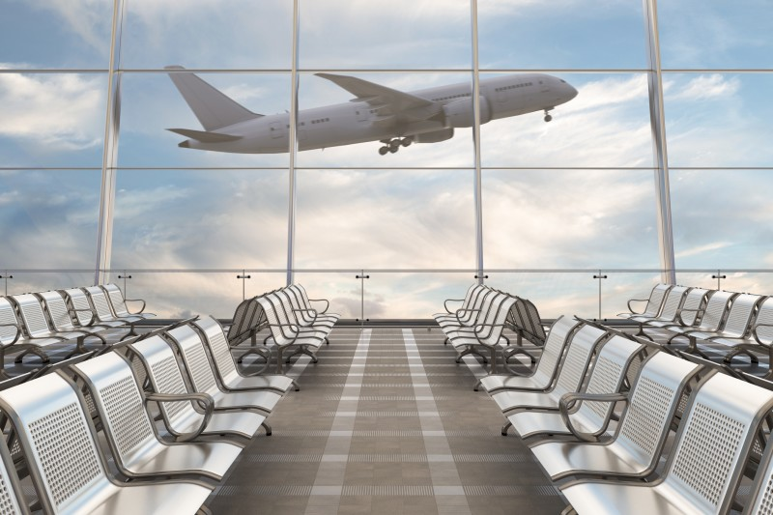
This is an airport of first class.

Slide 8
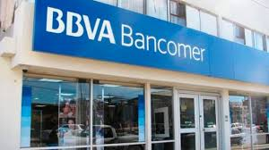
This is the national bank of México

Slide 9
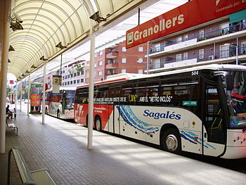
There is the bus station of first class

Slide 10
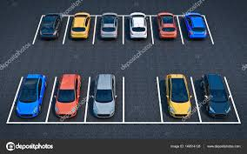
In the car park you can leave your car

Slide 11
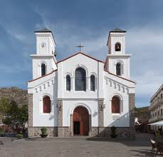
This is the church, here you can pray

Slide 12
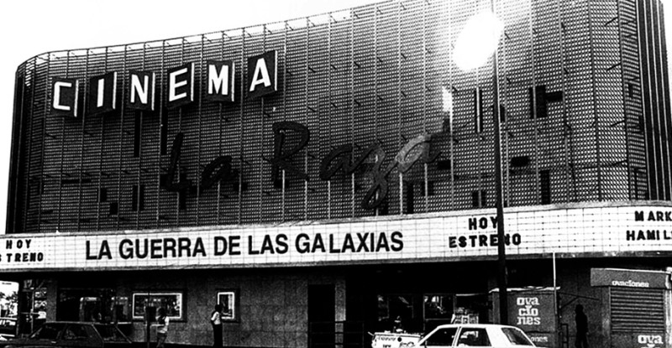
This is the cinema, it´s very funny

Slide 13
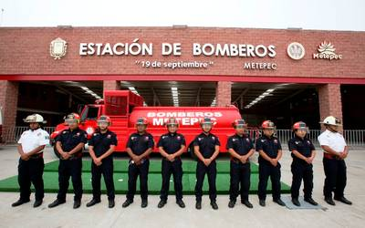
This is the fire station of Metepec

Slide 14
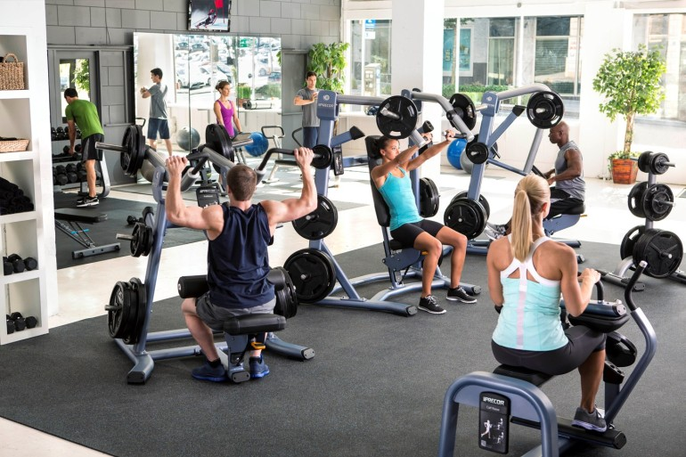
This is the gym, here you can do exercise

Slide 15
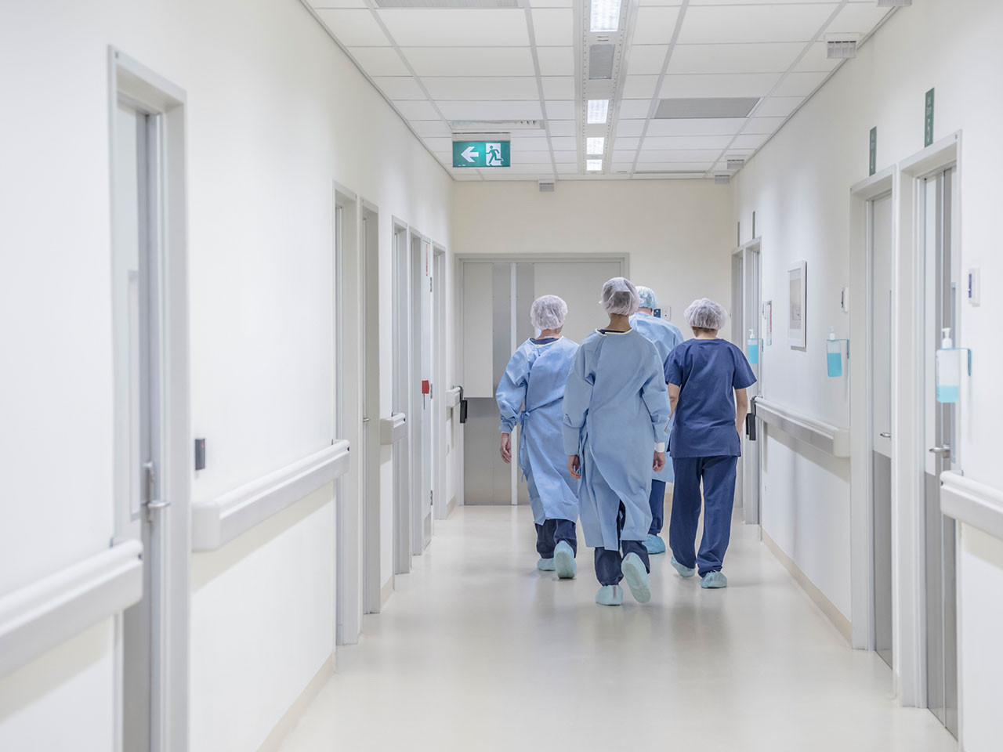
This is the hospital, there are some doctors

Slide 16
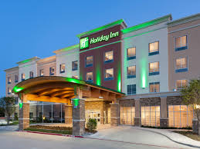
This is the hotel, people don´t live here

Slide 17
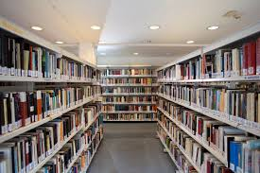
This is the library.

Slide 18
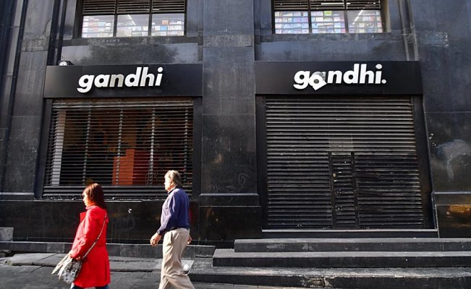
This is the book store, where you can buy some of your favorite books

Slide 19
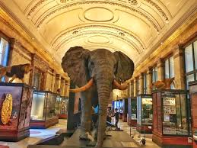
In the museums they keep some remains of extinct animals

Slide 20
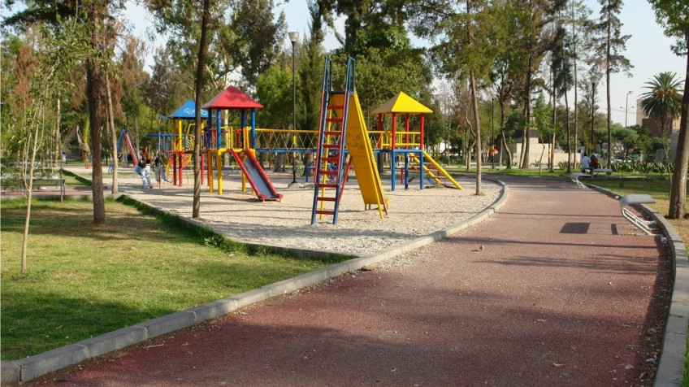
This is the park, here you can ride a bike

Slide 21
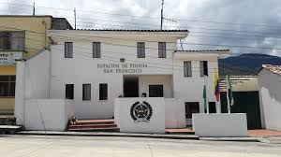
This is the police station

Slide 22
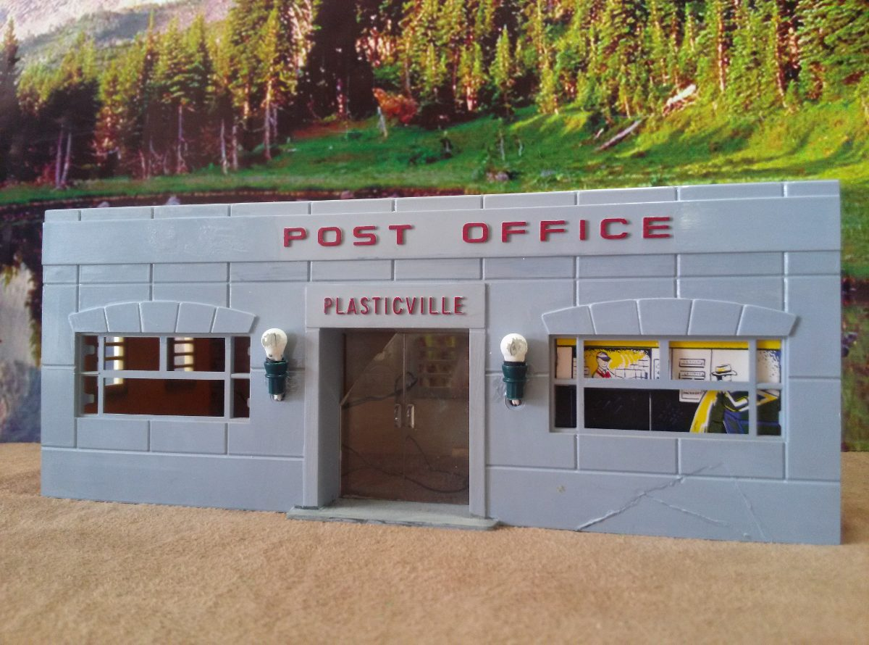
This is the post office, currently there aren´t many of them in town

Slide 23
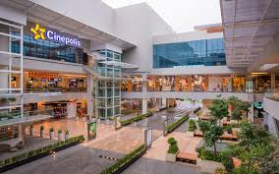
This is the shopping centre, come to buy some jeans!

Slide 24
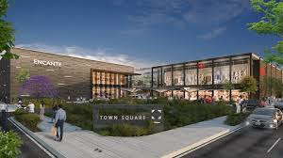
This is the new square of Metepec

Slide 25
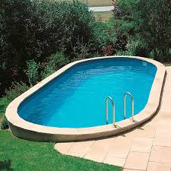
This is the swimming pool, come to swim with your family !

Slide 26
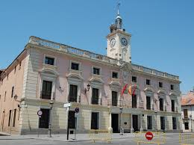
This is the town hall where the president works

Slide 27
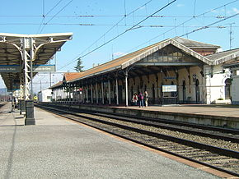
This is the train station of second class

Slide 28
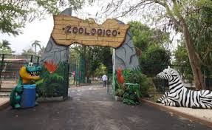
This is the zoo, here you can find many animals

Slide 29
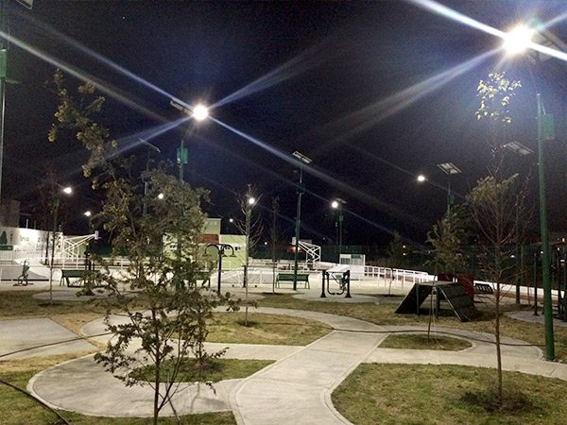
This is San Mateo Atenco park, the place where I live, here I´m going to skate

Slide 30
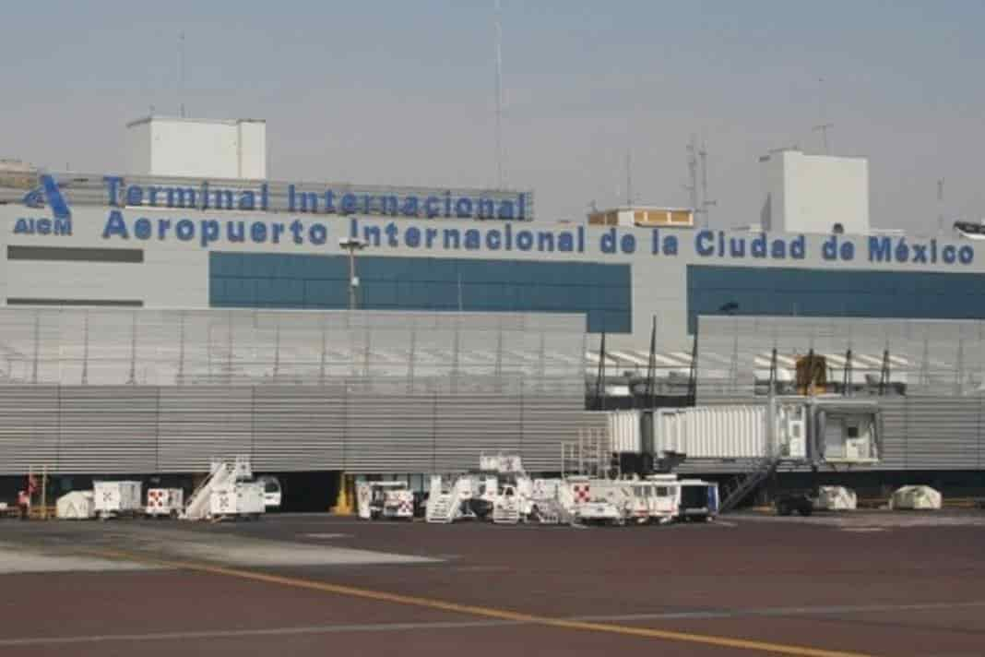
This is the international airport of Mexico City, capital of my country

Slide 31
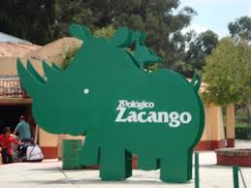
This is the Zacango´s Zoo, one of the most famous in the State of Mexico

Slide 32
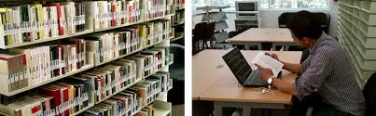
This is the library of my university, UAEMex, located in Toluca

Slide 33
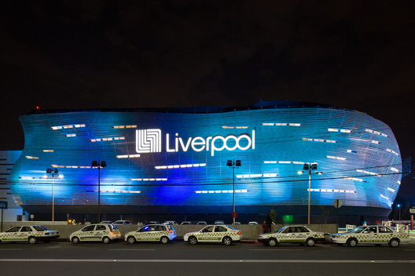
This is the shopping centre of Toluca, here I come to buy my clothes

Slide 34
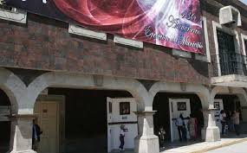
This is the town hall of San Mateo Atenco located on Benito Juarez´s street

Slide 35
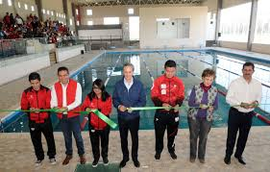
This is the semi-Olympic pool of my municipality

Slide 36
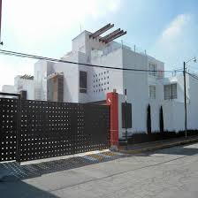
This is the residential Encanto, located on the street of my house.

