Slide 1


UNIVERSIDAD AUTÓNOMA DEL ESTADO DE MÉXICO
PLANTEL “LIC ADOLFO LOPÉZ MATEOS” DE LA ESCUELA PREPARATORIA
Asignatura: INGLES II
Módulo II
Nombre del módulo : Estilos de vida saludables.
Elaborado por:
Susana Sánchez Bastida
Material didáctico solo visión proyectables: Observando y comparando mi entorno.

Slide 2
Propósito general
Emplea el idioma inglés para satisfacer sus necesidades inmediatas de interacción, supervivencia y de relación con su entorno inmediato, de forma simple, por medio de expresiones cotidianas, frases comunes, familiares y representaciones lingüísticas asociadas al contexto cultural y social.

Slide 3
Propósito de la unidad de aprendizaje de inglés II
Interactúa en el idioma inglés de forma oral y escrita, en situaciones sociales o académicas relacionadas con áreas de experiencia que le son relevantes, toma decisiones, realiza ofrecimientos, promesas y predicciones generales; expresa planes e intenciones, posibilidades, prohibiciones y necesidades. De igual modo establece condiciones, y asume las consecuencias de sus acciones, dando sugerencias y recomendaciones.

Slide 4
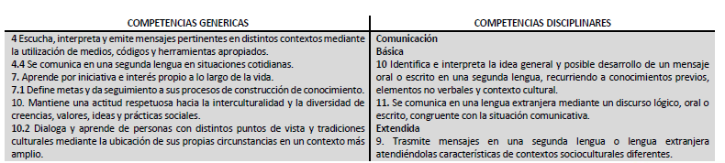
COMPETENCIAS

Slide 5
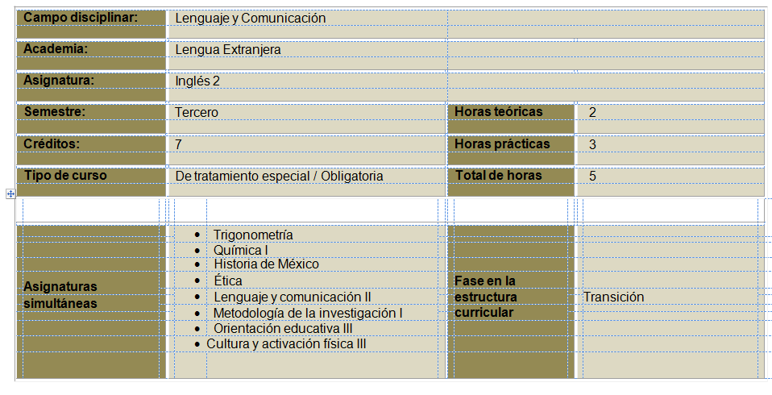

Slide 6
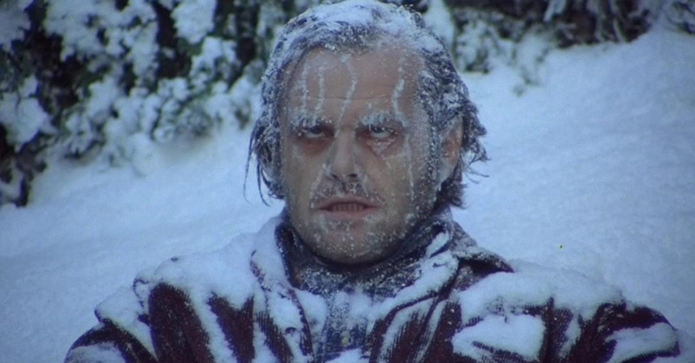
Today is colder than yesterday.

Slide 7

China is bigger than Italy

Slide 8
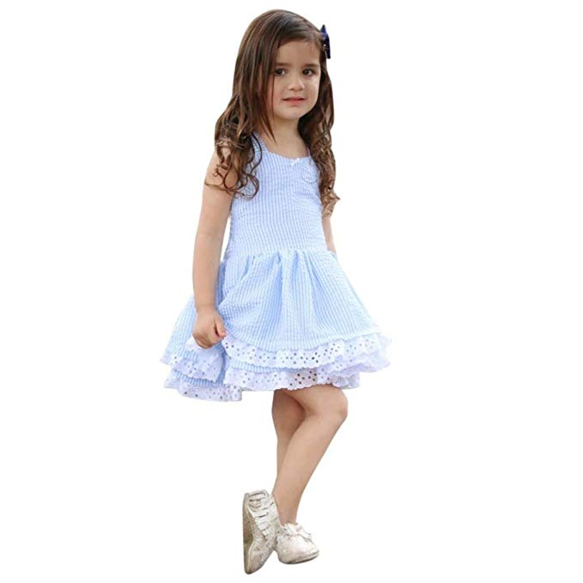
She is younger than her brother

Slide 9
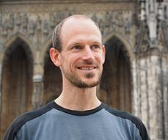
He is older than his friend.

Slide 10

I stayed awake longer than I expected

Slide 11

My car is newer than yours.

Slide 12
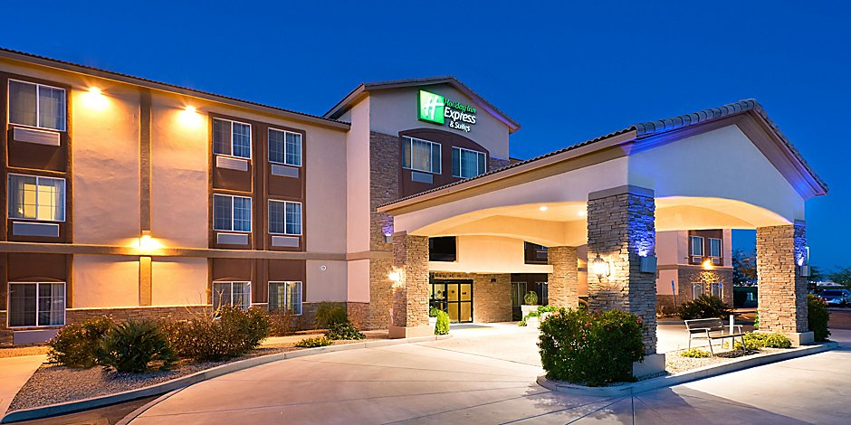
His house is bigger than mine

Slide 13
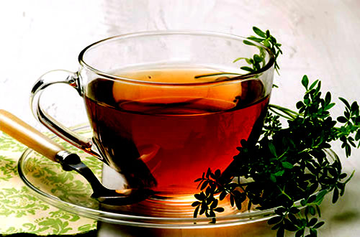
Tea is cheaper than champagne

Slide 14

We are smarter than yhey are in maths

Slide 15
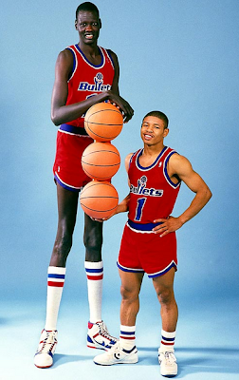
I am taller than my bothers

Slide 16

Gold is more valuable than silver

Slide 17
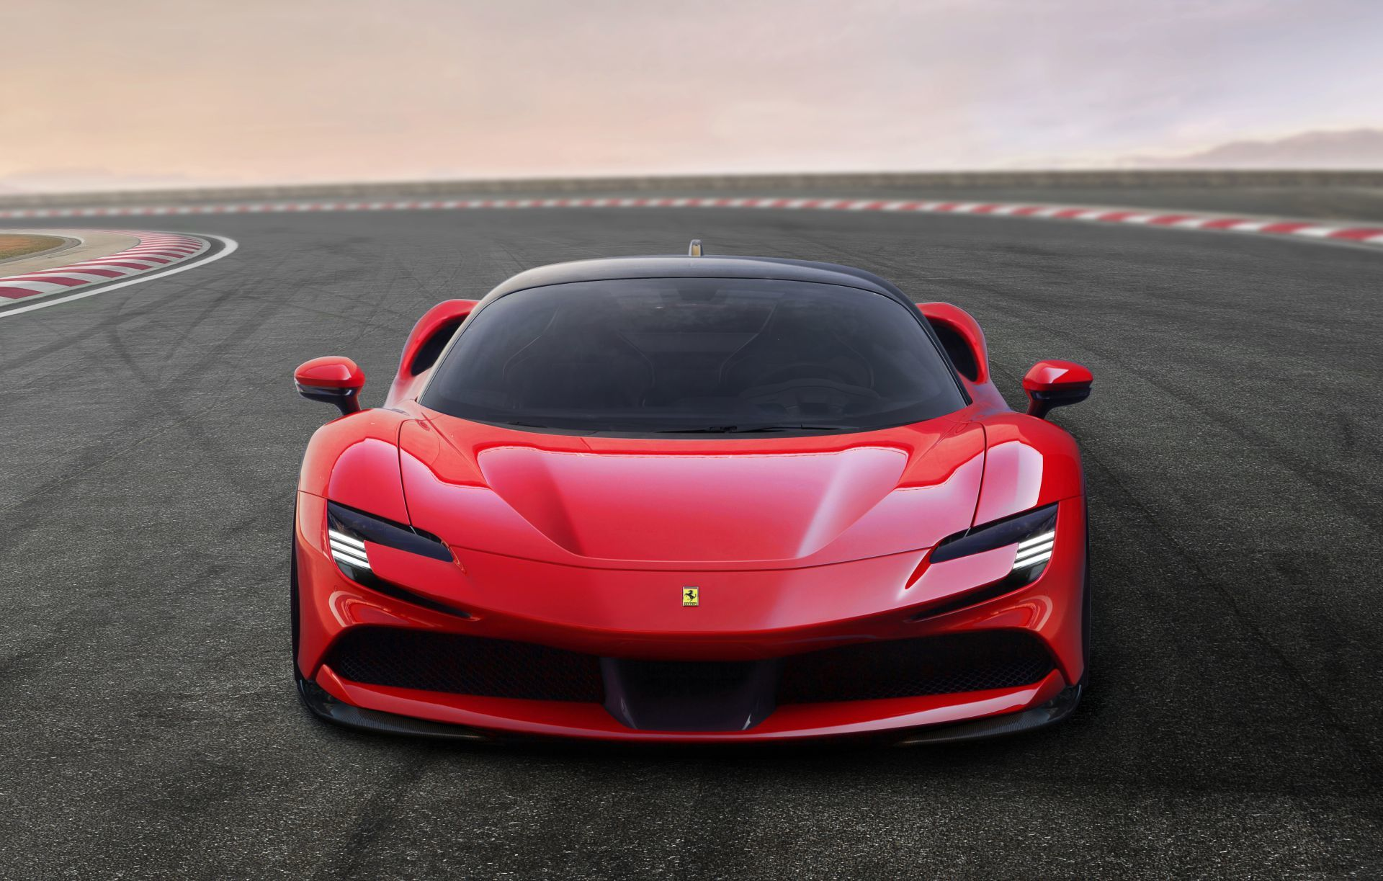
His car is more expensive than my car.

Slide 18
His car is more beautiful than my car.

Slide 19
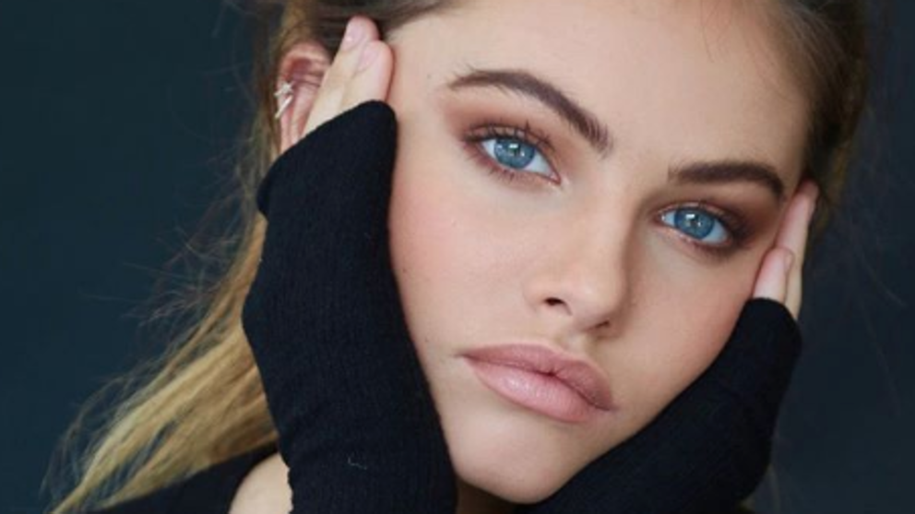
She is more beautiful than her sister.

Slide 20

She is more ambitious than her sister.

Slide 21

She is the smartest person I know

Slide 22
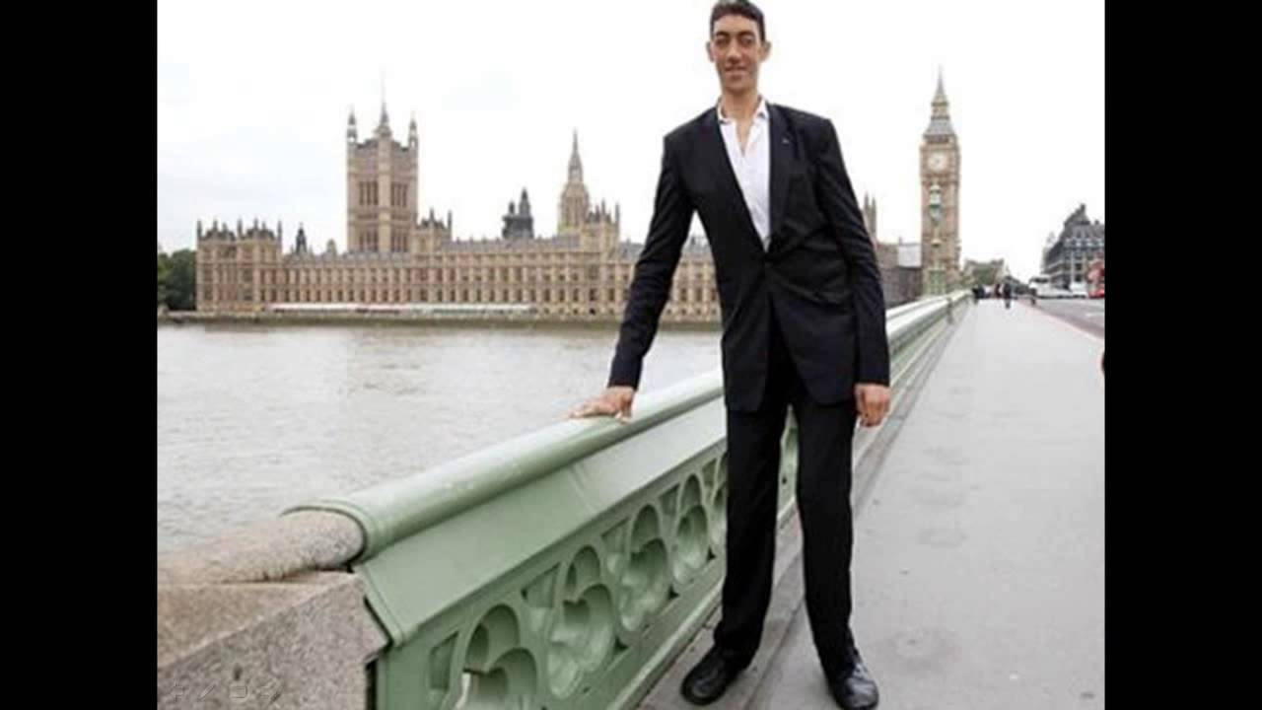
He is the tallest person I know

Slide 23
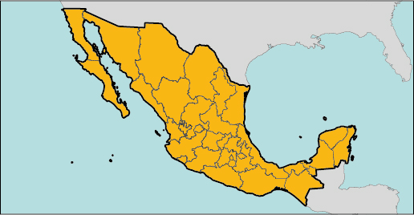
Mexico is the biggest country I have visited

Slide 24

She is the youngest in her family.

Slide 25
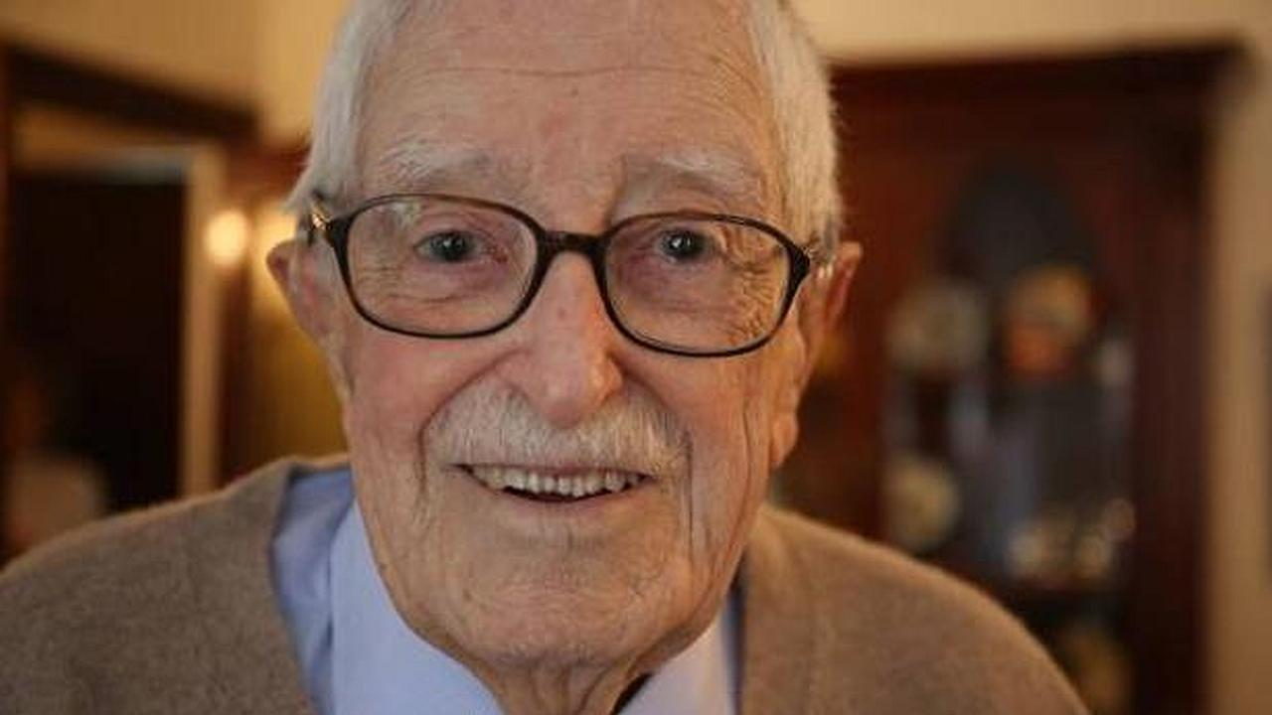
He is the oldest man I know.

Slide 26
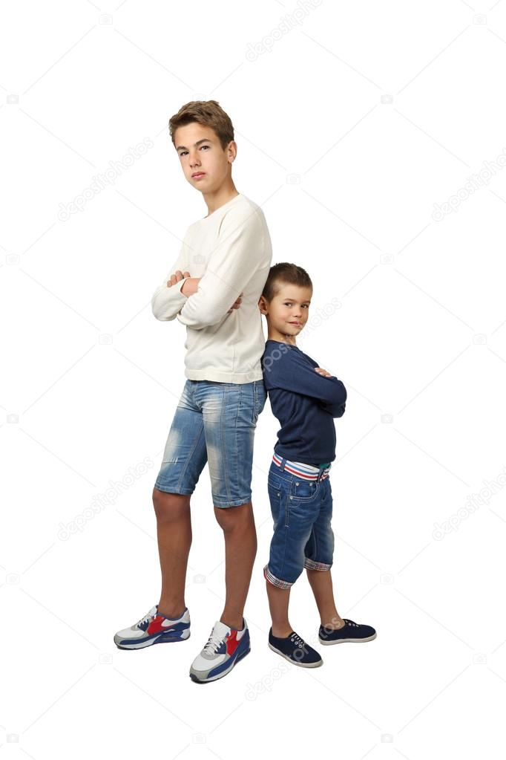
I am the tallest in the class

Slide 27

I am the happiest man in the world.

Slide 28
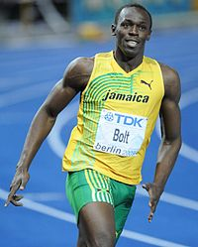
He is the fastest runner I have ever seen.

Slide 29
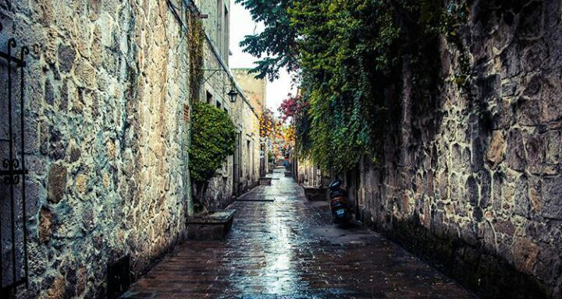
This is the narrowest road I have ever seen.

Slide 30
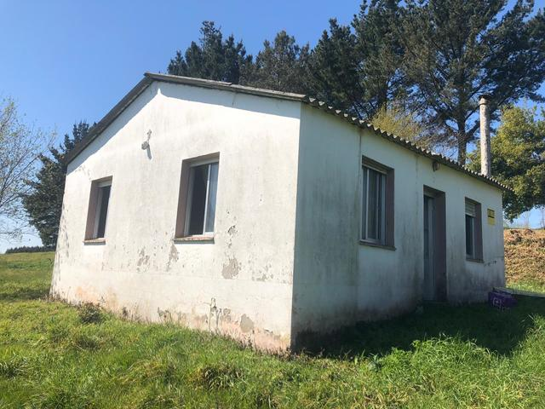
She is living in the smallest house in town

Slide 31
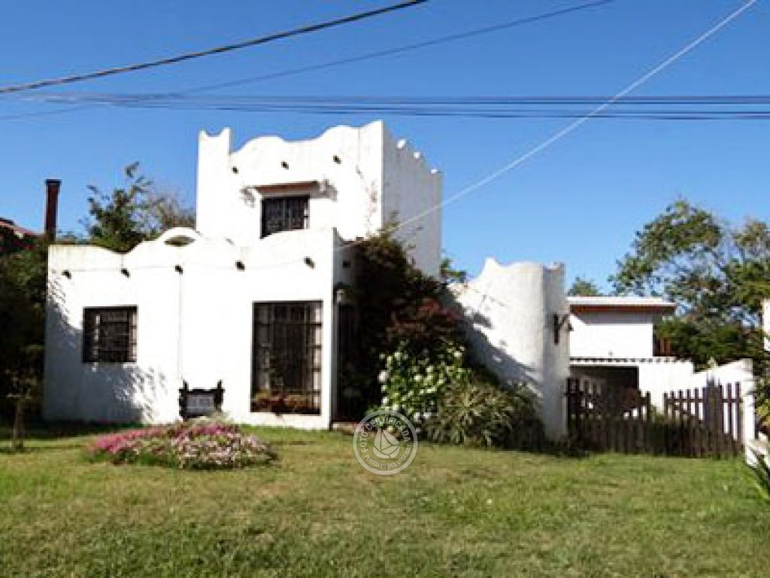
She is living in the biggest house in town

Slide 32
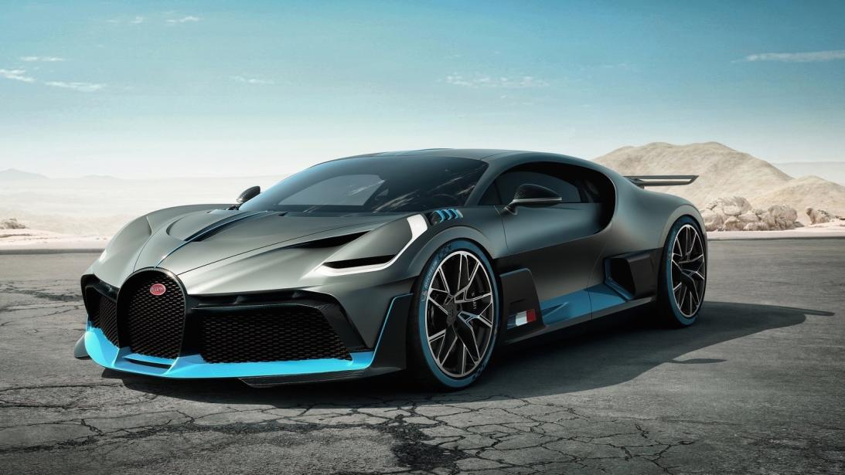
This car is the most expensive he has bought

Slide 33
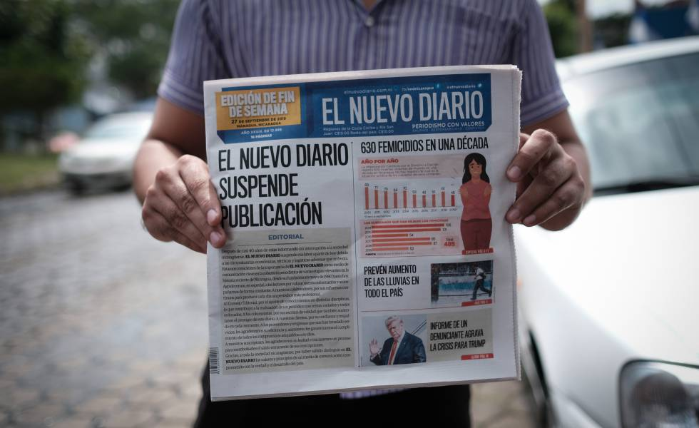
I read the most important newspaper every morning

Slide 34
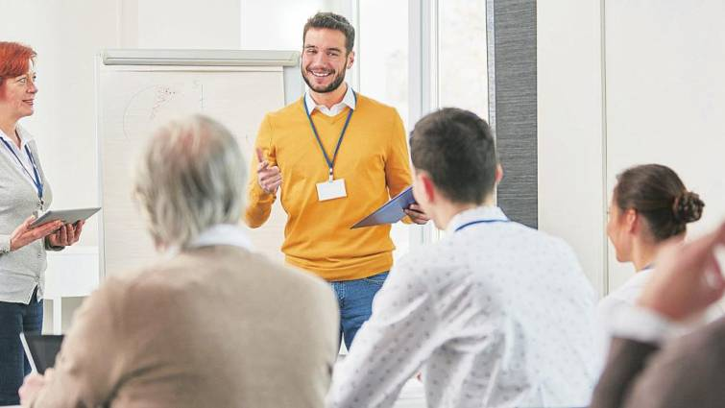
She is the most ambitious person in the team.

Slide 35

I am the most serious person in the classroom

Slide 36
Bibliografía básica
Solutions. elementary workbook / 3rd ed. (incluye cd, ISBN: 9780194552813, Autor: Paul a.falla
Imágenes : google images

