Slide 1

Material Didáctico:
Sólo Visión
2019
M. EN C. ED. IRMA GABRIELA BAREETO ESTÉVEZ
UA: Inglés Técnico Administrativo

Slide 2
UNIDAD DE COMPETENCIA 2
Describir las ventajas y desventajas de la mercadotecnia, conocer las características de las campañas exitosa.
Conocer las características y pasos de una presentación formal.

Slide 3
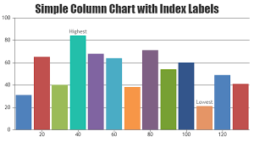
Search reading and
guessing, skimming,
analyzing the organization of
the information in
paragraphs.
READING

Slide 4


GRAPHS AND TRENDS
VOCABULARY
GOING UP
GOING DOWN
decreased
fell
dropped
declined
rise, rose
increased
went up
grew

Slide 5
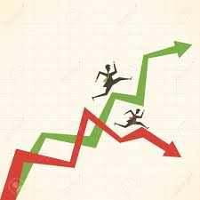

NO CHANGE
UP AND DOWN
stayed the same
remained constant
levelled off
stabilised
fluctuated
zig-zagged
fluttered
undulated

Slide 6

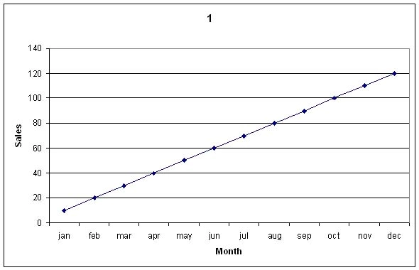
Big changes:
Adverbs / Adjectives
Small Changes Adjectives / Adverbs
gently
gradually
slightly
steadily
suddenly
sharply
dramatically
steeply
a lot

Slide 7
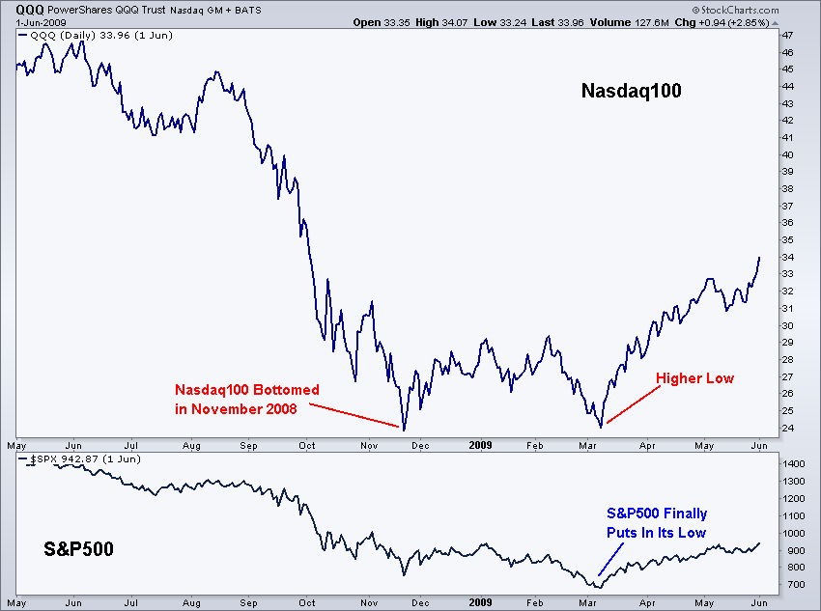
Low Points
bottomed out
reached a low

Slide 8
Describing graphs and trends in english
When it comes to presenting and explaining data charts, graphs, and diagrams, you should help people understand and memorize at least the main points from them. As to the use cases, diagrams and other visuals perfectly fit for describing trends, making a comparison or showing relationships between two or more items. In other words, you take your data and give it a visual comprehensible form.

Slide 9
Graphs, Charts & Diagrams
.
Data can be represented in many ways. The 4 main types of graphs are a bar graph or bar chart, line graph, pie chart, and diagram.

Slide 10
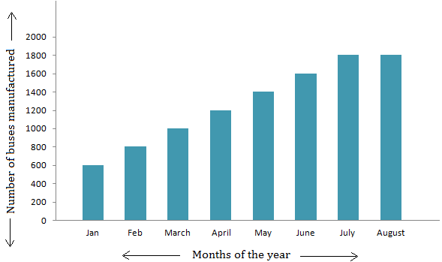
Bar graphs
They are used to show relationships between different data series that are independent of each other. In this case, the height or length of the bar indicates the measured value or frequency. Below, you can see the example of a bar graph which is the most widespread visual for presenting statistical data.

Slide 11
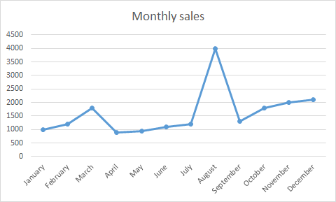
Line graphs
They represent how data has changed over time. This type of charts is especially useful when you want to demonstrate trends or numbers that are connected. For example, how sales vary within one year.

Slide 12
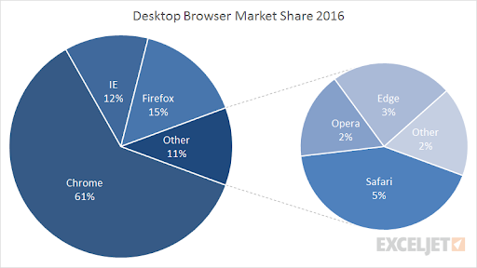
Pie charts
They are designed to visualize how a whole is divided into various parts. Each segment of the pie is a particular category within the total data set. In this way, it represents a percentage distribution.

Slide 13
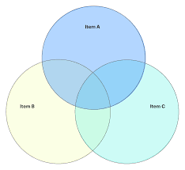
Diagram
It is a plan, drawing, or outline created to illustrate how separate parts work and overlap at the connecting points.

Slide 14
PRESENTATIONS IN ENGLISH
Giving the perfect oral presentation in English requires practice. Remember that even great orators like Steve Jobs, Abraham Lincoln, Nelson Mandela and Martin Luther King became excellent public speakers through years of dedicated practice.

Slide 15

10 TIPS FOR GIVING A GREAT PRESENTATION IN ENGLISH

Slide 16

1. THINK ABOUT THE DETAILS IN ADVANCE
Giving a presentation in front of an audience is always stressful. Thinking about such details as the location of the presentation, equipment, materials, timing, your appearance and outfit will help you avoid nervousness.

Slide 17
2. DO YOUR HOMEWORK
Make it easier for the audience and yourself: use simple language.
Prepare yourself for questions. Think about what questions the audience might ask.
Usually an orator has a maximum of 15 minutes to present. So, make the presentation simple, have no more than 20 slides using a font that is legible from a distance.
Don’t put large blocks of text in your presentation. No one will be interested in reading it; people prefer visual material. So think about images, graphs and videos that support your idea, but don’t overwhelm the audience with too many visual aids.
Effective preparation requires consideration of the following things:
Ask yourself what the presentation is all about, its title and its goal
Think about who your audience is
Figure out what your main message is
Think about the structure of the presentation: the opening, the main part and the summary

Slide 18
3. INTRODUCE YOURSELF AND SET THE THEME
At the beginning of the presentation, it’s important to introduce yourself, giving your full name, position and company you represent. Some people also include their contact information on the first slide. That’s in case you want someone from the audience to contact you after your presentation. After the introduction, don’t forget to state the topic of your presentation.
USEFUL PHRASES IN ENGLISH:
“Hello, ladies and gentlemen, thank you for coming…”
“The topic of today’s meeting is…”
“Let’s get the ball rolling”
“Shall we get started?”

Slide 19
4. PROVIDE AN OUTLINE OR AGENDA OF YOUR PRESENTATION
Providing an outline of the presentation is a must, as people want to know why they should listen to you. That’s why the opening part is very important. It should be cheerful, interesting and catchy. You should know it by heart, so you don’t lose track of your thoughts even if you are nervous.
USEFUL PHRASES IN ENGLISH:
“I’d like to give you a brief outline of my presentation…”
“Here is the agenda for the meeting…”
“My presentation consists of the following parts…”
“The presentation is divided into four main sections…”

Slide 20
5. Explain When the Listeners Can Ask Question
A Question & Answer period (Q&A) usually takes place at the end of the presentation, so you have enough time to deliver the main message of your speech without being interrupted by multiple questions. If you want the audience to ask questions during or after the presentation, say so.
USEFUL PHRASES IN ENGLISH:
“There will be a Q&A session after the presentation”
“Please feel free to interrupt me if you have any questions”
“I will be happy to answer your questions at any time during the presentation”

Slide 21
6. MAKE A CLEAR TRANSITION IN BETWEEN THE PARTS OF THE PRESENTATION
Using transition words and phrases in English makes your presentation look smooth and easy to follow.
USEFUL PHRASES IN ENGLISH:
“I’d like to move on to another part of the presentation…”
“Now I’d like to look at…”
“For instance…”
“In addition…”
“Moreover…”
“This leads me to the next point…”

Slide 22
7. WOW YOUR AUDIENCE
If you are not excited by your presentation, your audience will not be excited either. When presenting, you should plan to wow your audience. Use adjectives and descriptive words as they will help to attract the audience’s attention and make your speech more vivid and memorable.
USEFUL PHRASES IN ENGLISH:
“The product I present is extraordinary.”
“It’s a really cool device”
“This video is awesome”
“This is an outstanding example”

Slide 23
8. MAKE YOUR DATA MEANINGFUL
If you need to present numbers or some comparative analysis of algorithms for integration, use some visuals to present it. You can use charts, graphs or diagrams to make your data meaningful and visually attractive. Remember that pie charts are good for representing proportions, line charts to represent trends, column and bar charts for ranking.
USEFUL PHRASES IN ENGLISH:
“Here are some facts and figures”
“The pie chart is divided into several parts”
“The numbers here have increased or gone up”
“The numbers change and go down (decrease)”
“The numbers have remained stable”

Slide 24
9. SUMMARIZE
At the end of the presentation, briefly summarize the main points and ideas. Provide the audience with your opinion and give them a call to action, let them know what you want them to do with the information you’ve shared. End of the presentation by thanking all the listeners and inviting them to the Q&A.
USEFUL PHRASES IN ENGLISH:
“Let’s summarize briefly what we’ve looked at…”
“In conclusion…”
“I’d like to recap…”
“I’d like to sum up the main points…”

Slide 25
10. PRACTICE
Try rehearsing your presentation using the above tips. Practice in front of a mirror or with your friends, parents or spouse. The more you practice, the better. While practicing, try not to use crutch words (examples: uhhhhh, ahhhh, so on, you know, like etc.)

Slide 26
Consult this web site for more useful information about the topic:
https://www.tolingo.com/en/guide/business-english/presentation-tips/
https://www.englishclub.com/speaking/presentations.htm

Slide 27
REFERENCES
Khabibullina, A. (2016, September 13). 10 Tips for Giving a Great Presentation in English. Retrieved from https://www.ilac.com/tips-for-giving-a-great-presentation-in-english/
Presentations in English. (n.d.). Retrieved from https://www.englishclub.com/speaking/presentations.htm
Umama. “How to Describe Charts, Graphs, and Diagrams in the Presentation.” Language Learning with Preply Blog, 2 Sept. 2019, https://preply.com/en/blog/2018/08/17/charts-graphs-and-diagrams-in-the-presentation/.

