Slide 1
Consolidación de Aspectos Gramaticales de la UA Lengua inglesa IX
Licenciatura en Lenguas
Temas selectos complementarios
Clave de UA (L32039)
MATERIAL PROYECTABLE, SOLO VISIÓN
Elaborado por Dr. Luis Juan Solís Carrillo
Facultad de lenguas, UAEMEX
Semestre 2019 B

Slide 2
Índice
Presentación de la UA Diapositivas 3-4
Guion explicativo Diapositivas 5-7
Part One Diapositivas 8-21
Part Two Diapositivas 22-36
Part Three Diapositivas 37-50
Bibliografía Diapositivas 51-52

Slide 3
Presentación de la UA
La unidad de aprendizaje (UA) Lengua inglesa IX, y la UA que le sigue, Lengua Inglesa X, corresponde al nivel C2 del Marco Común Europeo de Referencia. Este esquema comparativo del dominio de las lenguas establece que se trata de un nivel avanzado del conocimiento del idioma inglés. Esto significa que el estudiante está en condiciones de hacer frente con éxito a una serie de desafíos de orden práctico que requieren una destreza y habilidad lingüísticas superiores.

Slide 4
Presentación de la UA
Las habilidades en C1 se sustentan en un dominio muy avanzado de la gramática inglesa, así como de un léxico con la suficiente amplitud para permitir la expresión flexible y adecuada en una infinidad de contextos y de situaciones comunicativas.
Es precisamente este último punto el que da origen a este material, cuya función primordial consiste en rescatar importantes contenidos gramaticales de la UA, con el fin de facilitar su estudio y comprensión. En especial de áreas que tradicionalmente resultan problemáticas a lo largo de la UA, a saber: los tiempos gramaticales, la voz pasiva y las distintas variedades de cláusulas.

Slide 5
Guion Explicativo
El presente material cubre aspectos fundamentales de los contenidos de todo programa de C1, como es el caso del programa de la UA Lengua inglesa IX.
El enfoque busca facilitar el estudio de los centrales de la UA, es decir, un curso de C1, independientemente del libro o material didáctico que se emplee.

Slide 6
Guion Explicativo
Es importante señalar que este material no pretende sustituir al docente en el aula de Lengua Inglesa IX ni mucho menos imponer reglas que delimiten los objetivos de la UA. Se trata más bien de una suerte de guía para facilitar al docente la presentación de los diversos contenidos gramaticales que conforman el programa. De igual manera, se pretende que los estudiantes tengan acceso a este material con la finalidad de consolidar los conceptos gramaticales estudiados previamente en el aula.
Una vez dicho lo anterior, se describen de manera general los contenidos de las diapositivas y se dan algunas sugerencias para su empleo.

Slide 7
Guion Explicativo
En todas las partes de este material, se presentan ejemplos de las diversas estructuras o formas gramaticales; todo ello con la finalidad de ilustrar los aspectos más relevantes que deberán aprenderse.
En Part One se presentan los usos de los tiempos verbales que son fuente de diversos problemas en su aplicación.
En Part Two se dan ejemplos del uso correcto de la voz pasiva en una variedad de casos.
En Part Three se incluyen varios ejemplos de cláusulas con pronombres relativos. La finalidad de estas imágenes es simplemente ilustrar el uso de los relativos para unir ideas y observar los cambios semánticos del uso de las comas.
El docente debe sentirse en plena libertad para emplear este material en diversos momentos del tratamiento de cada punto del programa. De esta manera, el material puede emplearse como introducción rápida de los puntos por tratar, o bien como una suerte de sinopsis de los temas estudiados en clase.

Slide 8

Part One
Verb forms – present and past.

Slide 9


Continuous forms
Used to talk about temporary events:
I’m studying in the USA at the moment. (Present continuous)
I was backpacking around Peru this time last year. (Past continuous)

Slide 10
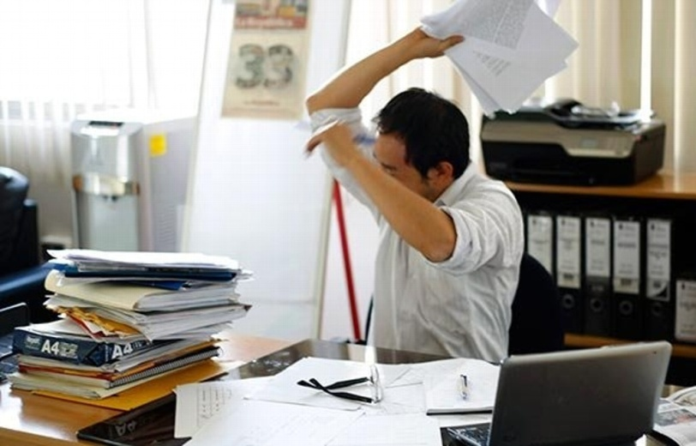
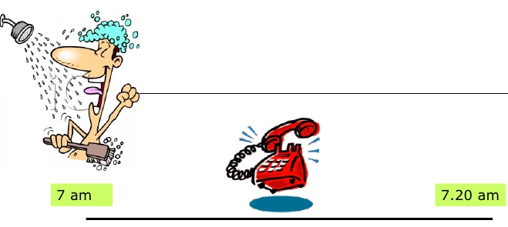
Continuous forms
Used to show an event is ongoing:
He‘s been working here for two weeks. (Present perfect continuous)
I was having a bath when the phone rang. (Past continuous: event in progress)

Slide 11


Continuous forms
Used to focus on the action/situation:
She’s always leaving the door open. (Present continuous)
I’ve been cooking all day. I’m exhausted. (Present perfect continuous)

Slide 12


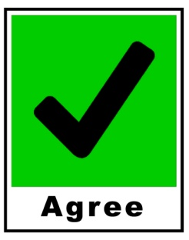

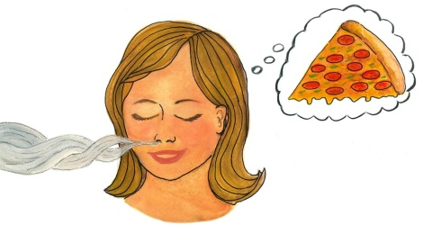


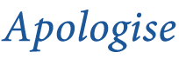


Notes
Some verbs are not normally used in the continuous:
Verbs that describe states of being. | Verbs used to describe the speech being “performed”. | Verbs of sense and perception.
Appear
*When these verbs are used in the continuous they change their meaning.

Slide 13

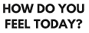
Notes
Some verbs which describes physical feelings can be used in the simple or continuous forms with little or no difference in meaning.

Slide 14
Perfect forms
For
≠
Since
We use perfect forms to talk about things which happen before or leading up to another time/event
He’s been a teacher for a long time.
Listen, I’ve found out something very interesting about artificial intelligence.
I’d already met J. K. Rowling, so she knew who I was.

Slide 15


Verb forms often confused
Present simple. | Present continuous.
The sun rises in the East. (It always does) | Look! The sun’s rising. (This is happening now)

Slide 16
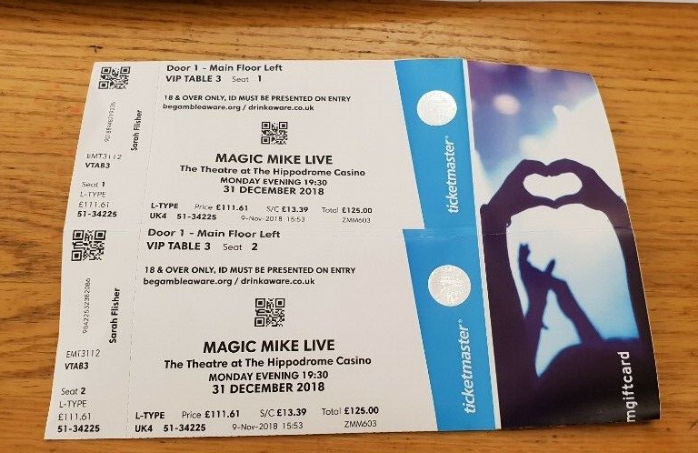
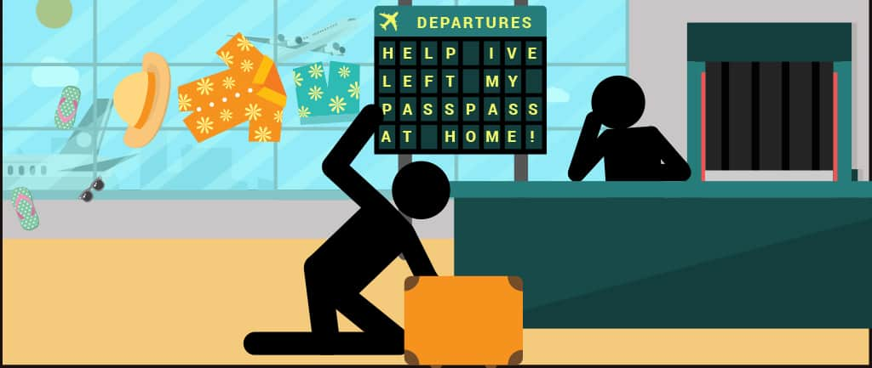
Verb forms often confused
Present perfect. | Past simple.
Oh no! I’ve left the tickets at home. | I left the tickets on the table when I left.

Slide 17
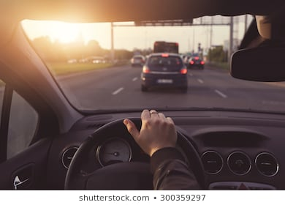
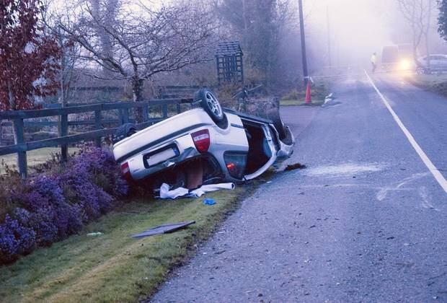
Verbs forms often confused
Past continuous. | Past simple.
At six o’clock I was driving home. | As I was driving home, he had an accident.

Slide 18
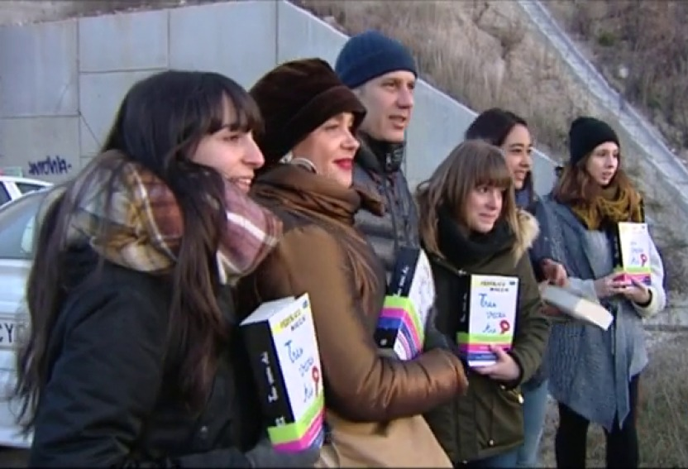

Verb forms often confused
Present perfect simple. | Present perfect continuous.
No, thanks. I’ve read that book three times. | I’ve been reading this book for over a month and still haven’t finished it.

Slide 19


Verb forms often confused
Past perfect simple. | Past perfect continuous.
I’d finished my dinner before she got there. | Before I came to London I had been working in Paris.

Slide 20


Verb forms often confused
Used to. | Would.
She used to live in London. | He would read the newspaper every morning./ He used to read the newspaper every morning.
Would is not used for discontinued states.

Slide 21

Part Two
The Passive

Slide 22
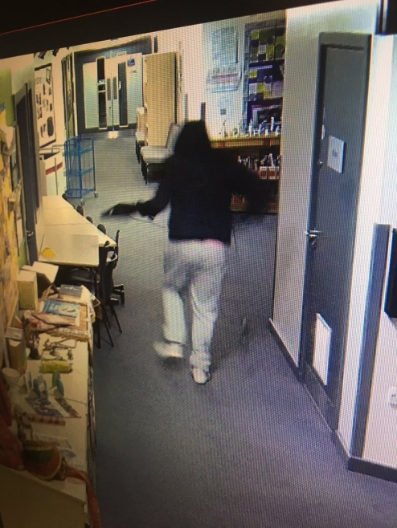
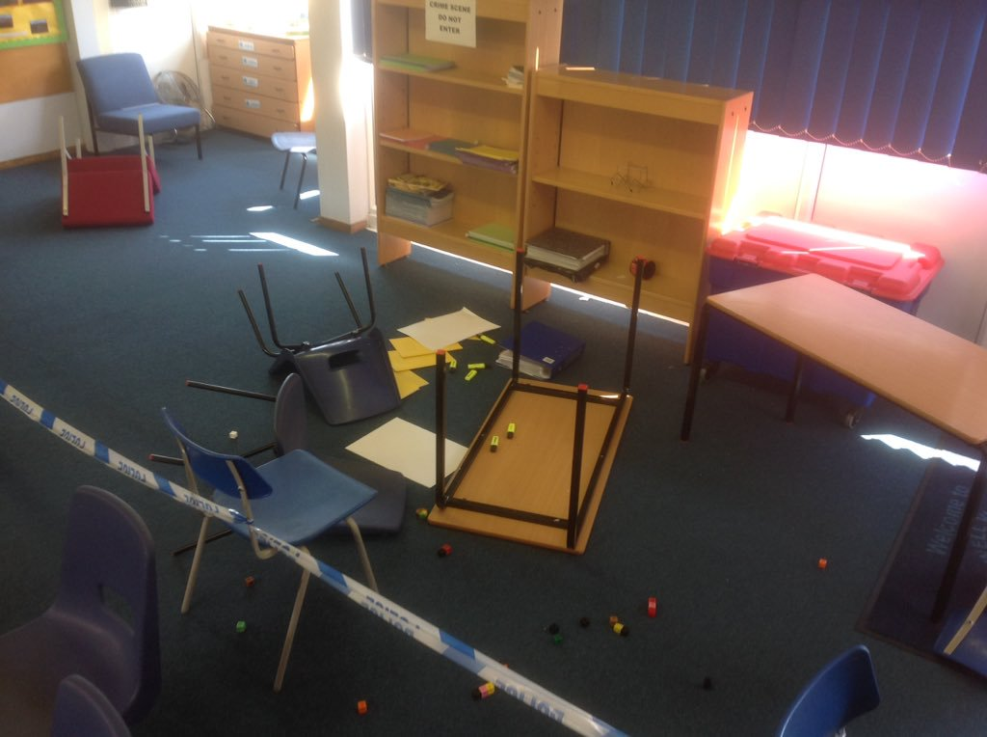
Use
When we don’t know who or what did something:
Our school was broken into last night.

Slide 23

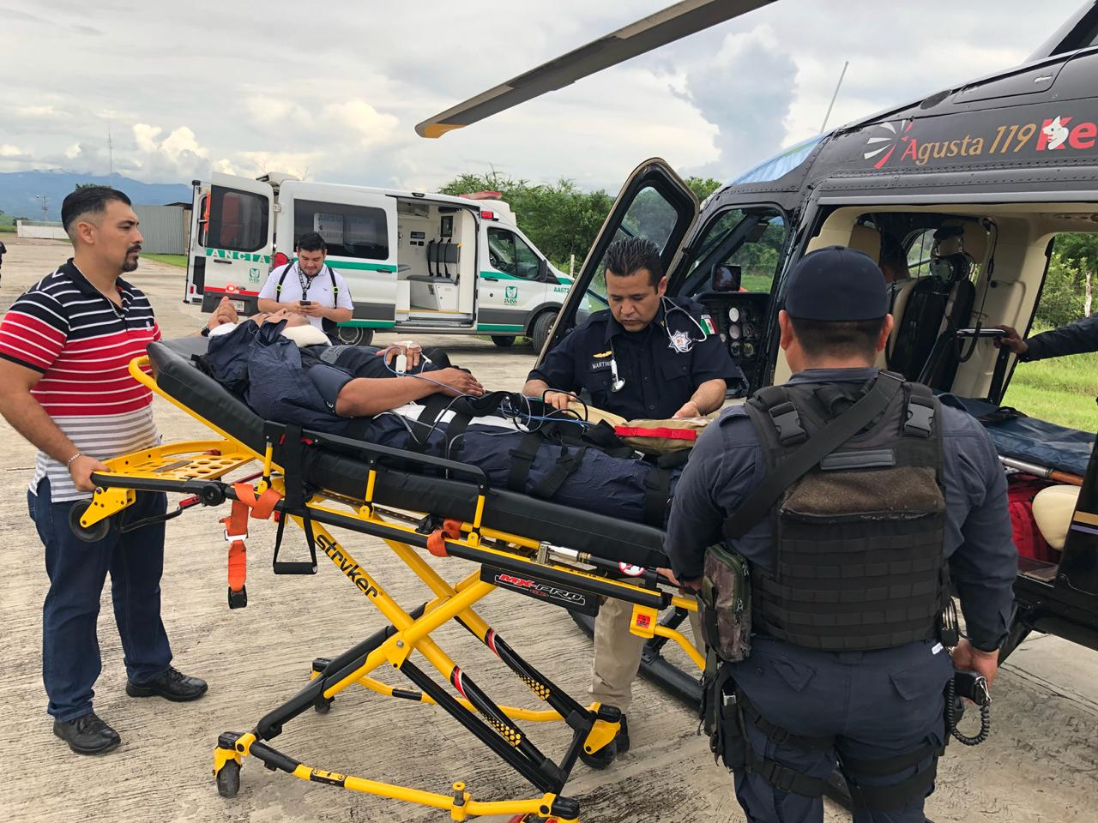
Use
When we wish to focus on who or what did something, we use by + the “doer”:
My husband was badly injured by a lorry.

Slide 24
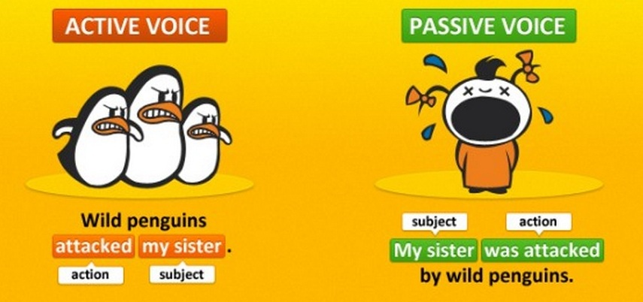
Use
The passive is more common in writing than speaking and can sound formal and impersonal.

Slide 25
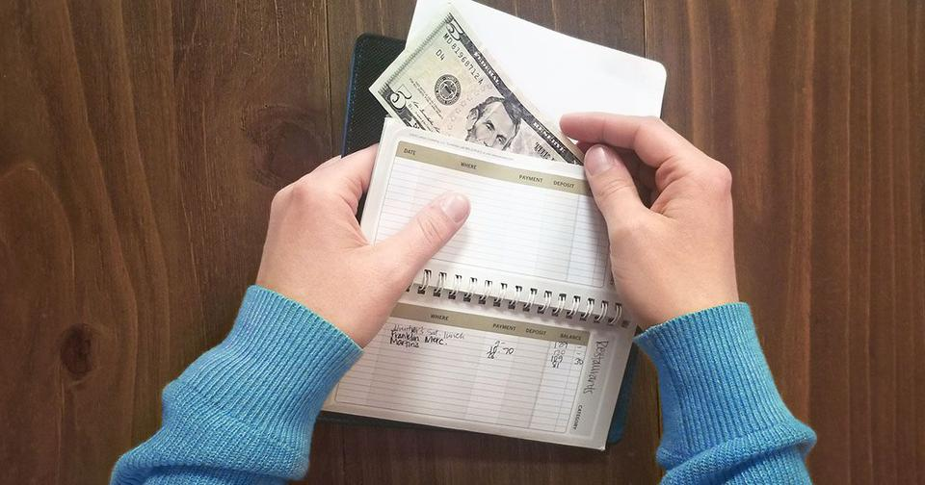
Use
It is often used:
In orders and rules
All money must be paid by the end of the week.

Slide 26
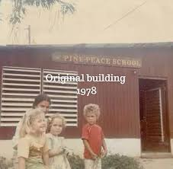
Use
It is often used:
To talk about events and achievements.
The school was founded in 1978.

Slide 27
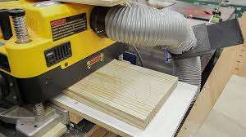
Use
It is often used:
To talk about processes
First, strips of wood are put through the machine.
In academic and scientific English:
A cure for cancer has been found.

Slide 28

Note
The passive cannot be used with:
Intransitive verbs = verbs with no direct object: It was arrived.
State verbs = be, have, seem: A bath is being had by Jane.

Slide 29
Form
Active versus passive forms
 | ACTIVE | PASSIVE
Modal verb (present) Modal verb + be + past participle | All students must take an entrance exam. | An entrance exam must be taken by all students.
Modal verb (past) Modal verb + have been + past participle | They should not have elected him. | He should not have been elected.
Make, see, hear, help be + past | They made me do it. | I was made to do it.
Participle + to – infinitive | They heard him shout. | He was heard to shout.
Let no passive form | They don’t let candidates use dictionaries. | Candidates are not allowed/permitted to use dictionaries.

Slide 30

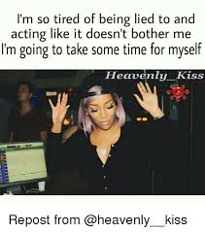
Form
Passive -ing forms and infinitives.
Verb + passive infinitive.
The film star agreed to be photographed.
Verb + -ing form.
I’m tired of being lied to.

Slide 31
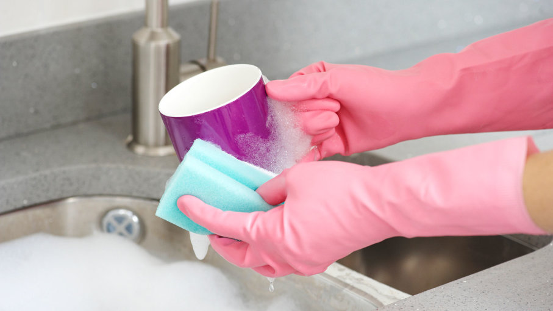
Form
Need + -ing can have a passive meaning.
The cups need washing.
The cups need to be washed.

Slide 32
Impersonal passive structures
Subject + passive verb + to-infinitive
He is considered/said/thought to be the greatest writer ever.
They are believed/reported/thought to have become extinct.

Slide 33
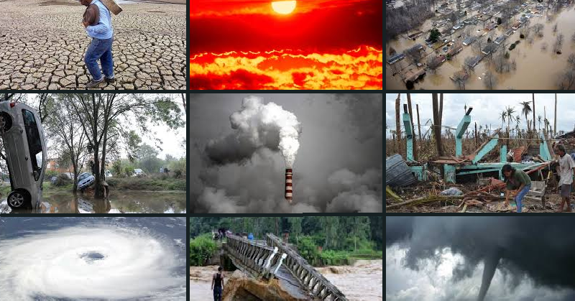
Impersonal passive structures
It + passive verb + that clause
It is thought/expected/said/understood that the weather will get worse.

Slide 34
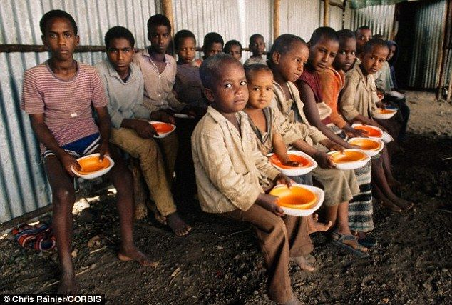
Impersonal passive structures
There + passive verb + to be
There are thought/expected/said/ known to be huge food shortages.

Slide 35


Have/get + object + past participle
We can use it to talk about something which someone else does for us because we have asked them to:
Have you had your hair cut?
I want to get the house redecorated.
Get is more informal than have

Slide 36
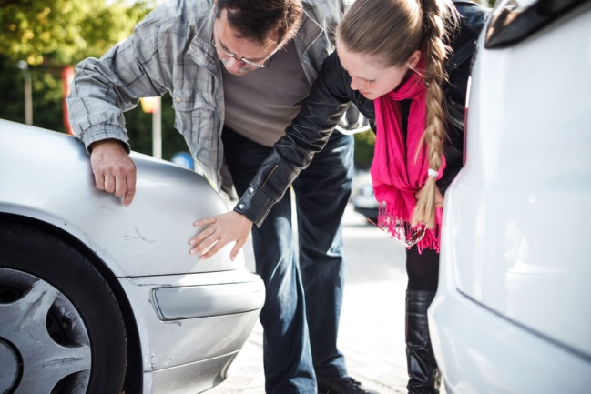
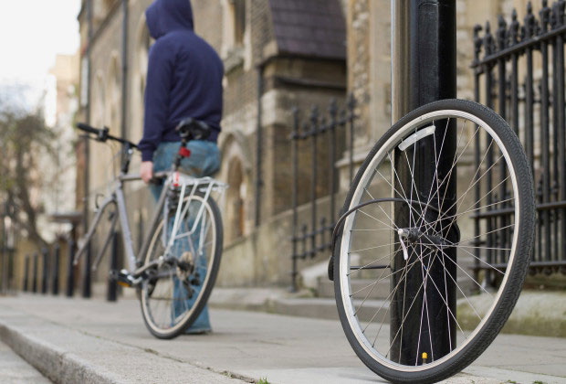
Have/get + object + past participle
We can use it for things that happened by accident or unexpectedly, usually unpleasant; it is fairly informal:
How did your car get damaged?
I’ve had my bike stolen.

Slide 37

Part Three
Relative clauses

Slide 38
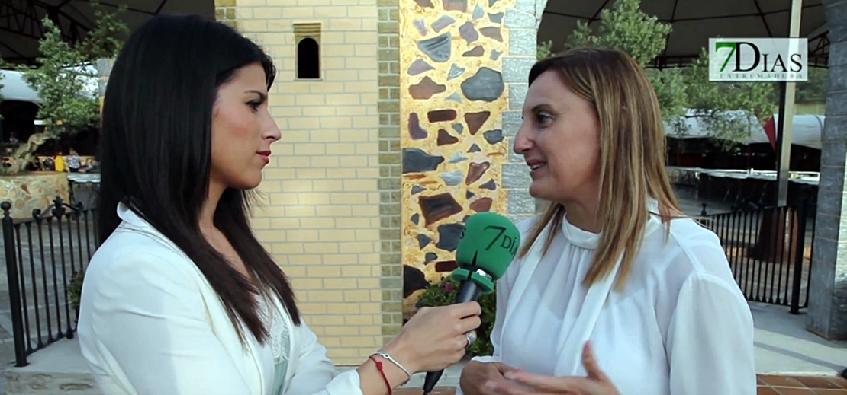
Relative pronouns and adverbs
1. A relative pronoun can be the subject of a relative clause:
I talked to the producer who/that made Dream School.

Slide 39

Relative pronouns and adverbs
Tania, who is very romantic, is always falling in love.

Slide 40

Relative pronouns and adverbs
Judy’s the woman whose parents have just retired.

Slide 41
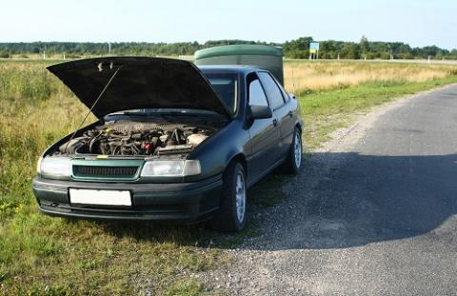
Relative pronouns and adverbs
This is the car which/that has broken down.

Slide 42


Note
We cannot:
Use a subject pronoun after a subject relative pronoun: I talked to the producer who she made Dream School.
Omit a subject relative pronoun: I talked to a woman [ ] made Dream School.

Slide 43
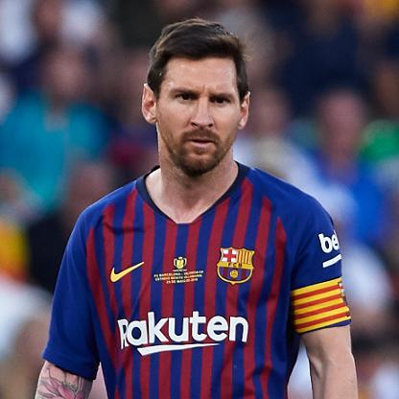
Relative pronouns and adverbs
2. A relative pronoun can be the object of a relative clause:
Lionel Messi, who I met once at a party, is a very nice man.
Lionel Messi, whom I met once at a party, is a very nice man. (formal)
Some of the goals which/that he scores are amazing.

Slide 44

Note
We cannot:
Use an object pronoun and an object relative pronoun in the same relative clause: The goals which he scores them are amazing.

Slide 45
Relative pronouns and adverbs
3. Relative adverbs include where, when, and why.
This is the place where/in which we spent our honeymoon.
1961 is the year when/in which he was born.
I know the reason why/that they came here.

Slide 46
Relative pronouns and adverbs
4. The relative pronoun which can be used to refer to a whole sentence, not just the subject/object:
He was very quiet, which is unusual for him.
He arrived at nine, which was when he was expected.

Slide 47


Defining relative clauses
These identify or classify a noun/pronoun.
They are necessary for the sense of a sentence.
We do not use commas.
He is someone who is generally very punctual.

Slide 48

Defining relative clauses
We can omit the defining relative pronoun if it is an object :
He’s the man (who/that) I met when we were volunteers

Slide 49

Non-defining Relative Clauses
Donald Trump, who has a long career in real estate, is the president of the USA.
Can we remove the part contained between the commas? Does the sentence still make sense?
Is the part between commas essential to the meaning of the main clause?

Slide 50

Non-defining Relative Clauses
Add commas where necessary:
1. My mother who is an old lady loves reading.
2. I passed the exam which was unusual.
3. The plane leaves from Toluca which is convenient.

Slide 51
Bibliografía Básica
1. Burgess, S. Thomas, A. (2019). Gold C1 Advanced. London: Pearson.
2. Burgess, S. Thomas, A. (2019). Gold C1 Advanced, Maximizer. London: Pearson.
3. Norris, R. French, A. (2014) Ready for Advanced: Coursebook. London: MacMillan
4. Norris, R. French, A. (2014) Ready for Advanced: Workbook. London: MacMillan

Slide 52
Bibliografía complementaria
1. Bradbury, T. Yeates, E. (2014) Exam Essentials: Cambridge Advanced Practice Tests 1, London, Heinle.
2. Hewings, M. (2002) Advanced Grammar in Use, Australia: CUP
3. McCarthy M. and O’Dell F.(2007) English Phrasal Verbs in Use, UK: CUP
4. O’Dell, Felicity. Black, M. (2015) Advanced Trainer Six Practice Tests with Answers , UK, CUP.
5. Powell, D. (2017) Common Mistakes at CAE and How to Avoid Them, UK, CUP.
6. Stanton, A. and Morris, S. (2006) CAE Practice Tests, England: Pearson Longman
7. Vince, M. (2003) Advanced Language Practice, UK: MacMillan

