Slide 1
Material Didáctico Audiovisual
Sólo Visión Proyectables Diapositivas
Inglés 1 - Módulo III
Bachillerato Universitario 2015
Mi entorno: casa, escuela y ciudad
Elaborado por:
M. en I. y G. E. Cesar Martínez Acevedo
Plantel “Dr. Ángel Ma. Garibay Kintana” de la Escuela Preparatoria

Slide 2
Inglés 1
PROPÓSITO GENERAL
Emplea el idioma inglés de forma sencilla para satisfacer sus necesidades inmediatas de interacción, supervivencia o de relación con su entorno, por medio de expresiones cotidianas y representaciones lingüísticas básicas asociadas al contexto cultural y social en el que se desenvuelve.
Continuar

Slide 3
Módulo III
Nombre del Módulo
Mi entorno: casa, escuela y ciudad.
Propósitos del Módulo
Asocia elementos de discurso, sencillos y rutinarios, ya sea en forma oral o escrita, sobre lo que puede hacer, lo que hay en el lugar en donde está, así como dar y solicitar indicaciones de cómo llegar a lugares y las tareas que realiza cada día.
Continuar

Slide 4
Competencia Disciplinar
Comunicación Básica
10 Identifica e interpreta la idea general y posible desarrollo de un mensaje oral o escrito en una segunda lengua, recurriendo a conocimientos previos, elementos no verbales y contexto cultural.
11. Se comunica en una lengua extranjera mediante un discurso lógico, oral o escrito, congruente con la situación comunicativa.
Extendida
9. Trasmite mensajes en una segunda lengua o lengua extranjera atendiéndolas características de contextos socioculturales diferentes.
Continuar

Slide 5
Competencia Disciplinar
4 Escucha, interpreta y emite mensajes pertinentes en distintos contextos mediante la utilización de medios, códigos y herramientas apropiados.
4.4 Se comunica en una segunda lengua en situaciones cotidianas.
7. Aprende por iniciativa e interés propio a lo largo de la vida.
7.1 Define metas y da seguimiento a sus procesos de construcción de conocimiento.
10. Mantiene una actitud respetuosa hacia la interculturalidad y la diversidad de creencias, valores, ideas y prácticas sociales.
10.2 Dialoga y aprende de personas con distintos puntos de vista y tradiciones culturales mediante la ubicación de sus propias circunstancias en un contexto más amplio.
Continuar

Slide 6
TEMAS
TEMA 1
TEMA 2
Habilidades y destrezas
Descripción de lugares (lo que hay y lo que no hay)
TEMA 3
TEMA 4
Obligaciones y deberes
Direcciones e indicaciones de cómo llegar a un lugar

Slide 7

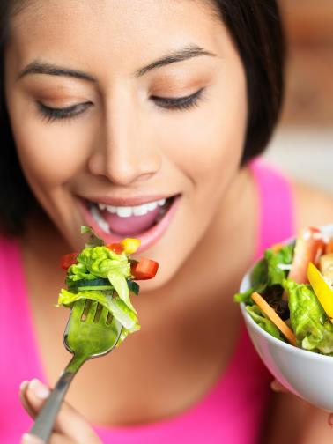
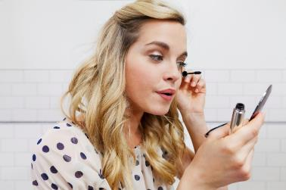
Abilities
CAN
BACK

Slide 8
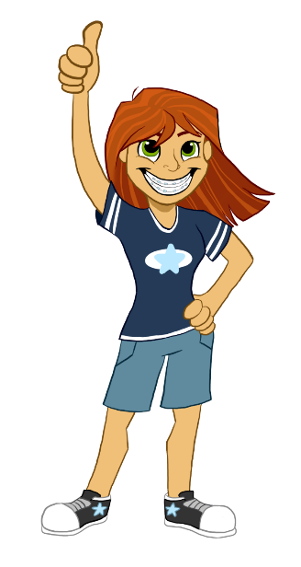
Abilities: Things I can do
BACK
Yes, I can
No, I can’t
Can you speak Spanish?
Can you play an instrument?
Can you dance cumbia?
Can you type quickly?
Can you cook?
Can you skateboard?
Can you drive a car?

Slide 9
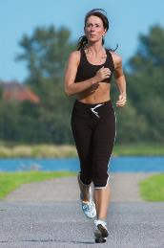
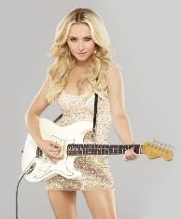
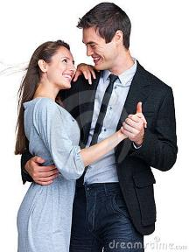
Use
BACK
We use CAN to describe abilities to perform an activity in particular. We use it use in positive sentences.
Examples:
I can run very fast.
She can play the guitar.
We can dance in the competence.

Slide 10
Use
BACK
We use CAN NOT, CANNOT or CAN’T to say that we haven’t got the ability to perform an activity. We use it use in negative sentences.
Examples:
I can’t run very fast.
She can’t play the guitar.
We can’t dance in the competence.

Slide 11
Write can or can’t according to the situation
BACK
I know the answer; I _____ answer the question now.
She is good at the piano; she _____ play the piano very well.
This test is very difficult; I _____ answer any question.
Maria can speak English but she _____ speak French.
You _____ sleep today because you are very nervous.
Juan _____ play tennis very well; he is a good tennis player.

Slide 12
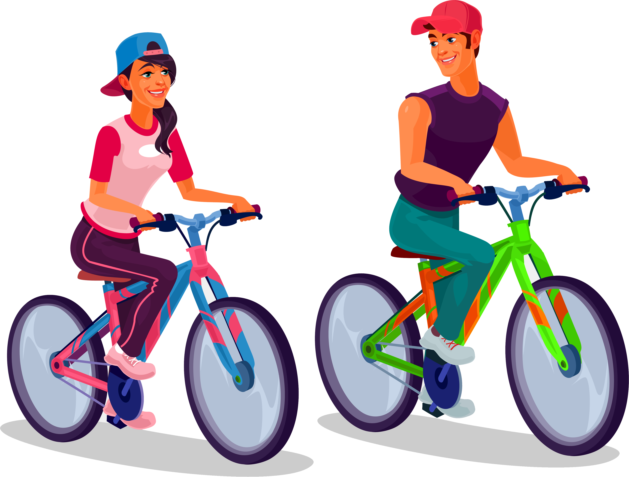
According to you Say what you can do or can’t do.
I _____ speak Chinese.
I _____ sing very well.
I _____ run 20 kilometres.
I _____ ride a bicycle.
I _____ play basket.
I _____ swim.
I _____ understand my teacher of English.
I _____ dance “Banda music”.
BACK

Slide 13
Tick
(✓) what you can do.
SPEAKING
Can you…?
 | You
Drive a car
Play golf
Sing
Speak French
Jump the rope
Eat chilli
Draw or write poems
Play soccer
Skateboard
BACK

Slide 14
Tick
(✓) what you can do.
Can you…?
SPEAKING
 | You | My friend
Drive a car
Play golf
Sing
Speak French
Jump the rope
Eat chilli
Draw or write poems
Play soccer
Skateboard
Yes, I can
No, I can’t
BACK

Slide 15
Now, say what can you and what can’t you do.
I can…
______________________.
______________________.
______________________.
______________________.
______________________.
I can’t
______________________.
______________________.
______________________.
______________________.
______________________.
BACK
WRITING

Slide 16

There is &
There are
Existence
BACK

Slide 17

Existence
In English when we talk about existence we use THERE IS (for singular) and THERE ARE (for plural).
THERE IS
THERE’S
when just one.
THERE ARE
for more than one.
BACK

Slide 18





EXAMPLES
There is a river in my town.
There is a ghost in this room.
There is an apple on the desk.
There is ice on the lake.
There is oil on the pavement.
There are two parks in my neighborhood.
There are 600 students in this school.
There are four windows in my room.
There are 7 rooms in my house.
There are 20 guests in the party.
BACK

Slide 19
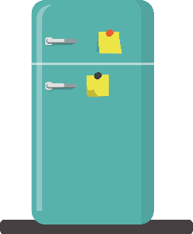
What’s in the fridge?
Look at the fridge for 40 seconds.
Check the things in the fridge.
Try to remember as many elements as you can.
BACK

Slide 20
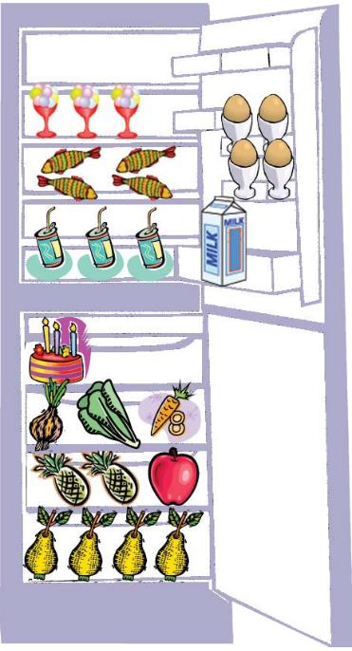
In the fridge
An ice
cream
An egg
A fish
A coke
Milk
A cake
Lettuce
An onion
Carrots
A pineapple
A pear
An apple
BACK

Slide 21
List of things in the fridge
Is there any milk?
Milk
Fish balls
Cheese
Pears
Onion
Chicken
Eggs
Are there any fish balls?
Is there any cheese?
Are there any pears?
Is there any onion?
Is there any chicken?
Are there any eggs?
BACK

Slide 22
List of things in the fridge
Is there any milk?
Milk
Fish balls
Cheese
Pears
Onion
Chicken
Eggs
Are there any fish balls?


Is there any cheese?

Are there any pears?

Is there any onion?

Is there any chicken?


Are there any eggs?
BACK

Slide 23
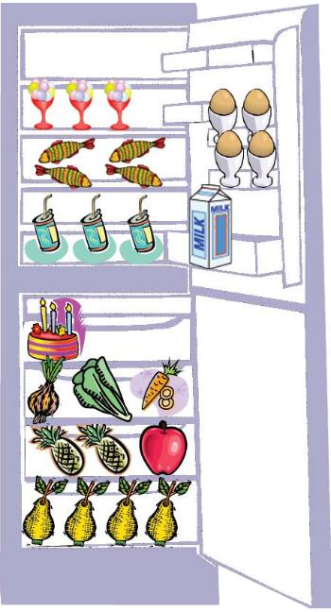
How many…?
eggs are there in the fridge?
cokes are there in the fridge?
onions are there in the fridge?
pears are there in the fridge?
BACK

Slide 24
There is a chair in this room.
There are 8 chairs in this room.
BACK

Slide 25
There is a lamp in this room.
There are 4 lamps in this room.
BACK

Slide 26
There is a computer in this room.
There are 5 computers in this room.
BACK

Slide 27
SPEAKING
How many flowerports are there?
BACK

Slide 28
SPEAKING
How many dogs are there?
BACK

Slide 29


SPEAKING
How many books are there?
BACK

Slide 30
SPEAKING
How many cats are there?
BACK

Slide 31
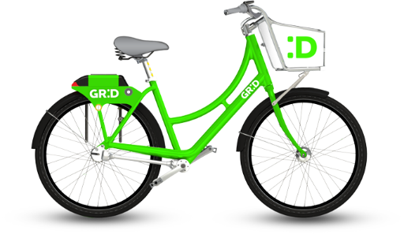
How many bikes are there?
SPEAKING
BACK

Slide 32

SPEAKING
How many balls are there?
BACK

Slide 33

Complete the sentences using IS or ARE
1. There _____ flowers in the garden next door.
2. There _____ a new rug on the floor.
3. There _____ eleven candles on the birthday cake.
4. There _____ peanut butter in the cupboard.
5. There _____ a sale on green beans today at the store.
6. There _____ only three more chapters left to read!
7. There _____ a newspaper sitting on the porch.
8. There _____ several quarters on the table by the couch.
9. There _____ two stray dogs running loose in the street.
10. There _____ a lost cell phone on the desk in the office.
11. There _____ three more months of school this year.
12. There _____ a package of crayons for you so you can color.
BACK

Slide 34
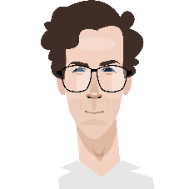
Don’t forget
THERE IS
A / AN
1 ELEMENT
THERE ARE
SOME
MANY
THERE ISN’T
A / AN
1 ELEMENT
THERE AREN’T
ANY
NONE
BACK

Slide 35
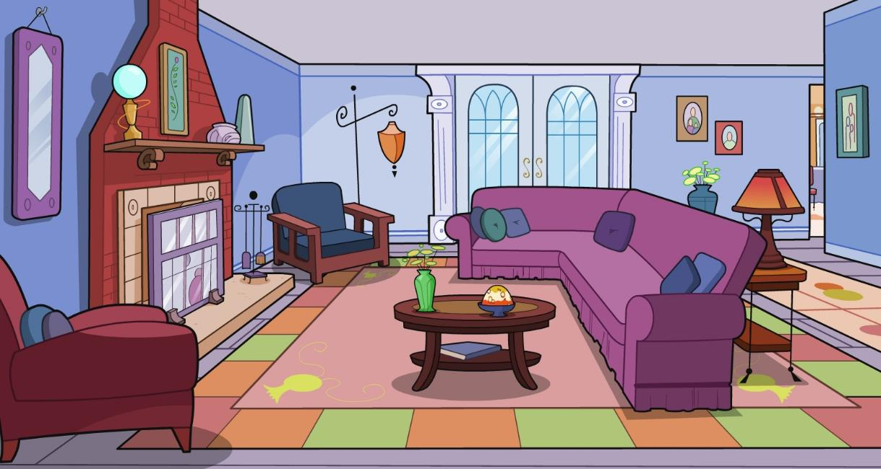
Can you describe how many objects are there in the room?
There is a/an
There are
BACK

Slide 36
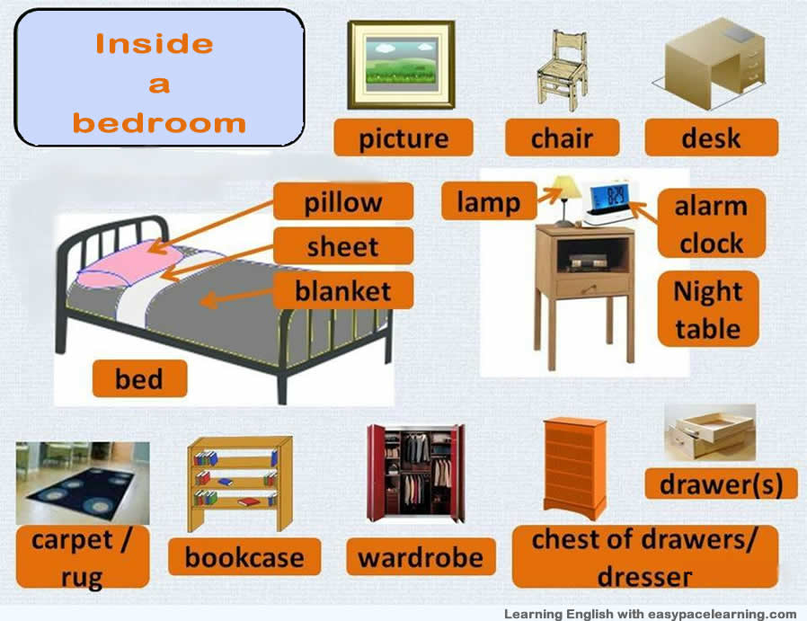
Vocabulary
BACK

Slide 37
Complete the following sentences with THERE IS / THERE ARE in the affirmative.
My name is Annie and I live in a very big house. _________________ twenty-three rooms in my house, but _________________ only twelve bedrooms. I live in one of the rooms on the third floor. In my room, _________________ a huge bed and _________________ nine windows. My bedroom isn’t small. On my bed _________________ lots of pillows, and _________________ my cat, Fluffy. In my closet _________________ many toys, and _________________ also many clothes. I don’t have a bathroom in my bedroom, but ________________ a bathroom next to my room. Also in my house _______________two kitchens, a big dining room and three living rooms. The house is really big!
BACK

Slide 38
Complete the following sentences with THERE ISN’T / THERE AREN’T in the affirmative.
1. ____________________ a flight from here to London.
2. ____________________ any movies that I want to see in the cinema.
3. I’m very hungry, but ____________________ any food in the refrigerator.
4. We want to go to the concert, but ____________________ any tickets.
5. ___________________ any money in my bank account so I can’t pay the bills.
6. ____________________ seventy minutes in an hour.
7. In my neighbourhood, ____________________ any children.
8. Henry can’t bake a cake because ____________________ any sugar in the cupboard.
9. It’s sunny today and ____________________ a cloud in the sky.
10. I’m sorry, ____________________ any letters for you today

Slide 39
 | AFFIRMATIVE | NEGATIVE | INTERROGATIVE | SHORT ANSWERS
Singular / uncountable | There is a/an… | There isn’t a/an… | Is there a…? | Yes, there is. No, there isn’t.
Plural | There are… | There aren’t … | Are there…? | Yes, there are. No, there aren’t.

Slide 40

Obligations
Have to
Don’t Have to
BACK

Slide 41
Complete the chart.
Say what activities you can do or you can’t do in these places.
 | At school | At home | In a restaurant | In a concert
Necessary or Compulsory to do
Not necessary or Not compulsory to do
BACK

Slide 42
SPEAKING
 | At school | At home
Necessary or Compulsory to do
Not necessary or Not compulsory to do
BACK

Slide 43
SPEAKING
 | In a restaurant | In a concert
Necessary or Compulsory to do
Not necessary or Not compulsory to do
BACK

Slide 44



HAVE TO
We use “HAVE TO” to say that something is necessary or compulsory.
Examples:
I have to wear a suit at work.
She has to do her homework everyday.
We have to pay attention in class.
BACK

Slide 45


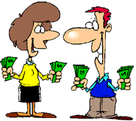
DON’T
HAVE TO
We use “DON’T HAVE TO” to say that something is NOT necessary.
But, it isn’t against the rules.
Examples:
I don’t have to wear uniform at school.
David doesn’t have to write. He memorizes everything.
They don’t have to save money. They’re rich.
BACK

Slide 46

Don’t forget…
I
You
We
They
have to…
don’t have to…
He
She
It
has to…
doesn’t have to…
BACK

Slide 47
Complete the following sentences with HAVE/HAS TO or DON’T/DOESN’T HAVE TO
James is a smart guy, he_____________________ a lot! (study)
Lorenz and Susan live in a really old house, they _____________ a new one. (buy)
A: Do you really ___________________ so fast? (speak)
I ________________ every single word! (write down)
B: No, you___________________________ every word I
say, just the most important ideas! (write down)
A: Oh, look at the time. I _____________ or I’ll loose the train! (run)
B: You___________________. The train is going to
be delayed. (run)
BACK

Slide 48
Complete the following sentences with HAVE/HAS TO or DON’T/DOESN’T HAVE TO
She has a wonderful hair but she _______________________ it every day. (wash)
We can share a taxi if you want to. You ___________________ home. (walk)
A: Do we go now or we _____________ for your sister? (wait)
B: We ________________ for my sister. She has
the Keys! (wait)
BACK

Slide 49
Write HAVE TO, HAS TO,
DON'T HAVE TO or DOESN'T HAVE TO.
Every man ____________ do military service in my country. It's obligatory.
When do we ____________ pay for the next term?
Policemen ____________ wear a uniform.
A pilot ____________ train for many years.
Does Susan ____________ work long hours?
I ______________ get up early on Sundays. I can stay in bed.
You ______________ have a visa to come to Ukraine.
Maria _______________ do it if you don't want to.
My daughter ________________ cook, because I cook for the whole family.
We _______________ pay. It's free.
BACK

Slide 50
Write have to, has to, don't have to or doesn't have to.
Every man ____________ do military service in my country. It's obligatory.
When do we ____________ pay for the next term?
Policemen ____________ wear a uniform.
A pilot ____________ train for many years.
Does Susan ____________ work long hours?
I ______________ get up early on Sundays. I can stay in bed.
You ______________ have a visa to come to Ukraine.
Maria________________ do it if you don't want to.
My daughter ________________ cook, because I cook for the whole family.
We _______________ pay. It's free.
has to
have to
have to
has to
have to
don’t have to
don’t have to
doesn’t have to
doesn’t have to
don’t have to
BACK

Slide 51
Imaging it’s Saturday.
Write 5 things that you have to do and
5 things that you don’t have to do.
I have to… | I don’t have to…
1. | 1.
2. | 2.
3. | 3.
4. | 4.
5. | 5.
BACK

Slide 52

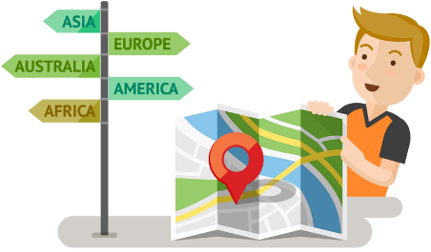
Prepositions of place
BACK
BACK

Slide 53




Where is the ball?
next to
in front of
behind
on
under
near the
between
in
BACK

Slide 54
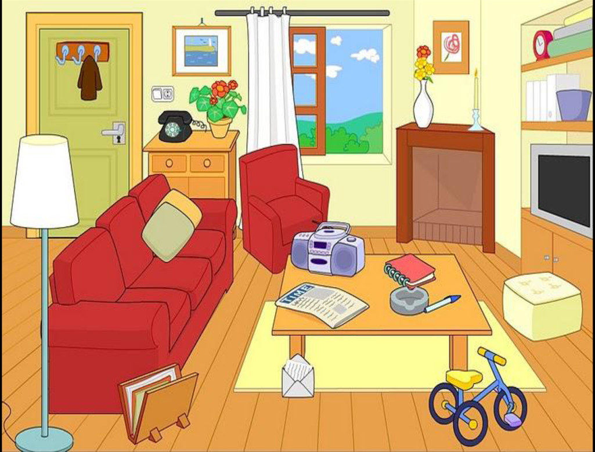
Where is the…?
Lamp
Pen
Rug
Newspaper
CD player
Window
Curtain
BACK

Slide 55
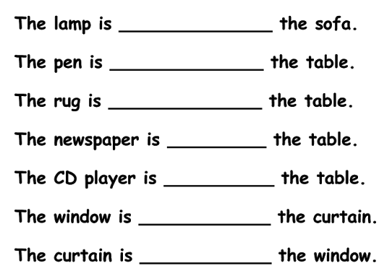
Where is the…?
WRITING
next to
on
under
on
on
behind
In front of
BACK

Slide 56
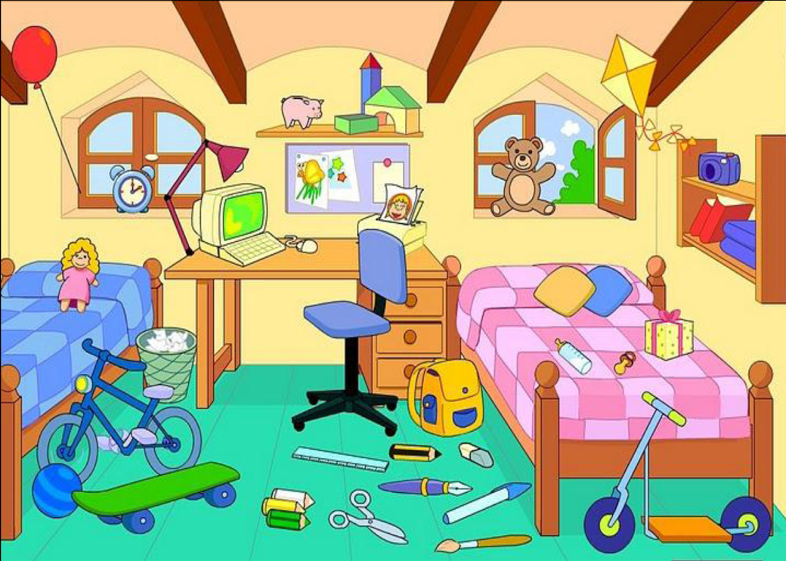
Where is the…?
Present
Bin
Printer
Bag
Lamp
Teddy bear
Red book
BACK

Slide 57
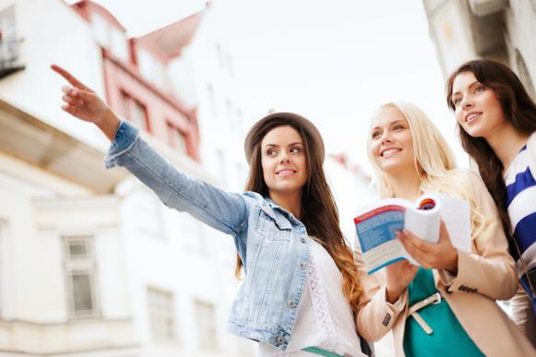
ASKING & GIVING DIRECTIONS
BACK
BACK

Slide 58
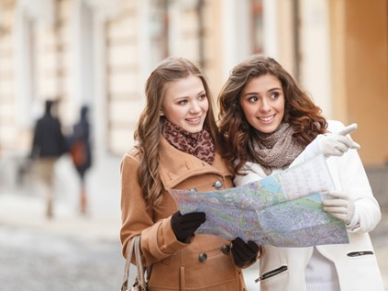
Asking for Directions
ONE PLACE
  Is there a … around here?
  Yes, there is
  No, there isn’t.
MANY PLACES
  Are there any… around here?
  Yes, there are.
  No, there aren’t.
BACK

Slide 59
Asking for directions
Excuse me,
  can you tell me how to get to (the) . . . ?
  where is (the) . . . ?
  how do I get to (the) . . . ?
  can you give me directions to (the) . . . ?
  what's the best way to get to (the) . . . ?
Thank you very much.
BACK

Slide 60
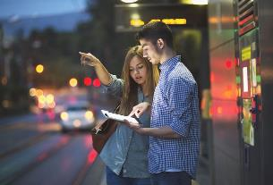
Giving Directions
 | Go straight ahead… Go along (on)…
 | Turn left Turn right
 | Take the first, second … on your right/left
BACK

Slide 61
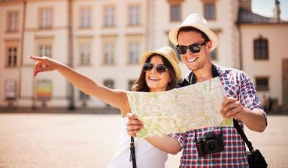
Giving Directions
 | Cross Go cross
 | Past / Go past
 | Go to the end
Main Square
Main square
BACK

Slide 62
References
It’s on the right / left.
It’s . . . blocks from here.
It’s opposite the . . .
It’s near the . . .
It’s next to the. . .
It’s between the . . . and the . . .
It’s at the end (of the) . . .
It’s at the corner.
It’s in front of the. . .
BACK

Slide 63
EXAMPLE
A: Excuse me, can you tell me how to get to the bank?
B: Go straight ahead on this street for two blocks. Turn left when you get to Maple Street. Go along on Maple for half a block. It's on the left.
BACK

Slide 64
VOCABULARY
Bank
Beauty salon
Bookstore
Church
College
Electronics shop
Flower shop
Gas station
Hardware store
Hospital
Laundromat
Library
Movie Theater
Pet shop
BACK

Slide 65
VOCABULARY
Post office
Restaurant
School
Shopping mall
Supermarket
University
Park
Stadium
Cinema
Theater
Zoo
Hotel
Coffee shop
Market
BACK

Slide 66
VOCABULARY
Block (s)
Traffic lights
Crossroads
Junction, T-junction
Street sign
Roundabout
Street
Road
Avenue
Boulevard
High way
BACK

Slide 67
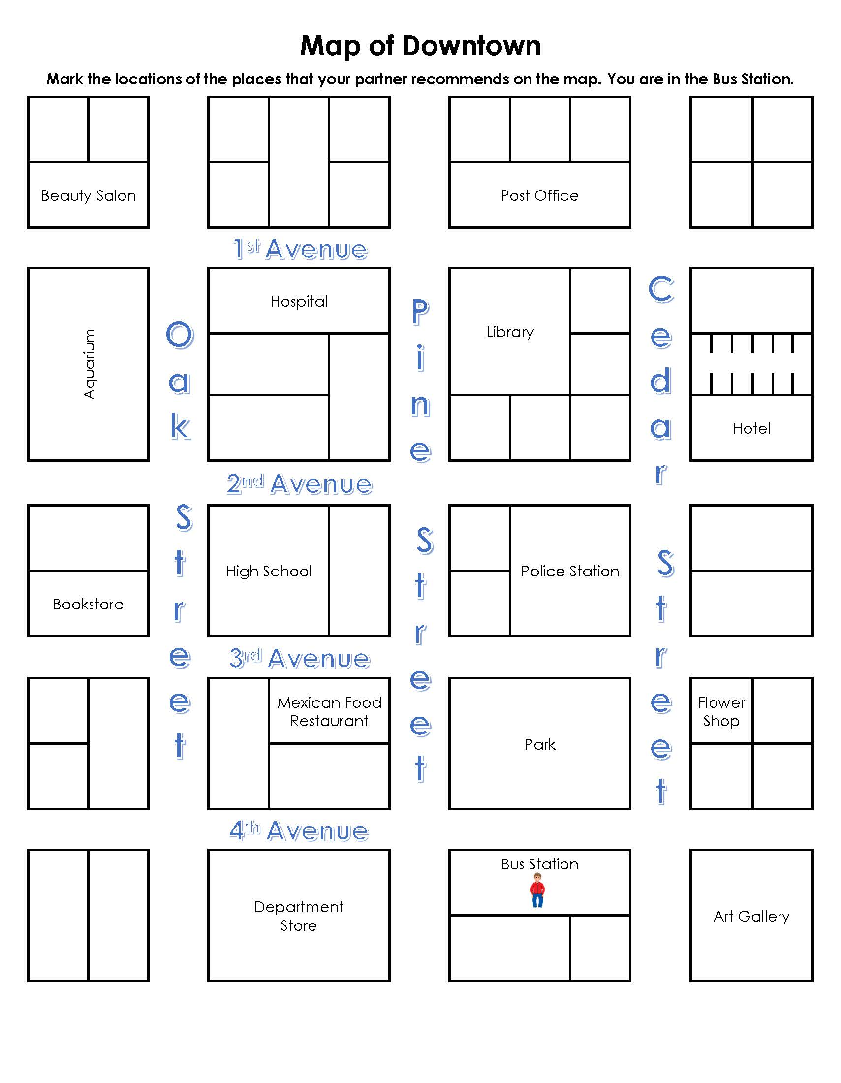
Look at the map and give directions
How can I get to Hospital?
How can I get to Restaurant?
How can I get to Hotel?
How can I get to Post office?
BACK

Slide 68
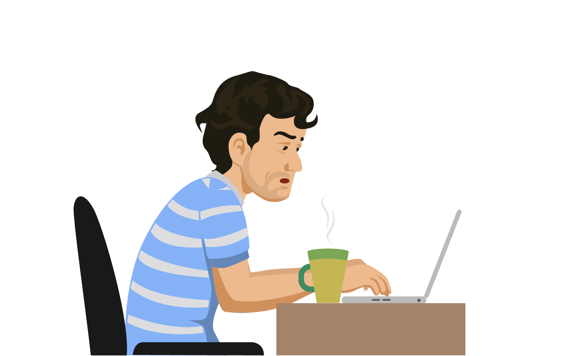

REFERENCIAS
BACK

Slide 69
Referencias
Mesografía
Tema 2
https://www.academia.edu/8032097/Unit_11_THERE_IS_THERE_ARE
https://studfiles.net/preview/5644113/
Tema 3
http://josecarlosmartinezcordero.blogspot.com/2014/07/
http://number1students.blogspot.com/2009/04/have-vs-have-got_13.html
Imágenes
Las imágenes se obtuvieron del sitio Freepik: http:www.freepik.com
BACK

