Slide 1
Material Didáctico Audiovisual
Sólo Visión Proyectables Diapositivas
Inglés 2 - Módulo II
Bachillerato Universitario 2015
Estilos de Vida SaludableS
Elaborado por: M. en I. y G. E. Cesar Martínez Acevedo
Plantel “Dr. Ángel Ma. Garibay Kintana”
de la Escuela Preparatoria

Slide 2
Inglés 2
PROPÓSITO GENERAL
Emplea el idioma inglés para satisfacer sus necesidades inmediatas de interacción, supervivencia y de relación con su entorno inmediato, de forma simple, por medio de expresiones cotidianas, frases comunes, familiares y aprendidas; y representaciones lingüísticas asociadas al contexto cultural y social.
Continuar

Slide 3
Módulo II
Nombre del Módulo
Estilos de vida saludables.
Propósitos del Módulo
Describir estilos de vida saludables por medio de estructuras gramaticales que le permiten sugerir cambios dehábitos alimenticios.
Continuar

Slide 4
Competencia Disciplinar
Comunicación Básica
10 Identifica e interpreta la idea general y posible desarrollo de un mensaje oral o escrito en una segunda lengua, recurriendo a conocimientos previos, elementos no verbales y contexto cultural.
11. Se comunica en una lengua extranjera mediante un discurso lógico, oral o escrito, congruente con la situación comunicativa.
Extendida
9. Trasmite mensajes en una segunda lengua o lengua extranjera atendiéndolas características de contextos socioculturales diferentes.
Continuar

Slide 5
Competencia Genérica
4 Escucha, interpreta y emite mensajes pertinentes en distintos contextos mediante la utilización de medios, códigos y herramientas apropiados.
4.4 Se comunica en una segunda lengua en situaciones cotidianas.
7. Aprende por iniciativa e interés propio a lo largo de la vida.
7.1 Define metas y da seguimiento a sus procesos de construcción de conocimiento.
10. Mantiene una actitud respetuosa hacia la interculturalidad y la diversidad de creencias, valores, ideas y prácticas sociales.
10.2 Dialoga y aprende de personas con distintos puntos de vista y tradiciones culturales mediante la ubicación de sus propias circunstancias en un contexto más amplio.
Continuar

Slide 6
TEMAS
Sustantivos Contable e Incontables
Some & Any
How Much & How Many
Recomendaciones

Slide 7
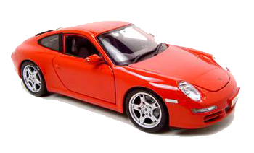
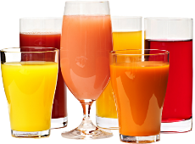
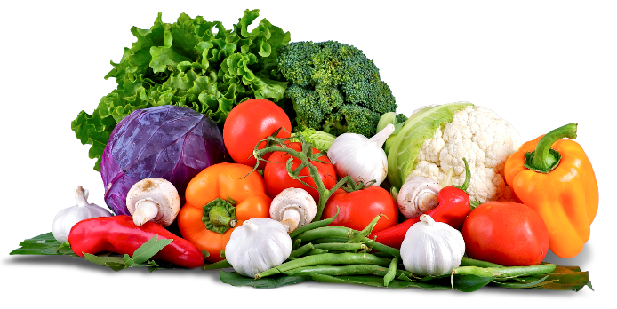
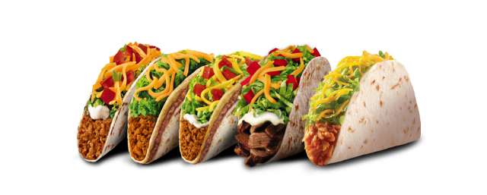
COUNTABLE & UNCOUNTABLE NOUNS

Slide 8

Competencias
Genéricas
4. Escucha, interpreta y emite mensajes pertinentes en distintos contextos mediante la utilización de medios, códigos y herramientas apropiados.
4.4 Se comunica en una segunda lengua en situaciones cotidianas.
Disciplinares
4 Produce textos con base en el uso normativo de la lengua, considerando la intención y situación comunicativa.
11 Se comunica en una lengua extranjera mediante un discurso lógico, oral o escrito, congruente con la situación comunicativa.

Slide 9
NOUNS
EXPLANATION
COUNTABLE
UNCOUNTABLE
Countable nouns are individual people, animals, places, things, or ideas which can be counted. Countable nouns can be SINGULAR & PLURAL. They can be used with A/AN, with numbers and many other determiners.
Uncountable nouns are things are seen as a whole or mass, because they cannot be separated or counted.

Slide 10
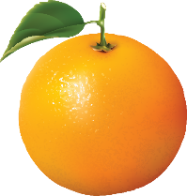
COUNTABLE NOUNS
THNIGS I CAN COUNT
EXPLANATION
SINGULAR:
a/an + noun
one + noun
PLURAL:
noun + -s
noun + -es
An
orange
Two
oranges
Three
oranges

Slide 11
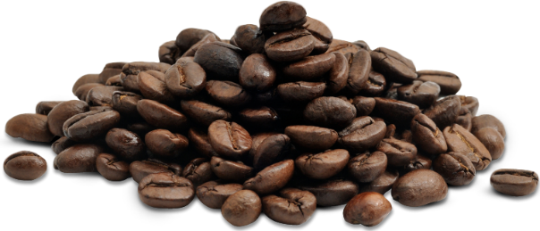
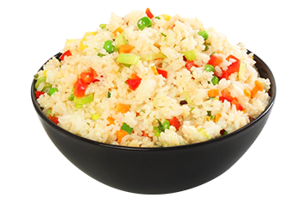
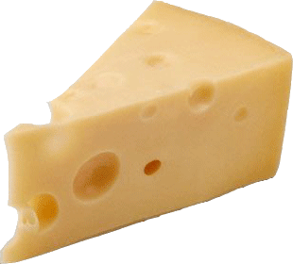
UNCOUNTABLE NOUNS
THNIGS I CAN´T COUNT
EXPLANATION
SINGULAR:
Only the noun
Cheese
Coffee
Rice

Slide 12
There is a mango.
I have an egg.
There are four apples.
I have two eggs.
There is sugar.
He has bread.
EXPLANATION
Singular countable
Plural countable
Uncountable

Slide 13
PRACTICE
Put the nouns in the correct column.
children | bird | egg | table | meat | men
coffee | cheese | bread | milk | tea | sandwiches
knife | feet | watch | cherries | poster | apples
Countable nouns |  | Uncountable nouns
Singular | Plural
egg | children | coffee

Slide 14
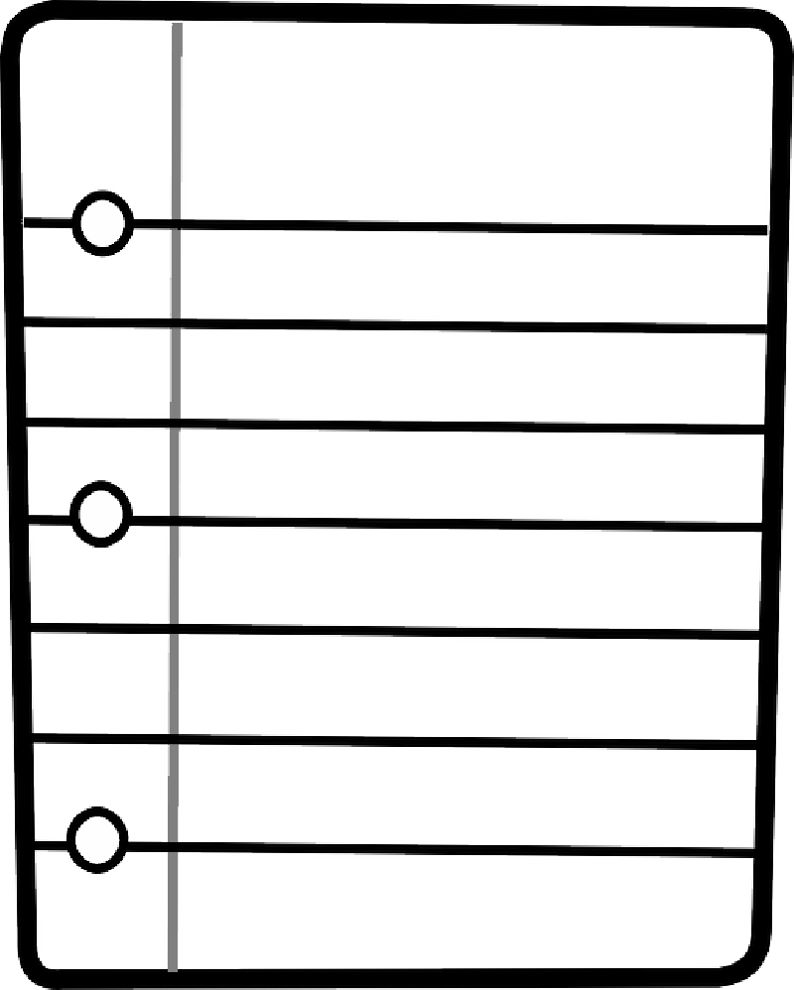
Shopping list
PRACTICE
Look at the following list of food. Organize the items in countable and uncountable nouns.
My Shopping List
Lettuce
Carrot
Corn
Broccoli
Tomato
Onion
Banana
Lemon
Rice
Grape
Meat
Ham
Coffee
Water
Popcorn
Nut
Yogurt
Sugar
Apple
Strawberry
Pepper
Mayonnaise
Milk
Cheese
Salt
Orange
Chicken
Tea
Bread
Soda
COUNTABLES | UNCOUNTABLE

Slide 15
Most Common Uncountable Nouns
EXPLANATION
Material or substances
air, water, plastic, metal, gold, silver, etc.
Feelings or Qualities:
friendship, love, sadness, happiness, etc.
Food & Drinks:
butter, bread, milk, juice, rice, jam, coffee, etc.
Other common words:
knowledge, intelligence, garbage, homework, information, money, news, traffic, work, weather, etc.
BUT

Slide 16
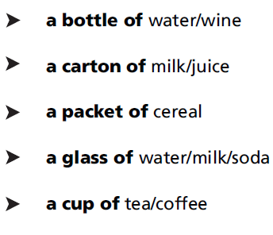
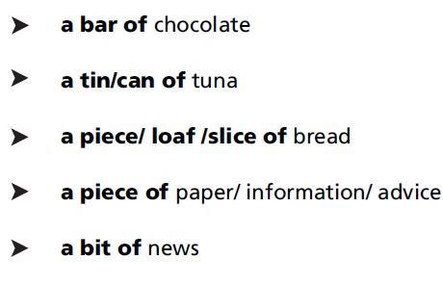
CONTAINERS
EXPLANATION

Slide 17

SOME OR ANY

Slide 18
Competencias
Genéricas
4. Escucha, interpreta y emite mensajes pertinentes en distintos contextos mediante la utilización de medios, códigos y herramientas apropiados.
4.4 Se comunica en una segunda lengua en situaciones cotidianas.
Disciplinares
4 Produce textos con base en el uso normativo de la lengua, considerando la intención y situación comunicativa.
11 Se comunica en una lengua extranjera mediante un discurso lógico, oral o escrito, congruente con la situación comunicativa.

Slide 19
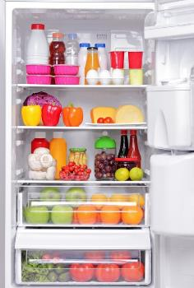
SOME
EXPLANATION
We use SOME to describe two or more elements in a positive sentences. We can use SOME with countables & uncountable nouns.
Examples:
I want SOME chocolate.
I have SOME friends at school.
Peter always drink SOME water in the gym.
There are SOME posters of my favorite singers.

Slide 20
Complete with a, an or some.
PRACTICE
Please, buy him ___________ nice present for his birthday.
Father gives me ___________ money every week.
Tom reads ___________ books every month.
This is ___________ excellent test.
Please buy me ___________ little hamster!
We need ___________ eggs to bake ___________ cake.
She invites ___________ boys from her class.
He always puts ___________ sugar in his coffee.
Mum, I've got ___________ letter for you.
I'd like ___________ cornflakes, please.

Slide 21
Describe things that you do using the following verbs and “SOME”.
WRITING
Activities:
Drink
Eat
Do
Have got
Buy
Draw
Give
Read
Sell
See
Sing
Take
Write
Want
Examples:
1. I read some books a day.
2. I write some letters.
3. I drink some tea.
4. I do some yoga.
5. ___________________
6. ___________________

Slide 22
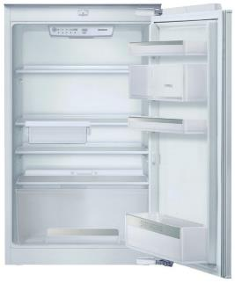
ANY
EXPLANATION
We use ANY to describe that there’s no elements in a negative sentences, but also we can use ANY in questions. We can use ANY with countables & uncountable nouns.
Examples:
I don’t want ANY chocolate.
I haven’t got ANY friends at school.
Peter doesn’t drink ANY water in the gym.
There aren’t ANY posters of my favorite band.

Slide 23
Complete with some or any.
PRACTICE
We haven't got _______ oranges at the moment.
I have seen _______ nice postcards in this souvenir shop.
Do you know _______ rock groups?
Is there _______ lemonade left?
I have _______ magazines for you.
Pam does not have _______ pencils on her desk.
There aren't _______ folders in my bag.
She always takes _______ sugar with her coffee.
We need _______ bananas.
There aren’t _______ apples on the table.
Have you got _______ tomatoes?
You can't buy _______ posters in this shop.

Slide 24
ANY
PRACTICE
Change the following sentences into negative using ANY.
We need some bananas. 1. We don’t need any bananas.
You are looking for some posters in this shop. 2. ________________________.
We have got some oranges at the moment. 3. ________________________.
Peter is buying some new books. 4. ________________________.
She always takes some sugar with her coffee. 5. ________________________.
There are some folders in my bag. 6. ________________________.
I have got some magazines for you. 7. ________________________.
There are some apples on the table. 8. ________________________.
Pam has got some pencils on her desk. 9. ________________________.

Slide 25
REVIEW
NOUNS | SINGULAR | PLURAL | A / AN | SOME | ANY
COUNTABLE
UNCOUNTABLE

Slide 26
PRACTICE
Choose SOME / ANY to fill in the blank
There is __________ milk in the bottle.
There isn’t __________ water in the glass.
There are __________ boys in the room.
I haven’t got __________ Apples.
Is there __________ tea in the cup?
Are there __________ oranges in the basket?
There aren’t __________ bananas on the basket.
I have got __________ money.

Slide 27
PRACTICE
Underline the correct word in each sentence
Are there a / any people at the bus station?
Look at this shirt!. Can I borrow an / some iron?
Did you buy a / some magazine?
Do you have any / some cheese at home?
There aren′t any / some payphones near here
She brings some / any balls to play
We don′t have any / some sandwiches left
You need some / any glue to fix that work

Slide 28


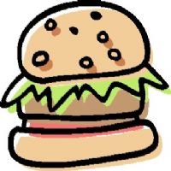

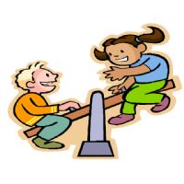

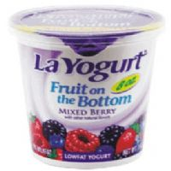

PRACTICE
Look at the pictures and complete the sentences with
A / AN / SOME / ANY
a) There aren't ____________bananas left.
b) Oh! I've lost ____________ earring!
c) I'll have ____________ hamburguer, please.
d) There are ____________ leaves on the ground.
e) There aren't ____________ children playing in the park today.
f) I haven't got ____________ camcorder, but I'd like to buy one.
g) Would you like ____________ yogurt?

Slide 29


HOW MUCH &
HOW MANY
Countable & Uncontable

Slide 30
Competencias
Genéricas
4. Escucha, interpreta y emite mensajes pertinentes en distintos contextos mediante la utilización de medios, códigos y herramientas apropiados.
4.4 Se comunica en una segunda lengua en situaciones cotidianas.
Disciplinares
4 Produce textos con base en el uso normativo de la lengua, considerando la intención y situación comunicativa.
11 Se comunica en una lengua extranjera mediante un discurso lógico, oral o escrito, congruente con la situación comunicativa.

Slide 31
Expressions to describe Quantities
EXPLANATION
Countable
A/An Some Few A few Many A lot of
Uncountable
Some little A little Much A lot of

Slide 32
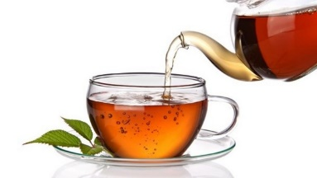
SPEAKING
We need some tea.
____________ tea do we need?
How much
We need…

Slide 33
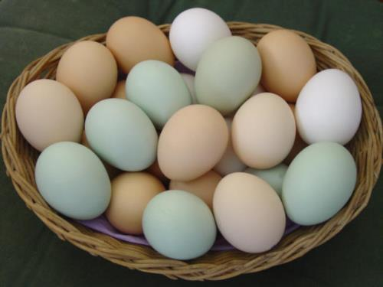
SPEAKING
We need some eggs for the party.
___________ egss do we need?
How many
We need…

Slide 34

SPEAKING
We need some paper.
__________ paper do we need?
How much
We need…

Slide 35

SPEAKING
We need some money.
_________ paper do we need?
How much
We need…

Slide 36

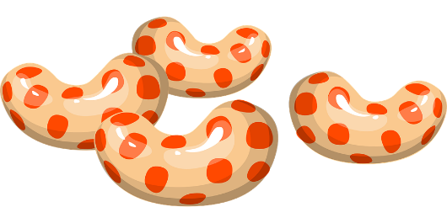
SPEAKING
We need some candy.
__________ candy do we need?
How many
We need…

Slide 37


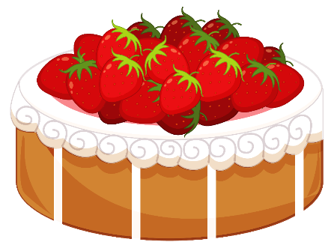
SPEAKING
We need some cakes.
__________ do we need?
How many
We need…

Slide 38

SPEAKING
How much
__________ work do you have to do?
I have to do…

Slide 39
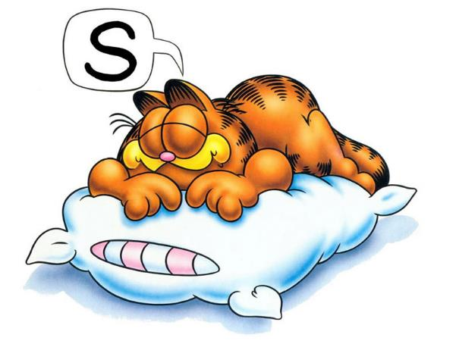
SPEAKING
How much
__________ sleep did you get last night?
I slept…

Slide 40
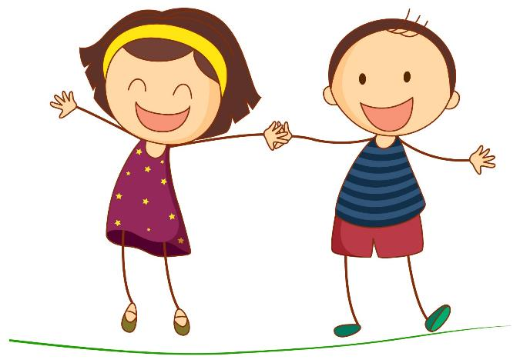
SPEAKING
How many
__________ children do you have?
I have…

Slide 41

SPEAKING
How many
__________ bottles of water are there in your fridge?
There are…

Slide 42
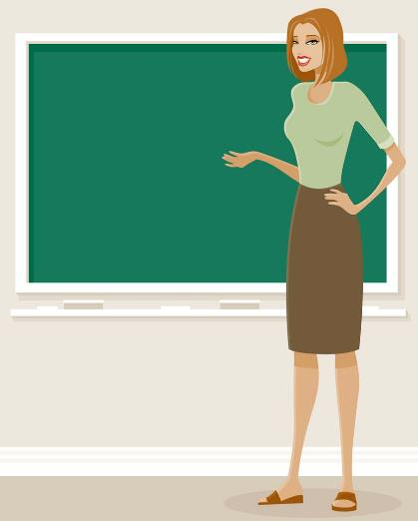
SPEAKING
How much
__________ English grammar do you know?
Welcome
I know…

Slide 43
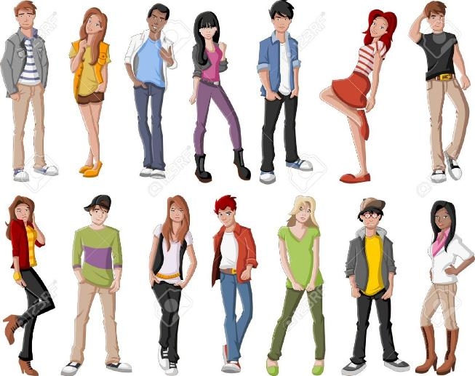
SPEAKING
How many
__________ Americans do you know?
I know…

Slide 44

SPEAKING
How much
__________ sugar do you take in your coffee?
I take…

Slide 45

SPEAKING
How many
__________ apples do you eat every week?
I eat…

Slide 46



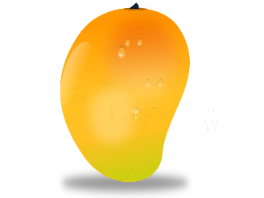


SPEAKING
How many
__________ fruit do you eat in an average week?
I eat…

Slide 47
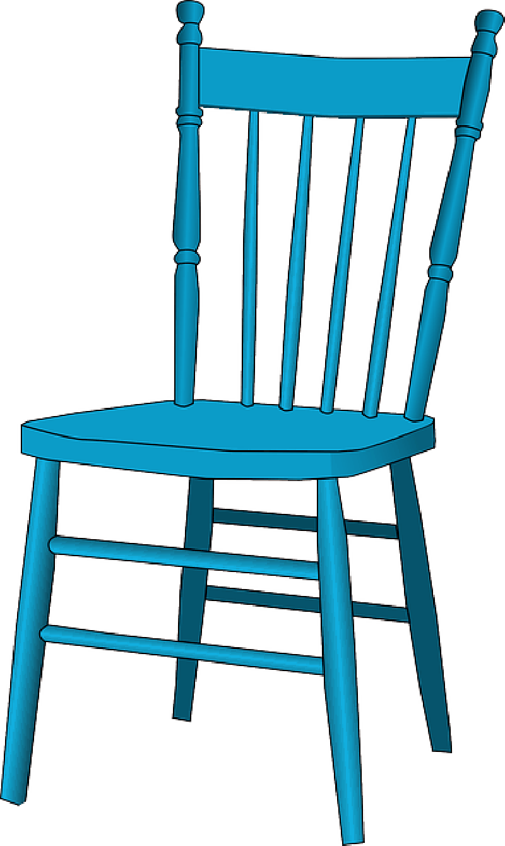
SPEAKING
How many
__________ chairs are there in your house?
There are…

Slide 48
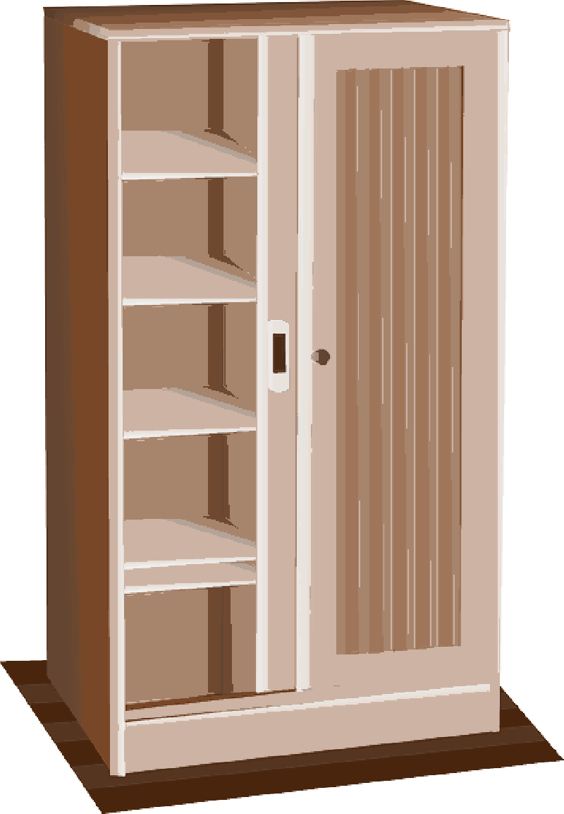


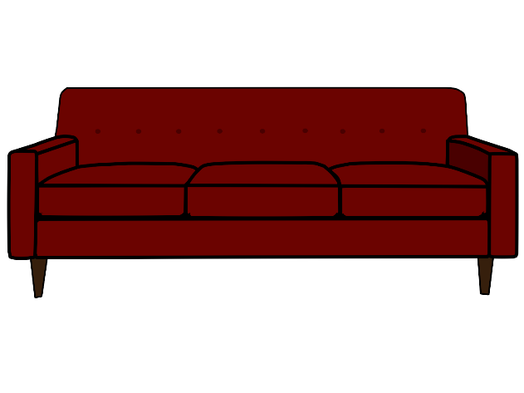
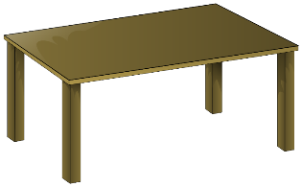
SPEAKING
How much
__________ furniture do you have?
There is…

Slide 49
Quantitites
Questions
How many…?
Countable
How much…?
Uncountable

Slide 50
Complete the following sentences using
HOW MUCH or HOW MANY
PRACTICE
__________ lemonade have we got? We've got only one bottle.
__________ bottles are there? Three.
__________ meat is there? We have got two steaks.
__________ bananas have we got? We haven’t got any.
__________ sugar have we got? Enough.
__________ bread have we got? Some.

Slide 51
Complete the following sentences using
HOW MUCH or HOW MANY
PRACTICE
__________ pens are in your bag? Six.
__________ money have we got? We haven’t got a lot.
__________ bikes are there in the garden? Two.
__________ children have they got? Three girls
__________ milk have we got? About one litre.
__________ steaks have we got? We’ve got six steaks.

Slide 52
Complete the following sentences using
HOW MUCH or HOW MANY
PRACTICE
______________ stars are there in the sky?
______________ people live on islands?
______________ birds are there?
______________ water is in the ocean?
______________ money is in a bank?
______________ countries are there in the world?
______________ bread is eaten per day?
______________ bones are there in the human body?
______________ sand is in the deserts?
______________ information is on the internet?

Slide 53


MODAL VERBS
Asking and Giving Advice

Slide 54
Competencias
Genéricas
4. Escucha, interpreta y emite mensajes pertinentes en distintos contextos mediante la utilización de medios, códigos y herramientas apropiados.
4.4 Se comunica en una segunda lengua en situaciones cotidianas.
Disciplinares
4 Produce textos con base en el uso normativo de la lengua, considerando la intención y situación comunicativa.
11 Se comunica en una lengua extranjera mediante un discurso lógico, oral o escrito, congruente con la situación comunicativa.

Slide 55
Good things / Bad things
WRITING
Place | Good things to do | Bad things to do
At school
At home
In a restaurant / Museum

Slide 56
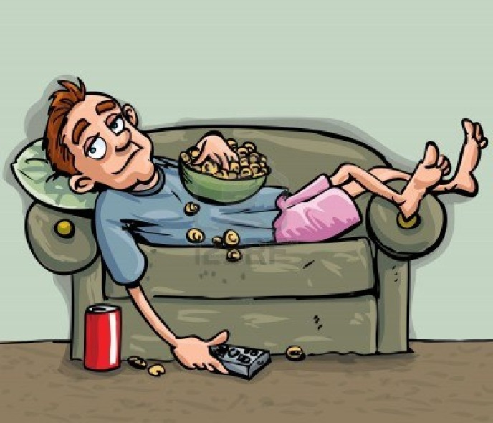
David’s Lifestyle

Slide 57
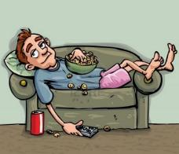
David’s Lifestyle
1. David smokes 20 cigarettes a day.
2. David takes the dog for a walk twice a day.
3. David watches six hours of TV per day.
4. David always eats cheeseburgers for breakfast.
5. David eats a few fruit.
6. David spends a lot of money on new clothes.
7. David never does exercise.
8. David drinks a lot of soda everyday.
9. David hasn’t got a job.

Slide 58

What things should David do to change his lifestyle?
SPEAKING
Work in pairs and Answer the folowing questions
The things does David do are good things or bad things?
Should David change his lifestyle?
What things should David do to change his lifestyle?
He should…
He shouldn’t…

Slide 59

EXPRESSIONS OF ASKING AND GIVING ADVICE
Expressions Of Asking for Advice
What should I do?
What do you think I should do?
Could you give me advice?
What do you advise me?
Expressions of Giving Advice
You should/shouldn’t……….
I think you should/shouldn’t………

Slide 60
Speaking Activity
Think about a problem you have at the moment. Write it on your notebook describing all the details.
Problem
I broke with my girlfriend last night because she made me angry. We argued a lot. Then she told me “It’s over”. I really love her so much, but I don’t know what to do. What should I do?

Slide 61
Speaking Activity
Walk around the room to talk to 5 different classmates about the problem you have.
Your classmates will give you advice on what you SHOULD or SOULDN’T do. Remember to use the expressions.
You should…
You shouldn’t…

Slide 62
Problems
WRITING
My girlfriend is seeing another person. I saw a message in her phone.
I want to be a cool, nice person. Very popular.
I can’t stop watching Netflix. Yesterday I watched Netflix for ten hours!
I have a problem. I am always late.
I am in love with two people.
What should I do?

Slide 63
Complete the following sentences using SHOULD or SHOULDN’T and the verb into parentheses.
PRACTICE
You __shouldn’t __ work so hard. Have a holiday.
I enjoyed that film. We ________________ go to the cinema more often.
You ________________ park here. It’s not allowed.
What _________I cook for dinner tonight?
You ________________ wear a coat. It’s cold outside.
The kids________________ eat so many sweets. They’re bad for them.
We ________________ arrive at the airport two hours before the flight.
David ________________ get a job. He needs money.
Sara ________________ arrive early to class. She’s always late.
I ________________ eat any more cake. I have eaten too much.

Slide 64
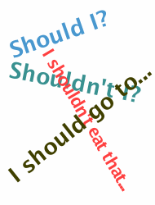
Conclusion
Uses:
We use SHOULD to give an opinion or a recommendation.
Examples
You should be more careful.
They shouldn’t talk so much.
We should invest more in Mexico.
We use SHOULD to ask and give an advice.
Examples
What do you think I should do?
You should phone her now.
He should see a doctor

Slide 65
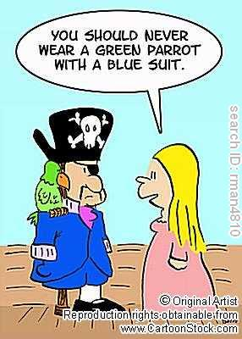
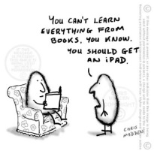
Just for laughs

Slide 66
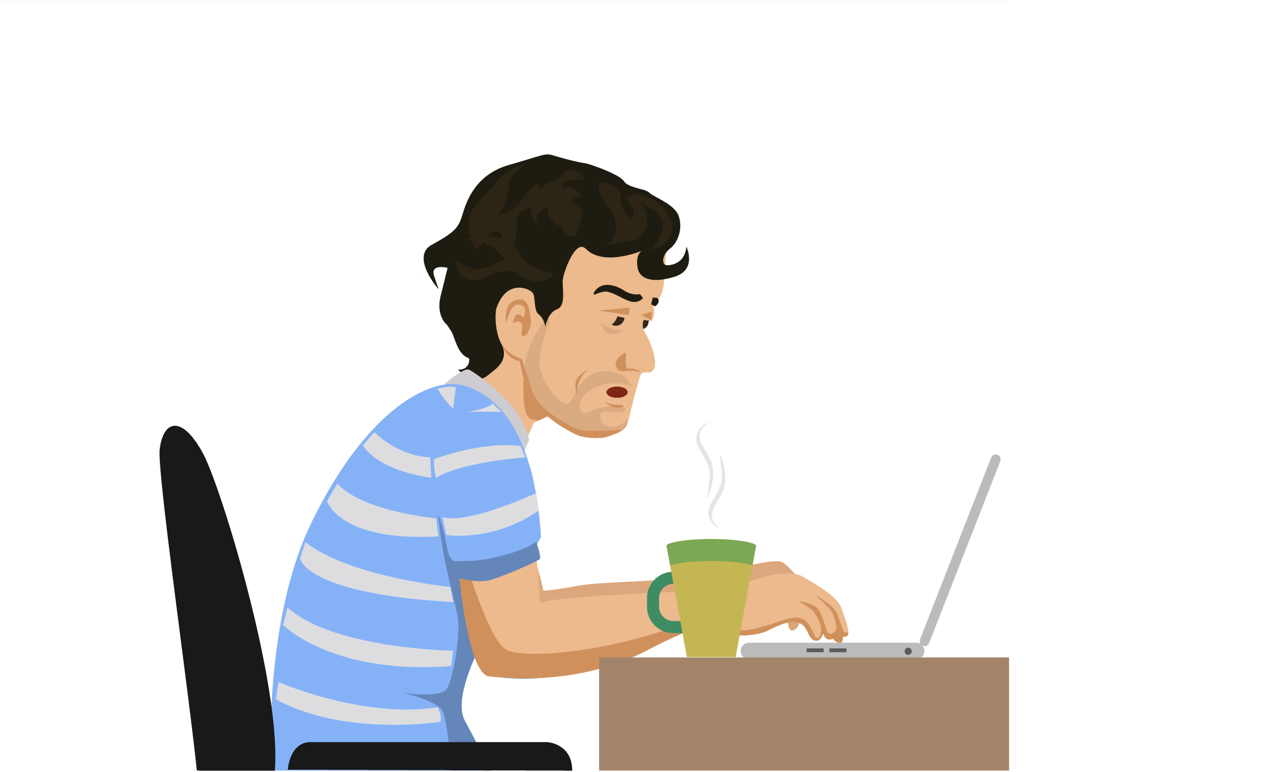

REFERENCIAS

Slide 67
Referencias
Mesografía
Tema 2
https://albertamiragyan11.wordpress.com/category/english/page/2/
https://www.englisch-hilfen.de/en/exercises/confusing_words/some_any.htm
http://www.edu.xunta.gal/centros/iesblancoamorculleredo/system/files/E2_%20extra_someanymuchmanya-lot-ofa-fewa-little-grammar-drills_47324.pdf
http://www.juntadeandalucia.es/empleo/recursos/material_didactico/especialidades/materialdidactico_ingles_base-turismo/general/archivos/solucionario_nivel_1.pdf
Tema 3
https://www.english-4u.de/en/grammar-exercises/how-much-many.htm
Imágenes
Las imágenes se obtuvieron del sitio Freepik: http:www.freepik.com

