Slide 1
Material Didáctico Audiovisual
Sólo Visión Proyectables Diapositivas
Inglés 2 - Módulo IV
Bachillerato Universitario 2015
La naturaleza y yo
Elaborado por: M. en I. y G. E. Cesar Martínez Acevedo
Plantel “Dr. Ángel Ma. Garibay Kintana”
de la Escuela Preparatoria

Slide 2
Inglés 2
PROPÓSITO GENERAL
Emplea el idioma inglés para satisfacer sus necesidades inmediatas de interacción, supervivencia y de relación con su entorno inmediato, de forma simple, por medio de expresiones cotidianas, frases comunes, familiares y aprendidas; y representaciones lingüísticas asociadas al contexto cultural y social.
Continuar

Slide 3
Módulo IV
Nombre del Módulo
La naturaleza y yo
Propósitos del Módulo
Describe características geográficas de distintos hábitats alrededor del mundo. Comparando rasgos que los diferencian entre sí.
Continuar

Slide 4
Competencia Disciplinar
Comunicación Básica
10 Identifica e interpreta la idea general y posible desarrollo de un mensaje oral o escrito en una segunda lengua, recurriendo a conocimientos previos, elementos no verbales y contexto cultural.
11. Se comunica en una lengua extranjera mediante un discurso lógico, oral o escrito, congruente con la situación comunicativa.
Extendida
9. Trasmite mensajes en una segunda lengua o lengua extranjera atendiéndolas características de contextos socioculturales diferentes.
Continuar

Slide 5
Competencia Genérica
4 Escucha, interpreta y emite mensajes pertinentes en distintos contextos mediante la utilización de medios, códigos y herramientas apropiados.
4.4 Se comunica en una segunda lengua en situaciones cotidianas.
7. Aprende por iniciativa e interés propio a lo largo de la vida.
7.1 Define metas y da seguimiento a sus procesos de construcción de conocimiento.
10. Mantiene una actitud respetuosa hacia la interculturalidad y la diversidad de creencias, valores, ideas y prácticas sociales.
10.2 Dialoga y aprende de personas con distintos puntos de vista y tradiciones culturales mediante la ubicación de sus propias circunstancias en un contexto más amplio.
Continuar

Slide 6
TEMAS
Comparativos
Superlativos

Slide 7

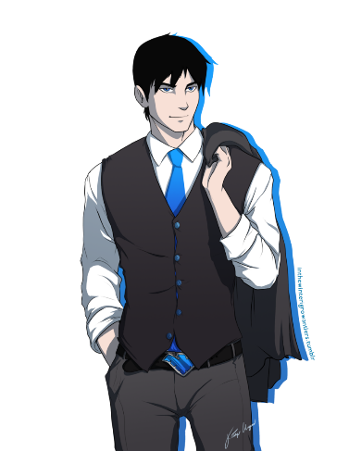


Comparativos
BACK

Slide 8
LOOK AT THE PICTURES AND DESCRIBE THEM USING DIFFERENT ADJECTIVES
BACK

Slide 9
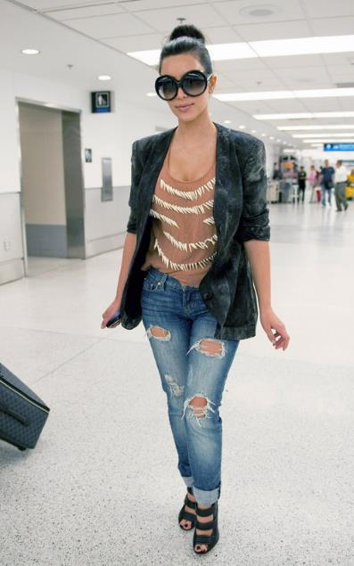
BACK
What is she like?
What does she look like?

Slide 10
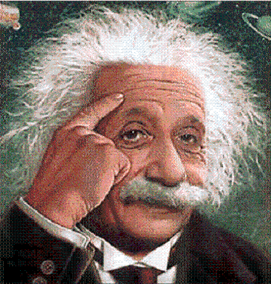
BACK
What is he like?
What does he look like?

Slide 11
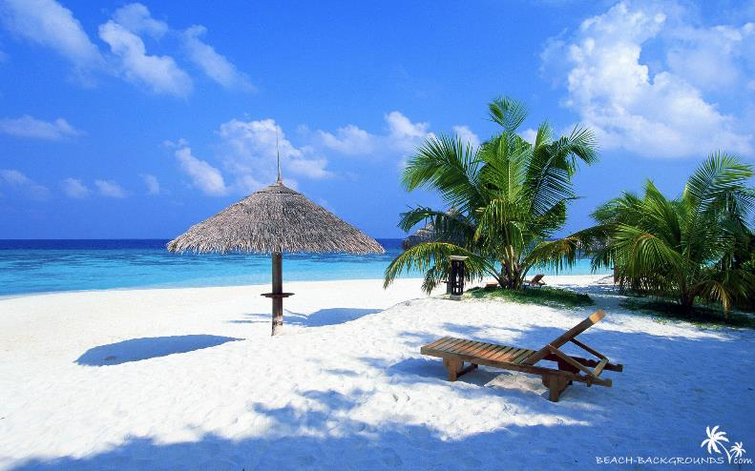
BACK
What is it like?

Slide 12
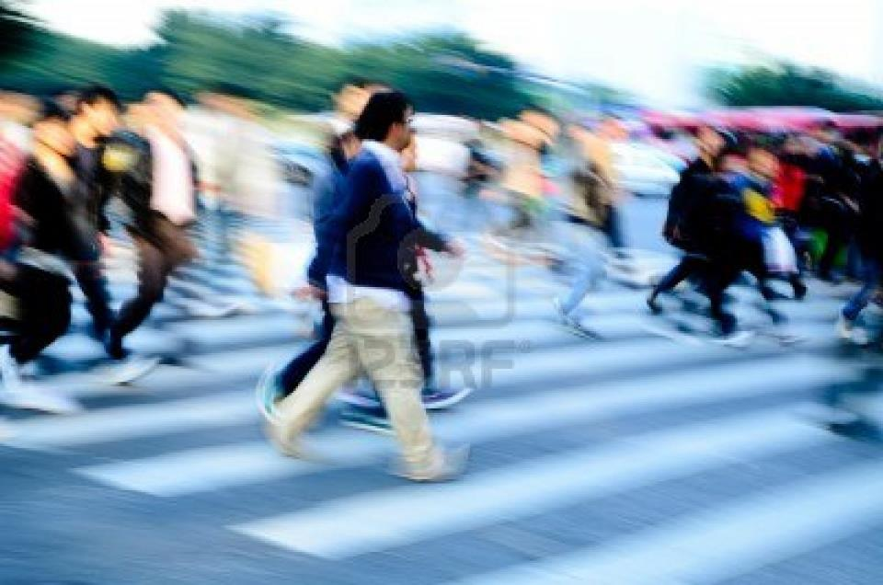
BACK
What is it like?

Slide 13
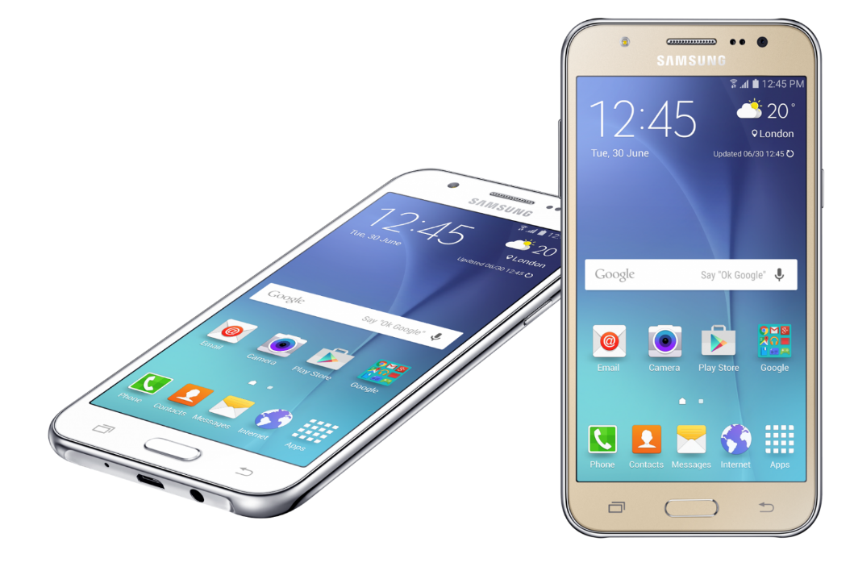
BACK
What is it like?

Slide 14
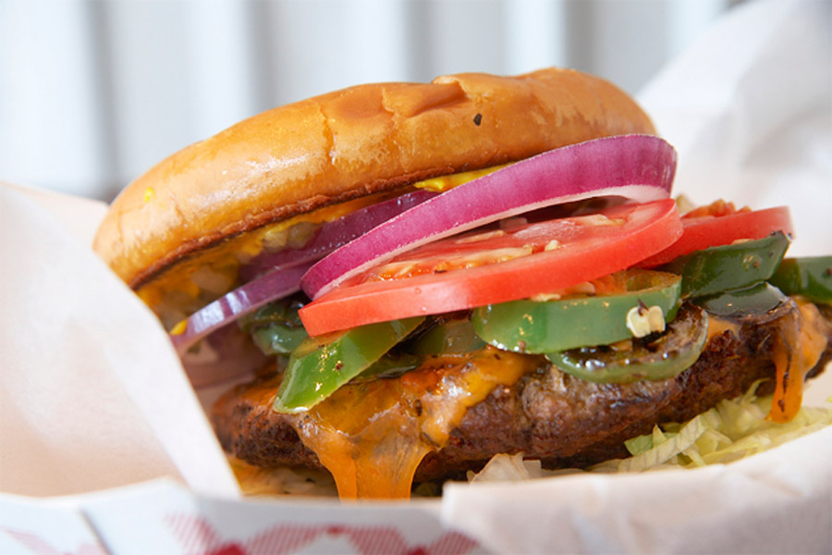
BACK
What is it like?

Slide 15
COMPARE THE FOLLOWING PICTURES
BACK

Slide 16
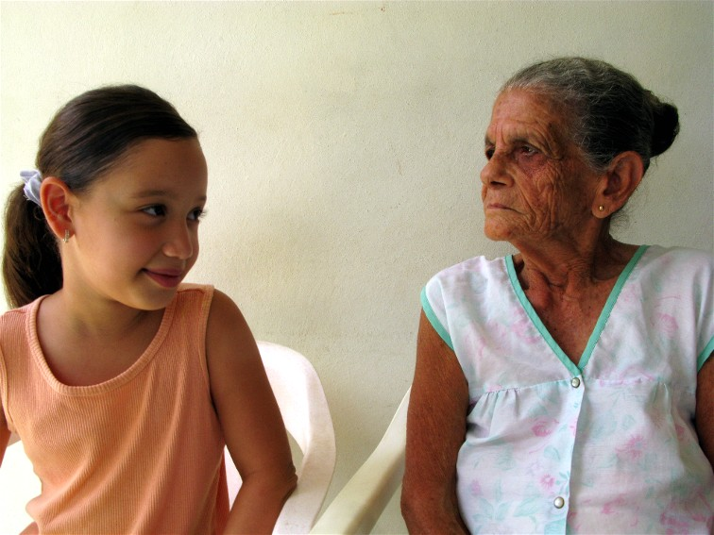
BACK
Sara is younger than Cecilia.

Slide 17
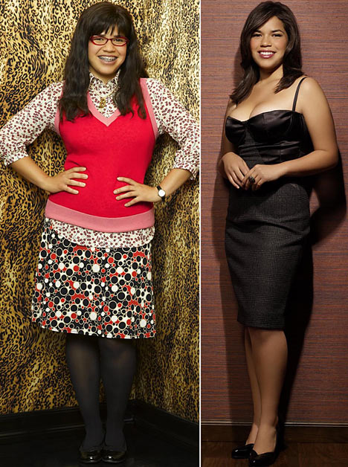
BACK
Betty is uglier than America.

Slide 18
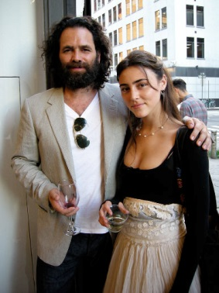
BACK
Ana is more popular than Carlos.

Slide 19
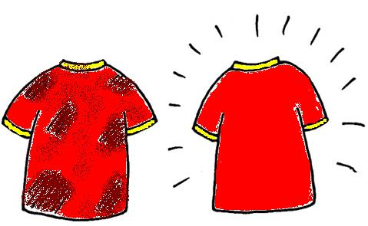
BACK
The first t-shirt is older than the second t-shirt.

Slide 20
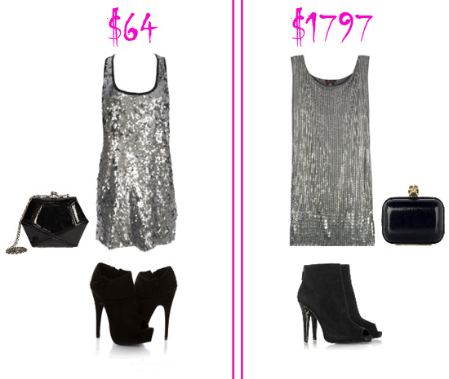
The second set is more expensive than the first set.
BACK

Slide 21
REGULAR SHORT ADJECTIVES
ADJECTIVE | COMPARATIVE FORM IS ______________ THAN ARE ____________ THAN
Tall
Fast
Big
Cheap
Cold
New
Tidy
Noisy
BACK

Slide 22
REGULAR LONG ADJECTIVES
ADJECTIVE | COMPARATIVE FORM IS MORE ______________ THAN ARE MORE ____________ THAN
Interesting
Awesome
Elegant
Beautiful
Important
Comfortable
Modern
Amazing
BACK

Slide 23
IRREGULAR ADJECTIVES
ADJECTIVE | COMPARATIVE FORM IS ______________ THAN ARE ____________ THAN
Good | Better
Bad | Worse
Well | Better
Far | Farther / Further
Old (members of the family) | elder
Little | less
Much | more
BACK

Slide 24
COMPARE THE FOLOWING PLACES USING THE ADJECTIVE GIVEN.
BACK

Slide 25

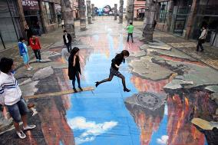
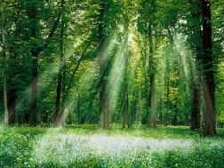
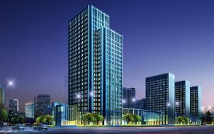
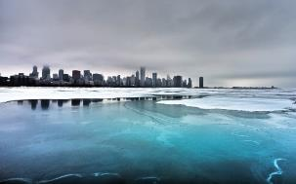
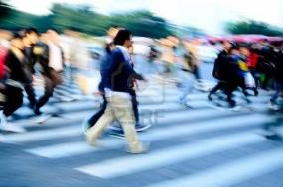
BACK
CANCUN BEACH
CHICAGO STREET
FOREST
RELAXING / NOISY / STRESSING / COLD
HOT / INTERESTING
NEW YORK
ALASKA
LOS ANGELES STREET

Slide 26
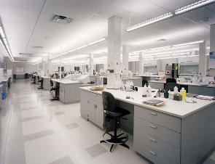
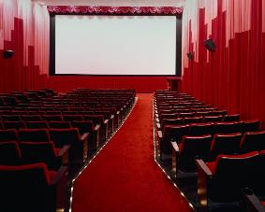
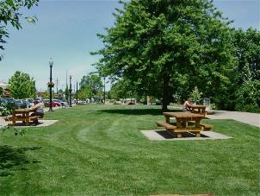
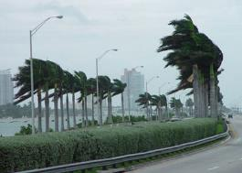
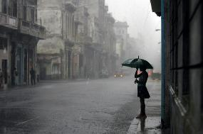
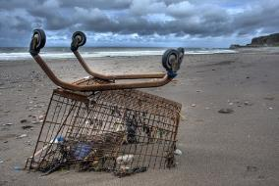
BACK
LAB
CINEMA THEATER
PARK
HOT / INTERESTING / WINDY / WET
DIRTY / BORING / SUNNY / TIDY
MIAMI BEACH
STREET
JAPANESE BEACH

Slide 27
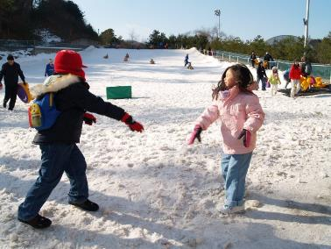
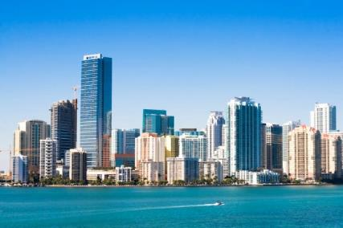
HOT / COLD
BACK
Alaska
Los Angeles

Slide 28
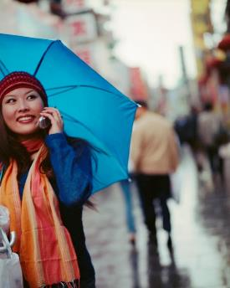
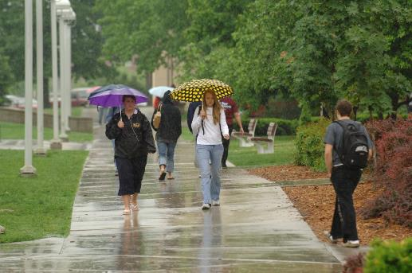
WET
BACK
China
England

Slide 29
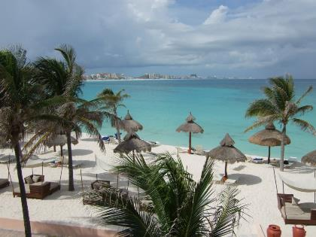
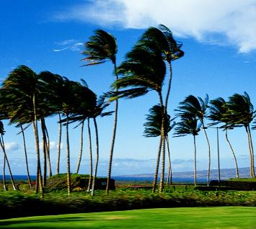
WINDY
BACK
Cancun
Hawaii

Slide 30
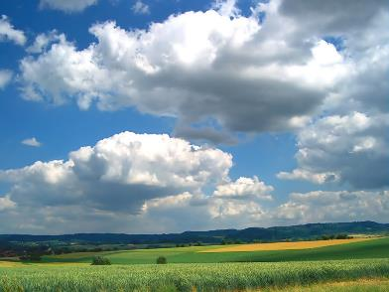
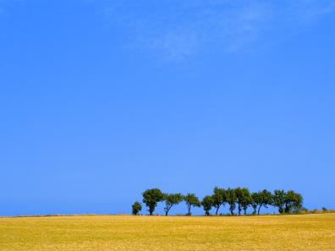
CLOUDY
BACK
Australia
South Africa

Slide 31
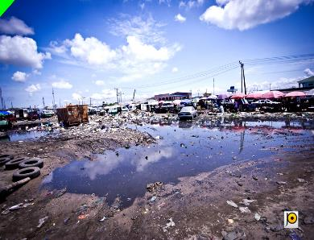
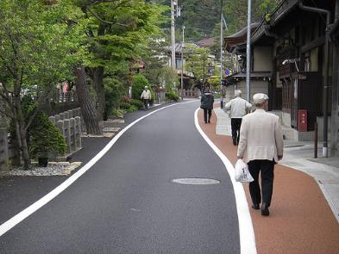
CLEAN / DIRTY
BACK
Damp
Street

Slide 32
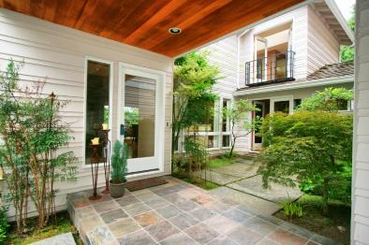
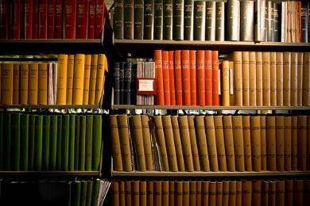
INTERESTING / BORING
BACK
House
Library

Slide 33
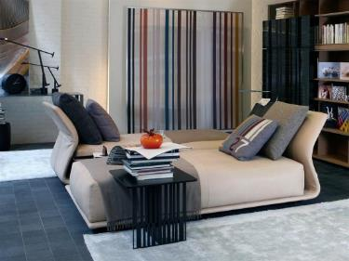
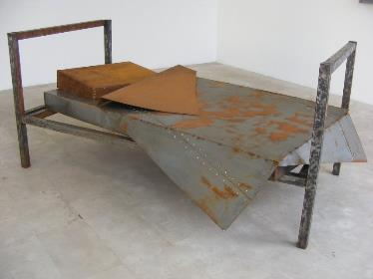
(UN) COMFORTABLE
BACK
Room A
Room B

Slide 34
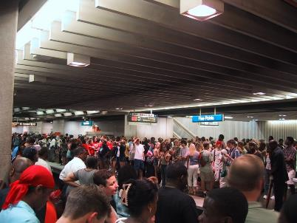
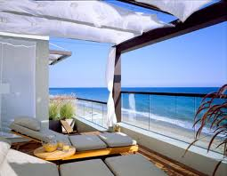
RELAXING
BACK
Subway
Beach

Slide 35



 | Manny |  | Homer |  | Alice
 | 28 years old |  | 39 years old |  | 9 years old
 | 55 kilos |  | 80 kilos |  | 33 kilos
 | 1.50 meters |  | 1.55 meters |  | 1.20 meters
Manny is ______________ than Homer.
Homer is ______________ than Alice.
Alice is ______________ than Manny.
Manny is ______________ than Homer.
Homer is ______________ than Manny.
Alice is ______________ than Homer.
Homer is ______________ than Alice.
Homer is ______________ than Manny.
(YOUNG)
(OLD)
(SLIM)
(SHORT)
(FAT)
(SHORT)
(UGLY)
(SLOW)
BACK

Slide 36
 | Manny |  | Homer |  | Alice
 | 28 years old |  | 39 years old |  | 9 years old
 | 55 kilos |  | 80 kilos |  | 33 kilos
 | 1.50 meters |  | 1.55 meters |  | 1.20 meters
(TIDY)
Manny is ______________ than Homer.
Alice is ______________ than Manny.
Alice has got ______________ hair than Manny.
Homer play the guitar ______________ than Alice.
Alice can run ______________ than Homer.
Alice draws ______________ than Manny.
Manny is ______________ than Homer.
Homer is a ______________ person than Manny.
(BEAUTIFUL)
(LONG)
(GOOD)
(FAST)
(BAD)
(INTELLIGENT)
(INTERESTING)
BACK

Slide 37
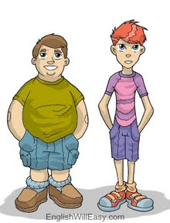
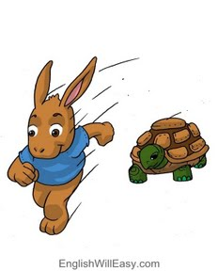
Make comparisons
BACK
Jack
Steve
The rabbit
The turtle

Slide 38
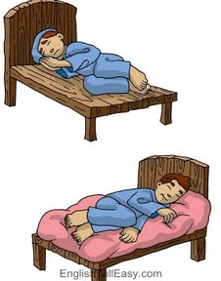
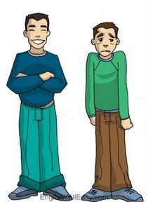
Make comparisons
BACK
Mario’s bed
David’s bed
Marcus
Michael

Slide 39
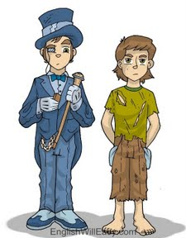
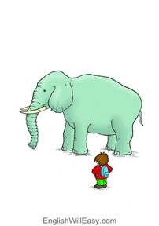
Make comparisons
BACK
Peter
Jesus
The elephant
The boy

Slide 40

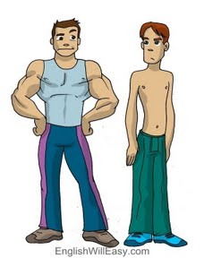
Make comparisons
BACK
Alicia
Sophie
Carlos
Eduardo

Slide 41
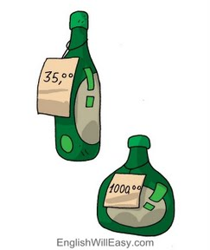
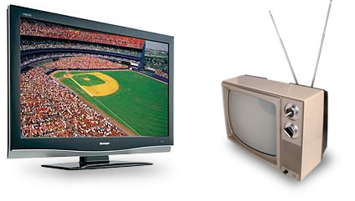
Make comparisons
BACK
The bottle of water
The bottle of wine
The plasma TV
The bulb TV

Slide 42
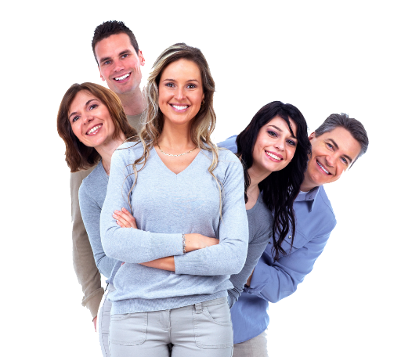
SUPERLATIVES
BACK

Slide 43

What Are Superlatives?
BACK
A superlative is a form of an adjective used for comparison.
The superlative form of an adjective is used to show something has a quality to the greatest or least degree.

Slide 44
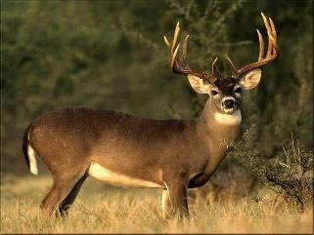



What is the fastest animal of the world?
BACK
Deer
Cheetah
The cheetah is the fastest animal.
Turtle
Dog

Slide 45

Who is the oldest person of the family?
BACK
Jack
34
Peter
76
Marie
36
Jennifer
75
David
6
Marion
9
Peter is the oldest person of the family.

Slide 46


Who was the most intelligent person of the world?
Albert Einstein
Mark Zuckerberg
Steve Jobs
Albert Einstein was the most intelligent person.
BACK

Slide 47




Who is the richest man of the world?
Carlos Slim
Helu
Sergey Brin and Larry Page
BACK
Jeff Bezos
Bill Gates
Jeff Bezos is the richest man of the world.

Slide 48

What is the most expensive iPhone?
BACK
The most expensive iPhone is the iPhone X S Max.

Slide 49

BACK
Who is the tallest girl?
Karlie Kloss
is the tallest girl.

Slide 50




Who is the most popular singer of the world?
BACK
Adele
Tylor Swift
Dua Lipa
Katy Perry
Tylor Swift is the most popular Singer of the world.

Slide 51




Which is the most polluted city?
BACK
Mexico City
England
Paris
Pekin
Pekin is the
Most polluted city.

Slide 52
REGULAR SHORT ADJECTIVES
BACK
ADJECTIVE | SUPERLATIVE FORM the ________-est
Tall
Fast
Big
Cheap
Cold
New
Tidy
Small
Noisy

Slide 53
REGULAR LONG ADJECTIVES
BACK
ADJECTIVE | SUPERLATIVE FORM the most ________
Interesting
Awesome
Elegant
Beautiful
Important
Comfortable
Boring
Modern
Amazing

Slide 54
IRREGULAR ADJECTIVES
BACK
ADJECTIVE | SUPERLATIVE FORM
Good | Best
Bad | Worst
Well | Best
Far | Farthest / Furthest
Old (members of the family) | eldest
Little | least
Much | most

Slide 55
Look at the following pictures.
Use superlative to describe them.
BACK

Slide 56




BACK
Gforce $4,800
Surface $6,200
Samsung $3,599
iPad $7,299

Slide 57

BACK
John 44 years
1.73 m.
David 32 years
1.74 m.
Jessica 27 years
1.68 m
Steve 39 years
1.71 m.

Slide 58




BACK
Turtle
Cheetah
Elephant
Giraffe

Slide 59




BACK
Hawaii
Mexico City
Alaska
Venezia

Slide 60




BACK
American Football
Soccer
Tennis
Basketaball

Slide 61
WRITE SENTENCES USING ADJECTIVES
BACK
Sports
+ Soccer
+ Basketball
+ American Football
+ Tennis
+ Boxing
Adjectives
+ Dangerous
+ Funny
+ Interesting
+ Popular
+ Boring

Slide 62
BACK
Types of films
Horror, Comedy, Thriller, Romance, Action, Sci-Fi
Music
Pop, Rock, Electronic, Ballads, Metal
Food
Mexican food, American food, Italian food, Chinese food
Subjects
Maths, English, Chemistry, Physical Education, History
Drinks
Coffee, juice, tea, water, milk

Slide 63
BACK
Devices
iPad, Smartphone, Notebook, GPS
Clothes
T-shirt, Trousers, Skirt, Blouse, Dress
Animal
Jiraffe, Elephant, Tiger, Dog, Turtle, Rabbit
Fruits
Apple, Watermelon, Orange, Banana, Strawberry
City
Mexico City, New York, Paris, Sao Paulo, Colombia

Slide 64
ADJECTIVES:
COMPARATIVE & SUPERLATIVE FORMS
BACK

Slide 65

big
BACK

Slide 66

bigger
BACK

Slide 67

biggest
BACK

Slide 68
big
BACK
bigger
biggest

Slide 69

tall
BACK

Slide 70

taller
BACK

Slide 71

tallest
BACK
BACK

Slide 72
tall
BACK
taller
tallest

Slide 73

small
BACK

Slide 74

smaller
BACK

Slide 75

smallest
BACK

Slide 76
small
BACK
smaller
smallest

Slide 77

fat
BACK

Slide 78

fatter
BACK

Slide 79

fattest
BACK

Slide 80
fat
BACK
fatter
fattest

Slide 81

happy
BACK

Slide 82

happier
BACK

Slide 83

happiest
BACK

Slide 84
happy
BACK
happier
happiest

Slide 85

fast
BACK

Slide 86

faster
BACK

Slide 87

fastest
BACK

Slide 88
fast
BACK
faster
fastest

Slide 89

pretty
BACK

Slide 90

prettier
BACK

Slide 91

prettiest
BACK

Slide 92
pretty
BACK
prettier
prettiest

Slide 93

busy
BACK

Slide 94

busier
BACK

Slide 95

busiest
BACK

Slide 96
busy
BACK
busier
busiest

Slide 97

sad
BACK

Slide 98

sadder
BACK

Slide 99

saddest
BACK

Slide 100
sad
BACK
sadder
saddest

Slide 101

clever
BACK

Slide 102

cleverer
BACK

Slide 103

cleverest
BACK

Slide 104


REFERENCIAS
BACK

Slide 105
Referencias
Imágenes
Las imágenes se obtuvieron del sitio Freepik: http:www.freepik.com
BACK

