Slide 1
Material Didáctico Audiovisual
Sólo Visión Proyectables Diapositivas
Inglés 3 - Módulo III
Bachillerato Universitario 2015
Acerca de mí, de quienes me rodean y lo que me rodea
Elaborado por: M. en I. y G. E. Cesar Martínez Acevedo
Plantel “Dr. Ángel Ma. Garibay Kintana” de la Escuela Preparatoria

Slide 2
Propósito General
Inglés 3
Interactúa en el idioma inglés de forma oral y escrita, en situaciones sociales o académicas relacionadas con áreas de experiencia que
le son especialmente familiares, para proporcionar información sobre sí mismo u obtener información de las personas que le rodean,
pasatiempos, describir intereses, actividades rutinarias, actividades en progreso, aspectos de su pasado personal y del lugar en donde
vive, eventos recientes, experiencias de vida; así como extraer información de distintas fuentes: visuales, auditivas y audiovisuales.
Continuar

Slide 3
Módulo III
Nombre del Módulo
Acerca de mí, de quienes me rodean y lo que me rodea.
Propósitos del Módulo
Asocia elementos lingüísticos y comunicativos, tanto de forma oral como escrita, para describirse a sí mismo, a las personas que le rodean, así como intercambiar opiniones en interacciones sociales y académicas con los que está familiarizado.
Continuar

Slide 4
Competencia Disciplinar
Comunicación
Básica
10. Identifica e interpreta la idea general y posible desarrollo de un mensaje oral o escrito en una segunda lengua, recurriendo a conocimientos previos, elementos no verbales y contexto cultural.
11. Se comunica en una lengua extranjera mediante un discurso lógico, oral o escrito, congruente con la situación comunicativa.
Extendida
9. Trasmite mensajes en una segunda lengua o lengua extranjera atendiéndolas características de contextos socioculturales diferentes.
Continuar

Slide 5
Competencia Genérica
4. Escucha, interpreta y emite mensajes pertinentes en distintos contextos mediante la utilización de medios, códigos y herramientas apropiados.
4.4 Se comunica en una segunda lengua en situaciones cotidianas.
7. Aprende por iniciativa e interés propio a lo largo de la vida.
7.1 Define metas y da seguimiento a sus procesos de construcción de conocimiento.
10. Mantiene una actitud respetuosa hacia la interculturalidad y la diversidad de creencias, valores, ideas y prácticas sociales.
10.2 Dialoga y aprende de personas con distintos puntos de vista y tradiciones culturales mediante la ubicación de sus propias circunstancias en un contexto más amplio.
Continuar

Slide 6

TEMAS
Simple Present
Personality Traits
Verb +
Infinitive or
gerunds

Slide 7
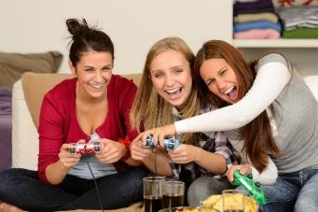
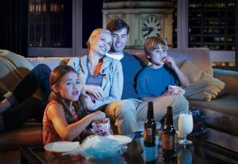

Simple Present
BACK
Everyday Activities:
Habits & Routines

Slide 8
Simple Present
BACK
We use the present simple to express regular routines and habits. Also, to talk about general facts. It is used with adverbs of frequency to say how often we do different activities.
always
100%
We see a boring film.
I tidy my room when I’m happy.
We sometimes have pizza after the film.
I usually play volleyball in a team.
I don’t always like teaching maths.
usually
often
sometimes
50%
rarely
hardly ever
never
0%

Slide 9
Expressions
BACK
There are some expressions that we use to say when the action happen. They go a the beginning or at the end of a sentence.
Every day
Every week
Every month
Every year
In the morning
In the afternoon
In the evening
At night
At weekends
On Monday, on Saturday
Once a day
Twice a month

Slide 10
Verbs
BACK
We use a verb in present simple with these people.
play
sing
read
pass
need
like
study
write
run
go
do
pay
watch
plays
sings
reads
passes
needs
likes
studies
writes
runs
goes
does
pays
watches
I
YOU
WE
THEY
HE
SHE
IT

Slide 11
Third person singular
BACK
HE / She / IT
s
In the third person singular the verb always ends in:
He wants some water.
She reads a book everyday.
Add ES to verbs
ending in:
Verbs ending in:
Consonant + Y
Changes the Y to I and add “ES”. Cry → Cries Try → Tries
Vowel + Y
We only add “S”
Play → Plays Buy → Buys
x
Fixes
Washes
Passes
Watches
Goes
sh
ss
ch
o

Slide 12
Negative and Questions
BACK
We use the auxiliary verb DON’T or DOESN’T.
play basketball at school.
sing in the shower.
read science fiction books
pass the ball.
need an umbrella.
like mexican food.
study maths at night.
write poems to my girlfriend.
run in the park.
go to the movies.
I
YOU
WE
THEY
DON’T
HE
SHE
IT
DOESN’T

Slide 13
Now, describe some activities that you do in your life.
__________________________________________.
__________________________________________.
__________________________________________.
__________________________________________.
__________________________________________.
__________________________________________.
__________________________________________.
__________________________________________.
BACK

Slide 14
Speaking Activity
BACK
Ask your classmates about the activities they do.
Hello, can you tell me one activity that you do?
Write the answer on your notebook.
Jessica always does exercise in the park
with her friends.
André eats in the school everyday.

Slide 15

Personality Traits
BACK
How to describe people’s personality

Slide 16
Adjectives to describe the personality in English
VERB TO BE – AM / IS / ARE
BACK
ambitious ambicioso
annoying pesado
argumentative, discutidor
bad-tempered malhumorado
big-headed creído, engreído
brave valiente
carefree d espreocupado
careless descuidado
cautious prudente, cauteloso, charming encantador
cheerful alegre, jovial;
conservative conservador
cowardly c obarde
crazy, nuts loco, chiflado
cruel cruel
boring aburrido
flirtatious coqueta
friendly amigable, simpático
generous generoso
hard-working trabajador
honest honesto
kind amable
lazy perezoso, flojo
loyal fiel
mean tacaño
modest modesto
moody cambiante
naive ingenuo, inocentón
naughty malo, travieso (niños)
open-minded de actitud abierta, sin prejuicios
narrow-minded cerrado de mente
polite cortés, educado
proud orgulloso
reliable fiable, confiable
self-confident seguro de sí mismo
selfish egoísta
sensible sensato, prudente;
sensitive sensible
shy tímido, vergonzoso
strict estricto, severo
sympathetic comprensivo
talkative hablador
weird raro, extraño

Slide 17
BACK
My teacher is talkative, sympathetic and funny. He´s also open minded, but sometimes he´s very strict.
Now describe yourself and 2 classmates:
I’m _____________________________________________________.
I’m also _________________________________________________, but sometimes I’m ___________________________________________.
________ is _____________________________________________________.
________ is also ______________________________________________, but sometime _________ is ___________________________________________.
________ is _____________________________________________________.
________ is also ______________________________________________, but sometimes _________ is ___________________________________________.

Slide 18
Present Continuos
BACK
Everyday Activities:
Habits & Routines

Slide 19

Present continuous
BACK
Explanation
We use PRESENT CONTINUOUS to show that an action is happening at the moment.
Action in Progress
PAST
PRESENT
FUTURE

Slide 20



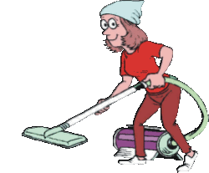
Examples
BACK
Right now, I’m watching my favorite TV series.
At the moment, my sister is doing her homework.
Now, my father is having dinner.
Right now, my mother is cleaning the living room.

Slide 21
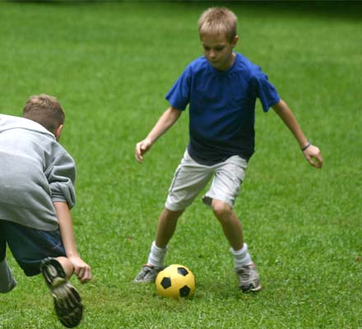
What are they doing?
BACK
Mario and Joseph are playing soccer in the backyard.

Slide 22

What is she doing?
BACK
Elisa is writing an essay for the history class.

Slide 23
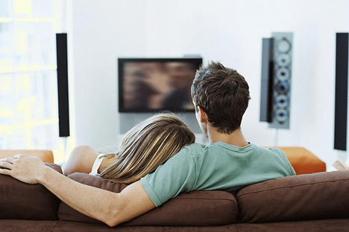
What are they doing?
BACK
My bother and his girlfriend are watching a movie.

Slide 24

What is she doing?
BACK
Melissa is taking some photos for the Graduation now.

Slide 25
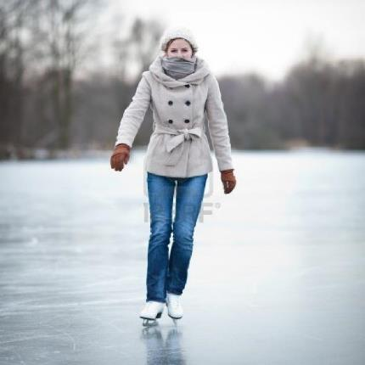
What is she doing?
BACK
Vanessa is ice skating in the lake at the
moment.

Slide 26
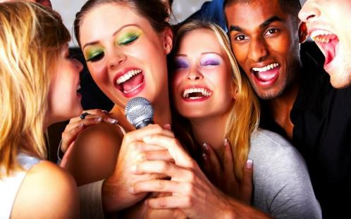
What are they doing?
BACK
Right now, my friends and I are singing in the party.

Slide 27
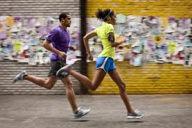
What are they doing?
BACK
Jack and Sophie are running in the marathon now.

Slide 28
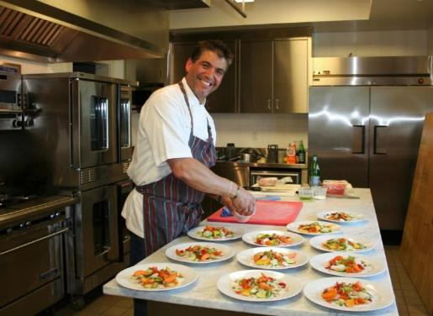
What is he doing?
BACK
My dad is cooking some fish for me and my family.

Slide 29
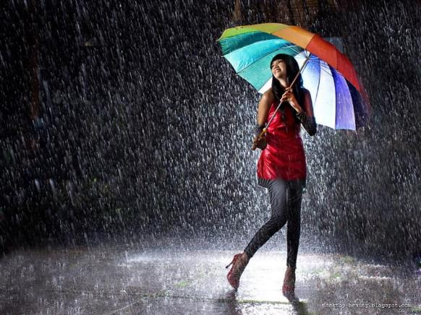
What is happening?
BACK
Right now, it is raining so hard.

Slide 30
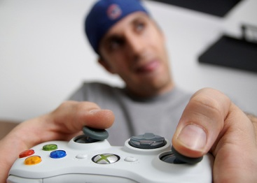
What is he doing?
BACK
Steve is playing videogames alone now.

Slide 31

BACK
And you…What are you doing?
Right now,
I’m talking on the phone.
Now,
I’m writing a letter to my friend.
At the moment,
I’m listening to pop music.

Slide 32
STRUCTURE
BACK
dancing
sleeping
doing
crying
watching
eating
etc.
AM
IS
ARE
I
He / She / It
You / We / They

Slide 33
There are some expressions that we use in PRESENT CONTINUOUS.
BACK
NOW
LISTEN!
AT THE MOMENT
RIGHT
NOW
LOOK!

Slide 34
What is happening in the following pictures
Makes sentences on your notebook
BACK

Slide 35
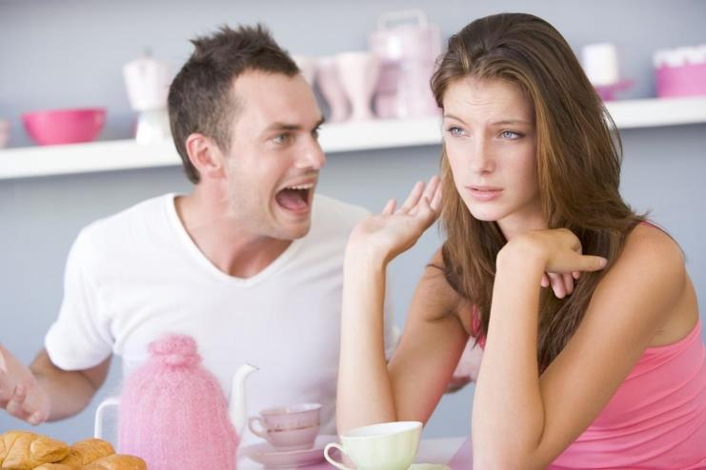
What are they doing?
BACK
They are ______________.

Slide 36
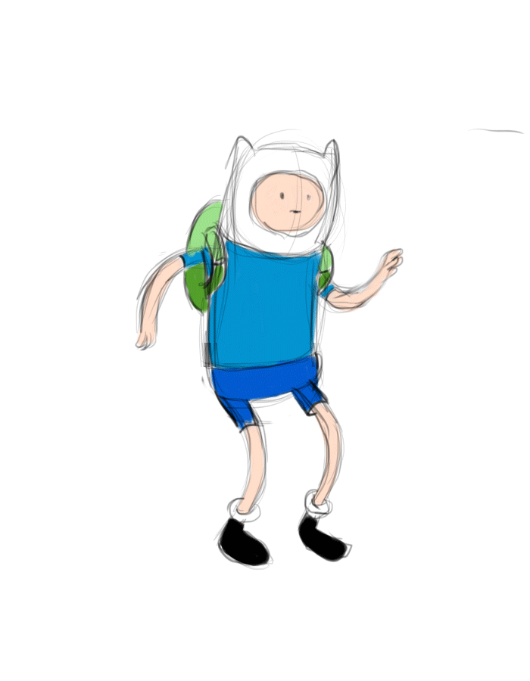
What is he doing?
BACK
He is ______________.

Slide 37
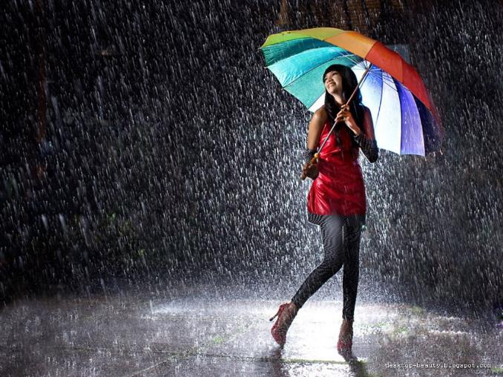
What is happening in the picture?
BACK
It is ______________.

Slide 38
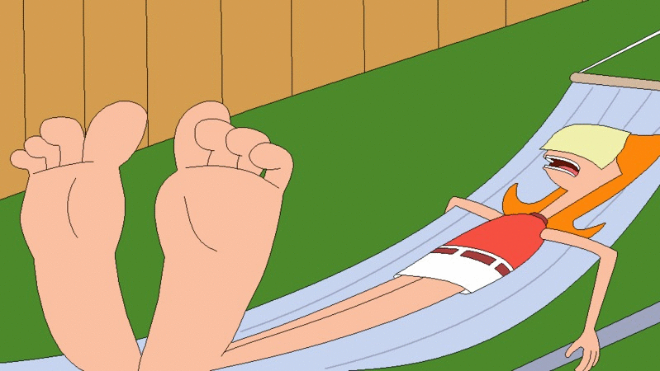
What is Candance doing?
BACK
Candace is ______________.

Slide 39

What is the hamster doing?
BACK
The hamster is ______________.

Slide 40
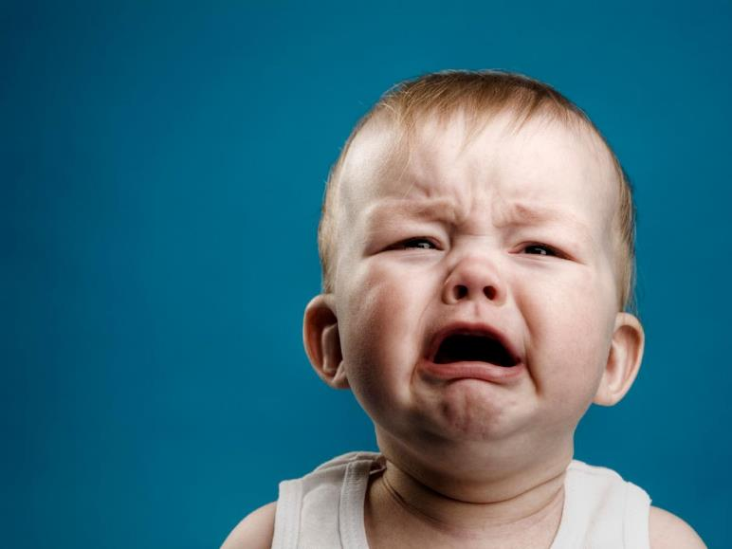
What is the baby doing?
BACK
The baby is ______________.

Slide 41

What is the fish doing?
BACK
The fish is ______________.

Slide 42

What is he doing?
BACK
He is ______________.

Slide 43
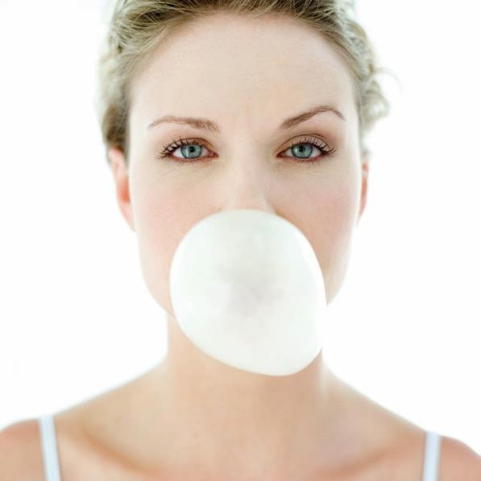
What is she doing?
BACK
She is ______________.

Slide 44

What is she doing?
BACK
She is ______________.

Slide 45
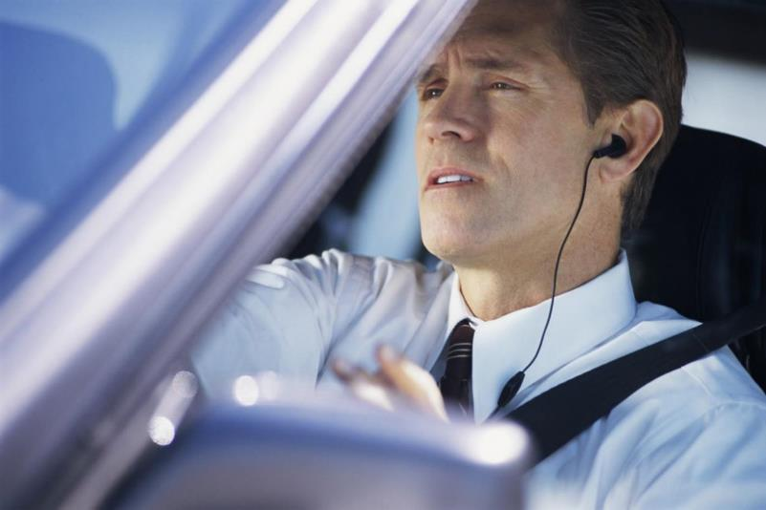
What is he doing?
BACK
The man is ______________.

Slide 46

VERB + INFINITIVE
OR
VERB + -ING FORM
BACK
Verb Patterns

Slide 47
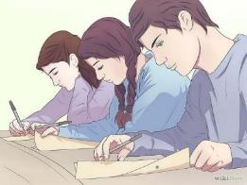
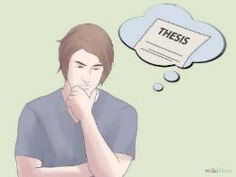
Infinitives vs. Gerunds
BACK
The basic difference between gerunds and infinitives is the following:
Using a GERUND suggests that you are referring to real activities or experiences.
Using an INFINITIVE suggests that you are talking about potential or possible activities or experiences.

Slide 48
MAIN VERBS
BACK
The main verb in the sentence determines whether you use a gerund or an infinitive.
After the main verb, both gerunds and infinitives can be used.
Infinitive verbs
MAIN VERB
Gerund Verbs

Slide 49
VERBS
+
INFINITIVE (TO …)
MAIN VERB | INFINITIVE
agree dare decide (not) expect help hope learn manage need offer pretend (not) promise (not) refuse try want would like | to play to drive to do to go to eat etc.
BACK

Slide 50
VERBS
+
GERUND (-ING…)
MAIN VERB | GERUND
avoid can't help can’t stand carry on deny enjoy fancy imagine interested in good at hate look forward to mind / don’t mind recommend spend time suggest | playing driving doing going eating etc.
BACK

Slide 51
Complete the following sentences with the correct form of the verb.
play / watch / learn / buy / be / meet / go / make
Do you fancy _________________ to ice-skate?
We always look forward to _________________ on holiday.
Josh's parents promised _________________ him a bike for his birthday.
Mary pretends _________________ ill because she doesn't want to work.
Sam suggested _________________ at the station.
You never offer _________________ dinner.
They decided ____________ a film.
I don't spend a lot of time _________________ computer games.
BACK

Slide 52
Complete the following sentences with the correct form of the verb.
play / watch / learn / buy / be / meet / go / make
learning
Do you fancy _________________ to ice-skate?
We always look forward to _________________ on holiday.
Josh's parents promised _________________ him a bike for his birthday.
Mary pretends _________________ ill because she doesn't want to work.
Sam suggested _________________ at the station.
You never offer _________________ dinner.
They decided _________________ a film.
I don't spend a lot of time _________________ computer games.
going
to buy
to be
meeting
to make
to watch
BACK
playing

Slide 53
Modifying Adverbs
BACK
How to describe people’s personality

Slide 54
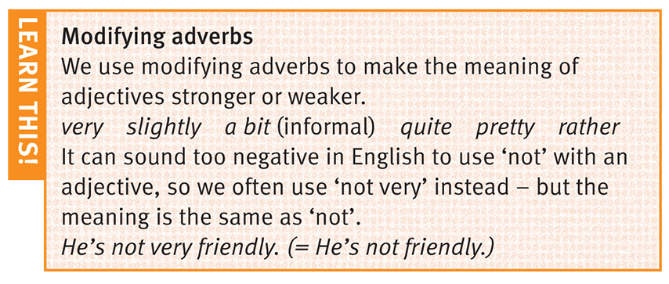
Modifying Adverbs
BACK
MUY/BASTANTE
LIGERAMENTE
UN POCO
BASTANTE
MUY
MUY

Slide 55
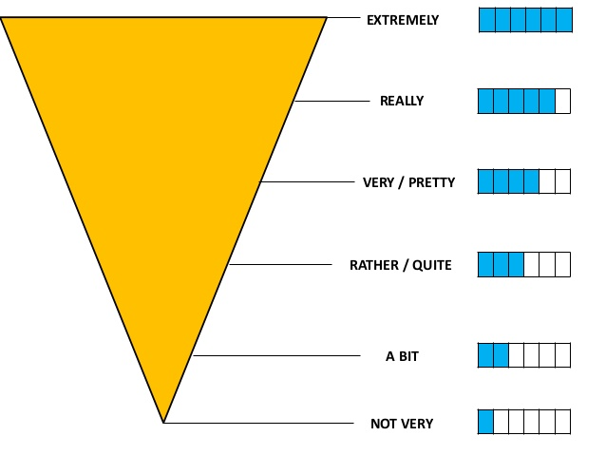
Modifying
Adverbs
BACK

Slide 56
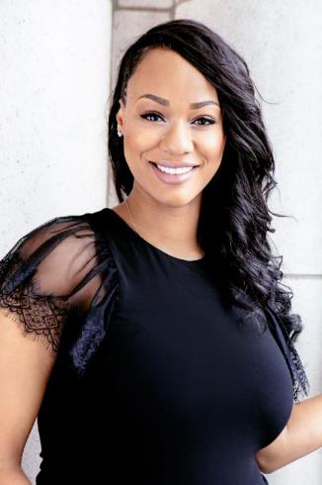
EXAMPLES
BACK
I’m quite a friendly peson and rather sensitive.
I’m sometimes slightly impatient.
I can be a bit lazy.
I’m pretty hard-working.
I’m not very tolerant of lazy people.

Slide 57

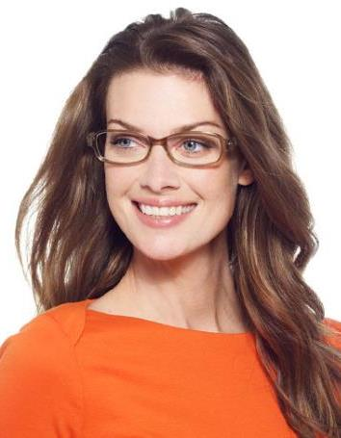
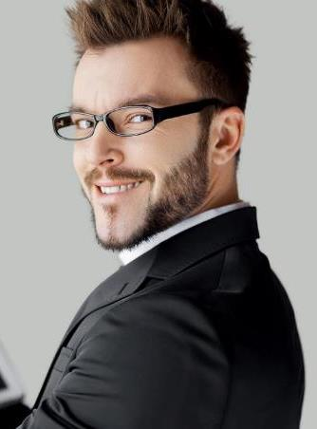
Can you describe the following people?
BACK

Slide 58

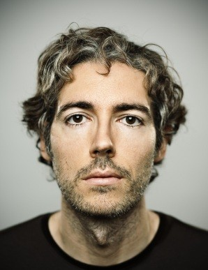
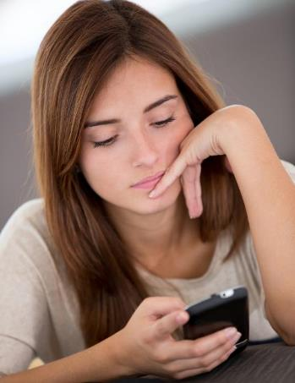
Can you describe the following people?
BACK

Slide 59
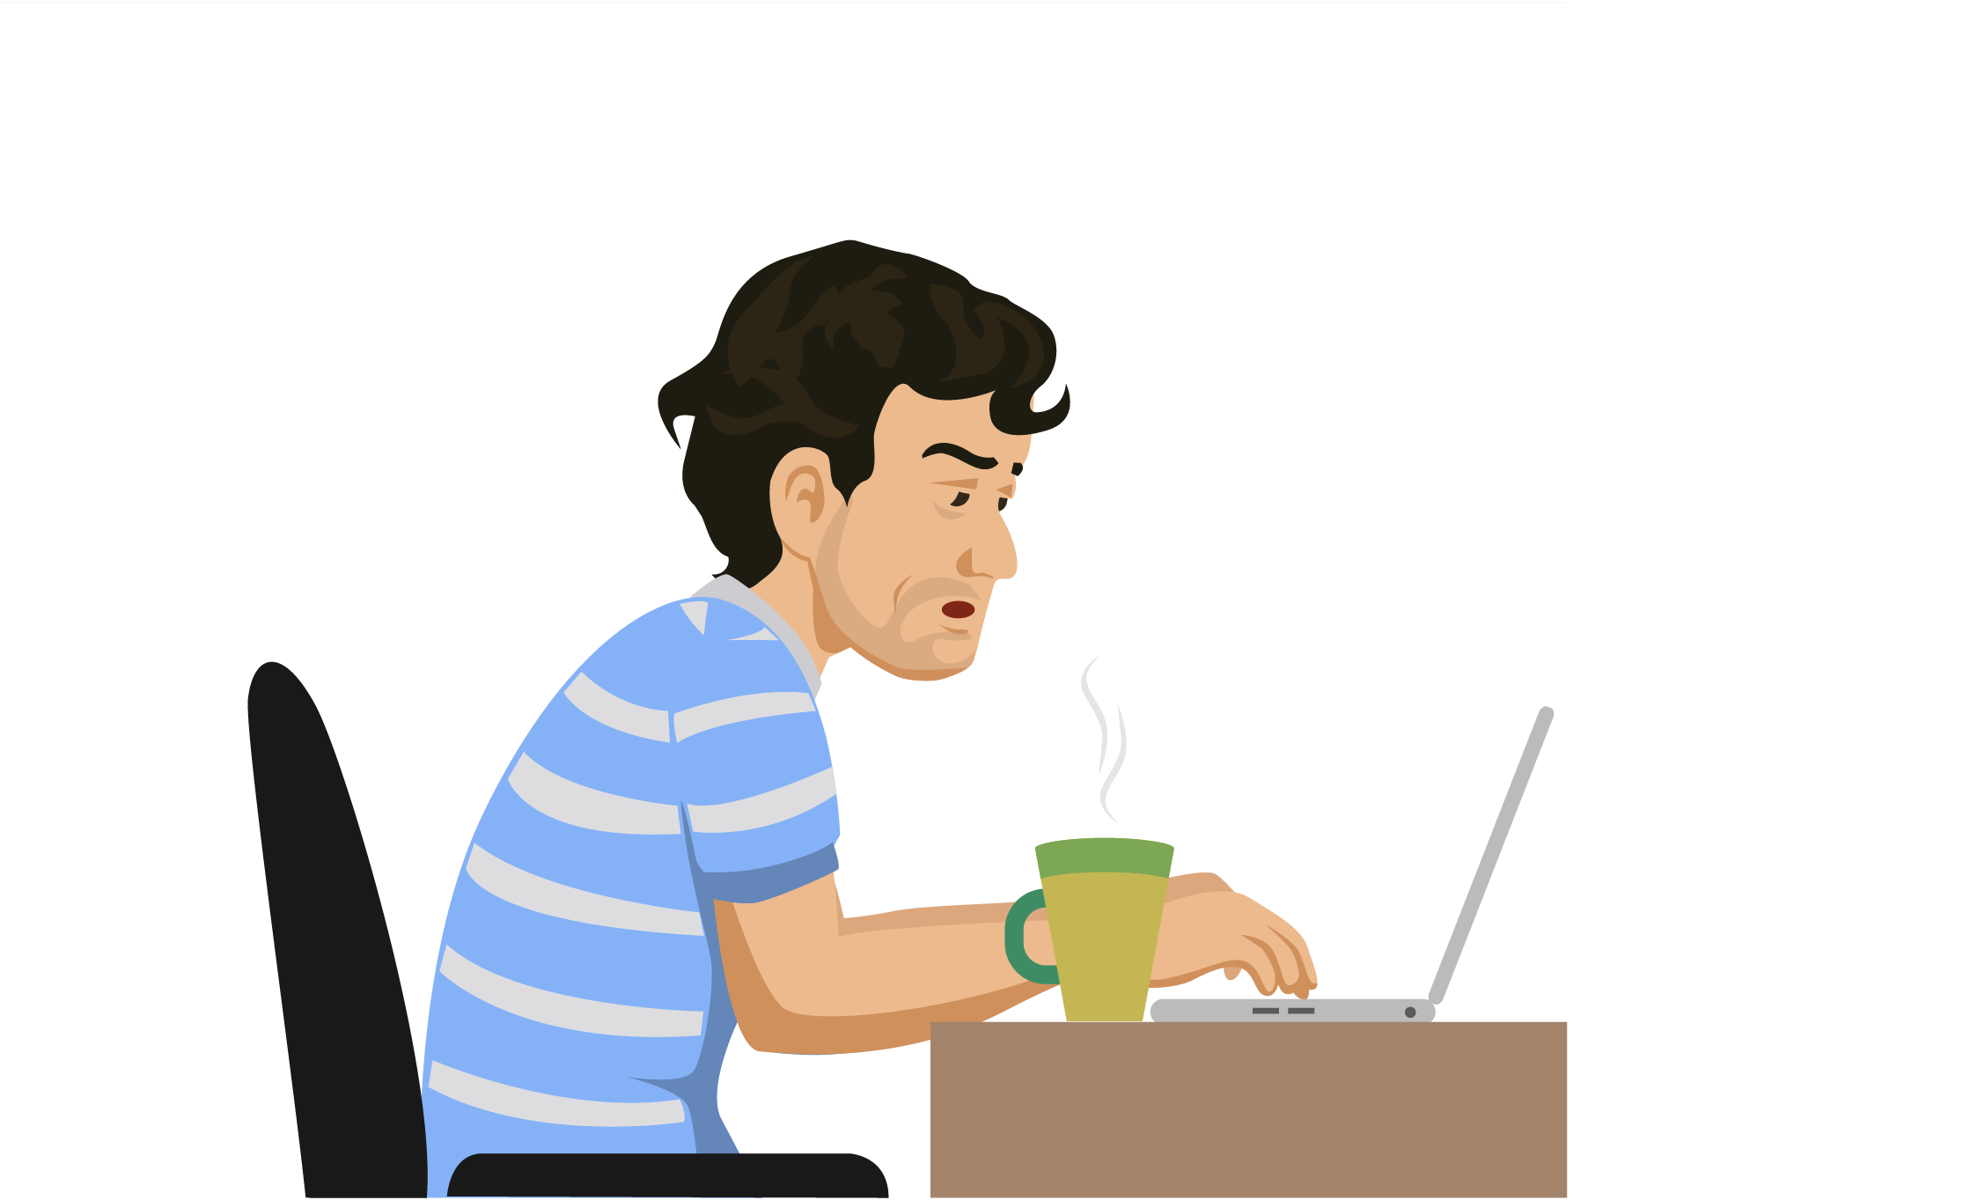

REFERENCIAS
BACK

Slide 60
Referencias
Mesografía
Tema 2
https://www.colegiopentagono.com/wp-content/uploads/2018/12/Roteiro_recuperac%CC%A7a%CC%83o_semestral_Bridges_9ano_2semestre_2018-1.pdf
Imágenes
Las imágenes se obtuvieron del sitio Freepik: http:www.freepik.com
BACK

