Slide 1
Material Didáctico Audiovisual
Sólo Visión Proyectables Diapositivas
Inglés 3 - Módulo IV
Bachillerato Universitario 2015
Historias y anécdotas
Elaborado por: M. en I. y G. E. Cesar Martínez Acevedo
Plantel “Dr. Ángel Ma. Garibay Kintana” de la Escuela Preparatoria

Slide 2
Propósito General
Inglés 3
Interactúa en el idioma inglés de forma oral y escrita, en situaciones sociales o académicas relacionadas con áreas de experiencia que
le son especialmente familiares, para proporcionar información sobre sí mismo u obtener información de las personas que le rodean,
pasatiempos, describir intereses, actividades rutinarias, actividades en progreso, aspectos de su pasado personal y del lugar en donde
vive, eventos recientes, experiencias de vida; así como extraer información de distintas fuentes: visuales, auditivas y audiovisuales.
Continuar

Slide 3
Módulo IV
Nombre del Módulo
Historias y anécdotas.
Propósitos del Módulo
Construye un mensaje, de forma oral y escrita, en el que narra acontecimientos de su pasado.
Continuar

Slide 4
Competencia Disciplinar
Comunicación
Básica
10. Identifica e interpreta la idea general y posible desarrollo de un mensaje oral o escrito en una segunda lengua, recurriendo a conocimientos previos, elementos no verbales y contexto cultural.
11. Se comunica en una lengua extranjera mediante un discurso lógico, oral o escrito, congruente con la situación comunicativa.
Extendida
9. Trasmite mensajes en una segunda lengua o lengua extranjera atendiéndolas características de contextos socioculturales diferentes.
Continuar

Slide 5
Competencia Genérica
4. Escucha, interpreta y emite mensajes pertinentes en distintos contextos mediante la utilización de medios, códigos y herramientas apropiados.
4.4 Se comunica en una segunda lengua en situaciones cotidianas.
7. Aprende por iniciativa e interés propio a lo largo de la vida.
7.1 Define metas y da seguimiento a sus procesos de construcción de conocimiento.
10. Mantiene una actitud respetuosa hacia la interculturalidad y la diversidad de creencias, valores, ideas y prácticas sociales.
10.2 Dialoga y aprende de personas con distintos puntos de vista y tradiciones culturales mediante la ubicación de sus propias circunstancias en un contexto más amplio.
Continuar

Slide 6
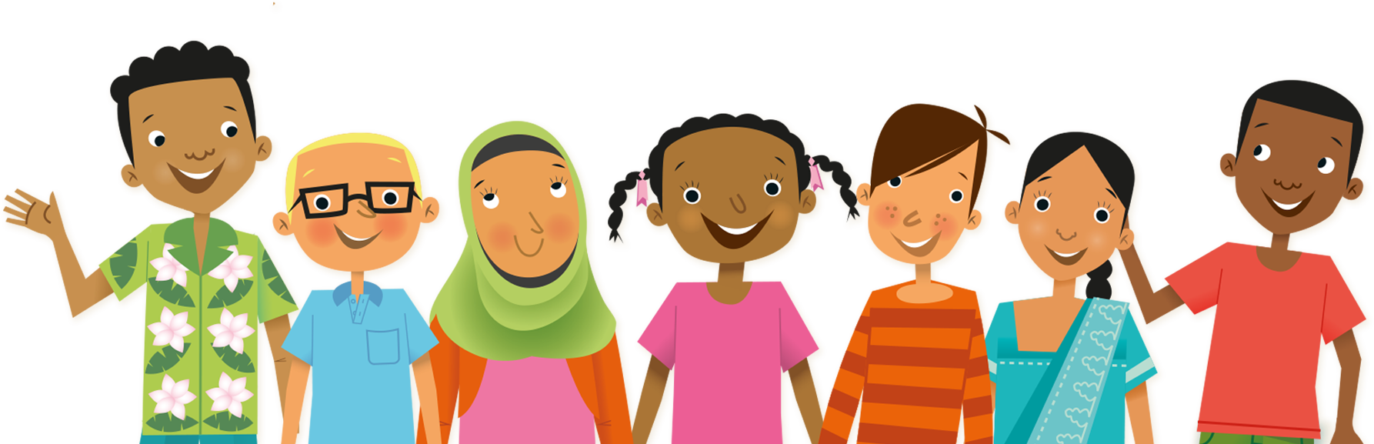
TEMAS
Simple Past
Simple Past vs
Past Continuous
Prepositions of Movement
Countable & Uncountable Nouns

Slide 7
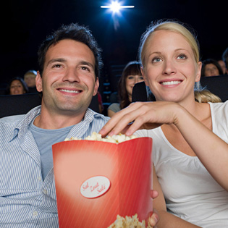
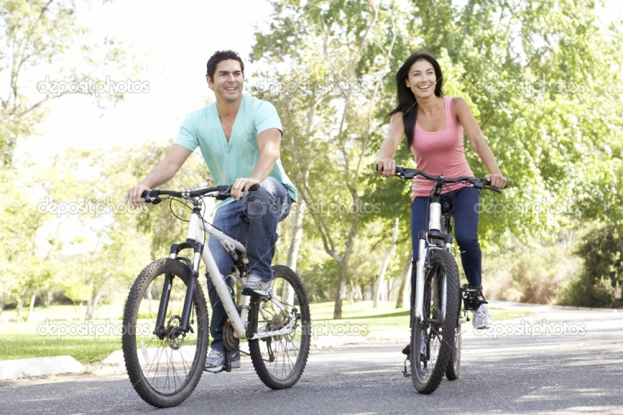
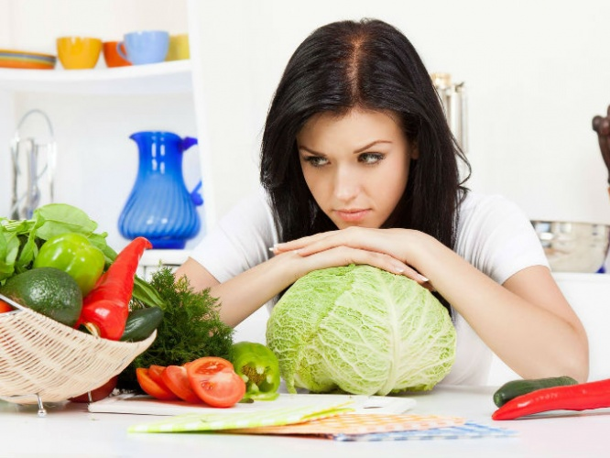
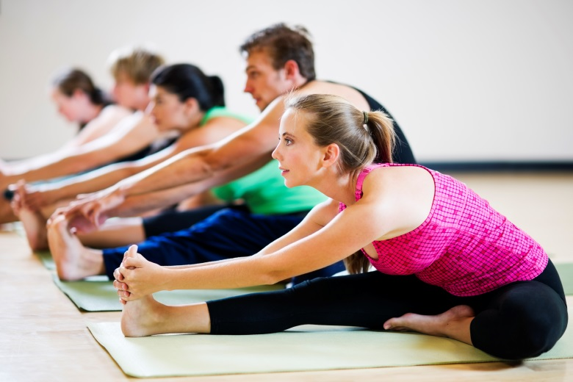

Simple Past

Slide 8
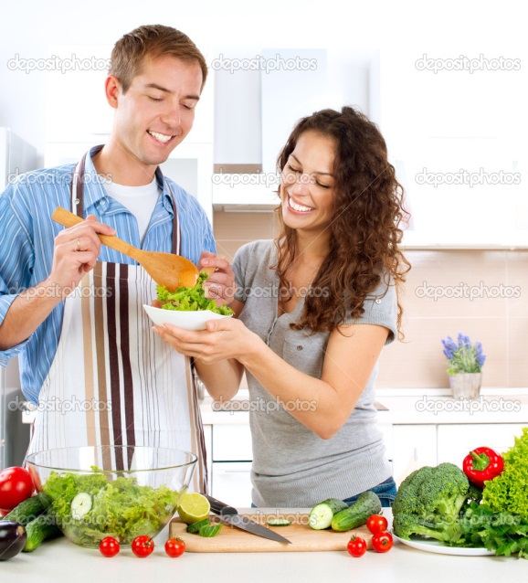
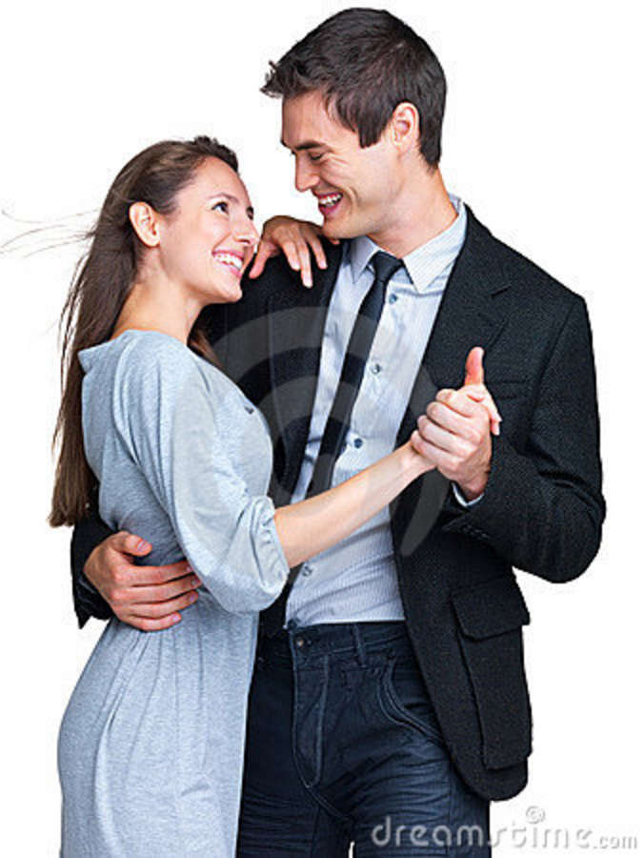
SIMPLE PAST
We use this tense to talk about things that happened in the past.

Slide 9
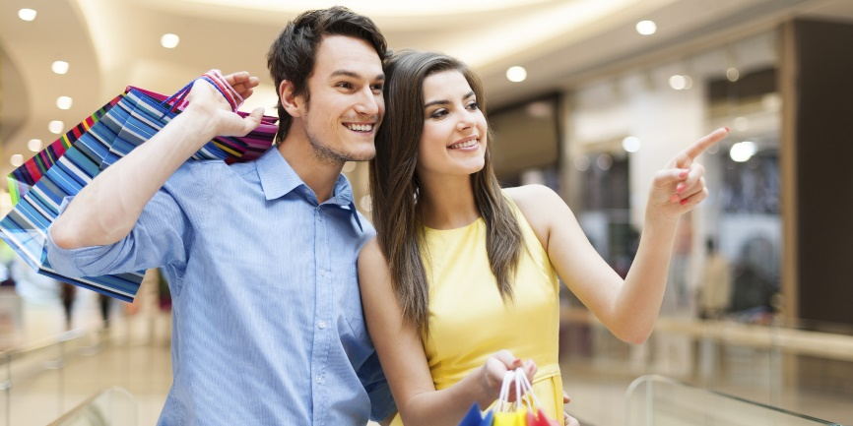
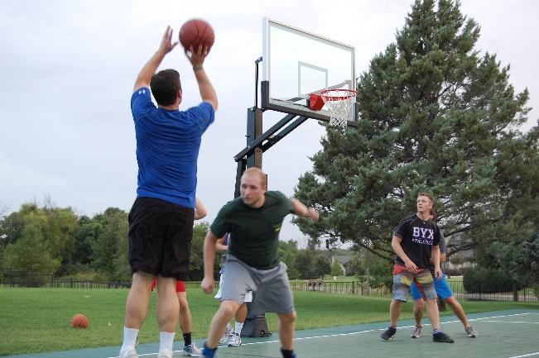
SIMPLE PAST
Use the Simple Past to describe actions, events, or states at a specific past time.
Last month I went shopping with my girlfriend.
Last weekend I played basketball with my friends.
Now
Past
Future

Slide 10
TIME EXPRESSIONS
2 days ago
2 weeks ago
5 years ago
a long time ago
AGO
for 2 weeks
for 5 months
FOR
LAST
last night, week, month, year
YESTERDAY
I went to the school yesterday.

Slide 11
VERB TO BE

Slide 12
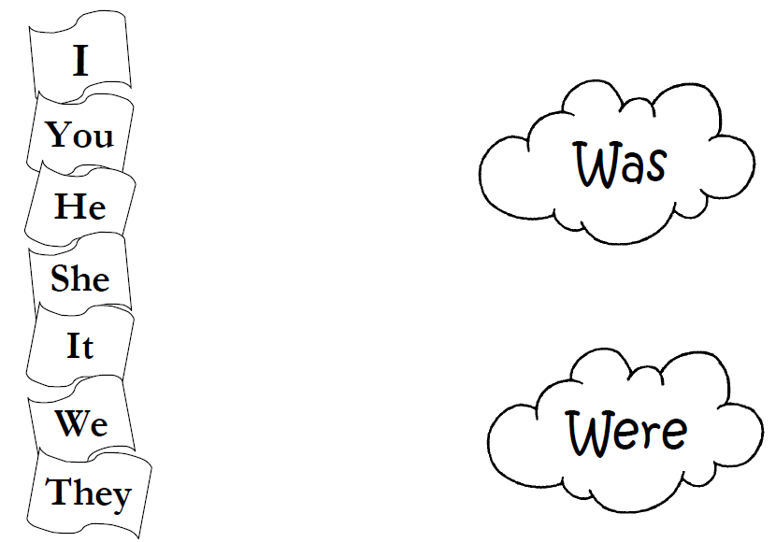

Slide 13
Complete the sentences with WAS or WERE
1. My best friend _________ very sad this morning.
2. Peter and Sara _________ in the cinema last night.
3. When I called my mother, it _________ late.
4. We _________ busy last weekend. We worked a lot.
5. The books _________ very interesting.
6. In the beach the weather _________ hot.
7. I _________ very tired this morning.
8. Sara _________ my best friend in school.
9. My dogs _________ hungry. They barked a lot.
10. The bus _________ full in the afternoon.

Slide 14
SIMPLE PAST
Regular Verbs
Irregular Verbs
Most verbs are regular and show this regularity by having -ed on the end.
The irregular verbs can end in a variety of ways.
walked regular
studied regular
taught irregular
gave irregular
became irregular
cried regular
lived regular
did irregular

Slide 15
REGULAR VERBS
IRREGULAR VERBS
We add -ED
We have to learn the irregular verb list by heart
I worked
You worked
He worked
She worked
It worked
We worked
You worked
They worked
I went
You went
He went
She went
It went
We went
You went
They went

Slide 16
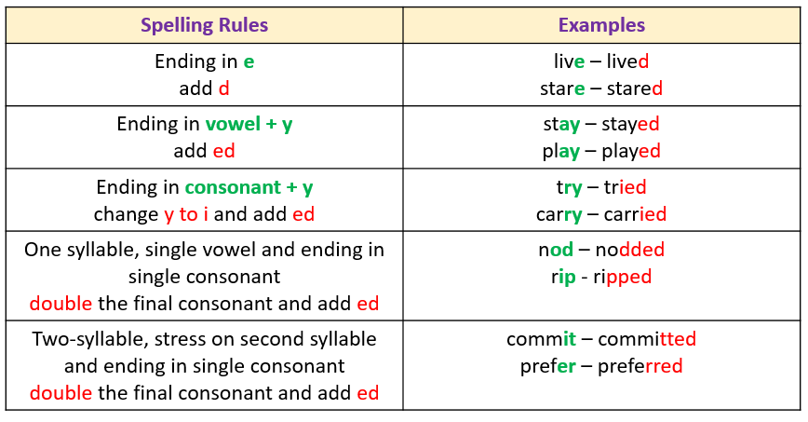
REGULAR VERBS

Slide 17
Do you know the past verbs?
Present Past
begin ___
buy ___
drive ___
do ___
feel ___
go ___
grow ___
hear ___
  Present Past
know ___
leave ___
lose ___
mean ___
pay ___
sell ___
sit ___
think ___

Slide 18
Do you know the past verbs?
Present Past
begin began
buy bought
drive drove
do did
feel felt
go went
grow grew
hear heard
  Present Past
know knew
leave left
lose lost
mean meant
pay paid
sell sold
sit sat
think thought

Slide 19
AFFIRMATIVE SENTENCE
I went to Rome yesterday.
She cleaned the house last week.
We played soccer two hours ago.

Slide 20
Fill in the blanks with the SIMPLE PAST of the verbs in brackets.
Last Saturday my father …. took…. (take) my friends and me to the circus. We ………(see)lots of things. My father …………………. (buy) us some popcorn and orange juice. We……………………. (eat) the popcorn and ………………………… (drink) the orange juice.
We …………………….. (laugh) at the funny clowns. There …………………. (be) a lion-tamer. The lions …………………… (do) tricks; they ………………………… (jump) through hoops. A girl ………………………. (ride) an elephant around the ring. We all ………………… (have)a wonderful time.

Slide 21
NEGATIVE SENTENCE
We add “did not” before the main verb to
form negative sentence. (did not = didn’t)
I did not see Sandy this morning.
John did not go to church last Sunday.
David did not watch TV last night.

Slide 22
NEGATIVE SENTENCE
I went to Rome yesterday.
I didn’t go to Rome yesterday.
She cleaned the house last week.
She didn’t clean the house last week.
We played soccer two hours ago.
We didn’t play soccer two hours ago.

Slide 23
Change the following sentences into Negative
We gave her a doll for her birthday.
She kissed me on the cheek.
IHe went to a club last night.
t rained yesterday.
Angela watched TV all night.
My parents came to visit me last July.
John wanted to go to the museum.
I bought a car last month.

Slide 24

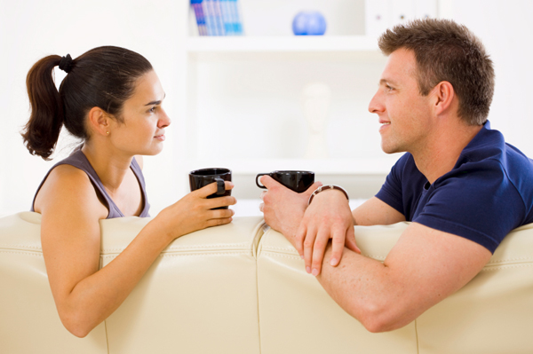
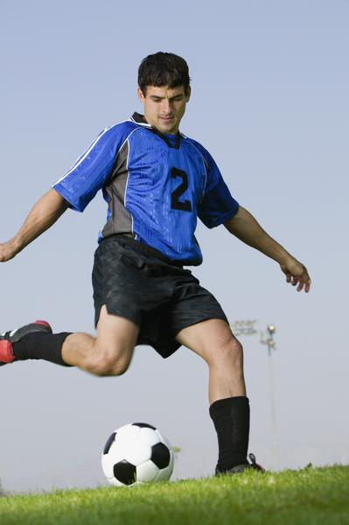
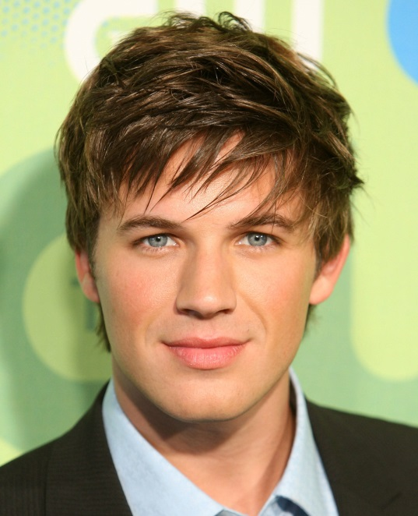
✓
✗
Marcus
✗
✓
What didn’t he do?
What did he do?

Slide 25
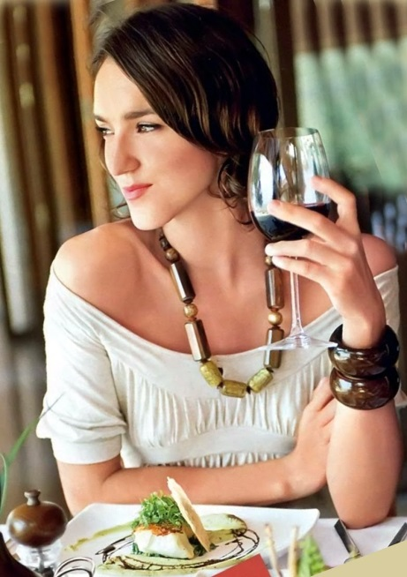

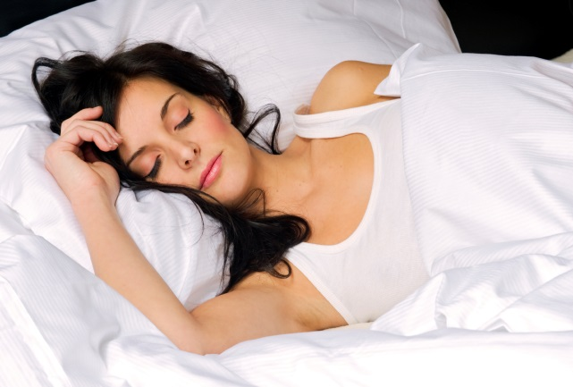

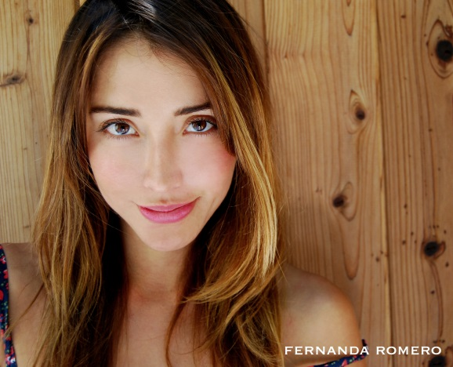
✓
✗
✗
✓
Fernanda
What didn’t she do?
What did she do?

Slide 26
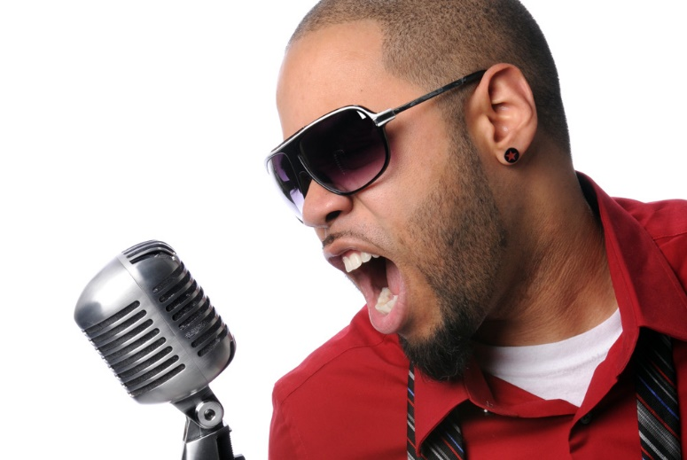
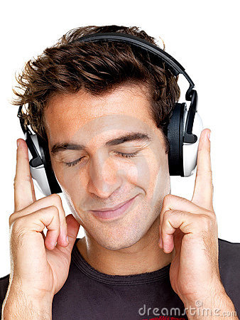
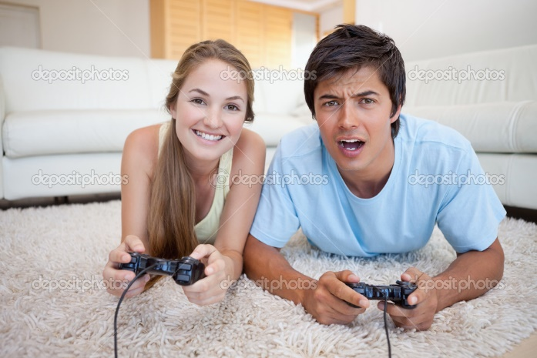
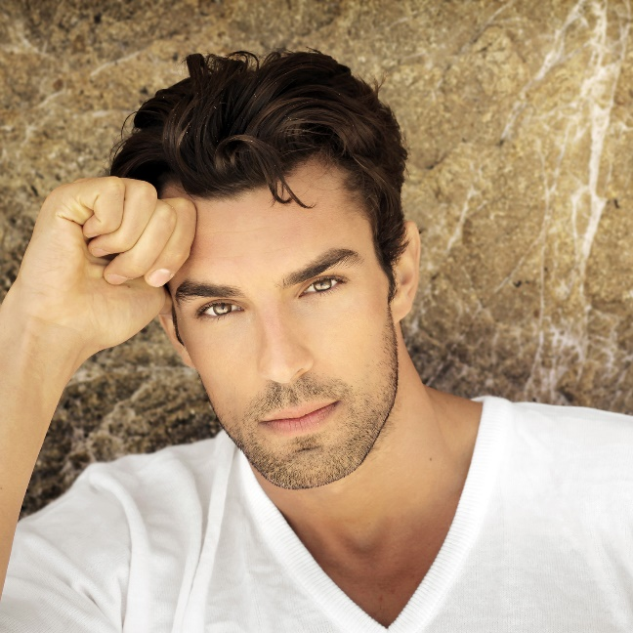
✓
✗
Steve
✓
✗
What didn’t he do?
What did he do?

Slide 27
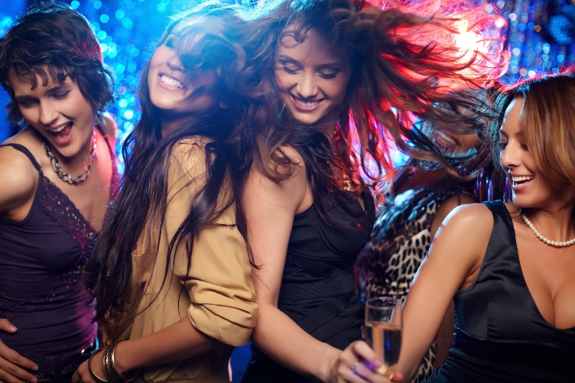
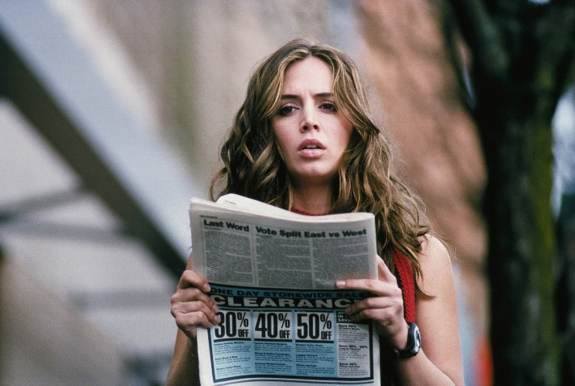
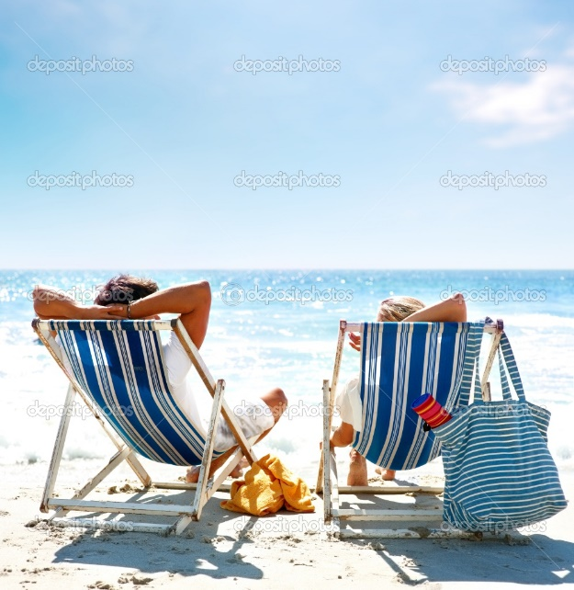

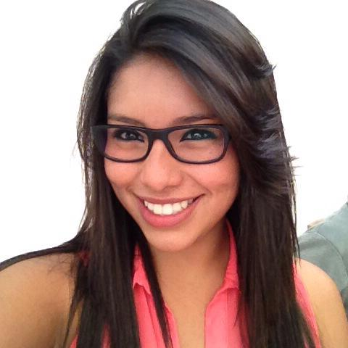
✓
✗
Gabriela
✗
✓
What didn’t she do?
What did she do?

Slide 28

What did you do?
What didn’t you do?
1._______________________________.
2._______________________________.
3._______________________________.
4._______________________________.
5._______________________________.
6.______________________________.
YOU

Slide 29
Translate the following sentences into English
1. Ayer no vi la televisión con mis amigos.
2. Ellos estudiaron mucho anoche.
3. Juan fue al cine con su novia.
4. Ellas comieron en el restaurante la semana pasada.
5. Ayer nosotros no fuimos al teatro.
6. Llovió hace dos meses.
7. Yo vendí mi casa y mi auto el fin de semana pasado.
8. Ella no visitó a sus papás esta mañana.
9. Tú caminaste en el parque anoche.
10. Mónica no compró una tableta. Ella compró un celular.

Slide 30
Translate the following sentences into English
1. I didn’t watch TV with my friends yesterday.
2. They studied much last night.
3. Juan went to the cinema with his girlfriend.
4. They ate in the restaurant last week.
5. Yesterday we didn’t go to the theatre.
6. It rained two months ago.
7. I sold my house and my car last weekend.
8. She didn’t visit her parents this morning.
9. You walked in the park last night.
10. Monica didn’t buy a Tablet. She bought a cell phone.

Slide 31
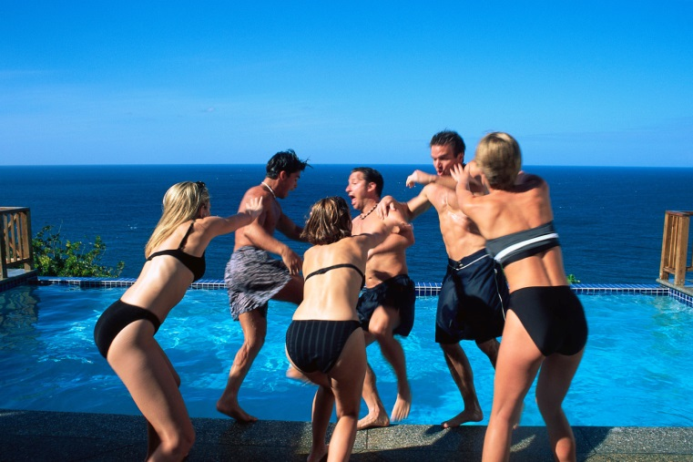
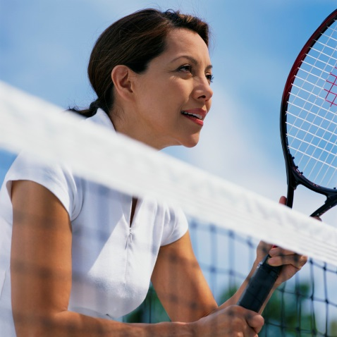
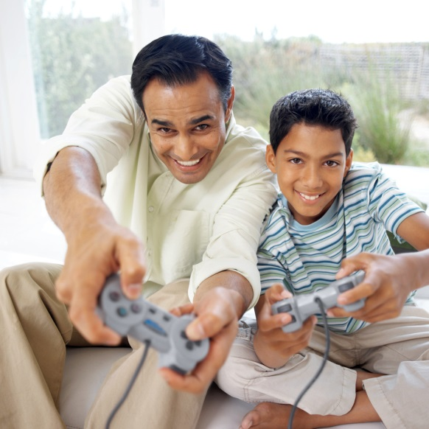
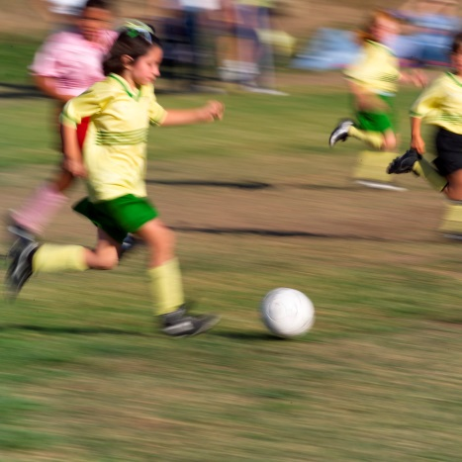
Simple Past vs
Past Continuos

Slide 32

The SIMPLE PAST and PAST CONTINUOUS are used together to express an interrupted action in the past. The simple past expresses the interruption, whereas the past continuous expresses the action that was interrupted.
X

X
2
Past
Present
1
I was walking along the road.
Suddenly, I saw a car hit a motorbike.
I was walking along the road,
when I saw a car hit a motorbike.
1
2

Slide 33
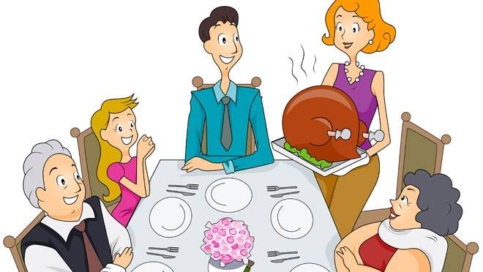
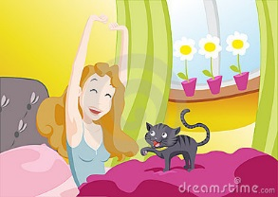
They were having dinner when Mary arrived.
1
2
The sun was shining when I got up this morning.
1
2

Slide 34
When Mary arrived, they were having dinner.
2
1
When I got up this morning, the sun was shining.
2
1

Slide 35
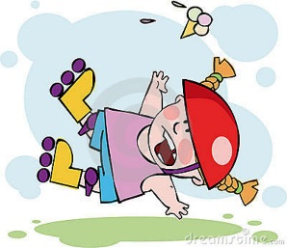
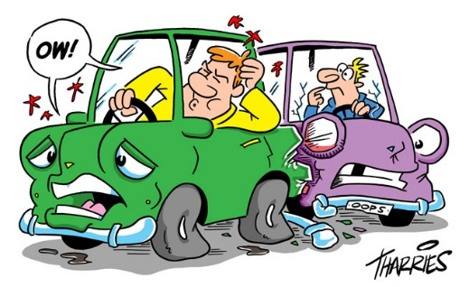
David fell while he was rollerblading.
2
1
He had an accident while Steve was driving home.
2
1

Slide 36
While he was rollerblading, David fell.
1
2
While Steve was driving home, he had an accident.
1
2

Slide 37

WHEN + Simple Past
Cuando
He was posting the letter when he saw an accident.
1
2
WHILE + Past Continuous
Mientras
He saw an accident while he was posting the letter.
1
2

Slide 38
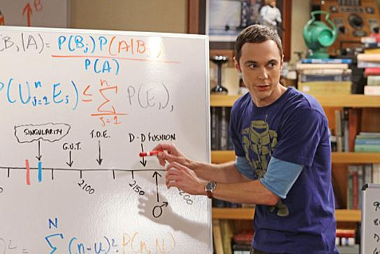
Let’s practice
What was sheldon doing at this time yesterday?
WORK
Sheldon on a physics problem.
was working

Slide 39
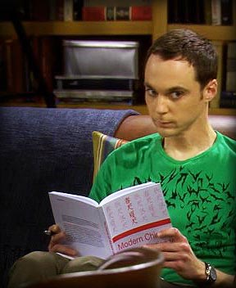
Let’s practice
What was sheldon doing last night?
LEARN
He Chinese.
was learning

Slide 40
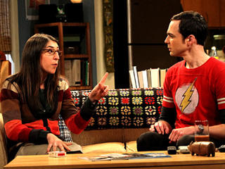
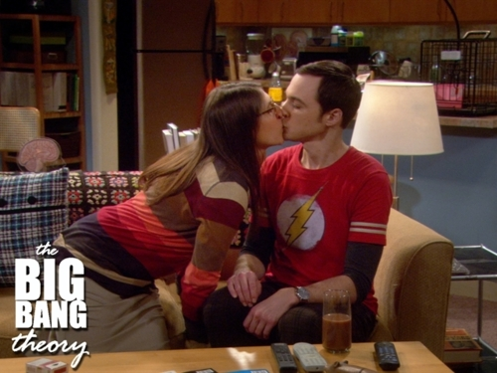
Let’s practice
TALK
KISS
Amy and Sheldon when
she him.
were talking
kissed

Slide 41
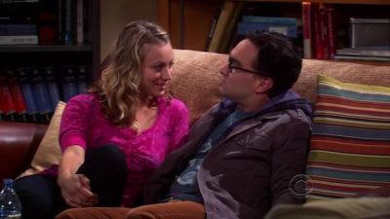
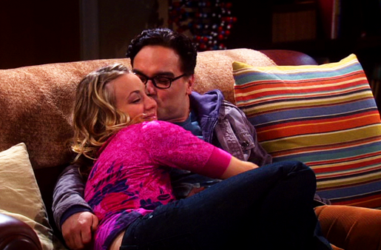
Let’s practice
SIT
HUG
Penny and Leonard on the sofa
when she him.
were sitting
hugged

Slide 42
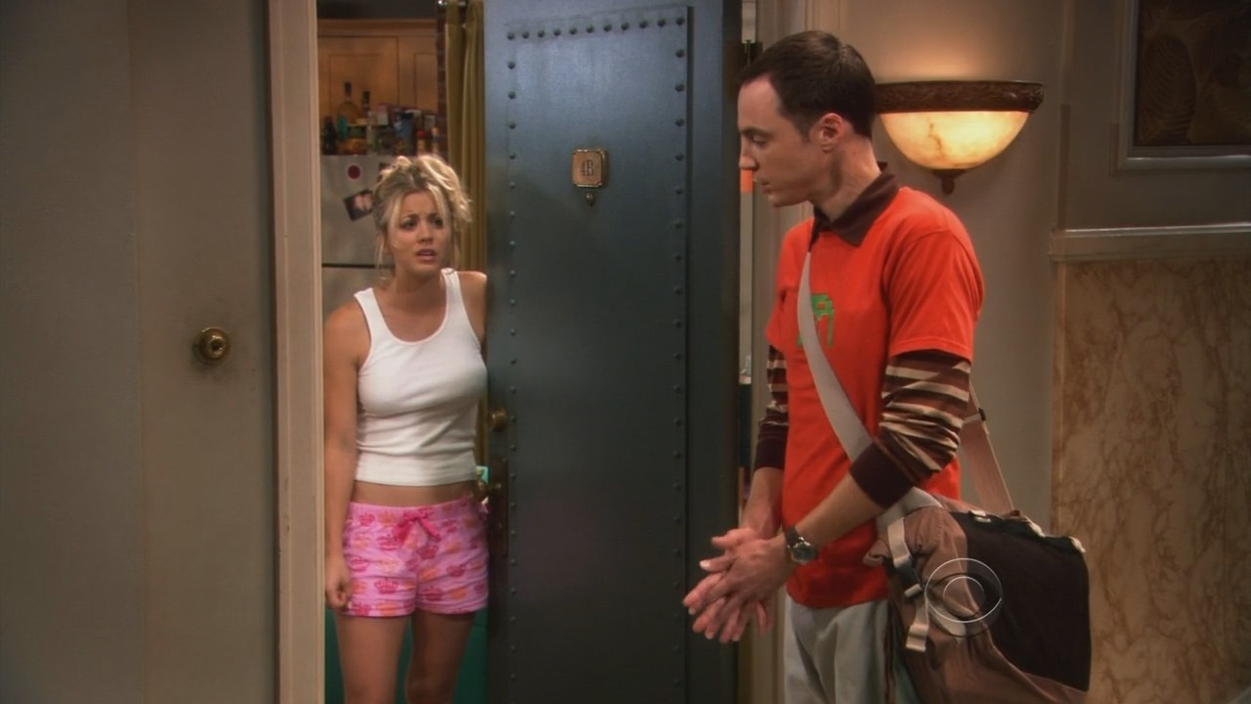
Let’s practice
SLEEP
KNOCK
Penny when Sheldon
on her door.
was sleeping
knocked

Slide 43
ACTIVITY
Now describe 5 activites that you were doing, then describe 5 activites that Interrupted the previous activities. Use WHEN or WHILE.
E.g. I was eating in the restaurant when my girlfriend called me.
E.g. When my girlfriend called me, I was eating in the restaurant.
E.g. My girlfriend called me while I was eating in the restaurant.
E.g. While I was eating in the restaurant, my girlfriend called me.
1. ______________________________________________________________.
2. ______________________________________________________________.
3. ______________________________________________________________.
4. ______________________________________________________________.
5. ______________________________________________________________.

Slide 44
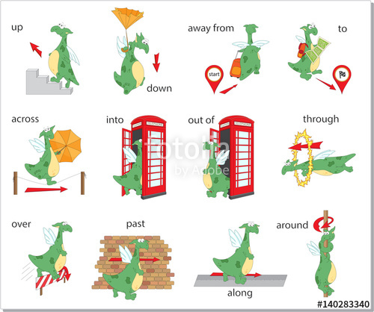
Prepositions of Movement

Slide 45
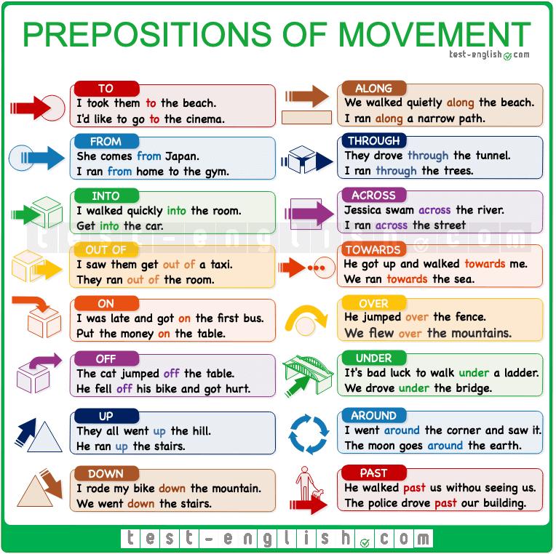

Slide 46
Complete using prepositions of movement
across | around | into | out of | over | through | up
along | down | into | over | past | under
I jumped __________ the swimming pool.
Every morning I go jogging __________ the beach.
I ran __________ the beach and into the sea.
I climbed __________ the bath when I'd finished washing.
The burglar jumped __________ the garden fence.
The road was closed so we couldn't drive through the town centre, we had to go __________ it.
I went __________ the kitchen to make a sandwich.
He climbed __________ the ladder to clean the second floor windows.
I didn't see the dog lying on the floor, and I fell __________ it.
I dropped a £1 coin and it rolled __________ the sofa so I couldn't find it.
We drove __________ Newcastle on the way to Edinburgh.
When I was a student I travelled __________ Germany, Poland and the Czech Republic.
After 6 hours of walking, we decided to go back __________ the mountain.

Slide 47
Answers
I jumped __________ the swimming pool. | into
Every morning I go jogging __________ the beach. | along
I ran __________ the beach and into the sea. | across
I climbed __________ the bath when I'd finished washing. | out of
The burglar jumped __________ the garden fence. | over
The road was closed so we couldn't drive through the town centre, we had to go __________ it. | around
I went __________ the kitchen to make a sandwich. | into
He climbed __________ the ladder to clean the second floor windows. | up
I didn't see the dog lying on the floor, and I fell __________ it. | over
I dropped a £1 coin and it rolled __________ the sofa so I couldn't find it. | under
We drove __________ Newcastle on the way to Edinburgh. | past
When I was a student I travelled __________ Germany, Poland and the Czech Republic. | through
After 6 hours of walking, we decided to go back __________ the mountain. | down

Slide 48
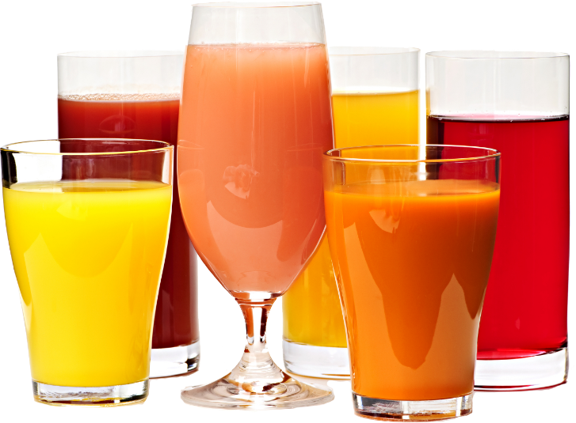
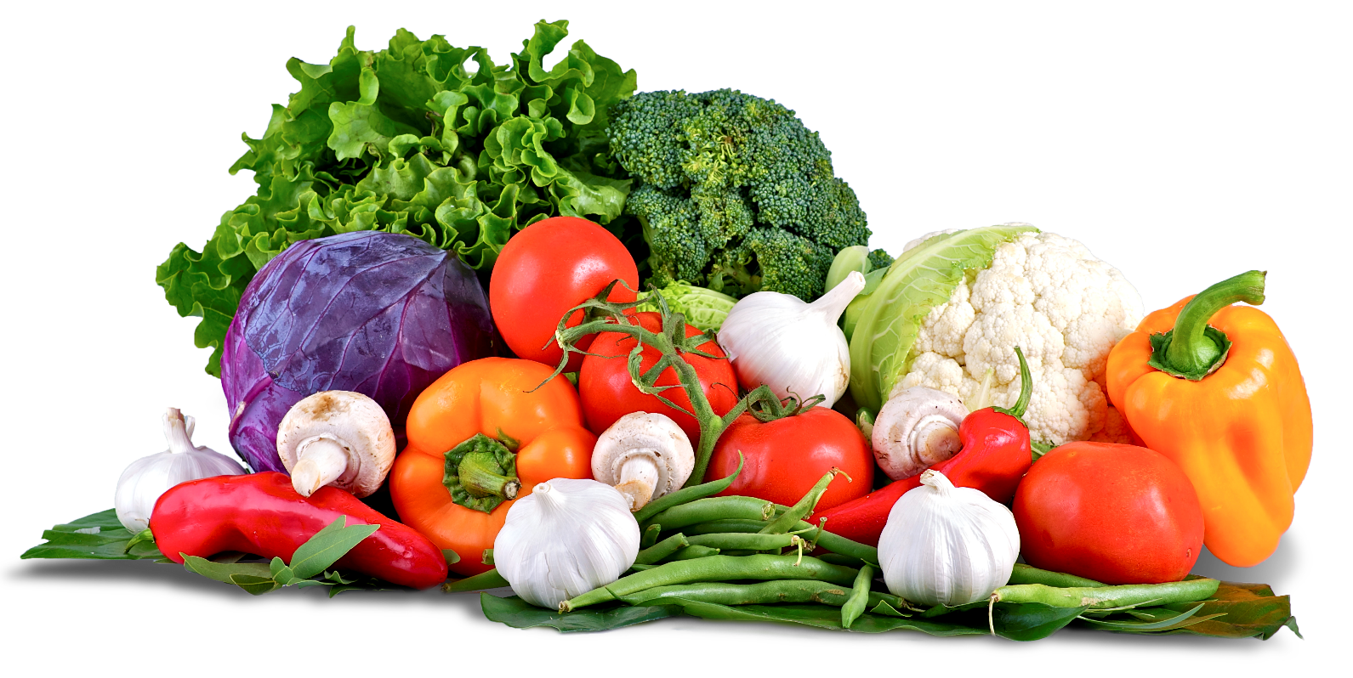
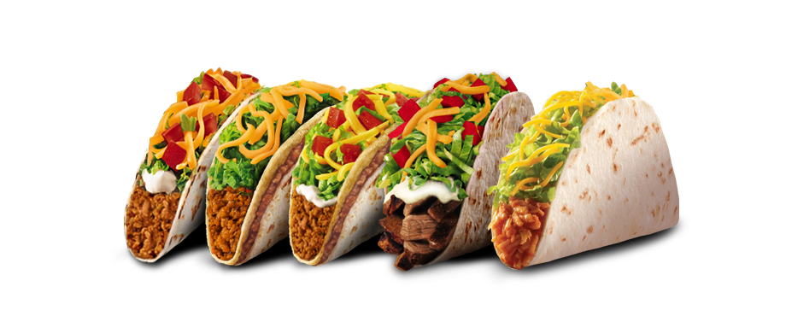
COUNTABLE & UNCOUNTABLE NOUNS

Slide 49
NOUNS
COUNTABLE
UNCOUNTABLE
We can use countable nouns to make nouns in plural and we can use them with a/an articles.
We cannot use uncountable nouns in plural also we cannot use a/an articles with them.

Slide 50
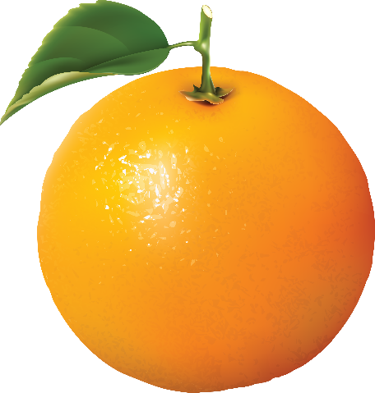
COUNTABLE nouns things I CAN COUNT
SINGULAR:
a/an + noun
one + noun
PLURAL:
noun + -s
noun + -es
An orange
Two oranges
Three oranges

Slide 51
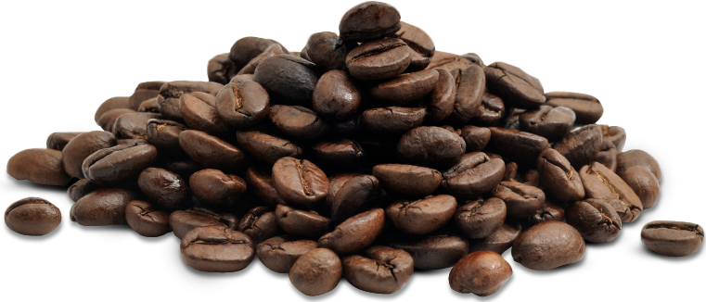
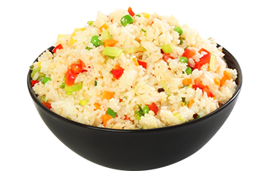
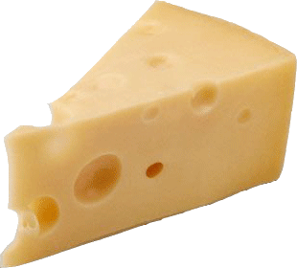
Uncountable nouns things I CAN´T COUNT
SINGULAR:
Only the noun
Cheese
Coffee
Rice

Slide 52
Singular countable
There is a mango.
There is an apple in the basket.
There are four apples.
I have two dogs.
There is sugar.
He has bread.
Plural countable
Uncountable

Slide 53
PRACTICE: Put the nouns in the correct column.
children | bird | egg | table | meat | men
coffee | cheese | bread | milk | tea | sandwiches
knife | feet | watch | cherries | poster | apples
Countable nouns |  | Uncountable nouns
Singular | Plural
egg | children | coffee

Slide 54
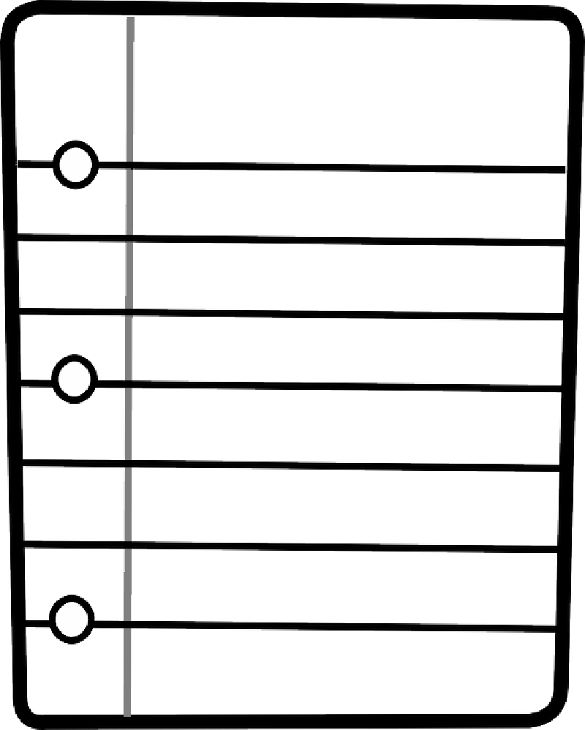
Shopping list
My Shopping List
Look at the following list of food. Organize the items in countable and uncountable nouns.
Lettuce
Carrot
Corn
Broccoli
Tomato
Onion
Banana
Lemon
Rice
Grape
Meat
Ham
Coffee
Water
Popcorn
Nut
Yogurt
Sugar
Apple
Strawberry
Pepper
Mayonnaise
Milk
Cheese
Salt
Orange
Chicken
Tea
Bread
Soda
COUNTABLES | UNCOUNTABLE

Slide 55
Containers
a bottle of water / wine / soda
a carton of milk / juice
a packet of cereal
a glass of water / milk / soda
a cup of tea / coffee
a bar of chocolate
a tin / can of beans / tuna
a piece / loaf / slice of bread
a bowl of rice / cereal
a bunch of grapes

Slide 56
Most Common Uncountable Nouns
Material or substances: air, water, plastic, metal, gold, silver, etc.
Feelings or Qualities: friendship, love, sadness, happiness, etc.
Food & Drinks: butter, bread, milk, juice, rice, jam, coffee, etc.
Other common words: knowledge, intelligence, garbage, homework, information, money, news, traffic, work, weather, etc.

Slide 57

SOME
We use SOME to describe two or more elements in a positive sentences. We can use SOME with countables & uncountable nouns.
Examples:
There are SOME posters of my favorite singers.
I want SOME pizza.
Peter always drink SOME water in the gym.
I have SOME friends at school.

Slide 58
Describe things that you do using the following verbs and “SOME”.
Activities:
Drink
Eat
Do
Have got
Buy
Draw
Give
Read
Sell
See
Sing
Take
Write
Want
Examples:
1. I read some books a day.
2. I write some letters at weekends.
3. I always drink some tea.
4. ___________________
5. ___________________
6. ___________________

Slide 59

ANY
We use ANY to describe that there are no elements in a negative sentences, but also we can use ANY in questions. We can use ANY with countables & uncountable nouns.
Examples:
There aren’t ANY posters of my favorite band.
I don’t want ANY pizza.
I haven’t got ANY friends at school.
Peter doesn’t drink ANY water in the gym.

Slide 60
ANY
Change the following sentences into negative using ANY.
We need some bananas. 1. We don’t need any bananas.
You are looking for some posters in this shop. 2. ________________________.
We have got some oranges at the moment. 3. ________________________.
Peter is buying some new books. 4. ________________________.
She takes some sugar with her coffee. 5. ________________________.
There are some folders in my bag. 6. ________________________.
I have got some magazines for you. 7. ________________________.
I eat some apples every day 8. ________________________.
Pam has got some pencils on her desk. 9. ________________________.

Slide 61
NOUNS | SINGULAR | PLURAL | A / AN | SOME | ANY
COUNTABLE
UNCOUNTABLE

Slide 62
PRACTICE
Underline the correct word in each sentence
There is a / some milk in the bottle.
Are there a / any people at the bus station?
There isn’t some / any water in the glass.
Did you buy a / some magazine?
There are some / any boys in the room.
Do you have some / any cheese at home?
There aren't some / any payphones near here.
She brings some / any balls to play.
We don't have some / any sandwiches left.
You need some / any glue to fix that work.
Is there a / any tea in the cup?

Slide 63








Look at the pictures and complete the sentences with
A / AN / SOME / ANY
a) There aren't ____________bananas left.
b) Oh! I've lost ____________ earring!
c) I'll have ____________ hamburguer, please.
d) There are ____________ leaves on the ground.
e) There aren't ____________ children playing in the park today.
f) I haven't got ____________ camcorder, but I'd like to buy one.
g) Would you like ____________ yogurt?

Slide 64


MUCH OR MANY?

Slide 65








Can you count these things?
boat
sand
water
bike
flower
Airplane
sugar
grape
rice
Ketchup

Slide 66

If you can count it, use ‘many’
a...a....chooo!
There are too many flowers

Slide 67

If you can count it, use ‘many’
I ate so many grapes that I felt sick yesterday.

Slide 68
If you can count it, use ‘many’
There are many boats at the dock.

Slide 69
If you can’t count it, use ‘much’
There is much sand in the beach.

Slide 70
If you can’t count it, use ‘much’
Look! There is too much water on the floor!
Clean it up!

Slide 71
Much or many?
For countable plurals, use MANY
For uncountable things, use MUCH

Slide 72
How _________ orange juice do you want?
much

Slide 73
How _________ biscuits did you eat?
many

Slide 74

There were too _____ people in the queue, so I didn’t wait.
many

Slide 75
He put so _____ salt in the soup that it tasted horrible.
much

Slide 76

The teacher gave us too _____ homework.
much

Slide 77

I saw _____ toucans in the tree.
many

Slide 78
Now try these
You are making too _____ noise!
How _____ sugar do you want in your tea?
How _____ apples are there?
Why are there so _____ policemen here?
How _____ chicken do you want?
How _____ chickens did you buy?
He has told me that so _____ times!
I have too _____ work to do.

Slide 79


Don’t forget
Countable
MANY
Uncountable
MUCH

Slide 80
Don’t forget
Countable
A FEW
Uncountable
A LITTLE

Slide 81
Now, write 8 sentences using
“many”, “much”, “A few” & “a Little”.
Activities:
Drink
Eat
Do
Have got
Buy
Draw
Give
Read
Sell
See
Sing
Take
Write
Want
1. ________________________________.
2. ________________________________.
3. ________________________________.
4. ________________________________.
5. ________________________________.
6. ________________________________.
7. ________________________________.
8. ________________________________.

Slide 82


REFERENCIAS

Slide 83
Referencias
Mesografía
TEMA 3
http://www.tinyteflteacher.co.uk/learning-english/prepositions/exercises/prepositions-movement.html
TEMA 4
https://www.englisch-hilfen.de/en/exercises/confusing_words/some_any.htm
https://www.grammarbank.com/quantifiers.html
http://www.primaryresources.co.uk/english/powerpoints/much_or_many.ppt
Imágenes
Las imágenes se obtuvieron del sitio Freepik: http:www.freepik.com

