Slide 1
Material Didáctico Audiovisual
Sólo Visión Proyectables Diapositivas
Inglés 4 - Módulo III
Bachillerato Universitario 2015
Customs and facts around the world.
Elaborado por: M. en I. y G. E. Cesar Martínez Acevedo
Plantel “Dr. Ángel Ma. Garibay Kintana” de la Escuela Preparatoria

Slide 2
Propósito General
Inglés 4
Interactúa en el idioma inglés de forma oral y escrita, en situaciones sociales o académicas relacionadas con áreas de experiencia que le son relevantes, toma decisiones, realiza ofrecimientos, promesas y predicciones generales; expresa planes e intenciones, posibilidades, prohibiciones y necesidades. De igual modo establece condiciones, y asume las consecuencias de sus acciones, dando sugerencias y recomendaciones.
Continuar

Slide 3
Módulo III
Nombre del Módulo
Customs and facts around the world.
Propósitos del Módulo
Expresa de forma oral y escrita las posibilidades, prohibiciones y necesidades de hechos y costumbres en su alrededor inmediato, así como en otros países.
Continuar

Slide 4
Competencia Disciplinar
Comunicación
Básica
10. Identifica e interpreta la idea general y posible desarrollo de un mensaje oral o escrito en una segunda lengua, recurriendo a conocimientos previos, elementos no verbales y contexto cultural.
11. Se comunica en una lengua extranjera mediante un discurso lógico, oral o escrito, congruente con la situación comunicativa.
Extendida
9. Trasmite mensajes en una segunda lengua o lengua extranjera atendiéndolas características de contextos socioculturales diferentes.
Continuar

Slide 5
Competencia Genérica
4. Escucha, interpreta y emite mensajes pertinentes en distintos contextos mediante la utilización de medios, códigos y herramientas apropiados.
4.4 Se comunica en una segunda lengua en situaciones cotidianas.
7. Aprende por iniciativa e interés propio a lo largo de la vida.
7.1 Define metas y da seguimiento a sus procesos de construcción de conocimiento.
10. Mantiene una actitud respetuosa hacia la interculturalidad y la diversidad de creencias, valores, ideas y prácticas sociales.
10.2 Dialoga y aprende de personas con distintos puntos de vista y tradiciones culturales mediante la ubicación de sus propias circunstancias en un contexto más amplio.
Continuar

Slide 6
TEMAS
Puede ser que...
Lo que debo y lo que no debo hacer
Sugerencias y recomendaciones
Modals for
possibility:
May, might & could
Modals for rules, prohibition and necessity:
Must, mustn’t and needn’t
Should
ought to

Slide 7
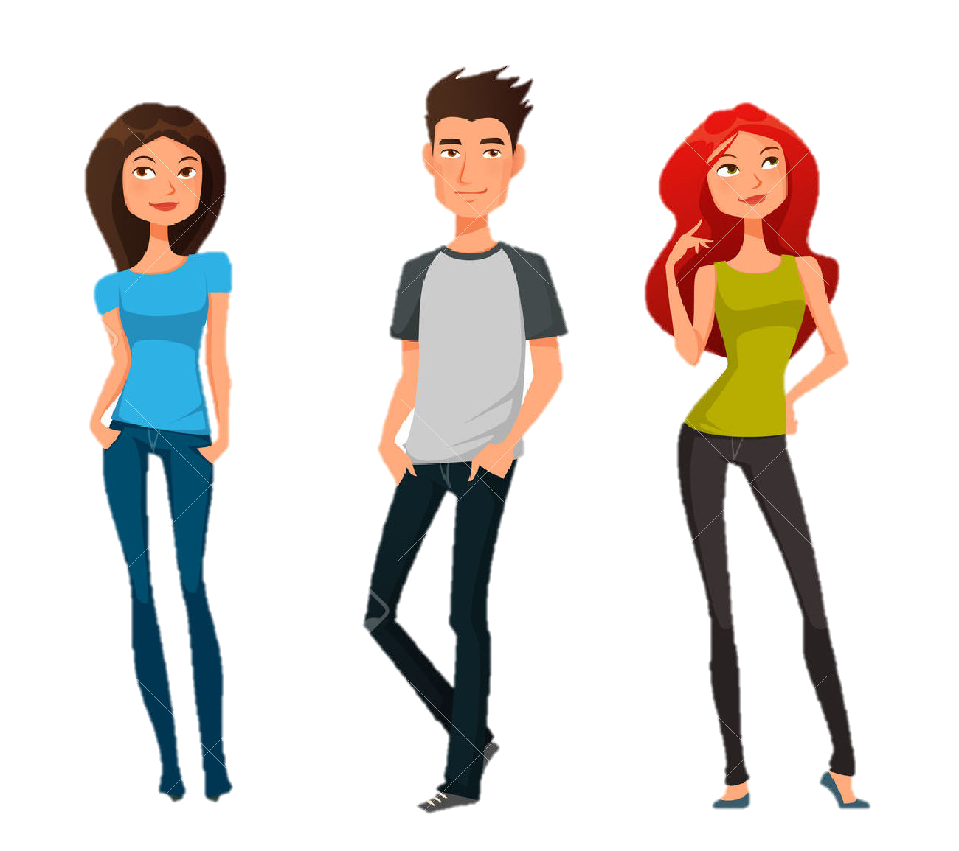

Modal Verbs
MAY, might & could

Slide 8
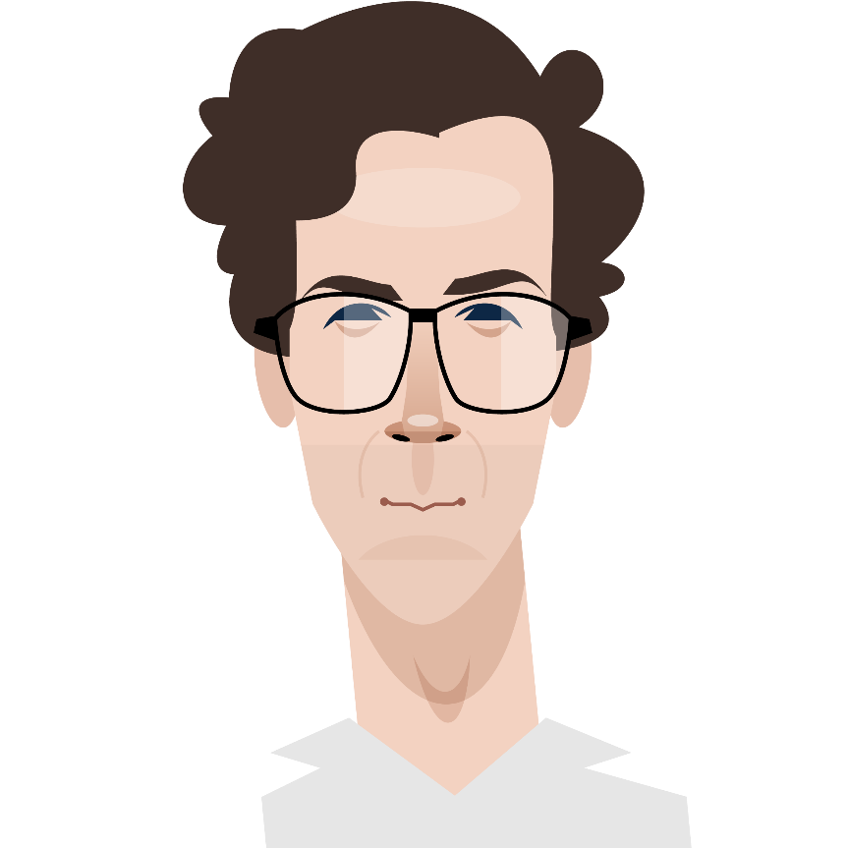
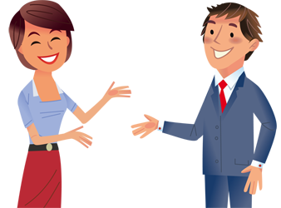
What is a modal verb?
Modal verbs are special verbs which behave very differently from normal verbs.

Slide 9
May
We can use 'MAY' to ask for permission. It is formal and is not used very often in spoken English.
EXAMPLES:
May I borrow your pen?
May we think about it?
May I go now?
We use 'MAY' to suggest something is possible.
EXAMPLES:
It may rain later today.
I may not have time to do it today.
Pete may come with us.

Slide 10
Might
We use 'MIGHT' to suggest a small possibility of something. ‘Might' suggests a smaller possibility that 'may‘. In fact, there is little difference and 'might' is more usual than 'may' in spoken English.
EXAMPLES:
She might be at home by now but it's not sure at all.
It might rain this afternoon.
I might not have time to go to the shops for you.
I might not go.

Slide 11


MAY vs. MIGHT
MAY is more possible than MIGHT.
I may go to the party tomorrow.
(It is more possible that I go to the party)
I might go to the party tomorrow.
(It is less possible that I go to the party)

Slide 12
MAY vs. MIGHT
MAY is more possible than MIGHT.
It may rain very hard tonight.
(It is more possible that it rains very hard tonight)
It might rain very hard tonight.
(It is less possible that it rains very hard tonight)

Slide 13
What activities are more possible that you do tomorrow?
Write 3 more possible & 3 less possible.
Go shopping
Clean my room
Do homework
Cook dinner
Watch TV series
Go dancing
Listen to music
Travel by bus
Eat in the school
Talk to my friends
Read a book
Take notes
Buy some chips
Drink orange juice

Slide 14
Exercises
More possibility
Less possibility
Write sentences with MAY or MIGHT.
1. (Perhaps I will go to the movies) I……………………….
2. (Perhaps I will rest tomorrow) I ………………………
3. (Perhaps I will travel to Europe) I ……………………………
4. (Perhaps it will snow today) It ……………………………
5. (Perhaps I will wear my new jeans) I ………………………
Write sentences with MAY NOT or MIGHT NOT.
6. (Perhaps I will not buy a house soon)………………………
7. (Perhaps I will not go out tonight)…………………………
8. (Perhaps I will not eat pasta at home)….…………………

Slide 15
COULD
We use ‘COULD' to talk about possibility in the present or future.
EXAMPLES:
She could go with us tonight if she wants.
I could do it, but I don’t have time.
They could win the match if they score one more goal.
If we fill in the form, we could participate in the contest.

Slide 16
MAY, MIGHT & COULD
I may go to the party tomorrow.
(It is more possible.)
I could go to the party tomorrow.
(It is possible.)
I might go to the party tomorrow.
(It is less possible.)
What’s the difference?

Slide 17
MAY, MIGHT & COULD
It may rain tonight.
(It is more possible.)
It could rain tonight.
(It is possible.)
It might rain tonight.
(It is less possible.)
What’s the difference?

Slide 18
Use one of the modal verbs in brackets to fill each gap.
You (may/might)________________ leave now if you wish.
(Could/May)________________ you open the window a bit, please?
He (can/could)________________ be French, judging by his accent.
(May/Can)________________ you play the piano?
Listen, please. You (may not/might not)________________ speak during this exam.
You (couldn't/might not)________________ smoke on the bus.
With luck, tomorrow (can/could)________________ be a sunny day.
The exam (can/might)________________ be easy. You never know.
Students (may/might)________________ study in the library from five to nine in the evening.
(May/Could)________________ you lend me 40 Euros till Monday?

Slide 19
Complete the sentences with the correct form of
CAN, COULD, MAY, OR MIGHT.
You don’t have to shout. I __________ hear you very well.
I’ll phone my brother, but he _________ be at home.
Ask Maria. She __________ know the answer.
Are you going to the theatre tomorrow? We _______ go but there ________ be any tickets left?
Accept their offer. You ___________ get a better opportunity.

Slide 20
Complete the sentences with the correct form of
CAN, COULD, MAY, OR MIGHT.
We ________ go to the Canary Islands this summer, but we haven’t booked anything yet.
My students don’t need a calculator. They _________ do difficult operations in their heads.
You __________ find a good restaurant near the cathedral. There are lots of restaurants there.
Don’t worry too much about that mistake. It _________ not be important.
Take a coat with you. It ___________ be cold this evening.

Slide 21

MUST, MUSTN’T AND NEEDN’T
MODALS VERBS

Slide 22
Place | Things to are necessary to do | Things that are not allowed to do | Things that are not necessary to do
At school

Slide 23
Place | Things to are necessary to do | Things that are not allowed to do | Things that are not necessary to do
At home | 1. 2. | 1. 2. | 1. 2.
In a restaurant | 1. 2. | 1. 2. | 1. 2.
In downtown | 1. 2. | 1. 2. | 1. 2.
In the cinema | 1. 2. | 1. 2. | 1. 2.
In a concert | 1. 2. | 1. 2. | 1. 2.

Slide 24
MUST
MUST is a word that is used to talk about an obligation, something you have to do, like following a law or a rule.
We use ‘MUST' when the speaker feels that something is necessary.
  The doctor to his patient: “You must exercise,”
  “We must be quiet, the children are sleeping.”
We use ‘MUST' to express a wish or strong desire:
  I must buy a newspaper; I want to see who won last night.
  We must invite Charles. We haven’t seen him in ages.

Slide 25



TRUE OR FALSE
Say if the following sentences are true or false.
_____ You must wash your hands before lunch.
_____ You mustn't listen to your parents.
_____ You must break the windows at school.
_____ You must take a shower every day.
_____ You mustn't eat fruit and vegetables every day.
_____ You must eat lots of sweets if you want to lose some weight
_____ You must feed your dog every day.
_____ You must say “Good Morning” to all people.

Slide 26
MUSTN’T / NEEDN’T
We use “MUSTN'T” to say that something is NOT ALLOWED.
We use “NEEDN'T”, “DON'T NEED TO” to say that something is NOT NECESSARY.
Examples
You mustn't walk on the grass here.
You mustn't put anything on the shelves until the glue has set hard.
They proved that watching a chess match needn't be boring.
We needn't go into details now, but we seem to agree on the general principles.

Slide 27
NEEDN’T
We can use either “NEEDN'T” or “DON'T HAVE TO” when we say that is unnecessary to do something.
Examples
• It would be good to see you, but you needn't (or don't have to) come if you're busy.
• You needn't (or don't have to) whisper. Nobody can hear us.

Slide 28
Summary
Modal | Substitutes
I must play football | I have to play football.
I need not play football. | I do not need to play football.
 | I do not have to play football.
I must not play football. | I am not allowed to play football.

Slide 29
MUSTN’T or NEEDN’T
Read the sentences and complete them using MUSTN’T or NEEDN’T.
I ___________ take the umbrella. It won't rain.
I ___________ cross this bridge. It's closed.
We ___________ be late. The train will leave in 10 minutes.
You ___________ hurry. We have plenty of time.
You ___________ smoke in here. It's forbidden. Look at that sign.
We have enough diesel, so we ___________ stop here.
You ___________ come if you don't want to.
They ___________ do the washing up, they have a dishwasher.
You ___________ show this e-mail to anyone else. I'll trust you.
The students ___________ forget their homework.

Slide 30
MUSTN’T or NEEDN’T
Read the sentences and complete them using MUSTN’T or NEEDN’T.
I needn’t take the umbrella. It won't rain.
I mustn’t cross this bridge. It's closed.
We mustn’t be late. The train will leave in 10 minutes.
You needn’t hurry. We have plenty of time.
You mustn’t smoke in here. It's forbidden. Look at that sign.
We have enough diesel, so we needn’t stop here.
You needn’t come if you don't want to.
They needn’t do the washing up, they have a dishwasher.
You mustn’t show this e-mail to anyone else. I'll trust you.
The students mustn’t forget their homework.

Slide 31
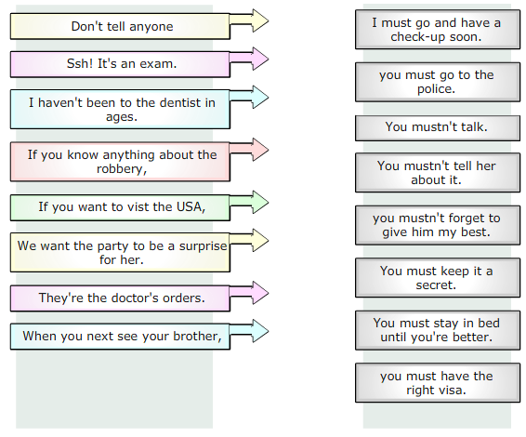
Practice

Slide 32


MODAL VERBS
Asking and Giving Advice

Slide 33
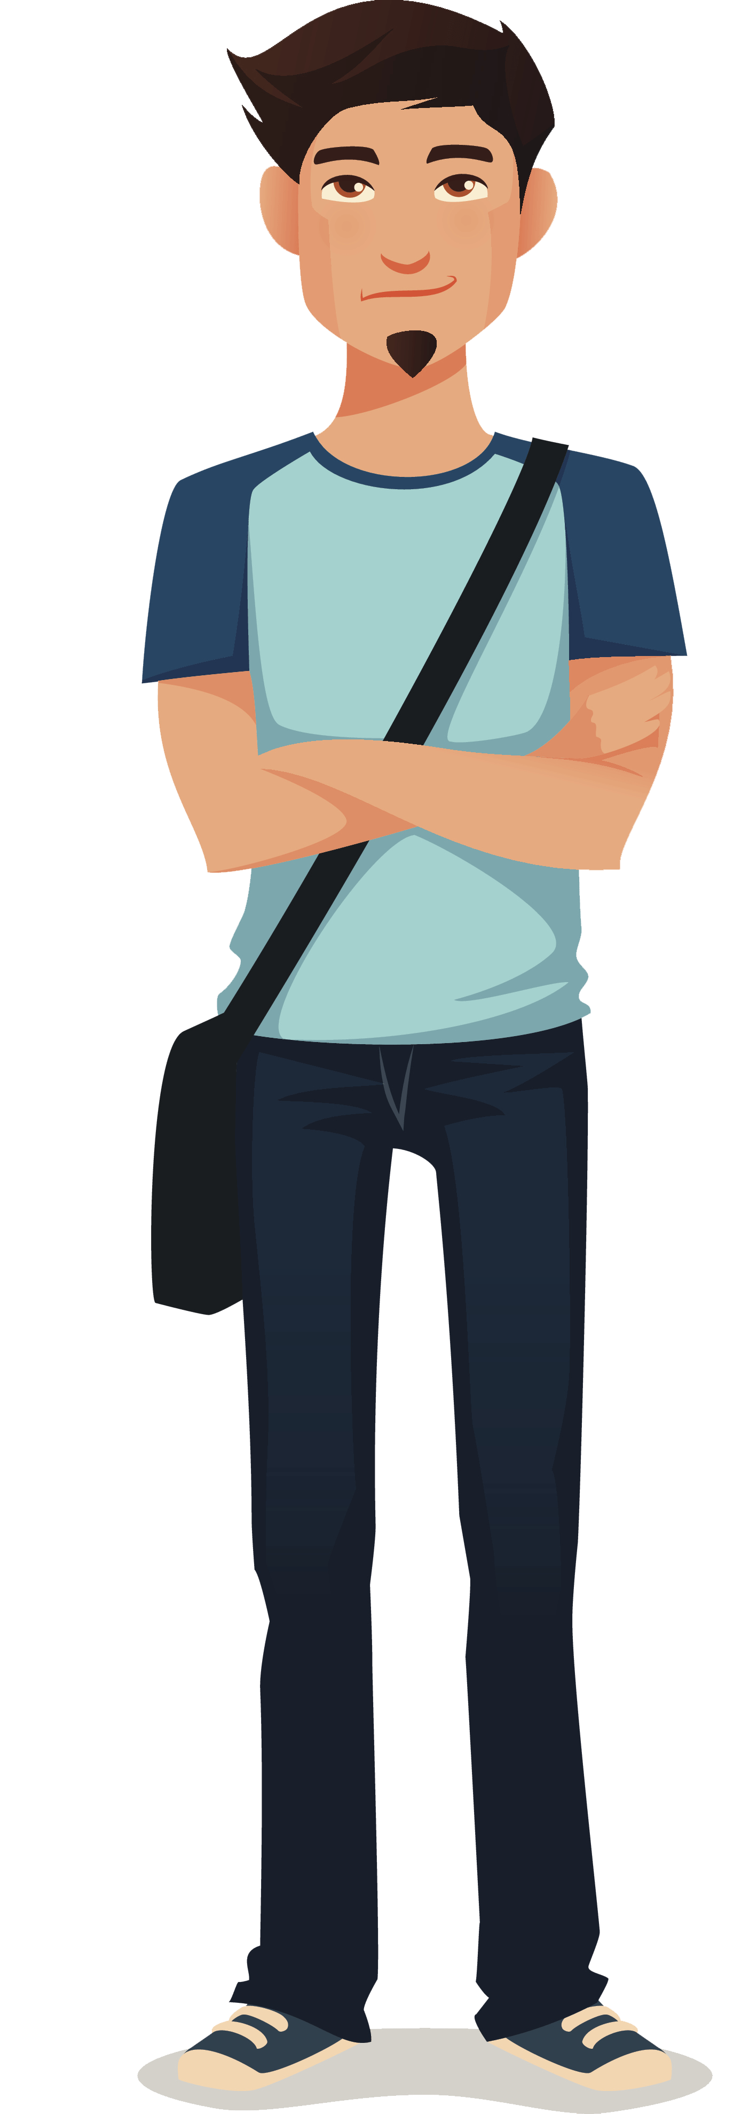
Personal Problems
I’m failing my English class.
What should I do?
I feel sad today.
What do you think should I do?
I’m bored. I want to do something interesting.
What should I do?
You should/ought to…

Slide 34
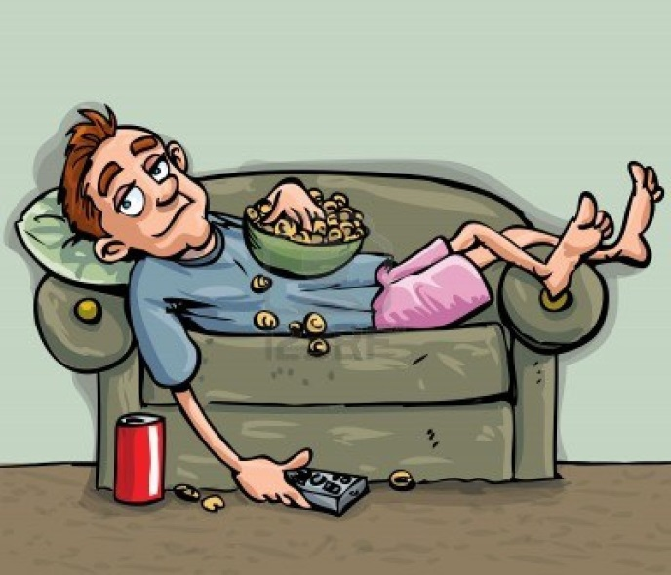
david’s lifestyle

Slide 35

david’s lifestyle
1. David usually smokes 10 cigarettes a day.
2. David hardly ever takes the dog for a walk.
3. David often watches six hours of TV per day.
4. David always eats cheeseburgers for breakfast.
5. David usually eats a few fruit.
6. David sometimes spends a lot of money on new clothes.
7. David never does exercise.
8. David drinks a lot of soda everyday.
9. David hasn’t got a job.
10. David doesn’t clean his room.
He should…
He shouldn’t…
What things should David do to change his lifestyle?

Slide 36
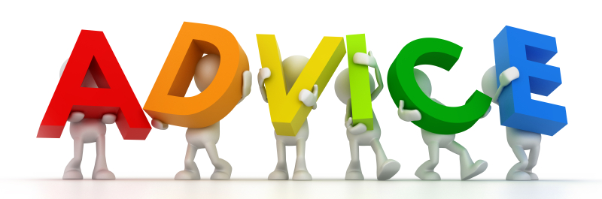
Expressions of asking and giving advice
Expressions Of Asking for Advice
What should I do?
What do you think I should do?
Could you give me advice?
What do you advise me?
Expressions of Giving Advice
You should/ought to/shouldn’t……….
I think you should/ought to/shouldn’t………

Slide 37

You should…
You shouldn’t…
PROBLEMS
I’m failing my English class.
I think my boyfriend/girlfriend has been cheating on me.
I’m fat and I’ve been gaining a lot of weight recently.
I had a fight with my best friend.
My cellphone is broken and doesn’t work.
I don’t like my new classmate.
I’m hungry, but I don’t have money.
My brother is an alcoholic.

Slide 38
Complete the following sentences using should or shoulDn’t and the verb into parentheses.
You __shouldn’t __ work so hard. Have a holiday.
I enjoyed that film. We ________________ go to the cinema more often.
You ________________ park here. It’s not allowed.
What _________I cook for dinner tonight?
You ________________ wear a coat. It’s cold outside.
The kids________________ eat so many sweets. They’re bad for them.
We ________________ arrive at the airport two hours before the flight.
David ________________ get a job. He needs money.
Sara ________________ arrive early to class. She’s always late.
I ________________ eat any more cake. I have eaten too much.

Slide 39
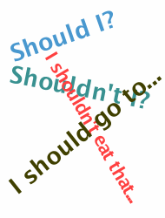
Conclusion
Uses:
We use should to give an opinion or a recommendation.
Examples
You should be more careful.
They shouldn’t talk so much.
We should invest more in Mexico.
We use should / ought to to ask and give an advice.
Examples
What do you think I should do?
You should phone her now.
He ought to see a doctor.
He ought to study for the exam.

Slide 40
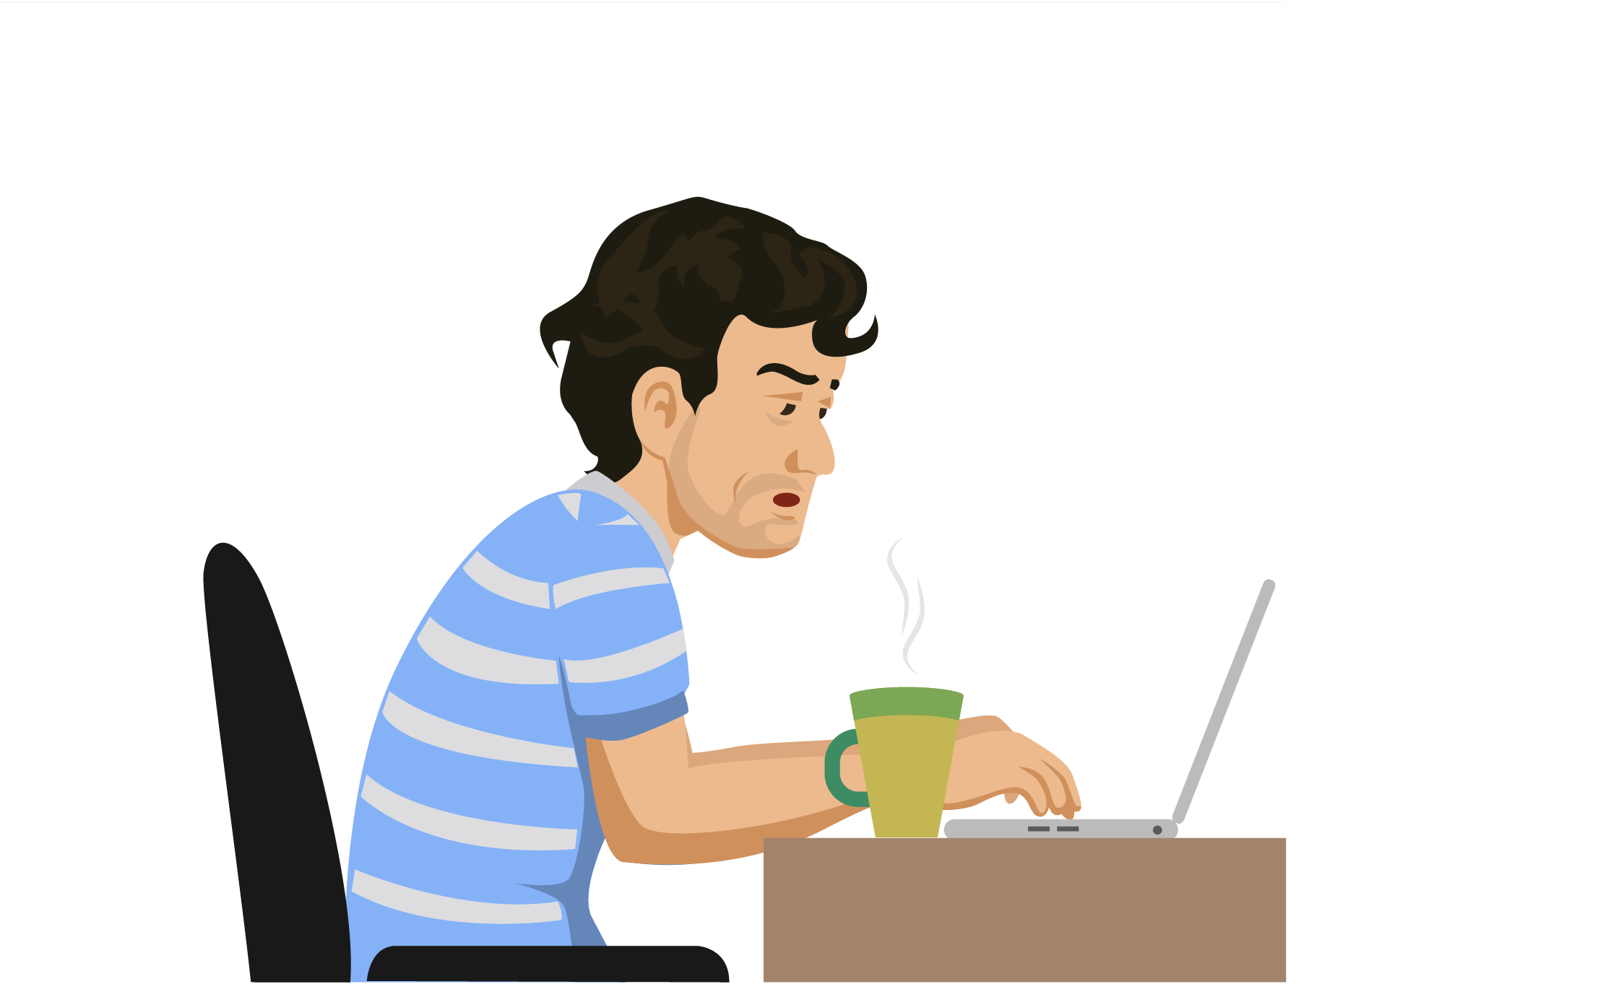

REFERENCIAS

Slide 41
Referencias
Mesografía
Tema 1
https://www.world-english.org/modals.htm
https://clasejoseangel.files.wordpress.com/2009/05/cancould-may-might.pdf
Tema 2
https://www.englisch-hilfen.de/en/exercises/modals/must_not_need_not.htm
Tema 3
http://www.universidadlaboraldemalaga.es/datos/Ingles/Los_Modales_5.pdf
http://www.edu.xunta.gal/centros/iesmartaguisela/system/files/modal%20verbs%20for%20bachillerato.ppt
Imágenes
Las imágenes se obtuvieron del sitio Freepik: http:www.freepik.com

