Slide 1
Material Didáctico Audiovisual
Sólo Visión Proyectables Diapositivas
Inglés 4 - Módulo IV
Bachillerato Universitario 2015
Let’s describe the stages of a process.
Elaborado por: M. en I. y G. E. Cesar Martínez Acevedo
Plantel “Dr. Ángel Ma. Garibay Kintana” de la Escuela Preparatoria

Slide 2
Propósito General
Inglés 4
Interactúa en el idioma inglés de forma oral y escrita, en situaciones sociales o académicas relacionadas con áreas de experiencia que le son relevantes, toma decisiones, realiza ofrecimientos, promesas y predicciones generales; expresa planes e intenciones, posibilidades, prohibiciones y necesidades. De igual modo establece condiciones, y asume las consecuencias de sus acciones, dando sugerencias y recomendaciones.
Continuar

Slide 3
Módulo IV
Nombre del Módulo
Let’s describe the stages of a process.
Propósitos del Módulo
Construye un mensaje de forma oral y escrita, para intercambiar información sobre publicaciones, eventos, atracciones y procesos.
Continuar

Slide 4
Competencia Disciplinar
Comunicación
Básica
10. Identifica e interpreta la idea general y posible desarrollo de un mensaje oral o escrito en una segunda lengua, recurriendo a conocimientos previos, elementos no verbales y contexto cultural.
11. Se comunica en una lengua extranjera mediante un discurso lógico, oral o escrito, congruente con la situación comunicativa.
Extendida
9. Trasmite mensajes en una segunda lengua o lengua extranjera atendiéndolas características de contextos socioculturales diferentes.
Continuar

Slide 5
Competencia Genérica
4. Escucha, interpreta y emite mensajes pertinentes en distintos contextos mediante la utilización de medios, códigos y herramientas apropiados.
4.4 Se comunica en una segunda lengua en situaciones cotidianas.
7. Aprende por iniciativa e interés propio a lo largo de la vida.
7.1 Define metas y da seguimiento a sus procesos de construcción de conocimiento.
10. Mantiene una actitud respetuosa hacia la interculturalidad y la diversidad de creencias, valores, ideas y prácticas sociales.
10.2 Dialoga y aprende de personas con distintos puntos de vista y tradiciones culturales mediante la ubicación de sus propias circunstancias en un contexto más amplio.
Continuar

Slide 6
TEMAS
Lo que me gusta leer
Describo un proceso
Passive
Voice:
Present Simple
Passive
Passive
Voice: Past
Simple
Passive

Slide 7
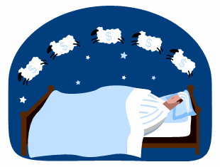
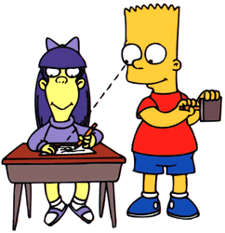
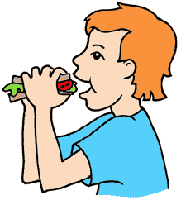

VOICE
ACTIVE vs. PASSIVE

Slide 8
Verbs and Voice
Voice is the form a verb takes to indicate whether the subject of the verb performs or receives the action.
There are two types of voice: Active Voice and Passive Voice.

Slide 9

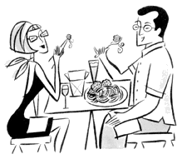

Active Voice
Active Voice is used to show that the subject of the sentence is performing or causing the action.
Examples:
I read the newspaper every day.
We eat chicken twice a week.
Ximena does exercise in the morning.

Slide 10
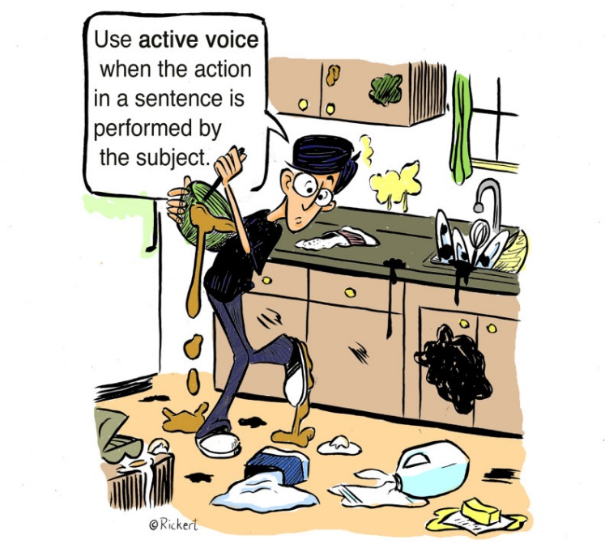
Norman made
a mess
in the kitchen.

Slide 11
Passive Voice
Passive voice is used when the object is the recipient of the action.
Examples:
The newspaper is read every day by me.
Chicken is eaten twice a week by us.
Exercise is done in the morning by Ximena.

Slide 12
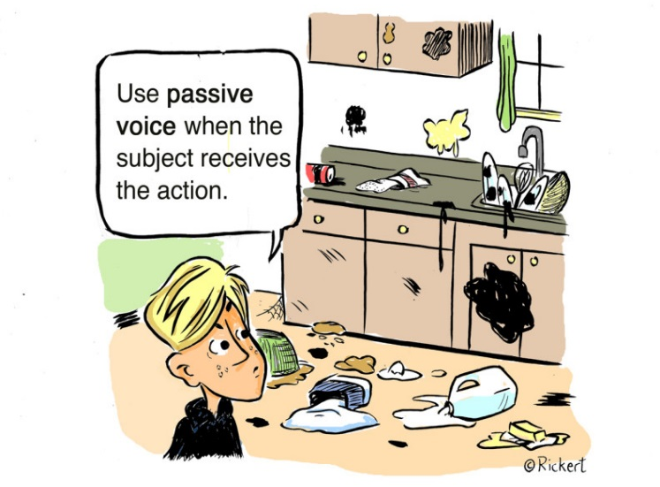
object
A mess
was made
in the kitchen.

Slide 13
Active Voice vs. Passive Voice
I read the newspaper every day.
The newspaper is read every day by me.
We eat chicken twice a week.
Chicken is eaten twice a week by us.
Ximena does exercise in the morning.
Exercise is done in the morning by Ximena.

Slide 14
Let’s Practice
Label the following sentences ACTIVE or PASSIVE.
ACTIVE
PASSIVE
PASSIVE
ACTIVE
PASSIVE
ACTIVE
ACTIVE
PASSIVE
PASSIVE
ACTIVE
Louise made the chocolate cake.
The chocolate cake was made by Louise.
The package was advertised by the travel agent.
The travel agent advertised the package.
The chain was broken by my brother.
My brother broke the chain on my bike.
I hemmed the prom dress.
The prom dress was hemmed by me.
The pencil on the floor was broken by him.
He broke the pencil on the floor.

Slide 15
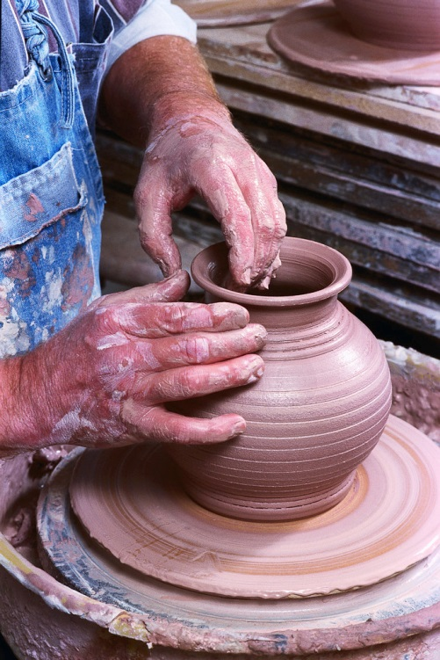
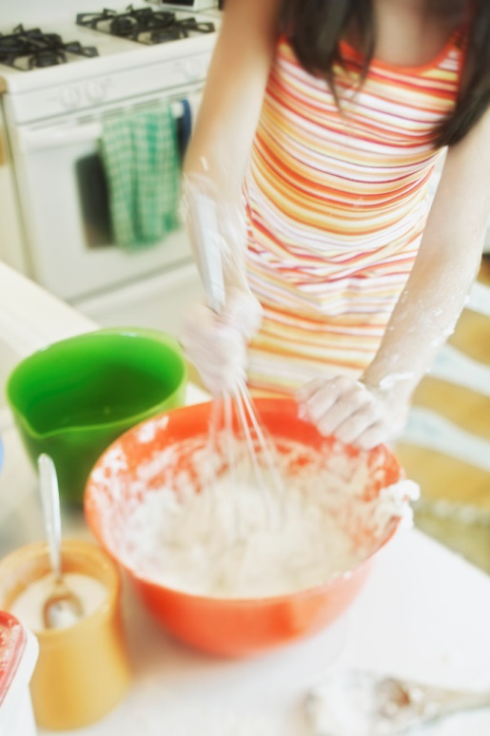

Passive Voice
PRESENT SIMPLE

Slide 16

Let’s see some examples

Slide 17
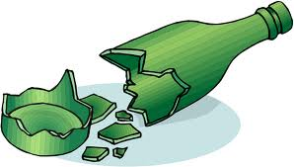
What is glass made from?
Glass is made from sand !!!

Slide 18
What is wine made of?
It´s very easy!!!
Wine is made of grapes

Slide 19
Who invented the blue jeans?
Blue jeans were invented by Levi Strauss
in 1873

Slide 20
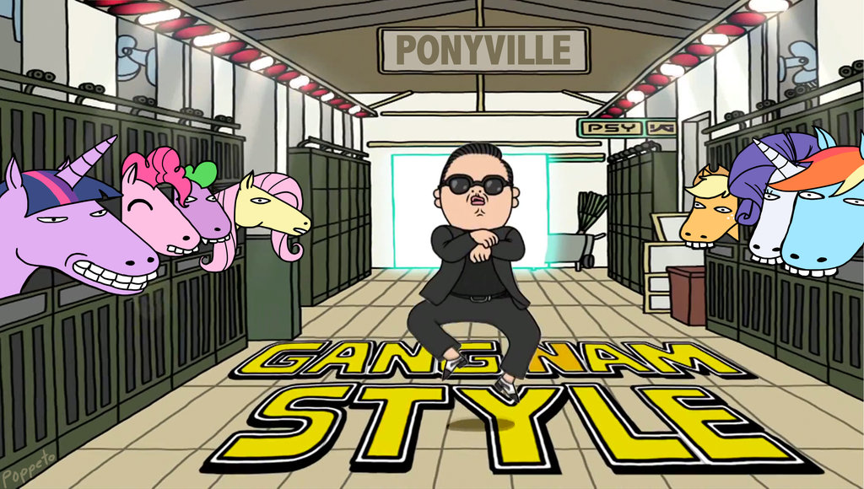
Who sings “ Gangnam style”?
Gangnam Style is sung by PSY .
You already knew it , didn´t you?

Slide 21

What are pancakes made of?
Pancakes are made of white flour, milk, water, eggs, salt and butter…
Mmm… Yummy!!!

Slide 22
What´s going on here?
Food chain
Grass is eaten by the rabbit .
The rabbit is eaten by the fox.

Slide 23
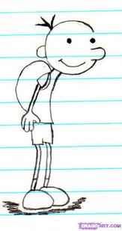
Who wrote
“Diary of a Wimpy Kid”?
It was written by Jeff Kinney

Slide 24
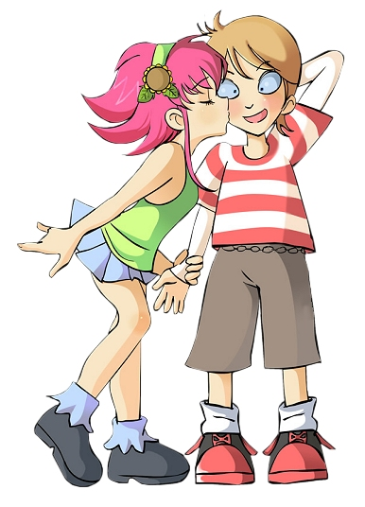
ACTIVE VOICE (the subject performs an action)
Who performs the action of kissing?
The girl kisses the boy.
PASSIVE VOICE (the object suffers the action)
Who “suffers” the action?
The boy is kissed by the girl.

Slide 25
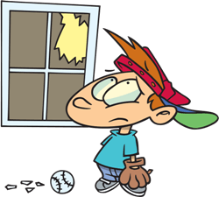
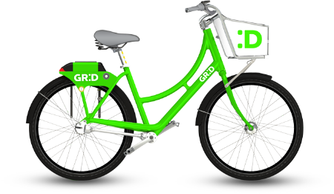

Why should we use the Passive Voice?
We use the Passive when the object is more important than the person who does the action.
Examples:
Active: Mario broke the window.
Passive: The window was broken.
It is not important who or what is performing the action.
Examples:
Passive: My bike was stolen.
Passive: Spanish is spoken in South America.

Slide 26

PASSIVE VOICE: STRUCTURE
VERBS
We use the verb TO BE:
Present: AM, IS or ARE
We use the PAST PARTICIPLE of the verbs:
Give Gave GIVEN
Eat Ate EATEN
Go Went GONE
Play Played PLAYED
Affect Affected AFFECTED
Carry Carried CARRIED

Slide 27
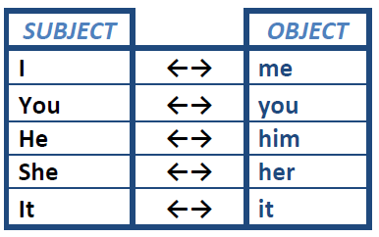
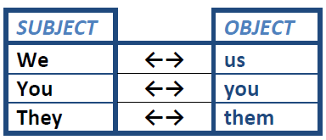

The subjects change to object and vice versa.

Slide 28
ACTIVE VOICE: Subjects perform an action.
We choose plastic film to cover the microphone.
Subject
Verb
Object
Complement

Slide 29
PASSIVE VOICE: Objects suffers the action.
We choose plastic film to cover the microphone.
Subject
Verb
Object
Complement
Plastic film is chosen to cover the microphone by us.
Object
Verb
Complement
Subject

Slide 30
STRUCTURE
Object
Verb
TO BE
Complement
Verb in PAST PARTICIPLE
Present:
IS
ARE

Slide 31
Complete the sentences (Active or Passive Voice). Use Simple Present.
He (sell) _____________________ cars.
The blue car (sell) _____________________.
In summer, more ice-cream (eat) _____________________ than in winter.
She (call) _____________________ her grandparents every Friday.
The letters (type) _____________________.
He (take) _____________________ his medicine every day.
Jane (take / not) _____________________ to school by her father.
We (go) _____________________ to school by bus.
She (work / not) _____________________ for a bank.
Milk (keep) _____________________ in the refrigerator.

Slide 32
Remember tense and number
Active Voice | Passive voice
I finish a project in eight hours. | A project is finished in eight hours.
I finish three projects in eight hours | Three projects are finished in eight hours
I finished a project in eight hours. | A project was finished in eight hours.
I finished three projects in eight hours. | Three projects were finished in eight hours.

Slide 33
Remember tense and number
Active Voice | Passive voice
I finish a project in eight hours. | A project is finished in eight hours.
I finish three projects in eight hours | Three projects are finished in eight hours
I finished a project in eight hours. | A project was finished in eight hours.
I finished three projects in eight hours. | Three projects were finished in eight hours.

Slide 34
Remember tense and number
Active Voice | Passive voice
I finish a project in eight hours. | A project is finished in eight hours.
I finish three projects in eight hours | Three projects are finished in eight hours
I finished a project in eight hours. | A project was finished in eight hours.
I finished three projects in eight hours. | Three projects were finished in eight hours.

Slide 35
Remember tense and number
Active Voice | Passive voice
I finish a project in eight hours. | A project is finished in eight hours.
I finish three projects in eight hours | Three projects are finished in eight hours
I finished a project in eight hours. | A project was finished in eight hours.
I finished three projects in eight hours. | Three projects were finished in eight hours.

Slide 36
Remember tense and number
Active Voice | Passive voice
I finish a project in eight hours. | A project is finished in eight hours.
I finish three projects in eight hours | Three projects are finished in eight hours
I finished a project in eight hours. | A project was finished in eight hours.
I finished three projects in eight hours. | Three projects were finished in eight hours.

Slide 37
Remember tense and number
Active Voice | Passive voice
I finish a project in eight hours. | A project is finished in eight hours.
I finish three projects in eight hours | Three projects are finished in eight hours
I finished a project in eight hours. | A project was finished in eight hours.
I finished three projects in eight hours. | Three projects were finished in eight hours.

Slide 38
Remember tense and number
Active Voice | Passive voice
I finish a project in eight hours. | A project is finished in eight hours.
I finish three projects in eight hours | Three projects are finished in eight hours
I finished a project in eight hours. | A project was finished in eight hours.
I finished three projects in eight hours. | Three projects were finished in eight hours.

Slide 39
Remember tense and number
Active Voice | Passive voice
I finish a project in eight hours. | A project is finished in eight hours.
I finish three projects in eight hours | Three projects are finished in eight hours
I finished a project in eight hours. | A project was finished in eight hours.
I finished three projects in eight hours. | Three projects were finished in eight hours.

Slide 40
IT’S YOUR TURN NOW (Present Passive)
Sandra wears a sweater every day.
A sweater is worn every day by Sandra.
2. I read fashion magazines.
Fashion magazines are read by me.
3. People buy chocolate here.
Chocolate is bought here by people.
4. Lucy doesn’t wear skirts.
Skirts aren’t worn by Lucy.
5. They hire young models here.
Young models are hired here by them.

Slide 41
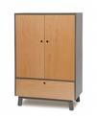

GAME: GUESS THE OBJECT
Write down 3 objects, do not show them to anybody!
Ask questions that use the passive voice to find out what the objects are.
Examples of questions:
1. What is it used for?
2. What is it made of?
3. Where is it found?
4. Where is it bought?
5. Who is it used by?

Slide 42
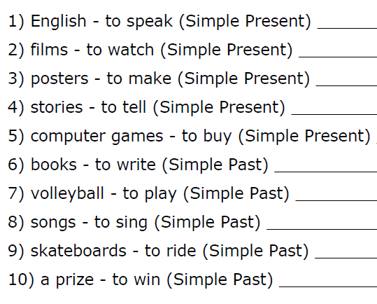
MAKE PASSIVE FORMS FROM THE GIVEN PHRASES.

Slide 43
Passive Voice
PAST SIMPLE

Slide 44
Verbs and Voice
Voice is the form a verb takes to indicate whether the subject of the verb performs or receives the action.
There are two types of voice: Active Voice and Passive Voice.

Slide 45
Active Voice
Active Voice is used to show that the subject of the sentence is performing or causing the action.
Examples:
I read the newspaper every day.
We eat chicken twice a week.
Ximena does exercise in the morning.

Slide 46
Active Voice vs. Passive Voice
I read the newspaper this morning.
The newspaper was read that morning by me.
We ate chicken last week.
Chicken was eaten the previous week by us.
Ximena did exercise in the morning.
Exercise is done in the morning by Ximena.

Slide 47
ACTIVE VOICE (the subject performs an action)
Who performs the action of kissing?
The girl kissed the boy.
PASSIVE VOICE (the object suffers the action)
Who “suffers” the action?
The boy was kissed by the girl.

Slide 48
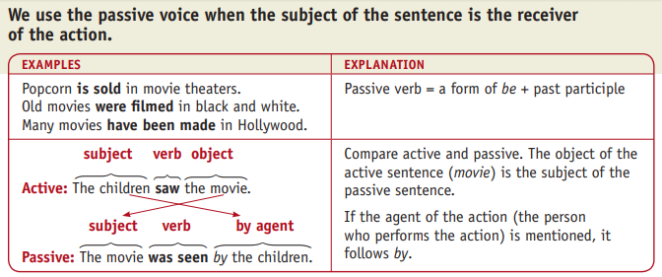
EXAMPLES

Slide 49
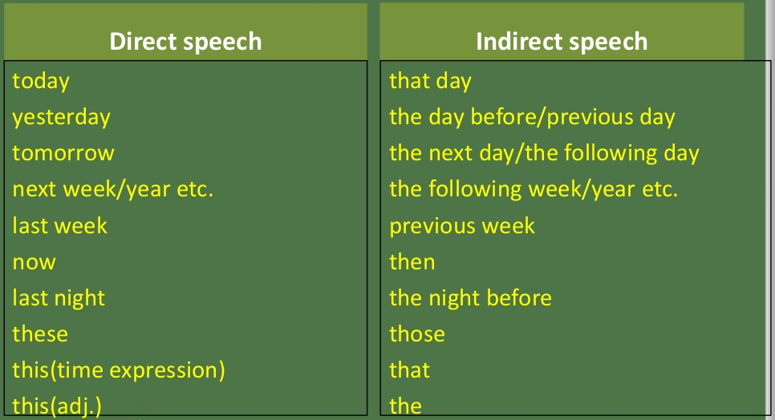
Expressions of Time

Slide 50
PASSIVE VOICE: STRUCTURE
VERBS
We use the verb TO BE:
Past: WAS or WERE
We use the PAST PARTICIPLE of the verbs:
Give Gave GIVEN
Eat Ate EATEN
Go Went GONE
Play Played PLAYED
Affect Affected AFFECTED
Carry Carried CARRIED

Slide 51
The subjects change to object and vice versa.

Slide 52
STRUCTURE
Object
Verb
TO BE
Complement
Verb in PAST PASRTICIPLE
Past:
WAS
WERE

Slide 53
Complete the sentences (Active or Passive Voice). Use Simple Past.
They (visit) _____________________ their granny.
We (visit) _____________________ by our teacher.
How many newspapers (print) _____________________ in Britain the previous month?
he (go) _____________________ to school in Boston.
Antony (grow up) _____________________ in the country.
The new shopping centre (build) _____________________ last year.
The film (produce / not) _____________________ in Hollywood.
Barbara (know) _____________________ James very well.
The jewels (hide / not) _____________________ in the cellar.
We (spend / not) _____________________ all day on the beach.

Slide 54
When / they / world’s largest diamond / discover answer - in 1905 simple past tense
Active Question:
When did they discover the world’s largest diamond?
Active Answer:
They discovered the world’s largest diamond in 1905.
Passive Question:
When was the world’s largest diamond discovered?
Passive Answer
The world’s largest diamond was discovered in 1905.

Slide 55

Where / someone / world’s largest diamond / find answer - in South Africa simple past tense
Active Question:
Where did someone find the world’s largest diamond?
Active Answer:
Someone found the world’s largest diamond in South Africa.
Passive Question:
Where was the world’s largest diamond found (by someone) ?
Passive Answer
The world’s largest diamond was found (by someone) in South Africa.

Slide 56
Why /a company / cotton /grow /in Goodyear answer – to make tires simple past tense
Active Question:
Why did a company grow cotton in Goodyear?
Active Answer:
A company grew cotton in Goodyear to make tires.
Passive Question:
Why was cotton grown (by a company) in Goodyear?
Passive Answer
Cotton was grown (by a company) in Goodyear to make tires.

Slide 57
When/a tire company/cotton/grow/in Goodyear answer - in the 1940s simple past tense
Active Question:
When did a tire company grow cotton in Goodyear?
Active Answer:
A tire company grew cotton in Goodyear in the 1940s.
Passive Question:
When was cotton grown (by a tire company) in Goodyear?
Passive Answer
Cotton was grown (by a tire company) in Goodyear in the 1940s.

Slide 58

When / someone / create / CDs answer – in 1982 simple past tense
Active Question:
When did someone create CDs?
Active Answer:
Someone created CDs in 1982.
Passive Question:
When were CDs created (by someone) ?
Passive Answer
CDs were created (by someone) in 1982?

Slide 59
How / Percy Spencer / discover / microwave cooking answer – accidentally simple past tense
Active Question:
How did Percy Spencer discover microwave cooking?
Active Answer:
Percy Spencer accidentally discovered microwave cooking.
Passive Question:
How was microwave cooking discovered (by Percy Spencer)?
Passive Answer
Microwave cooking was accidentally discovered (by Percy Spencer).

Slide 60
When / Percy Spencer / discover / microwave cooking answer – in 1945 simple past tense
Active Question:
When did Percy Spencer discover microwave cooking?
Active Answer:
Percy Spencer discovered microwave cooking in 1945.
Passive Question:
When was microwave cooking discovered (by Percy Spencer)?
Passive Answer
Microwave cooking was discovered (by Percy Spencer) in 1945.

Slide 61

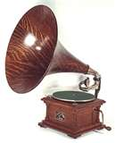
What / Thomas Edison / invent answer – the telephone & phonograph simple past tense
Active Question:
What did Thomas Edison invent?
Active Answer:
Thomas Edison invented the light bulb and phonograph.
Passive Question:
What was invented by Thomas Edison?
Passive Answer
The light bulb and phonograph were invented by Thomas Edison.

Slide 62
Make passive sentences (Past Passive)
1. A patient delayed Chris when he was leaving the hospital.
2. The car blocked the gate for two hours.
3. I had to take my dog to the vet.
4. The teacher’s explanation confused me.
5. The police caught the thieves.
6. The dog bit the children badly.
7. She sang a song in the concert.
8. Somebody hit me in the game.
9. We stopped the bus in the street.
10. A thief stole my car last weekend.
11. They didn't let him go in the party.
12. She didn't win the prize in the contest.
13. They didn't make their beds.
14. I did not tell them the truth.
15. He sent the letter to his girlfriend.

Slide 63
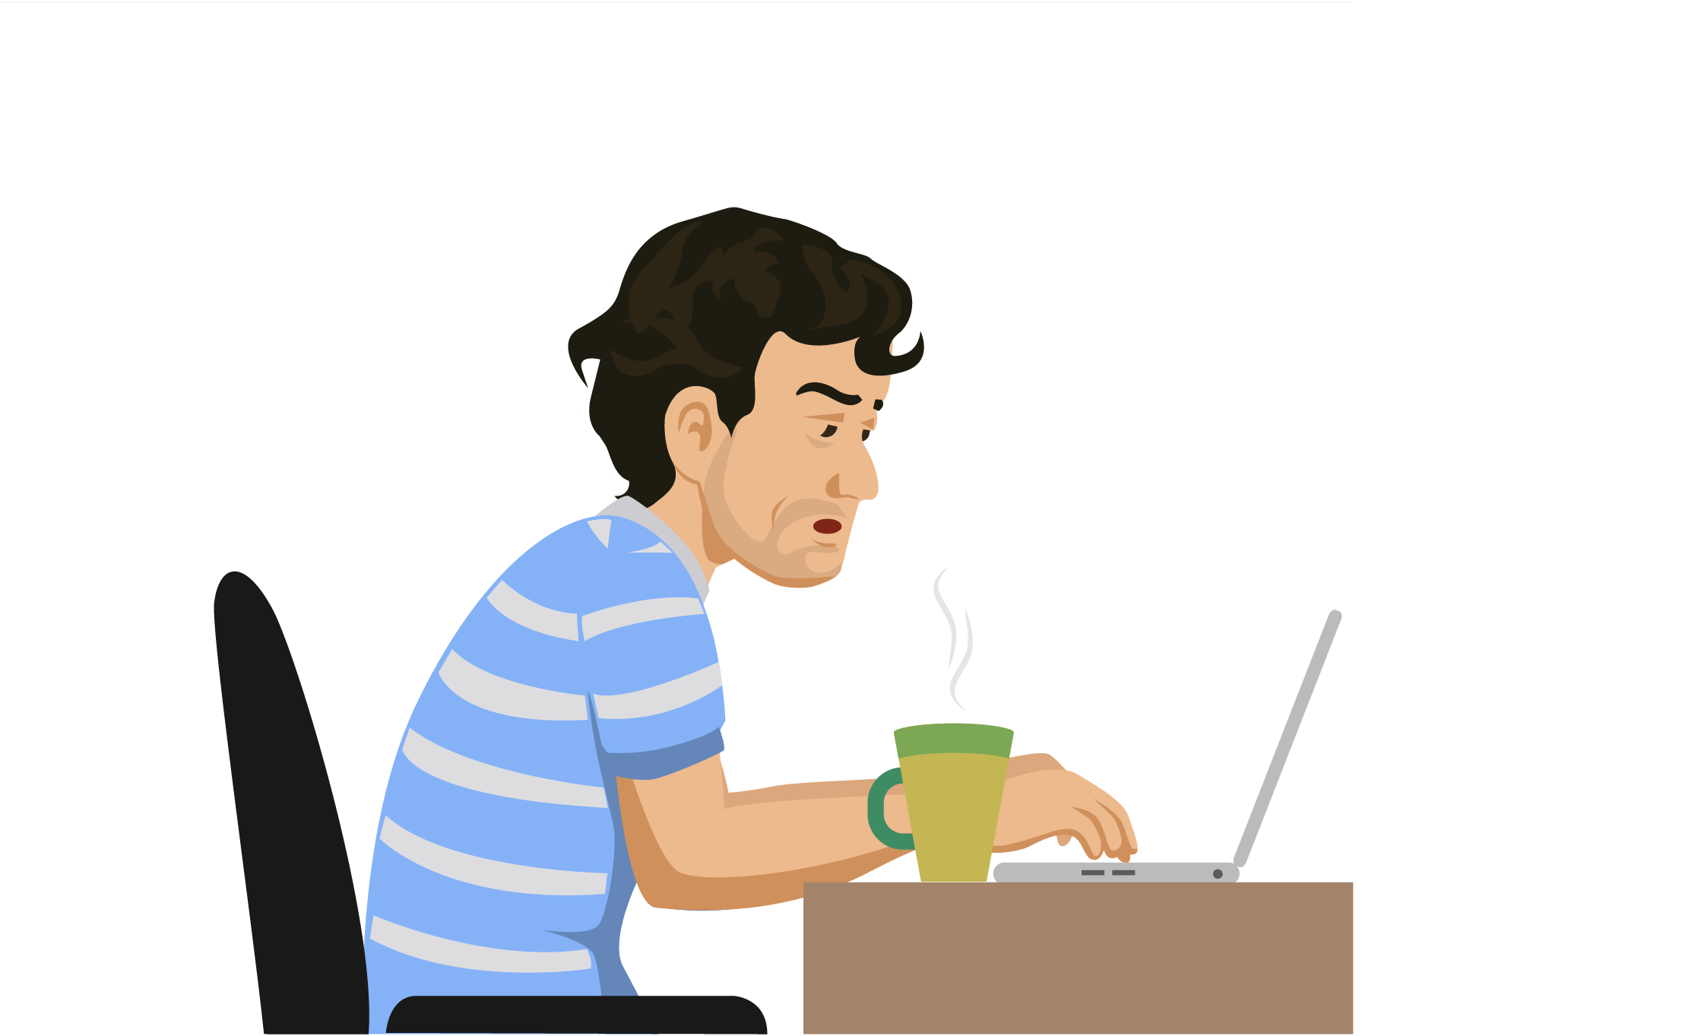

REFERENCIAS

Slide 64
Referencias
Mesografía
Tema 1
https://www.ego4u.com/en/cram-up/grammar/passive/exercises?simple-present-2
Tema 2
https://ngl.cengage.com/assets/downloads/grcontext_pro0000000013/in_context_3_su.pdf
https://www.ego4u.com/en/cram-up/grammar/passive/exercises?simple-past-2
http://www2.estrellamountain.edu/faculty/stonebrink/ESL040/passive%20review%20present%20past%20qu%20and%20a.ppt
Imágenes
Las imágenes se obtuvieron del sitio Freepik: http:www.freepik.com

