Slide 1
UNIVERSIDAD AUTÓNOMA DEL ESTADO DE MÉXICO
PLANTEL “LIC. ADOLFO LÓPEZ MATEOS” DE LA ESCUELA PREPARATORIA
TÍTULO: Modulo I “Sharing experiences and telling them when they happened”
TEMAS: Experiencias pasadas y acciones recientes
PROGRAMA EDUCATIVO: Inglés 4
NIVEL EDUCATIVO DONDE SE IMPARTE: Medio superior de la UAEMéx.
SEMESTRE: Tercero CBU 2015
RESPONSABLE DE LA ELABORACIÓN: M.EN P. E. N.M.S. Alma Rosa Lara Contreras, Profesora de asignatura.

Slide 2
Present perfect vs past simple
By Alma Rosa Lara Contreras

Slide 3
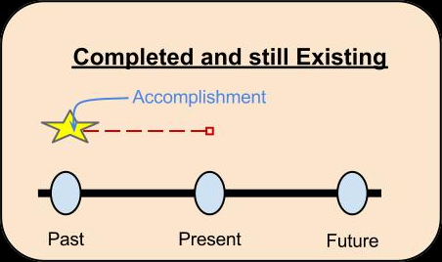
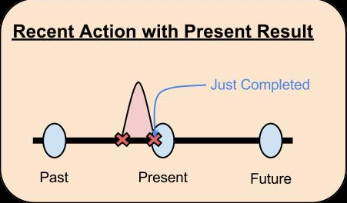
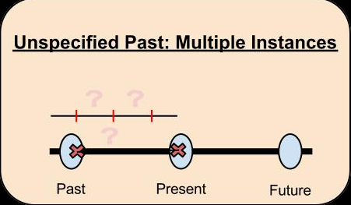
Present perfect- review
The present perfect tense is used to describe something that happened in the past, but the exact time it happened is not important. (life experience)
It is used when an action that happened in the past continues and continues in the present.
For recent situations that have a strong connection in the present.

Slide 4
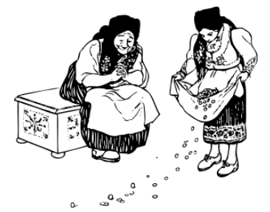
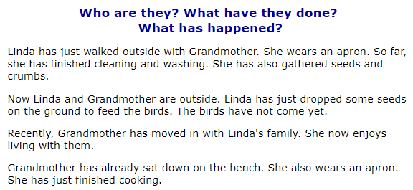
Identify present perfect

Slide 5
Identify present perfect

Slide 6
estructure
I have eaten I’ve
You have eaten You’ve
He has eaten He’s
She has eaten She’s
It has eaten It’s
We have eaten We’ve
You have eaten You’ve
They have eaten They’ve
I have NOT eaten
You have NOT eaten
He has NOT eaten
Have I eaten…?
Have they eaten …?
Has she eaten …?

Slide 7
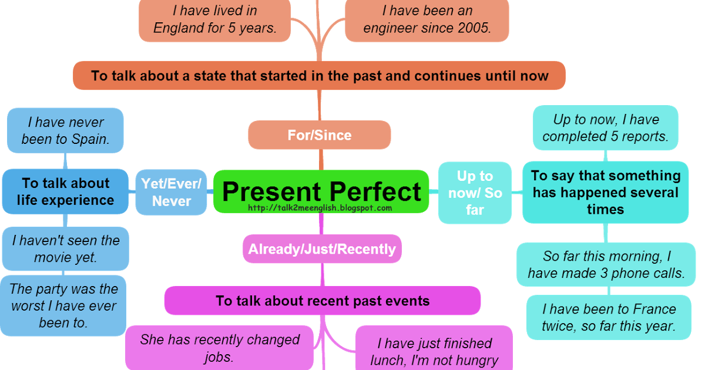
summary

Slide 8
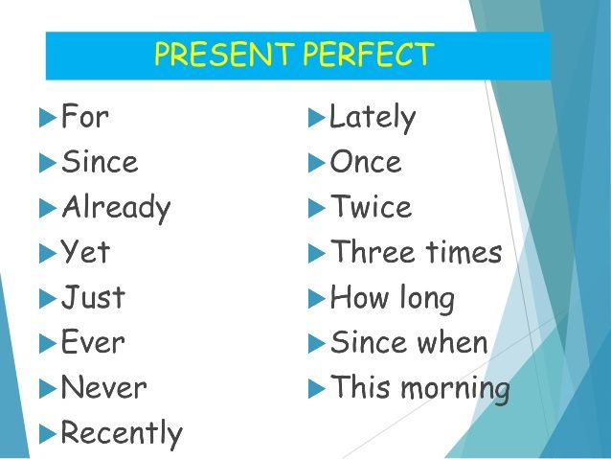
Time expressions

Slide 9
exercises
I (not/work) ____________________ today.
We (buy) ____________________ a new lamp.
We (not plan) ____________________ our holiday yet.
Where (be/you) ____________________?
He (write) ____________________ five letters.
She (not/see) ____________________ him for a long time.
(be/you) ____________________ school?
School (not start) ____________________ yet.
(speak/he) ____________________ to his boos?
No, he (have//not) ____________________ the time yet.

Slide 10
exercises
I (not/work) haven’t worked today today.
We (buy) ‘ve bought a new lamp.
We (not plan) haven’t planned our holiday yet.
Where (be/you) have you been?
He (write) has written five letters.
She (not/see) hasn’t seen him for a long time.
(be/you) Have you been at school?
School (not start) hasn’t started yet.
(speak/he) Has he spoken to his boos?
No, he (have//not) hasn’t had the time yet.

Slide 11
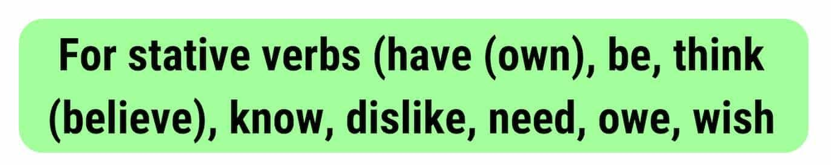
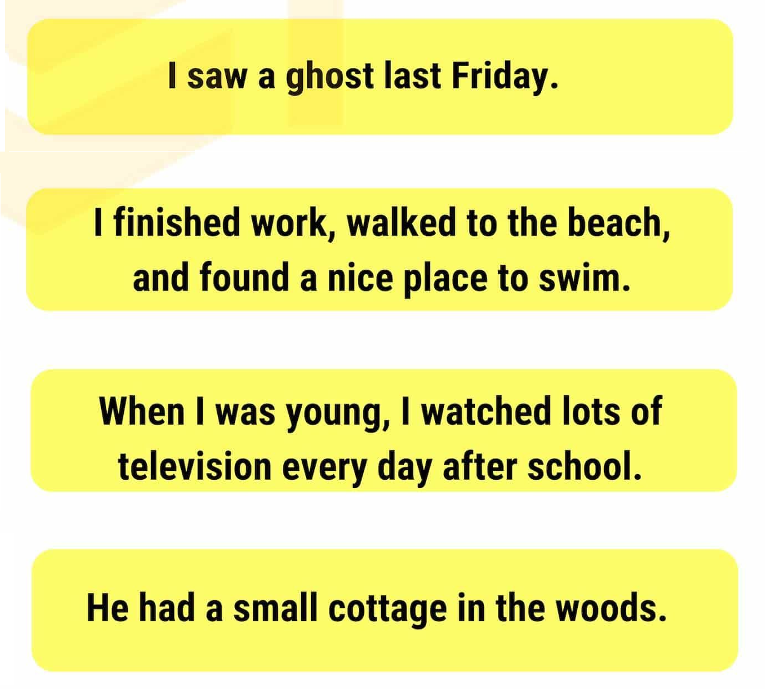
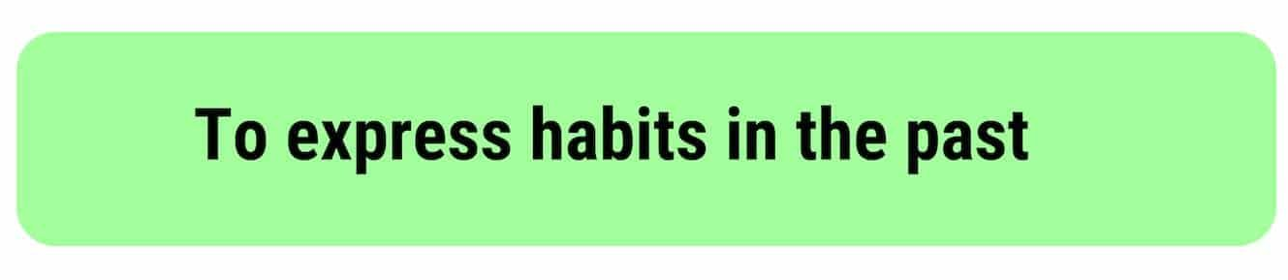
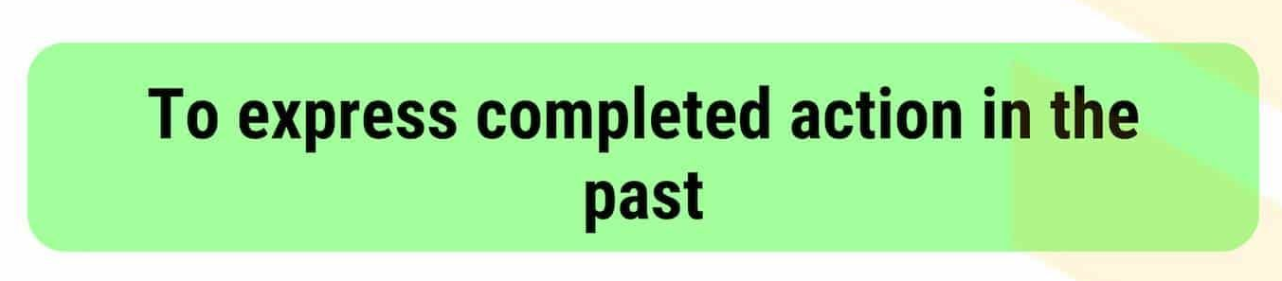
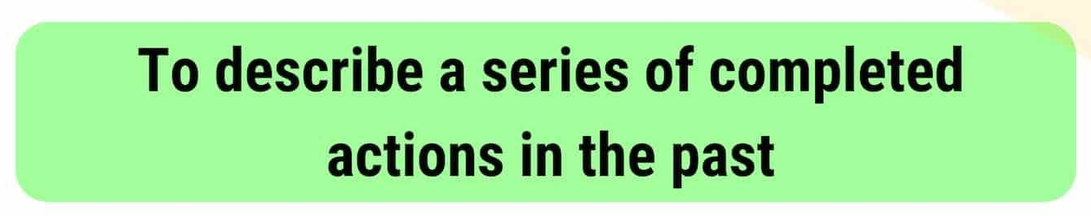
Past simple - review

Slide 12
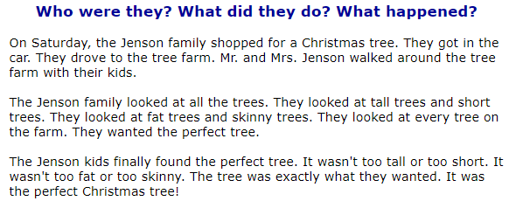

Identify past simple

Slide 13
Identify past simple

Slide 14
estructure
I started/ate
You started/ate
He started/ate
She started/ate
It started/ate
We started/ate
You started/ate
They started/ate
I DID NOT start/eat
He DID NOT start/eat
DID I start/eat…?
DID she start/eat …?

Slide 15
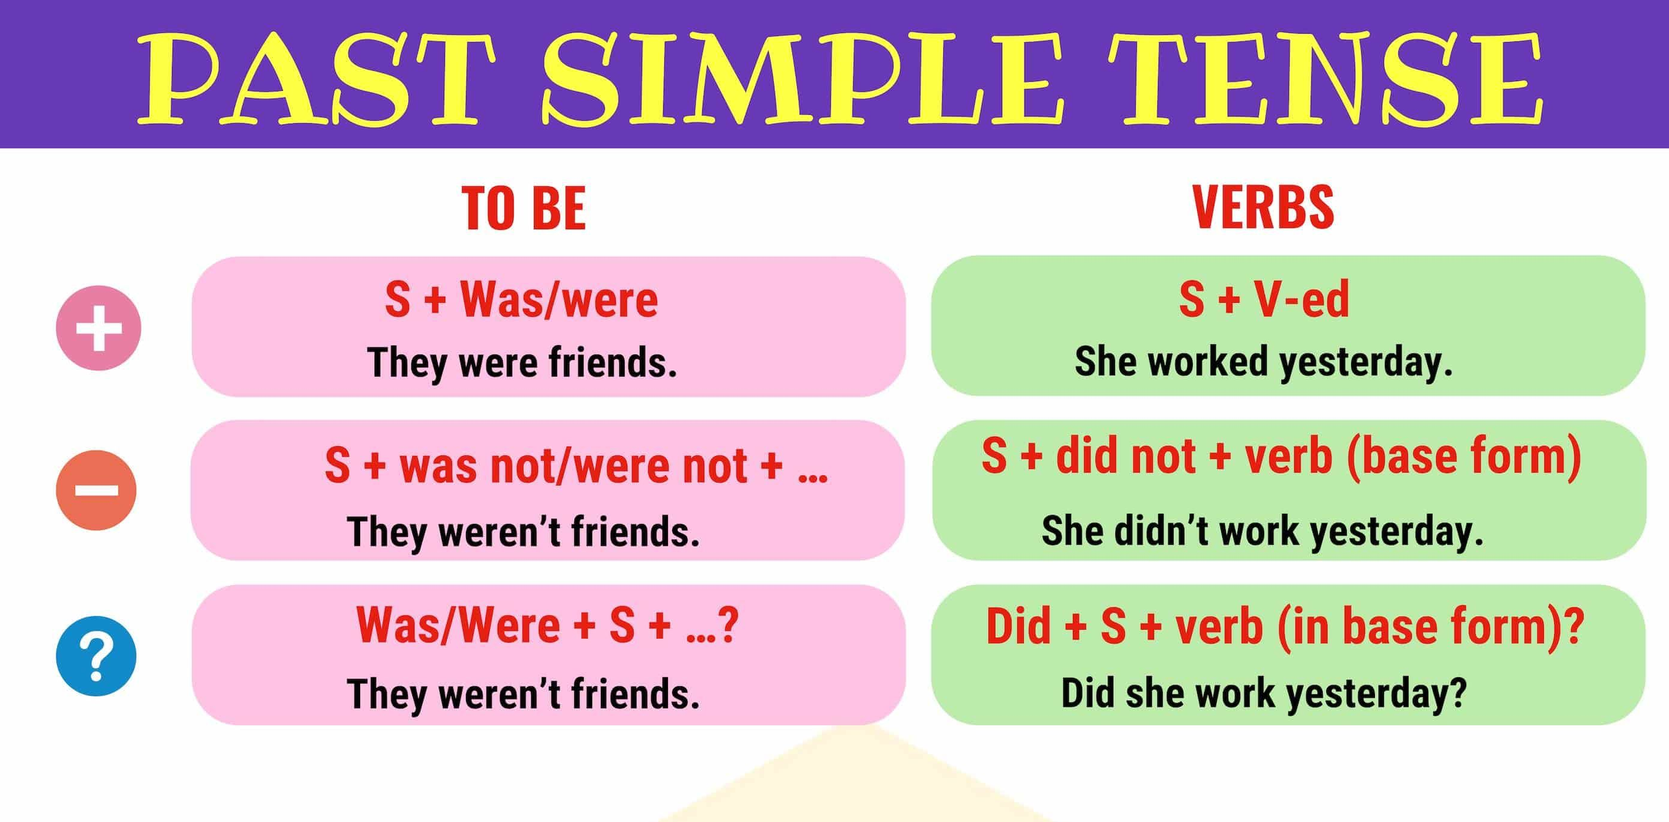
summary

Slide 16
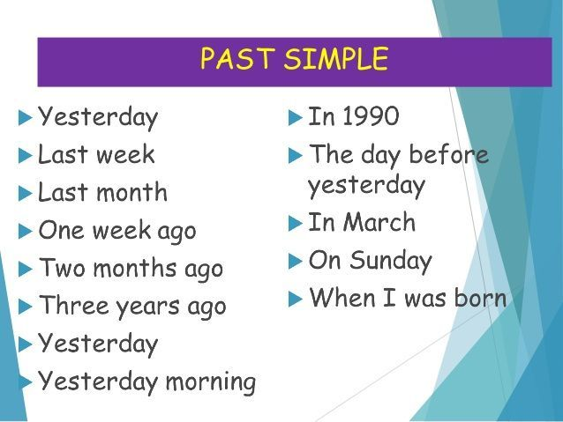
Time expressions

Slide 17
exercises
Last year I (spend) _______________ my holiday in Ireland.
It (be) _______________ great.
I (travel) _______________ around by car with two Friends and we (visit) _______________lots of interesting places.
In the evenings we usually (go) _______________ to a pub.
One night we even (learn) _______________ some Irish dances.
We (be) _______________ very lucky with the weather.
It (not/rain) _______________ a lot.
Be we (see) _______________ some beautiful rainbows.
Where (spend/you) _______________ your last holidays?

Slide 18
exercises
Last year I (spend) spent my holiday in Ireland.
It (be) was great.
I (travel) travelled around by car with two friends and we (visit) visited lots of interesting places.
In the evenings we usually (go) went to a pub.
One night we even (learn) learnt/learned some Irish dances.
We (be) were very lucky with the weather.
It (not/rain) didn’t rain a lot.
Be we (see) saw some beautiful rainbows.
Where (spend/you) did you spend your last holidays?

Slide 19
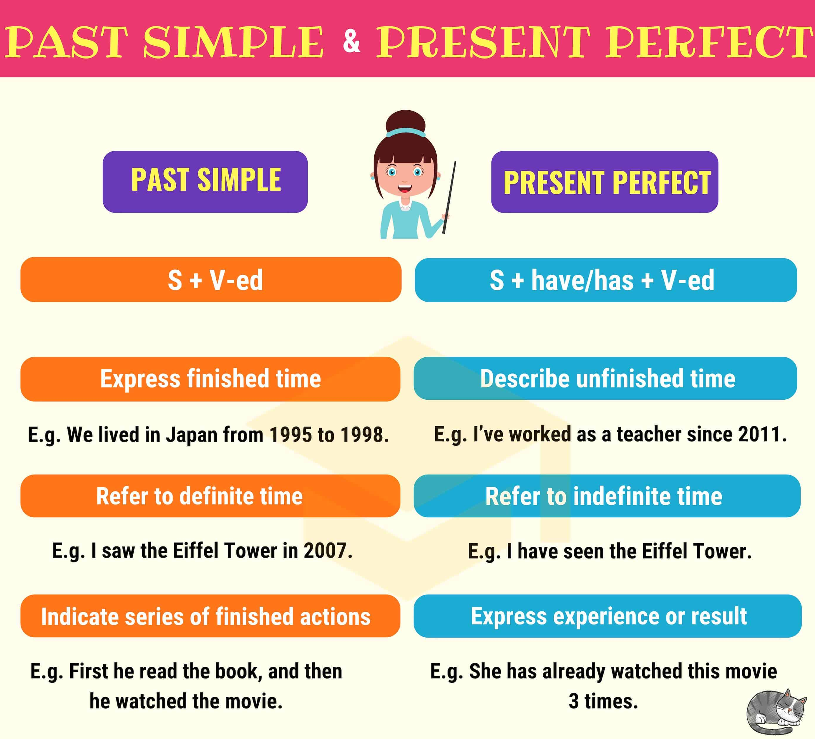
Present perfect vs past simple

Slide 20
Jim’s day
In small groups, transform the verbs in brackets into past simple or present perfect to fill in the gaps and your answer.
Jim __________(have) three accidents this year. The most recent accident __________ (happen) yesterday. A woman __________ (crash) into his car in the parking lot of the grocery store. The woman __________ (get) out of her car and __________ (yell) at Jim. She __________ (be) very angry. She __________ (say), "I'm an excellent driver. I __________ (never have) an accident before. This is your fault."
When Jim __________ (get) home, his wife (be) upset. She __________(say), "It __________ (cost) us $800 to repair the car after your last accident. I'm really worried that you __________ (become) a bad driver."
Jim __________ (insist), "It __________ (not be) my fault. The other driver __________ (drive) through a stop sign and then she __________ (hit) me. I __________ (be) very careful since the last accident. This __________(be) the worst day! I'm going to bed!"

Slide 21
Jim’s day
In small groups, transform the verbs in brackets into past simple or present perfect to fill in the gaps and explain your answer.
Jim has had three accidents this year. The most recent accident happened yesterday. A woman crashed into his car in the parking lot of the grocery store. The woman got out of her car and yelled at Jim. She was very angry. She said, "I'm an excellent driver. I have never had an accident before. This is your fault."
When Jim got home, his wife was upset. She said, "It cost us $800 to repair the car after your last accident. I'm really worried that you have become a bad driver."
Jim insisted, "It was not my fault. The other driver drove through a stop sign and then she hit me. I was very careful since the last accident. This has been the worst day! I'm going to bed!"

Slide 22
Gavin’s sick days
Gavin __________ (call) in sick to work on Monday. His boss was frustrated and said, "You __________ (call) in sick four times this month."
Gavin replied, "I'm sorry. I __________ (catch) a cold from my son. He __________ (start) daycare last month and he __________ (be) sick since then. I am a good employee and last year I __________ (not take) one sick day."
Gavin's boss said, "It's true. You __________ (be) a good employee. You __________(always do) your work on time and you __________ (bring) the company a lot of business since you __________ (start) working for us."
Gavin said, "Last week I __________ (show) Tina all the projects I have been working on. She __________ (say) she can help me. She __________ (work) on many similar projects since she __________ (be) hired."
Gavin boss replied, "Okay. Get lots of rest and we'll see you tomorrow.”

Slide 23
Gavin’s sick days
Gavin called (call) in sick to work on Monday. His boss was frustrated and said, "You have called (call) in sick four times this month."
Gavin replied, "I'm sorry. I caught (catch) a cold from my son. He started (start) daycare last month and he has been (be) sick since then. I am a good employee and last year I didn’t take (not take) one sick day."
Gavin's boss said, "It's true. You have been (be) a good employee. You have always done (always do) your work on time and you have brought (bring) the company a lot of business since you started (start) working for us."
Gavin said, "Last week I showed (show) Tina all the projects I have been working on. She said (say) she can help me. She has worked (work) on many similar projects since she was (be) hired."
Gavin boss replied, "Okay. Get lots of rest and we'll see you tomorrow.”

Slide 24
Experience in life and moments
Go bungee jumping
2 years ago
Brother and granma
Morelos
Excited, nervous.
Drove to Morelos
Arrived early
Flew in a plane
Jumped-worried
Plan a story about an expercience in llife and explain details about it. Follow the example given.

Slide 25
Experience in life and moments
Experience
When?
Who with?
Where?
What
happened?
So?
Then?
Later?
Finally?
Plan a story about an expercience in llife and explain details about it. Follow the example given.

Slide 26
referencias
Falla, Tim, Solutions: Pre-ingtermediate Student’s book,.Oxford Press, Oxford, London. 2nd edition.
Falla, Tim, Solutions: Pre-intermediate Workbook,.Oxford Press, Oxford, London. 2nd edition.
https://www.ego4u.com/
http://www.perfect-english-grammar.com/

Slide 27
Guion explicativo para el empleo del material, con relación a los objetivos y contenidos del curso
La asignatura de inglés 4 correspondiente al campo disciplinar de la Comunicación ubicándose en el quinto semestre con el propósito general de Interactúa en el idioma inglés de forma oral y escrita, en situaciones sociales o académicas relacionadas con áreas de experiencia que le son relevantes, toma decisiones, realiza ofrecimientos, promesas y predicciones generales; expresa planes e intenciones, posibilidades, prohibiciones y necesidades. De igual modo establece condiciones, y asume las consecuencias de sus acciones, dando sugerencias y recomendaciones. (programa de inglés 4, 2017).
El curso se compone de 4 módulos:
El primer módulo hace una revisión del pasado del estudiante y sus conexión con el presente, el módulo dos trata de las posibilidades y consecuencias en el futuro de hacer o dejar de hacer algo ahora, el tercero modulo es sobre costumbre y hechos alrededor del mundo, se revisan verbos modales en diferentes formas y con diferentes usos y finalmente el modulo cuatro, explica el uso de la voz pasiva en periódicos y revistas y como es más importante el objeto en lugar de la acción.

Slide 28
De forma más específica el módulo I “Sharing experiences and telling when they happened” tiene como propósito: Expresa de forma oral y escrita experiencias recientes y acciones que sucedieron en un momento específico de su vida.
Por lo que las presentes diapositivas se centran en la diferenciación de experiencias de vida y sus detalles, ¿Dónde?, ¿Cómo? , ¿cuando? Con el fin de explicar su vida pasada y presente y la de su entorno social inmediato.

Slide 29
Competencias
Competencia de la dimensión (perfil de egreso)
COMPETENCIA DISCIPLINAR
Comunicación. Básica
10 Identifica e interpreta la idea general y posible desarrollo de un mensaje oral o escrito en una segunda lengua, recurriendo a conocimientos previos, elementos no verbales y contexto cultural.
11. Se comunica en una lengua extranjera mediante un discurso lógico, oral o escrito, congruente con la situación comunicativa.
Extendida
9. Trasmite mensajes en una segunda lengua o lengua extranjera atendiéndolas características de contextos socioculturales diferentes.
COMPETENCIA GENÉRICA
4 Escucha, interpreta y emite mensajes pertinentes en distintos contextos mediante la utilización de medios, códigos y herramientas apropiados.
4.4 Se comunica en una segunda lengua en situaciones cotidianas.
7. Aprende por iniciativa e interés propio a lo largo de la vida.
7.1 Define metas y da seguimiento a sus procesos de construcción de conocimiento.
10. Mantiene una actitud respetuosa hacia la interculturalidad y la diversidad de creencias, valores, ideas y prácticas sociales.
10.2 Dialoga y aprende de personas con distintos puntos de vista y tradiciones culturales mediante la ubicación de sus propias circunstancias en un contexto más amplio.

Slide 30
Módulo 1
TEMA 1 | Experiencias pasadas y acciones recientes
Uso de la lengua | Present Perfect vs Simple Past
Vocabulario | -Shops and services. -Verbs: shopping and money. -Special occasions. -Formal letters expressions

