Slide 1
UNIVERSIDAD AUTÓNOMA DEL ESTADO DE MÉXICO
PLANTEL “LIC. ADOLFO LÓPEZ MATEOS” DE LA ESCUELA PREPARATORIA
TÍTULO: MODULO I “EL MUNDO DEL TRABAJO”
TEMAS: PLANES PARA EL FUTURO Y DESCRIPCIONES PARA EL FUTURO
PROGRAMA EDUCATIVO: INGLÉS 3
NIVEL EDUCATIVO DONDE SE IMPARTE: MEDIO SUPERIOR DE LA UAEMéx.
SEMESTRE: TERCERO CBU 2015
RESPONSABLE DE LA ELABORACIÓN: M.EN P. E. N.M.S. ALMA ROSA LARA CONTRERAS, PROFESORA DE ASIGNATURA.

Slide 2
JOBS
(-ER/-OR/-IST)
suffixes

Slide 3
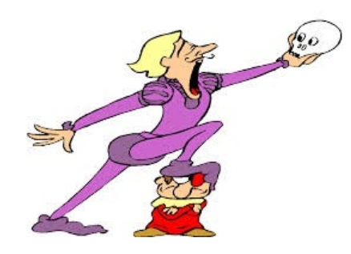

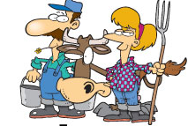
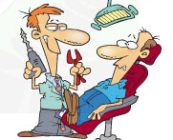
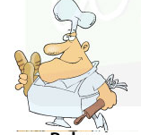
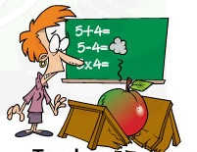


Professions & jobs
INSTRUCTIONS: Label the following occupations.

Slide 4
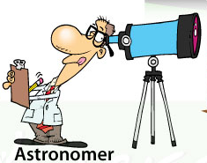
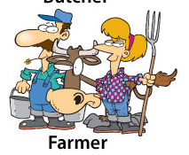
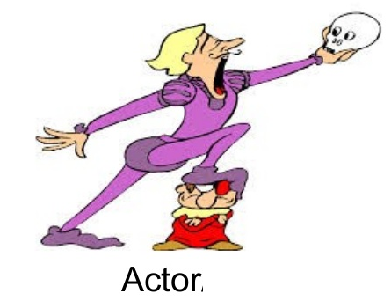
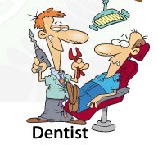
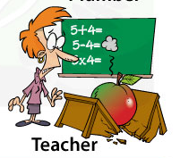


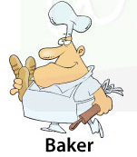
Professions & jobs

Slide 5
-ER / -OR / -IST
INTRUCTIONS: Transform the words below to créate professions by adding –or /-er /-ist and write them in the correct space of the chart.
-ER | -OR | -IST
WRITE * SCIENCE * CONDUCT
GOVERN * SING * DANCE
BIOLOGY * INVENT * NOVEL

Slide 6
-ER / -OR / -IST
INTRUCTIONS: Transform the words below to créate professions by adding –or /-er /-ist and write them in the correct space of the chart.
-ER | -OR | -IST
WRITER | CONDUCTOR | NOVELIST
SINGER | INVENTOR | BIOLOGIST
DANCER | GOVERNOR | SCIENTIST
WRITE * SCIENCE * CONDUCT
GOVERN * SING * DANCE
BIOLOGY * INVENT * NOVEL

Slide 7
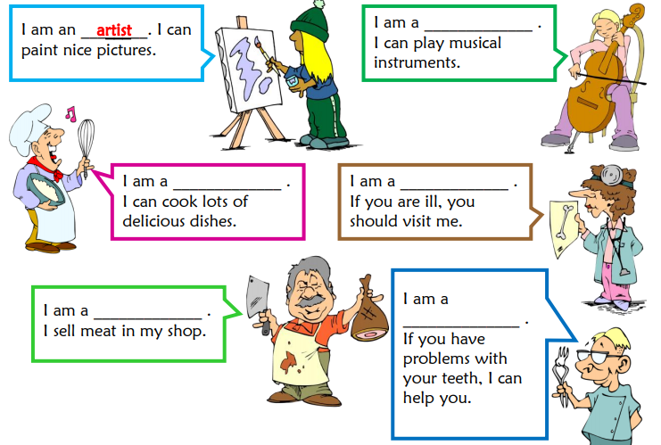
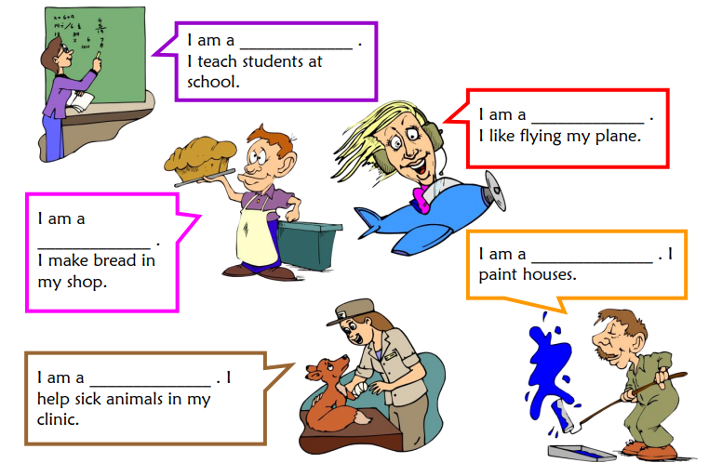
INSTRUCTIONS: Complete the gaps with a profession that best fits the description.

Slide 8
INSTRUCTIONS: Complete the gaps with a profession that best fits the description.
musician
teacher
pilot
cook
doctor
baker
painter
butcher
dentist
vet

Slide 9
Be going to will
future

Slide 10

Be going to
We use going to to talk about plans decided before the moment of speaking.

Slide 11

How?
Personal pronouns
I AM GOING TO do…
You ARE GOING TO do…
He IS GOING TO do…
She IS GOING TO do. . .
It IS GOING TO do. . .
We ARE GOING TO do. . .
You ARE GOING TO do. . .
They ARE GOING TO do. . .
I AM NOT GOING TO do…
You ARE NOT GOING TO do…
He IS NOT GOING TO do…
AM I GOING TO do…?
ARE YOU GOING TO do…?
IS SHE GOING TO do…?

Slide 12
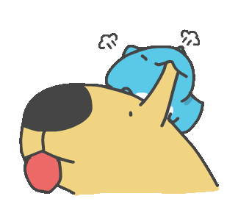
Examples:
I’m going to phone my mum after dinner.
I’m going to wear my black dress tonight.
She is going to get her nails done.
They are all going to the party.
CAN YOU THINK OF ANY MORE?

Slide 13

WILL
We use will to talk about decisions made at the moment of speaking.

Slide 14
How?
Personal pronouns
I WILL do…
You WILL do…
He WILL do…
She WILL do…
It WILL do…
We WILL do…
You WILL do…
They WILL do…
I WILL NOT/WON´T do…
You WILL NOT/WON´T do…
He WILL NOT/WON´T do…
WILL I do…?
WILL YOU do…?
WILL SHE do…?

Slide 15

Examples:
I won’t go to the movies with you.
He will return in the afternoon, maybe.
They will join us later.
A: I am going to travel to London tomorrow early in the morning ☹
B: Don’t worry, I will take you to the train.
THINK OF MORE!

Slide 16
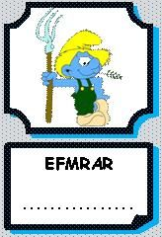








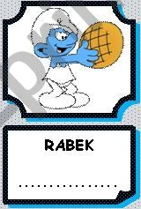


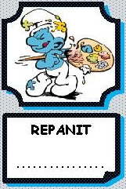

Going to and will with jobs
Review jobs:

Slide 17
Going to and will with jobs
Review jobs:
farmer
builder
doctor
actor
poet
carpenter
teacher
architect
baker
post man
astronaut
painter
cook

Slide 18

Examples:
When I finish my high school I will be a doctor but I haven’t decided it yet.
He is going to be a math teacher, he is studying hard for the university exam.
I have decided it. I am going to become a pilot when I finish my high school, I love planes.
Fortunately, I will finish my studies next year.
Try to think of more!

Slide 19

Exercises try to find the missing word in the following sentences
I am going to be a _____ because I love animals.
I_____ help my father in the shop when I finish homework.
She ______ be a kinder garden teacher or a psychologist.
He watches a lot of CSI T.V series and he is very clever, he definitely ______be a Police Officer.
I’d like firefighters so possibly I______ apply the exam next year.
Math is very easy for me so I ______ be the best math teacher once I finish my high school studies.

Slide 20
Exercises try to find the missing word in the following sentences
I am going to be a _VET_ because I love animals.
I_AM GOING TO_ help my father in the shop when I finish homework.
She _WILL_ be a kinder garden teacher or a psychologist, she is not sure yet!
He watches a lot of CSI T.V series and he is very clever, he definitely _IS GOING TO_be a police officer.
I’d like firefighters so possibly I_WILL_ apply the exam next year.
Math is very easy for me so I _AM GOING TO_ be the best math teacher once I finish my high school studies.

Slide 21
Be going to
We use be going to to talk about predictions based on evidence

Slide 22
examples
Look at those black clouds! It is going to rain
Run or we are going to miss the bus
I am going to get married (date, dress, ring, boyfriend)
CAN YOU THINK OF ANY MORE?

Slide 23
Will
We use will to talk about predictions based on
no evidence

Slide 24
examples
I think she will be a stylist or a make-up artist, she loves making people look pretty.
She will be a great teacher in the future
I will get married someday
CAN YOU THINK OF ANY MORE?

Slide 25
Going to and will
CAN YOU TELL THE DIFFERENCE?
I am going to get married
I will get married
I am going to get sick
I will get sick
I am going to have a baby
I will have a baby
I am going to fail English
I will fail English
I am going to do exercise
I will do exercise
I am going to be the president
I will be the president
I am going to do my homework
I will do my homework

Slide 26
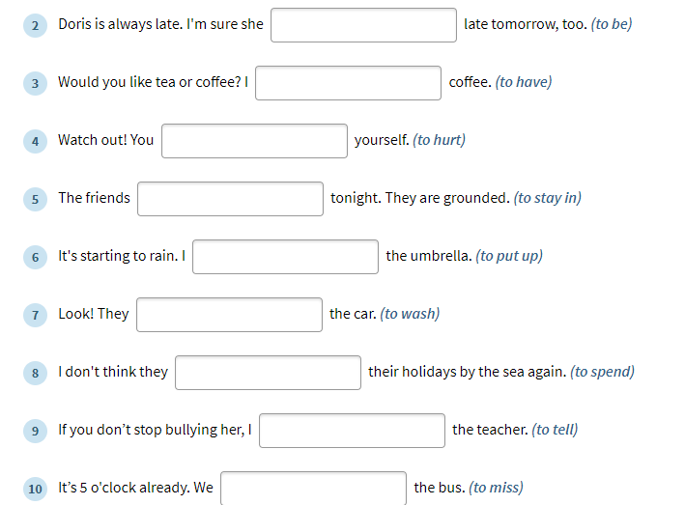
exercises

Slide 27
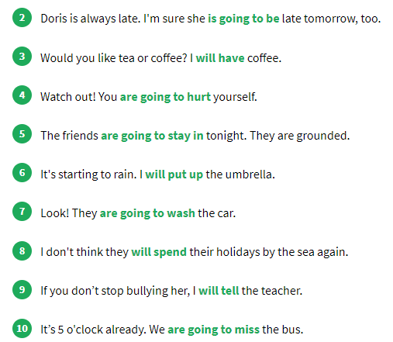

Slide 28
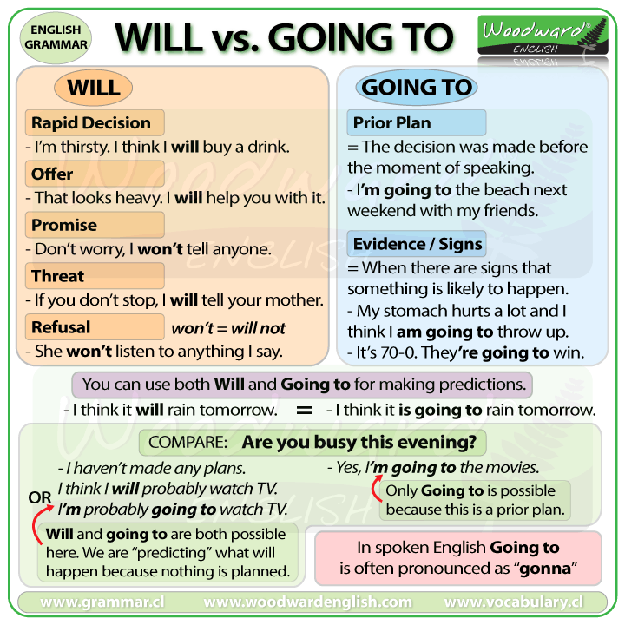

Slide 29
referencias
Falla, Tim, Solutions: Elementary Student’s book,.Oxford Press, Oxford, London. 2nd edition.
Falla, Tim, Solutions: Elementary Workbook,.Oxford Press, Oxford, London. 2nd edition.
https://www.ego4u.com/
http://www.perfect-english-grammar.com/

Slide 30
Guion explicativo para el empleo del material, con relación a los objetivos y contenidos del curso
La asignatura de inglés 3 correspondiente al campo disciplinar de la Comunicación ubicándose en el cuarto semestre con el propósito general de Interactúa en el idioma inglés de forma oral y escrita, en situaciones sociales o académicas relacionadas con áreas de experiencia que le son especialmente familiares, para proporcionar información sobre sí mismo u obtener información de las personas que le rodean, pasatiempos, describir intereses, actividades rutinarias, actividades en progreso, aspectos de su pasado personal y del lugar en donde vive, eventos recientes, experiencias de vida; así como extraer información de distintas fuentes: visuales, auditivas y audiovisuales. . (programa de inglés 3, 2017).
El curso se compone de 4 módulos:
El primer módulo hace una revisión del futuro y 2 temas gramaticales contrastando sus usos y sus estructuras, el módulo dos trata de las experiencias de vida, el tercero modulo es un repaso del semestre anterior donde se contrastan qué hago habitualmente y lo que estoy haciendo en este momento y finalmente el modulo cuatro, trata de explicar momentos y acciones del pasado.

Slide 31
De forma más específica el módulo I “El mundo del trabajo” tiene como propósito: Asocia elementos lingüístico – comunicativos para que de manera oral o escrita exprese sus planes en el futuro y haga predicciones basadas en una situación familiar que le sea familiar.
Por lo que las presentes diapositivas se centran en el desarrollo de planes y decisiones espontaneas así como también sobre predicciones sobre el futuro basadas en evidencia. De la misma forma se revisa en vocabulario de profesiones y ocupaciones.

Slide 32
Competencias
Competencia de la dimensión (perfil de egreso)
COMPETENCIA DISCIPLINAR
Comunicación. Básica
10 Identifica e interpreta la idea general y posible desarrollo de un mensaje oral o escrito en una segunda lengua, recurriendo a conocimientos previos, elementos no verbales y contexto cultural.
11. Se comunica en una lengua extranjera mediante un discurso lógico, oral o escrito, congruente con la situación comunicativa.
Extendida
9. Trasmite mensajes en una segunda lengua o lengua extranjera atendiéndolas características de contextos socioculturales diferentes.
COMPETENCIA GENÉRICA
4 Escucha, interpreta y emite mensajes pertinentes en distintos contextos mediante la utilización de medios, códigos y herramientas apropiados.
4.4 Se comunica en una segunda lengua en situaciones cotidianas.
7. Aprende por iniciativa e interés propio a lo largo de la vida.
7.1 Define metas y da seguimiento a sus procesos de construcción de conocimiento.
10. Mantiene una actitud respetuosa hacia la interculturalidad y la diversidad de creencias, valores, ideas y prácticas sociales.
10.2 Dialoga y aprende de personas con distintos puntos de vista y tradiciones culturales mediante la ubicación de sus propias circunstancias en un contexto más amplio.

Slide 33
Módulo 1
TEMA 1 | Planes para el futuro
Uso de la lengua | Be going to
Vocabulario | -jobs and work Suffixes er, or, ist Compound nouns
TEMA 2 | Predicciones hacia el futuro
Uso de la lengua | Will
Vocabulario | planes

