Slide 1
UNIVERSIDAD AUTÓNOMA DEL ESTADO DE MÉXICO
PLANTEL “LIC. ADOLFO LÓPEZ MATEOS” DE LA ESCUELA PREPARATORIA
TÍTULO: MODULO II “MIS EXPERIENCIAS”
TEMAS: DESCRIPCIÓN DE EXPERIENCIAS
PROGRAMA EDUCATIVO: INGLÉS 3
NIVEL EDUCATIVO DONDE SE IMPARTE: MEDIO SUPERIOR DE LA UAEMéx.
SEMESTRE: TERCERO CBU 2015
RESPONSABLE DE LA ELABORACIÓN: M.EN P. E. N.M.S. ALMA ROSA LARA CONTRERAS, PROFESORA DE ASIGNATURA.

Slide 2
Present Perfect
By Alma Rosa Lara Contreras

Slide 3

What is the Present Perfect?
The present perfect tense is used to describe something that happened in the past, but the exact time it happened is not important. (life experience)
It is used when an action that happened in the past continues and continues in the present.
For recent situations that have a strong connection in the present.
I have studied at this school for 2 years
I have had an accident 5 minutes ago.
I have travelled to Europe

Slide 4
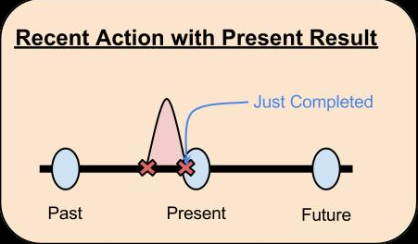
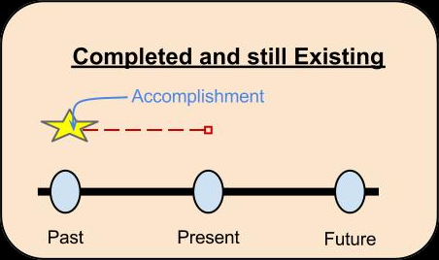
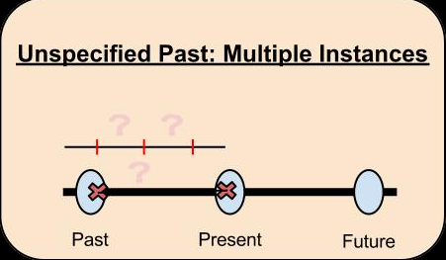

Slide 5

Examples:
This is the first time I have gone to a rock concert. (first time in life)
He has lived in the same city for 10 years (he arrived in the past and he still continues living here in present)
Have you seen my calculator? (- I want to use it now!)
Has she had an accident? (- Someone said she's in hospital!)
Have you done your homework? (- It's due today!)
THINK OF MORE!

Slide 6
Examples:
I have lost my dictionary. (I don't have my dictionary now; can you help me find it?)
Mary has fixed my computer (My computer is working now and I'm happy about it!)
You haven't eaten very much. (Don't you feel well? Don't you like it?)
I have scored the winning goal. (You did it in past and you won the match in present
You have studied at this High School for 2 years. (you started in past but it continues in present)
THINK OF MORE!

Slide 7

Estructure
I have eaten I’ve
You have eaten You’ve
He has eaten He’s
She has eaten She’s
It has eaten It’s
We have eaten We’ve
You have eaten You’ve
They have eaten They’ve
I have NOT eaten
You have NOT eaten
He has NOT eaten
Have I eaten…?
Have they eaten …?
Has she eaten …?

Slide 8
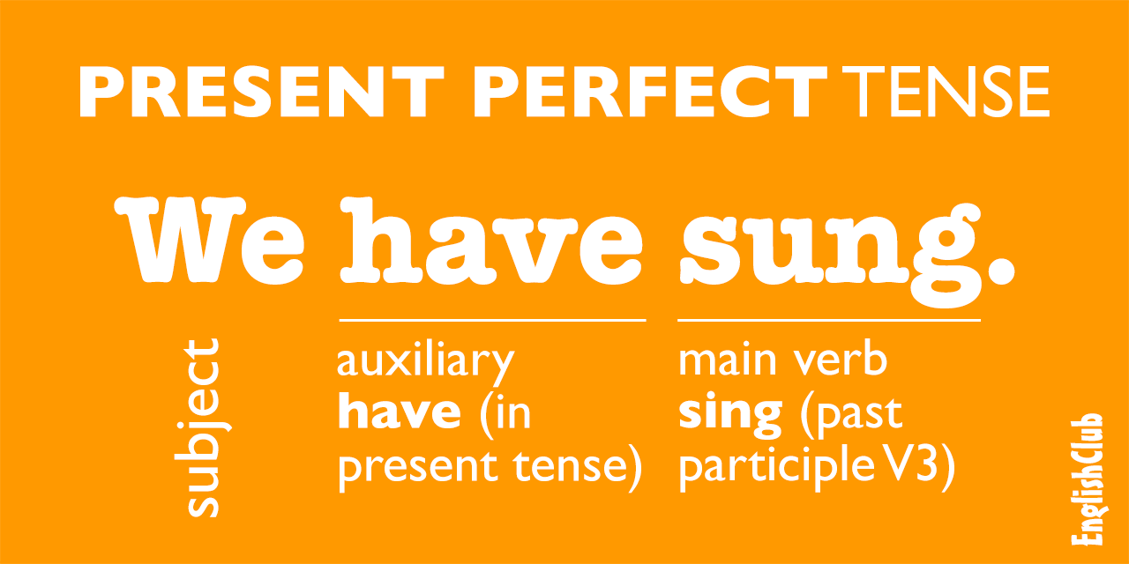

Slide 9
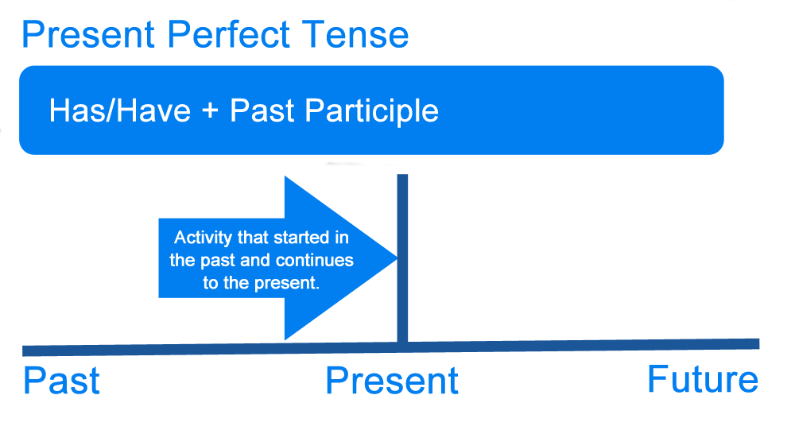

Slide 10
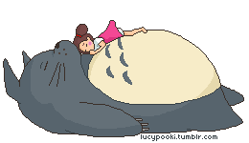
The present perfect tense is used with words or expressions of unfinished time.
Unfinished time started in the past and continues into the present.
(So, this week, for example, means all the days so far this week including today.)

Slide 11

Examples of unfinished time
I've played tennis 3 times already this week and it's only Thursday!
She's been back to Korea twice already this year, and she's going again next week!
Sorry, I've seen that film already. I don't want to see it again.
I've lived in Germany since 1986.
She's had a lot of bad luck recently.

Slide 12
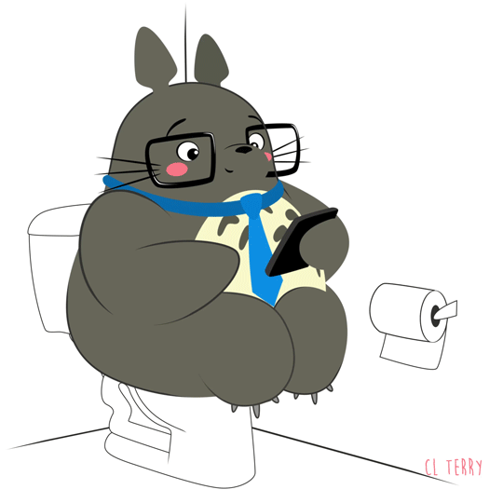
Be careful: sometimes an expression of unfinished time can be used with the past simple tense. Look at these examples and explanations:
I drank three cups of coffee this morning.
The speaker is talking in the evening so for him this morning is finished time.
I didn't see John today.
The student is talking after school when there is no more possibility of seeing John on this day. Today becomes an expression of finished time

Slide 13
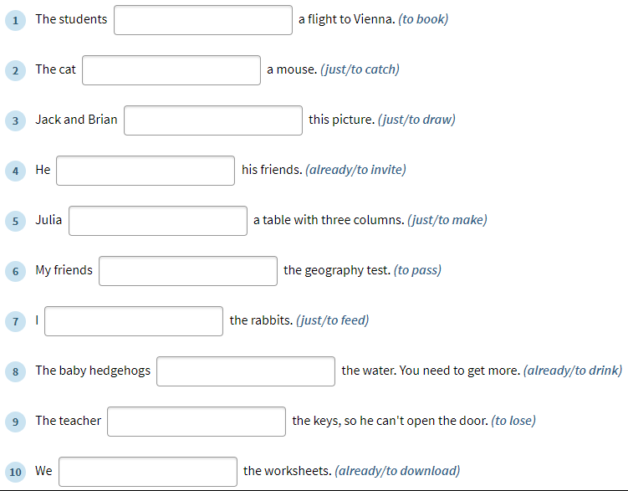

Slide 14
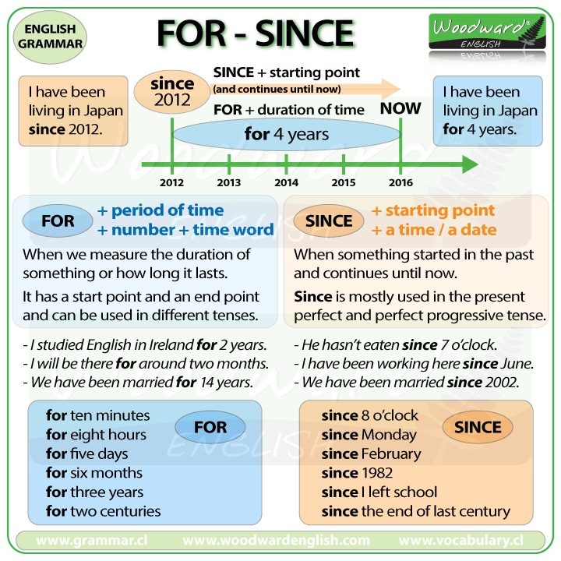

Slide 15
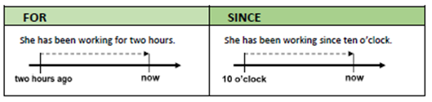
Exercises – How long have you…?
I have practiced boxing for 1 year
I have practiced boxing since 2018
FOR | SINCE
2 hours
3 days
 | August
 | 1998
3 months
 | 7 am
8 years
 | Saint Valentine’s Day
1 week

Slide 16
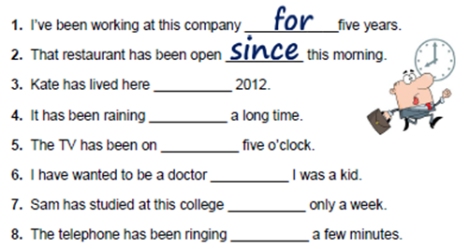
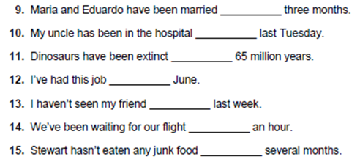

Slide 17
for
for
since
since
for
for
for
since
for
since
since
for
for

Slide 18
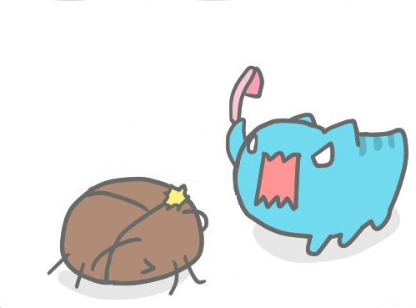
already / just / yet
Already, just and yet can are all used with the present perfect
Already means 'something has happened sooner than we expected:
The movie only came out yesterday, but I have already seen it.
Just means 'a short time ago':
I have just seen your brother going into the pet store! Are you getting a dog?
Yet is only used in questions and negative sentences. It means 'something is expected to happen.
Have you finished the report yet?
No, I haven't finished it yet.

Slide 19
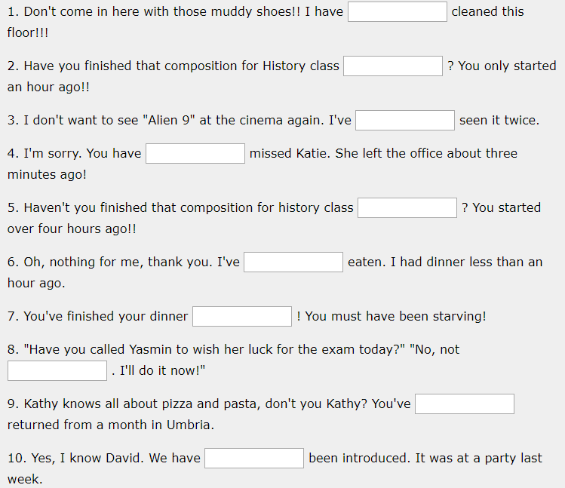
Complete the following sentences with JUST / YET / ALREADY

Slide 20
Complete the following sentences with JUST / YET / ALREADY
just
already
already
just
yet
just
already
yet
just
already

Slide 21

Complete the following sentences

Slide 22
Complete the following sentences
have booked
has just caught
have just drawn
has already invited
has just made
have passed
have just fed
have already drunk
has lost
have already downloaded

Slide 23
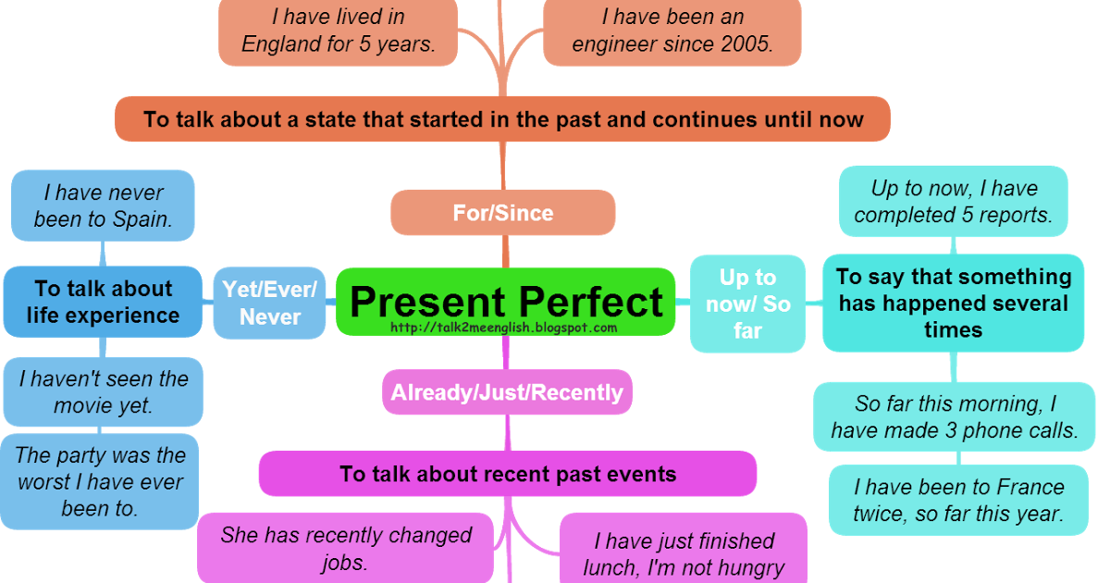

Slide 24
QUIZ
Decide whether the verbs in future in these sentences are wrong or right. Correct the ones that are wrong DO NOT write the whole sentences again.
Example: I don’t know your telephone number. Right ______________
Please don’t make so much noise. I study. Wrong am studying____
This is the second time I asked you to clean your room. _________ __________________
This is the fist time that I was to Italy. _________ __________________
Have Neil and Sarah already gone to go to the concert? _________ __________________
Mary isn’t here now, she’s been to the school. _________ __________________
Sophie has received the letter on Friday . _________ __________________
We haven’t completed the report last week. _________ __________________
They have recently received a new car. _________ __________________
I have phoned him yesterday. _________ __________________
We have known each other for January. _________ __________________
We have already met a couple of times. _________ __________________

Slide 25
QUIZ
Complete the following sentences about Loch Ness, use the verbs in brackets in affirmative, negative or questions.
­________________________________(hear) about the Monster of the Loch Ness in UK?
Many tourists from all over the world (be)_________________________ to Loch Ness.
However, most of them (see) _________________________ Nessie, the monster.
Only very few people say that the Loch Ness Monster (appear) _________________________ in front of them.
Even scientists (come) _________________________ to Loch Ness to find the monster.
And the boss of the Guinness brewery (promise) _________________________ to pay 500,000 pounds to the person who catches Nessie.
So far. Nobody (receive)_________________________ the reward.
Some people (claim) _________________________ to have photos.
Other say that they (catch) _________________________ Nessie on video.
But People (prove) _________________________ the existance of Nessie yet.

Slide 26
referencias
Falla, Tim, Solutions: Pre-intermediate Student’s book,.Oxford Press, Oxford, London. 2nd edition.
Falla, Tim, Solutions: Preintermediate Workbook,.Oxford Press, Oxford, London. 2nd edition.
https://www.ego4u.com/
http://www.perfect-english-grammar.com/

Slide 27
Guion explicativo para el empleo del material, con relación a los objetivos y contenidos del curso
La asignatura de inglés 3 correspondiente al campo disciplinar de la Comunicación ubicándose en el cuarto semestre con el propósito general de Interactúa en el idioma inglés de forma oral y escrita, en situaciones sociales o académicas relacionadas con áreas de experiencia que le son especialmente familiares, para proporcionar información sobre sí mismo u obtener información de las personas que le rodean, pasatiempos, describir intereses, actividades rutinarias, actividades en progreso, aspectos de su pasado personal y del lugar en donde vive, eventos recientes, experiencias de vida; así como extraer información de distintas fuentes: visuales, auditivas y audiovisuales. . (programa de inglés 3, 2017).
El curso se compone de 4 módulos:
El primer módulo hace una revisión del futuro y 2 temas gramaticales contrastando sus usos y sus estructuras, el módulo dos trata de las experiencias de vida, el tercero modulo es un repaso del semestre anterior donde se contrastan qué hago habitualmente y lo que estoy haciendo en este momento y finalmente el modulo cuatro, trata de explicar momentos y acciones del pasado.

Slide 28
De forma más específica el módulo II “Mis experiencias” tiene como propósito: Construye, de forma oral y escrita, un mensaje para narrar anécdotas, eventos recientes y experiencias en su vida o relacionadas con el entorno en el que se desenvuelve.
Por lo que las presentes diapositivas se centran en el desarrollo de la descripción de experiencias de vida que tienen una conexión con el pasado y el presente. No manifiestan cuando ocurrieron pero son importante para la vida diaria.

Slide 29
Competencias
Competencia de la dimensión (perfil de egreso)
COMPETENCIA DISCIPLINAR
Comunicación. Básica
10 Identifica e interpreta la idea general y posible desarrollo de un mensaje oral o escrito en una segunda lengua, recurriendo a conocimientos previos, elementos no verbales y contexto cultural.
11. Se comunica en una lengua extranjera mediante un discurso lógico, oral o escrito, congruente con la situación comunicativa.
Extendida
9. Trasmite mensajes en una segunda lengua o lengua extranjera atendiéndolas características de contextos socioculturales diferentes.
COMPETENCIA GENÉRICA
4 Escucha, interpreta y emite mensajes pertinentes en distintos contextos mediante la utilización de medios, códigos y herramientas apropiados.
4.4 Se comunica en una segunda lengua en situaciones cotidianas.
7. Aprende por iniciativa e interés propio a lo largo de la vida.
7.1 Define metas y da seguimiento a sus procesos de construcción de conocimiento.
10. Mantiene una actitud respetuosa hacia la interculturalidad y la diversidad de creencias, valores, ideas y prácticas sociales.
10.2 Dialoga y aprende de personas con distintos puntos de vista y tradiciones culturales mediante la ubicación de sus propias circunstancias en un contexto más amplio.

Slide 30
Módulo 2
TEMA 1 | Descripción de experienciaS
Uso de la lengua | -Present perfect - just - already - yet
Vocabulario | Phrasal verbs with get Adjectives to describe transport Holiday accommodation Transport

