Slide 1
UNIVERSIDAD AUTÓNOMA DEL ESTADO DE MÉXICO universidad autónoma del estado de méxico
FACULTAD DE LENGUAS
Programa educativo: Licenciatura en lenguas
Unidad de aprendizaje: Lengua inglesa I material: Comparativos y superlativos
Elaboró: MLA Margarita Aurora Caballero Gastélum
Notes:
Pre- actividad/introducción
Primero el maestro mostrará la lámina con las ilustraciones y los alumnos deberán practicar el nombre y pronunciación de los elementos de vocabulario:
A FISH
B CHICKEN
C POTATOES
D APPLES
F BANANAS
G MILK
K CAKE

Slide 2
INGLÉS I comparatives and superlatives
ÍNDICE……………………………………………………………… 2
GUION……………………………………………………………… 3
Comparatives ans superlatives………………………………... 8
  Extra practice (books and websites ………………….….35
  Referencias ………………………………….……………...…36

Slide 3
GUION DE USO PARA MATERIAL PROYECTABLE: INGLÉS I
JUSTIFICACIÓN
El presente material tiene como función principal apoyar al alumno y al maestro con material extra para su enseñanza-aprendizaje en la materia Lengua inglesa I. En la licenciatura en lenguas, la unidad de aprendizaje Lengua inglesa I es obligatoria para todos los alumnos, en el área de especialidad que elijan, docencia o traducción ya sea del inglés o francés.

Slide 4
GUION DE USO PARA MATERIAL PROYECTABLE: INGLÉS I
Los alumnos con énfasis en inglés, deben cursar de forma obligatoria, ocho niveles de lengua inglesa, por su parte, los alumnos que elijen la lengua francesa, únicamente cursan cuatro niveles de inglés. Por lo tanto, la unidad de aprendizaje Lengua inglesa I es esencial en su formación temprana en la lengua extranjera.

Slide 5
GUION DE USO PARA MATERIAL PROYECTABLE: INGLÉS I
Este material profundiza en el estudio de la lengua inglesa en un nivel principiante. el currículum de la Facultad de Lenguas señala que el alumno deberá manejar esta lengua en un nivel básico (A1 según CEFR), desarrollando las cuatro habilidades de la lengua.
El material que presentan las diapositivas se concentra en el tema de: comparativos y superlativos “comparatives and superlatives”.

Slide 6
Elegí este tema porque de acuerdo a mi experiencia, es un tema gramatical que, si no queda lo suficientemente claro, puede representar una problemática mayúscula en un nivel básico y después al avanzar en el estudio de la lengua inglesa.
El material de estas diapositivas cuenta en el pie de página con notas explicativas que pueden ayudar al maestro a seguir una clase desde la introducción-explicación-desarrollo-ejemplos y práctica extra, para de este modo practicas todas las habilidades de la lengua.

Slide 7
El maestro puede decidir utilizar todo el material en una sesión, aproximadamente 90 minutos, o elegir únicamente algunos ejercicios.
El tema comparatives and superlatives aparece en la unidad de conocimiento IV del programa Lengua inglesa I, p.15.
Asimismo, todos los ejercicios tienen las respuestas correctas en las notas correspondientes.
En las diapositivas 35 y 36 , se incluyen: materiales extra de consulta las y referencias usadas.
Espero que sea de gran utilidad para maestros y alumnos que estén interesados en el aprendizaje de la lengua inglesa.

Slide 8
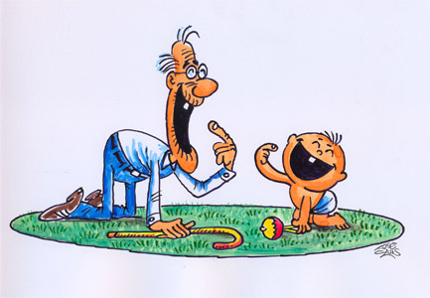
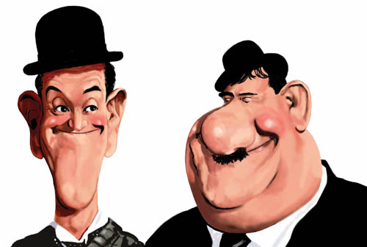
Comparatives and superlatives
Thin / Fat
Old/Young
Notes:
Pre-actividad
Primero, el maestro mostrará las imágenes para que los alumnos describan las diferencias entre estas dos imágenes, al mismo tiempo, llevará a cabo una lluvia de ideas para que los alumnos mencionen otros ejemplos de adjetivos que muestren opuestos: rápido- lento (fast-slow), caro-barato (expensive, cheap). El maestro pondrá los ejemplos en el pizarrón.

Slide 9

COMPARATIVES 1
Comparative forms of adjectives are formed when you add –er to a short adjective (one-syllable adjective):
Old- older big - bigger
Nice – nicer thin - thinner
Slow – slower hot – hotter
Easy – easier heavy - heavier
Notes:
El maestro explica de manera breve la diferencia entre adjetivos largos y cortos. Puede usar los adjetivos que los alumnos mencionaron en la actividad introductoria o usar los de esta diapositiva.
El maestro pondrá atención especial a los cambios ortográficos que tienen lugar en algunos adjetivos. Por ejemplo thin/thinner

Slide 10
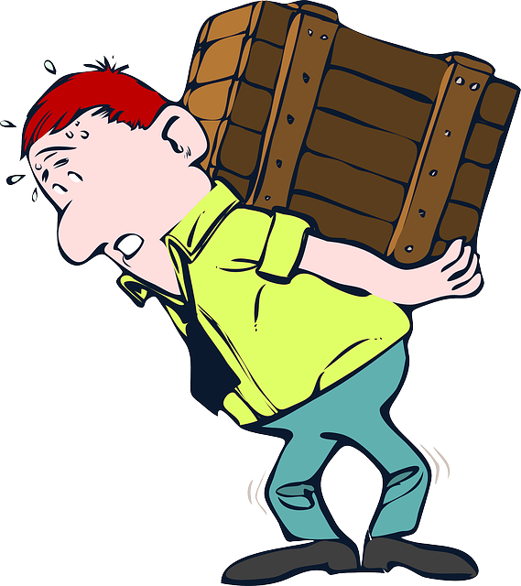
Exercise 1
Write the comparative:
Old: older 2. strong:
Large: 4. pretty:
High: 6. heavy:
Slow: 8. cheap:
Notes:
Exercise 1:
Los alumnos trabajan en parejas para encontrar los comparativos de los adjetivos del 1-8. El maestro deberá poner atención a la ortografía.
2. Stronger
3. Larger
4. Prettier
5. Higher
6. Heavier
7. Slower
8. cheaper

Slide 11

COMPARATIVES 2
THE COMPARATIVE FORMS OF LONG ADJETIVES (2 OR MORE SYLLABLES) IS FORMED ADDING THE WORD MORE BEFORE THE ADJECTIVE:
CAREFUL – MORE CAREFUL
INTERESTING – MORE INTERESTING
EXPENSIVE – MORE EXPENSIVE
DANGEROUS – MORE DANGEROUS
Notes:
El maestro ahora pone ejemplos con adjetivos largos, puede usar los que mencionaron los alumnos en la actividad introductoria y agregar los que están en esta diapositiva.

Slide 12

Exercise 2
Write the comparative:
Crowded: more crowded 2. important:
Polite: 4. careful:
Beautiful: 6. polluted:
Cosmopolitan: 8. romantic:
Notes:
Exercise 2:
Los alumnos trabajan en parejas para escribir el comparativo de los adjetivos en esta diapositiva. El maestro verifica las respuestas con los alumnos. También se revisarán los significados, en caso de tener alguna duda.
2. More important
3. More polite
4. More careful
5. More beautiful
6. More polluted
7. More Cosmopolitan
8. More romantic

Slide 13

Irregular adjectives
There are some exceptions to form comparatives with some adjectives.
Far – further / farther
Good – better
Bad - worse
Notes:
El maestro le indica a los alumnos que estos adjetivos tienen una forma irregular en su forma comparativa, y les indicará que la forma correcta es la que aparece en esta diapositiva.

Slide 14
use
You use comparatives to compare people, animals and things with other people, animals and things. To make the comparative sentence you add the word than.
Examples:
Toluca is smaller than mexico city.
I find history more interesting than physics.
My grade in french is worse than my grade in english.
Notes:
El maestro explica el uso de los comparativos y muestra los ejemplos de esta diapositiva.

Slide 15
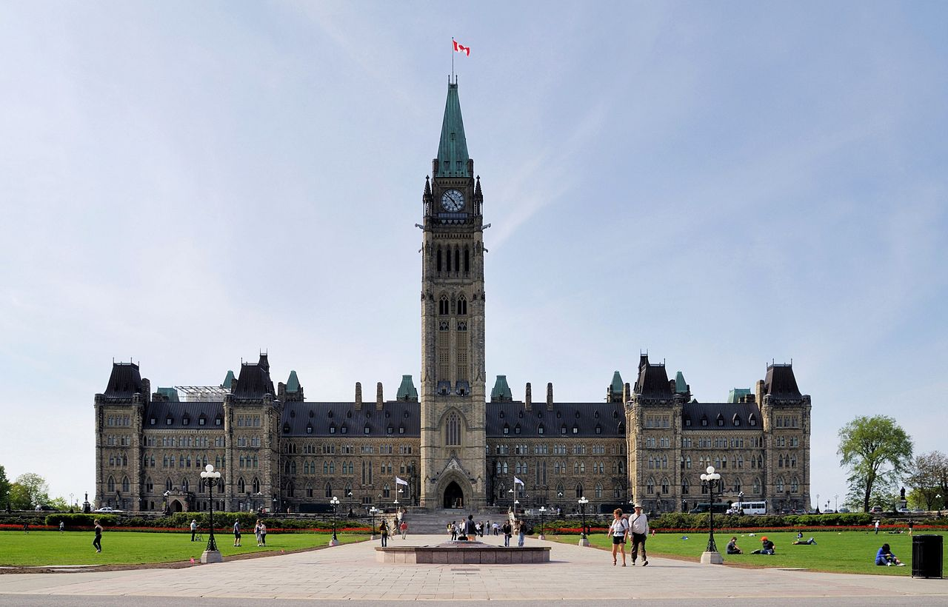
Practice 1
Complete the text with the adjectives in brackets in the comparative form
Many people think that Toronto is the capital of Canada. Actually, Ottawa is the capital. Ottawa is (1) ___________ (small) than Toronto. It’s also (2) __________ (cold) in winter. Lots of people say that Toronto is (3) __________ (interesting), because it’s (4) ___________ (big) and (5) ___________ (cosmopolitan). I think that Ottawa has more historical buildings than Toronto. Canadians also say that people from other cities are (6) __________ (friendly) than Torontians. Traffic in Toronto is (7) __________ (bad) than traffic in Ottawa. There are too many cars. Toronto and Ottawa are both safe cities. They are (8) ________ (safe) than many other North American cities. (Adapted from Straightforward A2)
Notes:
Answers:
1. smaller, 2. colder, 3. more interesting, 4. bigger, 5. more cosmopolitan, 6. friendlier, 7. worse, 8. safer.

Slide 16
Practice 2
cheap interesting
dangerous good
modern
Notes:
El maestro le pide a los alumnos que elaboren 5 oraciones que incluyan el comparativo de los adjetivos incluidos en esta imagen.
El maestro revisa junto con los alumnos las oraciones.
Ejemplos:
My second-hand car is cheaper than your new car.
I consider documentaries are more interesting than soap operas.
Driving at 120kmph is more dangerous than driving at 60kmph.
Eating fruit and vegetables is better for your health than eating junk food.
The new faculty building is mode modern than the original one.

Slide 17

Superlatives 1
superlative forms of adjectives are formed when you add –est to a short adjective (one-syllable adjective):
Old- oldest big - biggest
Nice – nicest thin - thinnest
Slow – slowest hot – hottest
Easy – easiest heavy - heaviest
Notes:
El maestro explica de manera breve la diferencia entre adjetivos largos y cortos. Puede usar los adjetivos que los alumnos mencionaron en la actividad introductoria o usar los de esta diapositiva.
El maestro pondrá atención especial a los cambios ortográficos que tienen lugar en algunos adjetivos. Por ejemplo thin/thinnest

Slide 18

Exercise 3
Write the superlative:
Old: oldest 2. strong:
Large: 4. pretty:
High: 6. heavy:
Slow: 8. cheap:
Notes:
Exercise 3:
Los alumnos trabajan en parejas para encontrar los superlativos de los adjetivos del 1-8. El maestro deberá poner atención a la ortografía.
2. Strongest
3. Largest
4. Prettiest
5. Highest
6. Heaviest
7. Slowest
8. cheapest

Slide 19

Superlatives 2
THE superlative FORMS OF LONG ADJETIVES (2 OR MORE SYLLABLES) IS FORMED ADDING The most BEFORE THE ADJECTIVE:
CAREFUL – the most CAREFUL
INTERESTING – the most INTERESTING
EXPENSIVE – the most EXPENSIVE
DANGEROUS – the most DANGEROUS
Notes:
El maestro ahora pone ejemplos con adjetivos largos, puede usar los que mencionaron los alumnos en la actividad introductoria y agregar los que están en esta diapositiva.

Slide 20

Exercise 4
Write the superlative form of the following adjectives:
Crowded: more crowded 2. important:
Polite: 4. careful:
Beautiful: 6. polluted:
Cosmopolitan: 8. romantic:
Notes:
Exercise 4:
Los alumnos trabajan en parejas para escribir el superlativo de los adjetivos en esta diapositiva. El maestro verifica las respuestas con los alumnos. También se revisarán los significados, en caso de tener alguna duda.
2. The most important
3. The most polite
4. The most careful
5. The most beautiful
6. The most polluted
7. The most cosmopolitan
8. The most romantic

Slide 21
Irregular adjectives
There are some exceptions to form comparatives with some adjectives.
Far – furthest / farthest
Good – the best
Bad – the worst
Notes:
El maestro le indica a los alumnos que estos adjetivos tienen una forma irregular en su forma superlativa, y les indicará que la forma correcta es la que aparece en esta diapositiva.

Slide 22
use
We use superlatives to compare people, animals and things with all the other people, animals, and things in that group.
  Star galleries is the most popular mall in the city.
  She is the most astonishing actress in Hollywood.
Notes:
El

Slide 23

PRACTICE 1
Write the superlative form of the following sentences:
Eg. A safe city: the safest city
A nice girl 5. A GOOD BOOK
An interesting book 6. A QUIET PLACE
A DANGEROUS PLACE 7. AN EXPENSIVE DRESS
A BAD GRADE 8. A BIG CLUB
Notes:
El maestro organiza a los alumnos en parejas y les pide que contesten el ejercicio. Después lo revisan de manera grupal.
The nicest girl
The most interesting book
The most dangerous place
The worst grade
The best book
The quietest place
The most expensive dress
The biggest club

Slide 24
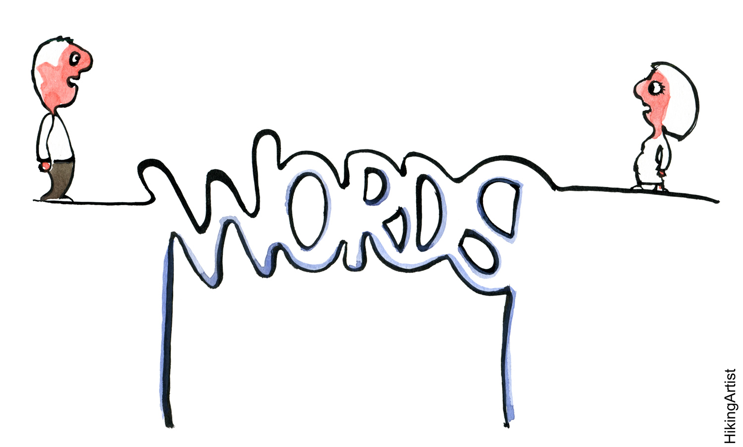
Practice 2
Complete the sentences using the superlative form of the adjectives in brackets.
One of the longest (long) words in english is floccinaucinihilipilification but i don’t know what it means!
_____ (short) words in english are a and i.
In spoken english, one of the ______(popular) words is i- because we think we’re ______(interesting) topic in the world!
______ (useful) noun in english is time. We use it all the time!
____ (fast) way to learn a language is to go and live in a different country.
Some people think _____ (important) thing for language learners is speaking.
I think _____ (good) way to improve your english is to learn lots of words – i try to learn ten new words every day. (adapted from: empower a2)
Notes:
El maestro y los alumno revisan las respuestas.
2. The shortest
3. The most popular / the most interesting
4. The most useful.
5. The fastest.
6. The most important
7. The best

Slide 25
Practice 3
Write sentences with comparatives (older, etc.) and superlatives (the oldest, etc.)
A
(big/small)
(A/D) A is bigger than D
(A) A is the biggest
(B) B is the smallest
C
D
B
Notes:
El maestro da las instrucciones para el siguiente ejercicio. Los alumnos deberán elegir la opción correcta –comparativo o superlativo, y completar cada ejercicio.
Para que sea más sencillo, el primer ejemplo en esta dispositiva indica la forma en la que se debe contestar este ejercicio.

Slide 26
2
A
B
C
d
(long/short)
(C/A) _____________________
_____________________
(B) _____________________
Notes:
Respuesta:
C is shorter than A
D is the longest
B is the shortest.

Slide 27
3
A B C D
                (Young/old)
                (D/a) ________________________
                (B) ________________________
                (C) ________________________
I’m 23
I’m 19
I’m 24
I’m 21
Notes:
Respuesta:
D is younger than A
B is the youngest
C is the oldest

Slide 28
4
A B C D
                (expensive / cheap)
                (D/B) _____________________
                (C) _______________________
                (A) _______________________
$8
$10
$15
$12
Notes:
Respuestas:
D is more expensive than B
C is the most expensive
A is the cheapest

Slide 29
5
RESTAURANT A
RESTAURANT B
RESTAURANT C
RESTAURANT D
(GOOD / BAD)
(C/D) ____________
______________
______________
(Adapted from: Essential grammar in use)
Notes:
Respuestas:
C is worse than D
A is the best restaurant
B is the worst restaurant

Slide 30
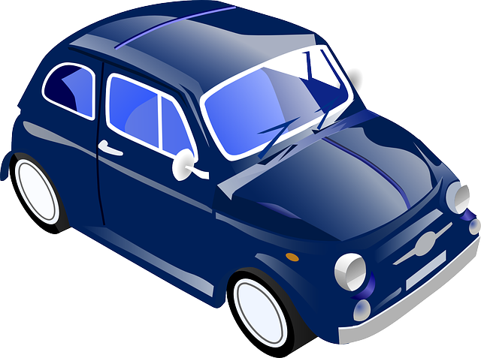
Extra practice 1
Complete the sentences. Use a comparative.
1. Helen’s car isn’t very big. She wants a bigger one.
2. My job isn’t very interesting, I want to do something more interesting.
3. You’re not very tall. Your brother is _____________________.
4. David doesn’t work very hard. I work ____________________.
5. my chair isn’t very comfortable. Yours is __________________.
6. Your plan isn’t very good. My plan is ______________________.
7. these flowers aren’t very nice. The blue ones are _____________.
8. My bag isn’t very heavy. Your bag is _________________________.
9. i’m not very interested in art. I’m _____________________________ in history.
10. it isn’t very warm today. It was ___________________________ yesterday. (From Essential grammar in use)
Notes:
Respuestas:
3. Taller than you.
4. Harder than him.
5. More comfortable.
6. Better than yours.
7. nicer.
8. Bigger than mine.
9. More interested
10. warmer.

Slide 31

Extra practice 2
Complete the sentences. Use a superlative (the oldest, etc)
1. this building is very old. It’s the oldest building in the town.
2. It was a very happy day. It was _____________________ of my life.
3. it’s a very good film. It’s __________________________ I’ve ever seen.
4. she’s a very popular Singer. She’s ___________________ in the country.
5. it was a very bad mistake. It was ___________________ i’ve ever made.
6. it’s a very pretty village. It’s _______________________ i’ve ever seen.
7. it was a very cold day. It was ________________________ of the year.
8. he’s a very boring person. He’s ______________________ i’ve ever met. (from Essential grammar in use.
Notes:
Respuestas:
2. The best day
3. The happiest day
3. The best film
4. The most popular Singer
5. The worst mistake
6. The prettiest village
7. The coldest day
8. The most boring person

Slide 32
Extra practice 3
Write sentences with a superlative (the longest, etc.)
Sydney is the largest city in Australia. (From Essential Grammar in use)
The USA
Africa
The solar system
South America
The world
Australia
Sydney
Brazil
Everest
Jupiter
Alaska
The Nile
Country
City
Planet
State
River
mountain
Large
Long
high
Notes:
Respuestas:
Brazil is the largest country in South America
Everest is the highest mountain in the world
Jupiter is the largest planet in the solar system
Alaska is the largest state in the USA
The Nile is the longest river in Africa

Slide 33
Extra practice 4
Underline the correct words to complete the sentences:
They say that chinese is one of the more difficult/the most difficult/ the difficultiest languages of the world.
italian is one of the most popular / most popular / the popularest languages to learn
In 2014, the goodest / the best / the most good tennis player was Novak Djokovic.
I work in one of the noisyest / the most noisy / the noisiest areas of the city.
I think otomi is the more strange/ the strangest / the most strange language! It is spoken in some areas of mexico.
I think spain the interistingest / the most interesting / most interesting country to visit in europe.
Messi is one of the most famous / the famousest / the more famous football players in the world.
Notes:
Respuestas:
2. The most popular
3. The best
4. The noisiest
5. The strangest
6. The most interesting
7. The most famous

Slide 34
Extra practice 5
Put the words in the correct order to make sentences
Funniest/one/of the/on tv/he’s/people. he’s one of the funniest people on tv.
In the world/the/animal/the cheetah/fastest/is. ____________________________.
The/sam/best/in our class/student/is. ______________________________________.
Was/the/day/wettest/last Tuesday/of the year. _____________________________.
One of/beautiful/the/she’s/women/most/in the world. _____________________.
Is/the/which/city/biggest/in the world?.___________________________________.
We/last year/the/had/Winter/since 1986/coldest. __________________________.
Japanese/language/is/hardest/to/learn/the. _______________________________.
(From Empower A2)
Notes:
Respuestas:
The cheetah is the fastest animal in the world. The fastest animal in the world is the cheetah.
Sam is the best student in our class. The best student in our class is Sam.
Last Tuesday was the wettest day of the year. The wettest of the year was last Tuesday.
She’s oen of the most beautiful women in the world.
Which is the biggest city in the world.
Last year we had the coldest Winter since 1986. We had the coldest Winter since 1986 last year.
Japanese is the hardest language to learn. The hardest language to learn is Japanese.

Slide 35

Extra practice 6
Read the note about the capital city. Tell your friend about it.
1. …………………… is bigger than …………………………….…..
2. …………………… is safer than ………………………………….
3. …………………… is more interesting than …………………….
London, England
Population: 7.2 million people live in London.
Attractions: You can visit the London Eye, Buckingham Palace and many museums, theatres and restaurants.
Weather: In the summer, tha average temperatura is 22°C. The average temperatura in the Winter is 7°C. It rarely snows.
Cime: lonson is a big city and violent in crime is a problema. Some áreas aren’t safe for tourists.
Pollution: Lonson has lots of cars, but the government is trying to reduce pollution. The River Thames is much cleaner today than it was in the past. (From Straightforward A2)
Notes:
Los alumnos utilizan la información en esta diapositiva y la siguiente para comparar ambas ciudades. Si así lo desea el maestro, los alumnos pueden usar sus ciudades de origen o elegir su ciudad favorita.

Slide 36

Tallinn, Estonia
Population: 430,000
Attractions: Tourists come to visit the beautiful old town with its buildings from the 13th and 14th Centuries.
Weather: The average temperatura in summer is 20°C. In Winter, it’s -5°C. Occasionally parts of the sea around Tallinn freese.
Crime: There is some violent crime, but visitors to the área are usually safe.
Pollution: Oil pollution from the Baltic Sea travels to Estonia’s rivers. Sometimes drinking wáter isn’t safe. (From Straightforward A2)
1. …………………… is bigger than …………………………….…..
2. …………………… is safer than ………………………………….
3. …………………… is more interesting than ………………………

Slide 37
Extra practice (books and websites)
Murphy, R. (2010) English Grammar in Use. Cambridge, UK: CUP
Naylor H. & Murphy, R. (2006) Eseential Grammar in Use Supplementary Exercises. Cambridge, UK.: CUP
Redman, S. (2007) English Vocabulary in Use. Cambridge, UK: CUP
https://www.ef.com/english-resources/english-grammar/countable-and-uncountable-nouns/
https://www.curso-ingles.com/aprender/cursos/nivel-basico/nouns/countable-and-uncountable-nouns
https://www.gingersoftware.com/content/grammar-rules/nouns/countable-uncountable-nouns/
https://learnenglish.britishcouncil.org/en/beginner-grammar/countable-uncountable-nouns-1

Slide 38
referencias
Anderson, p. (2015) empower a2. Cambridge, uk: cup
Clandfield, L. (2005) Straightforward Elementary: Student’s Book. Oxford, UK:McMillan.
Murphy, R. (2010) English Grammar in Use. Cambridge, UK: CUP.
Murphy, R. (2001) Essential Grammar in Use. Cambridge, UK: CUP.

