Slide 1
Universidad Autónoma del Estado de México
Facultad de Economía
Licenciatura en Negocios Internacionales, Bilingüe
Logistica Internacional*
Elaboró: dra en cea. Gabriela Munguía Vázquez
Fecha de elaboración 2019b

Slide 3
Unidad 4.- Los Incoterms (2010) y los RAFTD. (Revised American Foreing Trade definitions)

Slide 4
Guión explicativo de uso
Las siguientes diapositivas contienen puntos importantes sobre la Unidad 4 de UA Logistica Internacional*.
Éstas se complementan con ejemplos claros y ejercicios con la finalidad de ayudar a que el alumno tenga una mejor comprensión de los temas tratados.

Slide 5
Explanatory use guide
The following slides contain important points on the Unit 4 of the International Logistics* learning unit.
These are complemented with clear examples and exercises in order to help the student to have a better understanding of the class issues.

Slide 6
Logística Internacional*
Objetivos de la unidad de aprendizaje.
Seleccionar los mejores procedimientos para la importación y exportación de productos a nivel internacional, basándose en aspectos como el transporte, marítimo, aéreo, terrestre y multimodal, el tratamiento arancelario, INCOTERMS, tratados comerciales y demás factores que puedan afectar el precio del producto en el destino final.

Slide 7
Indices
Los Incoterms (2010) y los RAFTD. (Revised American Foreing Trade definitions)
4.1 Transport
4.2 The surrender of allowances
4.3 Border
4.4 Fees paid
4.5 Fees unpaid
4.6 Pier delivery
4.7 Differences and similarities between Incoterms and RAFTD
Application Exercises (Case study)

Slide 8
4.1 Transport

Slide 9
Factors Affecting
Transportation Decisions
Carrier (party that moves or transports the product)
  Vehicle-related cost
  Fixed operating cost
  Trip-related cost
Shipper (party that requires the movement of the product between two points in the supply chain)
  Transportation cost
  Inventory cost
  Facility cost

Slide 10
Transportation Modes
Trucks
  TL
  LTL
Rail
Air
Package Carriers
Water
Pipeline
Notes:
Notes:

Slide 11
Truckload (TL)
Average revenue per ton mile (1996) = 9.13 cents
Average haul = 274 miles
Average Capacity = 42,000 - 50,000 lb.
Low fixed and variable costs
Major Issues
  Utilization
  Consistent service
  Backhauls
Notes:
Notes:

Slide 12
Less Than Truckload (LTL)
Average revenue per ton-mile (1996) = 25.08 cents
Average haul = 646 miles
Higher fixed costs (terminals) and low variable costs
Major issues:
  Location of consolidation facilities
  Utilization
  Vehicle routing
  Customer service
Notes:
Notes:

Slide 13
Rail
Average revenue / ton-mile (1996) = 2.5 cents
Average haul = 720 miles
Average load = 80 tons
Key issues:
  Scheduling to minimize delays / improve service
  Off-track delays (at pickup and delivery end)
  Yard operations
  Variability of delivery times
Notes:
Notes:

Slide 14
Air
Key issues:
  Location/number of hubs
  Location of fleet bases/crew bases
  Schedule optimization
  Fleet assignment
  Crew scheduling
  Yield management
Notes:
Notes:

Slide 15
Package Carriers
Companies like FedEx, UPS, USPS, that carry small packages ranging from letters to shipments of about 150 pounds
Expensive
Rapid and reliable delivery
Small and time-sensitive shipments
Preferred mode for e-businesses (e.g., Amazon, Dell, McMaster-Carr)
Consolidation of shipments (especially important for package carriers that use air as a primary method of transport)

Slide 16
Water
Limited to certain geographic areas
Ocean, inland waterway system, coastal waters
Very large loads at very low cost
Slowest
Dominant in global trade (autos, grain, apparel, etc.)

Slide 17
Pipeline
High fixed cost
Primarily for crude petroleum, refined petroleum products, natural gas
Best for large and predictable demand
Would be used for getting crude oil to a port or refinery, but not for getting refined gasoline to a gasoline station (why?)

Slide 18
Intermodal
Use of more than one mode of transportation to move a shipment to its destination
Most common example: rail/truck
Also water/rail/truck or water/truck
Grown considerably with increased use of containers
Increased global trade has also increased use of intermodal transportation
More convenient for shippers (one entity provides the complete service)
Key issue involves the exchange of information to facilitate transfer between different transport modes

Slide 19
Design Options for a
Transportation Network
What are the transportation options? Which one to select? On what basis?
Direct shipping network
Direct shipping with milk runs
All shipments via central DC
Shipping via DC using milk runs
Tailored network
Notes:
Notes:

Slide 20
Trade-offs in Transportation Design
Transportation and inventory cost trade-off
  Choice of transportation mode
  Inventory aggregation
Transportation cost and responsiveness trade-off

Slide 21
Choice of Transportation Mode
A manager must account for inventory costs when selecting a mode of transportation
A mode with higher transportation costs can be justified if it results in significantly lower inventories

Slide 22
Inventory Aggregation: Inventory vs. Transportation Cost
As a result of physical aggregation
  Inventory costs decrease
  Inbound transportation cost decreases
  Outbound transportation cost increases
Inventory aggregation decreases supply chain costs if the product has a high value to weight ratio, high demand uncertainty, or customer orders are large
Inventory aggregation may increase supply chain costs if the product has a low value to weight ratio, low demand uncertainty, or customer orders are small

Slide 23
Trade-offs Between Transportation Cost and Customer Responsiveness
Temporal aggregation is the process of combining orders across time
Temporal aggregation reduces transportation cost because it results in larger shipments and reduces variation in shipment sizes
However, temporal aggregation reduces customer responsiveness

Slide 24
Tailored Transportation
The use of different transportation networks and modes based on customer and product characteristics
Factors affecting tailoring:
  Customer distance and density
  Customer size
  Product demand and value

Slide 25
Role of IT in Transportation
The complexity of transportation decisions demands to use of IT systems
IT software can assist in:
  Identification of optimal routes by minimizing costs subject to delivery constraints
  Optimal fleet utilization
  GPS applications

Slide 26
Risk Management in Transportation
Three main risks to be considered in transportation are:
  Risk that the shipment is delayed
  Risk of disruptions
  Risk of hazardous material
Risk mitigation strategies:
  Decrease the probability of disruptions
  Alternative routings
  In case of hazardous materials the use of modified containers, low-risk transportation models, modification of physical and chemical properties can prove to be effective

Slide 27
Making Transportation
Decisions in Practice
Align transportation strategy with competitive strategy
Consider both in-house and outsourced transportation
Design a transportation network that can handle
e-commerce
Use technology to improve transportation performance
Design flexibility into the transportation network

Slide 28
Summary of Learning Objectives
What is the role of transportation in a supply chain?
What are the strengths and weaknesses of different transport modes?
What are the different network design options and what are their strengths and weaknesses?
What are the trade-offs in transportation network design?

Slide 29
4.2 The surrender of allowances

Slide 30
International Transportation Process
From the shipper’s perspective, the management of international transportation involves the planning, implementation, and control of the procurement and use of freight transportation and related service providers to achieve company objectives.
Managing the international transportation process is more complex than that of domestic transportation because of the many differences between the trading nation’s transportation and customs regulations, infrastructure, exchange rates, culture, and language.

Slide 31
Buyer-Seller Agreement
The agreement between the buyer and seller determines the specific transportation criteria the seller must meet. These criteria include the product to be shipped, financial terms, delivery requirements (date and location), packing, the transportation method(s) to be used, and cargo insurance.

Slide 32
Order preparation
Order preparation involves either picking items ordered from inventory or manufacturing them. In either case, the seller must make sure the item prepared for shipping matches exactly what is ordered.
Failure to comply with the product specifications contained in the buyer’s purchase order indicates the buyer’s refusal to accept the shipment or to pay the invoice.

Slide 33
Documentation
International shipments movement is controlled by paper; without proper documentation the shipment does not move.
A missing or incorrect document can delay a shipment and/or prevent the shipment from entering a country. These documents are governed by the customs regulations of the shipping and receiving nations.

Slide 34
Export License
No special authorization is needed to export, but the president of the United States is authorized to control exports for national security, foreign policy, and items in short supply.
In addition, licensing by a federal agency having jurisdiction over a commodity can exercise licensing requirements for a given product, such as the Department of Agriculture having jurisdiction over grain.

Slide 35
Sales Documents
Three sales documents are generally used in international trade
  A pro-forma invoice
  A commercial invoice
  A consular invoice
All three contain essentially the same information: buyer, seller, product descriptions, payment terms, selling price, and other information requested by the buyer, bank, or importing country.

Slide 36
Sales Documents
The pro-forma invoice is issued by the seller to acquaint the importer and import government authorities with details of the shipment. It may be required to obtain necessary foreign exchange information and/or an import license or permit.
The commercial invoice, issued by the seller, is a bill of sale for the goods sold to the buyer, a basis for determining shipment value and importing duty assessment, and a requirement for clearing goods through customs.
The consular invoice is the same as the commercial invoice except it is a special form prescribed by the importing country and it must be completed in the language of the importing country.

Slide 37
Financial Documents
In the buyer-seller agreement, the credit extended by the seller to the buyer is delineated and takes the form of either a letter of credit or draft.
The letter of credit, issued by the buyer’s bank, is a guarantee by the buyer’s bank to the seller that payment will be made if certain terms and conditions are met. These conditions include, for example, documentation, shipping date, time limits, and so on. If these conditions are not met, payment will be withheld.

Slide 38
Financial Documents
The draft is credit extended by the seller directly to the buyer. It is a written order for a sum of money to be paid by the buyer on a certain date. Upon presentation of the draft to the buyer’s bank, the buyer’s bank collects the money from the buyer, releases the shipment documentation to permit the buyer to receiver the shipment, and remits the money to the seller.

Slide 39
Transportation Documents
As with domestic shipment, international shipments require a bill of lading.
The bill of lading acts as a contract of carriage, a receipt for the goods, and provides carrier delivery instructions. For water shipments, an ocean bill of lading is used; an airway bill is used for air carrier shipments.

Slide 40
Transportation
The transportation elements include the selection of carriers, ports/gateways, intermediaries, and the acquisition of insurance.
At lease three carriers are involved in an international shipment: a domestic, an international, and an foreign carrier.

Slide 41
4.3 Border

Slide 42
Special Trade Zones
Foreign trade zones are areas where foreign goods may be held or processed and then re-exported without incurring duties.
Trade zones can be useful as transshipment points to reduce logistics cost and redesign marketing approaches.
Governments and firms benefit from foreign trade zones.

Slide 43
Export Processing Zones and Economic Zones
In export processing zones, special rules apply that are different in other regions of the country.
These zones usually provide tax-free and duty-free treatment for production facilities whose output is destined abroad.
The maquiladoras of Mexico are one example of a program that permits firms to take advantage of sharp differentials in labor costs.
Through the creation of special economic zones, the Chinese government has attracted many foreign investors bringing in millions of dollars.

Slide 44
Centralized Logistics Management
In international logistics, the existence of a headquarters staff that retains decision-making power over logistics is important.
To avoid internal problems, both headquarters staff and local management should report to one person.
This individual can contribute an objective view when inevitable conflicts arise in international logistics coordination.

Slide 45
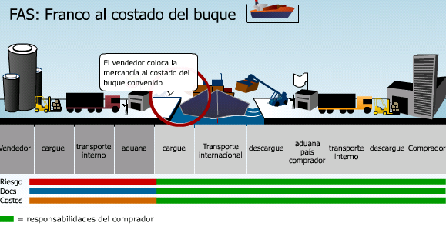
FAS – Free Alongside Ship
Fuente: Legiscomex

Slide 46
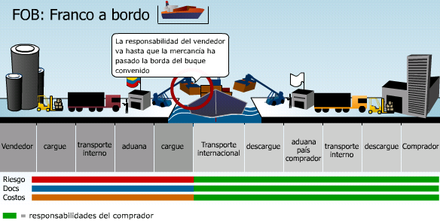
FOB – Free On Board
Fuente: Legiscomex

Slide 47
4.4 Fees paid

Slide 48
Marítimo
En los envíos transoceánicos, el transporte marítimo no tiene competencia. El flete es el mayor componente de coste dentro de la cadena logística de exportación (alrededor del 70%), y sus oscilaciones vienen dadas por la oferta disponible de flota, la capacidad de conseguir los retornos, las variaciones en la demanda (ciclo económico).
RECARGOS
CS: Congestion surcharge
Recargo por congestión
en puerto de escala
HL: Heavy lift
Recargo por extra peso
OOG: Out of gauge
Recargo por carga fuera
de anchura / altura
BAF: Bunker adjustment factor
Recargo por encarecimiento
del combustible
CAF: Currency adjustment factor
Recargo por fluctuación de divisa
EIS: Equipment imbalance surcharge
Recargo por reposición de equipo

Slide 49
Aéreo
Su coste es al menos 4 veces superior al marítimo y sólo se justifica en cadenas con productos de elevado valor, o con con necesidad de tiempo de transporte muy bajo (incidencias o productos perecederos)
RECARGOS
FSC: Fuel surcharge
Recargo por encarecimiento del combustible
GTC: Ground terminal charge
Recargo por costos operativos de pista
SCC: Security surcharge
Recargo por aplicación de procesos de seguridad

Slide 50
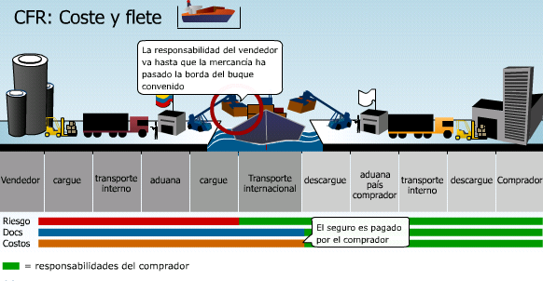
CFR – Cost and Freight
Fuente: Legiscomex

Slide 51
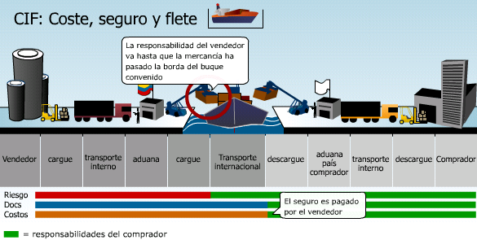
CIF – Cost, Insurance and Freight
Fuente: Legiscomex

Slide 52
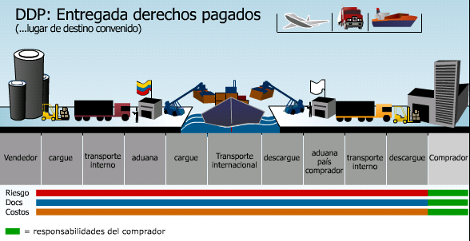
DDP – Delivered Duty Paid
Fuente: Legiscomex

Slide 53
4.5 Fees unpaid

Slide 54
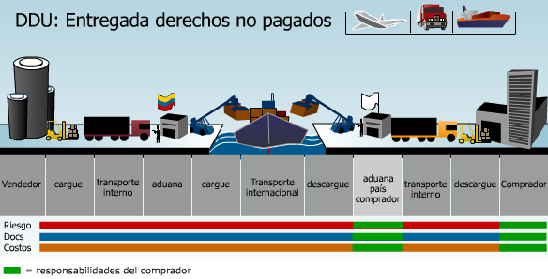
DDU – Delivered Duty Unpaid
Fuente: Legiscomex

Slide 55
4.6 Pier delivery

Slide 56
FAS – Free Alongside Ship
Fuente: Legiscomex

Slide 57
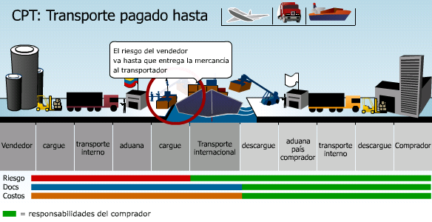
CPT – Carriage Paid To
Fuente: Legiscomex

Slide 58
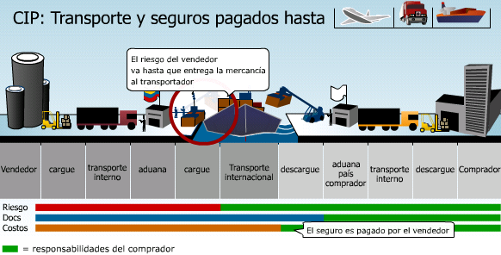
CIP – Carriage and Insurance paid to
Fuente: Legiscomex

Slide 59
4.7 Differences and similarities between Incoterms and RAFTD

Slide 60
Para facilitar las negociaciones y evitar malos entendidos entre comerciantes internacionales, se siguen reglas aceptadas en el ámbito internacional, que señalan las obligaciones y los derechos del comprador y del vendedor. Actualmente los más usados son los Términos de Comercio Internacional o INCOTERMS (International Commercial Terms), los cuales constituyen un conjunto de 13 reglas de la Cámara de Comercio Internacional, aunque algunos comerciantes en Estados Unidos siguen usando las Definiciones Revisadas del Comercio Exterior Estadounidense (RAFTD, por sus siglas en inglés) de la Cámara de Comercio de los Estados Unidos de Norteamérica.
Dado que ambos sistemas utilizan términos comunes, con diferente normatividad, es importante que el exportador deje bien establecido en el contrato que término se está usando.

Slide 61
RAFTD (ESTADOS UNIDOS)
Los RAFTD fueron derogadas en 1985, sin embargo, en la práctica se siguen utilizando por los importadores y exportadores de los Estados Unidos. No son de uso obligatorio, la validez la dan las partes en el momento en que son utilizados estos términos y son aceptadas por ellos, mediante los convenios y contratos establecidos.
Cuando se utilizan los RAFTD es importante que se incluya en los contratos o cotizaciones escritas la siguiente leyenda: Quotation Subject to the Revised American Foreign Trade Definitions 1941 (Cotización sujeta a las Definiciones Revisadas del Comercio Exterior Norteamericano de 1941). Con esto se garantiza que no habrá duda sobre los términos que se estén empleando.

Slide 62
Las definiciones tienen diferentes variantes. El término Ex -Works presenta seis variantes y el FOB otras tantas. A continuación se indican los diferentes tipos de RAFTD con sus variantes:
Siglas | Inglés | Español | Cometarios
Ex (lugar de origen | Ex - works Ex - factory Ex – mills Ex – mine Ex – plantation Ex – warehouse | Ex – planta Ex – fábrica Ex – molino Ex – mina Ex – plantación Ex – almacén | El precio cotizado se aplica solamente en el lugar de origen y el vendedor se compromete a poner la mercancía a disposición del comprador, en el lugar acordado, en la fecha fijada.

Slide 63
FOB (libre a bordo) | Named inland carrier at named inland point of departure | Porteador Interiore Específico en el lugar interior de embarque específico | El precio cotizado se aplica solamente en el lugar de embarque en el país, y el vendedor hace los arreglos necesarios para cargar la mercancía en ferrocarriles, camiones, barcazas, lanchones, aviones o cualquier otro medio de transporte disponible,
FOB (libre a bordo) | Named inland carrier at named inland point of departure freight prepaid to (named point of exportation) | Porteador interior específico en el lugar de embarque específico “flete pagado hasta” (lugar específico de exportación) | El vendedor cotiza un precio que incluye los gastos de transporte hasta el lugar específico del que partirá la exportación, sin asumir responsabilidad alguna sobre la mercancía después de obtener el correspondiente conocimiento de embarque sin tachadura alguna, u otro recibo de transporte en el lugar interior de partida específico.
FOB (libre a bordo) | Named inland carrier at named inland point of departure freight allowed to (named point) | Porteador interior específico en lugar de embarque específico “flete incluido hasta”(lugar específico) | El precio incluye los gastos de transporte hasta el lugar del cual se trate, fletes marítimos pagados a la entrega, y deduciendo el costo de transporte sin asumir responsabilidad alguna de las mercancías después de obtener un conocimiento de embarque sin tachadura alguna, u otro recibo de transporte en el lugar interior de embarque específico.
FOB (libre a bordo) | Named inland carrier at named point of exportation | Porteador Interior Especificó (libre a bordo) en lugar específico de exportación | El vendedor cotiza un precio que incluye el costo del transporte de ka mercancía hasta el lugar específico de exportación y asume cualquier pérdida o daño, o ambos, incurridos hasta ese momento.
FOB VESSEL (embarcación) | Named point of shipment | Puerto específico de embarque | Incluye todos los gastos hasta la entrega de la mercancía y todos los gastos de transporte hasta el lugar interior convenido en el país de importación.
FOB ( libre a bordo) | Named inland point in country of importation | Lugar interior específico en el país de importación | Se cotiza un precio que incluye el costo de la mercancía y todos los gastos de transporte hasta el lugar interior convenido en el país de importación.
FAS | Free Along Side | Libre al costado de la embarcación | Se cotiza un precio que incluye la entrega de la mercancía en el costado de la embarcación y al alcance del equipo de carga de ésta.
C & F | Cos & Freigth | Costo y Flete | El precio incluye el costo del transporte hasta el lugar en específico de destino de la mercancía.
CIF | Cost, Insurance & Freight | Costo, Seguro y Flete | Indica que además del costo de la mercancía, se incluye el seguro marítimo y todos los cargos de transporte hasta el punto específico de destino.
EX - DOCK | Named point of importation | Puesto en muelle en el país de destino | El vendedor cotiza un precio que incluye el costo de la mercancía y todos los costos adicionales y necesarios para situar la mercancía en el muelle del puerto específico de importación, con los impuestos pagados si es el caso.

Slide 64
INCOTERMS
Los INCOTERMS son los términos bajo los cuales se establecen las obligaciones y derechos de las partes participantes en un intercambio comercial internacional. Su importancia radica en que dependiendo del término que se use en el contrato, se desprenderán los derechos y obligaciones de cada una de las partes con relación al lugar donde se entrega la mercancía, regulando tres aspectos básicos entre el comprador y el vendedor: transferencia de riesgos, costos y documentación.
Cabe mencionar que en virtud de la "Segunda Resolución de Modificaciones a la Resolución Miscelánea de Comercio Exterior 1999" en la que se modifica la regla 3.5.1, se vuelve imprescindible incorporar correctamente los INCOTERMS 1990 en las operaciones de Importación y Exportación para determinar el correcto valor de aduanas de las mercancías. Es de esperarse que esta resolución se haga extensible a los 2000 porque de hecho ya se están utilizando.

Slide 65
Los INCOTERMS pueden clasificarse de dos formas:
1) Por grupos: se clasifica por la primera letra de las siglas deI INCOTERM; los términos que inician con las letras E y F son entregados en el país de origen y los que inician con C y D son entregados en el país de destino.
2) Por tipo de transporte a utilizar (el transporte que se recomienda):
A = Aéreo
M = Marítimo o fluvial
O = Cualquier tipo de transporte, incluyendo multimodal
T = Transporte terrestre
Las definiciones de cada uno de los INCOTERMS versión 2000, pueden ser consultadas en la Guía Básica del Exportador editado por Bancomext, en la biblioteca del mismo Bancomext.
Los INCOTERMS más utilizados para la exportación son:
Categoría E el EXW
Categoría C el CIF y CIP
Categoría F el FOB

Slide 66
Application Exercises (Case study)
Coloque verdadero o falso:
Si en una operación FCA la entrega de la mercadería al primer transportista designado por el comprador se realiza en los propios depósitos del vendedor, entonces seria lo mismo que utilizar el Incoterm EXW. Comente si esta de acuerdo, o no, y por qué.
Propuesta | Verdadero o Falso
El Incoterms CIP es para uso en cualquier medio de transporte excepto el marítimo.
El Incoterm CIF y el Incoterm FOB coinciden en la transferencia del riesgo
En el Incoterm FAS los trámites de exportación corren por cuenta del comprador
La cobertura del seguro en CIF debe hacerse en una moneda diferente a la del contrato

Slide 67
En función de la situación descrita, coloque el Incoterm en forma correcta y completa.
Situación Operativa | Incoterm correcto
Importamos 100 Toneladas de determinado Fertilizante provenientes de India. El flete y seguro de la mercadería fueron pagados en origen, desde India hasta Tucumán. Los riesgos se transfieren cuando la mercadería llega a nuestros depósitos en Tucumán, no obstante los trámites aduaneros en Argentina han corrido por nuestra cuenta. La mercadería se entrega sin descargar del camión.
Importamos grampas desde Shangai. La condición de venta incluye costos y gastos hasta que la mercadería se encuentra sobre el buque en el Puerto de Shangai.
Exportamos miel a USA, el medio de transporte será marítimo y nuestra responsabilidad en cuánto a costes y riesgos culmina cuando entregamos la mercadería al transportista. La mercadería debe estar despachada para exportación. No podemos llenar un contenedor completo, por lo que recurrimos a un agente para hacer la consolidación con mercaderías de otros exportadores. Este nos pide que le entreguemos la mercadería en Córdoba para hacer allí la consolidación.

Slide 68
Unit Summary
To conclude, many other types of transportation can be combined perfectly to reach people’s high requirement of the time-sensitive and convenience.
If the shipping from Mexico to China cannot finished by one type of transportation, the international multimodal transport would be a better way to support the strong timeliness.
Therefore, we should learn to combine all the advantages which are from each type of the transport to make the international transport more efficiently and instantly.

Slide 69
VI. Acervo bibliográfico
Bowersox, D (2013), “ supply Chain Logistics Managment”, Mc Graw Hill, cuarta edición, pag 419-452.
Ballou(2004)Business Logistics Management: Supply Chain Management. Planning, Organizing, and Controlling the Supply Chain, Prentice-Hall Internat., - 789 páginas
Chase,R, (2014), “ Administración de Operaciones: Producción y Cadena de Suministro”, Mc Graw Hill, 13° Edición, capitulo 17.
Chopra S. (2013). “Administración de la Cadena de Suministro”: Estrategia, Planeación y operación”, Quinta Edición, Pearson, Capítulo 14.
Coyle, (2013), Administración de la Cadena de suministro: Una perspectiva Logistica”, Cengage Learning, novena edición.
Legiscomex (2019), sistema de Inteligencia comercial en linea: https://www.legiscomex.com
Sosa, (2008), “Documentos, logística de transporte seguros y embalaje internacional de mercancías”, Carpenter Consulting Group,Mexico

