Slide 1
Material Didáctico Audiovisual
Sólo Visión Proyectables Diapositivas
Inglés 1 - Módulo IV
Bachillerato Universitario 2015
Yo: cómo soy y cómo son quienes me rodean
Elaborado por:
M. en I. y G. E. Cesar Martínez Acevedo
Plantel “Dr. Ángel Ma. Garibay Kintana” de la Escuela Preparatoria

Slide 2
Inglés 1
PROPÓSITO GENERAL
Emplea el idioma inglés de forma sencilla para satisfacer sus necesidades inmediatas de interacción, supervivencia o de relación con su entorno, por medio de expresiones cotidianas y representaciones lingüísticas básicas asociadas al contexto cultural y social en el que se desenvuelve.
Continuar

Slide 3
Módulo IV
Nombre del Módulo
Yo: cómo soy y cómo son quienes me rodean.
Propósitos del Módulo
Describe de manera oral y escrita, la apariencia de las personas, lo que están haciendo en el momento y sus actividades cotidianas por medio de apoyos visuales.
Continuar

Slide 4
Competencia Disciplinar
Comunicación Básica
10 Identifica e interpreta la idea general y posible desarrollo de un mensaje oral o escrito en una segunda lengua, recurriendo a conocimientos previos, elementos no verbales y contexto cultural.
11. Se comunica en una lengua extranjera mediante un discurso lógico, oral o escrito, congruente con la situación comunicativa.
Extendida
9. Trasmite mensajes en una segunda lengua o lengua extranjera atendiéndolas características de contextos socioculturales diferentes.
Continuar

Slide 5
Competencia Disciplinar
4 Escucha, interpreta y emite mensajes pertinentes en distintos contextos mediante la utilización de medios, códigos y herramientas apropiados.
4.4 Se comunica en una segunda lengua en situaciones cotidianas.
7. Aprende por iniciativa e interés propio a lo largo de la vida.
7.1 Define metas y da seguimiento a sus procesos de construcción de conocimiento.
10. Mantiene una actitud respetuosa hacia la interculturalidad y la diversidad de creencias, valores, ideas y prácticas sociales.
10.2 Dialoga y aprende de personas con distintos puntos de vista y tradiciones culturales mediante la ubicación de sus propias circunstancias en un contexto más amplio.
Continuar

Slide 6
TEMAS
TEMA 1
TEMA 2
Descripción de personas en relación con la apariencia física y la personalidad
Descripción de lo que las personas hacen en el momento que se les observa
TEMA 3
Descripción de hábitos, rutinas y actividades en progreso en Tiempo Presente Simple y Presente Continuo

Slide 7
PHYSICAL DESCRIPTIONS
BACK

Slide 8
PHYSICAL DESCRIPTIONS
When giving physical descriptions, the two most common verbs to use are BE and HAVE GOT, however, they are quite specific.
We use BE for height, weight, skin colour.
We use HAVE GOT for: hair (length), hair (style), hair (colour) and facial features.
BACK

Slide 9
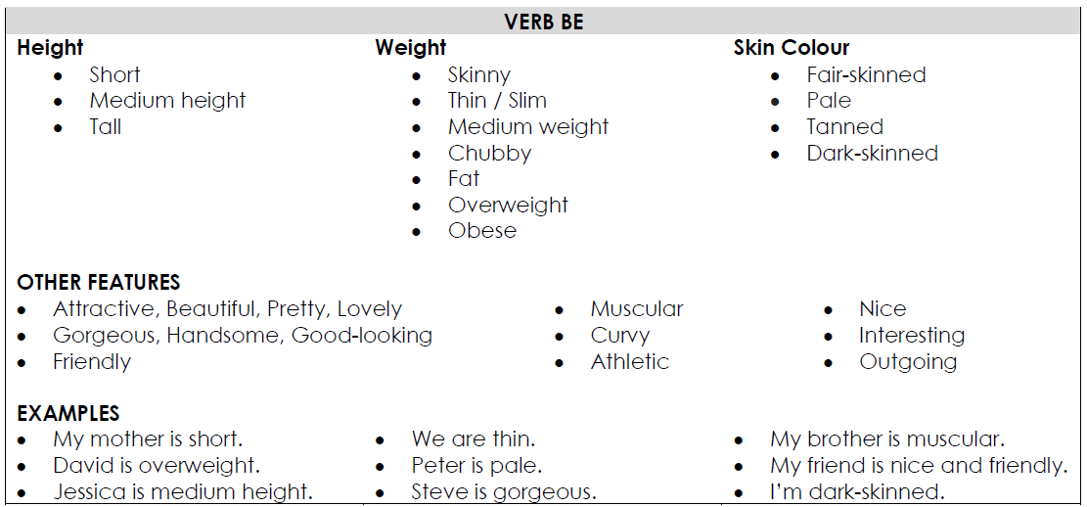
TO BE
BACK

Slide 10
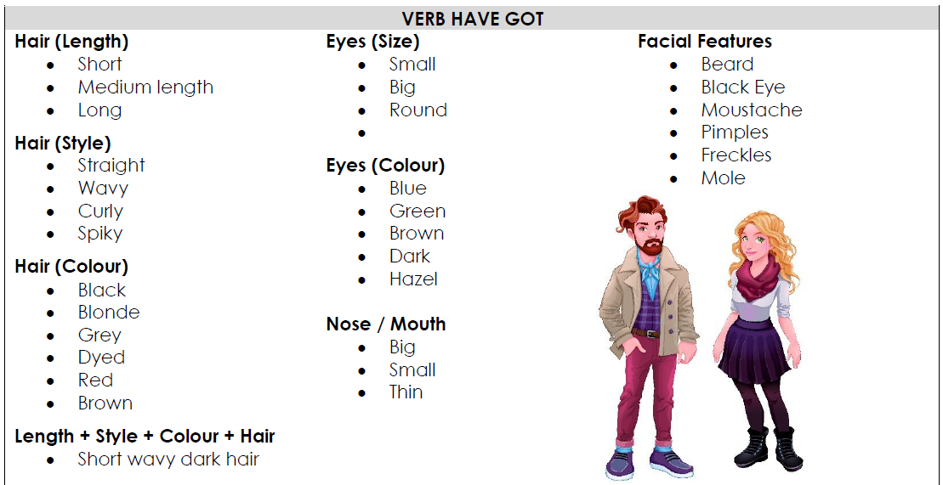
HAVE GOT
BACK

Slide 11
When you describe someone’s personal qualities you should support your description with examples and/or justifications. Match the adjectives to their justifications and say a few words about your friends and relatives.
Adjectives
generous
talkative
energetic
intelligent
bossy
outgoing
rude
impatient
popular
selfish
well-dressed
Justifications
always buys family presents
always tells people what to do
wears smart clothes
isn’t polite to other people
does well at school
is very active
cares only about him/herself
never stops chatting
hates waiting for anything
is liked by everyone
likes to meet people and communicate with them
BACK

Slide 12
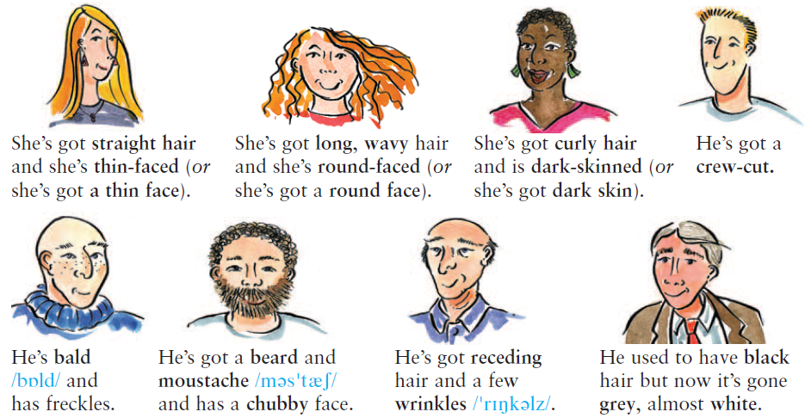
Hair, face, skin and complexion
BACK

Slide 13
Read these descriptions. What are the missing words? Write is or has.
1.- She is around 20. She is tall, slim and beautiful. She has long straight black hair.
2.- He ________ average height and average build. He ________ long hair. he ________ handsome.
3.- She ________ really cute. She ________ medium length wavy hair, and big beautiful eyes.
4.- He ________ average height and average build. He ________ a ponytail. He ________ handsome.
5.- She ________ around 60. She ________ short curly hair, and wears glasses.
6.- He ________ a wide face and a dark complexion. He ________ very muscular.
BACK

Slide 14
Describe the following people
BACK

Slide 15
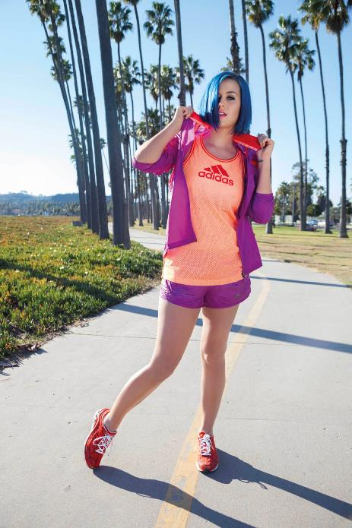
Describe the following people
She is…
She has…
BACK

Slide 16
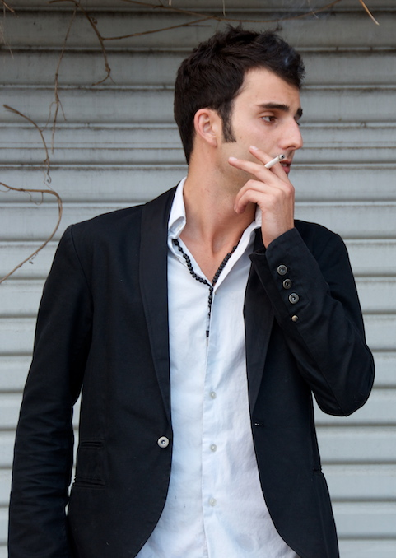
Describe the following people
He is…
He has…
BACK

Slide 17
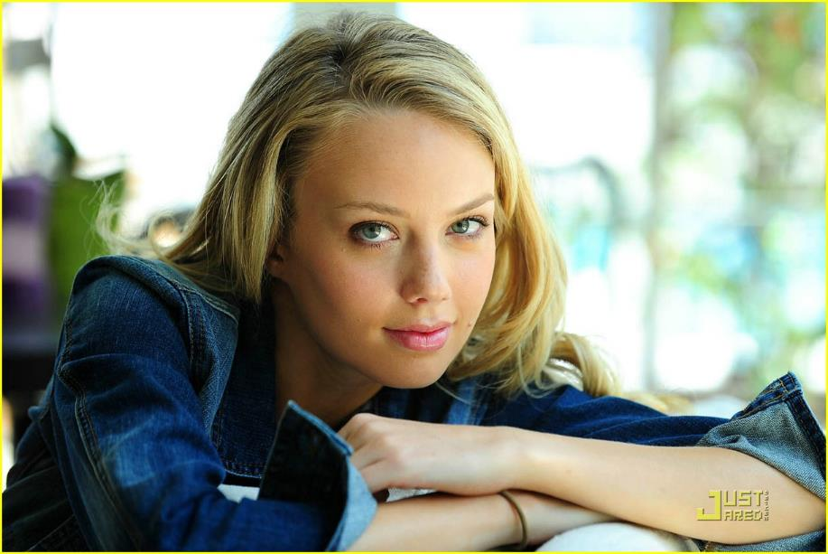
Describe the following people
She is…
She has…
BACK

Slide 18
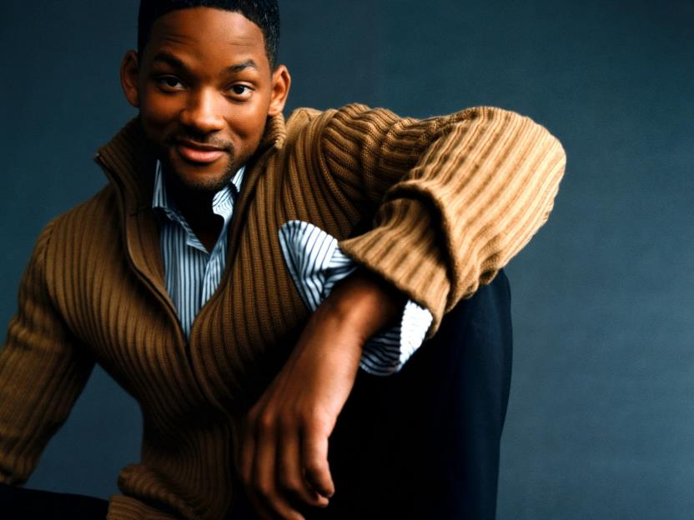
Describe the following people
He is…
He has…
BACK

Slide 19
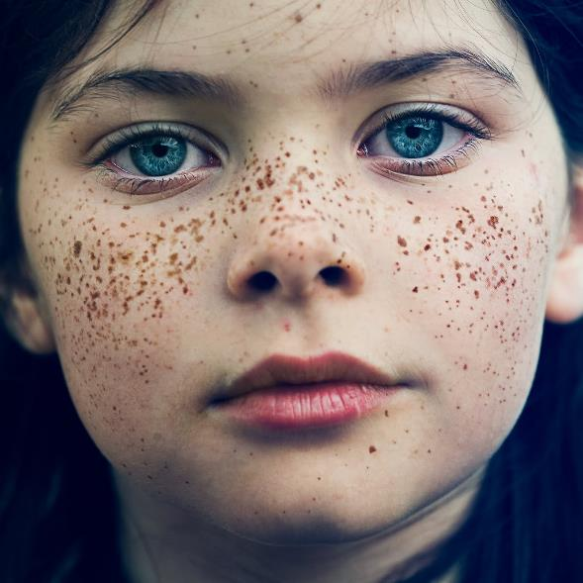
Describe the following people
She is…
She has…
BACK

Slide 20
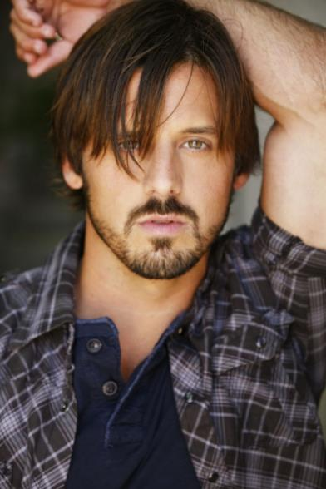
Describe the following people
He is…
He has…
BACK

Slide 21
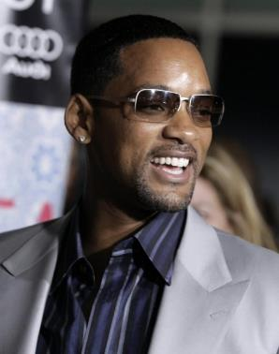
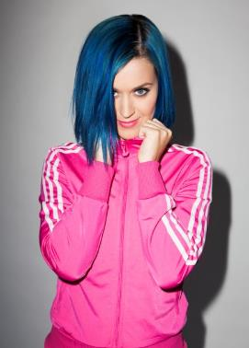
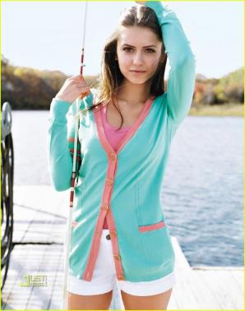
People’s CLOTHES
How to describe people’s clothes
BACK

Slide 22
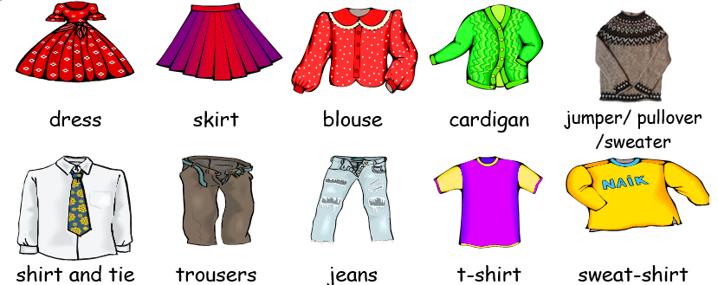
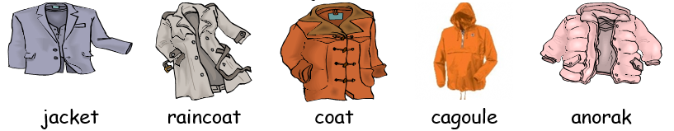
What are you wering?
BACK

Slide 23
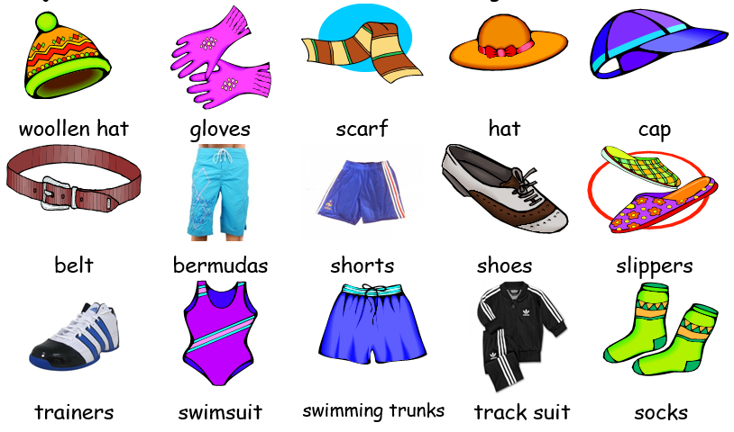
What are you wering?
BACK

Slide 24
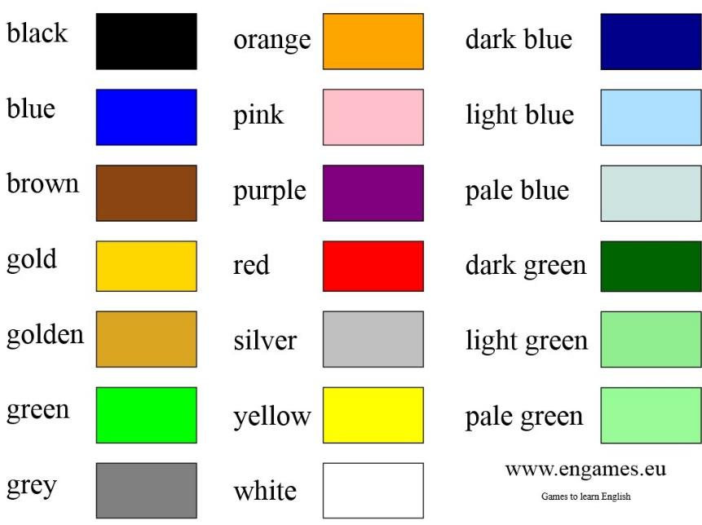
Colors
BACK

Slide 25
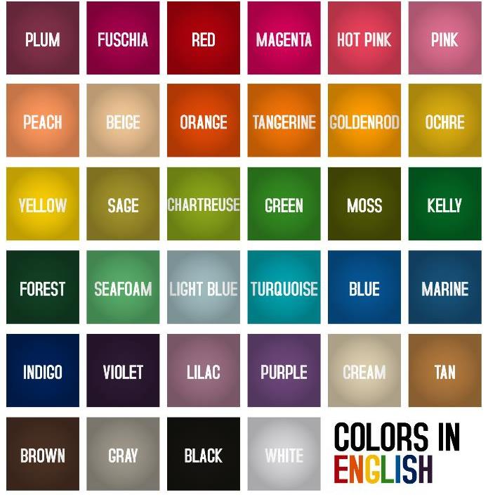
BACK

Slide 26
CLOTHING
Look at the photos and describe what they are wearing.
BACK

Slide 27
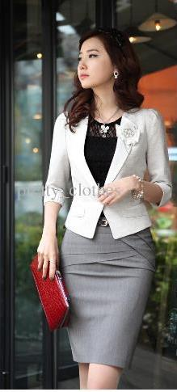
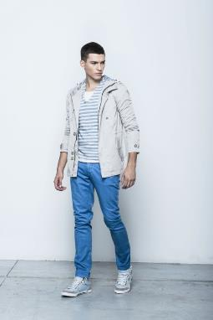
What are you wearing?
I’m wearing …
What is he/she wearing?
He/She is wearing…
What are they wearing?
They are wearing…
BACK

Slide 28

What is she wearing?
She is wearing…
…a white hat, a white blouse, a brown jacket, a black scarf, white jeans and two bags.
BACK

Slide 29
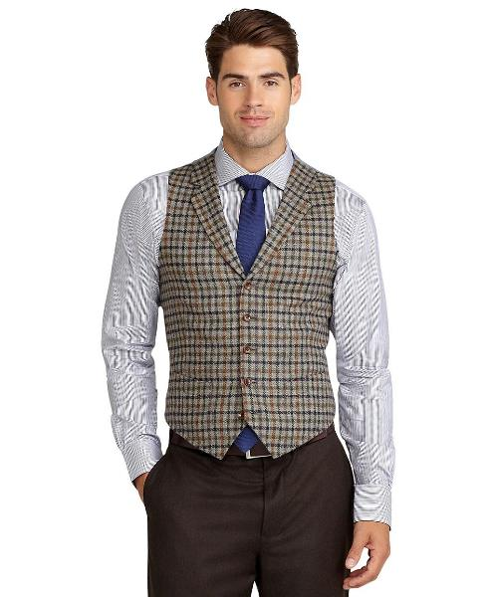
WHAT IS HE WEARING?
HE IS WEARING…
…a grey shirt, a blue tie, a brown waistcoat, a brown belt and brown trousers.
BACK

Slide 30
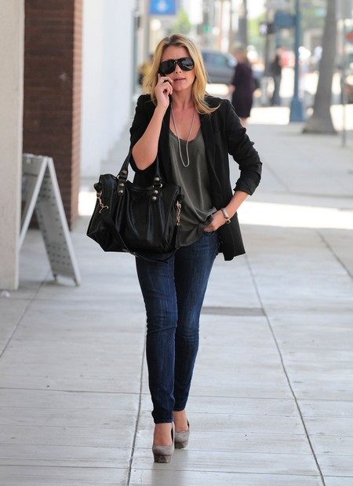
What is she wearing?
She is wearing…
…a black blazer, a green t-shirt, blue jeans, grey high heels, a black bag, glasses, a necklace and a bracelet.
BACK

Slide 31
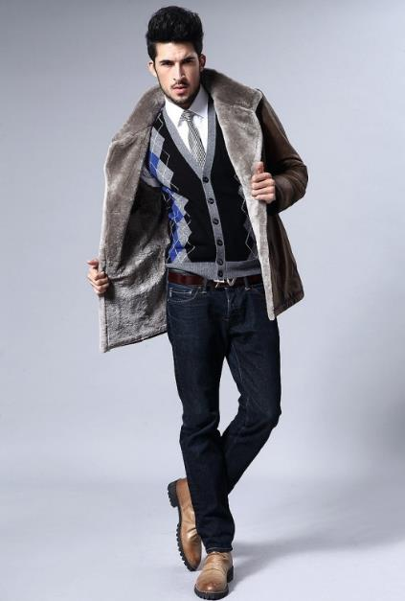
WHAT IS HE WEARING?
HE IS WEARING…
…a brown coat, a black sweater, a grey tie, a white shirt, a brown belt, blue jeans and brown boots.
BACK

Slide 32

What is she wearing?
She is wearing…
…a purple sweatshirt, an orange t-shirt, purple shorts and red trainers.
BACK

Slide 33
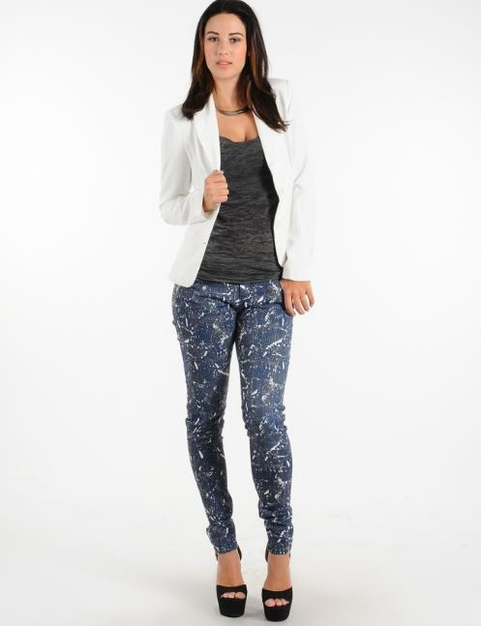
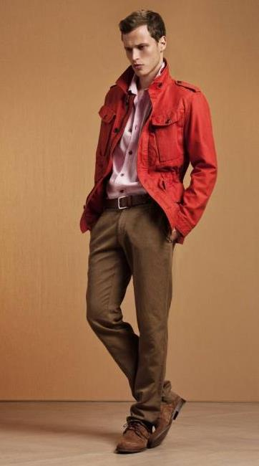
What are they wearing?
BACK

Slide 34
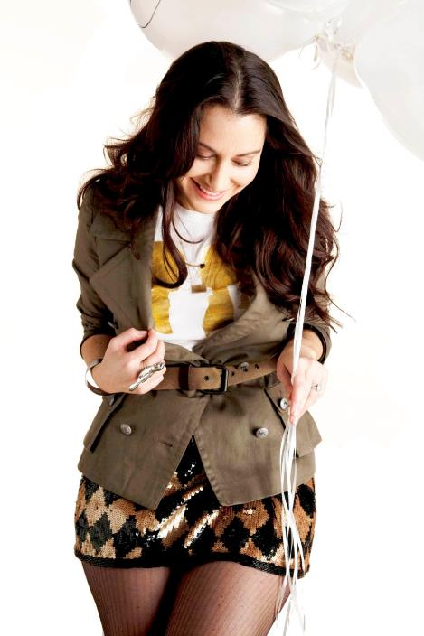
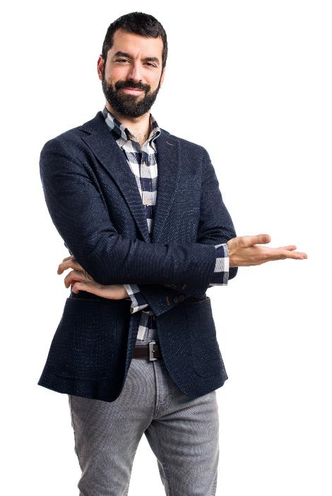
What are they wearing?
BACK

Slide 35

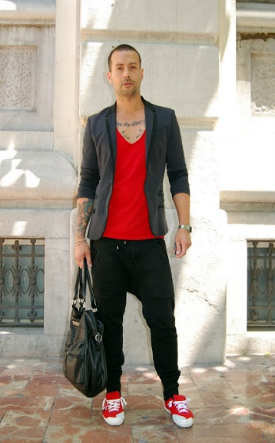
What are they wearing?
BACK

Slide 36


AND You… What are you WEARING NOW?
Today, I’m wearing…
______________________________
______________________________
______________________________
______________________________
BACK

Slide 37
Present Continuous
Activities that are happening now
BACK

Slide 38
Present continuous
Explanation
We use PRESENT CONTINUOUS to show that an action is happening at the moment.
Action in Progress
PAST
PRESENT
FUTURE
BACK

Slide 39

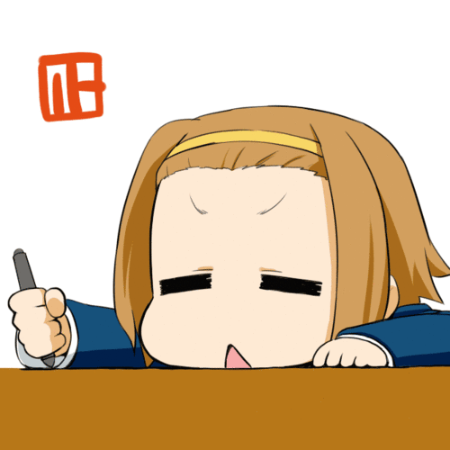
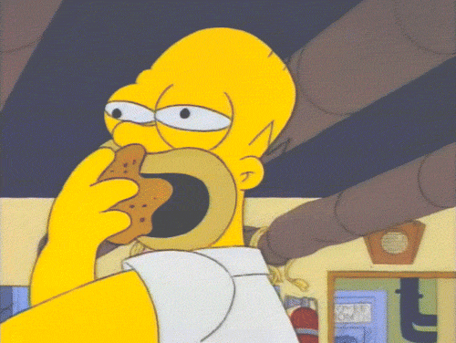
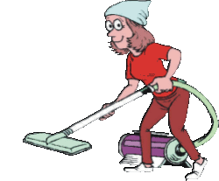
Examples
BACK
Right now, I’m watching my favorite TV series.
At the moment, my sister is doing her homework.
Now, my father is having dinner.
Right now, my mother is cleaning the living room.

Slide 40
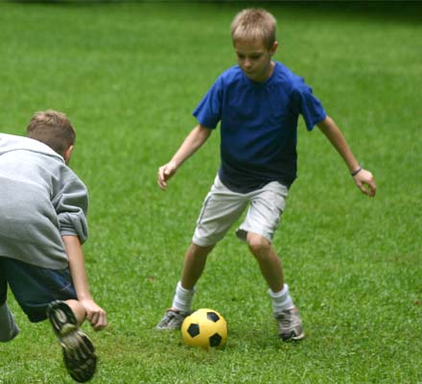
What are they doing?
Mario and Joseph are playing soccer in the backyard.
BACK

Slide 41
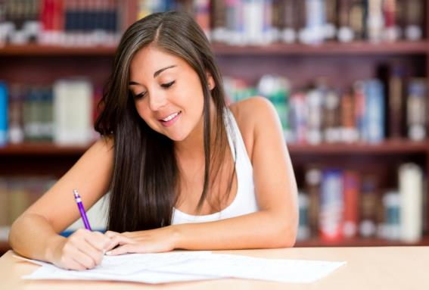
What is she doing?
Elisa is writing an essay for the history class.
BACK

Slide 42
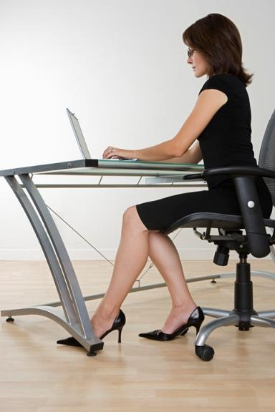
What is she doing?
My mother is working on the computer.
She is sending some
e-mails right now.
BACK

Slide 43
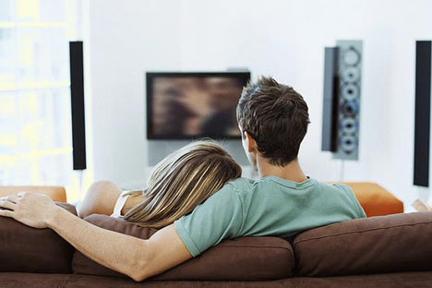
What are they doing?
My bother and his girlfriend are watching a movie.
BACK

Slide 44

What is she doing?
Melissa is taking some photos for the Graduation now.
BACK

Slide 45
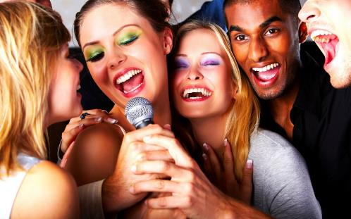
What are they doing?
Right now, my friends and I are singing in the party.
BACK

Slide 46
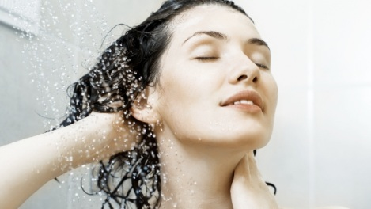
What is she doing?
Kathy is taking a shower at the moment.
BACK

Slide 47
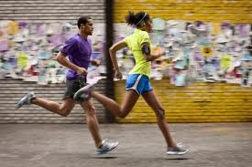
What are they doing?
Jack and Sophie are running in the marathon now.
BACK

Slide 48
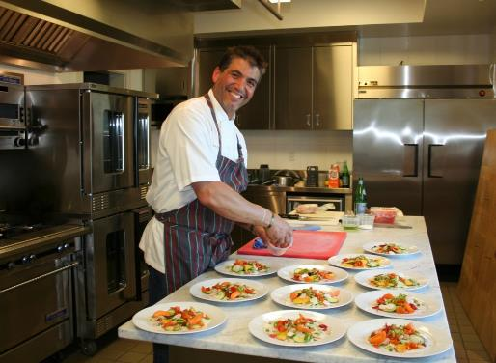
What is he doing?
My dad is cooking some fish for me and my family.
BACK

Slide 49

What is he doing?
David is trying to read the book for his homework.
BACK

Slide 50
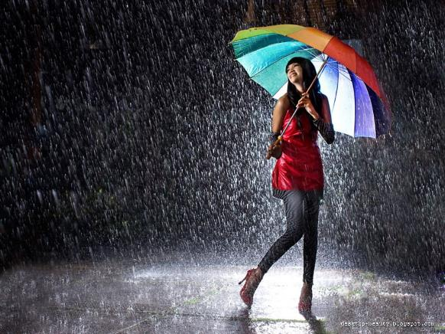
What is happening?
Right now, it is raining so hard.
BACK

Slide 51
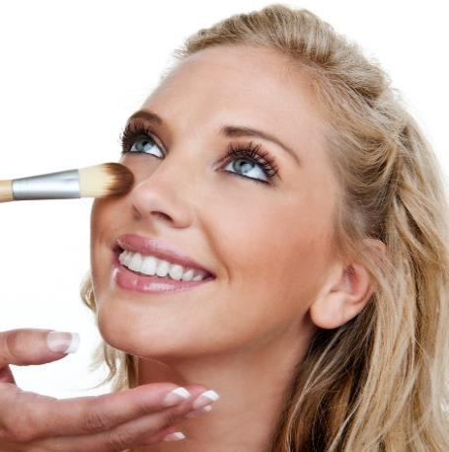
What is she doing?
Karla is putting make up for
the party right now.
BACK

Slide 52
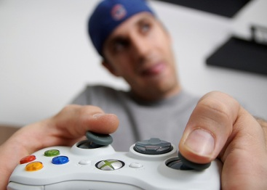
What is he doing?
Steve is playing videogames alone now.
BACK

Slide 53

And you…What are you doing?
Right now,
I’m talking on the phone.
Now,
I’m writing a letter to my friend.
At the moment,
I’m listening to pop music.
BACK

Slide 54
STRUCTURE
dancing
sleeping
doing
crying
watching
eating
etc.
AM
IS
ARE
I
He / She / It
You / We / They
BACK

Slide 55
There are some expressions that we use in PRESENT CONTINUOUS.
NOW
LISTEN!
AT THE MOMENT
RIGHT
NOW
LOOK!
BACK

Slide 56
What is happening in the following pictures
Makes sentences on your notebook
BACK

Slide 57
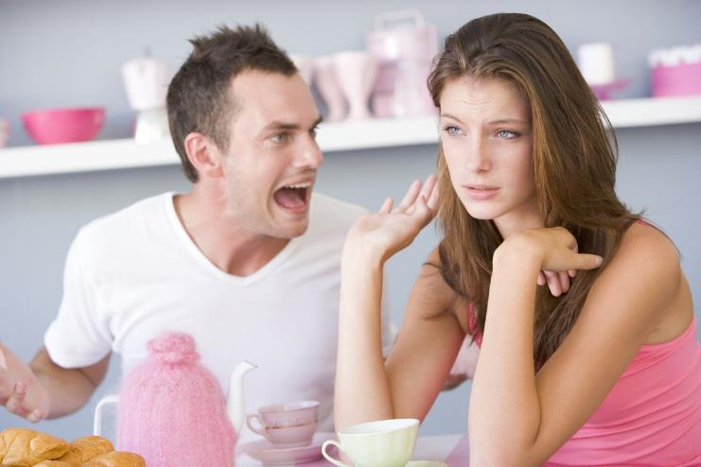
What are they doing?
They are ______________.
BACK

Slide 58
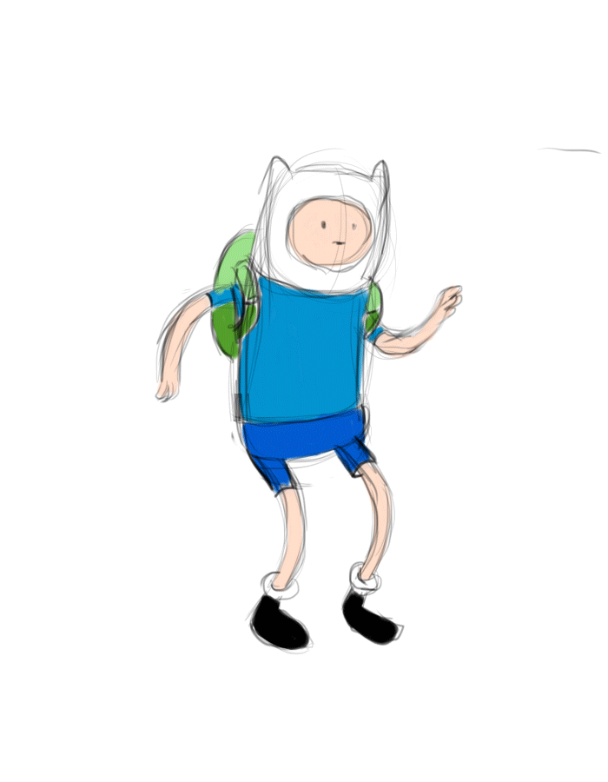
What is he doing?
He is ______________.
BACK

Slide 59
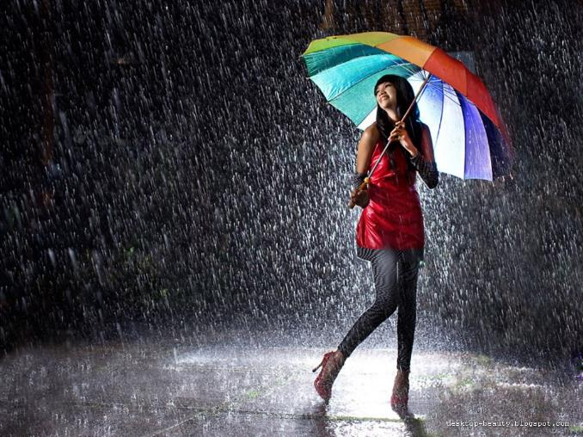
What is happening in the picture?
It is ______________.
BACK

Slide 60
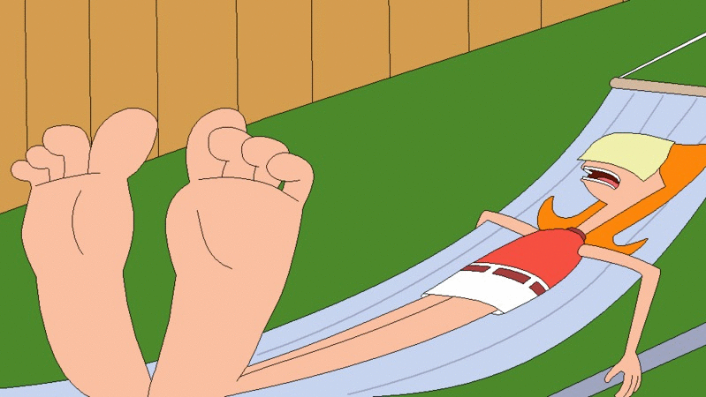
What is Candance doing?
Candace is ______________.
BACK

Slide 61

What is the hamster doing?
The hamster is ______________.
BACK

Slide 62
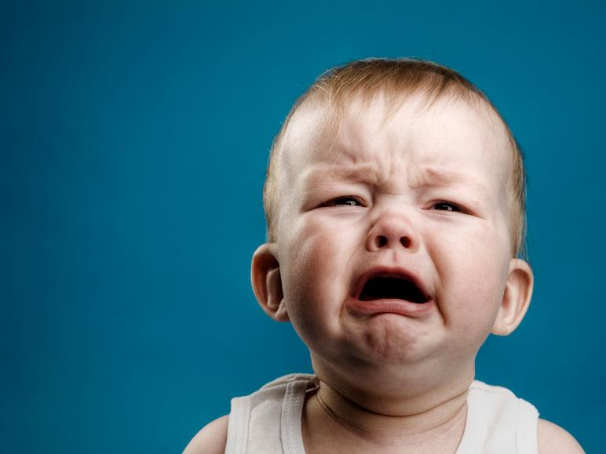
What is the baby doing?
The baby is ______________.
BACK

Slide 63

What is the fish doing?
The fish is ______________.
BACK

Slide 64
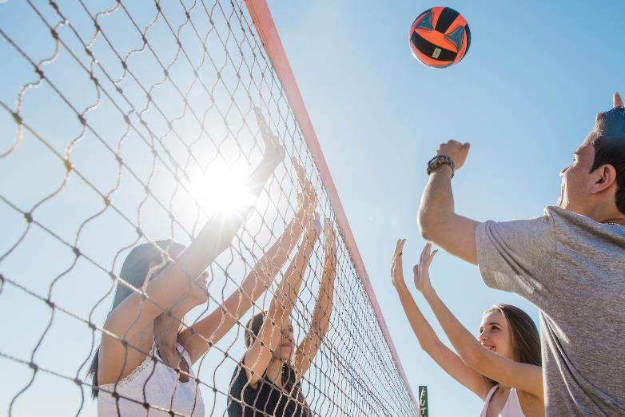
What are they doing?
The boys are______________.
BACK

Slide 65
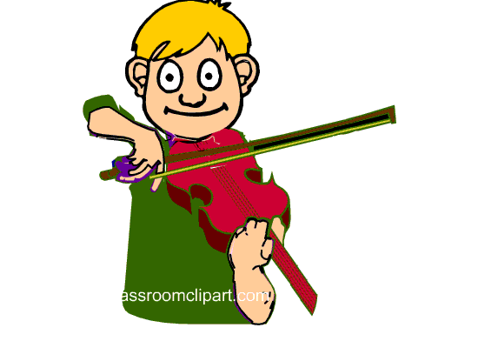
What is he doing?
He is ______________.
BACK

Slide 66
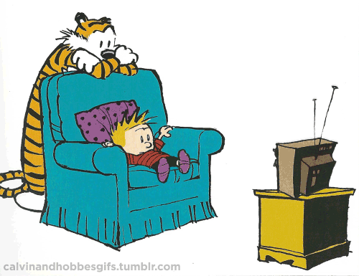
What are they doing?
They are ______________.
BACK

Slide 67
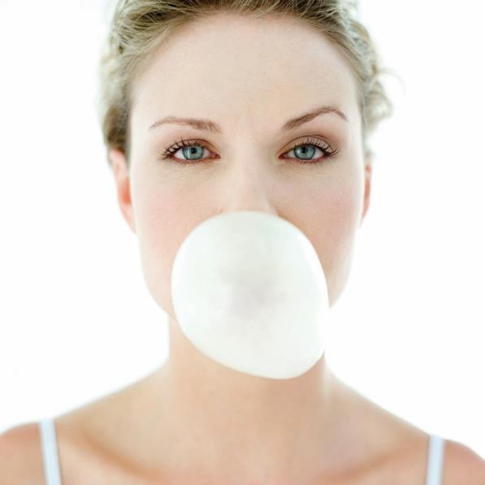
What is she doing?
She is ______________.
BACK

Slide 68

What is happening in the picture?
It is ______________.
BACK

Slide 69

What is she doing?
She is ______________.
BACK

Slide 70

What is he doing?
The man is ______________.
BACK

Slide 71

What are they doing?
The girls are ______________.
BACK

Slide 72
Simple Present Vs. Present Continuous
What’s the difference?

Slide 73
Simple Present
EXPLANATION
PAST
PRESENT
FUTURE
Use the PRESENT SIMPLE to express regular routines and habits.
The PRESENT SIMPLE is used to talk about actions and situations that are generally or permanently true.
The PRESENT SIMPLE is often used with adverbs of frequency.
Remember: Verb + “s” or “es”
BACK

Slide 74
Present Continuous
EXPLANATION
We use PRESENT CONTINUOUS to show that an action is happening at the moment.
Action in progress
PAST
PRESENT
FUTURE
dancing
sleeping
doing
crying
watching
eating
etc.
AM
IS
ARE
BACK

Slide 75
Simple Present vs Present Cotinuous
EXPLANATION
Every day, I watch TV at night.
In the evenings, my sister does her homework.
My father always cooks dinner.
Every weekend, my mother cleans the kitchen.
Right now, I’m watching my favorite TV series.
At the moment, my sister is doing her homework.
Now, my father is having dinner.
Look! My mother is cleaning the kitchen.
BACK

Slide 76
Expressions
EXPLANATION
SIMPLE PRESENT |  | PRESENT CONTINUOUS
Adverbs of frequency (always, usually, often, frequently, sometimes, seldom, rarely, hardly ever, never) Ever day, every week, every month, every year, etc. Once, twice, three times, four times… etc. a day/week/month/year |  | Now Right Now At the moment Today Listen! Look! Wait!
BACK

Slide 77
Look at the picture and choose the correct answer
PRACTICE
1. Peter drives / is driving a taxi in London.
2. He works / is working 12 hours a day.
3. He isn’t working / doesn’t work now.
4. He is reading / reads a newspaper.
BACK

Slide 78
Look at the picture and choose the correct answer
PRACTICE
5. Kate is a teacher. She teaches / is teaching physics.
6. She isn’t teaching / doesn’t teach now.
7. She has / is having a coffee.
8. She learns / is learning Greek because ...
9. …she is going / goes to Greece every summer.
BACK

Slide 79

Fill in the blanks with the present continuous or the simple present of the verb in brackets.
GRAMMAR
I ______________ (go) to town right now. I ______________ (want) some groceries.
He ______________ (write) a letter to his family now. He ____________ (never) forgets to write.
He ______________ (not think) it is a good idea. He ______________ (want) to do something else.
She ______________ (talk) to her friend at the moment. She ______________ (not listen) to the teacher.
I ______________ (read) an interesting book now. I ____________ (enjoy) it very much.
BACK

Slide 80

Fill in the blanks with the present continuous or the simple present of the verb in brackets.
GRAMMAR
We ______________ (watch) the news on television every morning.
He ______________ (teach) his friend how to play chess now. His friend ______________ (not know) how to play.
I ____________ (believe) you. You ______________ (not need) to explain.
The film ______________ (begin) right now. Please be quiet.
The sun is shining. It ______________ (not rain).
BACK

Slide 81
Simple Present or Present Continuous
GRAMMAR
He _____________________ to work everyday. (go)
Anne _____________________ to the music at the moment. (listen)
They _____________________ right now. (talk)
I _____________________ every morning. (jog)
He _____________________ friend this week. (help)
Mike _____________________ in the meeting. (sit)
We always _____________________ you. (help)
You _____________________ for your test. (learn)
Sometimes Mike _____________________ pizza. (eat)
He _____________________ in New york this year. (live)
BACK

Slide 82


REFERENCIAS
BACK

Slide 83
Referencias
Mesografía
http://www.learn-english-online.org/Lesson24/Lesson24.htm
https://www.magistricumacini.edu.it/magistricumacini/didattica/compiti/2018_2019/inglese/BIENNIO_recupero_inglese.pdf
Imágenes
Las imágenes se obtuvieron del sitio Freepik: http:www.freepik.com
BACK

