Slide 1
cartel científico, a Través de un Caso de estudio
Universidad Autónoma del Estado de México
Facultad de Ciencias
Biología
Comunicación Científica
Dr. Iván Gallego Alarcón
Septiembre de 2015

Slide 2
Guía para su uso
La Unidad de Aprendizaje “Comunicación Científica” tiene como propósito fortalecer la preparación del estudiante en el área de la investigación y desarrolla la habilidad de comunicar los resultados de la investigación científica en sus diferentes modalidades. El docente encontrará en este material una herramienta para trabajar con el estudiante la elaboración de carteles científicos. En esta unidad el alumno debe de conocer la importancia de un cartel, su función en la comunicación científica.
A través de este material el educador inicia con la definición del cartel científico, su lugar en la comunicación, los retos de elaborar un cartel, sus ventajas. Continua explicando las funciones, los tiempos, las características de esta forma de comunicación. Pasa después a explicar las herramientas digitales para su elaboración. En seguida el profesor cometa del contenido, la estructura del cartel y los tips de elaboración. Por ultimo a través de un caso de estudio el docente le pide a los educandos elaboren un cartel científico.
Al final de la unidad el alumno aplicara la competencia de comunicación científica “Cartel” diferenciará las secciones del mismo, así como sus funciones y ventajas. Lo que se logrará con la visión integral de los procesos, fomentando el trabajo en equipo.

Slide 3
Índice

Slide 4
Poster científico
Es un medio visual para comunicar los resultados de una investigación
Este tipo de comunicación científica siempre ha sido demeritado se tiene la impresión que un cartel o poster es una forma inferior de comunicación cuando se compara con presentaciones orales.
El carácter visual del poster no demerita el contenido
y rigurosidad científica, el comunicación personal con el
asistente figura un reto mayor del poster

Slide 5

Retos de un poster científico
Resumir en un espacio de 90 x 120 cm la información de tu trabajo
Discernir la información contenida en el poster
Lenguaje y redacción con base en el tipo de lector
Atraer a un espectador que ha sido impactado por una cantidad exagerada de poster
Generar curiosidad en el lector para iniciar platicas contigo (el autor)

Slide 6

El reto al realizar un cartel es darle al lector la información de tal manera que pueda discriminar rápidamente si es o no de su interés y, en caso de serlo, le permita acceder a ella de manera amigable y ligera.

Slide 7

Ventajas (Pacheco-Mendoza, 2014)
Los asistentes al congreso pueden leer analizar y estudiar el contenido del poster tantas veces como lo deseen.
Permite establecer un contacto directo con los autores, pues por regla general estos deben permanecer junto al poster un determinado tiempo.

Slide 8
Ventajas (Pacheco-Mendoza, 2014)
La comunicación grafica facilita la comprensión del contenido.
Es más fácil retener o recordar imágenes que el contenido de una presentación oral (90/10).
Si está bien realizado, puede ser una forma de comunicación amena y agradable.

Slide 9
Función (Margolles, 2014)
Conseguir colaboraciones, contactos y retroalimentación
Despertar curiosidad y atención hacia tu trabajo
Mejorar la percepción y recuerdo de tu trabajo y persona
Es una herramienta de marketing

Slide 10
Conseguir atención
Generar interés
Fomentar acción
3 segundos
30 segundos
180 segundos

Slide 11
Características
Margolles, 2014

Slide 12






Para elaborar un poster

Slide 13
Contenido del poster
Considera la información del poster como un resumen extendido, el cual debe de contener o hacer mención de:
Titulo
Autores
Literatura
Introducción
Metodologia
Resultados y Discusión
Conclusión
** Estructura común en congresos internacionales

Slide 14
Contenido del poster
Estructura opcional de alto impacto (Margolles, 2014)

Slide 15
TIPS de elaboración
El primer paso para crear posters científicos exitosos: Conocer a tu audiencia y contexto
50% Gráfico
25% Texto
25% Espacio
Si quieres crear posters científicos impactantes establece métricas y objetivos inteligentes
Busca siempre adaptar el contenido de tus investigaciones científicas para ayudar a los lectores
Crea un póster científico memorable: Planifica, crea, analiza, optimiza, repite y sistematiza

Slide 16

TIPS de elaboración
Aprovechar las herramientas digitales
Utiliza códigos QR para direccionar al lector hacia una pagina con más información o a tus datos de contacto

Slide 17
Caso de Estudio
Elaboración de cartel (poster) a partir de una exposición oral para congreso internacional de acuicultura

Slide 18
Caso de estudio
A partir de los datos del caso de estudio (presentación oral) elabora un cartel científico para el congreso:

Slide 19
Utiliza las siguientes instrucciones para elaborar el cartel
(Guidelines del Congreso Aquaculture 2006)
GUIDELINES FOR POSTER PRESENTATIONS
LANGUAGE
All abstracts must be presented in English – the official language of this conference.
POSTER SIZE
36 inches wide x 36 inches high – (Square format)
The poster must fit WITHIN these measurements.

Slide 20
COMPONENTS OF THE POSTER:
Posters should include a title, names of authors and their addresses, abstract, introduction materials and methods, results, discussion (or a combined results and discussion), conclusion, acknowledgments (if any), references, tables, and figures.
Title: The title should accurately reflect the contents of the poster. Brief, concise titles are encouraged. Below the title should include the name(s) of the author(s) and their address(es). The name of the presenter should be placed first.
Abstract: The abstract should be a concise highlight of the results and conclusions. Methodology should not be abstracted unless it is necessary to explain the results or unless the paper describes a new technique. Abstracts should be brief and easy to read.
Introduction: The introduction should explain why the research was conducted and why it is important. The introduction should contain a statement that describes the purpose or objective of the research. The introduction should condense the relevant information in the field that led the author to do the research. The introduction is not a complete literature review, and only the most relevant references should be cited.

Slide 21
Materials and Methods: The underlying goal of this section is to briefly describe what was done so that others can repeat the experiment. Experimental designs can be explained by use of figures if they will help clarify what was done. If the experiment was a complicated one with many sub-parts, subsections may be used to describe each sub-part.
Results: This section describes the data. Proper use of tables and figures can enhance and help explain the results. Statistical analysis of data is necessary, unless differences are so obvious that statistical analysis is superfluous. Although probability values of 0.05 and 0.01 are traditionally used, each author is free to choose his own level of significance.
Measurements: Use metric units of measurement. (When needed, English equivalents may be given in parentheses.) When using monetary symbols, please make sure the country of the currency is clear.
Discussion: This section should interpret the results and compare the results from this experiment to those found in similar research. The section can also be used to speculate about the results, to provide reasons for the trends, and to suggest new ideas that can advance our understanding about aquaculture.

Slide 22
Conclusion: This section should be used to briefly offer a synopsis of the conclusions of the research data. Concisely state the main conclusion. Leave the reader no doubts about the take-home message.
Acknowledgments: This section should be used to thank organizations which supported the research monetarily and individuals who assisted in the research or preparation of the paper (optional).
References: Select references with great care. Unless the paper is a review, there is no need to reference every paper written about a subject. Use only the most important ones (optional).

Slide 23


EVALUATION OF A RAS FOR THE RAINBOW TROUT CULTURE AT A DEVELOPING COUNTRY.
Iván Gallego Alarcón
Autonomous University of the State of México
Biotic Resources Research Center
Aquaculture Laboratory

Slide 24
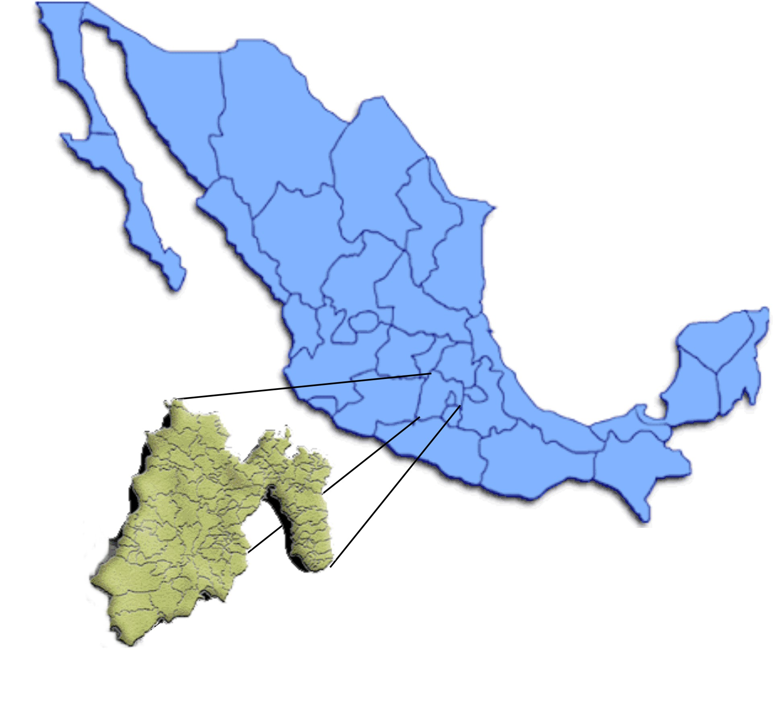
Introduction
The rainbow trout culture in Central Mexico has growth with a lot of pressure on the use of water resources.
Central Plateau of the Mexican Republic
Altitude of 1500 – 3,500 m
Temperature 10 – 30ºC
22,499.95 sq. km.
20 million population

Slide 25
Introduction
There are approximately 400 rainbow trout farms in the State of México with an average production of 4,000 tons/year.
Main water source: Springs, rivers and streams. At the rainy season 3.3 m³/s are used, and in the dry season only 1.9 m³/s.
The range of density in the farms goes from 8 kg/m³ to 18 kg/m³ of fish, when it has good water quality and infrastructure.

Slide 26
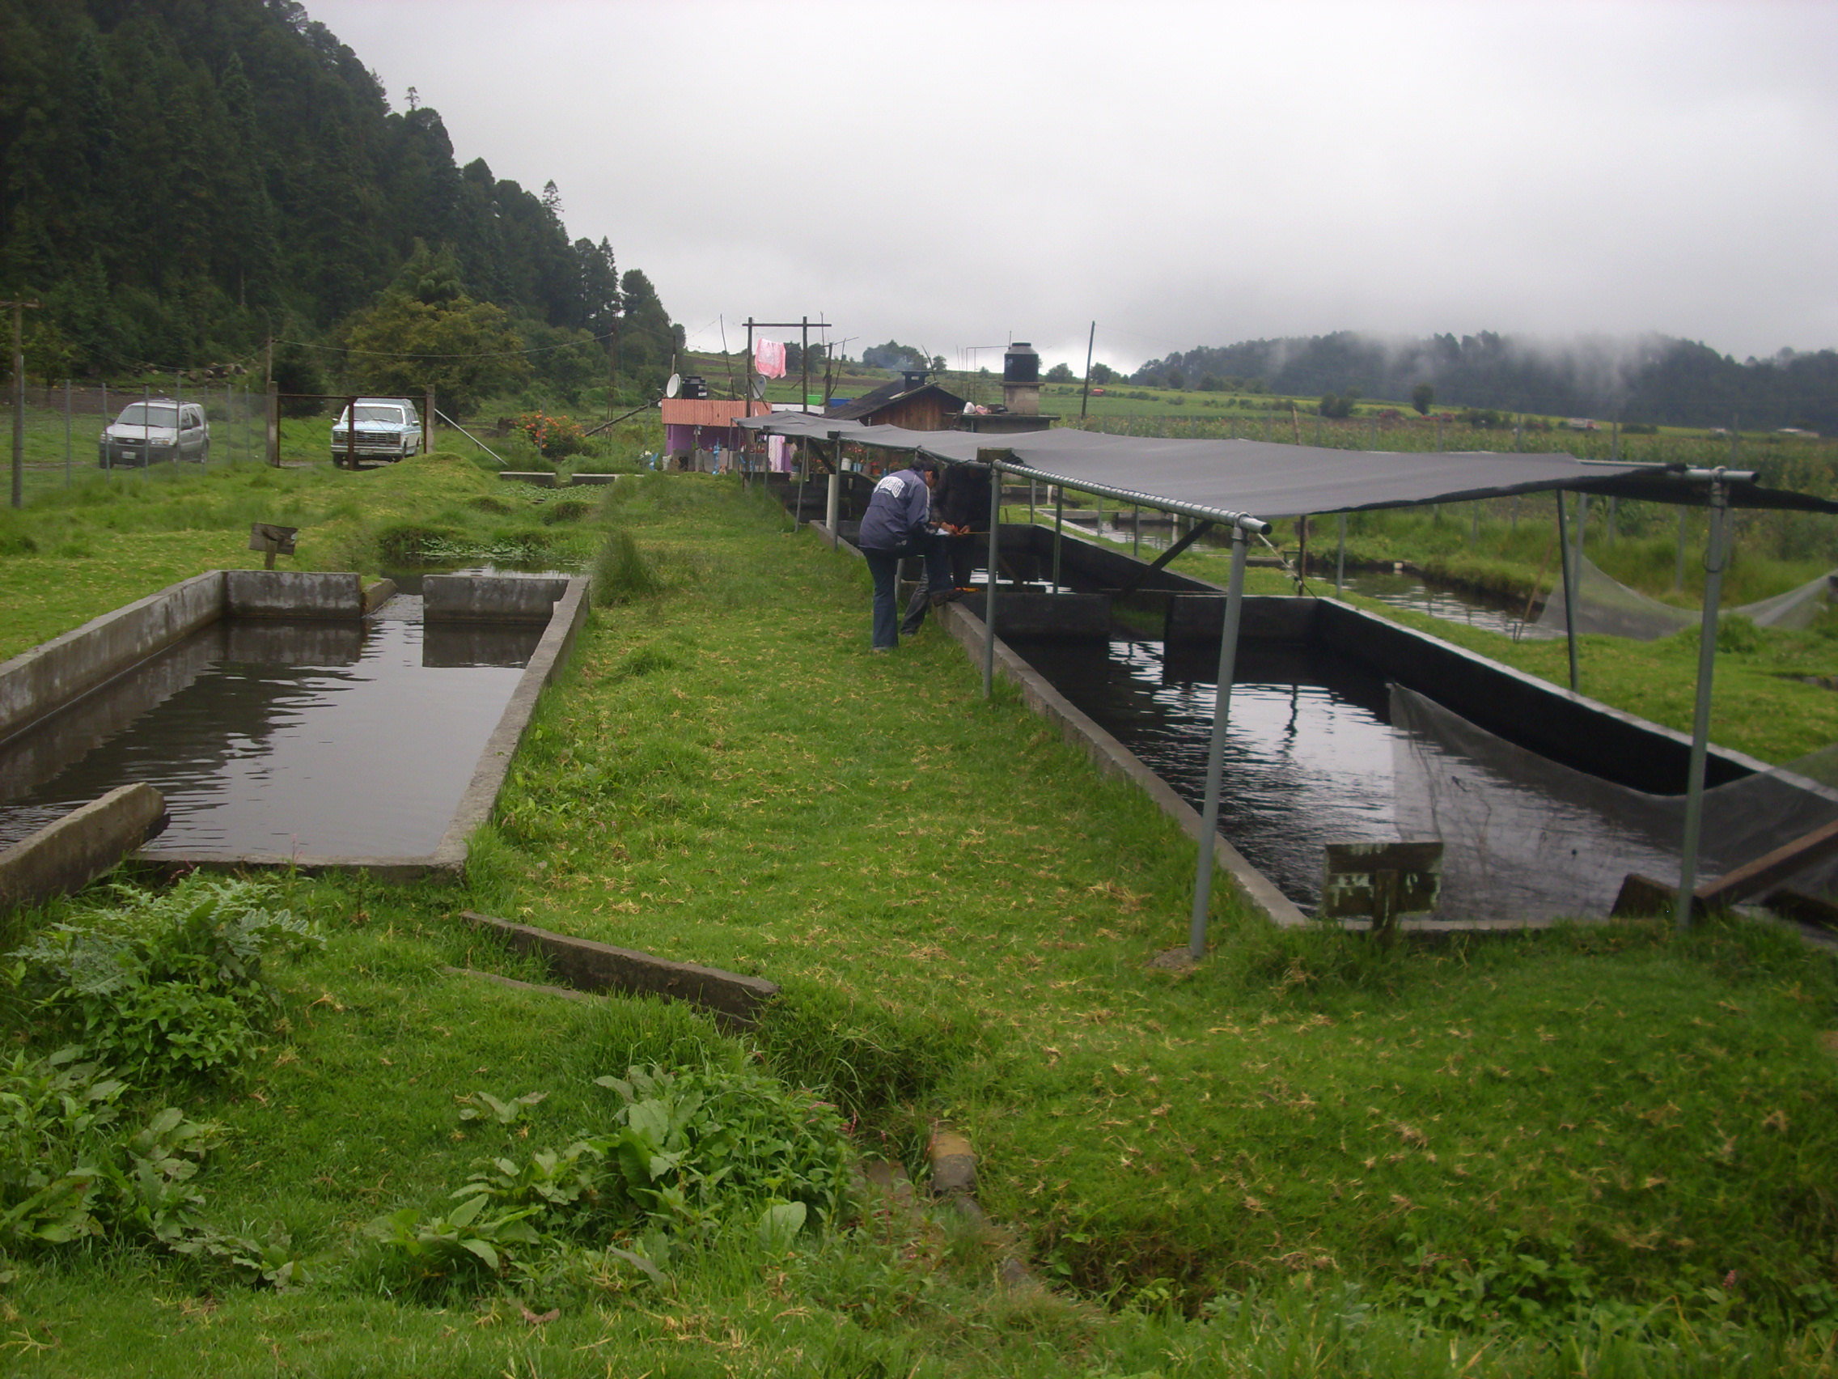
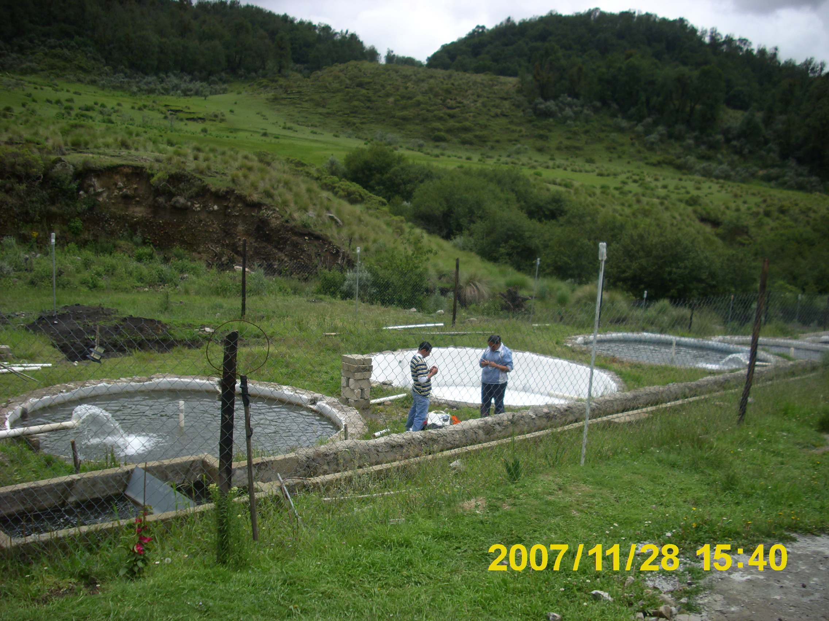
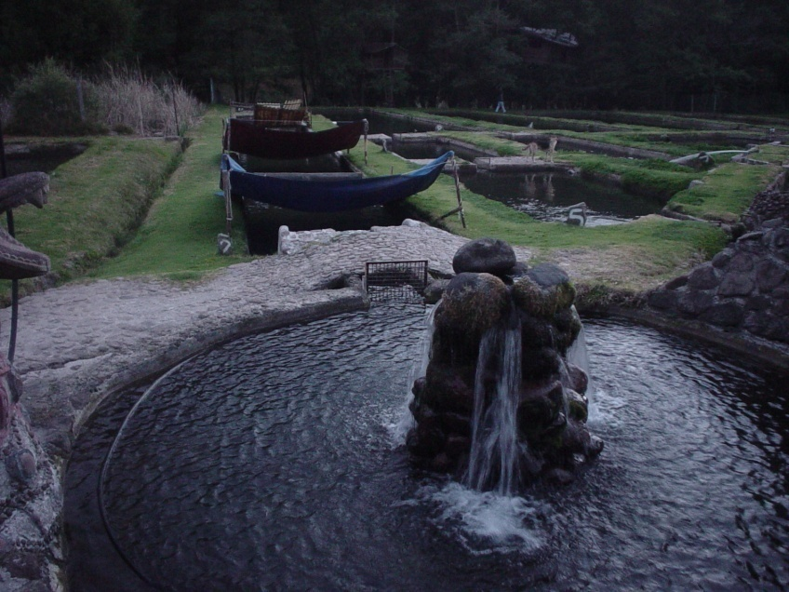
Introduction
Small farms, average of 10 tons per year production.
No electrical energy, low incomes, low skilled labor.
Low confidence on production with recircualting aquaculture systems.
Needs for alternative water sources.

Slide 27
Introduction
PROBLEMS
Variation of water flow through out the year
Rainwater harvest
Water quality variation between rainy and dry season.
Strong environmental and legal pressures (water use) for the trout farms.
The main problem according to the farmers is the water quiality and quantity for the trout culture.
Recirculating aquaculture systems (RAS)

Slide 28
Objective
In this study we propose the use of harvested rainwater in a recirculating aquaculture system (RAS) as an alternative to strengthen the production of high nutrition food and an alternative water use.

Slide 29
Methodology
The RAS had one tank of 6.28 m³ for the trout culture, a settling tank for solids removal, a trickling filter as a biofliter and a downflow sand filter.
It had a 2.1 L/s flow. To achieve good rainwater quality, sodium bicarbonate, marine salt and lime was added to the water in daily basis in order to maintain the pH and alkalinity at optimum ranges.

Slide 30
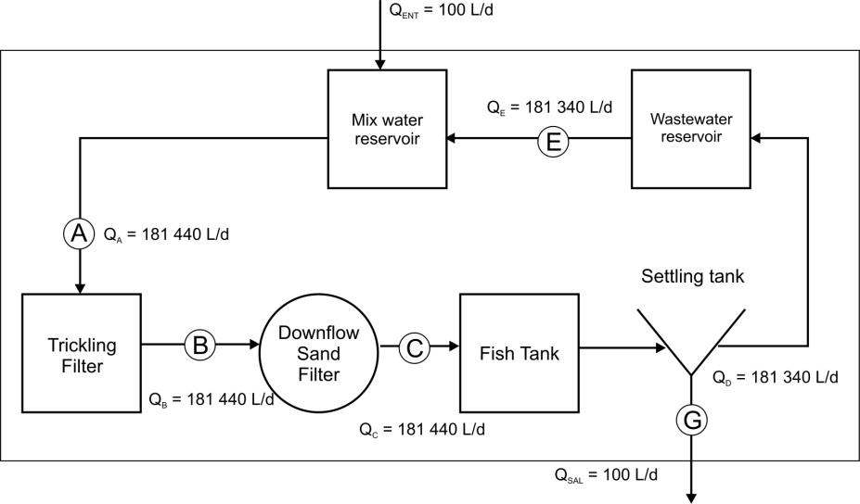
RAS

Slide 31
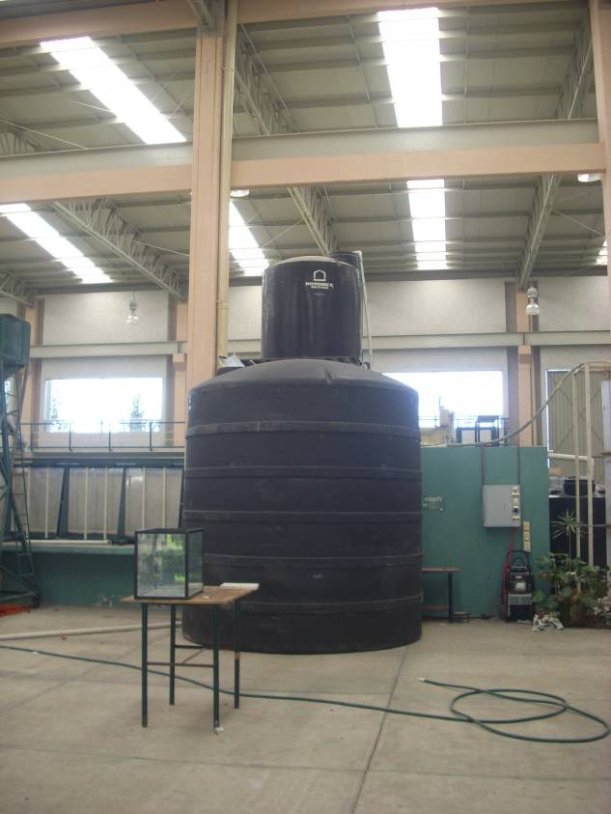
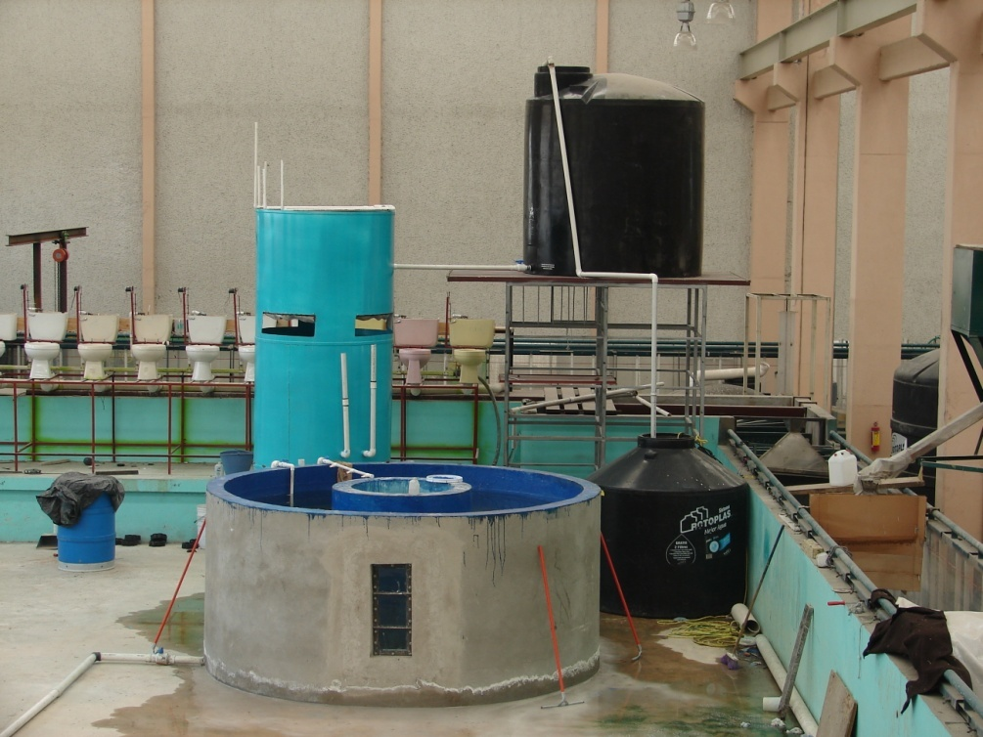
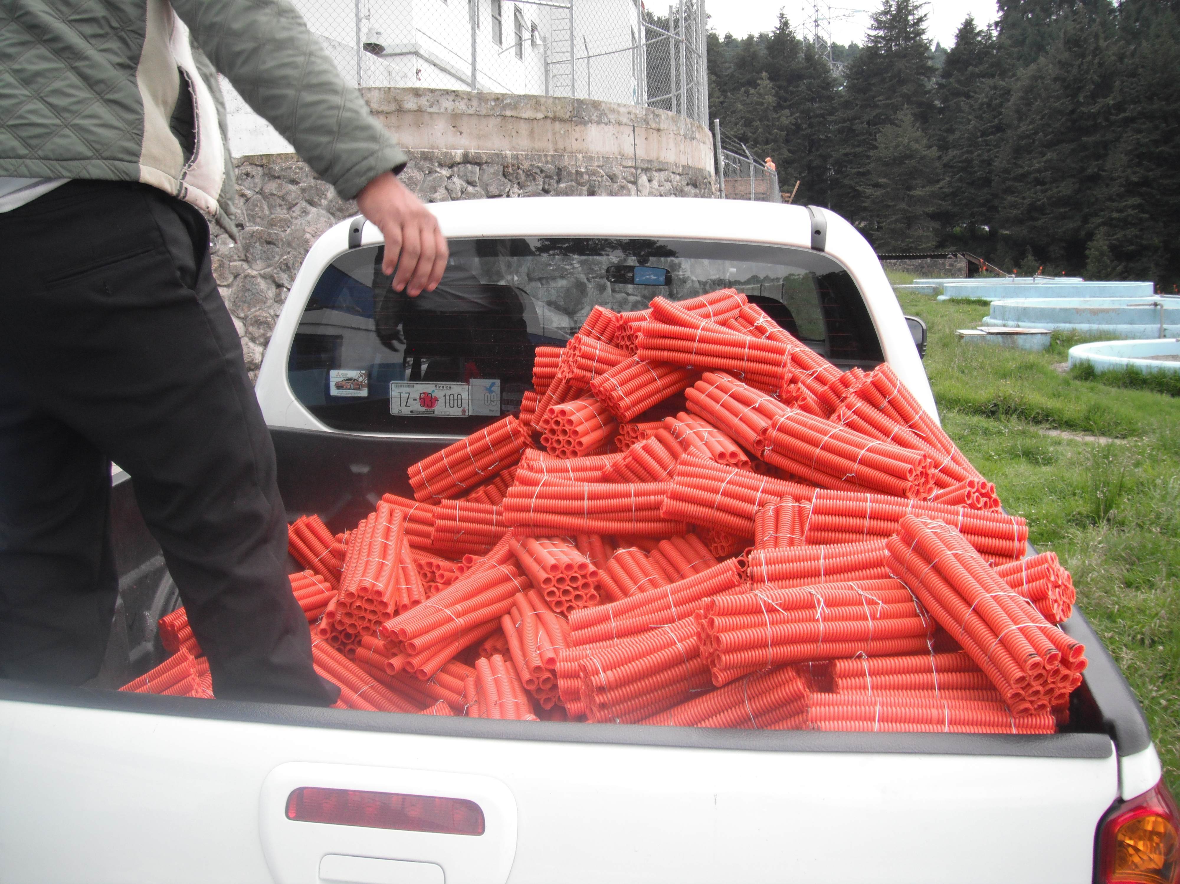
RAS
Rain water reservoir
Water reservoirs
Trickling filter
Sand filter
Fish tank

Slide 32
Methodology
A 121 days experiment was done in a recirculating aquaculture system suitable for the conditions of the trout activity at the State of Mexico (few farms with electric energy and skilled labor, low operation cost).
Trout Culture (average values)
 | Initial stock | Harvest
Total fish (org) | 387 | 359
Biomass (kg) | 41.49 | 180.42
Density (kg/m3) | 6.61 | 28.7
Weight (g) | 107.20 | 502.56
Length (cm) | 19 | 30
Mortality (%) |  | 14
Time (days) |  | 121

Slide 33
Rain water quality
Parameter | Unit | Value
DO | (mg/L) | 6.6
COD | (mg/L) | 4.9
N-NH₃ | (mg/L) | 0.92 (1.18 mg NH₄⁺/L)
N-NO₂⁻ | (mg/L) | 0.021 (0.069 mg NO₂⁻/L)
N-NO₃⁻ | (mg/L) | 1.7 (7.53 mg NO₃⁻/L)
TSS | (mg/L) | 14
Ca | (mg/L) | 1.41
K | (mg/L) | 0.18
Mn | (mg/L) | 0.25
Na | (mg/L) | 0.22
Cl⁻ | (mg/L) | 2.30
SO₄⁻² | (mg/L) | < 5.0
Fe | (mg/L) | 0.14
Mg | (mg/L) | 0.19
pH |  | 5.5
Alcalinity | (mg/L Ca CO₃) | 3.21
Temperature | (°C) | 17
To achieve equilibrium we added on daily basis:
Sodium bicarbonate
Marine salt and
Lime

Slide 34
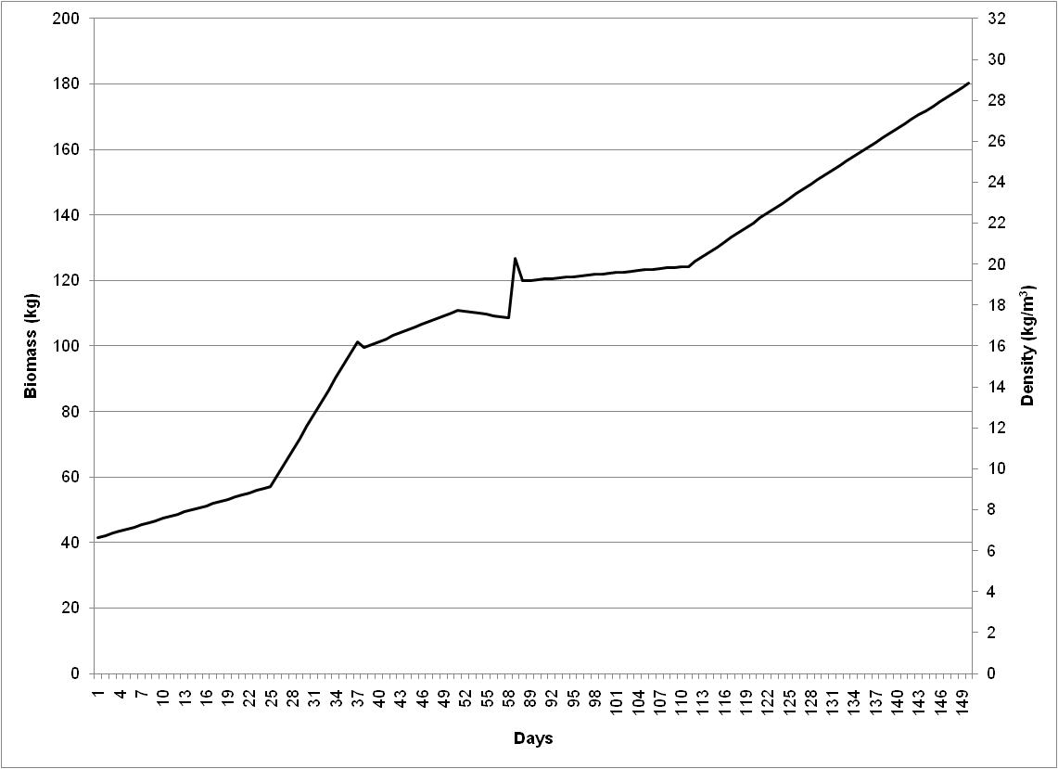
Results
An average of 4.5 ± 0.5 g/d of individual increment weight was observed at a temperature between 17 - 18°C.

Slide 35
Parameter |  | Symbol | Unit | Trickling Filter | Downflow Sand Filter
Media characteristics
1a | Manufacturer |  |  | CIRA - CIRB UAEM | CIRA - CIRB UAEM
1b | Type |  |  | Electrical pipe | Silica Sand
1d | Material |  |  | Plastic | Silica Sand
1e | Media dimensions |  |  | 5 x 3.75 cm | 20-30
1f | Specific surface area | SSA | m²/m³ | 414.00
Filter characteristics
2a | Filter height | H_{tank} | m | 1.10 | 1.50
2b | Water height | H_{water} | m | 0.80 | 0.90
2d | Filter volume | V0 | m³ | 1.55 | 2.01
2e | Cross-sectional | A_{cross} | m² | 420.00 | 1314.00
2f | Total active surface | A_{media} | m² | 289.80 | 1314.00
2g | Media volume | V_{media} | m³ | 0.80 | 0.60
2h | Hydraulic loading | L_{hyd} | m³/m² d | 0.43 | 0.14
2i | Hydraulic media | L_{media} | m³/m² d | 0.63 | 0.14
2l | Type of water distribution system |  |  | PVC Pipes
2o | Biofilter flow | Q_{filter} | m³/d | 181.44 | 181.44
2p | Make-up flow | Q_{mu} | m³/d | 181.44 | 181.44
2q | Rearing unit flow | Q_{ru} | m³/d | 181.44 | 181.44
2r | Reuse flow | Q_{reuse} | m³/d | 181.34 | 181.34
2t | Discharged flow | Q_{out} | m³/d | 0.10 | 0.10

Slide 36
Parameter |  | Symbol | Unit | Trickling Filter | Downflow Sand Filter
General influent waste characteristics—culture system supply
3a | Culture species |  |  | Rainbow trout | Oncorhynchus mikyss
3b | Feed rate and type of feed | FR | kg/d | 1.90 | 1.90
3c | Feeding frequency |  | #/d | 2.00 | 2.00
3d | Protein content of feed (as fed) |  | % | 45.00 | 45.00
3e | Cumulative feed burden | CBF | mg/L | 104.72 | 104.72
3g | Cumulative loading | CL | kg/lpm | 1.43 | 1.43
3h | Total ammonia nitrogen | N-NH_{3in} | mg N-NH₃/L | 0.80 | 0.67
3i | Nitrite-nitrogen | N-NO_{2in} | mg N-NO₂/L | 0.255 | 0.298
3j | Nitrate-nitrogen | N-NO_{3in} | mg N-NO₃/L | 57.38 | 56.47
3k | 5-d biochemical oxygen demand | BOD_{5in} | mg/L | 17.28 | 19.39
3l | Chemical oxygen demand | COD_{in} | mg/L | 47.58 | 44.88
3m | Alkalinity | ALK_{in} | mg/L CaCO₃ | 64.77 | 51.12
3n | pH | pH_{in} |  | 6.96 | 7.10
3p | Dissolved oxygen | DO_{in} | mg/L | 6.53 | 6.80

Slide 37
Parameter |  | Symbol | Unit | Trickling Filter | Downflow Sand Filter
Filter performance
5a | Time of acclimation | t | d | 38.00 | 38.00
5b | Ammonia flux (cross-sectional area) |  | g N-NH₃/m² d | 0.35 | 0.09
5c | Ammonia flux (media area) |  | g N-NH₃/m² d | 0.50 | 0.09
5d | BOD₅ flux (media area) |  | g BOD₅/m² d | 10.82 | 2.68
5d' | Flujo de DQO (empaque) |  | g COD/m² d | 29.79 | 6.20
5e | Temperature | T | °C | 17.00 | 17.00
5f | Total ammonia nitrogen out | N-NH_{3out} | mg N-NH₃/L | 0.67 | 0.29
5g | Nitrite-nitrogen out | N-NO_{2out} | mg N-NO₂/L | 0.298 | 0.197
5h | Nitrate-nitrogen out | N-NO_{3out} | mg N-NO₃/L | 56.70 | 57.56
5i | Percent TAN removal | PTR | % | 16.25 | 56.72
5k | ΔO₂ | ΔO₂ | mg/L | 0.27 | -1.30
5m | ΔpH | ΔpH |  | 0.14 | -0.08
5n | Nitrite-nitrogen generation | N-NO_{2gen} | % | 0.05 | -0.15
5o | Nitrate-nitrogen generation | N-NO_{3gen} | % | -0.85 | 1.63
5p | Volumetric TAN conversion rate | VTR | g N-NH₃/m³ d | 29.48 | 114.34
5q | Apparent volumetric nitrite conversion rate | VNR_{A} | g N-NO₂/m³ d | -9.75 | 30.39
5r | Volumetric nitrite conversion rate | VNR | g N-NO₂/m³ d | 19.73 | 144.73
5s | Surface TAN conversion rate | STR | g N-NH₃/m² d | 0.08 | 0.05
5t | Volumetric oxygen consumption rate | VOCR_{tot} | g O₂/m³ d | -61.24 | 391.16
5z | Total power (average daily) | P | kW/d | 25.34 | 25.34
5aa | Ammonia removal efficiency | ARE | g N-NH₃/kWh | 0.93 | 2.72
5cc | Oxygen utilization efficiency | OUE | g O₂/kWh | -1.93 | 9.31

Slide 38
IN
OUT
Parameters | Average ± SD | Units
N-NH₃ | 0.88 ± 0.73 | mg/L
N-NO₂ | 0.265 ± 0.251 | mg/L
N-NO₃ | 53.31 ± 16.22 | mg/L
COD | 59.04 ± 30.31 | mg/L
SST | 3.33 ± 0.10 | mg/L
Alkalinity | 52.38 ± 23.73 | mg/L
Temperature | 17.13 ± 1.26 | °C
pH | 6.94 ± 0.41
DO | 5.17 ± 0.63 | mg/L
Parameter | Average ± SD | Units
N-NH₃ | 0.29 ± 0.61 | mg/L
N-NO₂ | 0.202 ± 0.228 | mg/L
N-NO₃ | 55.55 ± 15.95 | mg/L
COD | 42.04 ± 21.16 | mg/L
SST | 1.92 ± 1.84 | mg/L
Alkalinity | 45.08 ± 21.82 | mg/L
Temperature | 17.27 ± 1.07 | °C
pH | 7.01 ± 0.38
DO | 5.49 ± 0.54 | mg/L
Parameter | Efficiency (%) ± SD
N-NH₃ | 78.15 ± 24.00
N-NO₂ | 27.00 ± 29.41
COD | 23.53 ± 31.31
TSS | 41.48 ± 28.64

Slide 39
Sand filter:
y = 228.45x + 7.18 R² = 0.913, R = 0.956
Where: x = TAN in the influent (mg/L); y = VTR (N-NH₃/L h).

Slide 40
Trickling filter:
y = 63.083x – 6.33 R² = 0.723, R = 0.851
Where: x = TAN in the influent (mg/L); y = VTR (N-NH₃/L h).

Slide 41
Thank you
Gracias

Slide 42
Referencias
Margolles P. 2014. Cómo hacer un poster científico exitoso en la práctica. En línea: http://www.neoscientia.com/como-hacer-un-poster-cientifico/. Consultado: Agosto 2015.
Gaurdiola E. 2010. El poster científico. En: Serés E., Rosich L., Bosh F. Presentaciones orales en biomedicina. Aspectos a tener en cuenta para mejorar la comunicación. Cuadernos de la fundación Dr. Antonio Esteve. Barcelona, España. P 85 – 102.
Nievas M., Burba J.L., Canovas L., Vega A.M. & Zani V. I. 2003. El póster científico. EDIUNC. Mendoza, Argentina. 126 p.

