Slide 1


UNIVERSIDAD AUTÓNOMA DEL ESTADO DE MÉXICO
FACULTAD DE LENGUAS
MATERIAL DE PROYECCIÓN
PARA LA UNIDAD DE APRENDIZAJE DE
DISCURSO PÚBLICO EN INGLÉS
DE LA LICENCIATURA EN LENGUAS DE LA FACULTAD DE LENGUAS
PUBLIC SPEAKING IN ENGLISH
UNIT 4 INFORMATIVE SPEECH
4.4 VISUAL AIDS
ELABORADO POR: L.L.I. TANIA CABRERA RAMÍREZ TOLUCA, MÉXICO, JUNIO DE 2015.
Notes:
El presente material de proyección tiene como objetivo explicar a los alumnos como se elaboran los visuales para una exposición usando Power Point. Algunos de los errores en las diapositivas están marcados a propósito o para ejemplificar lo que “sí” se debe hacer y lo que “no” debe hacerse. Previo a esta presentación, el profesor ya expuso la parte teórica del uso de visuales.
NOTA: El formato, el estilo, tamaño de letra, cantidad de texto, imágenes, combinación de colores a lo largo de la presentación no son uniformes, lo anterior es completamente a propósito debido a la naturaleza del tema; pues sugiere discusión con el grupo.

Slide 2
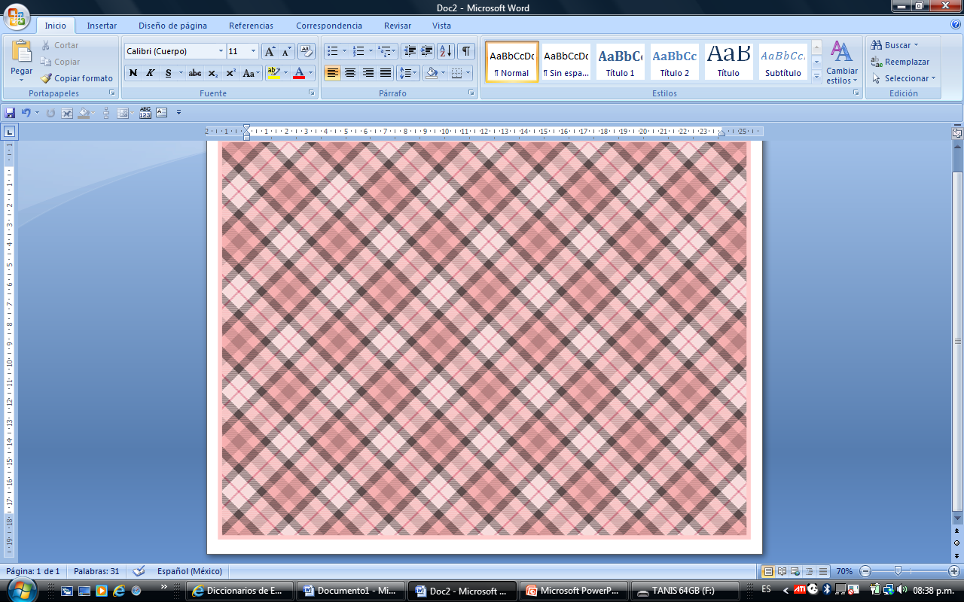
Public Speaking in English
V I S U A L A I D S
Notes:
La presentación y el estilo a lo largo de este material, no son uniformes puesto que el objetivo es proporcionar a los alumnos ejemplos de lo que deben y no deben incluir al elaborar el material de apoyo visual para sus exposiciones, concretamente el Discurso Informativo.

Slide 3
F O N T S I Z E A N D C O L O R
30pt. minimum font size
Three colors per slide
Notes:
Tell students to make text legible. Minimum font size is 30 pt. because sometimes people at the back can barely see. Take into consideration the size of the room.
Use color carefully. Use no more than three colors per slide, the colors should contrast with each other to provide better visibility. Do not forget to take into consideration the background color or images.

Slide 4
FONT SIZE AND COLOR
Verdad que no se alcanza a ver lo que aquí está escrito??
Digo, a menos que tengamos una supér vista, no alcanzamos a distinguir la info que el expositor nos quiere dar…
Y por consiguiente vemos una diapositiva como esta y no le prestamos atención…
Porque nos parece por demás aburrida y sin sentido el tener que leer toooodo lo que aquí dice…
Además de que habla del expositor o de la persona que hizo la presentación y el mensaje dice que no le dio tiempo de editar…
O simplemente lo copió tal cual de algún lugar y nomás puso la información para leer y ya… eso es exponer
O también nos está diciendo que no sabe como ocupar este tipo de paquetería y le dio igual el poner la información así
O nunca vio la presentación como si él fuera parte de la audiencia para confirmar que efectivamente se alcanza a ver desde atrás o desde otra perspectiva
O quizás sólo es cuestión de dar más oportunidad a que con la práctica esto de los apoyos visuales vaya mejorando
Y también nuestra capacidad de síntesis para saber qué poner y qué no en una diapositiva
O qué tipo de información utilizar en los apoyos visuales…
Así como los colores, el tamaño de letra, etc.!!
ARE YOU ABLE TO READ???
Maybe I am the one that needs glasses!!!
Notes:
In a regular document we would use a 12pts or 14pts font size. When building a sllideshow, the previous facts is not allowed. This is an example that must be provided to students.

Slide 5
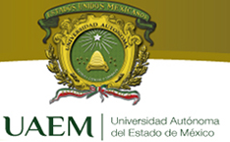
ARE YOU ABLE TO READ THIS?
Notes:
This is an example that must be provided to students in order to discuss the color font and background topic.

Slide 6
This is better, isn’t it?
Notes:
This is an example that must be provided to students. Images at the background should be used in grey colors.
The following six slides are real examples of some students previous presentations.
Comments are to be made about color font, size font and slide colors.

Slide 7
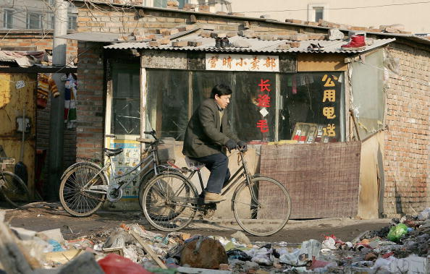
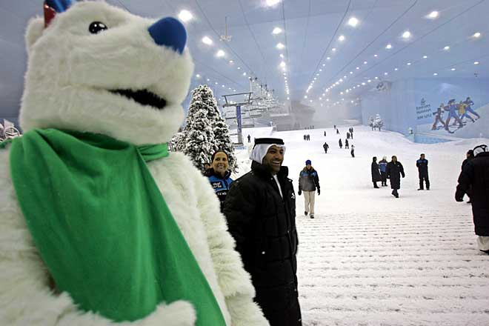
The differences between a poor and rich person
Notes:
 This is an example that must be provided to students. Allow discussion among them.

Slide 8
WATER
by: Dalia González
Notes:
 This is an example that must be provided to students. Allow discussion among them.

Slide 9
MACHU
PICCHU
Notes:
 This is an example that must be provided to students. Allow discussion among them.

Slide 10

Notes:
 This is an example that must be provided to students. Allow discussion among them.

Slide 11

Notes:
 This is an example that must be provided to students. Allow discussion among them.

Slide 12
Psychedelia And LSD
Verónica Alcántara Castorena
Notes:
 This is an example that must be provided to students. Allow discussion among them.

Slide 13
C O N T E N T
5 x 5 rule (words)
25-35 numbers (data charts)
Notes:
Talk to your students about the content in each slide. This is the information that is going to be displayed to the audience. According to Urech (2000, p.78) one should use a maximum of 25-35 numbers per visual aid. Data charts should only contain bottom line information, conclusions, and final results. Data charts include: percent, parts, graphics, timelines, frequency, correlation, etc. Backup slides can contain raw data.
She also mentions the 5 x 5 rule (five lines with a maximum of five words per line) should be used for word slides. This results in no more than 25 words per slide excluding the title.
Having clear and concise information on the slides makes it easier for the audience to retain information; we should simplify the slide and focus audience’s attention where we want it.
The following two slides are real

Slide 14
Do you really want to read all this paragraph?
CONTENT
A new format has been introduced for the 11th Al Ain Air Championship in December. The show will include will feature the world’s leading pilots vying for the trophy at the Al Ain International Airport.
UK pilot Richard Goodwin has confirmed his first appearance at the event, and daredevils including the UK Breitling Wingwalkers, Patrouille Reva from France, Redbull Firestars for China, and Glider FX from the UK will be taking part. Eight of the world’s premier teams will come together to compete for the title of Grand Champion, judged by a panel of expert and celebrity judges.
Notes:
This is an example that must be provided to students. Allow discussion. Among them.
The following slide is a real example of some students previous presentations.
Comments are to be made about the content and the animations that were used.

Slide 15
SYMPTOMS
There are many manifestations of eating disorders that people can experience. The first symptoms of eating disorders are usually binging, purging and even eating non-food items like pencil or paper. One eating disorder is anorexia nervosa. This is perceived to be the most common in our society mainly because of the publicity it attracts due to the many celebrities who suffer from it. Anorexia is basically associated with having an abnormally thin body.
Anorexia can manifest itself in various ways, including severe dieting, starvation, extreme exercising and even vomiting. Some people also often take dangerous weight loss pills to prevent weight gain. In addition, anorexia is particularly dangerous to the heart because it strains its normal functions, which can result in cardiovascular disease and endanger a person's life. Likewise, other body organs become weak from the lack of nutrients that enter the body; making the body unable to fight other diseases.
Another known eating disorder is bulimia nervosa. This is overindulgence in food and is accompanied by vomiting afterwards. While anorexia affects the heart, bulimia is a disorder that damages the digestive system. This is an equally dangerous eating disorder that can lead to death in severe cases.
A less detected, but still dangerous eating disorder is binge eating. Still another type of eating disorder is compulsive eating. Compulsive eating is known to afflict the most number of people among all the eating disorders but the symptoms of this condition are often very mild so it is not detected until the situation is severe.
Notes:
 This is an example that must be provided to students. Allow discussion among them.

Slide 16
P I C T U R E S A N D
A N I M A T I O N S
Text first ➔ picture
Use animations carefully
Notes:
Remind your students to classify information. If they are going to have a picture that can have a big impact on their audience, let the written information appear first, give any explanations and then let them see the picture, otherwise the audience will be amazed by the picture and they will not pay attention to the rest of the information.

Slide 17

PICTURES:
REALLY SMALL, ISN’T IT?
DID YOU SEE THAT ONE?
Notes:
Tell students that they should pay particular attention to animations.

Slide 18

CHOOSE:
Your audience will be moved by the picture and won’t care about the written information.
Notes:
Remind them to classify information and to make decisions about what to show first.

Slide 19

If your picture will catch your audience attention in a dramatic way…let the information appear first and then show them the picture.
Notes:
Some topics are really eye-catching, so the speaker must decide how to present them.
The following two slides are real examples of some students previous presentations.
Comments are to be made about the use and order of animations in slideshows.

Slide 20
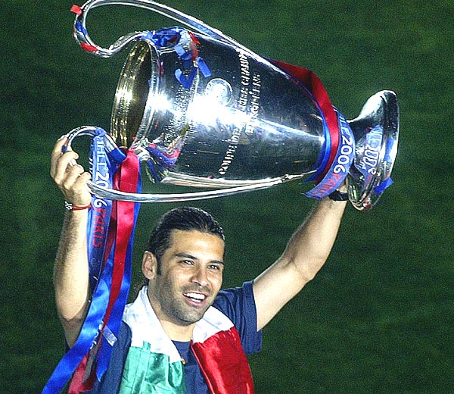
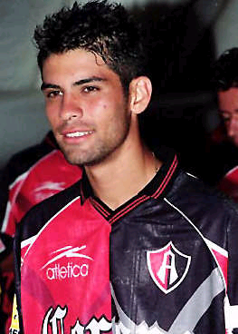
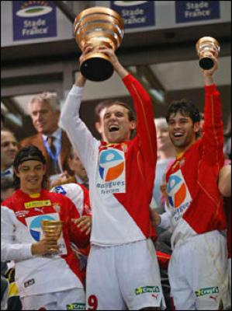
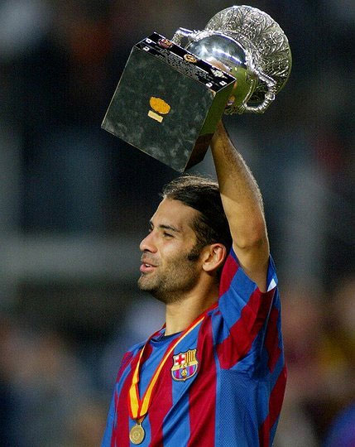
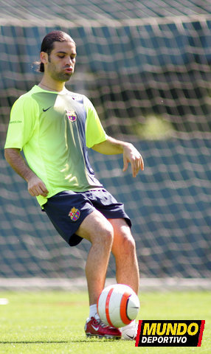
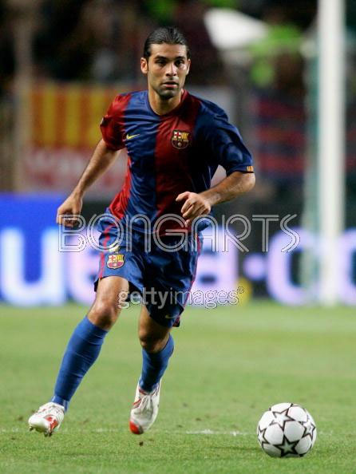
RAFAEL MARQUEZ
MY FAVORITE
Notes:
 This is an example that must be provided to students. Allow discussion among them..

Slide 21

A sword is a long-edged weapon or thrusting piece of metal, used in many civilizations throughout the world.
Notes:
 This is an example that must be provided to students. Allow discussion among them.

Slide 22
PAY PARTICULAR ATTENTION TO:
Spelling mistakes
Typos
Unusual Font
Notes:
Make sure to have your slides read by someone else before your presentation. Misspelled words or typos cannot be part of your slides. Using a common font size is better because some equipment will not have the font size students worked originally with and as a result al the text is going to be disorganized.

Slide 23
Check and as somebody to check it for you:
Headings in the center
Watch out: Speling !!!! ☺
And whatch out: typos !!
Not to many colors in your fonts!
Notes:
Check every point in the slide.
NOTE: This slide has some tipos and spelling mistakes which were written on purpose.
The following three slides are real examples of some students previous presentations.
Comments are to be made about the spelling mistakes, tipos, Font + color background, fons size, images and animations.

Slide 24

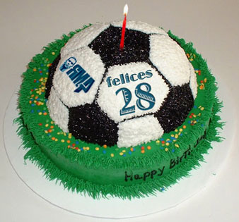
THE
BEAUTIFUL
OF
SOCCER
Notes:
 This is an example that must be provided to students. Allow discussion among them.

Slide 25



Don'ts...
• Don't drink a lot of alcohol.
• Don't eat or drink a lot late at night.
Do not watch te be before go to sleep.
Notes:
 This is an example that must be provided to students. Allow discussion among them.

Slide 26
THE NEW 7 WONDERS OF THE WORLD
Adelina Hernández Chávez
Notes:
 This is an example that must be provided to students. Allow discussion among them.

Slide 27
S L I D E S
Don´t read them
Up-load your slides
Print your slides
Notes:
James Kirkpatrick (2011), a doctoral student in Counseling Psychology in his article ‘Step model for More Effective Presentations’ states that there are three types of titles for visual aids:
1. Topic Title: used when it is not necessary to convey a specific message but only to provide information.
2. Thematic Title: used to tell the audience what information they should draw for the data presented.
3. Assertive Title: used when we want to give the audience our opinion about what conclusion they should draw from the data.
He also mentions:
“…Make your presentations people-centered, not media-centered. Avoid using too many slides and putting too much information on them. While you may need to use slides to present your data, remember that building rapport and interacting with your audience is critical. Slides alone cannot make a presentation interesting, your enthusiasm and delivery is the key to making a presentation lively…”
Visual aids, when used effectively, can help a speaker communicate better and listeners understand better. They help clarify and support our message. That is what they are called VISUAL AIDS.

Slide 28
Notes:
Visual aids, when used effectively, can help a speaker communicate better and listeners understand better.
They help clarify and support our message and that is what they are called VISUAL AIDS. It is just a guide so students must not rely on them 100% because sometimes we have power cuts.

Slide 29
THE END OF THE PRESENTATION
Questions
Thank the audience
The last slide
Notes:
Remind your students that in every presentations there must be time for clarifying doubts or to ask questions. Teach them that they should repeat the words “Thank You”, in order to thank the audience but those words shlud not be part of one slide.
A good idea is to copy and paste the first slide, that way the audience will be able to read the tittle of the presentation and the author. The well-known slide that appears at the end ‘Fin de la presentación’ is not an academic background for the round of questions.

Slide 30
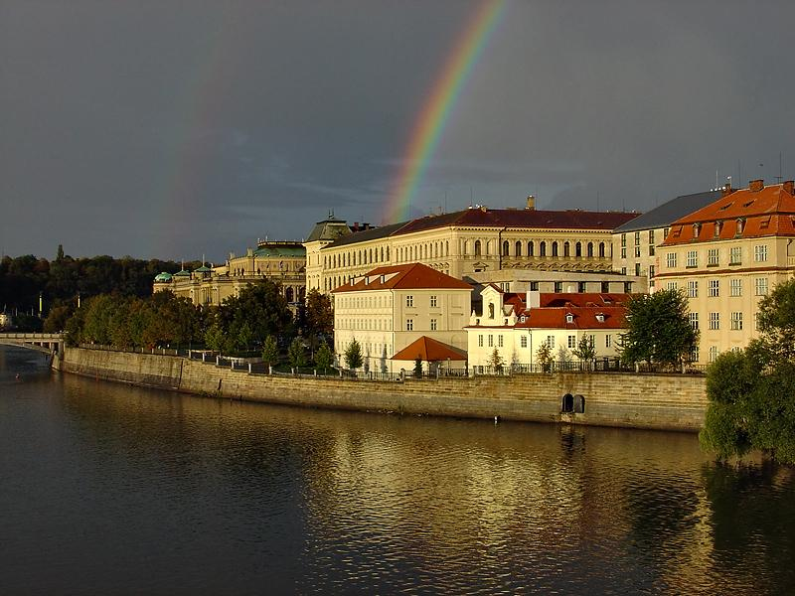
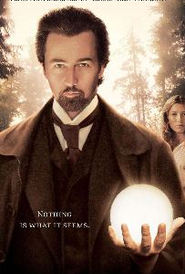
THANK YOU
ANY QUESTIONS ?
Notes:
 This is an example that must be provided to students. Allow discussion among them.
30

Slide 31

Notes:
 This is an example that must be provided to students. Allow discussion among them.

Slide 32
Public Speaking in English
V I S U A L A I D S
Tania Cabrera
Notes:
 This is an example that must be provided to students. Allow discussion among them.

Slide 33
YOU MUST REMEMBER:
The K.I.S.S. principle
Notes:
Finally, tell your students about the K.I.S.S. principle.
As this is a very common verb in English, students will be able to remember it.

Slide 34
Keep It Short & Simple
Notes:
Teach them that K.I.S.S. stands for: KEEP IT SHORT & SIMPLE

Slide 35
Public Speaking in English
V I S U A L A I D S
Notes:
 This is an example that must be provided to students. Allow discussion among them.
NOTE: This slide should be the last slide of the class, allow students to ask any questions thay may have.

Slide 36
REFERENCIAS
Bell, D. 2008. Passport to academic presentations. UK: Garnet education.
Bournemouth University, 2011. BU guide to citation in the Harvard style. Poole: Bournemouth University. Available from: http://www.bournemouth.ac.uk/library/citing_references/docs/Citing_Refs.pdf [Accessed 10 July 2015].
Comfort, J. 2006. Effective Presentations. 3rd ed. Oxford: Oxford University Press.
Grussendorf, M. 2007. English for presentations. New Yor : Oxford University Press.
Kirkpatrick, J. 2011. A Three-Step Model for More Effective Presentations. Journal of Counseling & Development. 65 (3), 178-190. Available from: http://onlinelibrary.wiley.com/doi/10.1111/j.2164-4918.1983.tb00180.x/abstract. [Accessed 06 July 2015].
Urech, E. 2000. Speaking Globally: How to make Effective Presentations Across International and Cultural Boundaries. Australia: Sydney. Macquaire University.

