Slide 1

Estrategias de lectura para la comprensión de textos académicos en Inglés
Plan de Estudios: Licenciatura en Lenguas
Unidad de Aprendizaje: Inglés para propósitos académicos
Unidad de competencia: Ecología. Hacer listas de referencia, composición de una investigación
Profesor: Guillermo Romero Hernández

Slide 2
Objetivo
Estrategias de lectura para la comprensión de textos académicos en Inglés
Proporcionar al alumno herramientas y estrategias que le permitan una mejor comprensión de textos académicos escritos en el idioma Inglés, para las diferentes áreas de conocimiento

Slide 3
Competencias
Ser capaz de aproximarse a la lectura de textos académicos en inglés
Identificar diferentes estrategias de comprensión lectora en Inglés
Ser capaz de aplicar las estrategias a un texto real del área de conocimiento propia del docente

Slide 4
Metodología general de trabajo
Lectura de comprensión
  Tipos o estilos de lectura para abordar textos académicos
  Estrategias para la lectura de comprensión
Factibilidad de las estrategias aplicadas al idioma Inglés
Lectura en Inglés
  Estructuras gramaticales básicas
  Vocabulario de sintaxis (nouns, verbs, adjectives, adverbs, conjunctions)
Componentes básicos de las oraciones en Inglés

Slide 5
Metodología general de trabajo
Estrategias de lectura de comprensión en inglés
  Skimming
  Scanning
Revisión de diferentes estrategias aplicables a textos académicos
Vocabulario técnico básico
  Componentes de cohesión y coherencia en Inglés
  Aspectos discursivos y comunicativos del Inglés
Adquisición de componentes generales de textos académicos (conjunctions, prepositions, connectors, idioms, phrasal verbs)

Slide 6
Metodología general de trabajo
Textos académicos reales
  Selección de textos académicos de acuerdo al área de conocimiento
  Resolución de ejercicios con asistencia del instructor
Resolución de ejercicios a través de equipos de trabajo

Slide 7

What is Reading?
“An active, fluent process which involves the reader and the reading material in building meaning”¹
¹ Anderson, N. J. (1999). Exploring second language reading. Boston, MA: Heinle & Heinle.

Slide 8
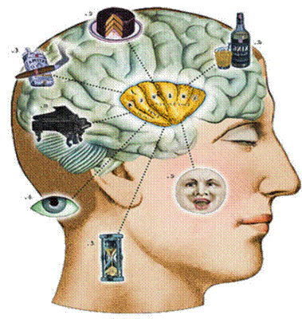
Cognitive processes
Decoding
Making inferences
Critical Reading

Slide 9

SCHEMA THEORY

Slide 10


Slide 11
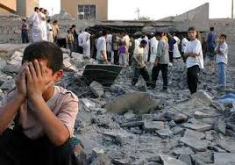

Slide 12
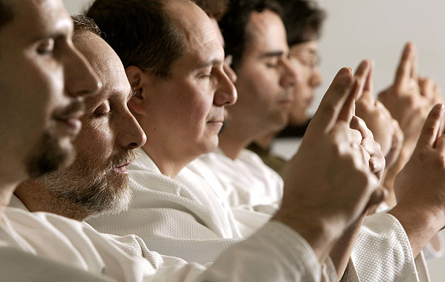

Slide 13
Schema
Schema is knowledge about the topic that individuals have already acquired through various experiences. These experiences and knowledge are activated when reading and can help the reader connect previous experiences to the content of the text.

Slide 14
There are 3 types of Schema
Content Schema: previous general knowledge about a topic
Linguistic Schema: linguistic information to decode words and their meaning
Formal Schema: knowledge about different organizations of text

Slide 15
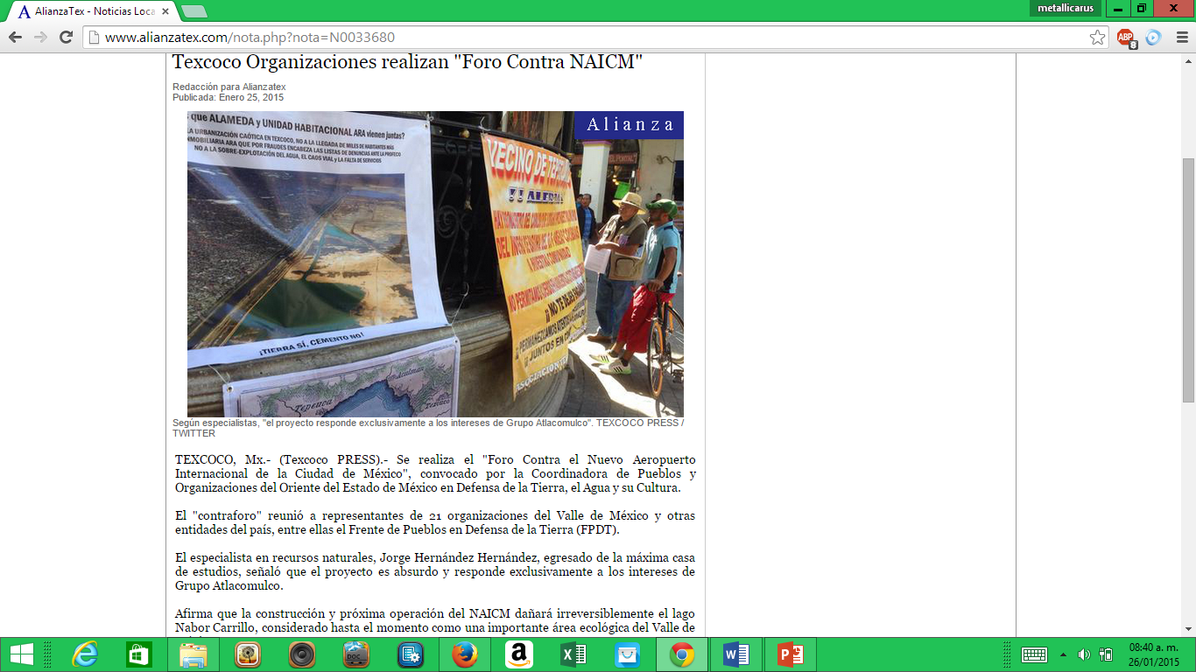

Slide 16
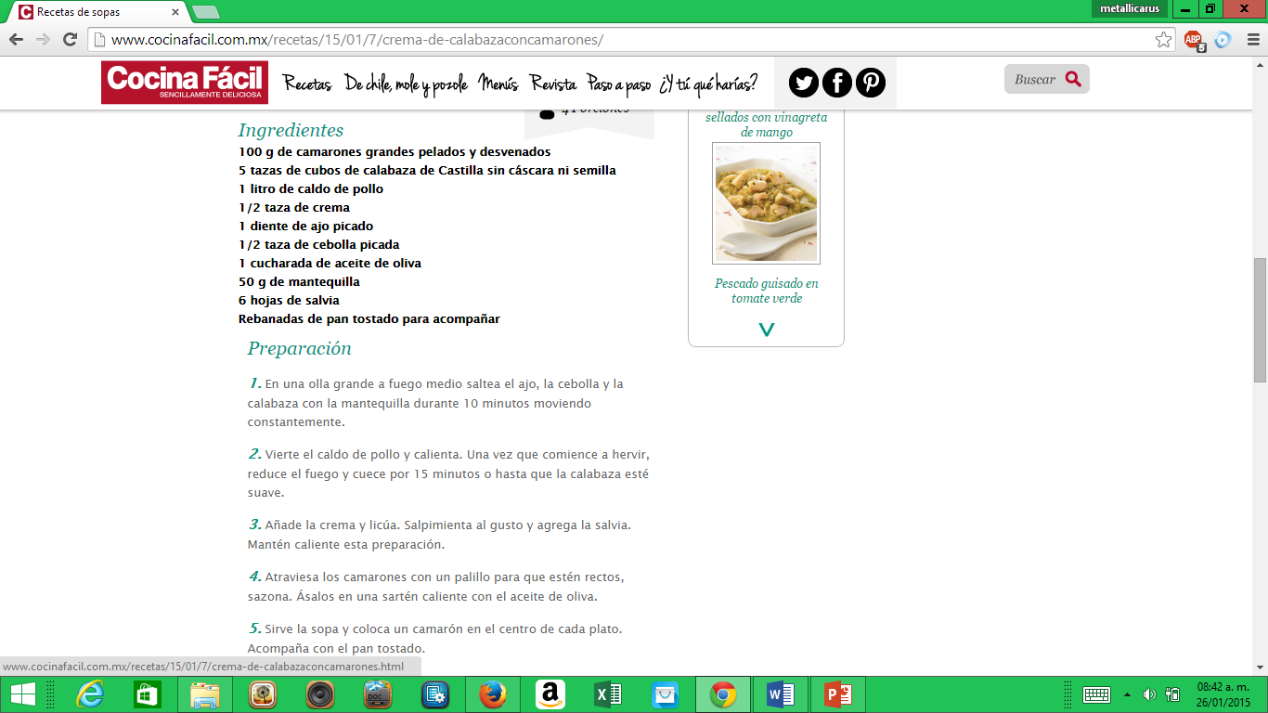

Slide 17
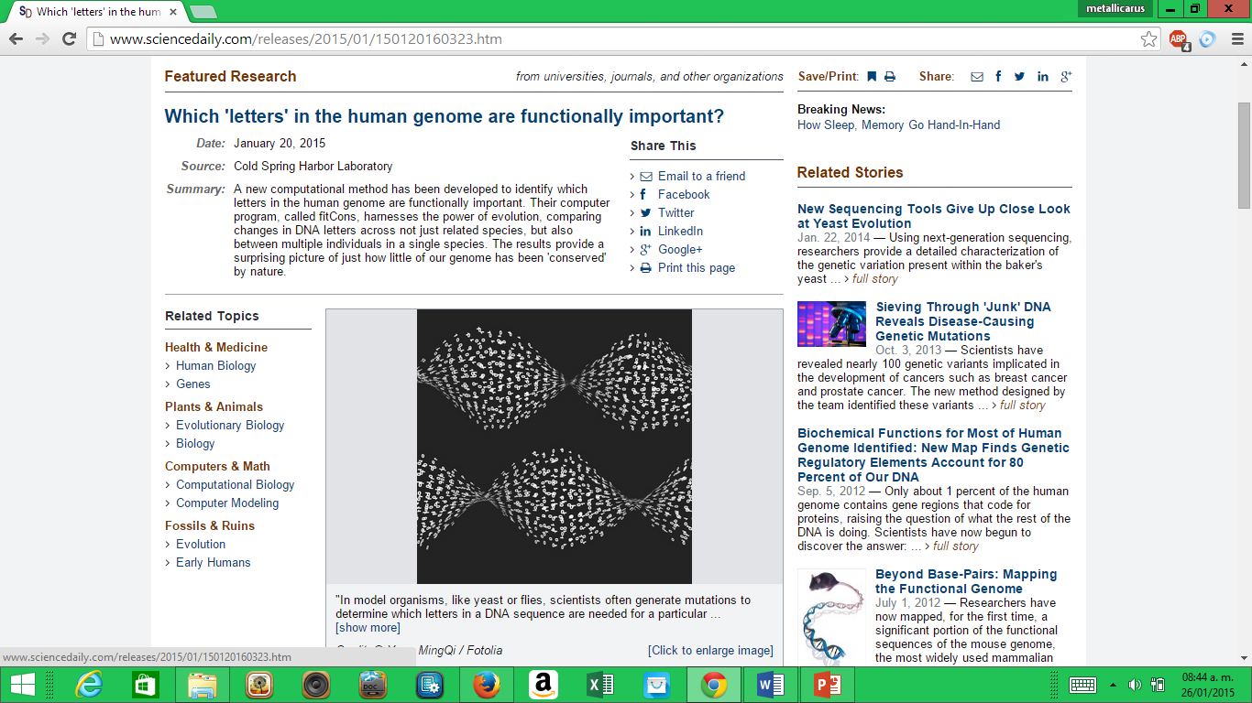

Slide 18
Cultural and Social Influences on Schema
Life at school
Relationships
Learning English

Slide 19
Basic Linguistics Concepts
Noun: the part of speech (or word class) that names or identifies a person, place, thing, quality, or activity.
Adjective: a part of speech that modifies (describes) a noun.

Slide 20
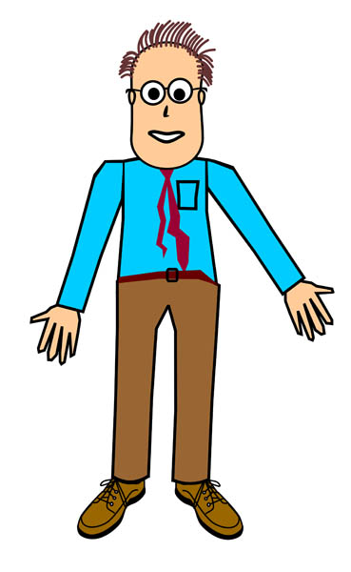

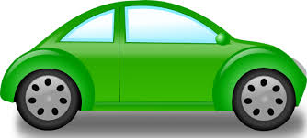


Examples of nouns:
Common nouns:

Slide 21
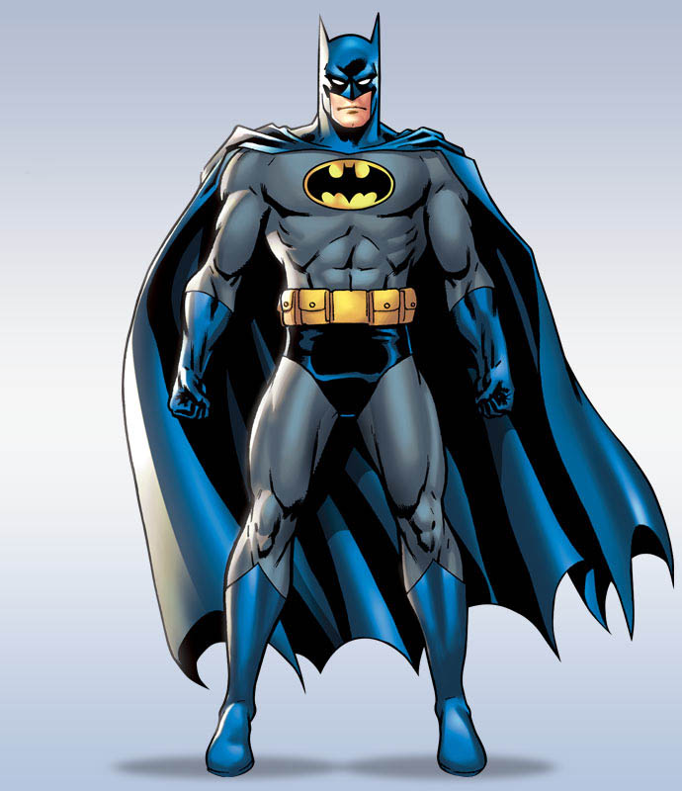


Proper nouns:

Slide 22
Adjectives
Great
Gorgeous
Expensive
Hideous
Tiny

Slide 23
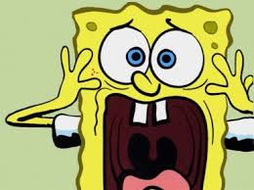
Noun-adjective relationship
Adjective + noun
That is a really big house
Noun + Adjective
That is a really house big

Slide 24
More basic concepts
Verb: any member of a class of words that function as the main elements of predicates, that typically express action or a state
Adverbs: The part of speech (or word class) that is primarily used to modify a verb, adjective, or other adverb.

Slide 25
Verbs
Verbs can:
End in s
End in ed
Be used along with auxilliary verbs (do, does, did, have, will, would)

Slide 26
Adverbs:
Frequency: always, usually, often, sometimes, rarely, hardly ever, never
Place: here, there, outside, upstairs, etc.
Manner: most adverbs of manner end in ly
Quickly, slowly, gently, slightly

Slide 27
Conjunctions
The part of speech (or word class) that serves to connect words, phrases, clauses, or sentences.
And
But
Or
Nor
For
Yet
So

Slide 28
More conjunctions…
After
Although
As long as
Even though
Provided that
Unless
Whereas

Slide 29
Activity
Circle the nouns, underline the adjectives, cross the verbs and check the adverbs found in the Reading.

Slide 30
Language structures
Statements
Subject + verb + object

Slide 31

Questions
Question word + Auxilliary verb + Subject + verb + object?

Slide 32
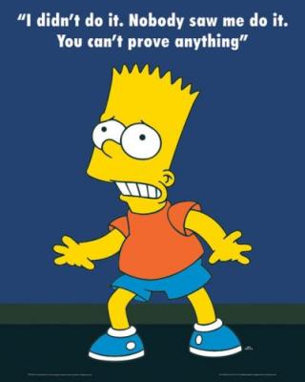
Negative sentences
Subject + Auxilliary verb + not + verb + object

Slide 33
Activities:
London
New Zealand
Reading Overview
Reading skills 1

Slide 34
Reading Strategies
1. Identify a purpose for reading
2. Use graphemic rules, which is a phonics approach, and consonant and vowel patterns to aid in bottom-up decoding
3. Use efficient silent reading techniques for improving fluency
  · Don't “pronounce” each word to yourself.
  · Try to visually perceive more than one word at a time, preferably in phrases.
  · Unless a word is crucial to global comprehension, skip it and try to determine the meaning through context

Slide 35
Reading strategies
4. Skimming (for main ideas): Skimming is a type of technique that requires fast reading. The reader reads quickly through a text just to get the main idea/ideas. For example, a reader might skim a dialogue in order to see if the opinions of the people involved in the dialogue are positive or negative
5. Scanning (for specific information): Scanning, similarly to skimming, consists of moving quickly through a text, but the difference is that you are looking for specific information.
6. Use semantic mapping or clustering
7. Use inference and guessing
9. Distinguish between literal and implied meanings

Slide 36
Activities
The Unexplained
  What´s the main topic the 3 people talk about?
  What do each of them think about it?
  Select a Reading from Reading Skills 1 and develop a graphic organizer
  Reading Skills 2
  Africa

Slide 37

Strategies for learning vocabulary
Reflecting
When encountering new words in a text, students can sometimes feel overwhelmed. However, there are different degrees of word knowledge. There are a number of different stages of knowledge, rather than just an 'on/off' switch for 'knowing' a word.

Slide 38
Student self-assessment tool
No knowledge |  |  |  |  | Expert knowledge
0 | 1 | 2 | 3 | 4 | 5
I have never seen the word before. | I have seen the word but am not sure what it means. | I understand the word when I see or hear it in a sentence. | I have tried to use this word, but I am not sure I am using it correctly. | I use the word with confidence in either speaking or writing. | I use the word with confidence, both in speaking and writing.

Slide 39
Asking questions about words
Are there certain words that often occur before or after the word? (Collocation)
(If it is a verb) Is there a particular preposition that often follows it? (Collocation)
Are there any grammatical patterns that occur with the word? (Grammar)
(If it is a noun) Is it countable or uncountable? (Grammar)
Did we study any of the members of this word family? (Word parts)
Are there any familiar roots or affixes for this word? (Word parts)
Is the word used in both speaking and writing? (Register/Appropriateness)
Could this word be used to refer to people? Animals? Things? (Meaning)
Does the word have any positive or negative connotations? (Meaning)

Slide 40

Using Word Parts
It is important to let readers, know that they can use word parts to their advantage when finding new words. Breaking words into affixes is an excellent way to decode unknown words. However, we need to explain to students that patterns are not absolute rules; they should not think that all endings or beginnings of words are affixes and have the same characteristics. Take for example the word waiter, which means somebody (signaled by the suffix -er) who waits (signaled by the root wait). However, would you say the same thing about the word shoulder?

Slide 41
Adjectives ending in –ed or -ing
Las terminaciones "-ed" y "-ing" no sólo se usan para formar los tiempos verbales del pasado y presente continuo, también se usan con adjetivos. Estos adjetivos están compuestos de un verbo y estas dos terminaciones, pero ten en cuenta que el sentido cambia dependiendo de que terminación se use.

Slide 42
Adjectives ending in -ed
Los adjetivos que terminan en "-ed" indican o describen emociones. Estos adjetivos suelen acabar en "-ado", "-ido" o "-edo" en español y van después del verbo "estar".
Ejemplos:
John is interested in art. (John está interesado en el arte.)
Denise was bored in class. (Denise estaba aburrida en clase.)
Luke is excited about his new job. (Luke está emocionado con su nuevo empleo.)

Slide 43
Adjectives ending in -ing
Los adjetivos que terminan en "-ing" indican o describen una característica de algo o alguien. A diferencia de los adjetivos que terminan en "-ed", no hay regla en español para formar estos adjetivos y van después del verbo "ser".
Ejemplos:
John is an interesting person. (John es una persona interesante.)
The class was boring so Denise fell asleep. (La clase era aburrida asi que Denise se durmió.)
Luke started an exciting new job. (Luke acaba de empezar un nuevo empleo emocionante.)

Slide 44

How can we identify if the word is an adjective or a verb?

Slide 45
Idiom: a manner of speaking that is natural to native speakers of a language
Every language has its own collection of wise sayings. They offer advice about how to live and also transfer some underlying ideas, principles and values of a given culture / society. These sayings are called "idioms" - or proverbs if they are longer. These combinations of words have (rarely complete sentences) a "figurative meaning" meaning, they basically work with "pictures".
This List of commonly used idioms and sayings (in everyday conversational English), can help to speak English by learning English idiomatic expressions. This is a list, which contains exactly 66 of the most commonly used idioms and their meaning.

Slide 46
Some examples
A hot potato
Speak of an issue (mostly current) which many people are talking about and which is usually disputed
Barking up the wrong tree
Looking in the wrong place. Accusing the wrong person
Cry over spilt milk
When you complain about a loss from the past.
Let the cat out of the bag
To share information that was previously concealed

Slide 47
More examples
Once in a blue moon
Happens very rarely.
Piece of cake
A job, task or other activity that is easy or simple.
Speak of the devil!
This expression is used when the person you have just been talking about arrives.
Not playing with a full deck
Someone who lacks intelligence

Slide 48
HANDS AT WORK!!
Food Challenge
Develop own text:
  Choose a paragraph from your own text, or work with the whole text
  Apply the strategies seen on the course to get main ideas and specific information
  Develop a summary or a graphic organizar to share it with the group
  GOOD LUCK!!

Slide 49

¡THANKS!

