Slide 1


Universidad Autónoma del Estado de México
Facultad de Lenguas
Licenciatura en la Enseñanza del Inglés
M.C. y T. E. Alma Delia García Ensástegui
Docencia de la producción escrita
Tema: teaching writing implications

Slide 2
Objective
The aim of this PPP is to know the theoretical basis when planning writing; firstly to face teaching beliefs, to identify the difference between the process and product approach, as well as the aspects to be taken into account.

Slide 3
Beliefs about teaching
How do I teach English?
What aspects do I take into account when teaching?
What are the main differences between proccess and product approach?
How do you encourage your sts to write?
Do you have enough time for developing writing?

Slide 4
Written
Usually permanent and written texts
Communicate across time and space
Spoken
Transient, unless recorded
Usually used for immediate interactions
More complex and intricate with longer sentences and many subordinate clauses
Punctuation and layout
Full of repetitions, incomplete sentences,
Corrections and interruptions
Writers receive no immediate feedback from their readers
Dynamic interaction between two or more people

Slide 5
Writing: product or process?
Richards (1990, p. 106) states two approaches:
Process approach
Teaching writing
Product/focused

Slide 6
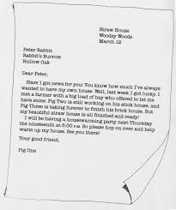
Product approach
Traditional approach
Mimic a model text
Organisation of ideas more important than ideas themselves
One draft
Controlled practice
Individual

Slide 7
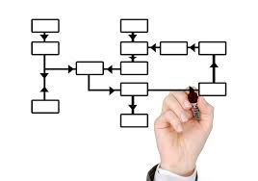
Process approach
text as a resource for comparison
Ideas as starting point
More than one draft
Collaborative
Emphasis on creative process

Slide 8

Skilled and unskilled writers.
Skilled writer
generate new ideas
concerned with revising meaning
before form
focus on the content and
organization
are able to do this recursively
Purpose in mind
assess and reassess
reread their text

Slide 9
Skilled writers
Get gr right
Have wide range of vocabulary
Use conventions
Punctuate meaningfully
Spell accurately
Use linking words

Slide 10

Skilled and unskilled writers.
Unskilled writer
preoccupied with form and structure
No editing
No rethinking
No revising

Slide 11
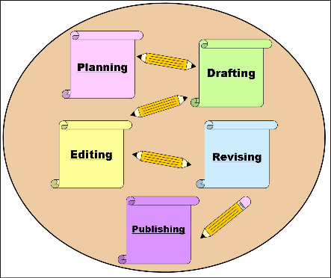
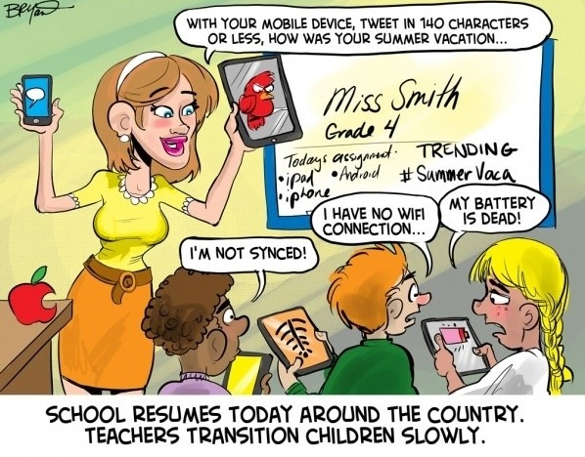

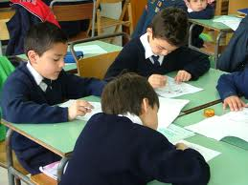
Teaching implicatios
Learning the approaches to teach writing.

Slide 12
Aspects of writing
Handwriting: some sts do not know it
Spelling: US vs English
Punctuation-capital letters non-universal
  English: January=month
  Spanish: enero= mes

Slide 13
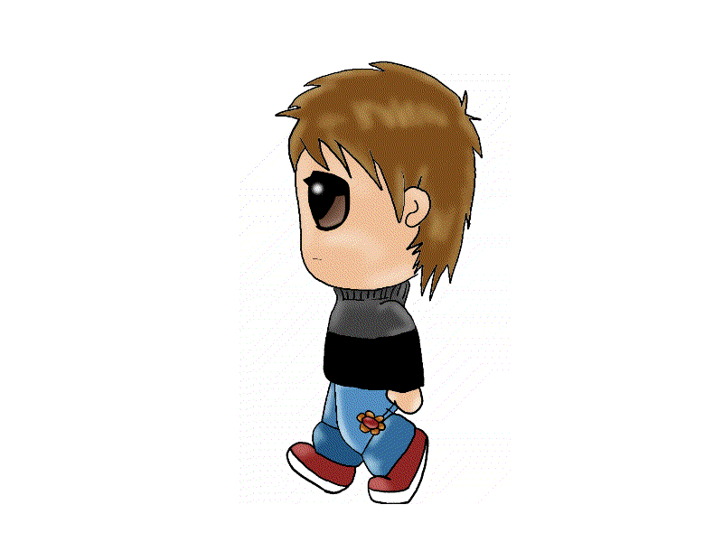
Aspects of writing
Sentence construction (gr rule)
verb (+adverb) compl.
Linking word

Slide 14
Aspects of writing
Property that distinguishes a sequence of sentences that form a discourse from a random sequence of sentences
Text cohesion
states or suggests the
main idea (or topic )
of a passage.
Example:
Topic sentence+ supported ideas
"Salva and the other boys made cows out of clay. The more cows you made, the richer you were. But they had to be fine, healthy animals. It took time to make a lump of clay look like a good cow. The boys would challenge each other to see who could make the most and best cows."
(Linda Sue Park, A Long Walk to Water. Clarion, 2010)
Taken from: [http://grammar.about.com/od/tz/g/topicsenterm.htm

Slide 15
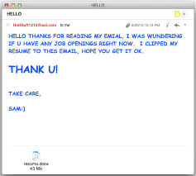
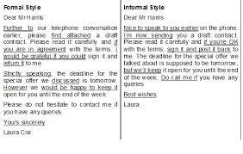
Aspects of writing
Register/style: formal
-vocabulary -addresser
-gr structures -addressee
-contractions

Slide 16


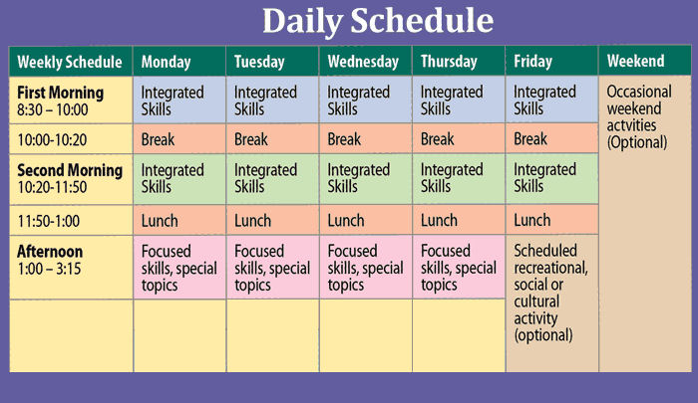
Encouraging sts to write
1. Have a positive and co-perative attitude towards writing
Ideas
  Encourage real writing: birthday card
  Plan enough time for planning
I always write my diary

Slide 17
Encouraging sts to write
Time for planning
  The more your sts write the better they do
  Do not ask it for out-of-class (unless advanced)
  Work more in the classroom

Slide 18

Encouraging sts to write
Have a positive and co-perative attitude towards writing
Ideas
  Encourage sts to show their writings
  Allow them to work in teams: pairs, groups.
I always write my diary

Slide 19
Encouraging sts to write
2. Prepare sts for writing
  Help sts to gather information from:
Reading
Talking to another
Listening
Another resource

Slide 20

Encouraging sts to write
2. Prepare sts for writing
  Help sts with model writings
  Analyse a piece of writing: topic sentence, supported ideas, linking words
  Point out the elements of a piece of writing

Slide 21

Encouraging sts to write
3. Structure writing activities
Plan writing activities: aim: PROGRESS
  Start with
Controlled
Freerer

Slide 22
Encouraging sts to write
3. Structure writing activities
Controlled activities
  Provide a clear model
  Give sts time to do the task
  Monitor them
  Assess them

Slide 23
Encouraging sts to write
3. Structure writing activities
Controlled activities
  Provide a clear model
  Give sts time to do the task
  Monitor them
  Assess them

Slide 24
Encouraging sts to write
4. Plan guided and freerer practice activities
Controlled activities
  Provide proper and feasible tasks
  Work on both: process and product approach
  Work with drafts

Slide 25
Reasons for writing
To consolidate learning
New structure
Vocabulary
To check sts’ progress
Vocabulary
Grammar structures
To diagnose
Teaching problems
Learning problemns

Slide 26

Role of the teacher
  Model
  Helper to build communicative potential
  Facilitator
  Guide
  Prompter

Slide 27

Producing written discourse
  The fact of moving from concepts to written text is complex
  Writing requires complex mental process
  The writer has to think:
    Gendre of the text (story, description, explanation)
    Purpose
    The amount

Slide 28
Producing written discourse
  Level in terms of meaning of sentences
  Content: which parts must be included
  Order: from the most important to the less
  Relations: are there enough ideas to talk about?
Pre
While
Post

Slide 29
Coherence and cohesion
  Introduction:
    Direct readers attention
    Existence of writer’s beliefs, opinions
  Background:
    Explain nature od the problem
    Explain desires of the writers
  Argument:
    State premises
    State conclusion
Refers to the linking relationships expressed in the surface structure of the text
Use variety of lexical and grammatical relationships
Types
  Reference

Slide 30
Coherence and cohesion
  Development
  Continuity
  Balance
  Completeness
  Component: structure, schema.
  Types of writings: narratives, instructions
  Substitution
  Ellipsis
  Conjunction
  Lexical

Slide 31
Guidelines for a process of writing activity
Introduction
Working with ideas
Planning
Drafting
Revieweing
Re-writing

Slide 32
Conclusion
Teaching writing requires planning; since to identify the different approaches to know the guidelines for writing.

Slide 33
Bibliography
Gower, R., & Walters, S. (1983). Teaching practice handbook. London: Heinemann Educational Books.
Hedge, Tricia. (1988) Writing /Oxford : Oxford University Press.

