Slide 1


Universidad Autónoma del Estado de México
Licenciatura en Lenguas
Unidad de aprendizaje de Taller de
microenseñanza del inglés
Tema: planning lesson, and managing the class 1.
Facultad de Lenguas
M. en Com. y Tec. Ed. Alma Delia García Ensástegui

Slide 2
Objetivo
El presente trabajo se deriva de la unidad de aprendizaje de taller de micro enseñanza, dirigido a los alumnos de la Facultad de Lenguas.
El objetivo es que los alumnos identifiquen cuales son los elementos externos al impartir una clase en cualquier idioma. Se toma en cuenta la elaboración del plan de clase, sus etapas, los enfoques y cómo manejar la clase.

Slide 3
PLANNING LESSONS
Functions:
- An aid to planning: written= think logically through the stages - time availability
- A working document:
- A record: of what you have done

Slide 4


What should be included in a
lesson plan?
Aims:
-What do I expect the students to do and/or to have
achieved by the end of the lesson?
-What specific language will they understand and use?
-What specific skills will they have developed?

Slide 5
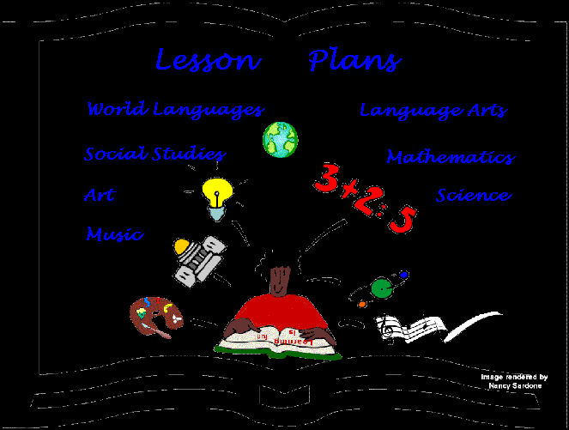
Procedure
The part of the lesson plan which lays out the steps- stages- in
the lesson plan to ensure that the aim (s) is achieved.
Indicate on your plan
-what will be done at each stage
-why

Slide 6

Procedure
-time
-materials you will use
-details (complex instructions)
Consider:
-Order of stages
-Approach (es)
-Activities
-Materials each stage
Answer:
-How much time do I have?
Approximately how will I
Divide up the lesson into
Stages?
How much time each stage?

Slide 7
PRESENTATION AND PRACTICE
STAGE 1 5 MINUTES Introduce the structures Context: giving someone who has a headache, and the replies to the advice.

Slide 8


PRESENTATION AND PRACTICE
STAGE 2 5 MINS Check students understanding and practice saying the model sentences

Slide 9

PRESENTATION AND PRACTICE
STAGE 3 10 MINS Guided practice, using cue cards-, in open then close pairs

Slide 10

PRESENTATION AND PRACTICE
STAGE 4 10 MINS Freer practice using a new context: Giving advice about preparing for a test.

Slide 11

PRESENTATION AND PRACTICE
STAGE 5 5 MINS Students make a record of the form and use of the structure in their notebooks.

Slide 12
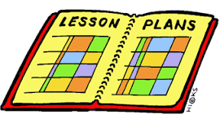
The lesson plan
It must have a beginning and a closure
The stages’ time vary according to the class
The material helps sts to learn easily
The five steps are not compulsory, three stages are also allowed.

Slide 13



APPROACH (ES) AND ACTIVITIES
Think what approach you use and what activities
to present
Aim
to revise
A text?
Visual?
Oral context?
A problem solving?
A language
item

Slide 14


Managing the class
Establish rapport
-notice their reaction
-to be in touch with the mood of class
@ Eye
contact
how
Lack of confidence

Slide 15

Managing the class
-sufficient range
-variety
-projection
@ Voice
when

Slide 16

@ Gesture
-reinforce instructions
-convey meaning lge
-cut down amoun verbal
explanation
Part
communication

Slide 17
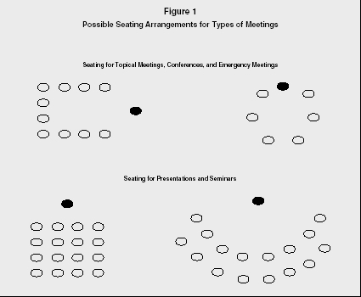
@ Classroom arrangement
Organization
of the sts
-their attitude to each other and to you
-your attitude to them
-how they interact
-types of activities they
can do

Slide 18

@ Attention spread
-don’t go round in a line
-give daunting tasks
-spend longer sts don’t understand
-not let individual sts hog
-remember sts back & sides

Slide 19

@ Teacher talk
-Teacher speaks most of the time
-It’s the only place where sts can
practice the lge
-Give them time to speak

Slide 20

@ eliciting
When teacher brings out sts’ knowledge,
suggestions and ideas.
asking questions
Get sts involved
Bring relevant information
Increase their amount of talk

Slide 21


@ giving instructions
Make sure all sts listening (by making eye contact)
Don’t give handout until you have given the instructions.

Slide 22

@ giving instructions
Use simple & short expressions:
  Listen up…
  Now…
  It’s time to…
Use visual clues, realia, pictures,
gestures, mimes (remember the role of the teacher: performer, guide)

Slide 23
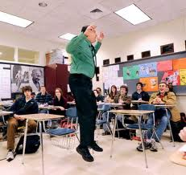
@ giving instructions
-Demonstrate or example
-Break the instructions down (if sts have to do several tasks)
1……
2…….

Slide 24

@ giving instructions
-Be decisive:
RIGHT
LISTEN
-Check understanding:
did you get it?
Juanito, please tell us what you have to
do….

Slide 25

@ setting up activities
controlled activities: depens on
  Level
  Aim of the class: vocabulary, gr, subskill
  Age
- use drills: listen and repeat:
choral or individual
-short dialogues (only one posible answer)

Slide 26

@ setting up activities
-guided activities (with low leveled-sts)
-dialogues
-role play (prompts)
-writing a model
-focused on the practice of particular language structure

Slide 27
@ setting up activities
-creative or free communication:
- speaking
- writing
-ways to set up interactive activities:
-sts talk to each other
-sts fulfill a task
Material
Communicative activities

Slide 28
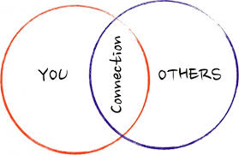
@ setting up activities
Do interactive activities
- give more speaking time
-withdraw individual performances
-encourage rapport
-allow sts to work collaboratively
-allow sts to be independent

Slide 29

@ setting up activities
Do interactive activities
- give opportunity for shy sts to participate
- provide a change in pace
-adds a variety of the lesson

Slide 30
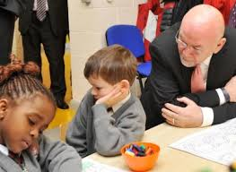
@ setting up activities
Do interactive activities
-pair-work: should be gradual
- make sure the task is clear and understood
-structured
-tutored-activity

Slide 31
Referencias
Gower R. et al. ( 1998), Teaching Practice Handbook, London: Heinemann.
Harmer J. (1991), The Practice of English Language Teaching, London: Longman

