Slide 1
Material didáctico para la Ua corrientes literarias del inglés
UNIVERSIDAD AUTÓNOMA DEL ESTADO DE MÉXICO
FACULTAD DE LENGUAS
ACADEMIA DE ESTUDIOS CULTURALES
TEMAS: RENAISSANCE IN ENGLISH LITERATURE
30 DE SEPTIEMBRE DE 2015
ELABORÓ: DRA. CELENE GARCÍA ÁVILA

Slide 2
Humanismo y renacimiento en la literatura inglesa

Slide 3
Francis Bacon
William Shakespeare

Slide 4
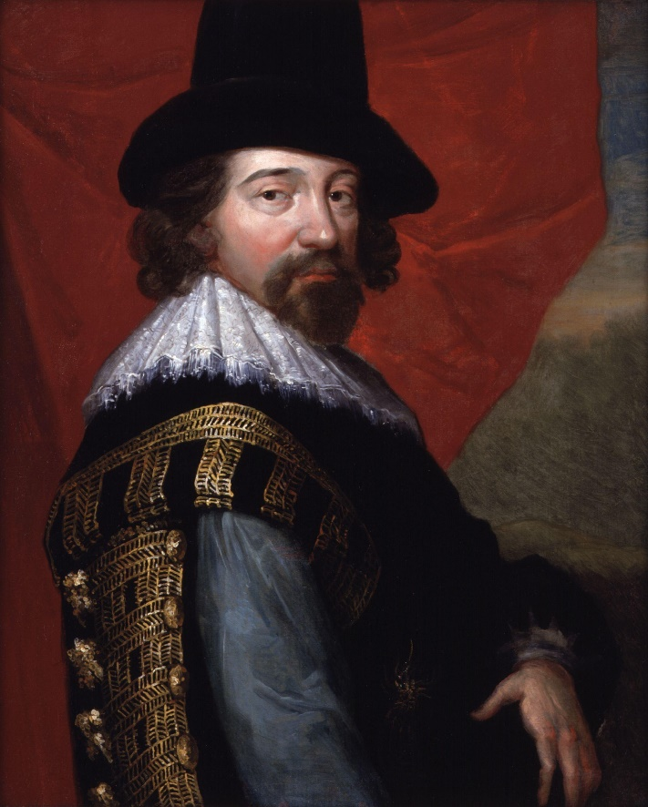
The Life of francis bacon
(1561–1626)

Slide 5
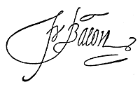
WHO WAS FRANCIS BACON?
Francis Bacon was born on January 22, 1561 in London, England.
He served as attorney general and Lord Chancellor of England.
His more valuable work was philosophical.
Bacon took up Aristotelian ideas, arguing for an empirical, inductive approach, known as the scientific method, the foundation of modern scientific inquiry.
In 1581, he landed a job as a member for Cornwall in the House of Commons.
He returned to Gray's Inn and completed his education.
By 1582, he was appointed the position of outer barrister.
In 1584, he composed A Letter of Advice to Queen Elizabeth, his very first political memorandum.

Slide 6
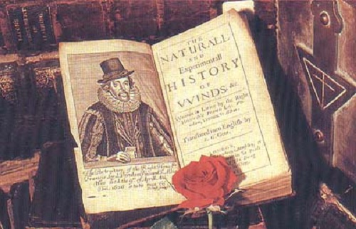

Slide 7
Style
Bacon’s writing style includes a number of features common to the Elizabethans and the Jacobeans:
In Bacon’s style there is an over luxuriance of figures of speech. Bacon is master of perceiving analogies in similes and metaphors.
Bacon’s style is compact yet polished and indeed some of its conciseness is due to the skillful adaptation of Latin idiom and phrase. But its wealth of metaphor is characteristically Elizabethan and reflects the exuberance of the Renaissance
Bacon set up a new method of prose writing, which was at once easy, simple, graceful, rhetorical, musical and condensed. (See The Essays)

Slide 8
Bacon's Philosophy
Bacon developed a dislike for Aristotelian philosophy at Trinity College, and he also opposed Platonism. He felt that Aristotle's system was more suited to disputation than to discovery of new truth and that Plato's doctrine of innate knowledge turned the mind inward upon itself, "away from observation and away from things."
Bacon's new method emphasized "the commerce of the mind with things." Science was to be experimental, to take note of how human activity produces changes in things and not merely to record what happens independently of what men do.
Bacon wanted an "active science" , with an ethical component. Science should be a practical instrument for human betterment.

Slide 9
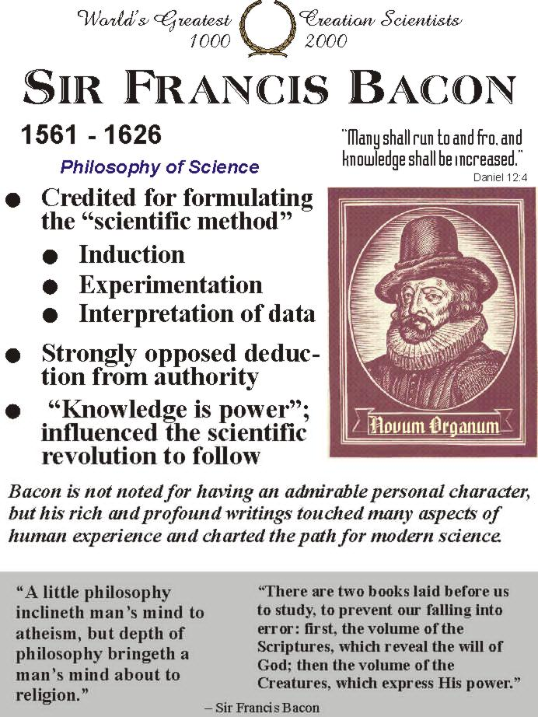

Slide 10
The Renaissance OF Sir Francis bacon
Gifted as a writer, scientific thinker, judge, and politician, Bacon is a man of the Renaissance. He deliberately cultivated numerous talents.
Bacon sought to promote the responsible use of reason, as well as other thinkers of the Renaissance.
Bacon was also a typical Renaissance thinker in his emphasis on ethics and morality: truth must be known but also practiced (see his essays under the subtitle “Civil and Moral.”)
However, Bacon was under no illusions about human nature. For instance, in his essay “Of Truth,” he makes clear his belief that humans have natural tendencies to want to be willful and to lie.

Slide 11
WRITING CAREER
During his career as counsel and statesman, Bacon often wrote for the court. In 1584, he wrote his first political memorandum, A Letter of Advice to Queen Elizabeth. In 1592, to celebrate the anniversary of the queen's coronation, he wrote an entertaining speech in praise of knowledge. The year 1597 marked Bacon's first publication, a collection of essays about politics. The collection was later expanded and republished in 1612 and 1625.
In 1605, Bacon published The Advancement of Learning in an unsuccessful attempt to rally supporters for the sciences. In 1609, he departed from political and scientific genres when he released On the Wisdom of the Ancients, his analysis of ancient mythology.

Slide 12
Bacon then resumed writing about science, and in 1620, when he published Novum Organum, presented as Part Two of The Great Saturation.
Other works:
1622, The History of Henry VII (a historical work for Prince Charles).
Historia Ventorum and Historia Vitae et Mortis.
In 1623, De Augmentis Scientarium, a continuation of his view on scientific reform. In 1624, The New Atlantis and Apothegms were published.
1627, Sylva Sylvarium.
Although Bacon's body of work covered a fairly broad range of topics, all of his writing shared one thing in common: It expressed Bacon's desire to change antiquated systems.

Slide 13
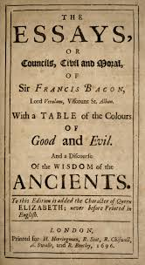
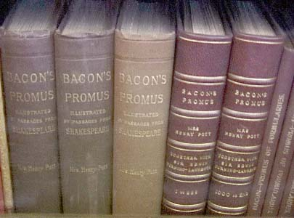

Slide 14
Final years
In March 1626, while testing the effects of cold on the preservation and decay of meat, he stuffed a hen with snow near Highgate, England, and caught a chill. Ailing, Bacon stayed at Lord Arundel's home in London. He soon developed bronchitis. On April 9, 1626, a week after, Francis Bacon died.
After Bacon's death, his theories began to have a major influence on the evolving field of 17th-century European science. British scientists belonging to Robert Boyle's circle("Invisible College“) followed through on Bacon's concept of a cooperative research institution, so they established the Royal Society of London for Improving Natural Knowledge in 1662. The Royal Society utilized Bacon's applied science approach and followed the steps of his reformed scientific method.
Political philosopher Thomas Hobbes played the role of Bacon's last amanuensis. The "father of classic liberalism," John Locke, as well as 18th-century Encyclopedists and inductive logicians David Hume and John Mill, also showed Bacon's influence in their work.

Slide 15
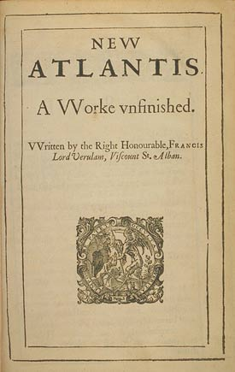
The New Atlantis
Bacon's literary executor, Dr. Rowley, published The New Atlantis in 1627, the year after the author's death. It seems to have been written about 1623, during that period of literary activity which followed Bacon's political fall. None of Bacon's writings gives in short apace so vivid a picture of his tastes and aspirations as this fragment of the plan of an ideal commonwealth.

Slide 16
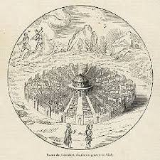
Bacon was a virtuous man displaying Aristotle’s four cardinal virtues: justice, wisdom, fortitude, and temperance in addition to the three theological virtues: faith, hope and charity.
His definitive thoughts concerned the utopian condition that he hoped man could achieve in The New Atlantis. The New Atlantis represents the kind of Society, according to Bacon, which was the most desirable for man (Epstein 160). A society of such nature would reach fruition upon the establishment of the Royal Society

Slide 17
http://www.egs.edu/library/francis-bacon/biography/
http://plato.stanford.edu/entries/francis-bacon
http://www.biography.com/people/francis-bacon-9194632

Slide 18
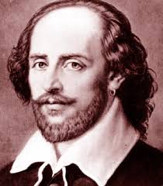
The life of William Shakespeare
(1564–1616)

Slide 19
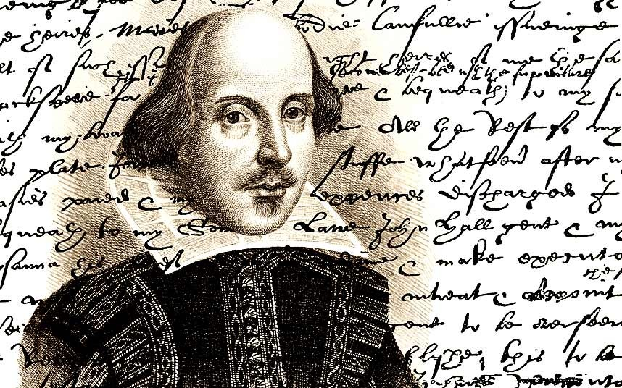

Slide 20
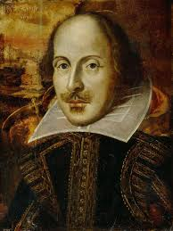
WHO WAS SHAKEASPEARE?
English poet, playwright, and actor, widely regarded as the greatest writer in the English language and the world's pre-eminent dramatist.
Often called England's national poet, and the "Bard of Avon".
38 plays, 154 sonnets, two long narrative poems, and a few other verses, some of uncertain authorship.
Shakespeare was born and brought up in Stratford-upon-Avon, Warwickshire. At the age of 18, he married Anne Hathaway, with whom he had three children. Sometime between 1585 and 1592, he began a successful career in London as an actor, writer, and part-owner of a playing company called the Lord Chamberlain's Men, later known as the King's Men.

Slide 21
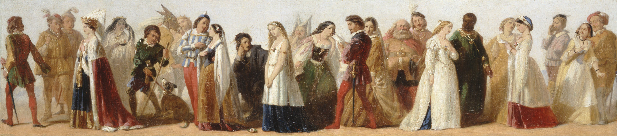
Style
Shakespeare's first plays were written in the conventional style of the day. (it does not always spring naturally from the needs of the characters or the drama). The poetry depends on extended, metaphors and conceits, and the language is often rhetorical—written to declaim rather than speak.

Slide 22
Influence
Shakespeare's work has made a lasting impression on later theatre and literature. In particular, he expanded the dramatic potential of characterization, plot, language, and genre.
He widely used Soliloquies to explore characters' minds rather than to convey information about characters or events.
His work heavily influenced later poetry. The Romantic poets attempted to revive Shakespearean verse drama, though with little success.

Slide 23
The Renaissance in Shakespeare's Time
The ideology that dominated the Middle Ages was heavily focused on the absolute power of God and was enforced by the formidable Catholic Church.
From the Fourteenth Century onwards, people started to break away from this idea. The renaissance movement did not necessarily reject the idea of God, but rather questioned humankind’s relationship to God – an idea that caused an unprecedented upheaval in the accepted social hierarchy. In fact, Shakespeare himself may have been Catholic.
This focus on humanity created a new-found freedom for artists, writers and philosophers to be inquisitive about the world around them.

Slide 24
Final years
Shakespeare spent the last five years of his life in New Place in Stratford. He died on 23 April 1616 at the age of 52 and was buried in Holy Trinity Church in Stratford. He left his property to the male heirs of his eldest daughter, Susanna.

Slide 25
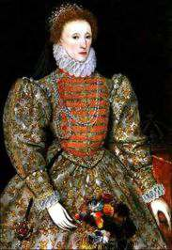
Shakespeare’s social context
The queen Elizabeth ruled when Shakespeare began to write. (1558-1603)

Slide 26
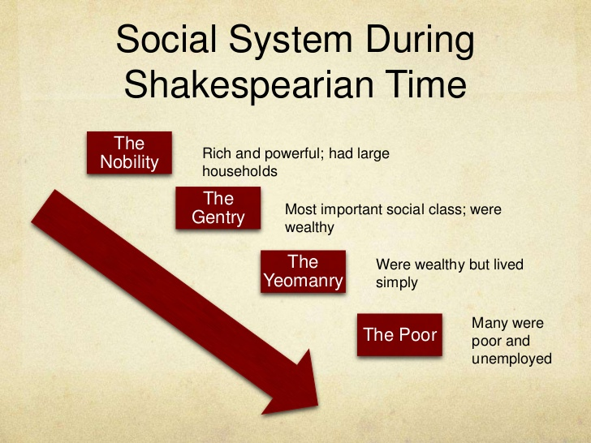
The social classes

Slide 27
Women's Work
The only career open to all Elizabethan women was marriage; a wife's job was to run the household and help her husband in whatever he did. Her work varied according to his.

Slide 28
Elizabethan era
The Elizabethan Era is named after the greatest Queens of England - Queen Elizabeth I. The Elizabethan Era is not only famous for the Virgin Queen but also for the era itself - Great Explorers, such as Sir Francis Drake and Walter Raleigh. The era of the very first Theatres in England - William Shakespeare, the globe Theatre and Christopher Marlowe!

Slide 29

King Lear is a tragedy play by William Shakespeare.
It depicts the descent into madness of the title character after he disposes of his kingdom between two of his three daughters based on their flattery, bringing tragic consequences for all. Based on the legend of Leir of Britain, a mythological pre-Roman Celtic king, the play has been widely adapted for the stage and motion pictures.

Slide 30
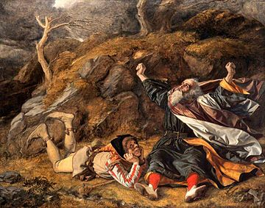
Originally drafted between 1603 and its first known performance on St. Stephen's Day in 1606, the first attribution to Shakespeare was a 1608 publication in a quarto of uncertain provenance; it may be an early draft or simply reflect the first performance text. The Tragedy of King Lear, a more theatrical revision, was included in the 1623 First Folio

