Slide 1
Centro Universitario UAEM Texcoco
Licenciatura en Lenguas
Unidad de Aprendizaje: Semántica del Inglés
Unidad de Competencia I.
Presentación: Conceptos Generales
Elaborado por: Emmanuel Ruiz Zamora

Slide 2


Slide 3
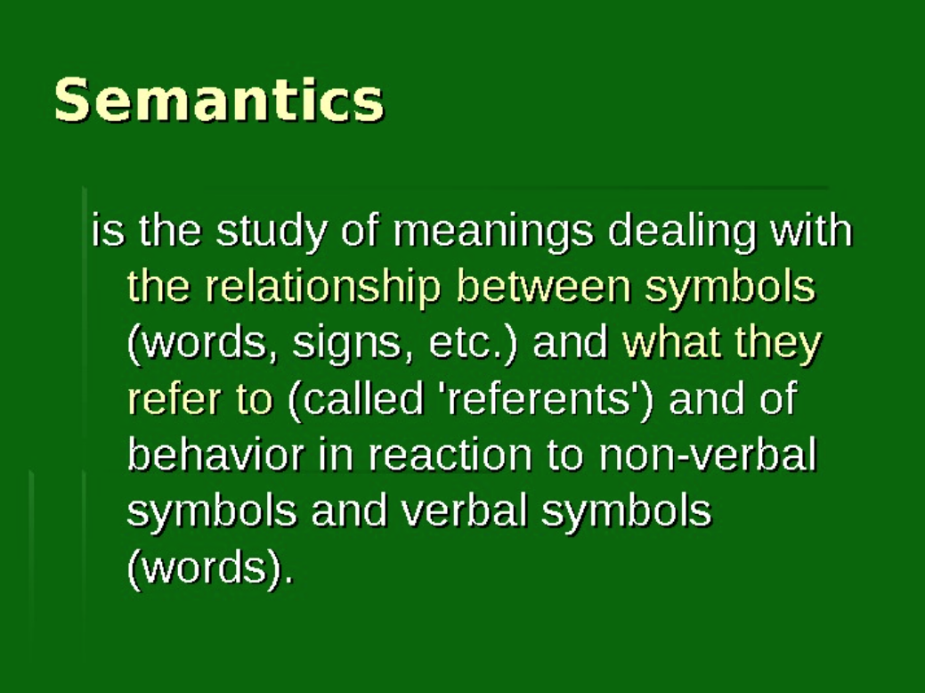
Notes:
Solicitar a los alumnos leer la definicion y discutir sobre ella

Slide 4
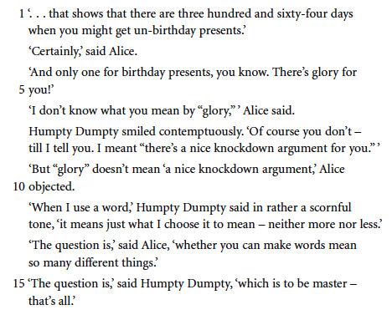
Introducción
Notes:
Entregar este extracto y resolver el ejercicio de la siguiente diapositiva en parejas

Slide 5
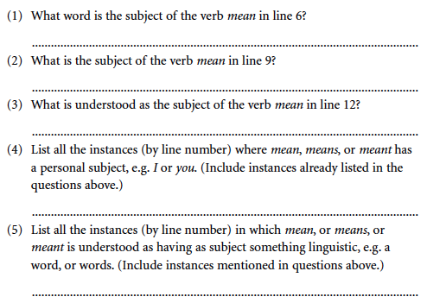
Practice
Notes:
Los alumnos resuelven el ejercicio en parejas

Slide 6
i. The study of semantics
Semantics: Study of meaning in language.
Sentence meaning: What a sentence means, whats it counts as the equivalent of in the language concerned.
Speaker meaning: What a speaker means when he uses a piece of language.
Theory: A precisely, specified, coherent and economical frame-work of independent statements and definitions, constructed so that as large a number as possible of particular basics facts can either be seen to follow for it or be describable in teams of it.
Notes:
Solicitar a los alumnos la lectura en voz alta y aclarar dudas

Slide 7
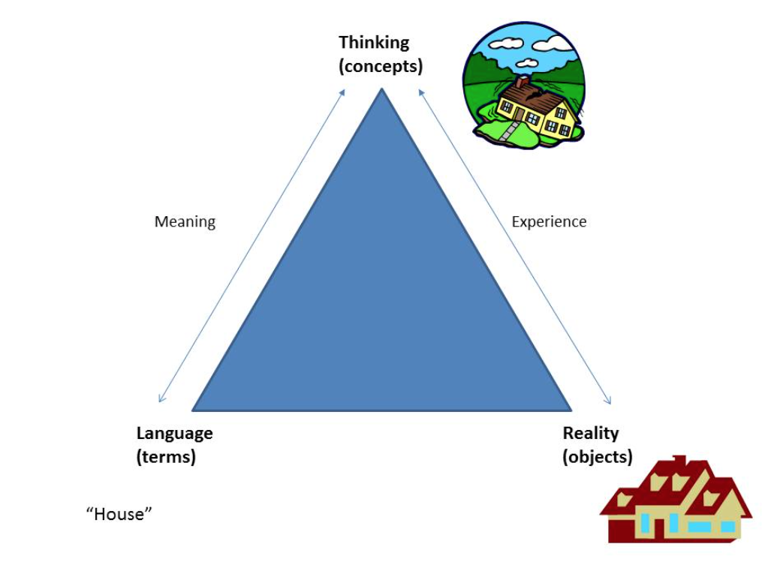
Notes:
Explicar la tiranguilacion entre el lenguaje-mundo real y concepto

Slide 8
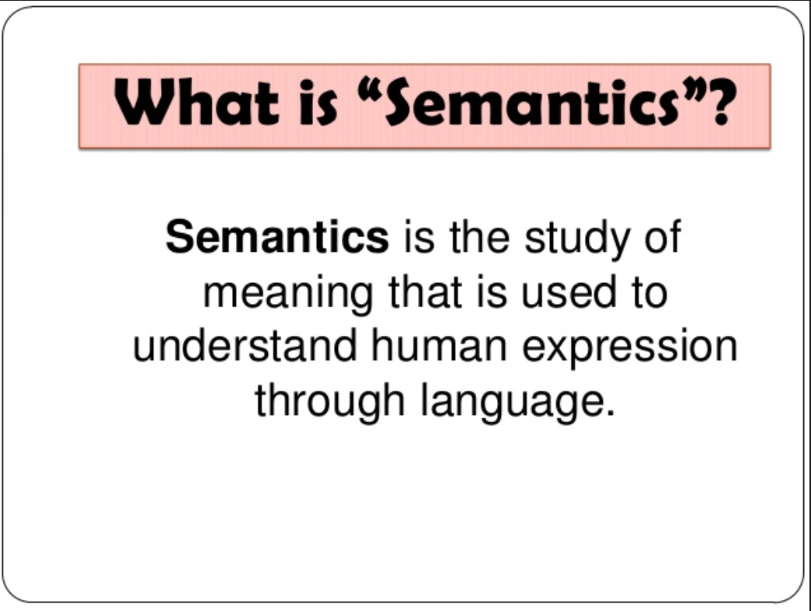
Discussion
Notes:
Los alumnos discuten en pequeños grupos el concepto de semántica

Slide 9
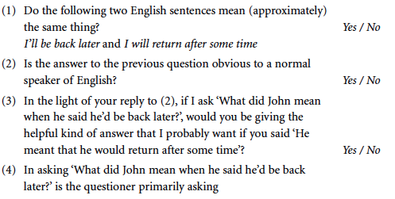
Practice
Notes:
Los alumnos en parejas responden el ejercicio

Slide 10
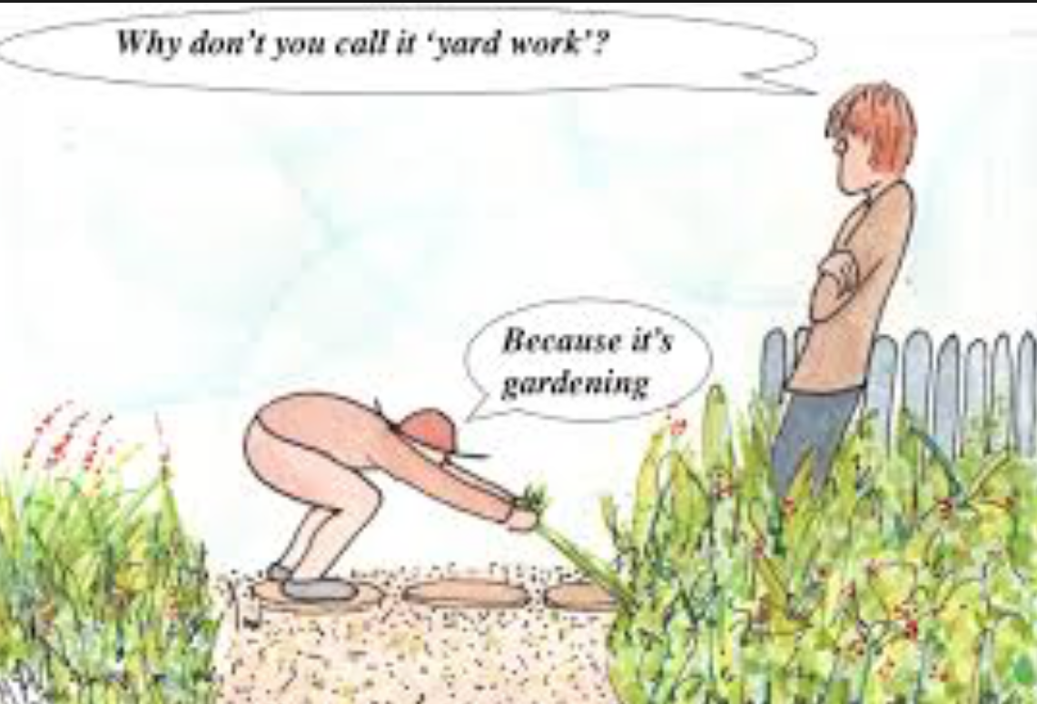
Discussion
Notes:
Los alumnos discuten sobre la imagen y su implicacion semantica

Slide 11
II. Basic Concepts
Utterance: Any stretch of talk, by one person, before and after which there is silence on the part of the person. Use by a particular speaker on a particular occasion, of a piece of language, such has a sequence of sentences, or a singular phrase, or even a single word.
Proposition: Part of the meaning of the utterance of a declarative sentence which describes some state of a affairs.
Sentence: Physical event nor a physical object. It is, conceived abstractly, a string of words put together by the grammatical rules of a language. A sentence can be thought of as the ideal string of words behind various realizations in utterances and inscriptions. Grammatically complete string of words expressing a complete thought.
Notes:
Solicitar a los alumnos la lectura y discusión en voz alta

Slide 12
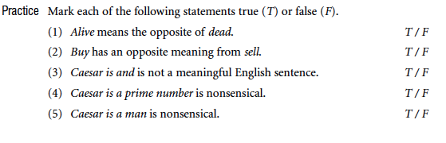
Practice
Notes:
Los alumnos responden el ejercicio de manera individual

Slide 13
II. Basic Concepts
Sense: Is its place in a system of semantics relationships with other expressions in the language. The first of this semantics relationships that we will mention is sameness of meaning, and intuitive concepts which we will illustrate by example. We will deal first with the senses of words in context.
Means of reference: A speaker indicates which things in the word (including persons) are being talked about.
Notes:
Solicitar a los alumnos la lectura y discusión en voz alta

Slide 14
II. Basic Concepts
Referring expression: Any expression used in a utterance to refer to something or someone ( or a clearly delimited collection of things or people), used with a particular reference in mind.
Opaque context: Part of a sentence which could be made into a complete sentence by the addition of a referring expression, but where the addition o diffent referring expressions, even though refer to the same thing or person, in a given situation, will yield sentences with different meanings when uttered in a given situation.
Equative sentence: Used to assert the identity of the referents of two referring expressions, to assert that two referring expressions have the same referent.

Slide 15
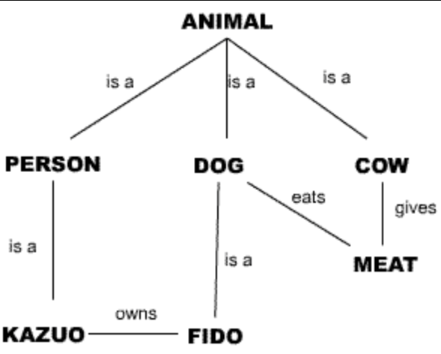
Discussion
Notes:
Los alumnos discuten sobre la imagen y su implicacion semantica

Slide 16
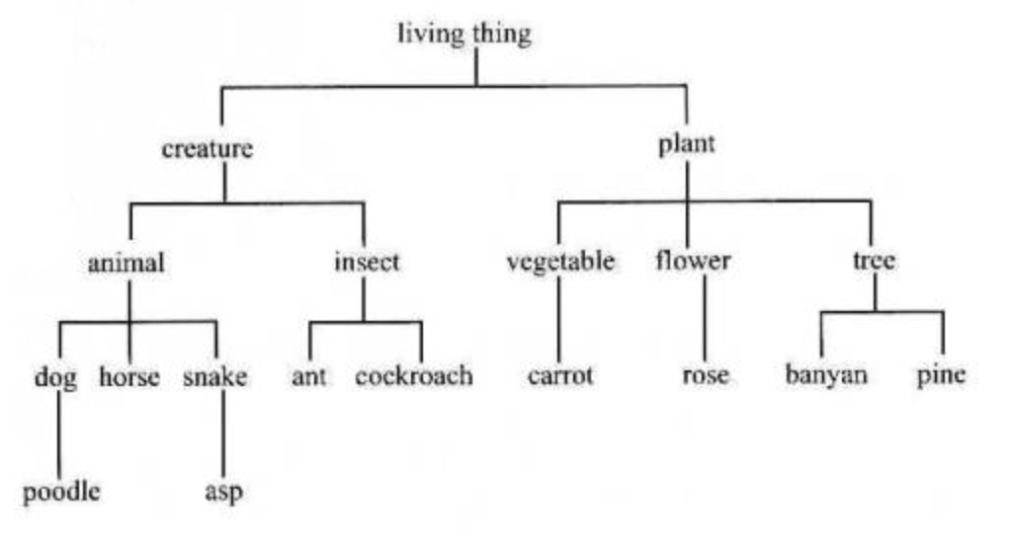
Discussion 2

Slide 17
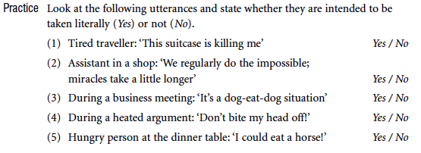
Practice
Notes:
Los alumnos resuelven el ejercicio en parejas

Slide 18
II. Basic Concepts
Predicator: Declarative sentence in the word (sometimes a group of words) which does not belong to any of the referring expressions and which, of the remainder, makes the most specific contribution to the meaning of the sentences. Describes the state or process in which the referring expressions are involved.
Degree: Number indicating the number of arguments it is normally understood to have in simple sentences.
Predicate: Any word (or sequence of words) witch (in a given single sense) can function as the predicator of a sentence.
Notes:
Solicitar a los alumnos la lectura y discusión en voz alta

Slide 19
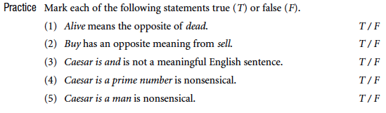
Practice
Notes:
Los alumnos resuelven el ejercicio en parejas

Slide 20
II. Basic Concepts
Universe of discourse: For any utterance as the particular word, real or imaginary ( or part real, part imaginary), that the speaker assumes he is talking about at the time.
Generic sentence: In which some statement is made about a whole unrestricted class of individuals as opposed to any particular individual.
Notes:
Solicitar a los alumnos la lectura y discusión en voz alta

Slide 21
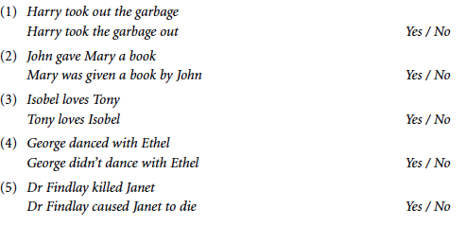
Practice

Slide 22
II. Basic Concepts
Deictic: Word is one which takes some element of its meaning from the context or situation ( the speaker, the addressee, the time and the place) of the utterance in which it is used.
Context: Utterance is a small subpart of the universe of discourse shared by speaker and hearer and includes facts about the topic of the conversation in which the utterance occurs, and also facts about the situation in which the conversation itself takes place.
Definiteness: Feature of a noun phrase select by a speaker to convey his assumption that the header will be able to identify the referent of the noun phrase, usually because it is the only thing of its kind in the context of the utterance, or because it is unique in the universe of discourse.
Notes:
Solicitar a los alumnos la lectura y discusión en voz alta

Slide 23
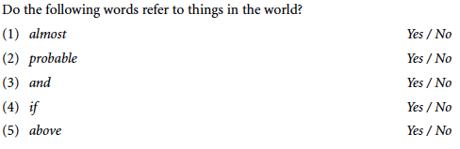
Practice
Notes:
Los alumnos responden el ejercicio de manera individual

Slide 24
II. Basic Concepts
Extension: Predicate in the set of all individuals to which that predicate can truthfully be applied. It is the set of things which can potentially be referred by using and expression whose main element is that predicate.
Prototype: Predicate is an object which is held to ve very typical of a king of the object which can be referred to by an expression containing the predicate. Can be thought of as the most typical member of the extension of a predicate.
REFERRING EXPRESSIONS
Referent: Thing picked out by the use of that expression on a particular occasion of utterance.
Extension: The complete set of all things which could potentially (in any possible utterance) be the referent of a referring expression whose head constituent is that predicate.
Prototype: Typical member of its extension.
Notes:
Solicitar a los alumnos la lectura y discusión en voz alta

Slide 25
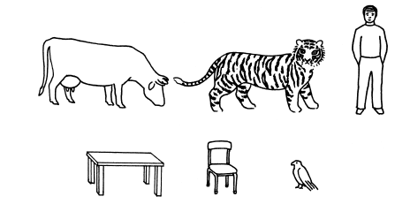
Practice
Notes:
Los alumnos discuten sobre la imagen y su implicacion semantica

Slide 26
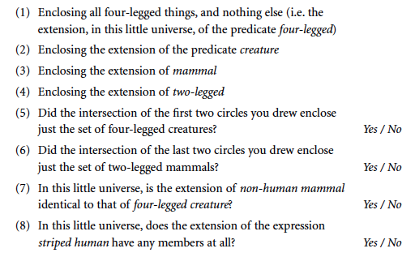
Practice
Notes:
Los alumnos resuelven el ejercicio en parejas

Slide 27
Referencias
Hurtford, J.R.B. Healy (1995). Semantics, a Coursebook. Cambridge University Press.

Slide 28
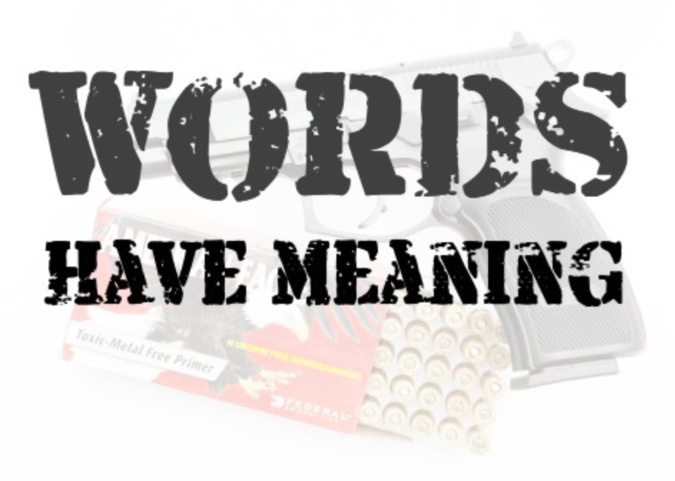
Notes:
Los alumnos discuten las implicaciones de la imagen.

Slide 29
Extra exercises
http://www.cs.bham.ac.uk/~pxc/nlp/InteractiveNLP/NLP_mean1.html
http://www.ello.uos.de/field.php/Semantics/Semanticsidentifysenserelations

Slide 30
End of Main concepts.

