Slide 1

Universidad Autónoma del
Estado de México
Centro Universitario UAEM Valle de México
Ingeniería en Computación
Unidad de Aprendizaje Inglés C2
Taking a message and reporting what has been said in meetings
Direct and indirect speech
Reporting verbs
Marzo, 2016
Guadalupe Yazmín Sosa Jiménez
Notes:
PORTADA 1

Slide 2

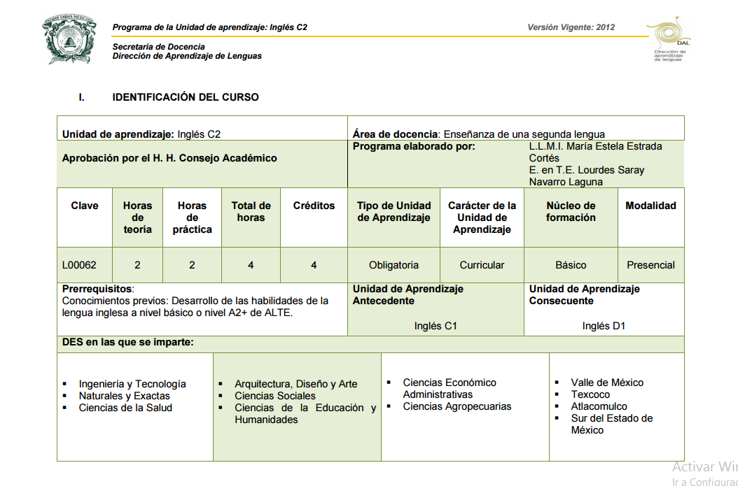

Notes:
INTERIORES

Slide 3
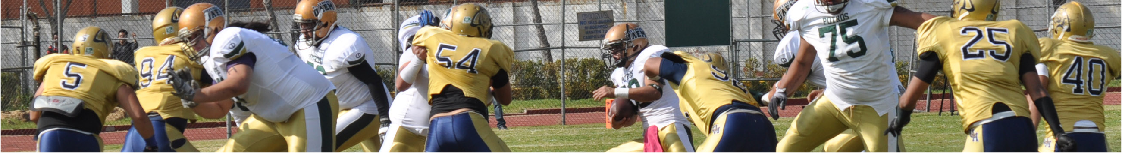

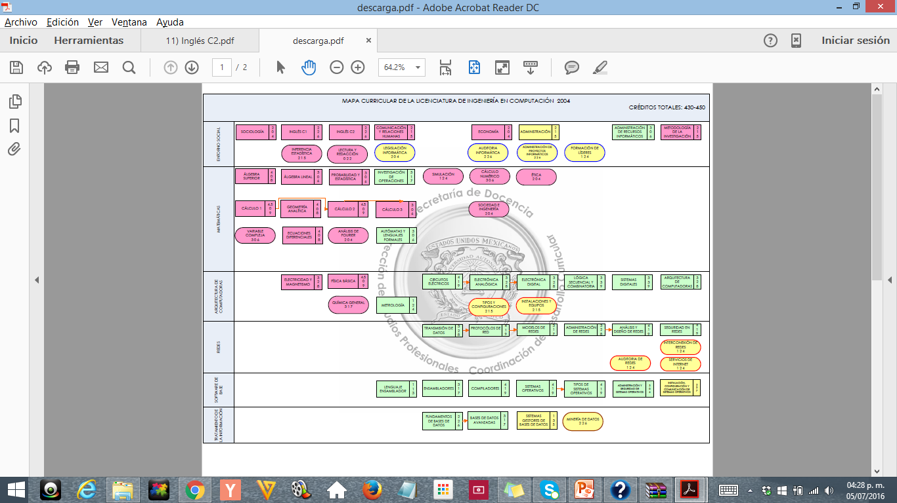
Notes:
INTERIORES

Slide 4
SCRIPT
The following material has been designed as an extra tool for students that are learning Reported Speech structure. The first slides are based on the different tenses in english, and how they have to changed when reporting information.
This material shows how sentences must be changed; it contains short explanations of each tense, and some examples too.It also has some exercises and their answer key.
Hope you like it!
Notes:
INTERIORES

Slide 5
REPORTED SPEECH
We use reported speech when we want to tell someone what somebody said. We usualy use a reporting verb (say, tell, ask). In this material, we will focus on the use of the verb “say”.
There are also some words that have to be changed when reporting infotmation (now, tomorrow, yesterday, here, this, etc).
For further information watch the following video: https://www.youtube.com/watch?v=Z-BmrNvYc3g
Notes:
INTERIORES

Slide 6
Objective of the unit of competence
Students will be able to repeat back part of what someone has said, in a written and spoken way.
Notes:
INTERIORES

Slide 7
Contents
Reported Speech
Reporting verbs
Note taking
Highlight main ideas
Using memory to recall
Notes:
INTERIORES

Slide 8

If we want to report someone’s words, we
have to consider two diferent options to do
so:
1st Option “Direct Speech” using quotation marks (“I work in a bank”)
2nd Option “Reported Speech” (He said he worked in a bank)
Notes:
INTERIORES

Slide 9
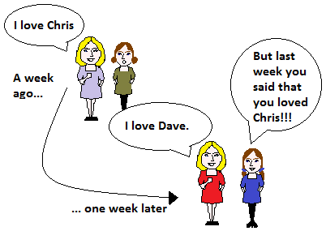
When we report what someone else said, the tenses, word order and
pronouns may be different from the original sentence.
Notes:
INTERIORES

Slide 10
These are the changes we have to make depending on the tense:
DIRECT SPEECH | REPORTED SPEECH
Simple Present | Simple Past
Present Continuos | Past Continuos
Present Perfect | Past Perfect
Present Perfect Continuos | Past Perfect Continuos
Simple Past | Past Perfect
Past Continuos | Past Perfect Continuos
Past Perfect | Past Perfect
Past Perfect Continuos | Past Perfect Continuos
“Will” Future | “Would” Conditional
Notes:
INTERIORES

Slide 11
Expressions of time and place are changed as indicated in the following list:
Direct Speech | Reported Speech
Now | Then
Today | That day
Tonight | That night
Yesterday | The previous day/the day before
Tomorrow | The next day/ The following day
The day before yesterday | Two days before
The day after tomorrow | In two days
Last week | The previous week/ the week before
Notes:
INTERIORES

Slide 12
Direct Speech | Reported Speech
Last month | The previous month/the month before
Last year | The previous year/the year before
Next week/month/year | The following week/month/year
Last night | The previous night
Here | There
This/it | That
These | Those
Thus | So
Ago | Before
Notes:
INTERIORES

Slide 13
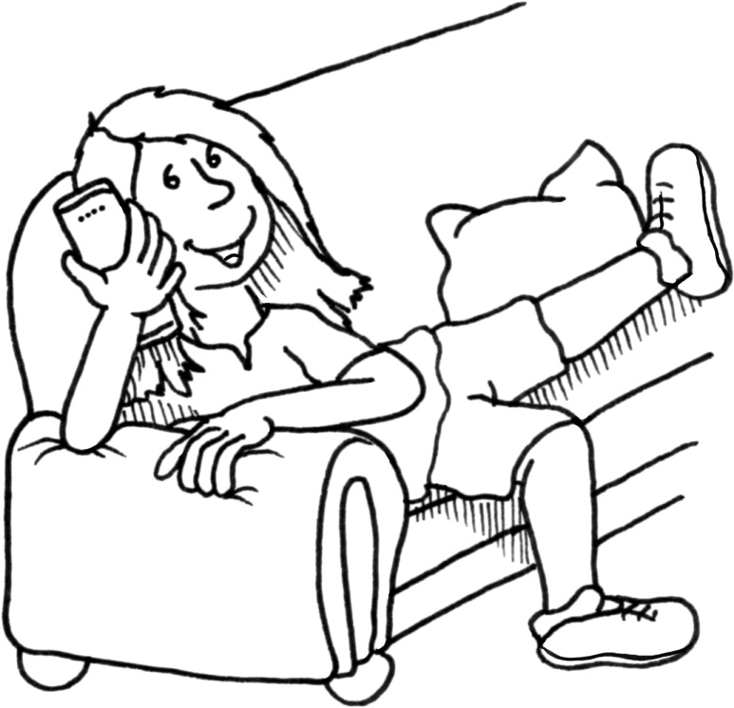

DIRECT SPEECH | REPORTED SPEECH
Simple Present | Simple Past
Direct Speech: “I want to go to the cinema”
The Present Simple tense (want) usually changes to the Past Simple (wanted) in Reported Speech;
Reported Speech: She said that she wanted to go to the cinema.
Example:
Mario: "I often have a big hamburger“
He said that he often had a big hamburger
Notes:
INTERIORES

Slide 14
Exercises
Instructions: Change the following Direct Speech sentences into Reported Speech (Simple Present- Simple past).
“They live in Boston” Ana said
_________________________________________________________
2. “Denisse downloads the latest tunes” Roger said
_________________________________________________________
“I love chocolate” She said
_________________________________________________________
4. “ That mobile is mine” Luis said
_________________________________________________________
5. “I have a habit of reading before I go to bed” My father said
_________________________________________________________
Notes:
INTERIORES

Slide 15
Answer Key
“They live in Boston” Ana said
Ana said that they lived in Boston
2. “Denisse downloads the latest tunes” Roger said
Roger said that Denisse downloaded the latest tunes
“I love chocolate” she said
She said that she loved chocolate
4. “ That mobile is mine” Luis said
Luis said that that telephone was his
5. “I have a habit of reading before I go to bed” My father said
My father said he had the habit of reading before he went to bed
Notes:
INTERIORES

Slide 16
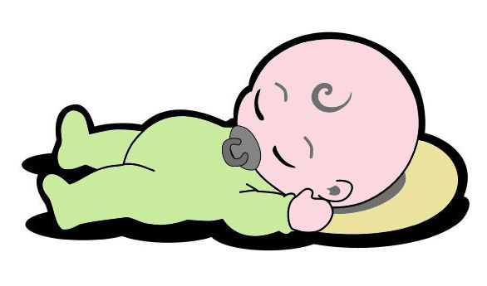

DIRECT SPEECH | REPORTED SPEECH
Present Continuos | Past Continuos
Direct Speech: “Be quiet. The baby is sleeping”
The Present Continuos (is leeping) usually changes to the Past Continuos
(was sleeping)
Reported Speech: She told me to be quiet because the baby was sleeping
Example:
Gina: “I am doing the laundry”
She said that she was doing the laundry
Notes:
INTERIORES

Slide 17
Exercises
Instructions: Change the following Direct Speech sentences into Reported Speech (Present Continuos- Past Continuos).
“We are having a meeting in the conference room” They said
_________________________________________________________
2. “Marco is making a phone call” The secretary said
_________________________________________________________
“I am writing the annual report” Tere said
_________________________________________________________
4. “ The manager is giving a conference” Luisa said
_________________________________________________________
5. “The board directors are having lunch at the canteen” Carlos said
_________________________________________________________
Notes:
INTERIORES

Slide 18
Answer Key
“We are having a meeting in the conference room” They said
They said that they were having a meeting in the conference room
2. “Marco is making a phone call” The secretary said
The secretary said that Marco was making a phone call
“I am writing the annual report” Tere said
Tere said that she was writing the annual report
4. “ The manager is giving a conference” Luisa said
Luisa said that the manager was giving a conference
5. “The board directors are having lunch at the canteen” Carlos said
Carlos said that the board directors were having lunch at the canteen
Notes:
INTERIORES

Slide 19


DIRECT SPEECH | REPORTED SPEECH
Present Perfect | Past Perfect
Direct Speech: “They have always been very kind to me”
The Present Perfect tense (have been) usually changes to the Past Perfect (had been) in Reported Speech;
Reported Speech: She said that they had always been very kind to her.
Example:
“We have watched this movie three times”
He said that they had watched that movie three times”
Notes:
INTERIORES

Slide 20
Exercises
Instructions: Change the following Direct Speech sentences into Reported Speech (Present Perfect- Past Perfect).
“She has already finished the report” He said
_________________________________________________________
2. “The customers haven’t placed their order yet” The secretary said
_________________________________________________________
“I have done this job for ages” She said
_________________________________________________________
4. “ She has just changed job” Luis said
_________________________________________________________
5. “They have played that song 4 times this morning” Mary said
_________________________________________________________
Notes:
INTERIORES

Slide 21
Answer key
“She has already finished the report” He said
He said that she had already finished the report
2. “The customers haven’t placed their order yet” The secretary said
The secretary said that the costumers hadn’t placed their order yet
“I have done this job for ages” She said
She said that she had done that job for ages
4. “ She has just changed job” Luis said
Luis said that she had just changed job
5. “They have played that song 4 times this morning” Mary said
Mary said that they had played that song 4 times that morning
Notes:
INTERIORES

Slide 22

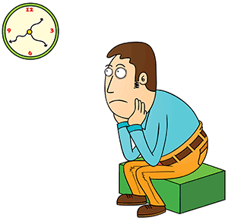
DIRECT SPEECH | REPORTED SPEECH
Present Perfect Continuos | Past Perfect Continuos
Direct Speech: “I have been working in this company since 1985”
The Present Perfect Continuos tense (have been working) usually changes to the Past Perfect Continuos (had been working) in Reported Speech;
Reported Speech: He said that he had been working in that company since 1985.
Example:
“I have been waiting for you since two o’clock”
He said that she had been waiting for him since two o’clock”
Notes:
INTERIORES

Slide 23
Exercises
Instructions: Change the following Direct Speech sentences into Reported Speech (Present Perfect Continuos- Past Perfect Continuos).
“We have been looking for the motorway for more than an hour” He said
_________________________________________________________
2. “George has been living in the city since 1994” She said
_________________________________________________________
“She has been writing that letter for an hour” He said
_________________________________________________________
4. “We have been working since seven o’clock” Laura said
_________________________________________________________
5. “I have been reading this magazine since early in the morning” Claudia said
_________________________________________________________
Notes:
INTERIORES

Slide 24
Answer Key
“We have been looking for the motorway for more than an hour” He said
He said that they had been looking for the motorway for more than an hour
2. “George has been living in the city since 1994” She said
She said that George had been living in the city since 1994
“She has been writing that letter for an hour” He said
He said that she had been writing that letter for an hour
4. “We have been working since seven o’clock” Laura said
Laura said that they had been working since seven o’clock
5. “I have been reading this magazine since early in the morning” Claudia said
Claudia said that she had been reading that magazine since early in the morning
Notes:
INTERIORES

Slide 25
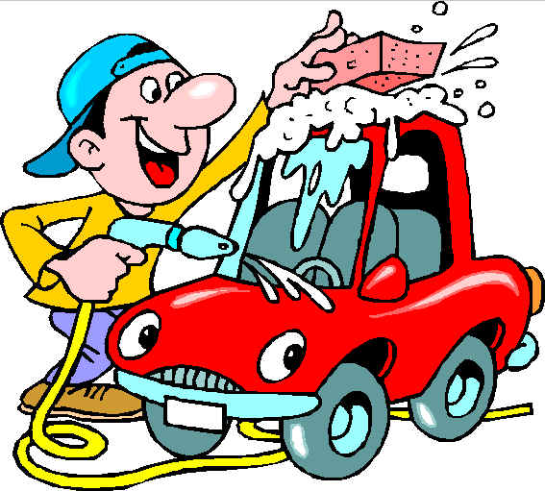

DIRECT SPEECH | REPORTED SPEECH
Simple Past | Past Perfect
Direct Speech: “He washed the car yesterday” She said
The Simple Past Tense (washed) usually changes to the Past Perfect Tense (had washed) in Reported Speech;
Reported Speech: She said that he had washed the car the day before
Example:
“I arrived from the airport at 8:00”
She said that she had arrived at 8:00”
Notes:
INTERIORES

Slide 26
Exercises
Instructions: Change the following Direct Speech sentences into Reported Speech (Simple Past-Past Perfect).
“Sheyla studied Japanese for five years” Mario said
_________________________________________________________
2. “They did not stay at the party the entire time” She said
_________________________________________________________
“We talked on the phone for thirty minutes” My mother said
_________________________________________________________
4. “My brother went to the same school as me” Lisa said
_________________________________________________________
5. “I was a very shy child” Carmen said
_________________________________________________________
Notes:
INTERIORES

Slide 27
Answer Key
“Sheyla studied Japanese for five years” Mario said
Mario said that Sheyla had studied Japanese for five years
2. “They did not stay at the party the entire time” She said
She said that they hadn’t stayed at the´party the entire time
“We talked on the phone for thirty minutes” My mother said
My mother said that they had talked on the phone for thirty minutes
4. “My brother went to the same school as me” Lisa said
Lisa said that her brother had gone to the same school as her
5. “I was a very shy child” Carmen said
Carmen said that she had been a very shy child
Notes:
INTERIORES

Slide 28
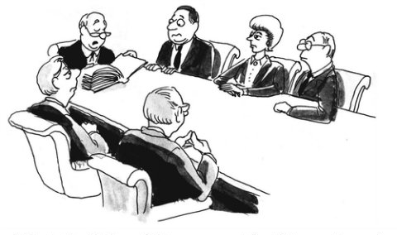
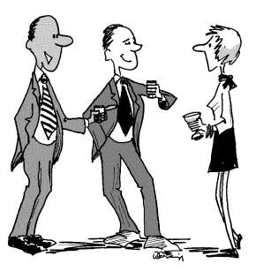
DIRECT SPEECH | REPORTED SPEECH
Past Continuos | Past Perfect Continuos
Direct Speech: “They were having a meeting” He said
The Past Continuos tense (were having) usually changes to the Past Perfect Continuos (had been having) in Reported Speech;
Reported Speech: He said that they had been having a meeting
Example:
“They were listening to the CEO”
She said that they had been listening to the CEO
Notes:
INTERIORES

Slide 29
Exercises
Instructions: Change the following Direct Speech sentences into Reported Speech (Past Continuos-Past Perfect Continuos)
“Karla was waiting for us at the bus station ” Jessie said
_________________________________________________________
2. “I was writing an e-mail yesterday afternoon” He said
_________________________________________________________
“They were having lunch at the cafeteria” Hector said
_________________________________________________________
4. “The teacher was grading the exams” Lety said
_________________________________________________________
5. “Lupita was listening to music this morning” Ivon said
_________________________________________________________
Notes:
INTERIORES

Slide 30
Answer Key
“Karla was waiting for us at the bus station ” Jessie said
Jessie said that Karla had been waiting for them at the bus station
2. “I was writing an e-mail yesterday afternoon” He said
He said that he had been writing an e-mail yesterday afternoon
“They were having lunch at the cafeteria” Hector said
Hector said that they had been having lunch at the cafeteria
4. “The teacher was grading the exams” Lety said
Lety said that the teacher had been grading the exams
5. “Lupita was listening to music this morning” Ivon said
Ivon said that Lupita had been listening to music that morning
Notes:
INTERIORES

Slide 31


DIRECT SPEECH | REPORTED SPEECH
Past Perfect | Past Perfect
Direct Speech: “Adriana had studied English before ” He said
The Past Perfect Tense (had studied) don’t change and remain the same tense, Past Perfect (had studied) in Reported Speech;
Reported Speech: He said that Adriana had studied English before
Example:
“Cristina had never been to an opera before last night” Her sister said
Her sister said that she had never been to an opera before the previous night
Notes:
INTERIORES

Slide 32
Exercises
Instructions: Change the following Direct Speech sentences into Reported Speech (Past Perfect-Past Perfect)
“We had had this car for ten years” Jimmy said
_________________________________________________________
2. “She had never seen a bear before” Meli said
_________________________________________________________
“George had repaired many cars before” He said
_________________________________________________________
4. “He said that her mother had bought her dress in the mall ” Mario said
_________________________________________________________
5. “We hadn’t prepared the dinner yet” My parents said
_________________________________________________________
Notes:
INTERIORES

Slide 33
Answer Key
“We had had this car for ten years” Jimmy said
Jimmy said that they had had that car for ten years
2. “She had never seen a bear before” Meli said
Meli said that she had never seen a bear before
“George had repaired many cars before” He said
He said that George had repaired many cars before
4. “My mother had bought her dress in the mall ” Mario said
Mario said that his mother had bought her dress in the mall
5. “We hadn’t prepared the dinner yet” My parents said
My parents said that they hadn’t prepared the dinner yet
Notes:
INTERIORES

Slide 34
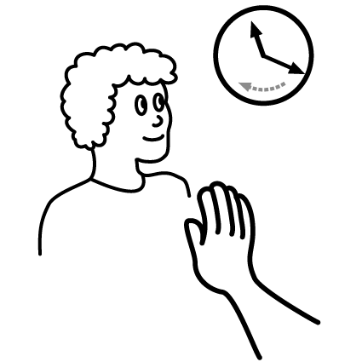
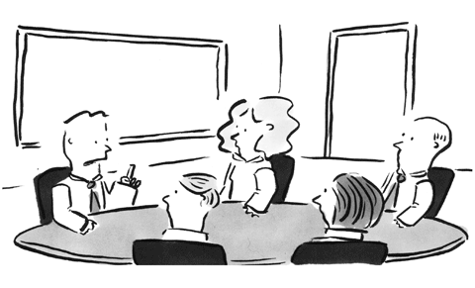
DIRECT SPEECH | REPORTED SPEECH
Past Perfect Continuos | Past Perfect Continuos
Direct Speech: “He had been waiting here for more than two hours” She said
The Past Perfect Continuos Tense (had been waiting ) don’t change and remain the same tense, Past Perfect Continuos (had been waiting ) in Reported Speech;
Reported Speech: She said that he had been waiting there for more than two hours
Example:
“They had been talking for over an hour” The teacher said
The teacher said that they had been talking for over an hour
Notes:
INTERIORES

Slide 35
Exercises
Instructions: Change the following Direct Speech sentences into Reported Speech (Past Perfect Continuos -Past Perfect Continuos)
“James had been teaching at the university for more than a year” Fer said
_________________________________________________________
2. “I had not been studying English very long” Martha said
_________________________________________________________
“The manager had been giving a talk for more than three hours” He said
_________________________________________________________
4. “All the girls had been overeating last Christmas” Grandma said
_________________________________________________________
5. “He had been exercising so hard” She said
_________________________________________________________
Notes:
INTERIORES

Slide 36
Answer Key
“James had been teaching at the university for more than a year” Fer said
Fer said that he had been teaching at the university for more than a year
2. “I had not been studying English very long” Martha said
Martha said she had not been studying English very long
“The manager had been giving a talk for more than three hours” He said
He said the manager had been giving a talk for more than three hours
4. “All the girls had been overeating last Christmas” Grandma said
Grandma said all the girls had been overeating the previous Christmas
5. “He had been exercising so hard” She said
She said he had been exercising so hard
Notes:
INTERIORES

Slide 37


DIRECT SPEECH | REPORTED SPEECH
Will | Would
Direct Speech: “I will be in Mexico on Monday” She said
When having the modal Will (will be) we have to change it for the modal Would (would be) in Reported Speech;
Reported Speech: She said that she would be in Mexico on Monday
Example:
“My friends will help us” Rene said
Rene said that his friends would help them
Notes:
INTERIORES

Slide 38
Exercises
Instructions: Change the following Direct Speech sentences into Reported Speech (Will-Would)
“I will send her the information” The boss said
_________________________________________________________
2. “She will translate the e-mail” The assitant said
_________________________________________________________
“I will get her some coffee” He said
_________________________________________________________
4. “We will have our annual meeting next Monday” The CEO said
_________________________________________________________
5. “They won’t be on time” She said
_________________________________________________________
Notes:
INTERIORES

Slide 39
Answer Key
“I will send her the information” The boss said
The boss said he would send her the information
2. “She will translate the e-mail” The assitant said
The assitant said she would translate the e-mail
“I will get her some coffee” He said
He said he would get her some coffee
4. “We will have our annual meeting next Monday” The CEO said
The CEO said they would have their annual meeting the following Monday
5. “They won’t be on time” She said
She said the wouldn’t be on time
Notes:
INTERIORES

Slide 40
References:
http://dep.uaemex.mx/
http://learnenglish.britishcouncil.org/en/quick-grammar/reported-speech-1
http://learnenglishteens.britishcouncil.org/grammar-vocabulary/grammar-videos/reported-speech
http://learnenglishteens.britishcouncil.org/grammar-vocabulary/grammar-videos/reported-speech
https://images.google.com/
Notes:
INTERIORES

Slide 41

Guadalupe Yazmín Sosa Jiménez
Centro Universitario
UAEM Valle de México
Notes:
CONTRAPORTADA

Slide 42
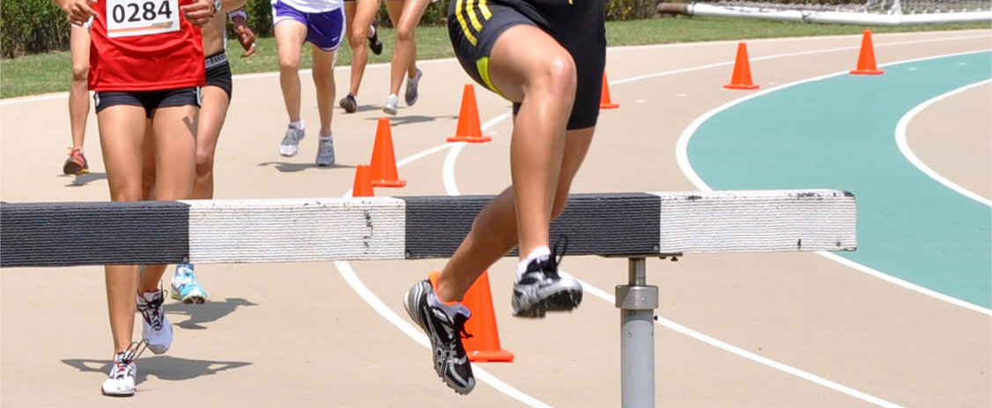


Marzo 2016
Notes:
PORTADA 2

