Slide 1
UNIVERSIDAD AUTÓNOMA DEL ESTADO DE MÉXICO
SECRETARIA DE DOCENCIA
DIRECCIÓN DE ESTUDIOS DE NIVEL MEDIO SUPERIOR
PLANTEL «LIC. ADOLFO LÓPEZ MATEOS» DE LA ESCUELA PREPARATORIA
Programa de la Asignatura De Inglés 3 de Cuarto Semestre
OCCUPATIONS
Elaborado por: L.L.I. Mitzi Belinda Dávila González
Total de créditos: 7
horas prácticas:3
horas teóricas: 2

Slide 2
Módulo I
Tema 1: Personality and appearance adjectives (preffixes), present simple.
Objetivos:
Asocia elementos lingüísticos de forma oral y escrita para identificar las actividades de personas.
Emplea la estrategia de «scanning» para comprender el contenido de un texto que describe la personalidad de las personas, sus actividades diarias en su área de trabajo.
Identifica los adjetivos positivos y negativos que usan prefijos
Nota: Se deben tener una gran variedad de ejemplos para que el alumno reconozca e identifique los adjetivos que usan prefijos.

Slide 3
DESCRIPCIÓN DE LA ACTIVIDAD
Se divide la clase en dos equipos, A y B.
Cada equipo debe participar por turnos , se inicia con el equipo A, se proyecta sólo la definición del oficio o profesión y un integrante del cada equipo debe leerla en voz alta mientras que el resto de sus compañeros de equipo deben decir el nombre del oficio o profesión mencionado.
En aso de que ningún miembro del equipo responda correctamente, se le dará la palabra al equipo contrario.
Después de que los alumnos hayan mencionado la respuesta correcta se les mostrará la imagen para comprobar la respuesta correcta.
Posteriormente el equipo B inicia con la misma dinámica hasta tener la respuesta correcta.
De esta forma se proyectarán todas las láminas para que ambos equipos participen.
Se llevará el conteo de aciertos de cada equipo. El equipo que tenga más puntos será el ganador
Extensión: al finalizar la actividad el alumno realiza una descripción escrita acerca de las características y personalidades de cada oficio o profesión así como sus actividades diarias mencionando adjetivos con prefijos.

Slide 4
Person who acts in
the theatre/films/on television
He plays others characters
He is has to be hard-working, strong, funny, violent, etc.

Slide 5
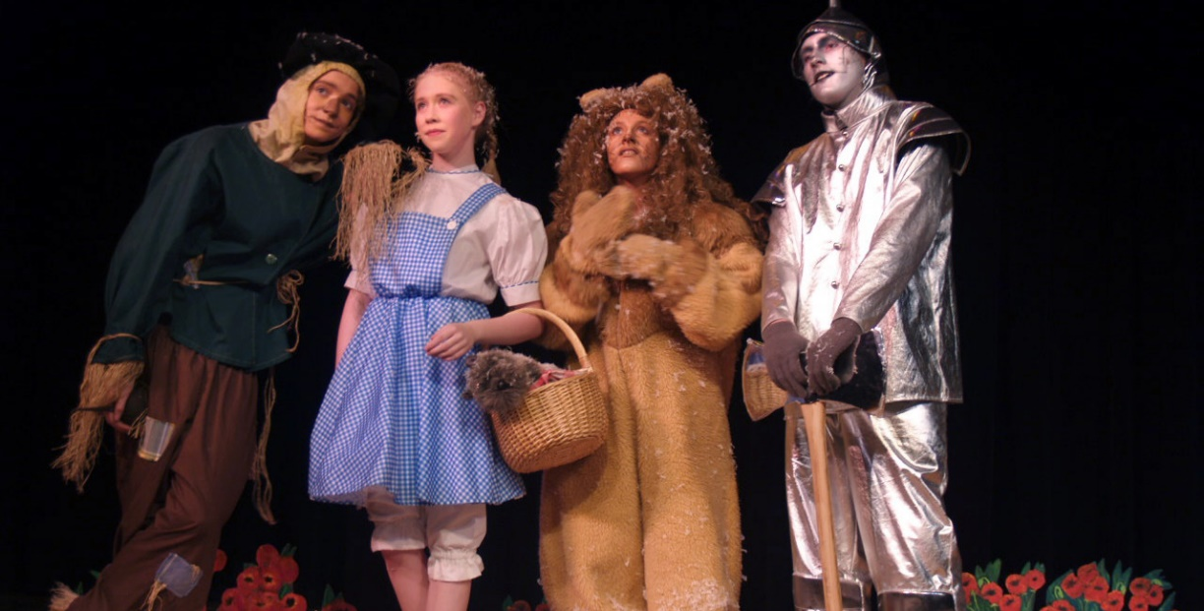
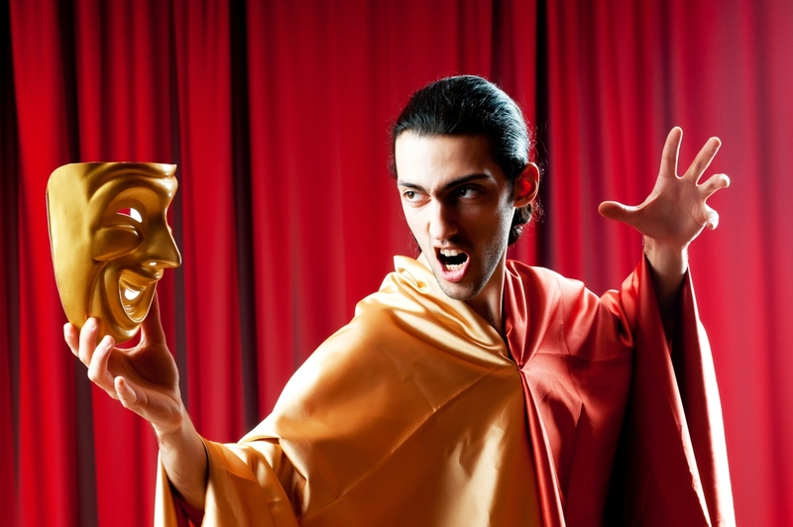
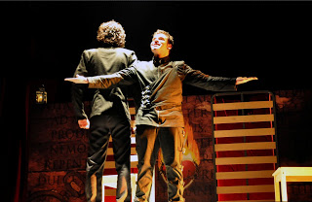
ACTOR

Slide 6
Person who works in a school. teaches, learns, and helps people .
He/she scolds us when we do wrong but rewards us if we do well .He is very tolerant and patient

Slide 7

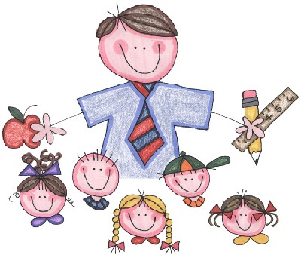

Teacher

Slide 8
Person who likes running
Use weapons and uniforms. He may be in plane or boat, he can be very rude.
The job is dangerous but important.

Slide 9
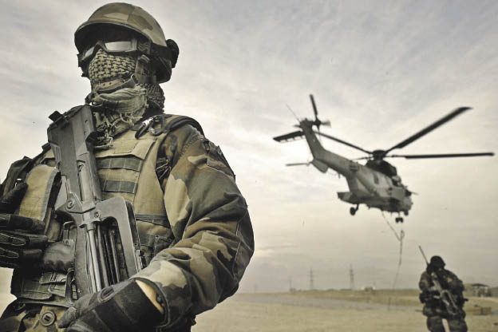
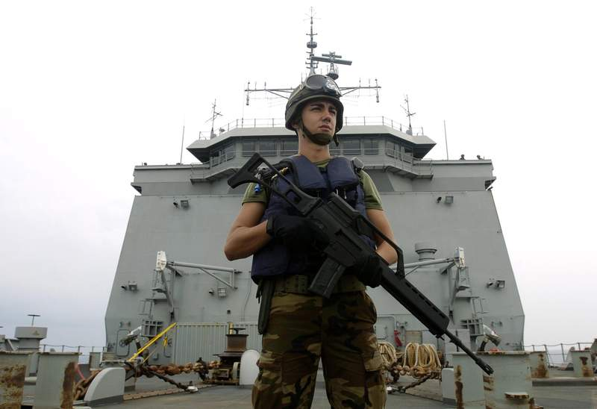
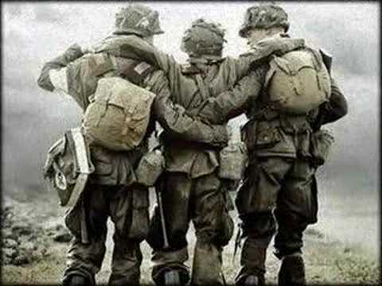
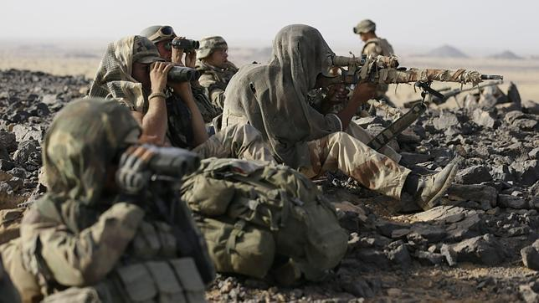
SOLDIER.

Slide 10
Person who studies law.
He helps when you have legal problems, he/she is talkative and clever.
He/she is always dressed in a suit and tie and knows how to defend .

Slide 11

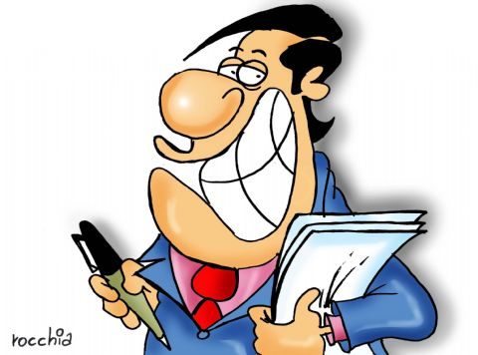


LAWYER

Slide 12
People who keep the lights on. He can´t be careless.
They are the workers who install , maintain and repair electrical wiring in our homes and businesses.

Slide 13



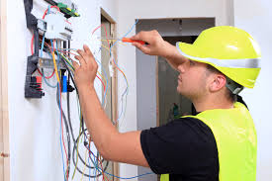
Electrician

Slide 14
Person who works to find lost things under the earth in time.
Studies the culture and history of the places . He is very patient.
Teaches about the evolution of humans , animals, plants , etc

Slide 15

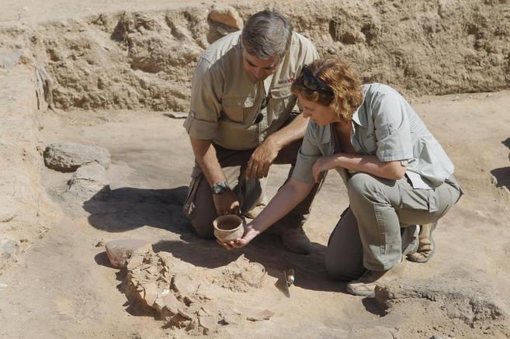
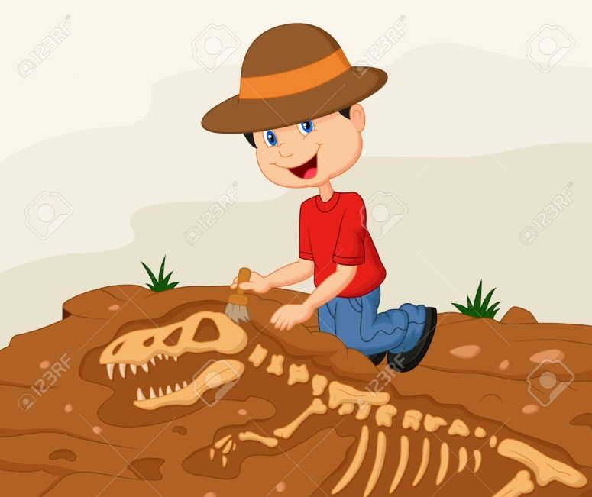

Archaeologist

Slide 16
Person who has the sensitivity to create a work or activity.
He is very creative, and sensitive.
He works professionally in a show as a singer, actor, dancer or painter.

Slide 17
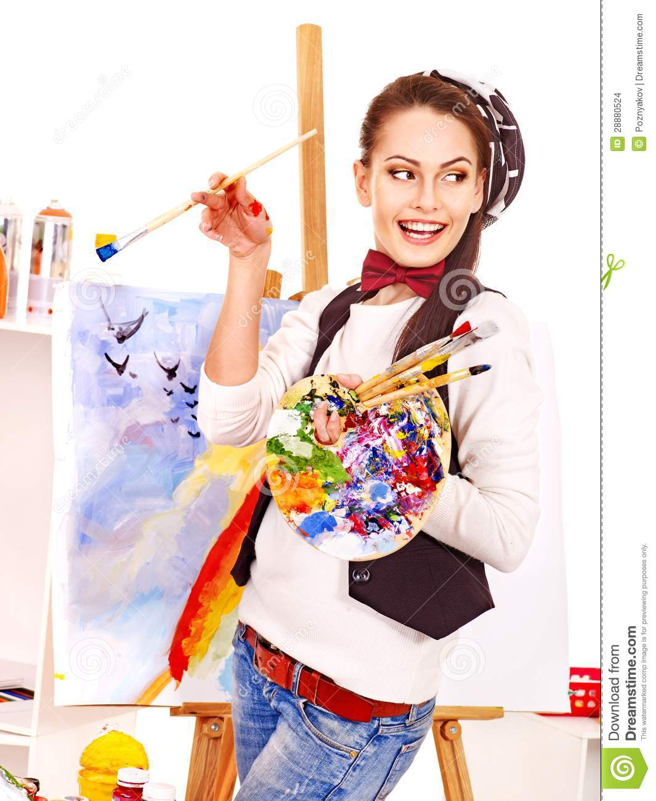
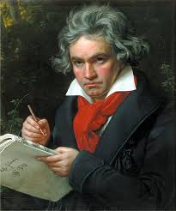
Artist

Slide 18
He’s a composer and interpreter.
He shares his talent with others. He is sentitive and talented.
He uses instruments or sings to express feelings.

Slide 19
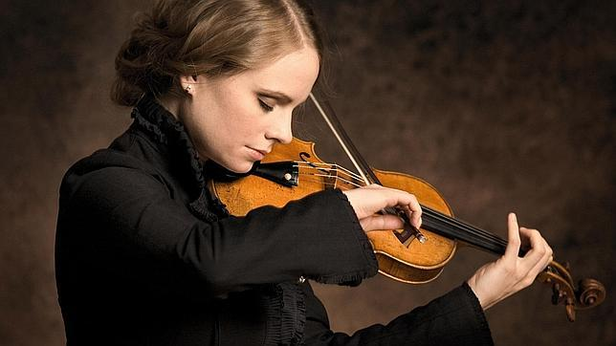
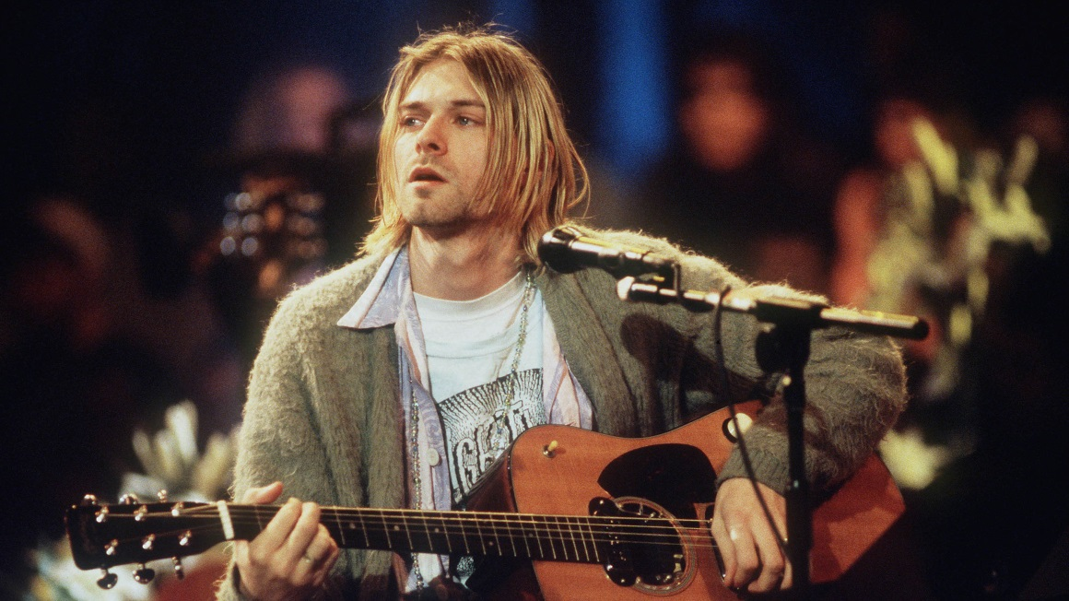
Musician

Slide 20
He’s responsible for the development, design, build and maintain buildings, cities and structures. He is strong, hard-working and sociable.
He works in a team.

Slide 21
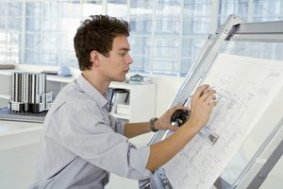

Architect

Slide 22
He cares grows up animals and plants, he is very hard-working, he can’t be lazy.
He lives in the countryside.

Slide 23
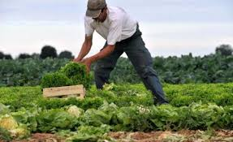
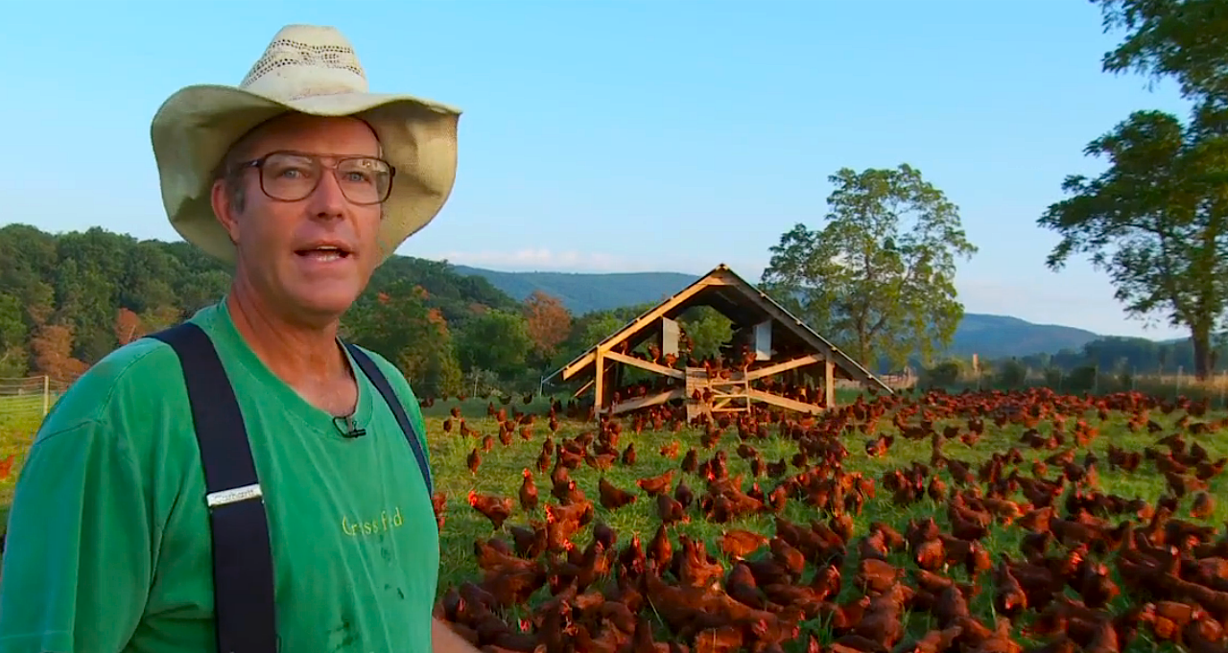
Farmer

Slide 24
He gives presciptions and wears a white clothes.
He can make blood test. He is very toletant and honest.

Slide 25
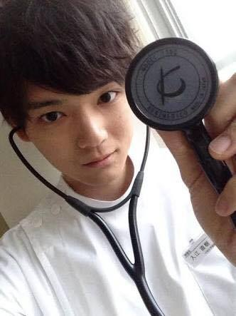
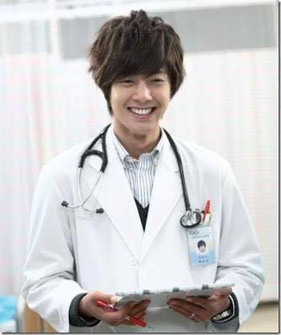

Doctor

Slide 26
He writes in a computer or paper.
He has an big imagination.
He shows his work in magazines or books. He is creative and clever

Slide 27

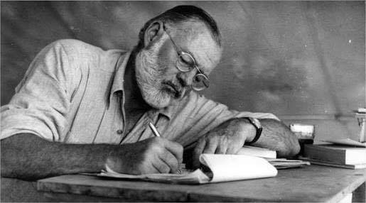
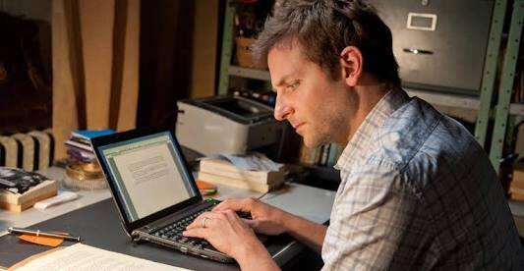
Writer

Slide 28
He prepares a solution of substances.
He uses a thermometer.
He wears a dressing gown. He is honest, confident and serious.

Slide 29

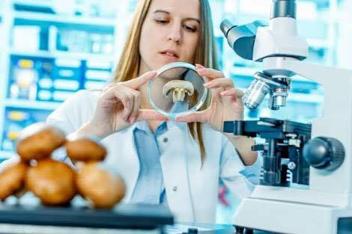

Scientist

Slide 30
He interviews important people.
He presents information about important news.
He writes in a newspaper. He is clever and can’t be impolite.

Slide 31
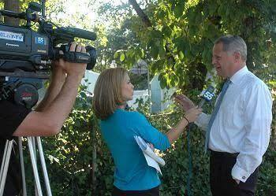
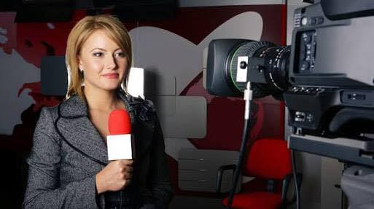
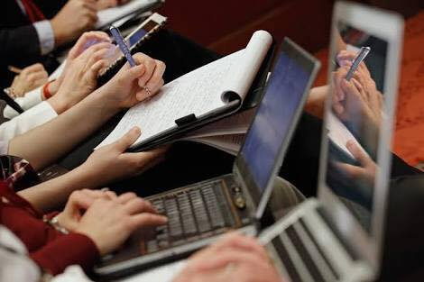
Journalist

Slide 32
He cuts people´s hair.
He works in a saloon.
He uses the sscissors and beauty products.
He is very talkative and friendly.

Slide 33

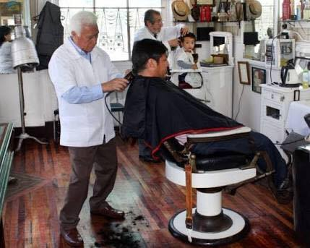
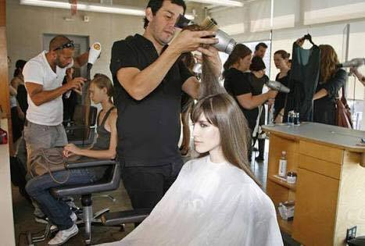
Hairdresser

Slide 34
*He works in a factory
*He helps the company’s president, he is very active and hard-working.

Slide 35
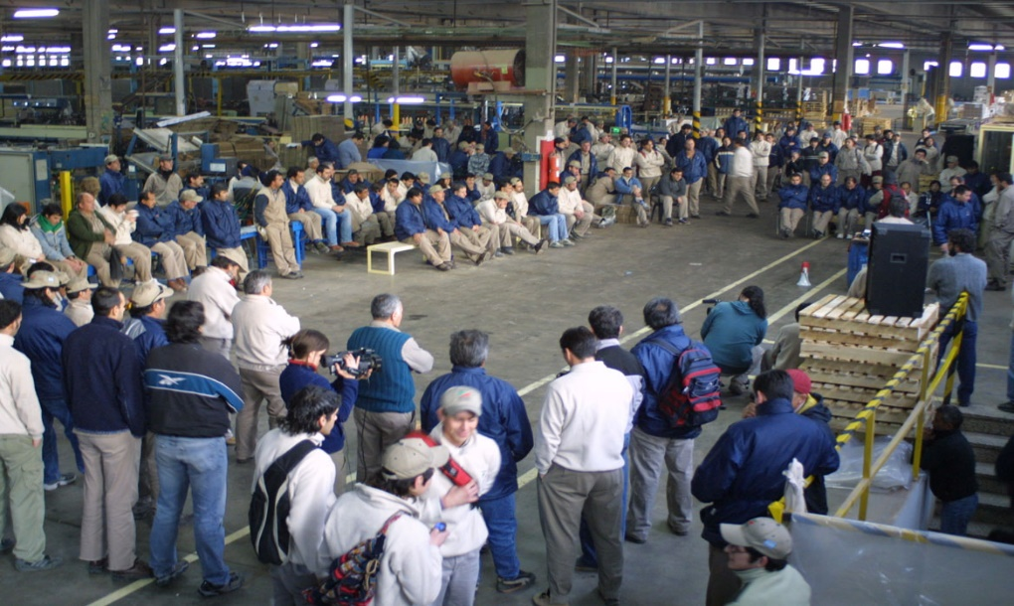
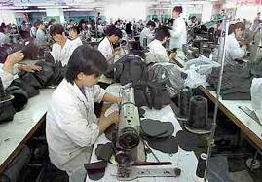
FACTORY WORKER

Slide 36
* He can design buildings or bridges. He is very creative, he can’t be irresponsible.
*He oversees and coordinates the activities of people
*He works in the factory or in construction

Slide 37

ENGINEER

Slide 38
*He can fix a pipeline, a bath or gas leaks. He is clever and creative.
*He works in houses

Slide 39
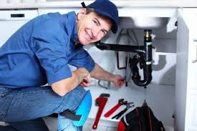

PLUMBER

Slide 40
*He can build buildings , a hotel, a house. He can rebuild your house, he is can´t be weak.

Slide 41

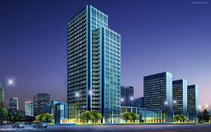
BUILDER

Slide 42
He/she takespeople to the airport/their homes/their jobs, etc.
He/she works in a car
He/she wins a lot of money. He/she is sometimes rude, impatient and irresponsible

Slide 43
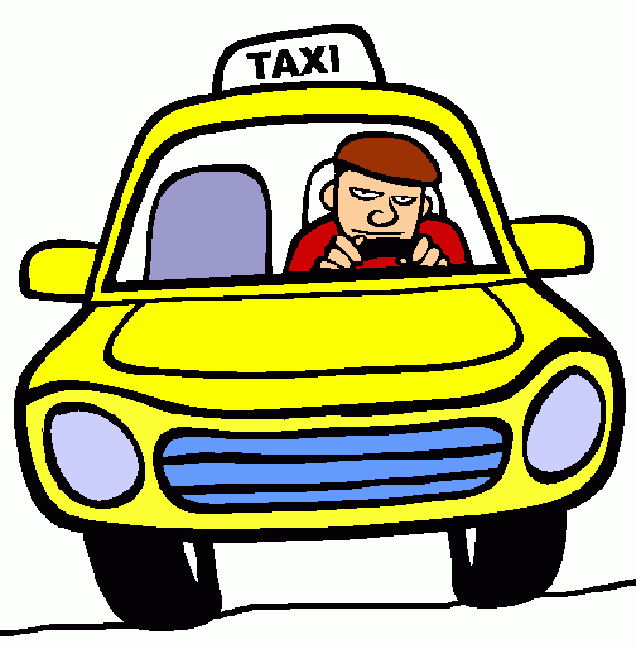


Taxi driver

Slide 44
Person who writes letters, files documents, etc., for someone.
She/he answer the phone for an important person.
She/he receives visits and she/ he calculates some accounts

Slide 45


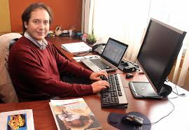
Secretary

Slide 46
He/she is a person who specializes in treating sick animals.
He/she tries to prevent and cure animals.
He/she is very kind and sensitive.

Slide 47

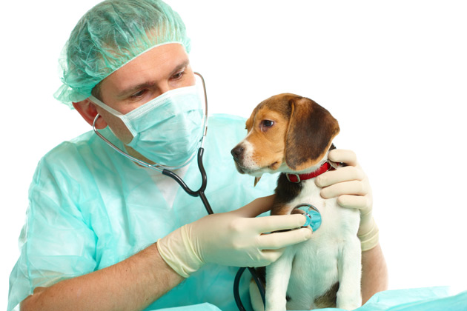
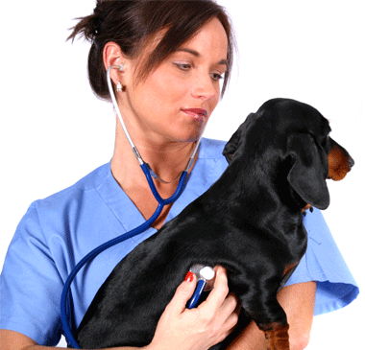

Vet

Slide 48
She is a person who attends and look after the patients.
She is trained or employed to look after the sick people.
She/he makes patients feel comfortable.

Slide 49
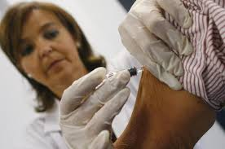
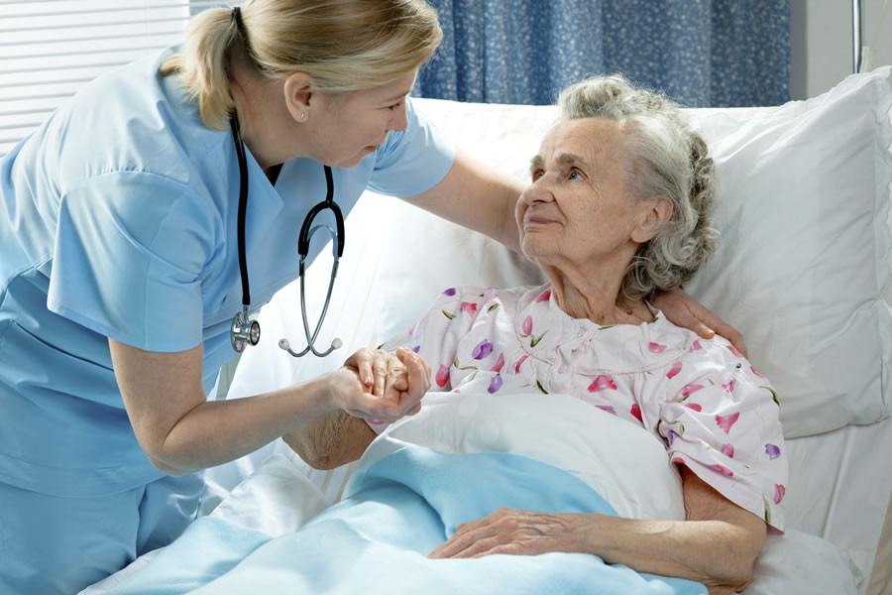

Nurse

Slide 51
References
Falla, Davis, Paul A Davies. Solutions Pre-Intermediate Student's book. Orford. 2012. 2° Ed.
Google images.
http://www.gingersoftware.com/content/grammar-rules/adjectives/
http://grammar.about.com/od/pq/g/prefix.htm
http://www.perfect-english-grammar.com/relative-clauses.html
https://learnenglish.britishcouncil.org/es/english-grammar/adjectives/order-adjectives
https://es.wikipedia.org
http://grammar.about.com/od/words/a/comprefix07.htm

