Slide 1
UNIVERSIDAD AUTÓNOMA DEL ESTADO DE MÉXICO
FACULTAD DE LENGUAS
Material: “Apoyo a Literatura contemporánea en inglés”.
PROGRAMA EDUCATIVO: Licenciatura en lenguas
UNIDAD DE APRENDIZAJE: LITERATURA CONTEMPORÁNEA EN INGLÉS.
Créditos: 4
ELABORÓ: Dr. Luis Juan Solís Carrillo
MATERIAL ELABORADO Y EMPLEADO EN EL SEMESTRE 2016A

Slide 2
GUION DE USO PARA MATERIAL PROYECTABLE
LITERATURA CONTEMPORÁNEA EN INGLÉS
El presente material tiene una función primordial: apoyar al estudiante a adquirir habilidades lectoras avanzadas en el idioma inglés. Como parte fundamental de su formación —ya sea con un perfil de egreso centrado en la docencia o en la traducción—, las destrezas de comprensión de la lengua escrita son condición sine qua non para el desarrollo profesional del egresado.

Slide 3
Con el fin de facilitar la tarea del docente y del alumno, el presente material proyectable busca ejemplificar de forma visual las diversas aportaciones al mundo de las letras contemporáneas en lengua inglesa. Esto representa la parte medular del programa de la UA Literatura contemporánea del inglés, la cual, a la letra se plantea como objetivo: “Conocer las principales vanguardias y autores más destacados del siglo XX”. Si bien se conserva este objetivo, se han incluido obras y autores más contemporáneos. Con ello, se brinda un panorama más extenso del tema.

Slide 4
Este material, no está por demás decirlo, no es un sustituto de la clase o del docente. Se trata, en cambio, de una herramienta que facilite la labor del profesor y que permita al estudiante comprender mejor los rasgos, temas, estilos, y méritos literarios de importantes obras contemporáneas en lengua inglesa. Para su uso se sugiere lo siguiente:
Comenzar siempre con un encuadre temático. Esto significa que las diapositivas se usan como complemento didáctico de los ejemplos y explicaciones del docente.
Cada diapositiva constituye un punto de partida que puede ampliarse con más ejemplos, tanto del docente como de los alumnos, con base en la lectura específica de un texto.

Slide 5
Por la propia naturaleza de la UA, se exige que la clase se imparta en lengua inglesa. Esto debe ser un punto ineludible para todos los participantes en el curso. Solo de esta manera, será posible cumplir a cabalidad con el objetivo del a UA.
En la medida de lo posible, el docente deberá aportar ejemplos que vinculen el texto literario con otras expresiones de las artes, como el cine, la música, etc. De esta manera, se verá con mayor claridad la universalidad de las artes y su importancia en la vida profesional del futuro especialista en lenguas.

Slide 6
El punto anterior sirve no solo para conectar las otras artes con el fenómeno de las letras, sino para que el estudiante se dé cuenta plena de la estrecha relación que esta UA guarda con otras asignaturas de su formación profesional. Así pues, será recomendable que el docente establezca estas relaciones y las ponga de manifiesto en el aula.
El orden de las diapositivas no obedece a ninguna secuencia programática establecida de antemano. Se trata de ilustraciones adaptables a los avances de cada grupo y docente. De esta manera, no será incorrecto comenzar por un autor inglés o por uno canadiense. El docente podrá emplear este material de la forma que mejor se adapte a las necesidades didácticas de cada grupo.

Slide 7
En cuanto a la secuencia didáctica sugerida, cabe decir lo siguiente:
Este material permite al estudiante adquirir los nuevos conceptos partiendo de una fase inicial centrada en la mera identificación de los rasgos que caracterizan al fenómeno o la figura literaria.
Posteriormente, el alumno debe reconocer, en un texto literario, la presencia de temáticas y estilos narrativos que conforman el carácter “contemporáneo” de cada obra y autor estudiados.
En una etapa posterior, es necesario que la atención asuma una postura más crítica, es decir, que el estudiante esté en condiciones de observar la relación entre el contenido expresado en el lenguaje literario y la forma en que la obra dialoga con otras y da respuesta a las problemáticas de su tiempo.
He aquí, de forma resumida, el guion con los lineamientos y sugerencias que permitirán el uso en el aula de esta colección de diapositivas. Espero que les sea de mucha utilidad.

Slide 8
UNIDADES TRATADAS EN ESTE MATERIAL
Unidad I: Contextos histórico y social. Lecturas temáticas introductorias.
Unidad II: Historia sobre la historia (Barnes un otros autores).
Unidad III: Rebeldía y búsqueda de identidad.
El material toma como punto de partida, y expande, este programa.
Incluye lecturas sugeridas adicionales.

Slide 9
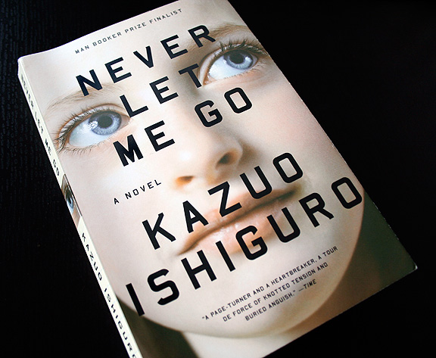
Never let me go
Kazuo Ishiguro

Slide 10
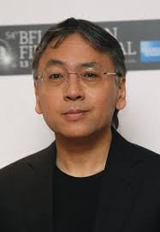
Kazuo Ishiguro
was born on 8 November 1954
He was born in Nagasaki, Japan, and his family moved to England in 1960 when he was 5 years old.
He came to Britain in 1960 when his father began research at the National Institute of Oceanography, and was educated at a grammar school for boys in Surrey.

Slide 11
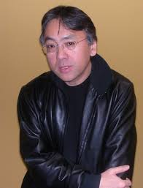
In 1974 he began his studies at the University of Kent, Canterbury. He graduated in 1978 with a Bachelor of Arts (honors) in English and Philosophy.
After spending a year writing fiction, he resumed his studies at the University of East Anglia. He has been writing full time since 1982.

Slide 12
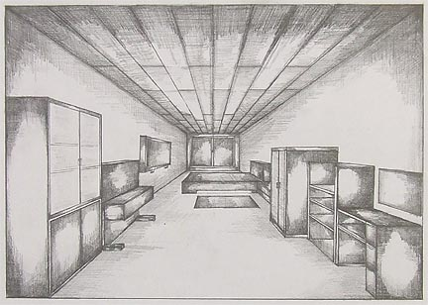
Ishiguro's novels are preoccupied by memories, their potential to digress and distort, to forget and to silence, and above all to haunt. The protagonists of his fiction seek to overcome loss (the personal loss of family members and lovers; losses resulting from war) by making sense of the past through acts of remembrance.

Slide 13

2005: Time magazine names Never Let Me Go on its list of the 100 greatest English language novels since the magazine was founded in 1923.
It was shortlisted for the 2005 Booker Prize (an award Ishiguro had previously won in 1989 for The Remains of the Day.

Slide 14
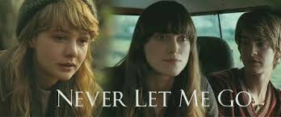
Never Let Me Go was extremely well-received critically, and is included in the curriculum of many high-school and college courses.
It was adapted into a film by Mark Romanek in 2010.

Slide 15
Author’s Statement
“I am a writer who wishes to write international novels. What is an 'international' novel? I believe it to be one, quite simply, that contains a vision of life that is of importance to people of varied backgrounds around the world. It may concern characters who jet across continents, but may just as easily be set firmly in one small locality.”

Slide 16
a sense of an ending by Julian Barnes

Slide 17
Early life
Julian Barnes was born in Leicester, England on January 19, 1946. He was educated at the City of London School from 1957 to 1964 and at Magdalen College, Oxford, from which he graduated in modern languages (with honours) in 1968.
After graduation, he worked as a lexicographer for the Oxford English Dictionary Supplement for three years. In 1977, Barnes began working as a reviewer and literary editor for the New Statesman and The New Review. From 1979 to 1986 he worked as a television critic, first for The New Statesman and then for The Observer.

Slide 18

Career
His first novel, Metroland (1980), is the story of Christopher, a young man from the London suburbs who travels to Paris as a student, finally returning to London. The novel deals with themes of idealism and sexual fidelity, and has the three-part structure that is a common recurrence in Barnes' work.

Slide 19

His second novel Before She Met Me (1982) features a darker narrative, a story of revenge by a jealous historian who becomes obsessed by his second wife's past.

Slide 20
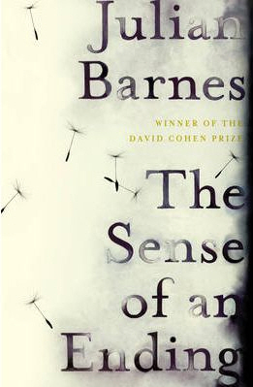
The Sense of an Ending
Jules Barnes

Slide 21


The Sense of an Ending
Barnes' eleventh novel, The Sense of an Ending, published by Jonathan Cape, was released on 4 August 2011. In October of that year, the book was awarded the Man Booker Prize. Head judge, Stella Rimington, said The Sense of an Ending was a "beautifully written book" and the panel thought it "spoke to humankind in the 21st Century." The Sense of an Ending also won the Europese Literatuurprijs and was on The New York Times Bestseller List for several weeks.

Slide 22
Awards and honors
2012 Europese Literatuurprijs
2011 Costa Book Awards, shortlist, The Sense of an Ending
2011 Booker Prize, winner, The Sense of an Ending
2011 David Cohen Prize for Literature.
2008 San Clemente literary prize
2004 Commandeur de L'Ordre des Arts et des Lettres
2004 Austrian State Prize for European Literature [14]
1985 Geoffrey Faber Memorial Prize
1993 Shakespeare Prize
1992 Prix Femina Étranger, winner, Talking It Over
1986 E. M. Forster Award from the American Academy and Institute of Arts and Letters
1981 Somerset Maugham Award

Slide 23
SOME Ideas behind the novel
The Imperfection of memory
Unreliability of history.
“History is that certainty produced at the point where the imperfection of memory meet the inadequacies of documentation
Existentialism, Camus, Suicide, Eros and Thanatos
Class conflict
Meditation and aging
Oedipus complex

Slide 24
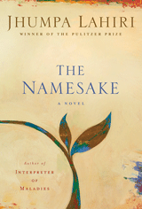
THE NAMESAKE
Jhumpa Lahiri

Slide 25
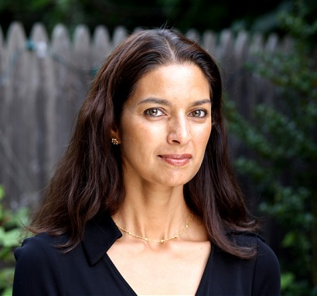
ABOUT THE AUTHOR
Lahiri Nilanjana Sudeshna "Jhumpa" Lahiri (born on July 11, 1967) is an Indian American author. She was born in London, the daughter of Indian immigrants from the state of West Bengal.
Her family moved to the United States when she was two; Lahiri considers herself an American: "I wasn't born here, but I might as well have been."

Slide 26
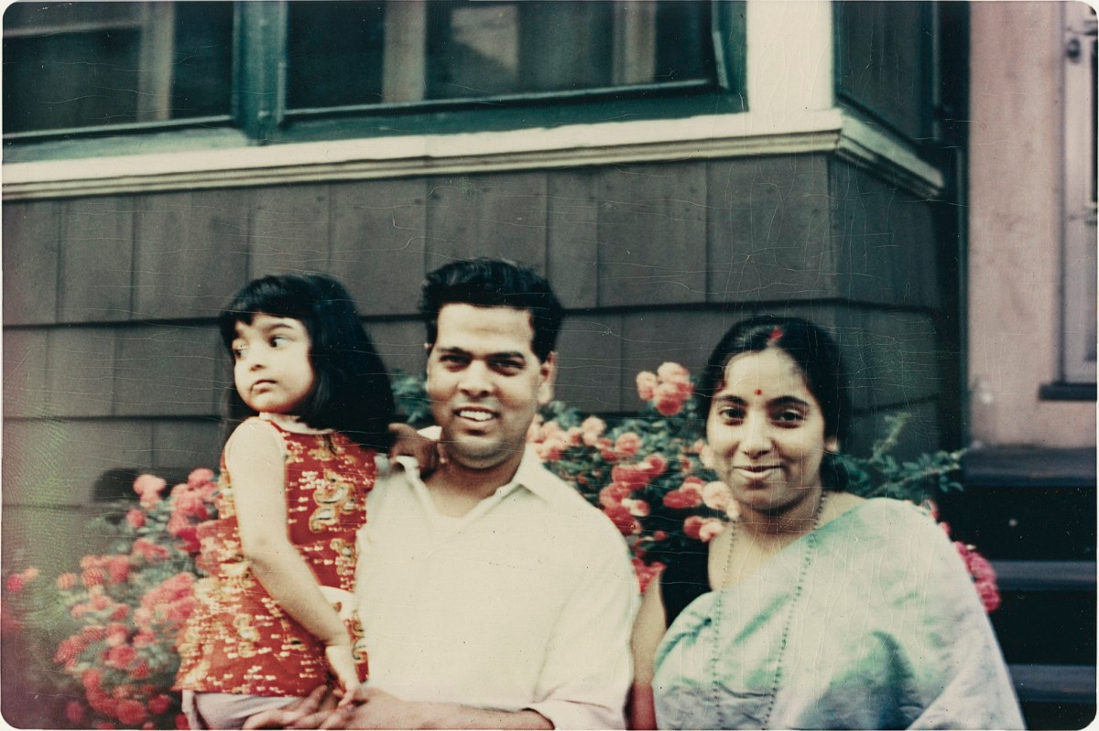
ABOUT THE AUTHOR
Lahiri grew up in Kingston, Rhode Island, where her father Amar Lahiri works as a librarian at the University of Rhode Island.
Lahiri's mother wanted her children to grow up knowing their Bengali heritage, and her family often visited relatives in Calcutta (now Kolkata).

Slide 27
ABOUT THE AUTHOR
When she began kindergarden in Kingston, Rhode Island, Lahiri's teacher decided to call her by her pet name, Jhumpa, because it was easier to pronounce than her "proper name.“
Lahiri graduated from South Kingstown High School, and received her B.A. in English literature from Barnard College in 1989.

Slide 28
WRITING
Lahiri's writing is characterized by her "plain" language and her characters, often Indian immigrants to America who must navigate between the cultural values of their homeland and their adopted home.
Lahiri's fiction is autobiographical and frequently draws upon her own experiences as well as those of her parents, friends, acquaintances, and others in the Bengali communities with which she is familiar.

Slide 29
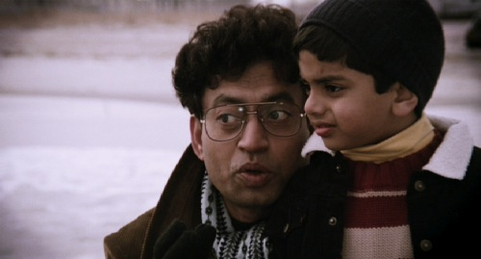
Themes
Lahiri examines her characters' struggles, anxieties, and biases to chronicle the nuances and details of immigrant psychology and behavior.

Slide 30
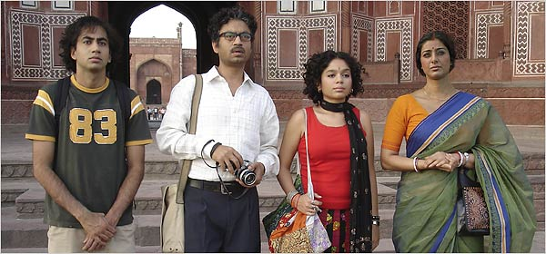
The Namesake
“He is afraid to be Nikhil, someone he doesn't know. Who doesn't know him […] It's a part of growing up, they tell him, of being a Bengali.”
Jhumpa Lahiri, The Namesake

Slide 31
The Namesake
The Namesake is the first novel by Jhumpa Lahiri. It was originally a novella published in The New Yorker and was later expanded to a full-length novel.
The Namesake was published in Bengali under the title Samanai.

Slide 32
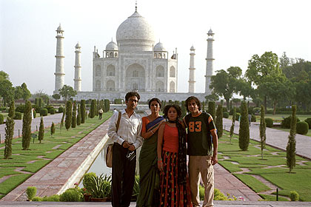
THEMES
Identity
In The Namesake, everybody is lost. Every character struggles with his or her identity, because every character feels the tug and pull of different cultures, different traditions, and different dreams.

Slide 33
Family
The Namesake explores many different types of families: the extended Bengali family and its customs; American families; smaller nuclear families; families with divorced parents; families with mixed race parents; young parents and their children.
Each generation has its own way of being happy or unhappy, with each succeeding generation deciding whether to stick with their parents' customs, or to come up with a few of their own.

Slide 34
The “Other”
Characters are constantly making comparisons between Indian and American life. For Indian immigrants such as Ashima and Ashoke, many aspects of American culture are foreign to them, and they also feel like strangers in American society.
They struggle to maintain certain Indian traditions, while adapting to American customs, such as Christmas, for the sake of their children.

Slide 35
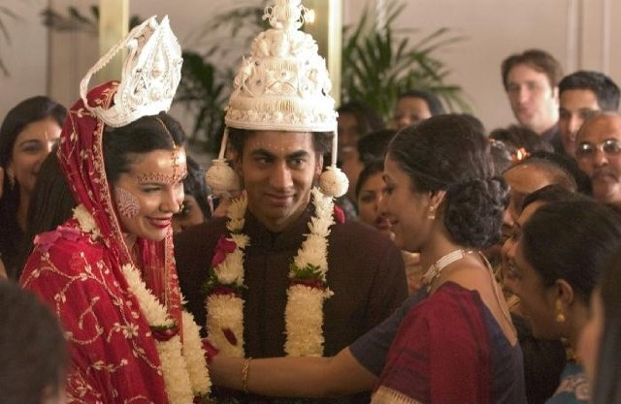
Indian-American characters such as Gogol and Moushumi often feel foreign in both India and America, as though they're lost in between the world of their parents and the world in which they were born. They often feel they are tourists, only, unlike most tourists, they have no chance of a homecoming.

Slide 36
Themes
Home
How do I get home? That's one question Gogol can't seem to answer. He is never quite at home. And he's not the only one who's having trouble finding a place to put his feet up.
The characters of The Namesake all seek to create homes for themselves, and the houses they live in reflect their personalities.

Slide 37
Themes
The rich Ratcliffs live in a lavish mansion. Gogol's bachelor pad is spare and depressing. The Gangulis' first apartment is small and cramped, but filled with love.
If a home reflects identity, it's no wonder Gogol has trouble finding and creating a lasting one. Plus, it makes it all the more fitting that he chooses to be an architect. If he can't find a home, he might as well build one.

Slide 38
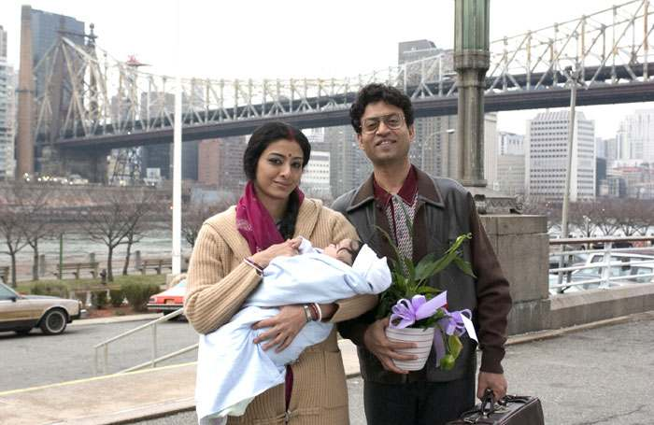
Love
How each character feels about his or her identity as an Indian, American, or Indian-American affects their romantic decision-making:
Gogol's love choices in particular often reflect his own love-hate relationship with his Indian heritage, while other characters who are more at ease in their Indian-American identities (such as his sister, Sonia) seem to have better luck in love.

Slide 39
American, Indian and European Contrasts
Each region in the book is described in great detail. In addition to giving us a sense of what life is like in each of these countries, each country also stands for different things to different characters – escape, home, freedom, failure, etc.
For most of the Indian and Indian-American characters, India embodies tradition, custom, and heritage. To the children of Indian immigrants, though, their parents' homeland often appears backward and unfamiliar.

Slide 40
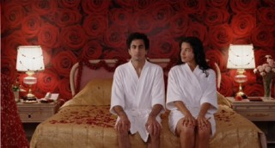
Dissatisfaction
Happiness is elusive for the characters in The Namesake. Often, the characters' discontent is caused by the difference between their dreams and the reality they live in.
For some, like Ashima, the primary source of unhappiness is homesickness, as they constantly compare life in the United States to life back in India.

Slide 41
Class
The main Indian-American characters grow up with parents who are educated professionals; they graduate from Ivy League universities and enter similarly elite careers such as architecture and academia.
But these characters often envy the lifestyle of their Anglo-American peers, who come from well-to-do families, who have never had to pull themselves up by their bootstraps the way their Indian parents have.

Slide 42
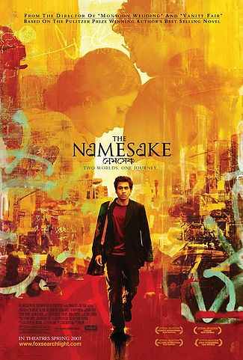
MOVIE
In March 2007, a film adaptation of the novel was released in the United States, Canada, United Kingdom, and India.
It was directed by Mira Nair and Sooni Taraporevala adapted the novel to a screenplay.
Jhumpa Lahari, the author, appears in the movie.

Slide 43

DISGRACE
j.M COTZEE

Slide 44
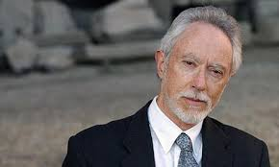
John Maxwell "J. M." Coetzee ( born 9th February 1940)
South African novelist, essayist, linguist, translator and recipient of the 2003 Nobel Prize in Literature

Slide 45
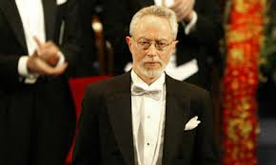
His father, Zacharias Coetzee, was an occasional lawyer, government employee and sheep farmer, while his mother, Vera Coetzee (born Wehmeyer) was a schoolteacher.
The family spoke English at home, but Coetzee spoke Afrikaans with other relatives. Coetzee is descended from early Dutch immigrants to South Africa in the 17th century, he also has German and Polish ancestry.

Slide 46
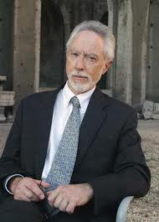
Coetzee spent most of his early life in Cape Town and in Worcester in Cape Province (modern-day Western Cape) as recounted in his fictionalized memoir, Boyhood (1997).
The family moved to Worcester when Coetzee was eight, after his father lost his government job due to disagreements over the state's apartheid policy.

Slide 47
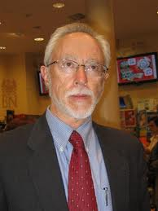
Coetzee attended St. Joseph's College, a Catholic school in the Cape Town suburb of Rondebosch. Later studied mathematics and English at the University of Cape Town, receiving his Bachelor of Arts with Honors in English in 1960, and his Bachelor of Arts with Honors in Mathematics in 1961.

Slide 48
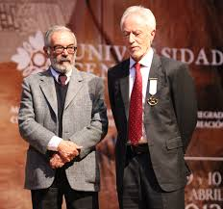
In March 1970, Coetzee was one of 45 faculty members who occupied the university's Hayes Hall and were subsequently arrested for criminal trespassing.
He then returned to South Africa to teach English literature at the University of Cape Town. He was promoted to Professor of General Literature in 1983, and was Distinguished Professor of Literature between 1999 and 2001

Slide 49
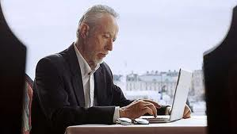
Upon retiring in 2002, Coetzee relocated to Adelaide, Australia, where he was made an honorary research fellow at the English Department of the University of Adelaide, where his partner, Dorothy Driver, is a fellow academic.

Slide 50
Nobel Prize in Literature, 2003
On 2 October 2003, Horace Engdahl, head of the Swedish Academy, announced that Coetzee had been chosen as that year's recipient of the Nobel Prize in Literature, making him the fifth African writer to be so honoured,and the second South African after Nadine Gordimer.
When awarding the prize, the Swedish Academy stated that Coetzee "in innumerable guises portrays the surprising involvement of the outsider".
The press release for the award also cited his "well-crafted composition, pregnant dialogue and analytical brilliance," while focusing on the moral nature of his work.
The prize ceremony was held in Stockholm on 10 December 2003

Slide 51
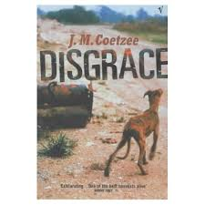
Disgrace was published in 1999. It won the Booker Prize. The writer was also awarded the Nobel Prize in Literature four years after its publication.

Slide 52
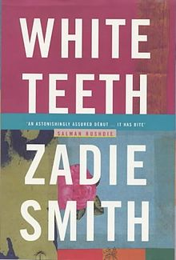
White teeth
Zadie Smith

Slide 53
About the author
Zadie Smith

Slide 54

Zadie Smith (born on 25 October 1975) is an English novelist, essayist, and short story writer.
Smith was elected a fellow of the Royal Society of Literature in 2002.
As of 2012, she has published four novels, all of which have received substantial critical praise.
In 2003, she was included on Granta's list of 20 best young authors, and was also included in the 2013 list.

Slide 55


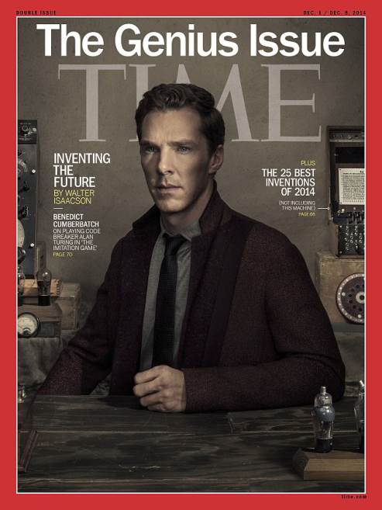
She joined New York University's Creative Writing Program as a tenured professor on 1 September 2010.
Smith has won the Orange Prize for Fiction.
The Anisfield-Wolf Book Award in 2006.
Her novel White Teeth was included in Time magazine's list of 100 Best English-language Novels from 1923 to 2005.

Slide 56

Career
White Teeth was introduced to the publishing world in 1997, before it was completed. On the basis of a partial manuscript an auction among different publishers for the rights started, with Hamish Hamilton being successful. Smith completed White Teeth during her final year at Cambridge. Published in 2000, the novel became a best-seller immediately. It was praised internationally and won a number of awards. The novel was adapted for television in 2002 by Channel 4.

Slide 57
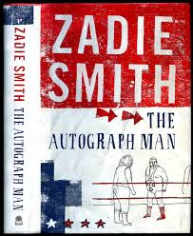
In interviews, she reported that the hype surrounding her first novel had caused her to suffer a short spell of writer's block. Nevertheless, her second novel, The Autograph Man, was published in 2002 and was a commercial success, although the critical response was not as positive as it had been to White Teeth.

Slide 58
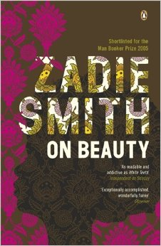
The second novel was followed by another, On Beauty (published in September 2005), which is set largely in and around Greater Boston and which attracted more acclaim. This third novel was shortlisted for the Man Booker Prize,[14] and won the 2006 Orange Prize for Fiction and the Anisfield-Wolf Book Awards

Slide 59
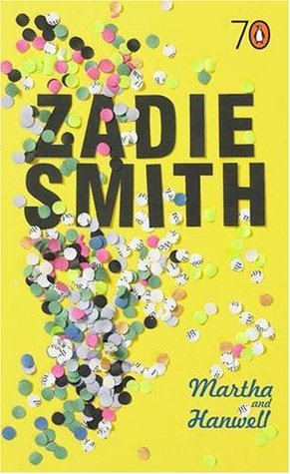
Later in the same year, Smith published Martha and Hanwell, a book combining two short stories about two troubled characters. Originally published in Granta and The New Yorker, Penguin Books published Martha and Hanwell with a new introduction by Smith as part of their pocket series to celebrate their 70th birthday.

Slide 60
White Teeth
Zadie Smith

Slide 61

General Information
Author: Zadie Smith
Year: 2000
Country: United Kingdom
Pages: 480

Slide 62

Plot
It focuses on the later lives of two wartime friends—the Bangladeshi Samad Iqbal and the Englishman Archie Jones—and their families in London.

Slide 63
The story mixes pathos and humour while illustrating the dilemmas of immigrants and their offspring as they are confronted by a new, different society. Contrasted in the setting of a different host culture, disparate aspects of non-British cultures emerge. Middle-and working-class British cultures are also satirised through the characters of the Chalfens and Archie.

Slide 64
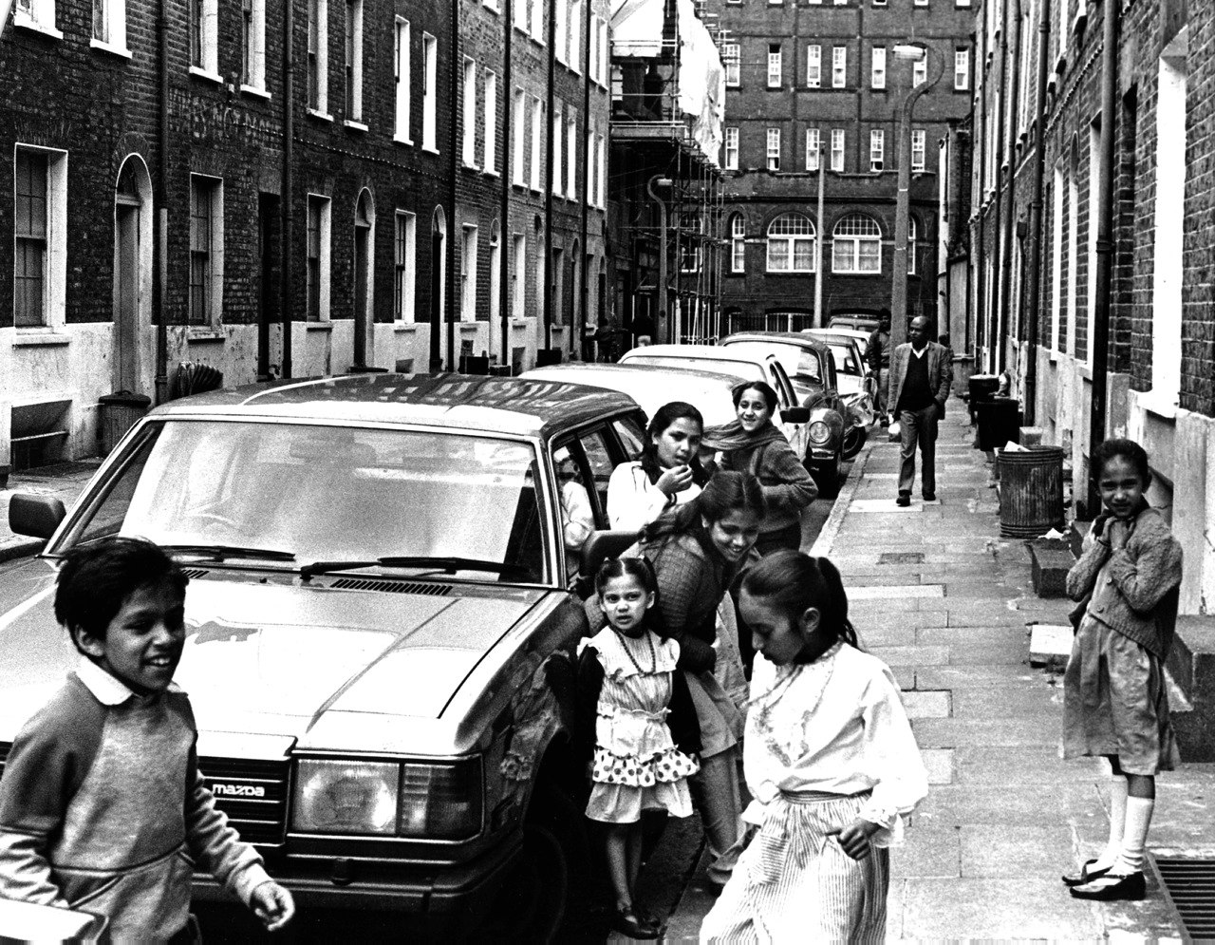
Topics:
Immigration:The novel depicts the lives of a wide range of backgrounds, including Afro-Caribbean, Muslim, and Jewish. In keeping with Smith's epigraph, “what is past is prologue,” the characters and their various cultural backgrounds show the complexity involved in immigration and replanting one’s roots.

Slide 65
Roots
Roots are a pervasive theme in White Teeth. Samad clutches onto them, viewing them as sacred and necessary. He worries that he or his family will lose their roots. For her part, Irie is also conflicted about her own roots. She starts saving money to travel to Jamaica with her grandmother while simultaneously hating her kinky African hair and her Jamaican curves. She dreams of a future when roots will not matter. When she gets pregnant and realizes she'll never know who the father is, she is almost happy her daughter will not have to deal with the problem of roots.

Slide 66
Multinarrative viewpoints
Smith's ensemble cast of characters allows her to approach the idea of multiculturalism from multiple viewpoints. For instance, readers witness both Alsana's and Clara's first-hand encounters with the prejudices of London society. On the other hand, readers also witness Alsana subscribing similar prejudices to Clara.

Slide 67
White teeth
Irie, by becoming a dentist and looking after the teeth of her community, shows that she is trying to look after a unifying, not differentiating, element in society. The theme of attempting to unify elements of different cultures in a new host culture is typical of literature by and about the offspring of immigrants in different cultures.

Slide 68
Chance
Most of the critical relationships in the lives of the main characters are ones developed by chance.
Future is not written
Everyone makes its own destiny

Slide 69
Assimilation
Second-generation children Irie, Millat and Magid struggle to find a way to fit into mainstream white British society. Irie chemically straightens her hair and desires a thin white body.
The children are drawn to the Chalfens, who physically manifest their idea of proper British whiteness.
They align themselves with the Chalfens despite numerous hints that something is not quite right with the family
The quest for assimilation eventually alienates the children from their parents.
The Jehovah’s Witness characters do not exhibit any ulterior motives: Hortense and Ryan Topps are committed to the Jehovah’s Witness doctrine and are satisfied by their simple, isolated lives.

Slide 70
Fundamentalism
Fundamentalism is shown in three contrasting manifestations throughout the second half of the novel
KEVIN, FATE, and Jehovah's Witnesses. Many of the characters who join FATE and KEVIN are drawn by the sense of security inherent to fundamentalism or the excitement of extreme action, rather than the doctrine of the groups themselves.
Millat's desire to participate in hip-hop or mafia culture was fulfilled by his membership in KEVIN; Mo Hussein-Ishmael joined KEVIN for status; Joshua is less concerned about eliminating animal cruelty than rebelling against his father

Slide 71
Samad Miah Iqbal
Archie's best friend, a middle-aged World War II veteran with a crippled right hand. Samad was born in Bangladesh and met Archie when they were soldiers in Eastern Europe. His wife is Alsana Begum, and his twin sons are Magid and Millat. More than anything, Samad wants his sons to grow into religious, traditional Bengali Muslim men.

Slide 72
Clara Jones
was an awkward, unpopular Jehovah's Witness who spent her adolescence proselytizing door-to-door. When she meets the equally unappealing Ryan Topps, she abandons her religion and takes up his rebellious ways

Slide 73
Alsana Begum
Alsana Iqbal, née Begum, is the young wife of Samad Iqbal, to whom she was promised before her birth. They have twin sons, Magid and Millat. To help pay bills, she sews clothing for an S&M shop called Domination in Soho. Although charismatic and judgmental by nature, she thinks marriage is best handled with silence

Slide 74
Irie Ambrosia Jones
Irie – whose name means "OK, cool, peaceful" in Patois – is the daughter of Clara and Archie Jones. Irie has been friends with Magid and Millat Iqbal since birth. After struggling with her sexuality and racial identity

Slide 75
Millat Zulfikar Iqbal
Millat, born 2 minutes later than his twin brother Magid, is the younger son of Samad and Alsana. After Magid is sent to Bangladesh, Millat comes into his own as a trouble-making, pot-smoking, womanizing rebel

Slide 76
Magid Mahfooz Murshed Mubtasim Iqbal
Magid is the elder son of Samad and Alsana, and twin brother of Millat. Magid is intellectually precocious and insists on dressing and acting like an adult, even at a very young age. Magid resents his heritage and wishes he and his family were more "normal" and English.

Slide 77
Marcus Chalfen
Marcus Chalfen is a Jewish genetic engineer and husband of Joyce Chalfen. His controversial FutureMouse experiment involves genetically altering a mouse so that it develops cancers at specific times and sites.

Slide 78
Joyce Chalfen
Joyce is a horticulturalist, writer, and the wife of Marcus Chalfen. She has four sons, all who adore her fiercely. Joyce is a natural nurturer and constantly feels the need to care for things and people.

Slide 79
Joshua Chalfen
Joshua is the son of Joyce and Marcus Chalfen. Originally interested in his studies at Glenard Oak School, Joshua rebels against the Chalfens (particularly his father) by joining the animal-rights groups FATE.

Slide 80


Slide 81
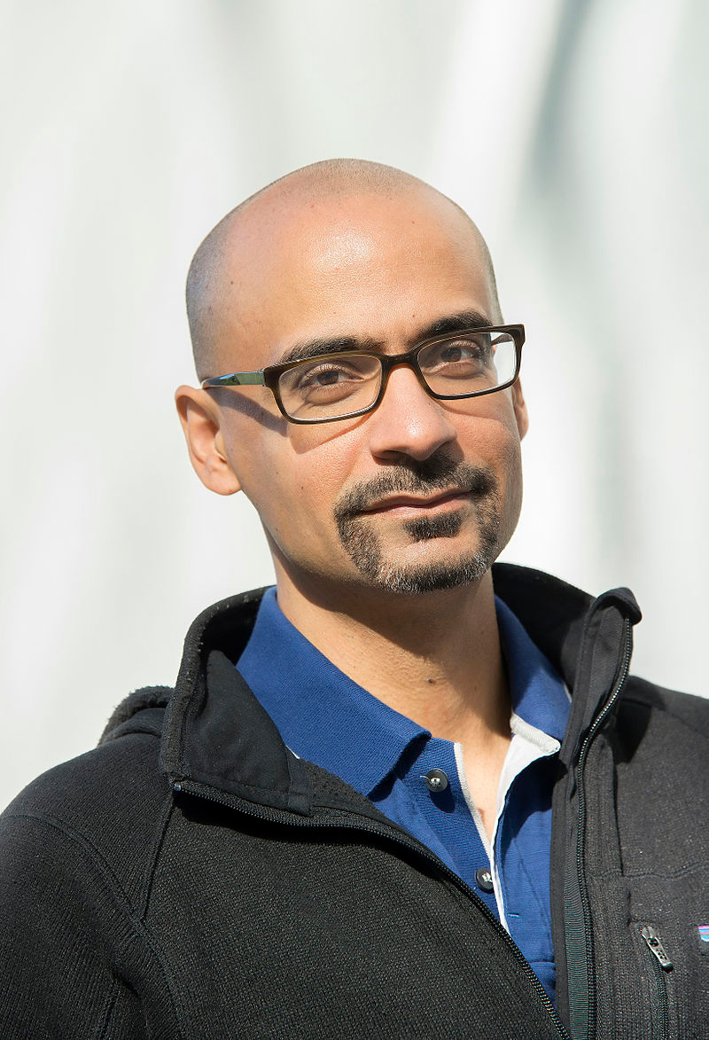
SOBRE EL AUTOR
Junot Díaz (1968) es un autor estadounidense, de origen dominicano.
Es profesor de escritura creativa en el Massachusetts Institute of Technology (MIT)
Es editor literario de Boston Review.
Se dedica igualmente a apoyar a Freedom University, una organización de voluntarios cuyo fin es ofrecer educación a migrantes indocumentados.

Slide 82
SOBRE EL AUTOR
Nació en Santo Domingo, República Dominicana, Díaz emigró con su familia a Nueva Jersey cuando tenia seis años.
Hizo el bachillerato en el Cedar Ridge High School de Old Bridge (1987), se licenció en inglés en la Universidad Rutgers (1992) e hizo un Master of Fine Arts en Cornell.
Depués de graduarse, Díaz publicó su primer libro, una colección de cuentos titulada Drown en 1995.

Slide 83


Entre sus obras más destacadas de cuentan las siguientes:
Drown (1996)
The Brief Wondrous Life of Oscar Wao (2007)
This Is How You Lose Her (2012)

Slide 84
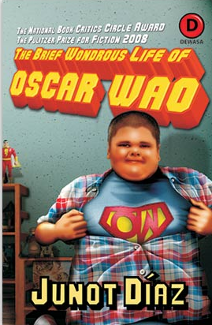
The Brief Wondrous Life of Oscar Wao
La novela es una crónica de la vida de Oscar De León, un chamaco regordete, de origen dominicano, que vive en Paterson, Nueva Jersey. Además de pasarse la vida soñando con el amor, Oscar es un lector obsesivo de ciencia ficción y de novelas fantásticas.
El problema es que no obtiene lo que busca por culpa de — la maldición ancestral que persigue a su familia desde hace varias generaciones.
Por culpa del fukú sus antepasados acaban en la cárcel, torturados o muertos en trágicos accidentes.
La peor desgracia es su mala suerte en el amor. Oscar se decide poner fin a las maldades del fukú.

Slide 85
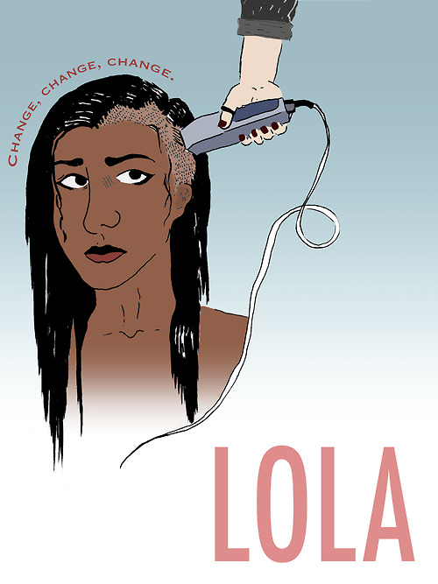
The novel centers on Lola, Oscar’s sister, as well as those of Hypatía Belicia Cabral, and his Grandfather’s Abelard.
Most of the story is told by Yunior de Las Casas, Oscar’s alter ego.

Slide 86
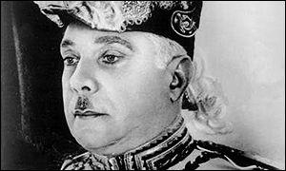
Against the backdrop of New Jersey como telón de fondo, this family saga is marked by the presence of infamous Dominiac dictator Rafael Leónidas Trujillo.

Slide 87
A small digression around de Trujillo
During his dictatorship there were:
Mass lay-offs
Murders of political opponents
Repression of the media
Elimination of political parties.
Sex abuse and scandals.
Masacró a 20,000 haitianos

Slide 88
Unas palabras acerca de Abelard
When the family talks about it at all —which is like never— they always begin in the same place: with Abelard and the Bad Thing he said about Trujillo. 22
22. There ard othe beginnings certainly, better ones, to be sure—if you ask me I would have started when the Spaniards “discovered” the New World—or when the U.S. invaded Santo Domingo in 1916—but if this is the opening the de León chose for themeselves, then who am I to question their historiagraphy?

Slide 89

El narrador agrega una nota al pie…
And where were the Mirabal sisters murdered? In a canefield, of course. And then their bodies were put in a car and a crash was simulated! Talk about two for one?

Slide 90
“This is, almost in spite of itself, a novel of assimilation, a fractured chronicle of the ambivalent, inexorable movement of the children of immigrants toward the American middle class, where the terrible, incredible stories of what parents and grandparents endured in the old country have become a genre in their own right.”
― The New York Times

Slide 91
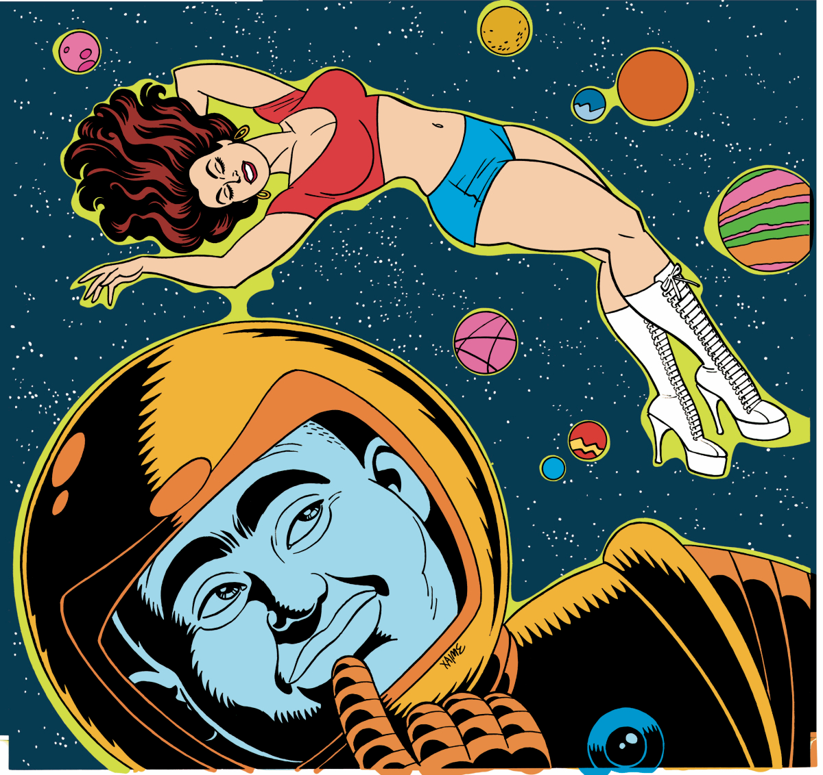
The role of comics and sci-fi in the novel constitute Oscar’s vision of the world.

Slide 92
A simple of the language used in the novel:
“What more sci-fi than Santo Domingo? What more fantasy than the Antilles?”

Slide 93
A few more examples of the language used in the novel:
"the Dictatingest Dictator who ever Dictated“
“You could say a bad thing about El Jefe at eight-forty in the morning, and before the clock struck ten, you’d be in the Cuarenta having a cattleprod shoved up your ass.”

Slide 94
The Brief Wondrous Life..." Use of Spanglish...
"Beli might have been a puta major in the cosmology of her neighbors, but a cuero she was not”.

Slide 95
A few lines of the opening paragraph…
They say it came first from Africa, carried in the screems of the Taínos, uttered just as one world perished and another began; that it was a demon drawn into creation through the nightmare door that was cracked open in the Antilles. Fuku americanus, or more colloquially, fukú—generally a curse or a doom of some kind; specifically the Curse and the Doom of the New World.

Slide 96
FUENTES Y REFERENCIAS EMPLEADAS
Jago, Carol et al. Literature & Composition: Reading - Writing – Thinking, Bedford/St. Martin's, USA, 2011
Pike, David L., Costa, Ana. Literature: A World of Writing Stories, Poems, Plays, and Essays, Pearson, USA, 2011.
Reaske, Christopher. How to Analize Poetry, Monarch Books, USA, 2014.
Roza, Greg. Patterns in Poetry: Recognizing and Analyzing Poetic Form and Meter, Rosen Publishing Group, USA, 2005.

Slide 97
Shanafelt, Collin. Literary Analysis & Essay Writing Guide, Gatsby's Light Publications, New York, 2012.
Stopbaugh, James P. Skills for Literary Analysis, Student’s Book, Master Books, USA, 2013.
Stopbaugh, James P. Skills for Literary Analysis, Teacher’s Book, Master Books, USA, 2013.

Slide 98
Bibliografía: Obras y autores estudiados
Barnes, Julian. The Sense of an Ending, Vintage, UK, 2012.
Coetzee, J.M. Disgrace, Penguin Books, London, 2000.
Díaz, Junot. The Brief Wondrous Life of Oscar Wao, Riverhard Books, USA, 2008.
Ishiguro, Kazuo. Never Let Me Go, Vintage, UK, 2006.
Lahiri, Jumpha. The Namesake, Mariner Books, USA, 2004.
Smith, Zadie. White Teeth, Vintage, London, 2001.

