Slide 1
Universidad Autónoma del Estado de México
Material: “Apoyo a Literatura de los pueblos angloparlantes”.
Autor: Dr. Luis Juan Solís Carrillo
Espacio: Fac. Lenguas, UAEMEX
Unidad de aprendizaje: Literatura de los pueblos angloparlantes.
Créditos: 4
Material diseñado y empleado en el semestre 2016 A

Slide 2
GUION DE USO PARA MATERIAL PROYECTABLE
LITERATURA DE LOS PUEBLOS ANGLOPARLANTES
La finalidad del presente material es la de apoyar al estudiante a adquirir habilidades lectoras avanzadas en el idioma inglés. Esta finalidad se integra al objetivo de la UA, el cual reza: “Sensibilizarse ante la existencias, importancia y calidad de la producción literaria en la lengua de especialidad, poco difundida en el mundo de habla hispana. En otras palabras, se trata de un objetivo doble. Por un lado contribuir al mejoramiento de las destrezas del estudiante de lengua inglesa. Por otro lado, brindarle un panorama de las letras en su idioma de especialidad

Slide 3
Este material, cabe aclarar, no pretende ser un sustituto de la clase o del docente. Más bien, es una herramienta que ayuda a profesores y estudiantes a comprender los usos y las características generales de cada obra y autor. Para su uso se sugiere lo siguiente:
Comenzar siempre con un encuadre temático. Esto significa que las diapositivas se usan como complemento didáctico de los ejemplos y explicaciones del docente. En este caso concreto, será indispensable partir de un repaso de los tiempos y del entorno geográfico, social y político en el que está inmersa la obra que se estudia. Se busca que el panorama sea lo más extenso posible para dar cabida a obras y autores de regiones angloparlantes ubicadas en la “periferia”, es decir, fuera del Reino Unido, Canadá o Los Estados Unidos.
Cada diapositiva constituye un punto de partida que puede ampliarse con más ejemplos, tanto del docente como de los alumnos, con base en la lectura específica de un texto.

Slide 4
Por la propia naturaleza de la UA, se exige que la clase se imparta en lengua inglesa. Este será un punto fundamental. No hay forma de lograr los objetivos del curso si no este no se imparte en inglés.
El docente deberá incluir ejemplos de obras y autores y de sus relaciones con otras manifestaciones artísticas y sociales. De esta manera, se verá la que la literatura no ocurre en el vacío sino que se enlaza con otras expresiones, como el cine, por ejemplo. De esta manera, el docente deberá recomendar películas, lecturas complementarias, música, etc., que sirvan para vincular la obra literaria con otros fenómenos de su tiempo.
En la medida de lo posible, el docente deberá regresar al análisis textual directo, para así aportar ejemplos de las figuras estilísticas que dan vida a una obra.

Slide 5
El punto anterior sirve no solo para conectar las figuras literarias y retóricas con sus usos en el texto, sino para que el estudiante aprecie la originalidad del discurso literario en manos de sus mejores exponentes en lengua inglesa. De esta manera, el análisis servirá para que el alumno se percate de la estrecha relación que esta UA guarda con otras, correspondientes a su área de especialización. Así pues, será recomendable que el profesor establezca estas relaciones y las ponga de manifiesto en el aula.
El orden de las diapositivas no obedece a ninguna secuencia programática establecida de antemano. Se trata de ilustraciones adaptables a los avances de cada grupo y docente. De esta manera, no será incorrecto emplear las diapositivas correspondientes a un autor de Trinidad y Tobago, antes o después de otro del Reino Unido.

Slide 6
En cuanto a la secuencia didáctica sugerida, cabe decir lo siguiente:
Este material permite al estudiante adquirir los nuevos conceptos partiendo de una fase inicial centrada en la mera identificación de los rasgos que caracterizan al fenómeno o la figura literaria.
Posteriormente, el alumno debe reconocer, en un texto literario, la presencia de las diversas características del entorno angloparlante (temas, géneros, etc.)
En una etapa posterior, es necesario que la atención asuma una postura más crítica, es decir, que el estudiante esté en condiciones de observar la relación entre el contenido expreso en el lenguaje literario y la forma en que la obra responde a su momento histórico y la manera en que contribuye a ese gran diálogo en el que participan las diversas expresiones en lengua inglesa.
He aquí, de forma resumida, el guion con los lineamientos y sugerencias que permitirán el uso en el aula de esta colección de diapositivas. Espero que les sea de mucha utilidad.

Slide 7
Literatura de los pueblos angoparlantes
Unidades de competencia
UNIDAD I: Las colonias británicas desde la literatura inglesa
UNIDAD II: La respuesta literaria desde la colonia
UNIDAD III: Las literatura de las colonias y excolonias británicas
UNIDAD IV: El caso de las literaturas étnicas de EUA. (OPCIONAL)
El material se centra en las Unidades I, II y III.

Slide 8
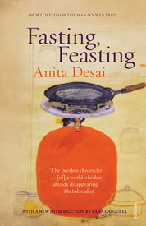

Slide 9
Women
Aruna and Uma are raised, educated, and groomed only with marriage in mind. When the multiple attempts of MamaPapa to arrange a marriage for Uma fail, it becomes Uma’s job to take care of her baby brother, Arun, and later her aging parents.
Mama’s identity is tied in with her role as the wife of an important man, and she seldom disagrees with him.
Anamika meets the social expectations of female submission—yet, abused to death, Anamika experiences the ultimate loss of freedom that threatens all women who are forced to fulfill the feminine ideal. Dr. Dutt and Mira-masi both represent women who, independent of family and men, defy female social roles.

Slide 10
Men
Men also lose their free will and individual expression to the social roles they must fill. As a child, Arun is showered with care and attention, unlike his neglected sister. Uma.
MamaPapa place high demands on Arun for him to work hard in school and achieve constantly, giving Arun no alternative path.
While Papa has the most authority in Uma’s household, his ego and pride are bound to his social role as a male head of the household. He cannot appear vulnerable, and so never forms genuine human connections.

Slide 11
American society
American society as portrayed in the novel also places gendered expectations onto its members, particularly in regards to male and female beauty. Mrs. Patton, like her daughter Melanie, is burdened by American ideals of female perfection and beauty, which are obsessed with dangerous degrees of thinness and over-tanning. Mr. Patton and Rod similarly fulfill the traditional Macho American stereotype of athleticism and hard work. Like Papa, Mr. Patton assumes passive control over the members of his household.

Slide 12
Plenty/"Feasting" vs. Want/"Fasting"
Access to resources play a large factor in determining the quality of life and opportunity available to individual characters in the novel.
Plenty and want are not what they appear to be, and characters who seem to have much are often found wanting; likewise, those who seem to have little are rich in spiritual ways.
India is contrasted with America, and Uma’s lower middle class parents are contrasted with wealthier families in India.

Slide 13
Loneliness and Togetherness
The difference between loneliness and being alone is a tension that affects many characters throughout the novel.
Loneliness affects many characters—yet, togetherness, especially within families, doesn’t always solve the loneliness of the individual.
Balancing the needs for both community and solitude is a constant struggle, especially for Uma and Arun.

Slide 14
Arun: Quiet, introverted baby brother of Uma, the youngest child; a vegetarian who shows no athletic prowess; fears being drawn into the judgment and expectations of others.

Slide 15
Aruna — Aruna is the pretty, confident, and socially ambitious younger sister of Uma and second daughter of Mama and Papa.
As a child, school comes easily to Aruna, though she takes no interest in it. While she is kind and helpful to Uma during their childhoods, she becomes snappy and superior when they approach adolescence, laughing at Uma's rejection by prospective husbands.

Slide 16
Early life
Anita Mazumdar was born in Mussoorie, India, to a German mother, Toni Nime, and a Bengali businessman, D. N. Mazumdar. She grew up speaking German at home and Bengali, Urdu, Hindi and English outside the house. She first learned to read and write in English at school and as a result English became her "literary language“. She began to write in English at the age of seven and published her first story at the age of nine.

Slide 17
…
She was a student at Queen Mary's Higher Secondary School in Delhi and received her B.A. in English literature in 1957 from the Miranda House of the University of Delhi.
The following year she married Ashvin Desai, the director of a computer software company and author of the book Between Eternities: Ideas on Life and The Cosmos.
They have four children, including Booker Prize-winning novelist Kiran Desai. Her children were taken to Thul (near Alibagh) for weekends, where Desai set her novel The Village by the Sea. For that work she won the 1983 Guardian Children's Fiction Prize, a once-in-a-lifetime book award judged by a panel of British children's writers.

Slide 18
Career
Desai published her first novel, Cry The Peacock, in 1963.
She considers Clear Light of Day (1980) her most autobiographical work as it is set during her coming of age and also in the same neighborhood in which she grew up.
In 1984 she published In Custody – about an Urdu poet in his declining days – which was shortlisted for the Booker Prize.

Slide 19
Career
In 1993 she became a creative writing teacher at Massachusetts Institute of Technology.
Her novel, The Zigzag Way, set in 20th-century Mexico, appeared in 2004.
Her latest collection of short stories, The Artist of Disappearance was published in 2011.

Slide 20
Lord of the flies
BY William Golding

Slide 21
“I am not a theologian or a philosopher. I am a storyteller.”
—William Golding
British novelist William Golding wrote the critically acclaimed classic Lord of the Flies. He was awarded the Nobel Prize for Literature in 1983.

Slide 22
About the author
William Golding was born September 19, 1911, in Saint Columb Minor, Cornwall, England. In 1935 he started teaching English and philosophy in Salisbury. He temporarily left teaching in 1940 to join the Royal Navy. In 1954 he published his first novel, Lord of the FliesOn June 19, 1993, he died in Cornwall, England.

Slide 23
Early life
William Golding was raised in a 14th-century house next door to a graveyard. His mother, Mildred, was an active suffragette who fought for women’s right to vote. His father, Alex, worked as a schoolmaster.

Slide 24
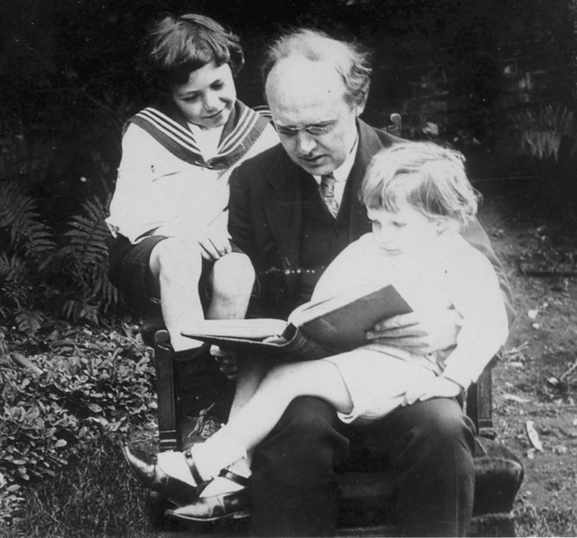
William received his early education at the school his father ran, Marlborough Grammar School. When William was just 12 years old, he attempted, unsuccessfully, to write a novel. A frustrated child, he found an outlet in bullying his peers. Later in life, William would describe his childhood self as a brat, even going so far as to say, “I enjoyed hurting people.”

Slide 25
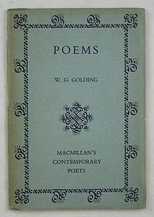
After primary school, William went on to attend Brasenose College at Oxford University. His father hoped he would become a scientist, but William opted to study English literature instead. In 1934, a year before he graduated, William published his first work, a book of poetry aptly entitled Poems. The collection was largely overlooked by critics.

Slide 26
Teaching
After college, Golding worked in settlement houses and the theater for a time. Eventually, he decided to follow in his father’s footsteps. In 1935 Golding took a position teaching English and philosophy at Bishop Wordsworth’s School in Salisbury. Golding’s experience teaching unruly young boys would later serve as inspiration for his novel Lord of the Flies.

Slide 27
Royal Navy
Golding spent the better part of the next six years on a boat, except for a seven-month stunt in New York, where he assisted Lord Cherwell at the Naval Research Establishment. While in the Royal Navy, Golding developed a lifelong romance with sailing and the sea.
During World War II, he fought battleships at the sinking of the Bismarck, and also fended off submarines and planes. Lieutenant Golding was even placed in command of a rocket-launching craft

Slide 28
Of his World War II experiences, Golding has said, “I began to see what people were capable of doing. Anyone who moved through those years without understanding that man produces evil as a bee produces honey, must have been blind or wrong in the head.” Like his teaching experience, Golding’s participation in the war would prove to be fruitful material for his fiction.
In 1945, after World War II had ended, Golding went back to teaching and writing.

Slide 29
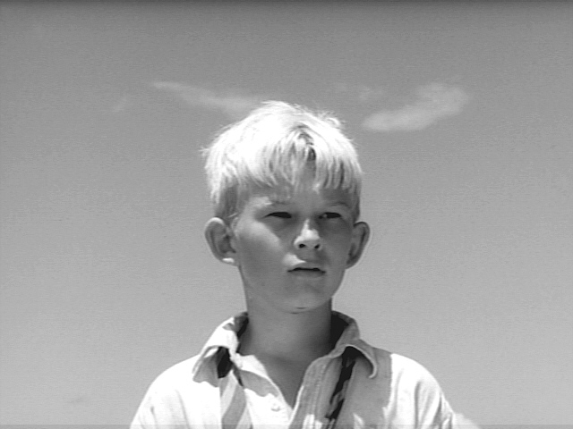
Simon
Quiet
fearful but curious
always seeking truth

Slide 30


Slide 31

In 1963, the year after Golding retired from teaching, Peter Brook made a film adaptation of the critically acclaimed novel. Two decades later, at the age of 73, Golding was awarded the 1983 Nobel Prize for Literature. In 1988 he was knighted.
In 1990 a new film version of the novel was released, bringing the book to the attention of a new generation of readers

Slide 32
Death and Legacy
Golding spent the last few years of his life quietly living with his wife, Ann Brookfield, at their house near Falmouth, Cornwall, where he continued to toil at his writing.
On June 19, 1993, Golding died of a heart attack in Cornwall. He was survived by his wife and their two children, David and Judith. After Golding passed away, his completed manuscript for The Double Tongue was published posthumously.

Slide 33

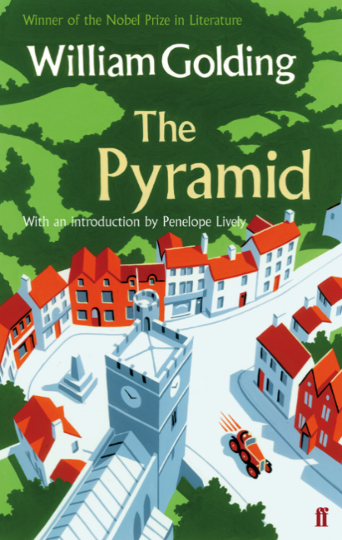
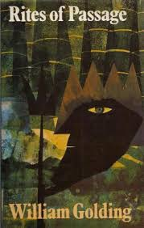
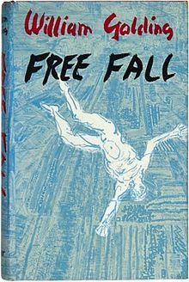
Among the most successful novels of Golding’s writing career were Rites of Passage (winner of the 1980 Booker McConnell Prize), Pincher Martin, Free Fall and The Pyramid. While Golding was mainly a novelist, his body of work also includes poetry, plays, essays and short stories.

Slide 34
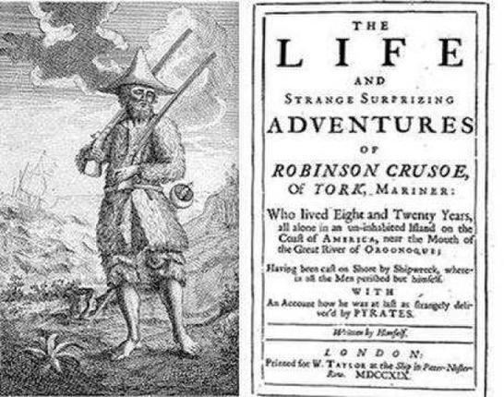
Golding’s Fantasy
It was published in a collection of Science Fiction, but that wasn’t quite accurate, since Golding wrote a book of fantasy without science. He had two very clear predecessors, Daniel Defoe’s “Robinson Crusoe” and an example of which he tried to mock“The Coral Island” by Ballantyne, which was very successful in England by portraying some kids as “Good Robinsons”.

Slide 35
Characters:
The book shows of a lot of symbolism in the actions and personalities and physical appearance of its characters, it is here where the story begins to evince a stark fantasy that becomes cruel as portraying realism by means of a play of symbols.

Slide 36
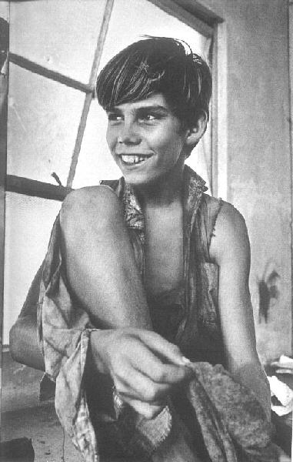
Ralph
13 years old
Dignified
Possibly a boy-scout?
Represents common sense
Depicts democracy

Slide 37
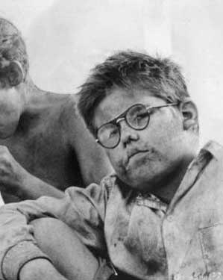
Piggy
Fatty
Wears glasses
Intelectual
Asthmatic
Timorous
Despised and relegated
by the others

Slide 38
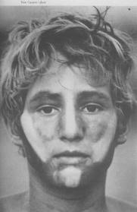
Jack
Soloist of a choir
whose all members survive
The hunter of the group
Violent
Depicts fascism

Slide 39
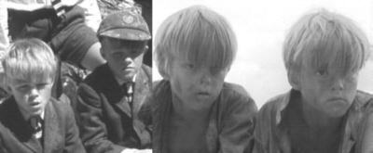
Samaneric twins
Represent the
inconsistency the masses
Unwise
Careless
Blindly follow their leader

Slide 40
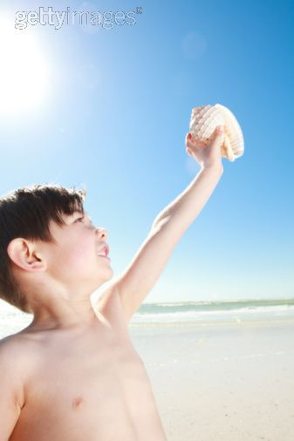
White conch
The biggest symbolism in the book is the White Conch used as a horn call, which gives its holder the right to speak, it is the symbolism that Ralph uses, when he is chosen as the leader, to demonstrate itThe white conch depicts, democracy , order and common sense itself.

Slide 41
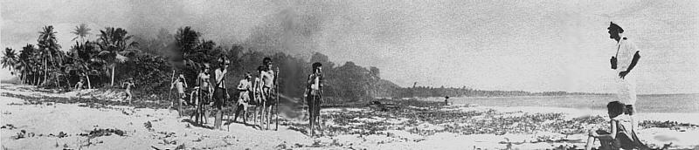
Wellness perishes
In a few weeks, the apparent democracy falls apart, Jack gets banned by everyone, and becomes a fugitive, chased to be killed, and they almost get it, but they are found, due to the fire, by an official of an English cruise who sees them painted like savages, except for Ralph, who is crying due to his failure.

Slide 42
Golding’s intentions
Children were the ideal people to do so, since in them, logic is still incipient and has not replaced pure imagination. A child doesn’t distinguish between games and duties, his boss must be strong to impose. Ralph is the only one who thinks as an adult, but he lacks the words to express his feelings and tries to defend a social formula that he doesn’t fully understand,

Slide 43
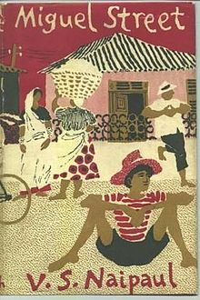
Miguel Street
V.S. Naipaul

Slide 44
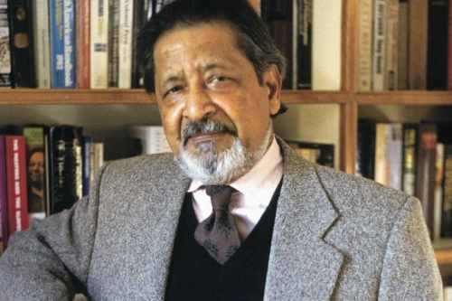
Vidiadhar Surajprasad Naipaul

Slide 45
About the author
Born in 17 August 1932 in Chaguanas, Trinidad.
Son of Indian immigrants, his grandparents worked as servants. His Father became a journalist whose reverence for writing and writers inspired him to become a writer.
At seven years old, Naipaul enrolled in the Queen’s Royal College. Upon graduation, Naipaul won a scholarship that allowed him to study at Oxford.
Although the Naipauls believed themselves to be descendants of the Hindu Brahmins, they did not practise any of their traditions. Soon, the family started to only speak English.

Slide 46
About the author
In 1952, he began doubting his writing skills and became depressed. On impulse, he went on a trip to Spain, where he spent all his savings. Prior to his travel to Spain, he met Patricia Ann Hale, who would become his wife and partner in his writing career.
In 1954 Naipaul moved to London, where he worked for four years as the presenter of a weekly BBC show. During his time there, he began writing Miguel Street which won the Somerset Maugham Award.
In 2001, he was awarded the Nobel Prize in Literature.
V. S. Naipaul was knighted in 1989.

Slide 47
V.S. Naipaul’s most notable works
Miguel Street
A House for Mr. Biswas (considered one of the best English-language novels of the XX century)
In a Free State (winner of the Booker Prize in 1971)
A Bend in the River (nominated to the Booker prize)
The Enigma of Arrival
Half a life (nominated to the Booker prize)

Slide 48
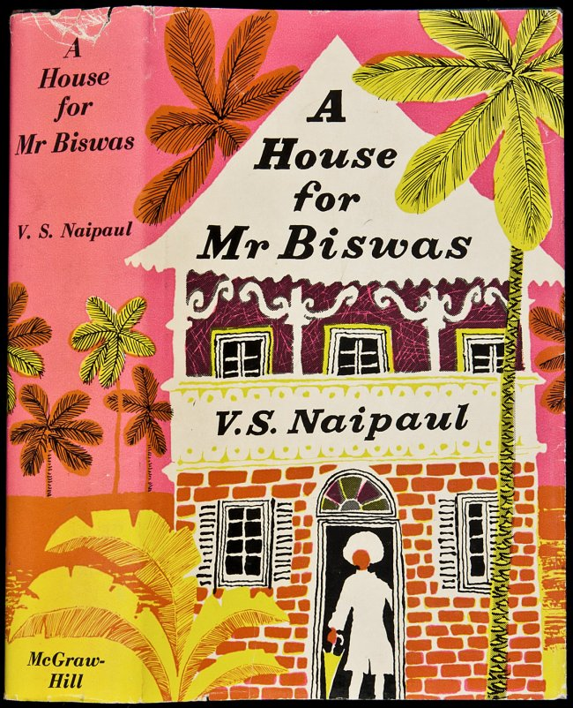
A House for Mr. Biswas
The novel is often cited as Naipaul’s best work. Both the Modern Library and Time magazine include it in their top 100 lists of best English-language books of the XX century.

Slide 49
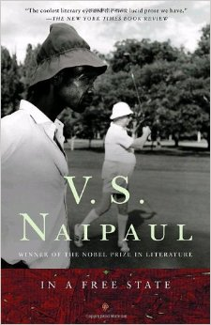
In a Free State
Published in 1971, it contains three stories linked through a fragmented narrative. In the three stories, the price of freedom is debated through analogies, but no main theme can be stablished.
It won the Booker Prize of 1971.

Slide 50
Main themes in his books
His fiction is often highly autobiographical. In Helen Hayward’s opinion, Naipaul “returns repeatedly to his origins, to tell the story of his life over and over again in a variety of forms. As he notes:
"I said earlier that everything about me is in my books. I will go further
now. I will say I am the sum of my books. Each book intuitively sensed
and, in the case of fiction, intuitively worked out. Each stands on what has gone before, and grows out of it. I feel that at any stage of my literary career it could have been said that the last book contained all the others.”

Slide 51
MAIN THEMES IN HIS BOOKS
DISPLACEMENT, ALIENATION AND RUTHLESSNESS:
Alienation has been one of his central themes. It is defined as a feeling of separation or isolation, associated with minorities who have limited power to bring about changes in society. A lack of sense of place and self which Naipaul and his family, as Indians in Trinidad, experienced.
The word home is linked to identity, so his works often center on the relationship between the place of living and the identity developed in those places.

Slide 52
MAIN THEMES IN HIS BOOKS
Displacement is depicted in A House for Mr. Biswas. Mr. Biswas, a portrayal of Naipaul’s own father, is a man caught up in three cultures. It depicts Naipaul’s own cultural dislocation and displacement.
Naipaul’s strongest vision of destruction of identity through geographical displacement is found in his novel In a Free State. In this story, the main character attempts to reach a ‘free state.’

Slide 53
MAIN THEMES IN HIS BOOKS
POST- COLONIAL THIRD WORLD:
Subsequent novels developed more political themes as he began to write about colonial and post-colonial societies in the process of decolonization
He concentrates on major themes related to the problems of these nations of the “Third World” and how they function in the postcolonial order.

Slide 54
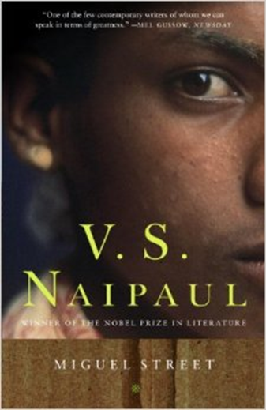
MIGUEL STREET
¨The sketches are written lightly, so that tragedy is understated and comedy is overstated, yet the ring of truth always prevails.¨
— The New York Times

Slide 55
Setting
Miguel Street is set in Trinidad and Tobago during wartime. It collects various short stories linked by the setting, Miguel Street, a fictionalized version of Luis Street, where Naipaul lived most of his childhood with his family in a an Indian community. Many of the minor characters appear as central characters in other stories.

Slide 56
Naipaul writes from the first-person and describes his own experiences within each episode, except towards the end of the book.
Each story focuses on a single character who lives in Miguel Street. The stories are narrated by a unnamed boy.

Slide 57
Important Themes in Miguel Street
STILLNESS OR PARALYSIS
Some characters seem unable to finish their respective works.
For example, Mr. Popo the carpenter, never finishes making anything, and the poet B. Wordsworth, who is working on the greatest poem ever written but has never written past the first line.

Slide 58
Important Themes in Miguel Street
DISORDER AND SCAPE
Naipaul depicts the conditions of disorder in Port of Spain, Trinidad.
In a way, the characters are unable to scape Miguel Street. In the novel there is only one person who really escapes Miguel Street.
It can be said that the novel depicts the embracing of escapism as a means to cope with the futility of inner-city life.

Slide 59
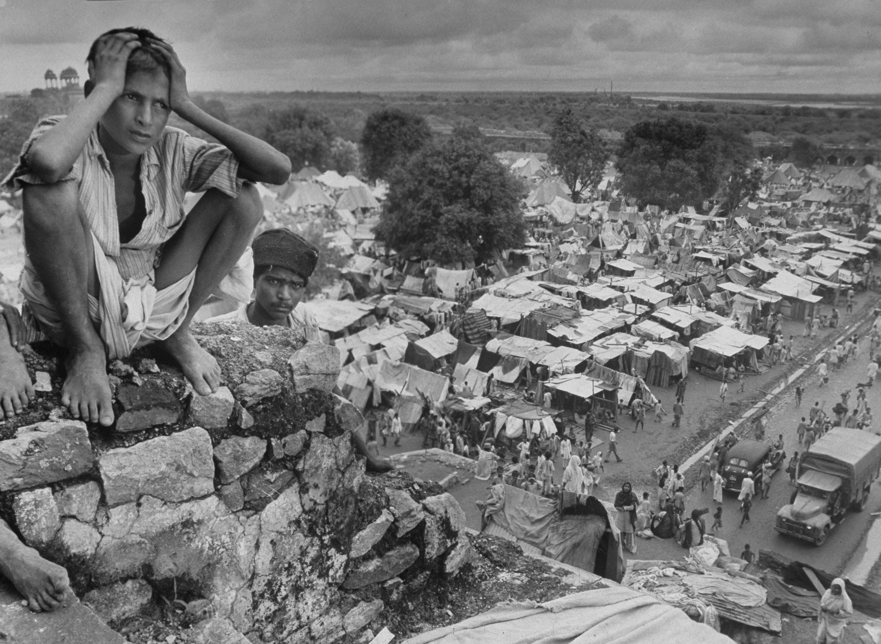
Important Themes in Miguel Street
Post colonialism and its influence on the disadvantaged in society.

Slide 60
Important Themes in Miguel Street
Masculinity
Almost all the characters in the book are men who are poor, and are habitually out of work. They rarely achieve their aims and have dysfunctional relationships with women.
The idea of manliness in Miguel Street involves being unfaithful. For example, Bogart is considered “a man among we men…” because he leaves his wife to have children with another woman.

Slide 61
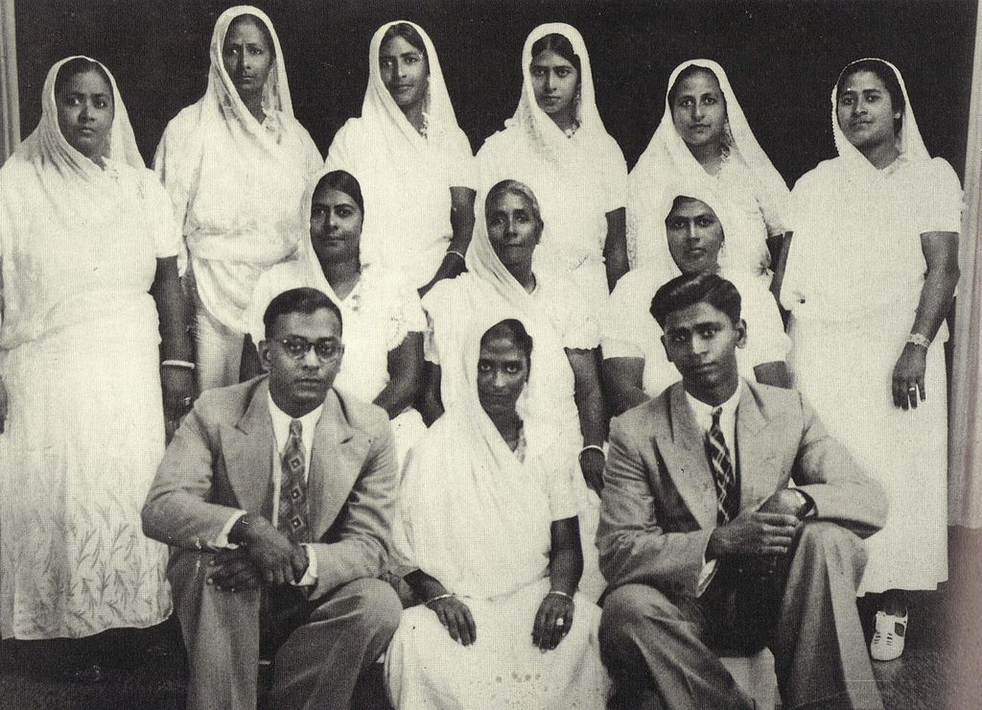
Important Themes in Miguel Street
Women, though marginal or invisible, take charge of family and community relationships. They are supposed to be both loyal, subservient to their husbands.

Slide 62
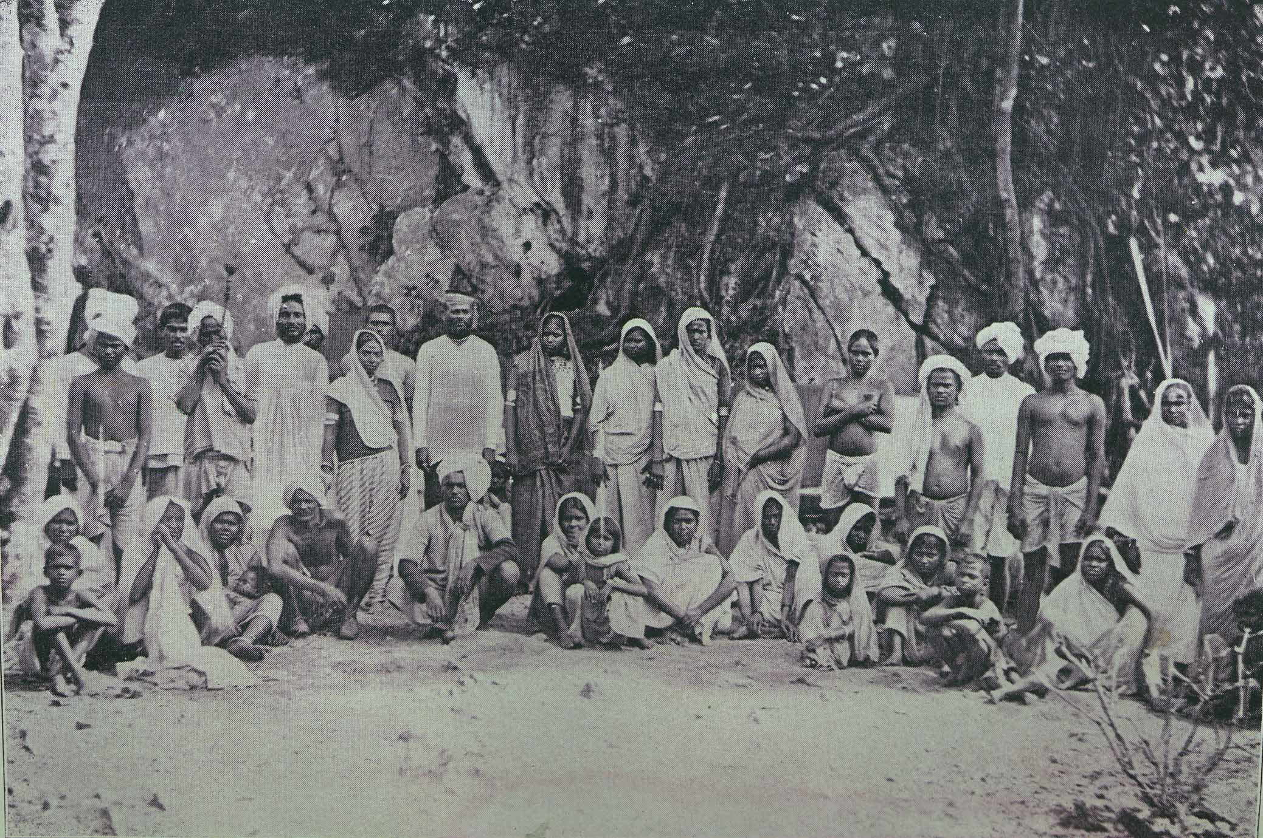
Historical background
The 1930’s in Trinidad and Tobago were a time of decolonization, when many people had to reassess their identity.
By the late XX century, Trinidad and Tobago were no longer profitable colonies because sugar was being produced more cheaply elsewhere. Britain ruled Trinidad and Tobago as a crown colony until 1956.

Slide 63
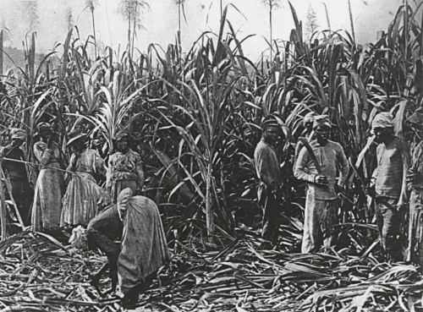
Historical background
The populations of both Trinidad and Tobago owe their main origins to massive eighteenth- and nineteenth-century importations of African slaves and East Indian indentured servants who were needed to work on the sugar plantations.

