Slide 1
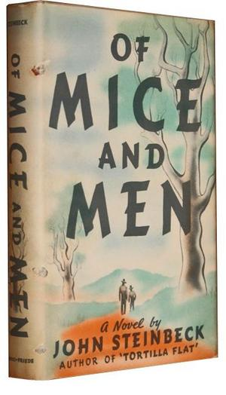
Of mice and men
By: John Steinback.

Slide 2
About the author
John Steinbeck was an American novelist, whose Pulitzer Prize-winning novel, The Grapes of Wrath, portrayes the plight of migrant workers during the Great Depression.
It can be said that John Steinbeck gave voice to working class America. In 1939, he reported on migrant farm workers for the San Francisco Chronicle, providing the basis for his Pulitzer Prize-winning novel, The Grapes of Wrath.

Slide 3
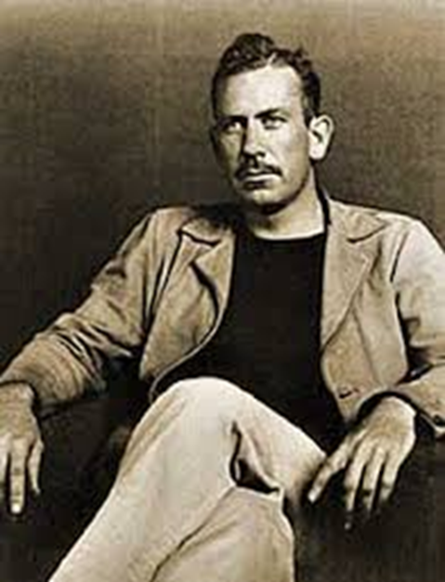
A few biographical facts
Born on February 27, 1902, in Salinas, California, John Steinbeck dropped out of college and worked as a manual laborer before achieving success as a writer. His 1939 novel, The Grapes of Wrath, about the migration of a family from the Oklahoma Dust Bowl to California, won a Pulitzer Prize and a National Book Award. Steinbeck served as a war correspondent during World War II, and was awarded the Nobel Prize for Literature in 1962. He died in New York City in 1968

Slide 4
Early years
Steinbeck was raised with modest means. His father, John Ernst Steinbeck, tried his hand at several different jobs to keep his family fed: He owned a feed-and-grain store, managed a flour plant and served as treasurer of Monterey County. His mother, Olive Hamilton Steinbeck, was a former schoolteacher.

Slide 5
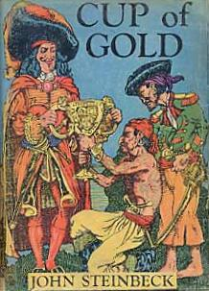
Early career
Following Stanford, Steinbeck tried to make a go of it as a freelance writer. It was during this time that Steinbeck wrote his first novel, Cup of Gold (1929), and met and married his first wife, Carol Henning. Over the following decade, with Carol's support and paycheck, he continued to pour himself into his writing.

Slide 6
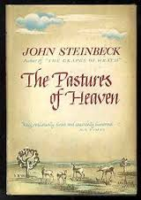
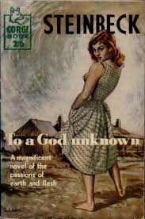
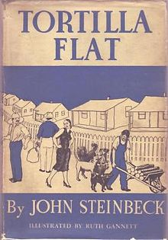
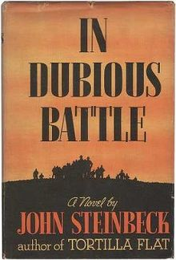
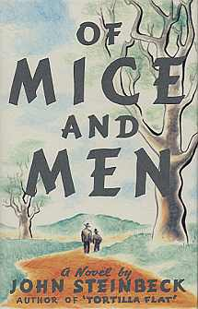
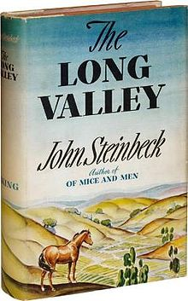
Early career
Steinbeck's follow-up novels, The Pastures of Heaven (1932) and To a God Unknown (1933), received tepid reviews. It wasn't until Tortilla Flat (1935), a humorous novel about paisano life in the Monterey region, was released that the writer achieved real success. Steinbeck struck a more serious tone with In Dubious Battle (1936), Of Mice and Men (1937) and The Long Valley (1938), a collection of short stories.

Slide 7
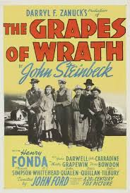
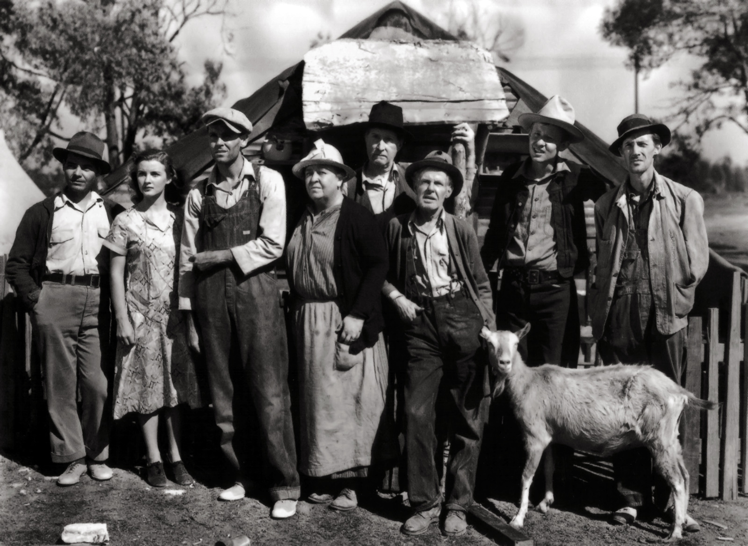
The grapes of Wrath
Widely considered Steinbeck's finest and most ambitious novel, The Grapes of Wrath was published in 1939. Telling the story of a dispossessed Oklahoma family and their struggle to carve out a new life in California at the height of the Great Depression, the book captured the mood and angst of the nation during this time period. At the height of its popularity, The Grapes of Wrath sold 10,000 copies per week.

Slide 8
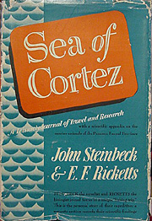
Later life
Following that great success, John Steinbeck served as a war correspondent for the New York Herald Tribune during World War II. Around this same time, he traveled to Mexico to collect marine life with friend Edward F. Ricketts, a marine biologist. Their collaboration resulted in the book Sea of Cortez (1941), which describes marine life in the Gulf of California

Slide 9


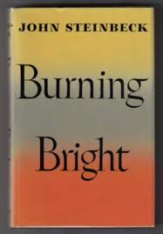

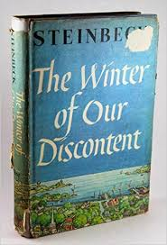
Later life
Steinbeck continued to write in his later years, with credits including Cannery Row (1945), Burning Bright (1950), East of Eden (1952), The Winter of Our Discontent (1961) and Travels with Charley: In Search of America (1962). Also in 1962, the author received the Nobel Prize for Literature—"for his realistic and imaginative writings, combining as they do sympathetic humour and keen social perception“
Steinbeck died of heart disease on December 20, 1968, at his home in New York City.

Slide 10
Of mice and men
Summary
George and Lennie, two migrant ranch worker, flee from Weed, California to a ranch near Salinas, California. They had to fled, because Lennie had scared a girl. He didn’t want to harm her, but he is not intelligent and he does not realize his own strength.

Slide 11
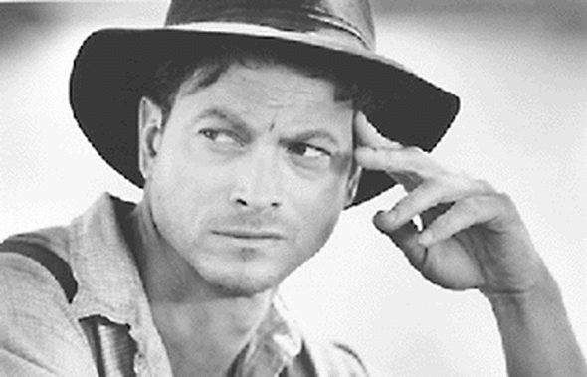
George
Intelligent
Short
Talks for both of them
Became frustrated and angry
Feels loneliness, fear, humiliation and pride thorough the story.

Slide 12
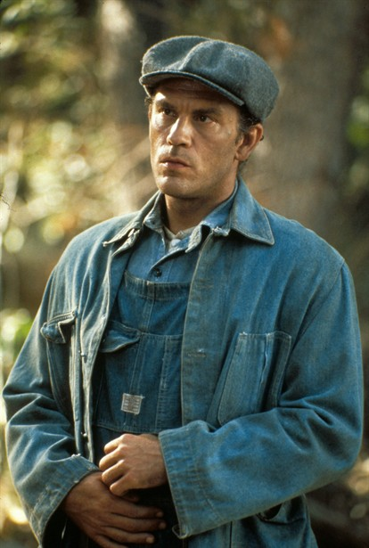
Lennie
Less intelligent
Tall
Strong
Tries to keep quiet.
Feels frustrated and angry too
Also experiences loneliness, fear, humiliation and pride thorough the story.

Slide 13
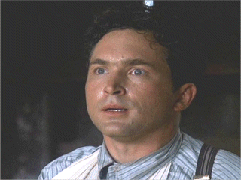
Curley
Always trying to get into fights with bigger people than him
Son of the owner of the ranch. A coward.

Slide 14
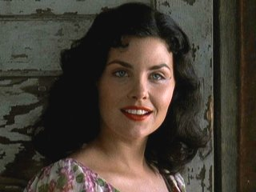
Curley’s wife
Promiscuous
Sensual
Looking for love among the workers
Faces great disappointment as a young person. She wanted to become a movie star, but her mother wouldn’t let her.

Slide 15
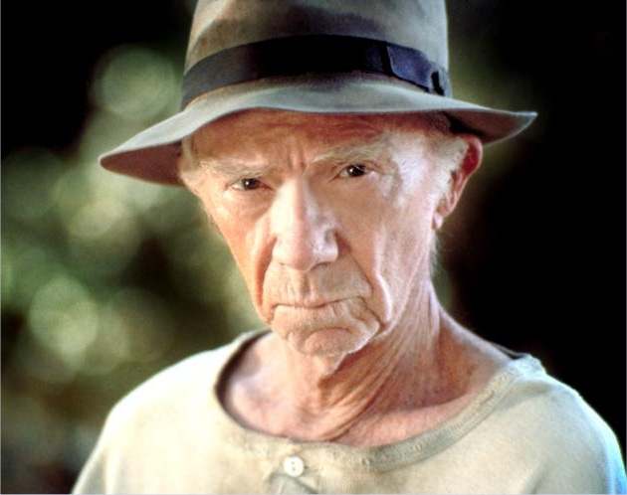
Candy
Old
Lonely
Lives only with his shepherd dog

Slide 16
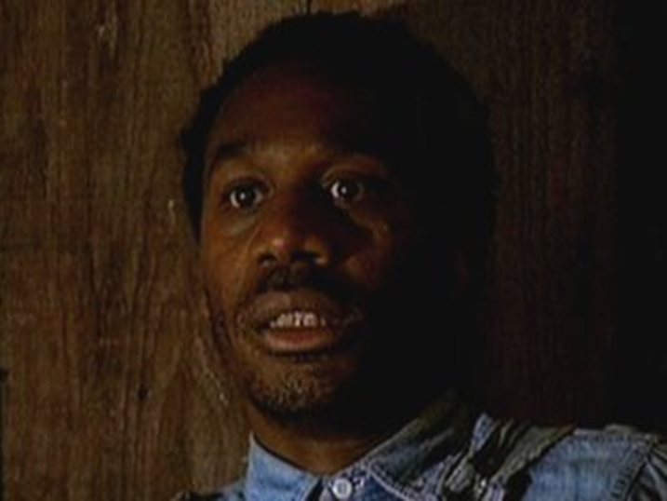
Crooks
Black worker
Lonely
Neat
Almost never speaks to anybody.
Works with the horses

Slide 17
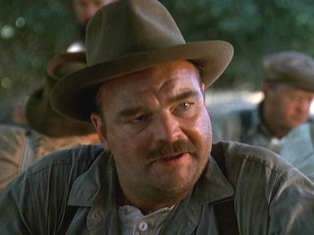
Carlson
Worker
Enjoys playing cards with the other workers.

Slide 18
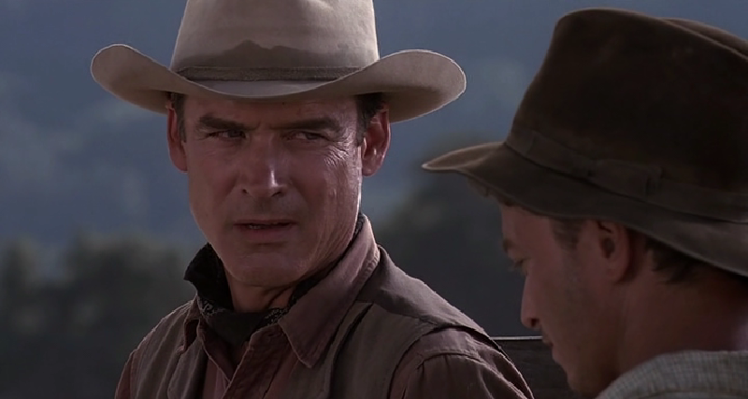
Slim
A worker of the farm whose work is organizing the others and taking care of them.

Slide 19
Theme List
The importance of dreams and goals to survive life’s troubles.
Racism
Anger and fear
Self acceptance
Knowing own’s strengths and weaknesses
Pursuit of ones’ dreams
Prejudice
Friendship

Slide 20
To Kill a Mockingbird
Harper Lee

Slide 21
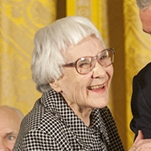
American, born in Alabama
1960–2016

Slide 22

Her work
To Kill a Mocking bird, published in 1960
Winner of a Pulitzer prize in 1961
It was voted "Best Novel of the Century" in a poll by the Library Journal
Classic of American literature
She was awarded the Presidential Medal of Freedom for her contribution to literature.
She assisted Truman Capote in his research for the book In Cold Blood

Slide 23
Background
Her mother was a homemaker.
Her father was a former newspaper editor and proprietor, practiced law and served in the Alabama State Legislature.
Her father once defended two black men accused of murdering a white storekeeper. Both clients, a father and son, were hanged.

Slide 24
Education
Enrolled at Monroe County High School
She developed an interest in English literature
After graduating from high school in 1944,she attended the then all-female Huntingdon College in Montgomery for a year
Then transferred to the University of Alabama in Tuscaloosa, where she studied law for several years and wrote for the university newspaper, but did not complete a degree.

Slide 25
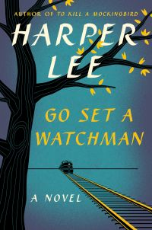
Prior to publis “To Kill a Mockingbird”
Lee moved to New York City and took a job as an airline reservation agent, writing fiction in her spare time
In the spring of 1957, a 31-year-old Lee delivered the manuscript for Go Set a Watchman to her agent to send out to publishers, but it was not published due to the fact, as stated by Lee, that it was "more a series of anecdotes than a fully conceived novel”.
It was later published, in 2015

Slide 26
After her publication
From the time of the publication of To Kill a Mockingbird until her death in 2016, Lee granted almost no requests for interviews or public appearances.
In 2015, she Published Go Set a Watchman
She did work on a follow-up novel —The Long Goodbye—, but eventually filed it away unfinished.
During the mid-1980s, she began a factual book about an Alabama serial murderer, but also put it aside when she was not satisfied.

Slide 27
Death
Lee died in her sleep on the morning of February 19, 2016, aged 89.
Prior to her death, she lived in Monroeville, Alabama.
her funeral was held at First United Methodist Church in Monroeville.

Slide 28
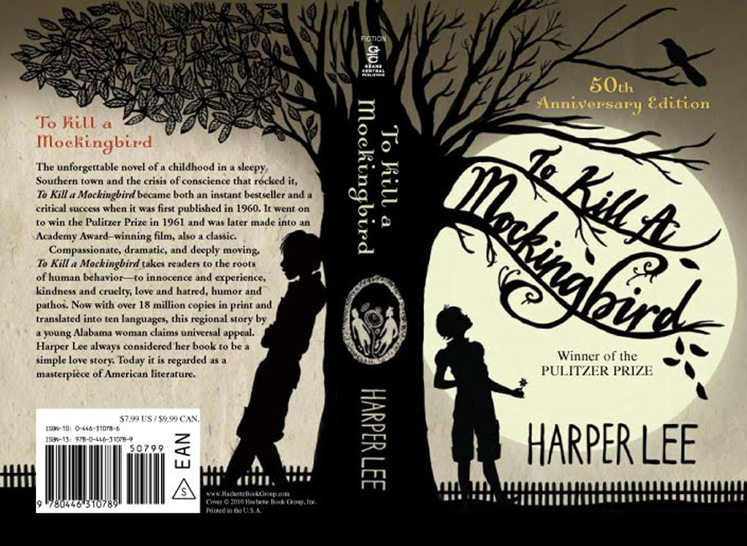

Slide 29
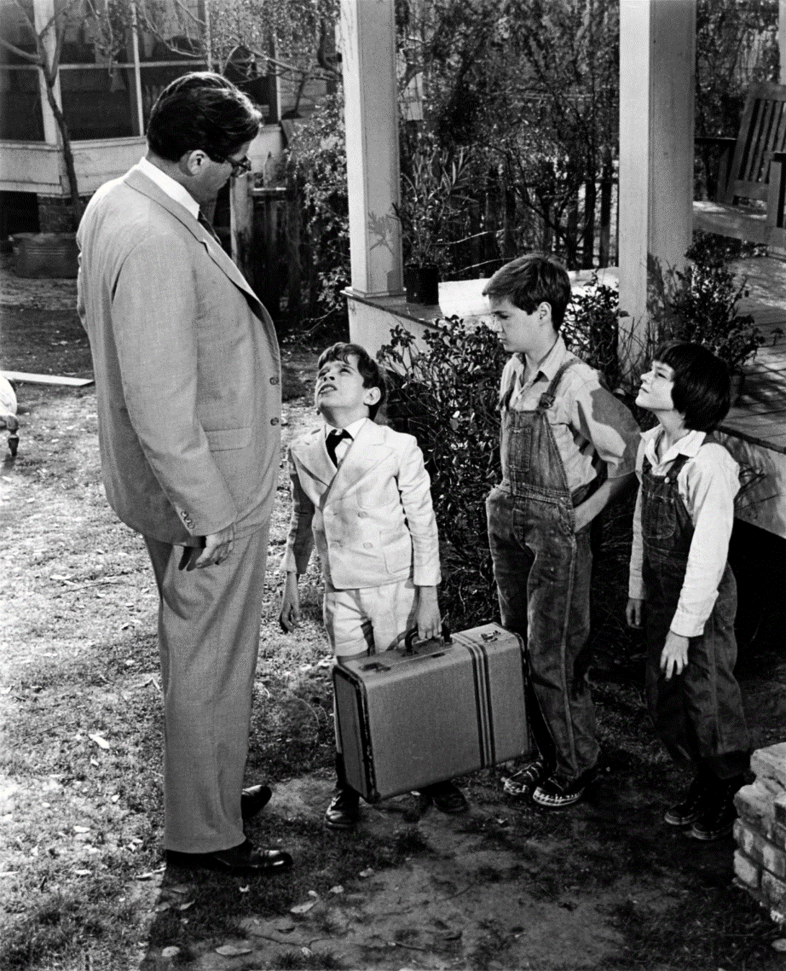
Plot summary
The story takes place during three years (1933–35) of the Great Depression in the fictional "tired old town" of Maycomb, Alabama, the seat of Maycomb County. It focuses on six-year-old Jean Louise Finch (Scout), who lives with her older brother, Jem, and their widowed father, Atticus, a middle-aged lawyer. Jem and Scout befriend a boy named Dill, who visits Maycomb to stay with his aunt each summer. The three children are terrified of, and fascinated by, their neighbor, the reclusive Arthur "Boo" Radley.

Slide 30
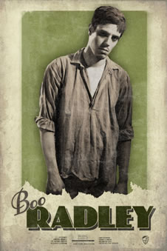
The adults of Maycomb are hesitant to talk about Boo, and, for many years few have seen him. The children feed one another's imagination with rumors about his appearance and reasons for remaining hidden, and they fantasize about how to get him out of his house. After two summers of friendship, Dill, Scout and Jem find that someone leaves them small gifts in a tree outside the Radley place. Several times the mysterious Boo makes gestures of affection to the children, but, to their disappointment, he never appears in person.

Slide 31
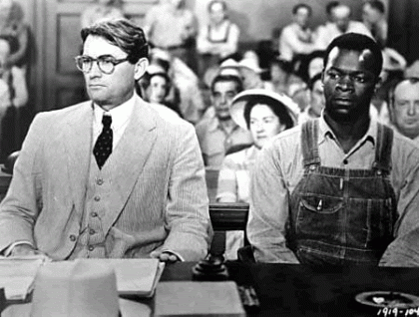
Judge Taylor appoints Atticus to defend Tom Robinson, a black man who has been accused of raping a young white woman, Mayella Ewell. Many of Maycomb's citizens disapprove, but Atticus agrees to defend Tom to the best of his ability. Jem and Scout are taunted for Atticus's actions, calling him a "nigger-lover". Atticus faces a group of men intent on lynching Tom.

Slide 32
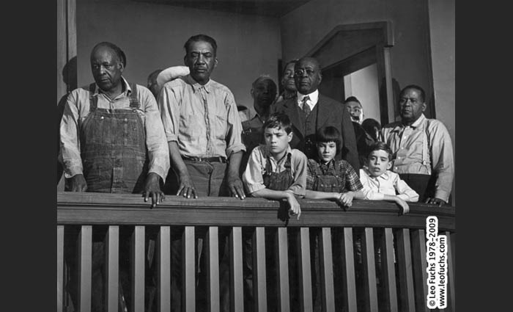
Atticus does not want Jem and Scout to be present at Tom Robinson's trial. Yet, Sykes, Jem, Scout, and Dill watch from the colored balcony. Despite significant evidence of Tom's innocence, the jury convicts him. Jem's faith in justice becomes badly shaken, as is Atticus', when the hapless Tom is shot and killed while trying to escape from prison.

Slide 33
Autobiographical elements
Lee has said that To Kill a Mockingbird is not an autobiography, but rather an example of how an author "should write about what he knows and write truthfully". Nevertheless, several people and events from Lee's childhood parallel those of the fictional Scout. Lee's father, Amasa Coleman Lee, was an attorney, similar to Atticus Finch, and in 1919, (as before said) he defended two black men accused of murder. After they were convicted, hanged and mutilated, he never tried another criminal case.

Slide 34
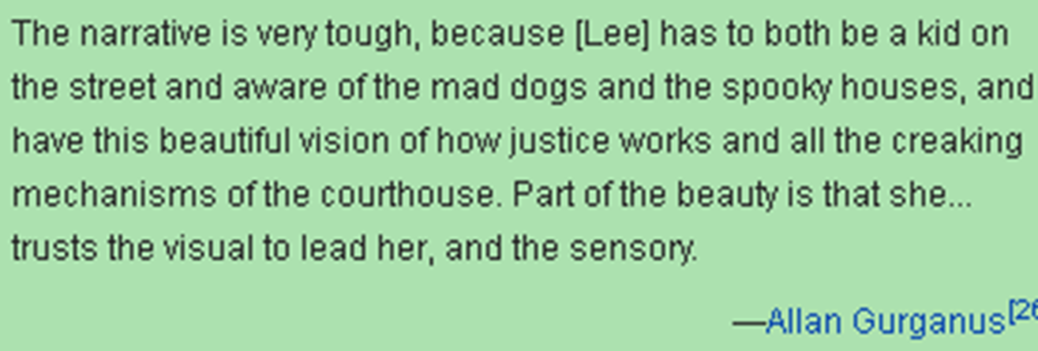
Style
The strongest element of style noted by critics and reviewers is Lee's talent for narration, which in an early review in Time was called "tactile brilliance". Writing a decade later, another scholar noted, "Harper Lee has a remarkable gift of story-telling. Her art is visual, and with cinematographic fluidity and subtlety we see a scene melting into another scene without jolts of transition”.

Slide 35
Stylistic features
Lee combines the narrator's voice of a child observing her surroundings with a grown woman's reflecting on her childhood, using the ambiguity of this voice together with the narrative technique of flashback to play intricately with perspectives.

Slide 36
Gender
Scholars have characterized To Kill a Mockingbird as both a Southern Gothic and coming-of-age or Bildungsroman novel.
The grotesque and near-supernatural are evident in the presence of Boo Radley and his house.
Outsiders are also an important element of Southern Gothic texts and Scout and Jem's questions about the hierarchy in the town cause scholars to compare the novel to Catcher in the Rye and Adventures of Huckleberry Finn.

Slide 37
Themes
Southern life
Racial injustice
Class
Courage
Compassion
Gender roles
Laws written and unwritten
Loss of innocence

Slide 38
Adaptation
1962 film
Main article: To Kill a Mockingbird (film)
I n 1962, the book was made into the well-received film with the same title, starring Gregory Peck as Atticus Finch.
The movie was a hit at the box office, grossing more than $20 million from a $2-million budget. It won three Oscars. It was nominated for five more Oscars including Best Actress in a Supporting Role for Mary Badham, the actress who played Scout.

Slide 39
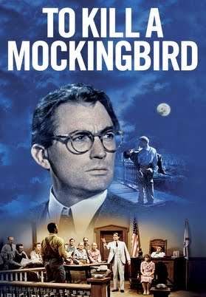


Slide 40
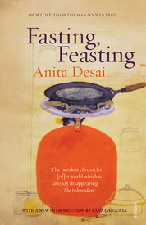

Slide 41
About the author
Anita Mazumdar was born in Mussoorie, India, to a German mother, Toni Nime, and a Bengali businessman, D. N. Mazumdar. She grew up speaking German at home and Bengali, Urdu, Hindi and English outside the house. She first learned to read and write in English at school and as a result English became her "literary language“. She began to write in English at the age of seven and published her first story at the age of nine.

Slide 42
…
She was a student at Queen Mary's Higher Secondary School in Delhi and received her B.A. in English literature in 1957 from the Miranda House of the University of Delhi.
The following year she married Ashvin Desai, the director of a computer software company and author of the book Between Eternities: Ideas on Life and The Cosmos.
They have four children, including Booker Prize-winning novelist Kiran Desai. Her children were taken to Thul (near Alibagh) for weekends, where Desai set her novel The Village by the Sea. For that work she won the 1983 Guardian Children's Fiction Prize, a once-in-a-lifetime book award judged by a panel of British children's writers.

Slide 43
Career
Desai published her first novel, Cry The Peacock, in 1963.
She considers Clear Light of Day (1980) her most autobiographical work as it is set during her coming of age and also in the same neighborhood in which she grew up.
In 1984 she published In Custody – about an Urdu poet in his declining days – which was shortlisted for the Booker Prize.

Slide 44
Career
In 1993 she became a creative writing teacher at Massachusetts Institute of Technology.
Her novel, The Zigzag Way, set in 20th-century Mexico, appeared in 2004.
Her latest collection of short stories, The Artist of Disappearance was published in 2011.

Slide 45
Career
Desai has taught at Mount Holyoke College, Baruch College and Smith College. She is a Fellow of the Royal Society of Literature, the American Academy of Arts and Letters, and of Girton College, Cambridge (to which she dedicated Baumgartner's Bombay). In addition, she writes for the New York Review of Books.

Slide 46
Selected works
The Artist of Disappearance (2011)
The Zigzag Way (2004)
Diamond Dust and Other Stories (2000)
Fasting, Feasting (1999)
Journey to Ithaca (1995)
Baumgartner's Bombay (1988)
In Custody (1984)
The Village by the Sea (1982)
Clear Light of Day (1980)
Games at Twilight (1978)
Fire on the Mountain (1977)
Cat on a Houseboat (1976)
Where Shall We Go This Summer? (1975)
The Peacock Garden (1974)
Bye-bye Blackbird (1971)
Voices in the City (1965)
Cry, The Peacock (1963)
Journey to Ithaca (1996)

Slide 47
THEMES IN FASTING, FEASTING
Gender and social roles
The pressures and expectations placed on the different characters in the novel show the contrast in the social roles men and women are expected to fulfill, both in India and in the United States. While men are expected to be hard working, academic, and successful, the social value of women is dependent on their submissiveness, domestic abilities, beauty and child bearing.

Slide 48
Women
Aruna and Uma are raised, educated, and groomed only with marriage in mind. When the multiple attempts of MamaPapa to arrange a marriage for Uma fail, it becomes Uma’s job to take care of her baby brother, Arun, and later her aging parents.
Mama’s identity is tied in with her role as the wife of an important man, and she seldom disagrees with him.
Anamika meets the social expectations of female submission—yet, abused to death, Anamika experiences the ultimate loss of freedom that threatens all women who are forced to fulfill the feminine ideal. Dr. Dutt and Mira-masi both represent women who, independent of family and men, defy female social roles.

Slide 49
Men
Men also lose their free will and individual expression to the social roles they must fill. As a child, Arun is showered with care and attention, unlike his neglected sister. Uma.
MamaPapa place high demands on Arun for him to work hard in school and achieve constantly, giving Arun no alternative path.
While Papa has the most authority in Uma’s household, his ego and pride are bound to his social role as a male head of the household. He cannot appear vulnerable, and so never forms genuine human connections.

Slide 50
American society
American society as portrayed in the novel also places gendered expectations onto its members, particularly in regards to male and female beauty. Mrs. Patton, like her daughter Melanie, is burdened by American ideals of female perfection and beauty, which are obsessed with dangerous degrees of thinness and over-tanning. Mr. Patton and Rod similarly fulfill the traditional Macho American stereotype of athleticism and hard work. Like Papa, Mr. Patton assumes passive control over the members of his household.

Slide 51
Family life and individual freedom.
At the heart of many of the character’s stories lies a common search for freedom to be oneself and to carve out one’s own life path. The needs and desires of the individual are in constant tension with the demands of the family, which is the central social institution throughout the novel.

Slide 52
Plenty/"Feasting" vs. Want/"Fasting"
Access to resources play a large factor in determining the quality of life and opportunity available to individual characters in the novel.
Plenty and want are not what they appear to be, and characters who seem to have much are often found wanting; likewise, those who seem to have little are rich in spiritual ways.
India is contrasted with America, and Uma’s lower middle class parents are contrasted with wealthier families in India.

Slide 53
Tradition/India vs. Modernity/West
Throughout the novel, we see conflict between old ways, or ‘tradition’ running against new ways, or ‘modernity’.
Most frequently, tradition is associated with India/Rural/Home/Extended Family/
Poverty/Fasting
Modernity is associated with Western/Urban/Individuality/Commercialism/Feasting.

Slide 54
Loneliness and Togetherness
The difference between loneliness and being alone is a tension that affects many characters throughout the novel.
Loneliness affects many characters—yet, togetherness, especially within families, doesn’t always solve the loneliness of the individual.
Balancing the needs for both community and solitude is a constant struggle, especially for Uma and Arun.

Slide 55
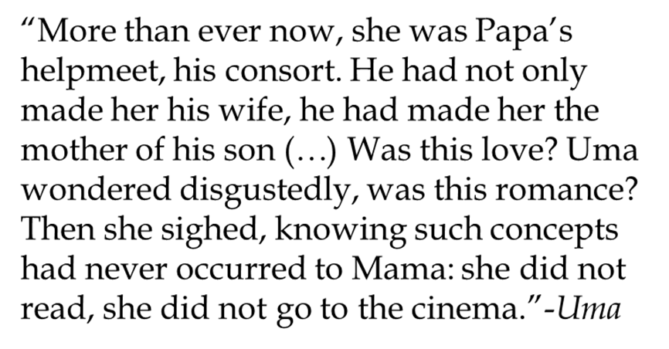
Characters
Uma: Oppressed heroine; the never-married daughter; enthusiastic about pursuing school; isn’t pretty, accomplished or flirtatious; loves people, poetry, and wandering; fearless and curious about new people.

Slide 56
Arun: Quiet, introverted baby brother of Uma, the youngest child; a vegetarian who shows no athletic prowess; fears being drawn into the judgment and expectations of others.

Slide 57
Aruna — Aruna is the pretty, confident, and socially ambitious younger sister of Uma and second daughter of Mama and Papa.
As a child, school comes easily to Aruna, though she takes no interest in it. While she is kind and helpful to Uma during their childhoods, she becomes snappy and superior when they approach adolescence, laughing at Uma's rejection by prospective husbands.

Slide 58
Mama — Mama is the wife of Papa and the mother of Uma, Aruna, and Arun. Mama is the picture of a proud, submissive wife, seldom expressing an opinion different than her husband's.
Papa — Papa is a proud, yet insecure middle-class legal magistrate, the husband of Mama and the father of Uma, Aruna and Arun.

Slide 59
Mrs. Patton — Mrs. Patton is the sister of Mrs. O'Henry, wife to Mr. Patton and mother of Rod and Melanie, and the host who invites Arun to stay with her and her family in Massachusetts. A suburban American stay-at-home mother, Mrs. Patton is obsessed with shopping, particularly for groceries.
Mr. Patton — Mr. Patton is the husband of Mrs. Patton, and the father of Melanie and Rod. Working full-time in an office, Mr. Patton leaves housekeeping and cooking to his wife, with the exception of the barbecue.

Slide 60
Melanie — Melanie is the daughter of Mr. and Mrs. Patton, and the sister of Rod. Struggling with bulimia and anorexia, Melanie is frequently bitter, angry, and difficult to talk to.
Rod — Rod is the son of Mr. and Mrs. Patton and the brother of Melanie. Even-tempered and unemotional, Rod betrays little reaction to the conflicts and tension within his home. He knows about Melanie's eating disorder.

Slide 61
Anamika — Anamika is the beautiful, graceful, intelligent daughter of Lily Aunty and Bakul Uncle, niece to MamaPapa and cousin to Uma. Kind and sweet, Anamika is everyone in the family's favorite girl, and as children, Uma and Aruna fight for her affections.
Lily Aunty and Bakul Uncle — Bakul Uncle is the brother of Papa, and Lily Aunty is his wife. Almost always mentioned together, Bakul Uncle and Lily Aunty have a marriage much like Mama and Papa's—neither one expresses a different will or opinion than the other.

Slide 62
Mira-Masi — Mira-masi is the widowed, religious wife of an elder cousin of Papa's family. She has dedicated her life to her worship of the Hindu god Shiva, and spends her days traveling the country, making pilgrimages to sacred rivers and temples.
Ramu — Ramu is the son of Lily Aunty and Bakul Uncle, brother of Anamika, and cousin to Uma. Rebellious and adventurous, Ramu is the "black sheep" of the family. Spending his youth traveling on the seas and throughout the country, Ramu disappears for long periods of time.

Slide 63

THINGS FALL APART
BY CHINUA ACHEBE

Slide 64
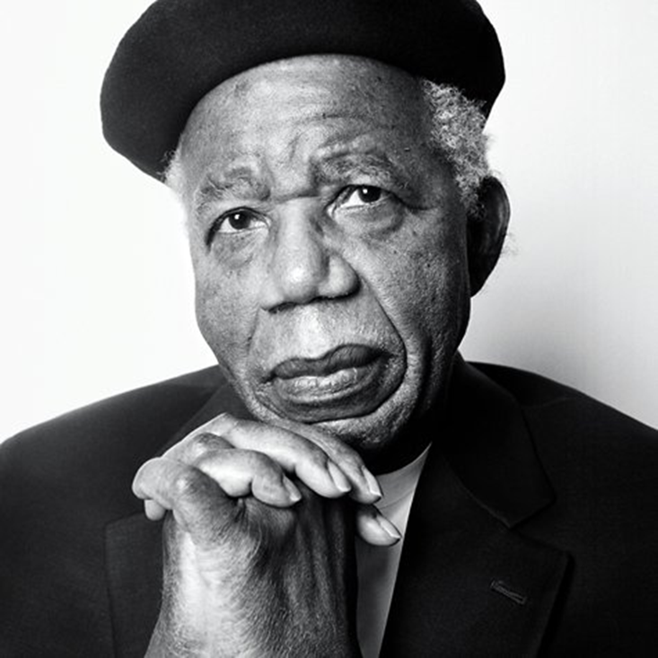
ABOUT THE AUTHOR
Chinualumogu Achebe; (16 November 1930 – 21 March 2013) was a Nigerian novelist, poet, professor, and critic. His first novel Things Fall Apart (1958) was considered his magnum opus, and is the most widely read book in modern African literature.

Slide 65
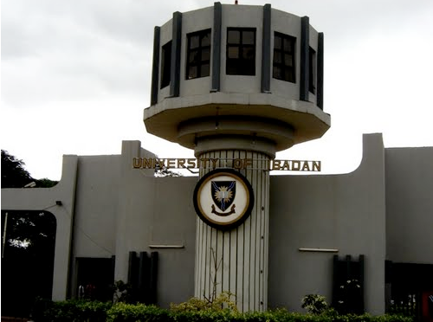
ABOUT THE AUTHOR
Raised by his parents in the Igbo town in South-Eastern Nigeria, Achebe excelled at school and won a scholarship for undergraduate studies at the University of Ibadan. He became fascinated with world religions and traditional African cultures, and began writing stories as a university student. He gained worldwide attention for Things Fall Apart in the late 1950s.

Slide 66
ABOUT THE AUTHOR
When the region of Biafra broke away from Nigeria in 1967, Achebe became a supporter of Biafran independence and acted as ambassador for the people of the new nation.
He lived in the United States for several years in the 1970s, and returned to the U.S. in 1990 after a car accident left him partially disabled.
From 2009 until his death, he served as David and Marianna Fisher University Professor and Professor of Africana Studies at Brown University.

Slide 67


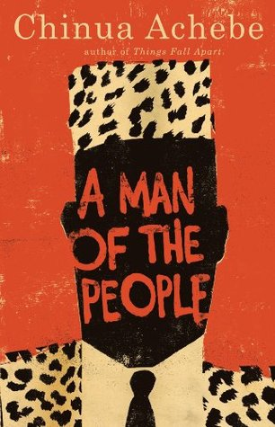
NOTABLE WORK
Things fall apart (1958)
No longer at ease (1960)
Arrow of God (1964)
A man of the people (1966)

Slide 68
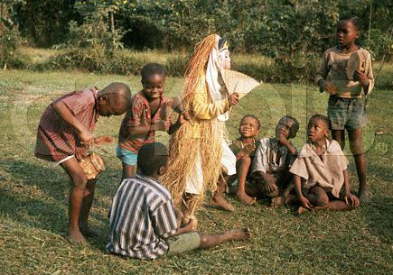
THE ORAL TRADITION IN HIS WORKS
The style of Achebe's fiction draws heavily on the oral tradition of the Igbo people. He weaves folk tales into the fabric of his stories, illuminating community values in both the content and the form of the storytelling.

Slide 69
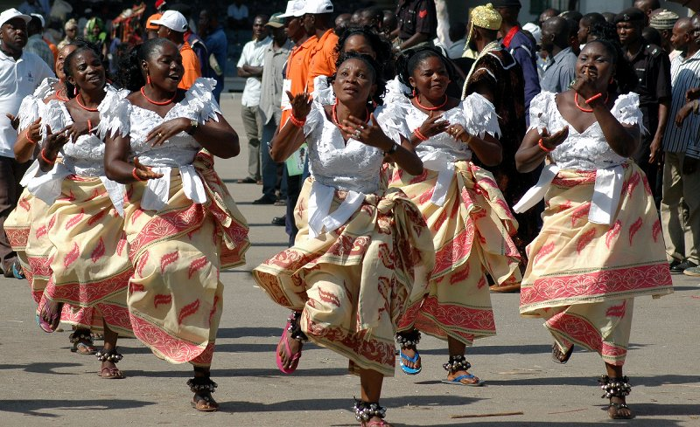
The tale about the Earth and Sky in Things Fall Apart, for example, emphasizes the interdependency of the masculine and the feminine. Achebe frequently includes folk songs and descriptions of dancing in his work.

Slide 70
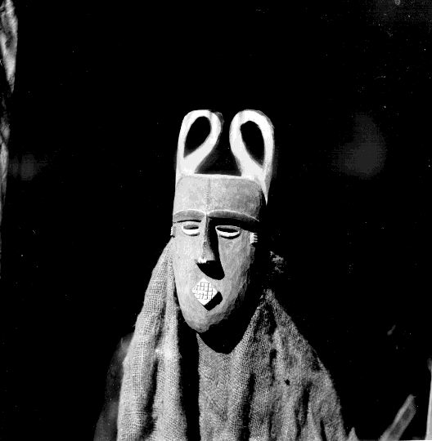
Another hallmark of Achebe's style is the use of proverbs, which often illustrate the values of the rural Igbo tradition. Critic Anjali Gera notes that the use of proverbs in Arrow of God "serves to create, through an echo effect, the judgement of a community upon an individual violation."

Slide 71
THE USE OF ENGLISH IN HIS WORKS
As the decolonization process unfolded in the 1950s, Achebe found his novels interrogated with extreme scrutiny with regard to his use of English.
The school of thought of Kenyan writer Ngũgĩ wa Thiong'o urged the use of indigenous African languages. English and other European languages, he said in 1986, were "part of the neo-colonial structures that repress progressive ideas".

Slide 72
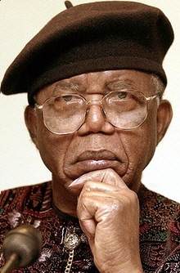
Achebe chose to write in English. In his essay "The African Writer and the English Language", he discusses how the process of colonialism – for all its ills – provided colonized people from varying linguistic backgrounds "a language with which to talk to one another".
As his purpose is to communicate with readers across Nigeria, he uses "the one central language enjoying nationwide currency". Using English also allowed his books to be read in the colonial ruling nations.

Slide 73
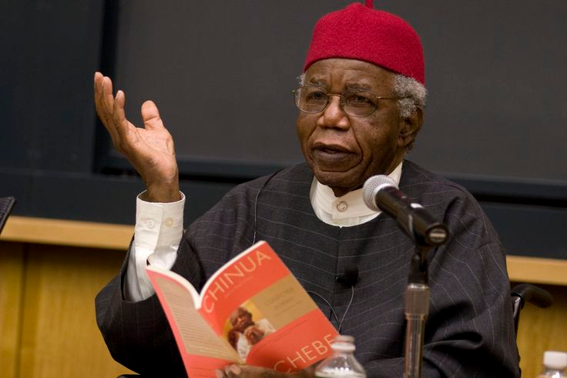
For an African writing in English is not without its serious setbacks. He often finds himself describing situations or modes of thought which have no direct equivalent in the English way of life.

Slide 74
As Chinua said:
“I feel that the English language will be able to carry the weight of my African experience. But it will have to be a new English, still in full communion with its ancestral home but altered to suit new African surroundings”

Slide 75
“The white man is very clever. He came quietly and peaceably with his religion. We were amused at his foolishness and allowed him to stay. Now he has won our brothers, and our clan can no longer act like one. He has put a knife on the things that held us together and we have fallen apart.”
― Chinua Achebe, Things Fall Apart

Slide 76

THINGS FALL APART
Written in 1958, it is seen as the archetypal modern African novel in English, one of the first to receive global critical acclaim. It is a staple book in schools throughout Africa. The title of the novel comes from a line in W. B. Yeats' poem "The Second Coming".

Slide 77
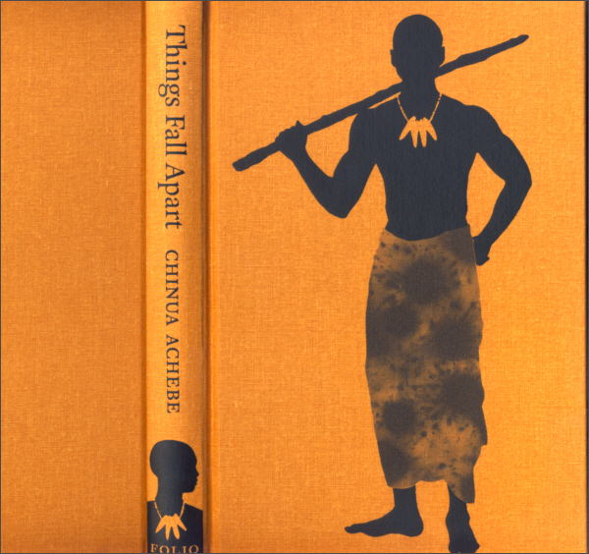
THINGS FALL APART
Considered Achebe's magnum opus, it has sold more than 8 million copies worldwide. Time Magazine included the novel in its TIME 100 Best English-language Novels from 1923 to 2005. The novel has been translated into more than fifty languages, and is often used in literature, world history, and African studies courses across the world.

Slide 78
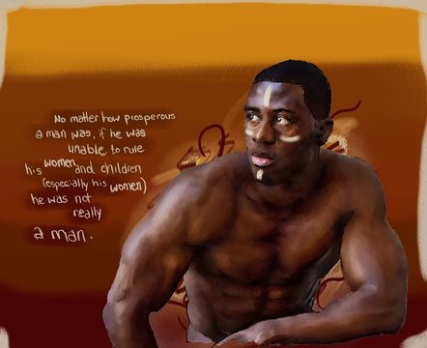
Okonkwo is an excellent, wonderfully human, central character: strong; headstrong; willful; proud. A traditionalist, he is acutely aware of the pitfalls of forgetting the past, but he is blind to the absurdities, cruelties and sheer backwardness of certain of his tribe's customs and of his own, sometimes outrageous, actions.

Slide 79
HISTORICAL BACKGROUND
Within forty years of the arrival of the British, by the time Achebe was born in 1930, the missionaries were well established. Achebe's father was among the first to be converted in Ogidi, around the turn of the century.
Achebe himself was an orphan raised by his grandfather. His grandfather, far from opposing Achebe's conversion to Christianity, allowed Achebe's Christian marriage to be celebrated in his compound.

Slide 80
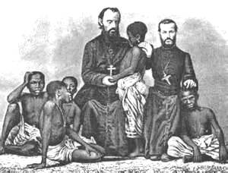
LITERARY SIGNIFICANCE
Ernest N. Emenyonu commented that "Things Fall Apart is indeed a classic study of cross-cultural misunderstanding and the consequences to the rest of humanity, when a belligerent culture or civilization, out of sheer arrogance and ethnocentrism, takes it upon itself to invade another culture, another civilization.”

Slide 81
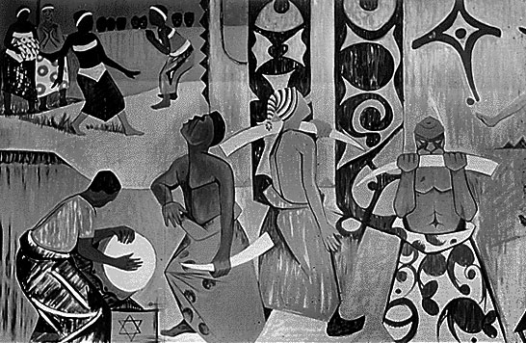
Achebe's writing about African society, in telling from an African point of view the story of the colonization of the Igbo, tends to extinguish the misconception that African culture had been savage and primitive. Achebe portrays a group of people with a religion, a government, a system of money, and an artistic tradition, as well as a judicial system.

Slide 82
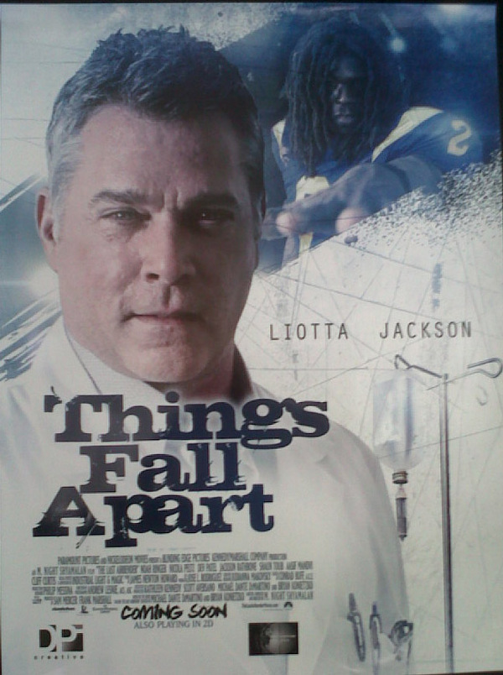
ADAPTATIONS
A dramatic radio program called Okonkwo was made of the novel in April 1961 by the Nigerian Broadcasting Corporation.
The book was made into a film in 1970.

Slide 83
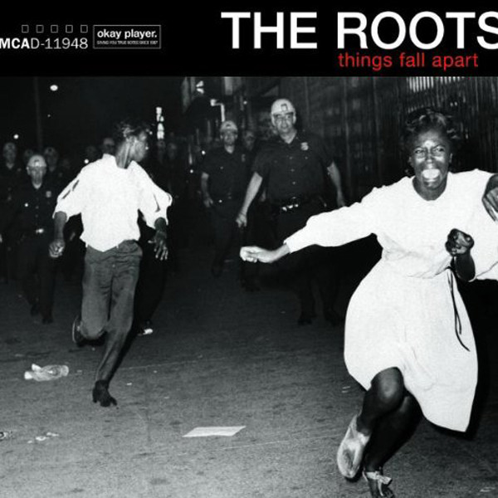
ADAPTATIONS
In 1987, the book was made into a very successful miniseries directed by David Orere and broadcast on Nigerian television by the Nigerian Television Authority
In 1999, the acclaimed American hip hop band The Roots released their fourth studio album Things Fall Apart as a tribute to the novel.

Slide 84
FUENTES Y REFERENCIAS EMPLEADAS
Jago, Carol et al. Literature & Composition: Reading - Writing – Thinking, Bedford/St. Martin's, USA, 2011
Pike, David L., Costa, Ana. Literature: A World of Writing Stories, Poems, Plays, and Essays, Pearson, USA, 2011.
Reaske, Christopher. How to Analize Poetry, Monarch Books, USA, 2014.
Roza, Greg. Patterns in Poetry: Recognizing and Analyzing Poetic Form and Meter, Rosen Publishing Group, USA, 2005.

Slide 85
Shanafelt, Collin. Literary Analysis & Essay Writing Guide, Gatsby's Light Publications, New York, 2012.
Stopbaugh, James P. Skills for Literary Analysis, Student’s Book, Master Books, USA, 2013.
Stopbaugh, James P. Skills for Literary Analysis, Teacher’s Book, Master Books, USA, 2013.
OBRAS ESTUDIADAS

Slide 86
Bibliografía:Obras Estudiadas
Achebe, Chinua. Things Fall Apart, Anchor, UK, 1994
Desai, Anita. Fasting Feasting, Mariner Books, USA, 2000
Golding, William. Lord of the Flies, Perigree Trade, London, 2011.
Lee Harper. To Kill a Mockingbird. Grand Central, New York, 1988
Naipaul. V.S. Miguel Street, Vintage, London, 2002.
Steinbeck, John. Of Mice and Men, Brawtley Press, USA, 2015.

