Slide 1
FACULTAD DE PLANEACIÓN URBANA Y REGIONAL
LICENCIATURA EN CIENCIAS AMBIENTALES
UNIDAD DE APRENDIZAJE: INGLÉS C2
Créditos institucionales de la UA: 6
Material visual: Diapositivas
Unidad de competencia I
PASSIVE VOICE
Elaborado por M. en C.E.F: Verónica Vilchis Esquivel
Semestre 2016-B

Slide 2
¿Cómo emplear este material?
El presente material tiene el propósito facilitar la exposición gráfica del tema “Passive voice” que se aborda en la unidad de aprendizaje I “Describing simple processes about environment” que corresponde al sexto semestre de la Licenciatura en Ciencias Ambientales, cuya área de docencia es Metodológica Instrumental y la sub área académica es Idioma.
La presentación deberá ir acompañada de una explicación oral del catedrático, ya que la aportación que éste pueda hacer mediante ejemplos y situaciones cotidianas brindará la oportunidad para que los estudiantes construyan su conocimiento de una forma sólida y bien soportada.

Slide 3

FUNCTIONS OF THE
PASSIVE VOICE
The passive voice is used to point out interest in the person, or object, experiencing the action rather than in the person or object which performs it.

Slide 4

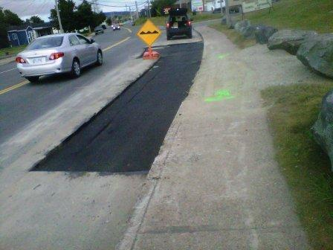
Example:
* The house was built in 2001 ( we are interested in the house, not in who built it).
Example:
* The road is being repaired. (we are interested in the road, not in the people who are repairing it).

Slide 5

Sometimes we use the passive voice because we do not know, or do not want to express, who performed the action.

Slide 6

Examples:
* I realised that the door had been left closed.
* Every year thousands of immigrants are killed in USA.
* All the cookies have been stolen.

Slide 7
The passive voice is often used in formal texts. By switching to the active voice it will help you express your ideas thus making it easier to understand them.

Slide 8
.
PASSIVE
ACTIVE
Waste materials are disposed of in a variety of ways.
Our planet is polluted with greenhouse gases.
The city disposes of waste materials in a variety ways.
Greenhouse gases pollute our planet.

Slide 9
If we want to say who or what performs the action, we will use the preposition:
BY

Slide 10

WARNING !
When we know who performed the action and we are interested on him / her, we can use BY, but it is better to use the ACTIVE VOICE.

Slide 11
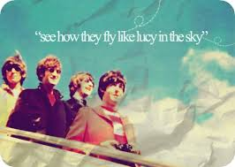
PASSIVE
ACTIVE
“Lucy in the sky with diamonds” was composed by the Beatles.
The Beatles composed “Lucy in the sky with diamonds”.

Slide 12
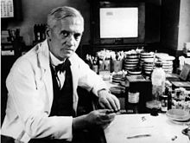
PASSIVE
ACTIVE
“Penicilin was discovered by Fleming”.
“Fleming discovered penicilin”.

Slide 13
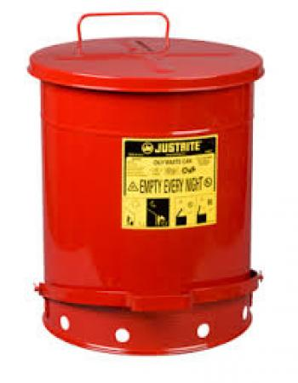
PASSIVE
ACTIVE
“These containers were designed by a scientist”.
“A scientist designed these containers”.

Slide 14
FORMING THE PASSIVE VOICE
VERB TO BE + PAST PARTICIPLE

Slide 15
VERB TO BE + PAST PARTICIPLE
It is necessary to use the verb TO BE in the appropriate tense, according to the context.

Slide 16
VERB TO BE + PAST PARTICIPLE
Simple Present:
to be + past participle
The streets are swept…

Slide 17
VERB TO BE + PAST PARTICIPLE
Present continuous:
to be + past participle
The streets are being swept…

Slide 18
VERB TO BE + PAST PARTICIPLE
Simple Past:
to be + past participle
The streets were swept…

Slide 19
VERB TO BE + PAST PARTICIPLE
Past continuous:
to be + past participle
The streets were being swept…

Slide 20
VERB TO BE + PAST PARTICIPLE
Present perfect:
to be + past participle
The streets have been swept…

Slide 21
VERB TO BE + PAST PARTICIPLE
Past perfect:
to be + past participle
The streets had been swept…

Slide 22
USING ACTIVE VOICE VERSUS PASSIVE VOICE
In a sentence using active voice, the SUBJECT performs the action expressed in the verb.
THE DOG bit the boy
subject

Slide 23
USING ACTIVE VOICE VERSUS PASSIVE VOICE
In a sentence using active voice, the SUBJECT performs the action expressed in the verb.
THE SCIENTIST has conducted an experiment.
subject

Slide 24
USING ACTIVE VOICE VERSUS PASSIVE VOICE
In a sentence using passive voice, the SUBJECT is acted upon, because he / she / it receives the action expressed in the verb.
THE EXPERIMENT has been conducted by the scientist.
object

Slide 25
USING ACTIVE VOICE VERSUS PASSIVE VOICE
In a sentence using passive voice, the SUBJECT is acted upon, because he / she receives the action expressed in the verb.
THE BOY was bitten by the dog.

Slide 26
EXERCISES:
* Identify the subject (agent), the verb (action) and the object in these sentences:
My father mixes garbage.
Subject: ___________
Verb: _____________
Object: ____________

Slide 27
ANSWER KEY
My father mixes garbage.
Subject: My father
Verb: mixes
Object: garbage

Slide 28
EXERCISES:
* Identify the subject (agent), verb (action) and object in these sentences:
The scavengers sell plastic.
Subject: ___________
Verb: _____________
Object: ____________

Slide 29
ANSWER KEY
The scavengers sell plastic.
Subject: The scavengers
Verb: sell
Object: plastic

Slide 30
EXERCISES:
* Identify the subject (agent), verb (action) and object in these sentences:
The president is opening the dump tomorrow.
Subject: ___________
Verb: _____________
Object: ____________

Slide 31
ANSWER KEY
The president is opening the dump tomorrow.
Subject: The President
Verb: is opening
Object: the dump

Slide 32
EXERCISES:
* Identify the subject (agent), verb (action) and object in these sentences:
The bridge was destroyed by the storm last night.
Subject: ___________
Verb: _____________
Object: ____________

Slide 33
ANSWER KEY
The bridge was destroyed by the storm last night.
Subject: the storm
Verb: was destroyed
Object: the bridge

Slide 34
EXERCISES:
* Identify the subject (agent), verb (action) and object in these sentences:
My hybrid car has been stolen! Call the police!!!!
Subject: ___________
Verb: _____________
Object: ____________

Slide 35
ANSWER KEY
My hybrid car has been stolen! Call the police!!!!
Subject: ---------
Verb: has been stolen
Object: My hybrid car

Slide 36
EXERCISES:
* Decide if these sentences are written in ACTIVE or PASSIVE VOICE.
That door WAS PAINTED yesterday. ___________
Michelangelo PAINTED the Sistine Chapel. ___________
Michael Schumacher DRIVES for Ferrari. ___________
In the UK, everyone DRIVES on the left. ___________
Inter-city trains ARE USUALLY DRIVEN by men. ___________

Slide 37
ANSWER KEY
That door WAS PAINTED yesterday. PASSIVE
Michelangelo PAINTED the Sistine Chapel. ACTIVE
Michael Schumacher DRIVES for Ferrari. ACTIVE
In the UK, everyone DRIVES on the left. ACTIVE
Inter-city trains ARE USUALLY DRIVEN by men. PASSIVE

Slide 38
EXERCISES:
* Write PASSIVE SENTENCES using the verbs in brackets.
I ___________________ (teach) by an old Japanese man.
This letter ____________________(should/type), not handwritten!
The documents _____________ (should/print) today.

Slide 39
ANSWER KEY
I WAS TAUGHT (teach) by an old Japanese man.
This letter SHOULD BE TYPED (should/type), not handwritten!
The documents SHOULD BE PRINTED today.

Slide 40
EXERCISES:
* Put the following ACTIVE sentences into PASSIVE VOICE.
The gardener has planted some trees.
______________________________________________
2) Paul has finished his assignment.
_______________________________________________

Slide 41
ANSWER KEY
The gardener has planted some trees.
Some trees have been planted by the gardener.
2) Paul has finished his assignment.
His assignment has been finished by Paul.

Slide 42
EXERCISES:
* Put the following ACTIVE sentences into PASSIVE VOICE.
3) They will advertise the product on TV.
______________________________________________
2) Someone is repairing the fence.
_______________________________________________

Slide 43
ANSWER KEY
3) They will advertise the product on TV.
The product will be advertised on Tv by them.
2) Someone is repairing the fence.
The fence is being repaired by someone.

Slide 44
Bibliografía
Oxenden, C. et. al. (2005). New English File Pre-intermediate, OUP
Elbaum, S. (2010). Grammar in Context (Vols. 1, 2 & 3) Heinle Cengage learning. 5th ed. USA
http://www.grammarbank.com/esl-passive-voice.html. Consultado en septiembre de 2016.
https://owl.english.purdue.edu/owl/owlprint/539/. Consultado en octubre de 2016.
http://www.edufind.com/english/english-gramar/passive-voice/. Consultado en septiembre de 2016.

