Slide 1

Universidad Autónoma del
Estado de México
Centro Universitario UAEM Valle de México
Ingeniería en Computación
Unidad de Aprendizaje Inglés C1
Describing factual events and expressing opinions dreams and hopes
First Conditional
Second Conditional
Octubre 2017
Guadalupe Yazmín Sosa Jiménez
Notes:
PORTADA 1

Slide 2

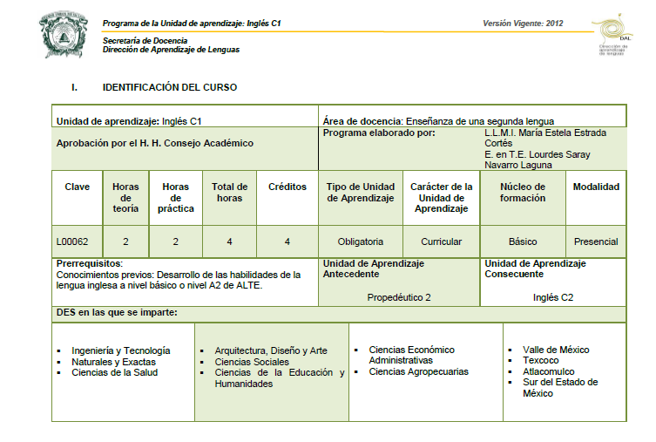

Notes:
INTERIORES

Slide 3
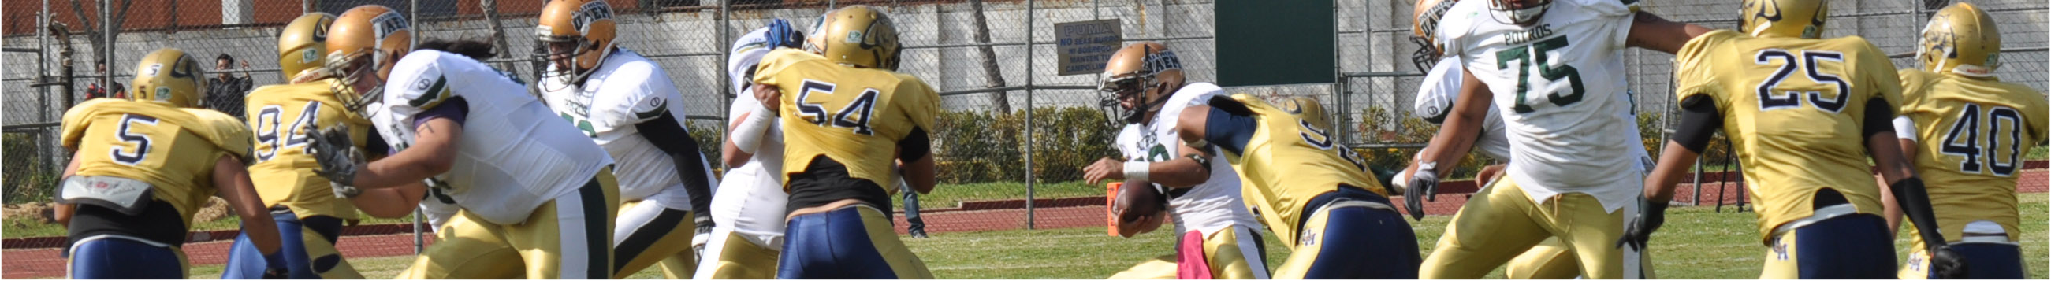

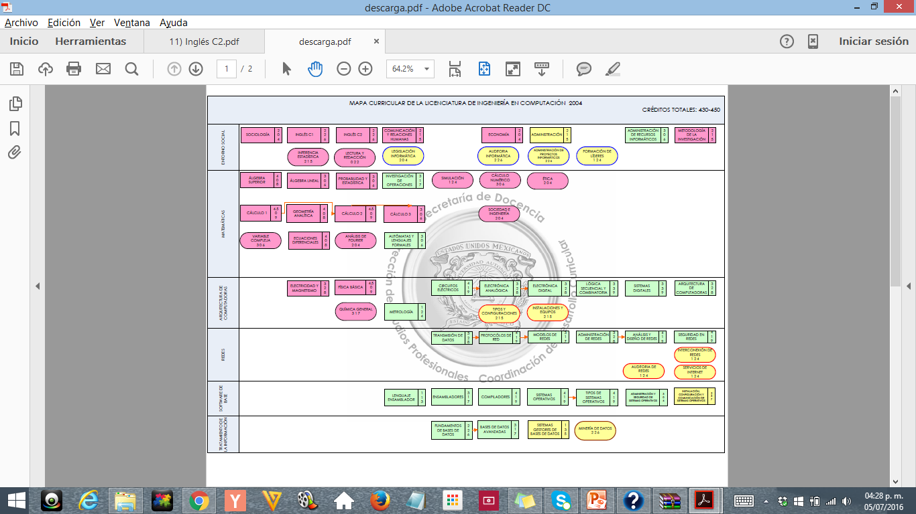
Notes:
INTERIORES

Slide 4
SCRIPT
This material contains an explanation about the correct use of First Conditional and Second Conditional, their structure and when to use each one of them. The first slides are based on the description of the form and meaning of the first grammar point.
This first part of the presentation, shows how First Conditional sentences must be formed in positive, negative and questions. You will find some examples and activities with their answer key.
Get advantage from it!
Best regards,
Notes:
INTERIORES

Slide 5
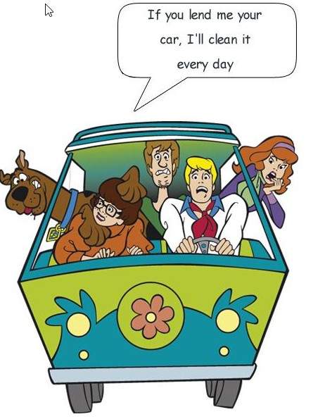
FIRST CONDITIONAL
First Conditional sentences are sometimes called the first or future conditional. Both clauses refer to the future, although the verb in the if clause is in a present tense.
For further information watch the following video:
https://www.youtube.com/watch?v=iT9osVd4G-A
If Clause | Conditional clause
If + present tense | Future tense
If it gets colder tonight, | I’ll turn on the heating.
Notes:
INTERIORES

Slide 6

Objective of the unit of competence
Students will be able to express a possible condition and a probable result in the future.
Notes:
INTERIORES

Slide 7
Contents
First Conditional
Describing dreams, hopes and ambitions
Describing real events
Expressing belief, opinion, agreement and disagreement politely
Notes:
INTERIORES

Slide 8

We often use First Conditional to express aspects of persuasion such as cajoling and negotiating and for giving warnings and making threats.
Persuasion: I’ll take the children to the party if you collect them from school.
Notes:
INTERIORES

Slide 9
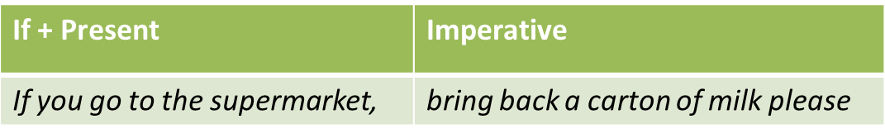
Warning: If you try to take a short cut, you’ll get lost.
Threat: If you poke your brother again, I’ll punish you.
Other forms:
We use an imperative rather than a future form of the verb in the conditional clause.
Notes:
INTERIORES

Slide 10
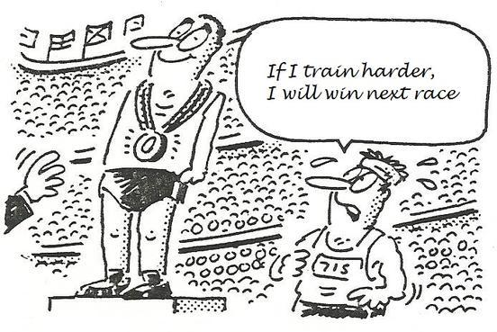
First Conditional sentences express the results of actions or conditions:
Real conditional sentences express factual or future results. When the result is future, use will in the result clause.
(A factual result: use present tense in both clauses)
If a hotel room has wireless Internet, guests don’t have to go to a business center to check e-mail.
If clause (the condition) | Result clause (the result)
If the business center is still open, | I’ll check my e-mail.
Notes:
INTERIORES

Slide 11

(A future result: Use present tense in the If clause and future with will in the result clause.)
If she checks in early, she’ll get the room she wants.
Questions:
If they don’t have a non-smoking room, will you stay at a different hotel?
Where will you go if they don’t have a room for tonight?
If there are not rental cars at the airport, what will they do?
Notes:
INTERIORES

Slide 12

Negative
For negative sentences the corresponding auxiliaries are used. In the first example, we can see that the negative part goes in the result clause.
In the following example, we can see that the negative part is in the If clause.
If clause (the condition) | Result clause (the result)
If it rains, | the children won’t go for a walk.
If clause (the condition) | Result clause (the result)
If Jenny doesn’t buy the book, | her friends will be angry with her.
Notes:
INTERIORES

Slide 13

Be careful!
Never use will in the if clause.
If you hurry, you’ll catch the shuttle. NOT if you will hurry, you’ll catch the suttle.
In conditional sentences, the clauses can be reserved with no change in meaning.
In writing, use a comma when the if clause comes first.
If the fitness center is still open, I’ll go swimming.
I’ll go swimming if the fitness center is still open.
Notes:
INTERIORES

Slide 14
First Conditional common mistakes
Common mistakes | Correct structure
If you will go to England, you will improve your English. | If you go to England, you will improve your English.
If I will see him, I'll tell him. | If I see him, I'll tell him.
I call him if I find his number. | If I find his number, I will call him.
If I will find his telephone number, I call him. | If I find his telephone number, I’ll call him.
I do some work in the garden if it not rains tomorrow. | I’ll do some work in the garden if it doesn’t rain tomorrow.
Notes:
INTERIORES

Slide 15
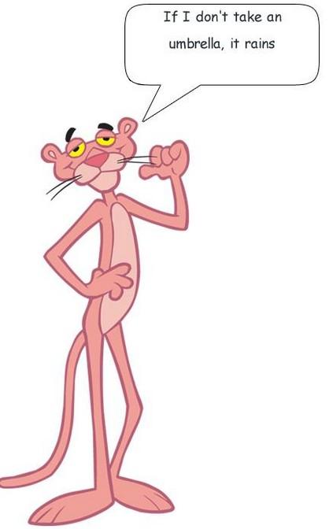
Exercises
Write factual if the conditional express a fact. Write future if it expresses a future result.
______ If you make your reservation in advance, you save a lot of money.
______ She’ll miss the 11:00 shuttle if she doesn’t check out early today.
______ If a guest is in a hurry, a taxi is faster than the shuttle.
______ We will call your room this evening if there are any messages.
______ If you request a suite, you usually get free breakfast.
______ You´ll have to pay a daily fee if you want wireless service.
Notes:
INTERIORES

Slide 16
Answer Key
Factual If you make your reservation in advance, you save a lot of money.
Future She’ll miss the 11:00 shuttle if she doesn’t check out early today.
Factual If a guest is in a hurry, a taxi is faster than the shuttle.
Future We will call your room this evening if there are any messages.
Factual If you request a suite, you usually get free breakfast.
Future You´ll have to pay a daily fee if you want wireless service.
Notes:
INTERIORES

Slide 17
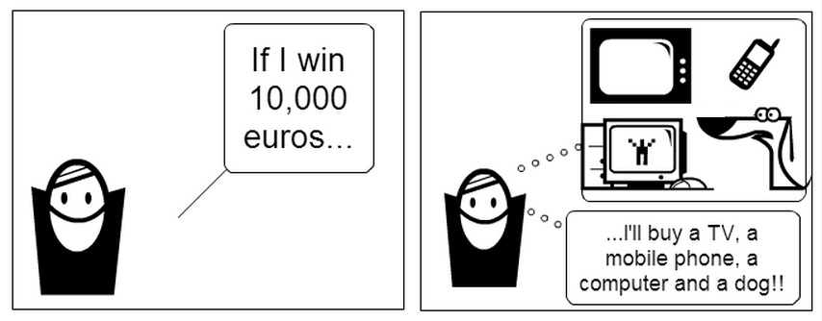
Exercises
Instructions: Complete the real conditional statements and questions with correct forms of the verbs.
_____________ to order breakfast at the restaurant if _____________.
you/not/be able you/ not/ hurry
2. If _____________ a suite on their next cruise, _____________ a lot more comfortable.
They/ get They/ be
3. _____________ a room with a king size bed if _____________ affordable?
you/reserve it/be
4. _____________ me a hand if _____________ help with my luggage?
someone/ give I/ need
5. Who _____________ if _____________ laundry service?
we/ call we/ need
Notes:
INTERIORES

Slide 18
Answer Key
Instructions: Complete the real conditional statements and questions with correct forms of the verbs.
You won’t be able to order breakfast at the restaurant if you don’t hurry.
If they get a suite on their next cruise, they will be a lot more comfortable.
Will you reserve a room with a king size bed if it is affordable?
Will someone give me a hand if I need help with my luggage?
Who will we call if we need laundry service?
Notes:
INTERIORES

Slide 19
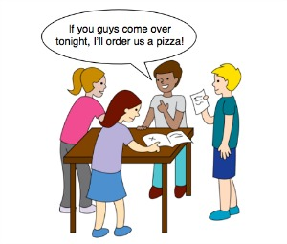
Matching activity
Match the two sentences halves and write a-h next to the numbers 1-8.
1. ___If they don’t stop that noise, | a. unless I have to babysit.
2. ___ If you can’t repair your headphones, | b. I'll go next door and complain.
3. ___ Ice cream melts | c. you will need to buy new ones.
4. ___ I'll see you on Saturday night | d. if you fancy a chat.
5. ___ Call me | e. if you don't keep it in the freezer
Notes:
INTERIORES

Slide 20
Answer Key
1. b If they don’t stop that noise, | a. if I have to babysit.
2. c If you can’t repair your headphones, | b. I'll go next door and complain.
3. e Ice cream melts | c. you will need to buy new ones.
4. a I won’t see you on Saturday night | d. if you fancy a chat.
5. d Call me | e. if you don't keep it in the freezer
Notes:
INTERIORES

Slide 21

Exercises
Instructions: Complete the statements with correct forms of the verbs.
If you (wash) __________ the dishes, I (cook) __________ dinner tonight.
If my dad (have) __________ time next week, we (paint) __________ my room.
You (learn) __________ a lot about American history if you (visit) __________ the exhibition.
If the weather (be / not) __________ too bad tomorrow, we (play) __________ golf.
We (get / not) __________ there on time if we (catch / not) __________ the bus.
Notes:
INTERIORES

Slide 22
Answer Key
Instructions: Complete the statements with correct forms of the verbs.
If you wash the dishes, I will cook dinner tonight.
If my dad has time next week, we will paint my room.
You will learn a lot about American history if you visit the exhibition.
If the weather isn’t too bad tomorrow, we will play golf.
We won´t get there on time if we don’t catch the bus.
Notes:
INTERIORES

Slide 23
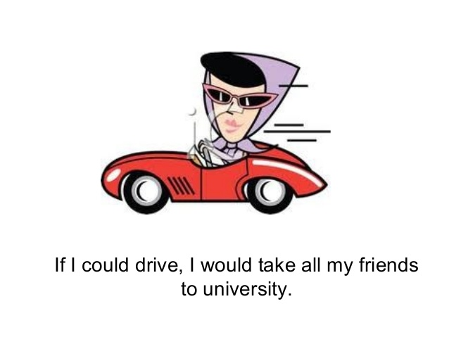
This is the second part of the material in which you will find some reference about Second Conditional. The first slides are based on the explanation of the structure and its use. After the explanation, you will find some excercises about Second Conditional with their corresponding answer key.
Notes:
INTERIORES

Slide 24
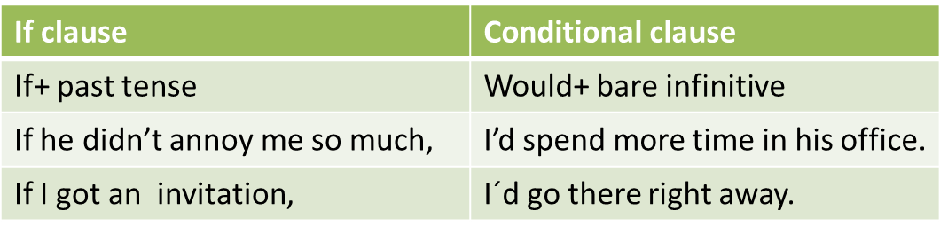
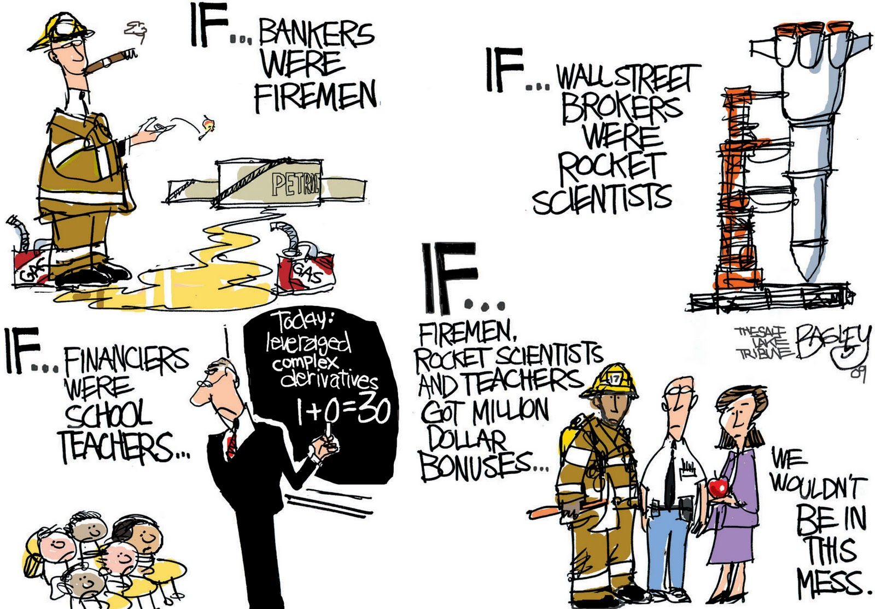
SECOND CONDITIONAL
Second Conditional sentences are sometimes called the “hypothetical” or “unreal” conditional. We use them to refer to or speculate about something that is (or that perceive to be) impossible or “contrary to fact”. They can refer to the present or the future.
Notes:
INTERIORES

Slide 25

We have to keep on mind that Second Conditional is used to talk about an impossible or improbable situations, we can use if and the past simple together with would and the infinitive.
Positive structure
If clause (the condition) | Result clause (the improbable result)
SIMPLE PAST | WOULD + INFINITIVE
If you lost your passport, | it would take ages to get another one.
Notes:
INTERIORES

Slide 26

Negative structure
If clause (the condition) | Result clause (the improbable result)
SIMPLE PAST (negative) | WOULD + INFINITIVE
If I didn’t work in this company, | I would get another one.
If clause (the condition) | Result clause (the improbable result)
SIMPLE PAST | WOULD (negative) + INFINITIVE
If I had a car, | I wouldn’t arrive late to class.
Notes:
INTERIORES

Slide 27
Questions
Result clause (the improbable result) | If clause (the condition)
WOULD + INFINITIVE | SIMPLE PAST
What would you do | If you won the lottery?
If clause (the condition) | Result clause (the improbable result)
SIMPLE PAST | WOULD + INFINITIVE
If you were a famous person, | Who would you be?
Notes:
INTERIORES

Slide 28

Exercises
Match the sentence halves to make a complete sentence.
If you did more excercise, you ________healthier.
If I didn’t work , I ________ have any money
My French ________ if I lived in France for six months
If Paul ________ nicer, more people would like him
If we ________ less electricity, we’d save money
‘d be
were
wouldn’t
used
would improve
Notes:
INTERIORES

Slide 29
Answer key
Match the sentence halves to make a complete sentence.
If you did more excercise, you ‘d be healthier.
If I didn’t work , I wouldn’t have any money
My French would improve if I lived in France for six months
If Paul were nicer, more people would like him
If we used less electricity, we’d save money
Notes:
INTERIORES

Slide 30
Exercises
Complete the following sentences using Second Conditional.
If he (have) ___________ more time, he ___________ (learn) karate.
If they (tell) ___________ their father, he (be) ___________ very angry.
She (spend) ___________ a year in the USA if it (be) ___________ easier to get a green card.
If I (live) ___________ on a lonely island, I (run) ___________ around naked all day.
My brother (buy) ___________ a sports car if he (have) ___________ the money.
Notes:
INTERIORES

Slide 31
Answer Key
Complete the following sentences using Second Conditional.
If he had more time, he would learn karate.
If they told their father, he would be very angry.
She would spend a year in the USA if it were easier to get a green card.
If I lived on a lonely island, I would run around naked all day.
My brother would buy a sports car if he had the money.
Notes:
INTERIORES

Slide 32

Exercises
Second Conditional is used to talk about unreal situations in the present (things that are impossible, that won't happen, etc.) - Choose the correct response for each of the sentences:
If his nose were smaller, he _________ very handsome. (would be/ was)
I would come if I _________ a car. (would have/ had)
I ________ on a trip around the world if I won the lottery. (would go/ will go)
I ________ that if I were you. (will not do/ would not do)
If these walls _________ thicker, we wouldn't hear the neighbors. (would be/ were)
Notes:
INTERIORES

Slide 33
Answer Key
If his nose were smaller, he would be very handsome.
I would come if I had a car.
I would go on a trip around the world if I won the lottery.
I would not do that if I were you.
If these walls were thicker, we wouldn't hear the neighbors.
Notes:
INTERIORES

Slide 34

Exercises
Instructions: Complete the statements with the second conditional.
If I (have) __________ more time, I (learn) __________ to play the guitar.
If she (study) __________ harder, she (get) __________ better marks.
If we (know) __________ more about history, we (be / not) __________ afraid of the test.
I (go) __________ jogging with Tom and Sue if they (be) __________ here this week.
It (surprise) __________ me if she (help / not) __________ you.
Notes:
INTERIORES

Slide 35
Answer key
Instructions: Complete the statements with the second conditional.
If I had more time, I would learn to play the guitar.
If she studied harder, she would get better marks.
If we knew more about history, we wouldn’t be afraid of the test.
I would go jogging with Tom and Sue if they were here this week.
It would surprise me if she didn’t help you.
Notes:
INTERIORES

Slide 36
FIRST AND SECOND CONDITIONAL EXERCISES
Complete the following excercises using first or second conditional.
If you are late again, you _________ (have) problems with the boss.
I would go to Rome next summer if you _________ (come) with me.
What _________ you _________ (do) if you _________ (find) 1 million pesos.
Do you think I _________ (lose) weight if I eat less pasta?
Don’t worry. The dog _________ (get) better if you _________ (give) it the medicine.
Notes:
INTERIORES

Slide 37
Answer Key
Complete the following excercises using first or second conditional.
If you are late again, you will have problems with the boss.
I would go to Rome next summer if you came with me.
What would you do if you found 1 million pesos.
Do you think I will lose weight if I eat less pasta?
Don’t worry. The dog will get better if you give it the medicine.
Notes:
INTERIORES

Slide 38
FIRST AND SECOND CONDITIONAL EXERCISES
Complete the following exercises using first or second conditional.
If he _______________________(have) time, he will come.
If I was offered the job, I think I _______________(take) it.
If she ______________(be) hungry, she would eat something.
If he studied, he ___________________ (pass) the exam.
What will John do, if he ___________________(not get) the job?
Notes:
INTERIORES

Slide 39
ANSWER KEY
Complete the following exercises using first or second conditional.
If he has time, he will come.
If I was offered the job, I think I would take it.
If she were hungry, she would eat something.
If he studied, he would pass the exam.
What will John do, if he doesn’t get the job?
Notes:
INTERIORES

Slide 40
References:
http://dep.uaemex.mx/
http://speakspeak.com/resources/english-grammar-rules/conditionals/structure-and-usage-of-first-conditional
http://www.bbc.co.uk/worldservice/learningenglish/radio/specials/1159_gramchallenge38/
https://elt.oup.com/student/solutions/preint/grammar/grammar_08_012e?cc=mx&selLanguage=en
https://www.learnenglishfeelgood.com/grammar-secondconditional2.html
https://images.google.com/
Notes:
INTERIORES

Slide 41

Guadalupe Yazmín Sosa Jiménez
Centro Universitario
UAEM Valle de México
Notes:
CONTRAPORTADA

Slide 42
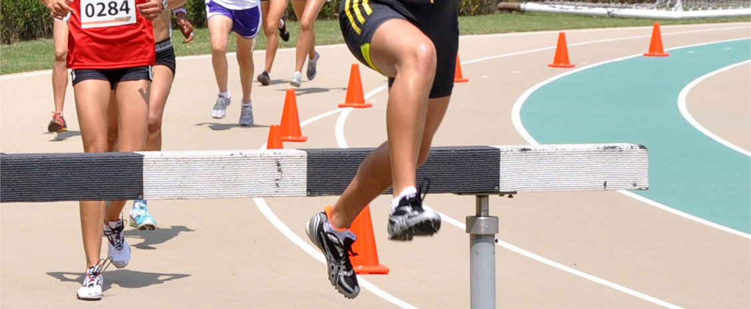


Octubre 2017
Notes:
PORTADA 2

