Slide 1
Identificación del material didáctico
Apoyo a UA Lengua Inglesa VII
Autor: Luis Juan Solís Carrillo
Tipo: Material proyectable, solo visión.
UA: Lengua inglesa VII
Clave: L32008
Programa: Licenciatura en lengua inglesa
Material diseñado y empleado en semestre 2017A
Facultad de lenguas, UAEMEX
Créditos 9
UNIDADES DE COMPETENCIA I-VI

Slide 2
ÍNDICE
Guion 3-11
Abreviaturas empleadas en material proyectable 12
Unidad de competencia I (UC I) Temas 13-20
Unidad de Competencia II (UC II) Temas 21-32
Unidad de Competencia III (UC III) Temas 33-40
Unidad de Competencia IV (UC IV) Temas 41-50
Unidad de Competencia V (UC V) Temas 51-62
Unidad de Competencia VI (UC VI) Temas 63-79
BIBLIOGRAFÍA FUNDAMENTAL 80-81

Slide 3
Guion explicativo, parte 1
Como parte de la formación de traductores o docentes de lengua inglesa, la UA lengua inglesa VII desempeña un papel fundamental. Lengua inglesa VII se ubica aproximadamente en los niveles B2/C1 del Marco común de referencia. Esto significa que el estudiante ha adquirido un grado intermedio superior o avanzado del idioma inglés, lo cual le permite leer textos con un alto grado de dificultad, escribir con propiedad artículos, ensayos, reseñas, etcétera.

Slide 4
Guion explicativo, parte 2
Del mismo modo, este nivel implica que el estudiante puede expresarse con fluidez y exactitud en muchos temas. Por otra parte, su comprensión auditiva es avanzada, lo cual le permite entender e interpretar los contenidos de diálogos o monólogos acerca de una gran diversidad de temas, a una velocidad natural de enunciación.

Slide 5
Guion explicativo, parte 3
El presente material de apoyo se traza como objetivo expander y consolidar las habilidades lingüísticas de los estudiantes que cursan la UA, ya sea con énfasis en docencia o en traducción. Se trata de una guía de apoyo únicamente, por lo que no constituye sustituto alguno del papel del docente o del empleo de otros materiales, como lo son los libros de texto, los cuadernos de ejercicios o los discos compactos del curso.

Slide 6
Guion explicativo, parte 4
Por lo antes señalado, este material sirve como un auxiliar en la presentación de los diversos temas y contenidos programáticos de la UA. Así pues, el material puede usarse antes, durante o al final de la exposición de los contenidos del curso, es decir, como una forma de introducir el tema o para darle mayor solidez. A continuación se presenta una lista de sugerencias para su buen uso como apoyo didáctico en clase.

Slide 7
Guion explicativo, parte 5
Al comienzo de cada unidad del programa, el docente puede emplearlo para que los estudiantes deriven las reglas implícitas en una determinada estructura sintáctica o bien deriven el significado de elementos léxicos.
Las diapositivas pueden usarse al finalizar cada unidad del programa, a modo de refuerzo, para dar mayor profundidad a los conocimientos adquiridos.
Un punto importante es que el material de apoyo invita al estudiante a crear y a emplear con naturalidad las nuevas estructuras que presentan las diapositivas. Se trata, pues, de una especie de generador de estructuras, frases u oraciones.

Slide 8
Guion explicativo, parte 6
Las diapositivas pueden usarse como un medio para corroborar predicciones de los estudiantes, es decir, se les solicita que den una lista de reglas de uso y de formación para un determinado aspecto gramatical. Una vez hecho esto, se muestra la diapositiva que confirma las aportaciones de los estudiantes.
El material recomienda la participación y el trabajo en pares o en grupos de no más de cuatros personas. Así, las diapositivas pueden servir para crear “dramatizaciones” en las que se pongan en práctica los nuevos conocimientos adquiridos.

Slide 9
Guion explicativo, parte 7
Un punto importante del material es que invita al estudiante a buscar, de forma personal, soluciones y respuestas a problemas de orden lingüístico sin que el docente posea la totalidad del conocimiento o la respuesta a cada pregunta.
Es necesario que el material de apoyo se emplee en cada una de las habilidades lingüísticas; por ejemplo, una vez comprendido un cierto aspecto de la lengua, se pide la redacción de un artículo, carta o propuesta, entre otros textos, con el fin de que lo visual invite a la escritura. De igual forma, el material se complementa con los contenidos del libro del curso o del cuaderno de trabajo. Así, se alcanza una mejor integración en el uso de las herramientas pedagógicas.

Slide 10
Guion explicativo, parte 8
  Es correcto que el docente decida no emplear todas las diapositivas cuando considere que los estudiantes ya poseen un buen dominio de algún determinado tema del programa. Dicho de otra forma, este material proyectable no tiene una naturaleza unidireccional y unívoca, por lo que el docente tiene la libertad para inventar el uso que más convenga a las necesidades del grupo.

Slide 11
Guion explicativo, parte 9
En las diapositivas introductorias al tema, concepto po ejercicio se aclara la Unidad de que competencia correspondiente, también llamada “módulo”.
De igual forma, se señala la naturaleza específica que se trata en cada caso. En ocasiones, será comprensión escrita, expresión oral, etcétera.
Incluso, si se trabaja a la par que el audio o el libro del curso, este material puede complementar la comprensión auditiva.
A continuación se desglosan las abreviaturas empleadas, con el fin de facilitar el uso por parte del docente.

Slide 12
ABREVIATURAS EMPLEADAS EN ESTE MATERIAL PROYECTABLE:
Use of English/Grammar (UE)
  Expresión oral (EO)
  Expresión escrita (EE)
  Comprensión auditiva (CA)
  Comprensión escrita (CE)
  Unidad de competencia o módulo del programa (UC)
  Las diapositivas indican, sin limitarse a ello, el área de énfasis de habilidad lingüística para los diversos ejercicios.
  UNIDADES DE COMPETENCIA I-VI

Slide 13
Approximating expressions:
(EO) UC I
It cost me three pound fifty something.
It took around two weeks or something like that.
There were just under / over / roughly / upwards of / somewhere in the region of / some two thousand people there.
I've been here for twenty odd years.
We'll leave at sixish / seven thirtyish.

Slide 14

She won´t tell us how old she is
But she’s thirtyish, at least. EO / UC I

Slide 15
Continuous forms can be used to:
Describe actions in progress at a specific time which is either stated or understood. (EO, EE, CO, CA, UE) UC I
  He was cooking his dinner when I phoned.
Talk about an activity that has recently stopped:
  It looks as though it's been raining here.
Emphasize repetition, duration or the temporary nature of an event:
  I've been trying to speak to him for weeks.
  She's only working there this month.

Slide 16
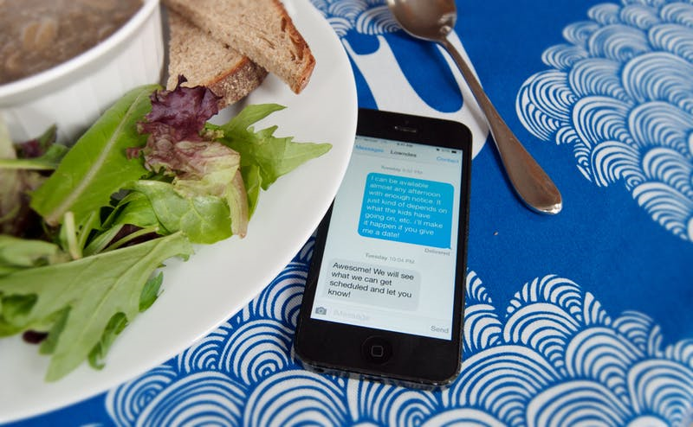
He was having dinner when he got a message.
UC I /UE, EO.

Slide 17
Talk and ask about arrengements or plans. UC I
(UE, EO, EE, CA, CE)
  I'm playing tennis with Paul tomorrow.
  Will you be going into town later?
Describe change and development:
  The weather's changing – it's getting cold again.

Slide 18
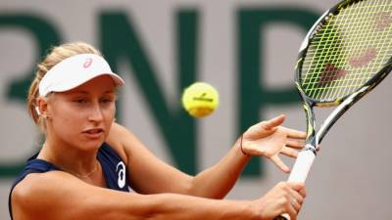
I am playing tennis with Paul Tomorrow

Slide 19
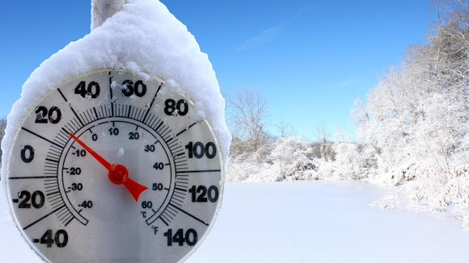
It’s getting cold again UC I, EO

Slide 20
Simple forms can be used to:
UC II, (UE, EE, CA, CE, EO)
Describe single or habitual actions, or repeated actions with a stated frequency or number:
  I often went to France as a child.
  You've told me that three times today!
Describe states:
  I think I know what she wants for Christmas.

Slide 21

I often went to France as a child…
UC II, EO, EE, UE

Slide 22
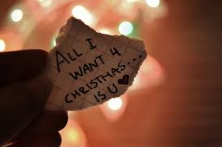
Simple forms can be used as in this example:
UC II, UE

Slide 23
Some state verbs can be used in the continuous form, but with a change in meaning:
  The situation appears to be improving. ( = seems)
  Janet Burns is currently appearing in The Flame at the Gilbert Theatre. ( = is performing)
Some others can be used in either simple or continuous form with no change in meaning:
  I feel/'m feeling terrible. My back really aches / is really aching.
  (UE, EO) Unidad de competencia (o módulo) II

Slide 24
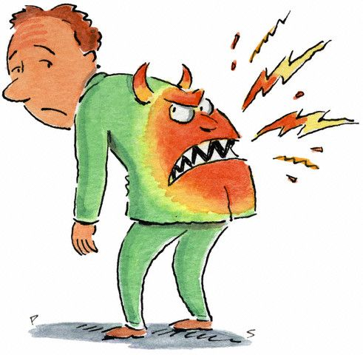
My back is really aching! UC II, EO

Slide 25
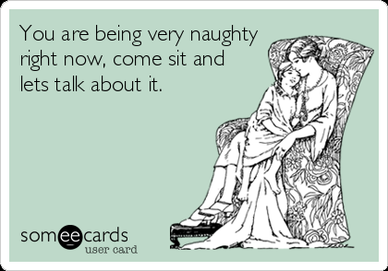

This continuous form can also be used as in the example below.
UC II , UE
What’s the difference in meaning in the two pictures?

Slide 26
Reference
and Substitution:
Reference: Use this, that, these, those before nouns or on their own to refer back to previously stated ideas:
  They were delighted at this news and...
  ...in the 1980s. In those days there were no fridges.
  UC II (UE, EE, CA, CE, EO)

Slide 27

There were no fridges in those days

Slide 28
Substitution: Use the following to substitute and avoid repetition of previously-used words and clauses: then, there, one(s), so, not, neither, nor, do, does, did.
  'I'm not sleeping as well as I did on holiday'. ( = slept)
  'Is it raining?' 'I think so.' ( = it is raining)
  I don't eat meat and neither does Elisa.
  ( = Elisa doesn't eat meat either).
  (UE, EE, CA, CE, EO) UC II

Slide 29
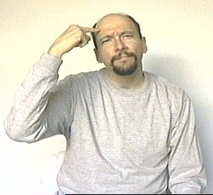
I think so

Slide 30
INFINITIVES, HOW TO USE THEM… UC II, UE
Use the full infinitive (with to):
  to express purpose:
    I drink water at work to improve my concentration.
  After certain adjectives, eg easy, surprised, likely.
  After certain verbs, eg agree, hope, refuse. (1)
  After certain nouns, eg ability, decision, effort. (2)

Slide 31
INFINITIVES, HOW TO USE THEM
Use the bare infinitive (without to):
After modal verbs. UC II
After these verbs: help, make, let, had better.
NB: The infinitive with to is also possible after help.
(UE)

Slide 32
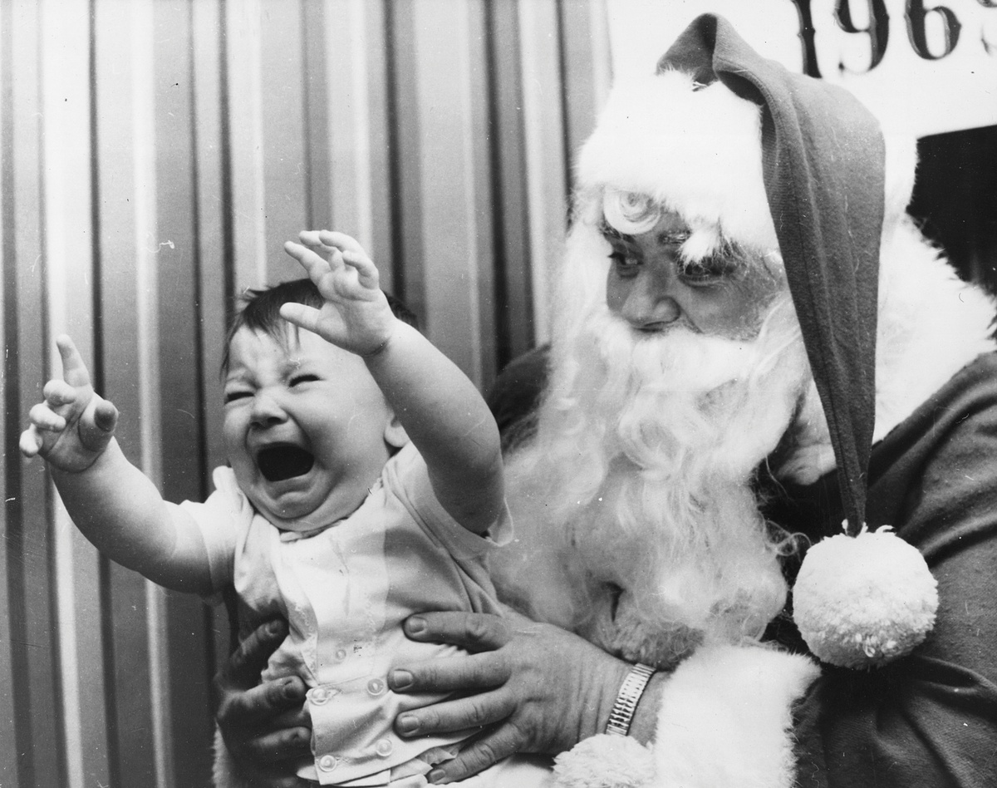
You’d better not cry.
Santa Claus is coming
tonight

Slide 33
THE GERUND, WHEN AND HOW TO USE IT (UE), UC III
  As the subject of a sentence or clause.
    Drinking water at work improves my concentration.
  After prepositions:
  It’s a gadget for peeling apples
  After certain verbs, eg appreciate, consider, deny:
  He denied having stolen the funds
  After have difficulty (in), it's no use, it's (not) worth, can't help:
  I can’t help falling in love with you

Slide 34

I cant help falling in love with you…UC III

Slide 35
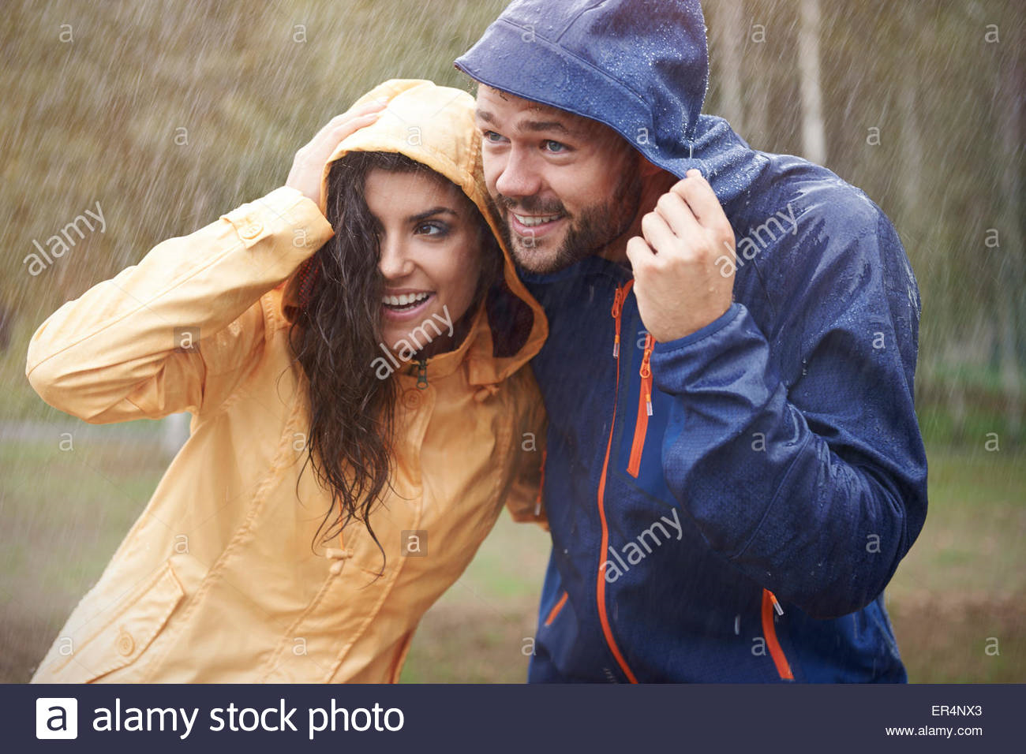
THE GERUND HOW AND WHEN TO USE IT…
UC III (UE, EE, CA, CE, EO)
Some verbs can be followed by either the gerund or infinitive:
With NO CHANGE in meaning, eg begin, continue, started.
Then It started raining…
Then it started to rain…

Slide 36
THE GERUND WHEN AND HOW TO USE IT
Gerund or Infinitive or both?
With a change in meaning: forget, go on, regret.
UC III (UE)

Slide 37


Can you explain the difference in meaning?
She went on writing ≠ He went on to write.
UC III(UE)

Slide 38
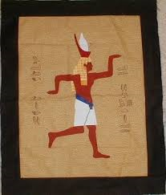
Comparatives UC III (UE)
Use like with nouns, pronouns or gerunds; use as with verb phrases.
  You all sit in this car, a bit like a rollercoaster car.
  If you work at home as I do/like me, you'll know how lonely it can get.
I WALK LIKE AN EGYPTIAN

Slide 39

Comparatives (UE) UC III
Use the + comparative, the + comparative when one thing is the result of another.
The more I hear the song, the better it sounds.

Slide 40
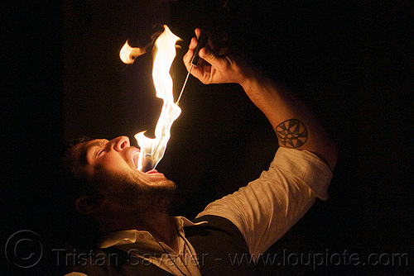
Use as + adjective/adverb + as to show similarities and not as/not so to show differences. Use not such with nouns/noun phrases:
  It's not as cold as yesterday. (UE, EE, CA, CE, EO) UC IV
It's not such a bad idea as it looks...

Slide 41
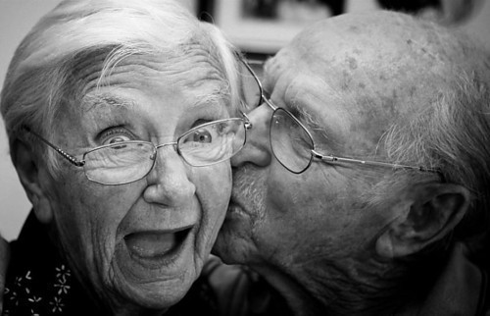
More Comparisons… UC IV (UE, EE, CA, CE, EO)
Use these words to modify comparisons. Before comparatives:
A little/slightly/much/(quite) a lot/far/three times, four times etc/a great deal
I came out a lot poorer than when I went in.
They were far older than most couples.
Oh, Tom. You are much younger than all of my ex boyfriends!

Slide 42
NOW, A FEW SUPERLATIVES UC IV
(UE, EE, CA, CE, EO)
Before superlatives:
  You can intensify adjectives by adding these phrases: by far, easily, far and away:
    It was by far the best day I've spent in a museum for a long time.

Slide 43

Use by far as in this example (EO) UC IV
I am by far the cutest girl in town

Slide 44
More comparisons… (EO) UC IV
Before as + adjective/adverb + as:
Not quite/(not) nearly/almost/just/half/twice, three times etc./nothing like/nowhere near/every bit:
Some of the explanations in the dinosaur exhibition weren't quite as clear as they could have been.
Before the same (as):
Not quite/(not) nearly/almost/just/exactly/(very) much

Slide 45
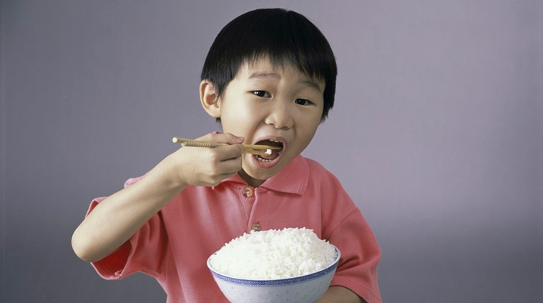
Look at this example. Can you produce a few more? (EE, EO) UC IV
I eat five times as much rice as the average Mexican boy.

Slide 46
ADDING EMPHASIS (EO, EE) UC IV
Do, does, did can add emphasis in positive statements. In speech the auxiliary is stressed:
  And we do have some evolving to do.
Empathic do often indicates contrast/contradiction.
Words such as but, however and although can also be used:
  I'm not a great tennis fan but I did watch the final on Saturday.
  'It doesn't work.' 'It does work – you have to push this button, not that one.'

Slide 47
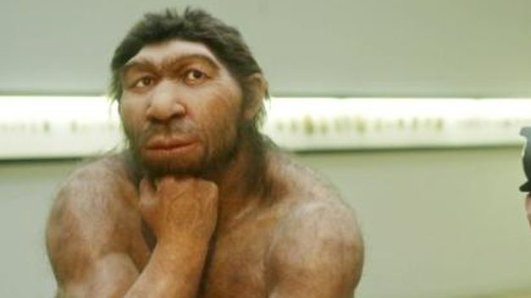
Look at this example. Can you produce a few more sentences with emphasis? (EO) UC IV
I DO HAVE SOME EVOLVING TO DO…

Slide 48
Other auxiliary verbs, positive or negative, can be stressed in speech to add emphasis or show contrast/contradiction:
  I am listening. I just closed my eyes, that's all.
  But he can't be married – he looks so young!
  UC IV (UE, EE, CA, CE, EO)

Slide 49
More examples of emphatic sentences UC IV (UE, EO)
Do is also used in persuasive commands, to show politeness or express annoyance.
Do help yourself to more meat.
Oh, do stop arguing, you two!

Slide 50

Look at this example of emphasis
Produce a few more examples UC IV(EO).
DO HELP YOURSELF!

Slide 51
FRONTING, HOW TO DO IT?
UC V (UE, EE, CA, CE, EO)
Look at these examples of fronting:
Who or what do the words in bold refer to in these sentences from the listening?
  Huge it was.
  £300 he paid for it, and very happy he was too!
  Really comfortable they are.
The above are examples'fronting': the complement or object is places before the subject and verb to give it emphasis.
  It was huge. -> Huge it was.
  He paid £150. -> £300 he paid.

Slide 52
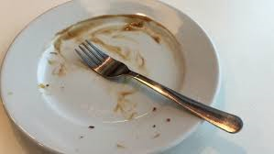
LOOK A THIS EXAMPLE UC V (UE)
Very good it was…

Slide 53
How is used with adjectives; what with nouns. UC V (EO, UE)
  How lucky you are!
  What an idiot I am!
Whole clauses can be fronted, particularly those beginning with a question word.
  Why anyone would want to bring a fishing boat to a place like this, I have no idea.
Clauses are often fronted before expressions such as I'm not sure, I don't know, I couldn't tell you.

Slide 54
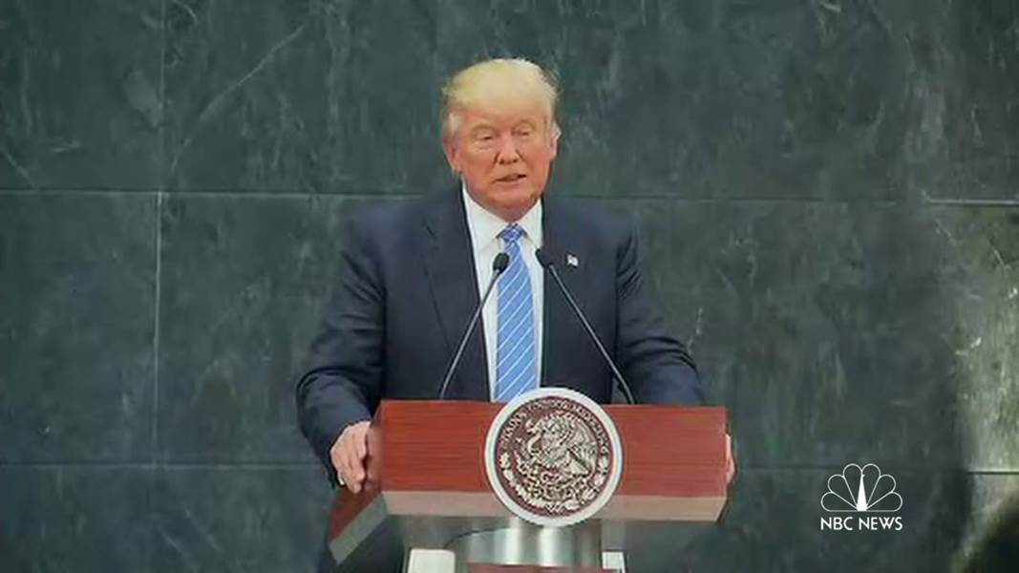
Fronting with wh-words, an example
Can you form other fronted sentences? UC V(EO)
Why he was invited to Mexico, I don’t understand

Slide 55
CLEFT SENTENCES (UE) UC V
Cleft sentences add emphasis to a noun, a person, a time, a phrase or a clause using the structures It is/was... that/who... or What...is/was... In the following examples, the underlined part of the sentence is being emphasized:
  It was an Australian, Albert Ellis, who made the discovery.
  What strikes one first about the island is its size.
  What they did was (to) ship phosphate to Australia.

Slide 56
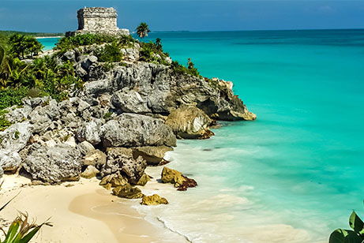
A Cleft Sentence. Can you produce a few more? (EO) UC V
What you must see in Mexico is Tulum

Slide 57
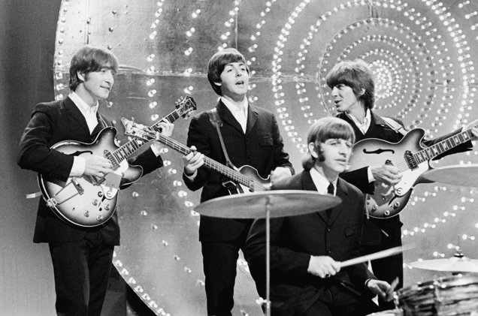
ADDING EMPHASIS WITH ALL, AN EXAMPLE.
Can you form more? (EO) UC V
ALL YOU NEED IS LOVE,
ALL YOU NEED IS LOVE.
LOVE IS ALL YOU NEED.

Slide 58
REPORTED SPEECH (EO, UE, CE) UC V
Some Reporting Verbs:
Say, tell, ask, remind, warn, recommend, suggest, deny, offer, refuse, admit.
OBSERVE AND LEARN the verb pattern:
The doctor suggested Olga should eat more vegetables

Slide 59
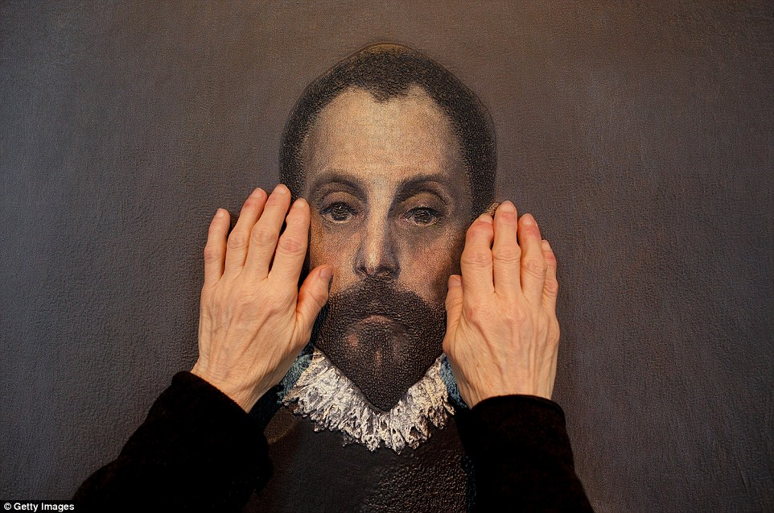
Reported Speech with to:
Agree, refuse, ask, tell. UC V
Don’t touch the portrait
He told me not to touch the portrait (UE)
DO NOT TOUCH THE PORTRAIT!

Slide 60

MODALS AND DEDUCTIONS
Can you work out a few rules?
His watch must be very expensive
He must have spent a fortune on his watch
A watch like his can’t be cheap
(UE, EE, CA, CE, EO) UC V

Slide 61
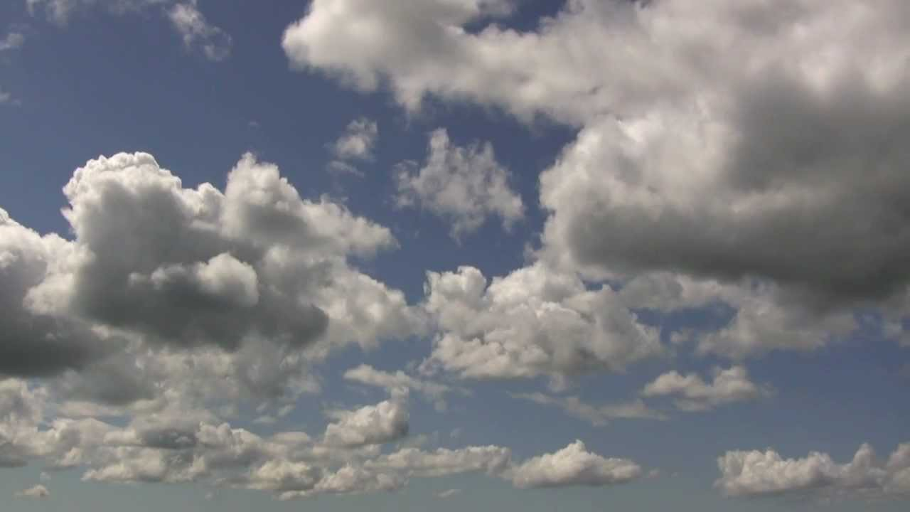
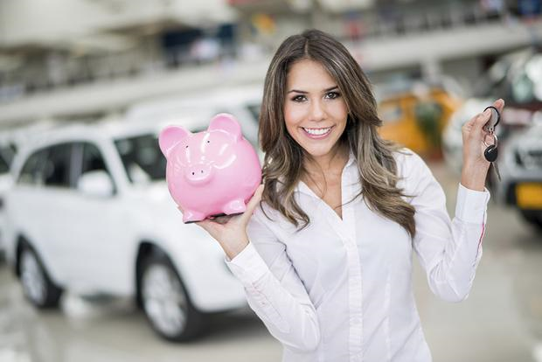

More examples of modals (might)
It might rain this evening
I might buy a car
She might be Korean
(UE, EE, CA, CE, EO) UC V

Slide 62
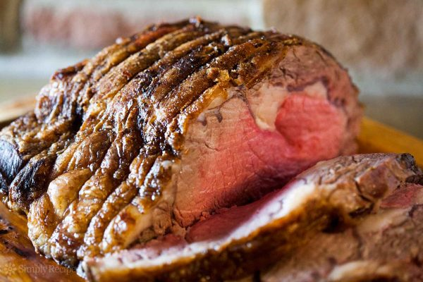
Expressing annoyance with might/could
  You might at least offer to pay for the damage.
  She could have told me she was vegetarian – I'd cooked a lovely beef dish.
  EO, UE, UC V

Slide 63

Might/May for concession or contrast. Can you produce other examples? UE, UC VI
He might be cute, but he is not my type.

Slide 64
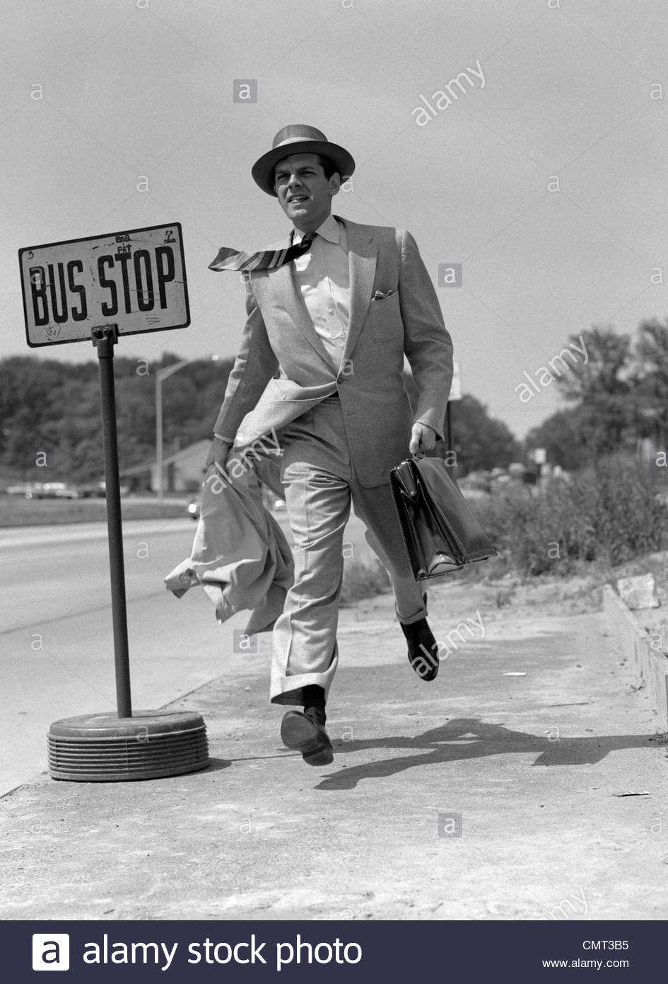
Might as well/may as well to suggest the best course of action, without having much enthusiasm for it.
UE, UC VI
The next bus doesn't come for another hour, so I might as well walk.

Slide 65
Question tags, examples. Work out a few rules
You speak French, don’t you?
I am not kidding, am I?
I am a teacher, aren’t I?
You will write, won’t you.
You’ve heard the news haven’t you?
EO, UC VI
'

Slide 66
Intensifying adverbs:
EE, UE, EO, UC VI
A number of adverbs collocate with certain adjectives, often to intensify or emphasize them as in these examples from the article:
  Perfectly normal behaviour.
  Highly revealing nuggets of information.

Slide 67

Question tags UC VI, EO
You are not a terrorist, …?
You packed your own bags, …?
You’ve just been to Russia, …?
You went to cuba too, …?
You can travel alone, …?
You are not married, …?

Slide 68
CONDITIONALS. Work out the rules
If I could swim like Phelps, I’d be rich and famous
Can he swim like Phelps? Is he rich and famous?
If I had a million dollaras, I’be buy a car.
Does he have a million dollars? Can he buy a car?
UE, EO, EE, UC VI.

Slide 69
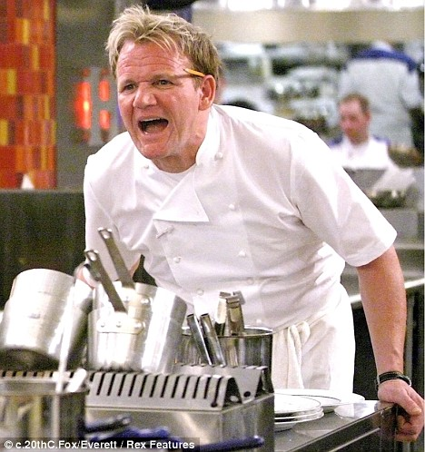
Observe this sentence. Can you produce others? UE, UC VI
Had I known you were a vegetarian, I would have cooked something else.
Did I know he was a vegetarian?
Did I cook something else?
What word can be used at the beginning of this sentence instead of “had”?
JUST EAT IT!

Slide 70
THE PASSIVE UC VI, EE, CE, UE
Form the passive with be + past participle.
    The first nylon toothbrush was introduced in 1938.
    He was taken to hospital
    A new planet has been discovered
    NOW ANSWER THIS QUESTION:
    Why has the person that performed the action been omitted in the examples above?

Slide 71

UE, UC VI
Choose the correct alternative and explain why it is correct:
A: I was made walk a lot in the army.
B: I was made to walk a lot in the army.

Slide 72
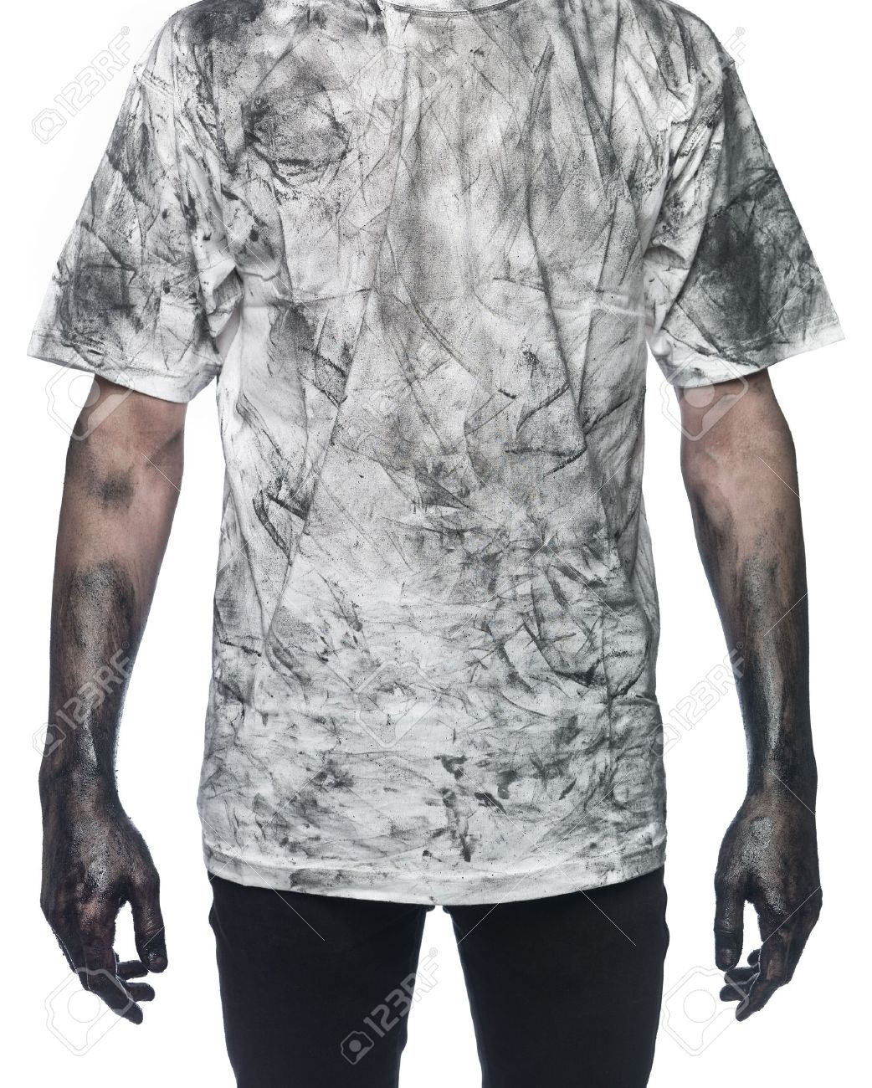
  SOMETHING NEEDS DOING UC VI, UE, EO
  Work out the rules
  This shirt needs washing

Slide 73

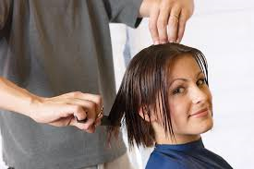

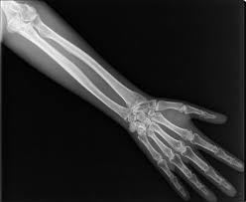
CAUSATIVE HAVE / GET UC VI, EO, UE
When and how do we use the causative have/get?
I had/got my wallet stolen
I am having/getting my hair cut
I had/ got the computer repaired last week
You should have your arm x-rayed

Slide 74

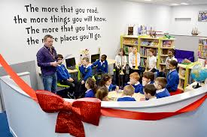

About to, bound to, due to and other phrases about the future. UC VI, EO
The film is about to start
The new library is due to open next month
They are bound to be very happy

Slide 75

I didn’t need to study French
I needn’t study French
Whats the difference in meaning? UC VI, UE

Slide 76

Was the action done? YES
Was the action necessary? NO
Then say needn’t UE, UC VI
30 words, not 300!!!
I needn’t have written so much!

Slide 77
3 Use wish/if only + past simple for wishes about present states.
I wish I knew how to play an instrument.
If only she wasn´t/weren´t so busy all the time.
4 Use would with dynamic verbs. I wish/If only I would is not possible: use I wish/If only I could.
I wish they would give a Little more thought to what they put on.
If only I could remember her name.
5 Use hope+ a present or future tense if there is a real possibility that something will happen.
I hope she comes on Friday – she said she might. UE, UC VI

Slide 78
WISHES, WORK OUT THE RULES
UE, UC VI
I wish I could speak French
I wish I had blue eyes
I wish you wouldn’t call me “bunny”
I wish it would stop raining
I wish I’d studied harder
I wish I hadn’t bough this computer.

Slide 79
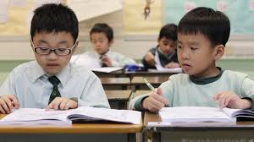
What would you say in this situation?
EO, UC VI
If only I…
I wish I..

Slide 80
Bibliografía fundamental
Alexander, Karen (2014), Advanced Expert Teacher’s Resource Book, UK: Pearson.
Bell, Jan. Gowell, Roger (2014), Advanced Expert Coursebook, UK: Pearson.
Gude, Kathy/ Stephens Mary (2008), CAE Result, Students’ Book, China: Oxford.
(2008), CAE Result, Workbook, China: Oxford.
(2008), CAE Result, Teacher’s Book, China: Oxford.
(2013), Ready for CAE, Teachers’ Book Pack, China: Oxford.

Slide 81
Bibliografía fundamental
Cambridge English Advanced 5 Self-study Pack (2012), Cambridge: Cambridge University Press.
Harrison Mark (2009) CAE Practice Tests, United Kingdom: Oxford University Press
Powell, Debra (2005), Common Mistakes at CAE and how to Avoid Them, Cambridge: Cambridge University Press.

