Slide 1
“APOYO A TRADUCCIÓN LITERARIA DEL INGLÉS”
Autor: Luis Juan Solís Carrillo
Material proyectable (solo visión) empleado en Semestre 2017 A
Unidad de Aprendizaje: Traducción Literaria del Inglés.
Clave: L32081
Créditos 8
Unidades de Competencia 4
Facultad de Lenguas, UAEMEX

Slide 2
INDICE
Guion 2-15
UC I 16
UC II 17-19
Ejercicios UC II, III, IV 20-53
Bibliografía 54-55

Slide 3
GUION DE USO PARA MATERIAL PROYECTABLE
ANÁLISIS LITERARIO EN INGLÉS
El presente material tiene una función primordial: apoyar al estudiante a adquirir habilidades lectoras avanzadas en el idioma inglés. Esta destreza es parte fundamental de su formación con un perfil de egreso centrado en la traducción.

Slide 4
GUION (CONTINUACIÓN)
Este material profundiza el Programa vigente de la UA Traducción literaria del Inglés. Es importante destacar que cubre los cuatro UNIDADES del programa vigente. Con especial énfasis en las tres primeras. Esto significa que puede emplearse para cualquier género literario considerado en el programa (cuento, novela, etc.). Este material ofrece al estudiante una serie de recursos analíticos con los que debe contar un lector eficiente de inglés a nivel avanzado.

Slide 5
Guion (continuación)
Este material, cabe aclarar, no pretende ser un sustituto de la clase o del docente. Más bien, es una herramienta que ayuda al docente y al alumno a comprender mejor los usos y características generales de cada figura. Para su uso se sugiere lo siguiente:

Slide 6
Comenzar siempre con un encuadre temático. Esto significa que las diapositivas se usan como complemento didáctico introductorio de los ejemplos y explicaciones del docente.

Slide 7
•Cada diapositiva constituye un punto de partida que puede ampliarse con más ejemplos, tanto del docente como de los alumnos, con base en la lectura específica del texto que, en ese momento, se esté traduciendo en clase.

Slide 8
•Una característica de este material es que puede emplearse con diversas clases de textos (narrativa, poesía, teatro, etcétera). De esta manera, se da lugar al estudio de cada uno de los contenidos del programa

Slide 9
En la medida de lo posible, el docente deberá aportar ejemplos de las figuras fuera de la órbita del texto literario. Por ejemplo, hará hincapié en el hecho de que la metáfora, el símil o la metonimia, por mencionar solo tres casos, también ocurren en contextos no literarios y de la vida cotidiana.
Por ejemplo, la metáfora a bull market o a bear market se usan en el contexto de las finanzas. Lo mismo puede decirse del símil: like father like son = de tal palo tal astilla.

Slide 10
El punto anterior sirve no solo para conectar las figuras literarias y retóricas con sus usos en el lenguaje cotidiano, sino para que el alumno se dé cuenta plena de la estrecha relación que esta UA guarda con otras, correspondientes al área de traducción. Así pues, será recomendable que el profesor establezca estas relaciones y las ponga de manifiesto en el aula.

Slide 11
El orden de las diapositivas no obedece a ninguna secuencia programática establecida de antemano. Se trata de ilustraciones adaptables a los avances de cada grupo y docente. De esta manera, no será incorrecto emplear las diapositivas correspondientes a exotismo, antes que las relativas a préstamo cultural, pues todas corresponden al ámbito del análisis de los niveles textuales/traductológicos considerados en el programa.

Slide 12
Guion (continuación)
En cuanto a la secuencia didáctica sugerida, cabe decir lo siguiente:
1. Este material permite al estudiante adquirir los nuevos conceptos partiendo de una fase inicial centrada en la mera identificación de los rasgos que caracterizan al texto literario. Más adelante, el alumno debe reconocer la presencia de dichos rasgos formales para su traducción al español.

Slide 13
2. En una etapa posterior, es necesario que la atención asuma una postura más crítica, es decir, que el estudiante esté en condiciones de observar la relación entre el contenido expreso en el lenguaje literario y la forma en que la figura sirve para dar énfasis a dicho mensaje.

Slide 14
Guion (continuación)
3. En otras palabras, se trata de que el estudiante establezca relaciones claras entre forma y contenido, aspectos fundamentales del programa.
Por ejemplo: observar la forma en que una aliteración, como: the buzz of busy buzzing bees sirve para realzar el concepto de bee (abeja) y sus rasgos característicos.

Slide 15
He aquí, de forma general, el guion con los lineamientos y sugerencias que permitirán el uso en el aula de esta colección de diapositivas. Espero que les sea de mucha utilidad.

Slide 16
UNIDAD DE CONTENIDO I (UC I)
Exotismo: Ivan se acercó al samovar y tomó un poco de té.
Préstamo cultural: Sake, Sushi, Hardware, entre otros
Calco: Baloncesto, Jardín de niños, FBI
Adaptación cultural: Millas = Kilómetros

Slide 17
UNIDAD DE CONTENIDO II
Rasgos y propiedades formales (Metáfora)
Definition: A metaphor is a figure of speech which makes an implicit, implied or hidden comparison between two things that are unrelated to each other, but have some characteristics common between them.
A metaphor can also be described as a resemblance of two contradictory or different objects based on a single or some common characteristics.

Slide 18
UNIDAD DE CONTENIDO II (UC II) “Niveles”
Fónico/gráfico
Prosódico
Gramatical
Oracional
Discursivo
Intertextual
Identifica estos niveles en los distintos textos que estudias en clase.

Slide 19
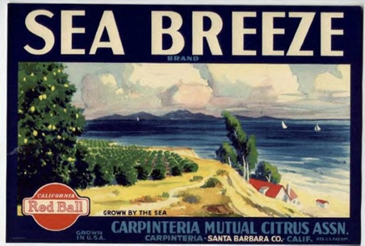
NIVELES UC II
¿A qué nivel pertenece lo siguiente?
The assignment was a breeze
Obviously, assignment and breeze have nothing in common. Except that, in this case, their meanings are united by a third element, which is not physically present in the sentence. That element is simplicity.
In other words, the assignment was really simple, easy, a piece of cake (another metaphor).

Slide 20
A FEW EXAMPLES OF METAPHORS.
UC II, III.
This one from John Donne, a metaphysical poet.
She’s all states and all princes.
Can you work out the meaning of this metaphor?
Is the poet’s lady poor or rich?

Slide 21
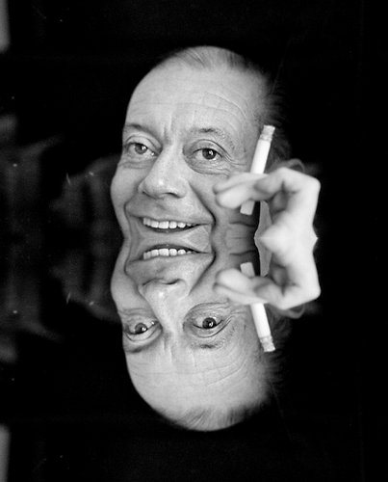
UC II, Another example? This one taken from a Cole Porter song:
You're the top!
You're the Colosseum.
You're the top!
You're the Louvre Museum…

Slide 22
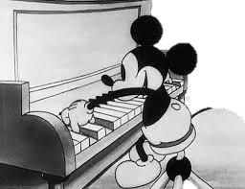
UC II. In fact this song is a long series of amusing metaphors. Can you translate a few in class?
You're Mickey Mouse.
You're the Nile,
You're the Tower of Pisa,
You're the smile on the Mona Lisa…

Slide 23
Analysis UC I, II, III
One of the things that one never finds in a metaphor are words such as like or as.
Every metaphor consists of three elements.
Love is a rollercoaster
Elements:
1. Tenor: Subject bieng discussed: Love.
2. Ground: What the poet believes:
In this case, that love has its ups and downs.
3. Vehicle: What the subject is compared to: Here, a rollercoaster.

Slide 24
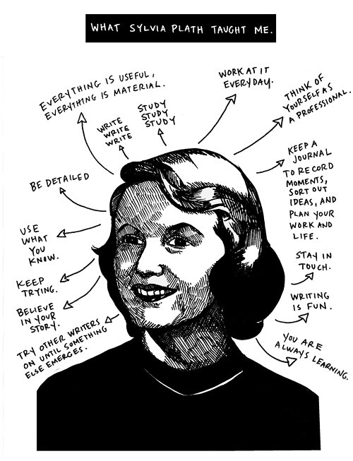
UC II, III
Metaphors
Traduce el siguiente texto:
By Sylvia Plath
I’m a riddle in nine syllables,
An elephant, a ponderous house,
A mellon strolling on two tendrils.
O red fruit, ivory, fine timbers!
This loaf’s big with its yeasty rising.
Money new-minted in this fat purse.
I’m a means, a stage, a cow in calf.
I’ve eaten a bag of green apples,
Boarded the train there’s no getting off.

Slide 25
A Further Look at the Poem. UC: 1, 2, 3 y 4
By means of which metaphors does Sylvia Plath express the following ideas about her new physical state.
Physical discomfort and disproportion?
The sense that her destiny cannot be reverted?
The loss of her identity?
The sense of carrying something precious?
The nausea associated with her condition?
Her similarities with the animal kingdom?
The feeling that she’s expanding?

Slide 26
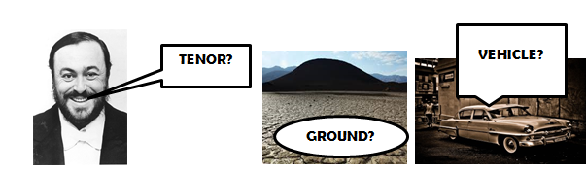
What are the tenor, ground and vehicle of some of the metaphors that Sylvia Plath uses in her poem? Analyze some of them. UC: II y III
For example this one:
(I'm’) a mellon strolling on two tendrils.

Slide 27
UC, II, III
Definition: A simile is a figure of speech that establishes a comparison between two different things. Similes always use words such as: like or as.
Example:
Love is like a roller coaster.
Perhaps you have noticed that is the same example given to illustrate what a metaphor is.
What makes the two figures different?
What important word is present here?
Do similes have a tenor, ground and vehicle?

Slide 28
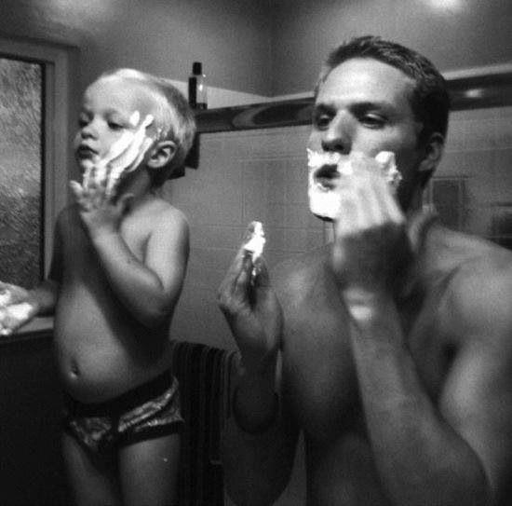
A Few Answers UC, 2, 3.
The two figures are different because the comparison, in the case of a metaphor is less direct, less obvious.
The word present here that makes the two figures different is the like. This word makes the comparison mor direct and clear.
Yes, both a metaphor and a simile have a tenor, ground and vehicle.
LIKE FATHER, LIKE SON...

Slide 29
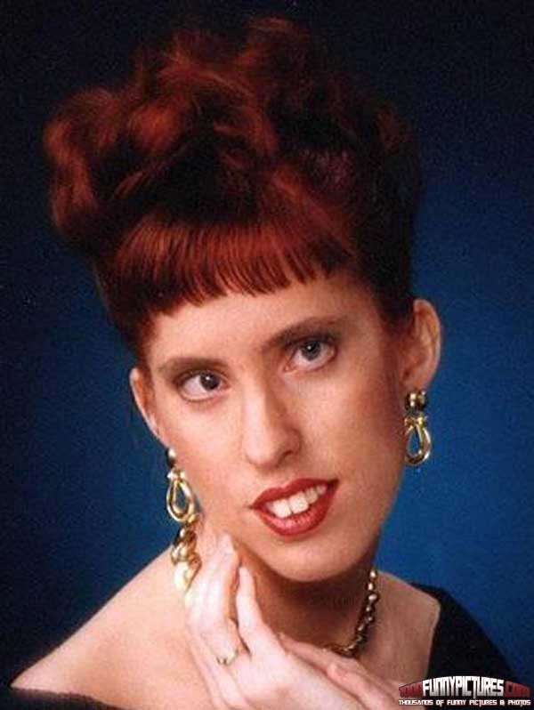
A famous simile is this one from one of Shakespeare Sonnets:
UC: II y III
My mistress’ eyes are nothing like the sun. Sonnet 130. William Shakespeare (1564 – 1616)
What’s the tenor here?
What’s the ground here?
What’s the vehicle?
What is the poet really saying about his mistress here?
Yeah, My mistress’ eyes are NOTHING like the sun...

Slide 30
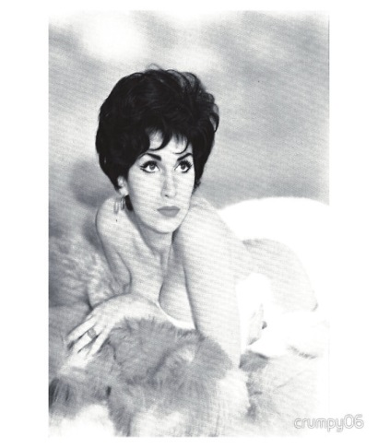
A Further Look at the Poem… UC I, II, III, IV.
Or at any other text in classs
Underline all the metaphors you can find.
Can you spot a simile?
Choose a few of the metaphors and analyze it.
Is the lady pretty?
Is her breath delicious?
Are her cheeks rosy?
Is she a goddess?
Does she have a pleasant voice?
Does the poet love her?
Find evidence to support your answers.

Slide 31
NIVEL ORACIONAL/RETÓRICO UC II, III
Synecdoche
Definition: From the Greek meaning “taking together”, it is a figure of speech that consists of taking one part to signify the whole (or vice versa sometimes).
TRANSLATE THIS EXAMPLE:
Many hands make light work

Slide 32
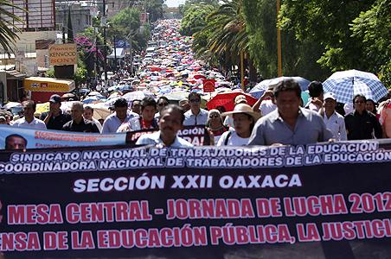
UC II, III y IV. Here the word hands refers not just to this body part,
but to the whole person working. In other words:
Many people working together work faster…

Slide 33
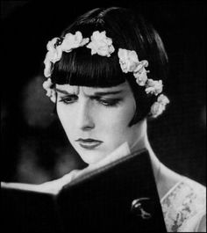
Another Example
In this case, the whole reprensents the part:
I’m reading Dickens
Dickens here refers to his whole literary output. But the reader means that he has been reading a novel, or story, by Dickens.
I’M READING DICKENS

Slide 34
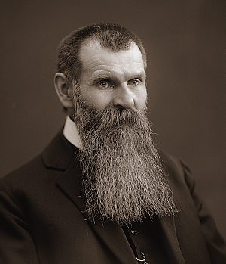
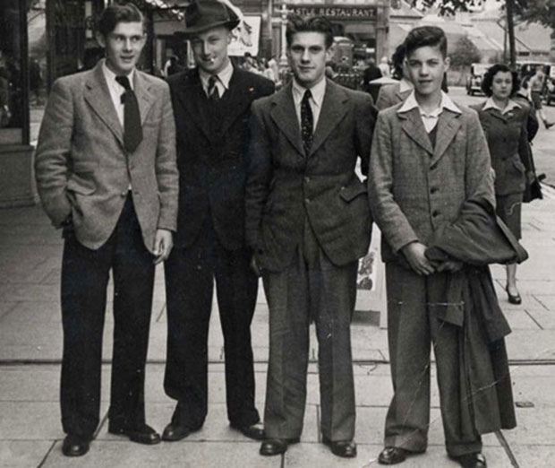
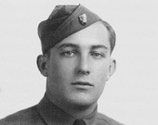
Traduece estos ejemplos UC II, III y IV
Mr Thomas is now a gray beard.
The street was crowded with suits…
This is a possibility being considered by the Pentagon.

Slide 35
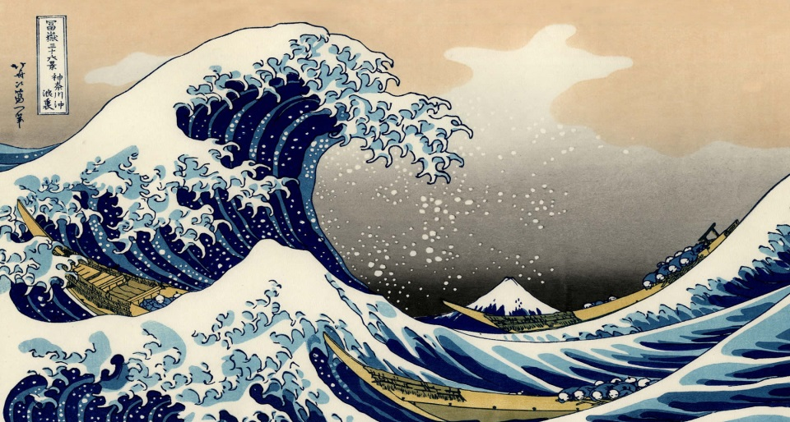
Traduce estos ejemplos. UC II, III y IV
The first one from The Rime of the Ancient Mariner, by Coleridge.
The western wave was all a-flame.
The day was well was nigh done!
Almost upon the western wave
Rested the broad bright Sun.
What do you think wave refers to?
Does wave refer to the part or the whole?

Slide 36
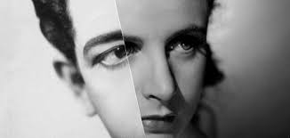
Traduce este ejemplo:
UC 2, 3, 4
Note the use of synecdoche in The Lady or the Tiger? by Frank R. Stockton:
His eye met hers as she sat there paler
and whiter than anyone in the vast ocean of anxious faces about her…
What does the word faces refer to?

Slide 37
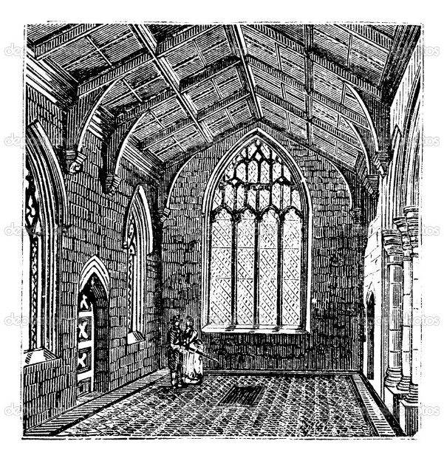
UC II, III y IV.
Elegy Written in a Country Churchyard, by Thomas Gray.
Nor you, ye Proud, impute to these the Fault
If Mem’ry o’er their Tomb no Trophies raise,
Where thro’ the long-drawn Isle and fretted Vault
The pealing Anthem swells the Note of Praise.
Traduce, en clase, el ejemplo anterior.
Identifica las sinécdoques.

Slide 38
NIVELES
Identifica este concepto en clase, con el texto que estés traduciendo. UC I, II, III, IV
Definition: This word comes from the Greek meaning “change of name”. This figure of speech refers to one concept by giving to it the name for another thing.
Example: The Crown = The King.
Notice that the crown is NOT a part of the king as are his hands, head, etc. However, metonymy always implies some kind of connection or proximity to the thing described.
What’s the connection between crown and king?

Slide 39
In everyday speech metonymy abounds.
Look at these examples:
UC I, II, III, IV
1. The White House is concerned about immigration.
White House is not the building, but the President and his advisors.
2. England decides to keep check on pollution.
This does not refer to the island nation, but to the government.
3. The pen is mightier than the sword.
Here pen refers to the written word, not the thing used for writing. The sword is not the weapon itself, but violence, war, aggression.

Slide 40
Examples from Literature
UC 2, 3, y 4
1. From Shakespeare’s “Julies Caesar” Act I.
Friends, Romans, countrymen, lend me your ears.
Explanation: Mark Anthony uses “ears”, but he he wants the people present there to listen to him attentively. It is a metonymy because the word “ears” replaces the concept of attention.

Slide 41
UC II, III, IV. Traduce estos ejemplos:
2. From Margaret Mitchell’s novel “Gone with the Wind”.
I’m mighty glad Georgia waited till after Christmas before it secedes or it would have ruined the Christmas parties.
Explanation: Scarlett uses “Georgia” to refer to everything that makes up the state: citizens, politicians, government etc. The name of a country or state refers to a whole nation and its government.

Slide 42
UC II, III y IV
3. From “Out, Out” by Robert Frost.
As he swung toward them holding up the hand
Half in appeal, but half as if to keep
The life from spilling.
Traduce el ejemplo anterior. Lee la explicación:
Explanation: life is a metonymy that refers to the spilling of blood. It develops a link between life and blood.

Slide 43
A Few More Examples, UC II, III y IV
4. These lines are from the poem “Yet Do I Marvel”, by Cullen.
The little buried mole continues blind,
Why flesh that mirror Him must someday die,
Traduce el ejmplo anterio y lee la explicación:
Explanation: Flesh represents the human body, humans. The poem questions God why we have to die when we are created in His likeness.

Slide 44
5. These lines are from Lycidas, by John Milton. UC 4
Traduce en clase este ejemplo:
But now my oat proceeds,
And listens to the herald of the sea
That came in Neptune’s plea,
He asked the waves, and asked the felon winds,
What hard mishap hath doomed this gentle swain?
Lee la explicación:
Explanation: In the above lines, Milton uses “oat” for a musical instrument made out of an oak-stalk. “Oat” represents the song that the poet is composing next to the ocean.

Slide 45
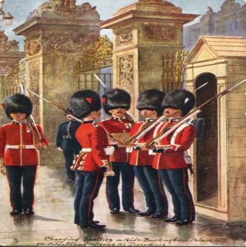
Consider this example. UC II, III y IV
Rifles were guarding the gate
Compared to…
The guards with rifles in their hands were guarding the gate.

Slide 46

Niveles, UC II, III y IV
Personification
Fear knocked on the door. Faith answered. There was no one there. - Proverb -
Traduce en clase el ejemplo anterior.
In the example above, fear and faith carry out actions that can only be performed by human beings: knock and answer.
FEAR KNOCKED ON THE DOOR!

Slide 47

One More Example of Personification (but not from literature…) UC II, III, IV
Traduce en clase el ejemplo siguiente y lee la explicación:
The only monster here is the gambling monster that has enslaved your mother! I call him Gamblor, and it's time to snatch your mother from his neon claws!
Why is this an example of personification?
Can you make up a few examples?

Slide 48
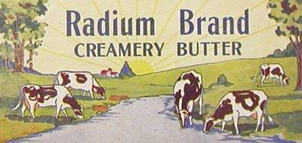
UC II, III y IV
Alliteration
Let’s have a look at some examples:
A big bully beats a baby boy.
But a better butter makes a batter better.
Why are these examples of alliteration?
What sounds are repeated for effect?

Slide 49
NIVELES, UC I, III, IV:
Identifica este nivel en el texto que estés traduciendo en clase
Alliteration
The fair breeze blew, the white foam flew,
The furrow followed free;
We were the first that ever burst
Into that silent sea.
From Samuel Taylor Coleridge’s “The Rime of the Ancient Mariner”

Slide 50
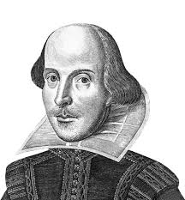
And this one by Maya Angelou
UC 2, 3 Y 4
Up the aisle, the moans and screams merged with the sickening smell of woolen black clothes worn in summer weather and green leaves wilting over yellow flowers.
Traduce en clase el ejemplo anterior
And another example from Shakespeare’s Romeo and Juliet:
From forth the fatal loins of these two foes;
A pair of star-cross’d lovers take their life.

Slide 51
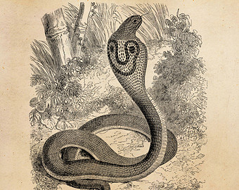
WHY USE ALLITERATION? UC 2, 3 y 4
Alliteration also makes reading and recitation of the poems much more attractive and appealing. This helps us learn them by heart. We must not forget fact that it adds flow and beauty to a piece of writing.
Silenciosa y con sigilo, silba en la selva la serpiente....

Slide 52

A Few More Notes. UC II, III y IV
  Alliteration is so colorful and musical that the marketing industry has, for decades, used this device. It makes brand names interesting and easier to remember, which helps attract customers and enhance sales.
A Few Examples:
Bed, Bath & Beyond
Chuckee Cheese
Krispy Kreme
Don't dream it. Drive it. – Jaguar

Slide 53

UC. II, III, IV.
Assonance
DEFINITION: Assonance occurs when two, or more, words close to one another repeat the same vowel sound but start with different consonant sounds.
Men sell the wedding bells.
Can you find assonance in this example?
Traduce en clase el ejemplo anterior

Slide 54
BIBLIOGRAFÍA: FUENTES Y REFERENCIAS EMPLEADAS
Jago, Carol et al. Literature & Composition: Reading - Writing – Thinking, Bedford/St. Martin's, USA, 2011
Pike, David L., Costa, Ana. Literature: A World of Writing Stories, Poems, Plays, and Essays, Pearson, USA, 2011.
Raffel, Burton. The Art of Translating Prose. Pennsylvania University Press, USA, 2015.
The Art of Translating Poetry, Pennsylvania University Press, USA, 2014.
.

Slide 55
Reaske, Christopher. How to Analize Poetry, Monarch Books, USA, 2014.
Roza, Greg. Patterns in Poetry: Recognizing and Analyzing Poetic Form and Meter, Rosen Publishing Group, USA, 2005.
Shanafelt, Collin. Literary Analysis & Essay Writing Guide, Gatsby's Light Publications, New York, 2012.
Stopbaugh, James P. Skills for Literary Analysis, Student’s Book, Master Books, USA, 2013.
Stopbaugh, James P. Skills for Literary Analysis, Teacher’s Book, Master Books, USA, 2013

