Slide 1
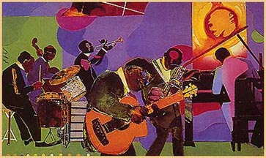
HARLEM RENAISSANCE

Slide 2
Créditos Institucionales
UNIVERSIDAD AUTÓNOMA DEL ESTADO DE MÉXICO
FACULTAD DE LENGUAS
Licenciatura en Lenguas
Literatura Moderna en Inglés
“Contexto histórico y características de la literatura moderna en lengua inglesa”
Elaboró: Dra. Celene García Ávila
SEMESTRE 2017 B
TOLUCA, MÉXICO, OCTUBRE 2016
Nota: Si se activa la función “comentarios”, podrá verse la guía para usar estas diapositivas.

Slide 3
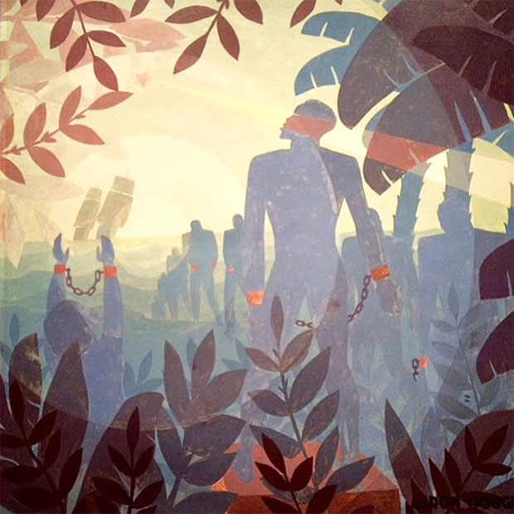
Background
It was time for a cultural celebration. African Americans had endured centuries of slavery and the struggle for abolition. The end of bondage had not brought the promised land many had envisioned.

Slide 4
Let America be America again
Langston Hughes
Let America be America again.
Let it be the dream it used to be.
Let it be the pioneer on the plain
Seeking a home where he himself is free.
(America never was America to me.)

Slide 5
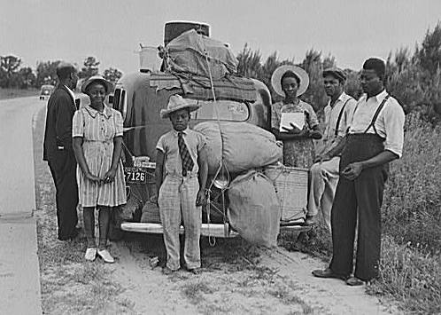
Instead, white supremacy was quickly, legally, and violently restored to the New South, where ninety percent of African Americans lived. Starting in about 1890, African Americans migrated to the North in great numbers.

Slide 6
Let America be America again
Langston Hughes
Let America be the dream the dreamers dreamed
Let it be that great strong land of love
Where never kings connive nor tyrants scheme
That any man be crushed by one above.
(It never was America to me.)

Slide 7
This Great Migration eventually relocated hundreds of thousands of African Americans from the rural South to the urban North. Many discovered they had shared common experiences in their past and their uncertain present circumstances. Instead of wallowing in self-pity, the recently dispossessed ignited an explosion of cultural pride. Indeed, African American culture was reborn in the Harlem Renaissance.

Slide 8
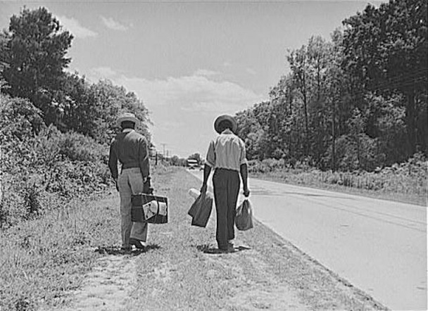

Slide 9
Let America be America again
Langston Hughes
O, let my land be a land where Liberty
Is crowned with no false patriotic wreath,
But opportunity is real, and life is free,
Equality is in the air we breathe.
(There's never been equality for me,
Nor freedom in this "homeland of the free.")

Slide 10
Unfortunately, northerners did not welcome African Americans with open arms. Most new migrants found themselves segregated by practice in run down urban slums. The largest of these was Harlem. Writers, actors, artists, and musicians glorified African American traditions, and at the same time created new ones.
Say, who are you that mumbles in the dark?
And who are you that draws your veil across the stars?

Slide 11
Let America be America again
Langston Hughes
Say, who are you that mumbles in the dark?
And who are you that draws your veil across the stars?
I am the poor white, fooled and pushed apart,
I am the Negro bearing slavery's scars.
I am the red man driven from the land,
I am the immigrant clutching the hope I seek―
And finding only the same old stupid plan
Of dog eat dog, of mighty crush the weak.

Slide 12
Yet I'm the one who dreamt our basic dream
In the Old World while still a serf of kings,
Who dreamt a dream so strong, so brave, so true,
That even yet its mighty daring sings
In every brick and stone, in every furrow turned
That's made America the land it has become.
O, I'm the man who sailed those early seas
In search of what I meant to be my home―
For I'm the one who left dark Ireland's shore,
And Poland's plain, and England's grassy lea,
And torn from Black Africa's strand I came
To build a "homeland of the free."

Slide 13
O, let America be America again ―
The land that never has been yet ―
And yet must be ― the land where every man is free.
The land that's mine ― the poor man's, Indian's, Negro's, ME―
Who made America,
Whose sweat and blood, whose faith and pain,
Whose hand at the foundry, whose plow in the rain,
Must bring back our mighty dream again.
Sure, call me any ugly name you choose―
The steel of freedom does not stain.
From those who live like leeches on the people's lives,
We must take back our land again,
America!

Slide 14
The free?
Who said the free? Not me?
Surely not me? The millions on relief today?
The millions shot down when we strike?
The millions who have nothing for our pay?
For all the dreams we've dreamed
And all the songs we've sung
And all the hopes we've held
And all the flags we've hung,
The millions who have nothing for our pay―
Except the dream that's almost dead today.

Slide 15
O, yes,
I say it plain,
America never was America to me,
And yet I swear this oath―
America will be!
Out of the rack and ruin of our gangster death,
The rape and rot of graft, and stealth, and lies,
We, the people, must redeem
The land, the mines, the plants, the rivers.
The mountains and the endless plain―
All, all the stretch of these great green states―
And make America again!

Slide 16
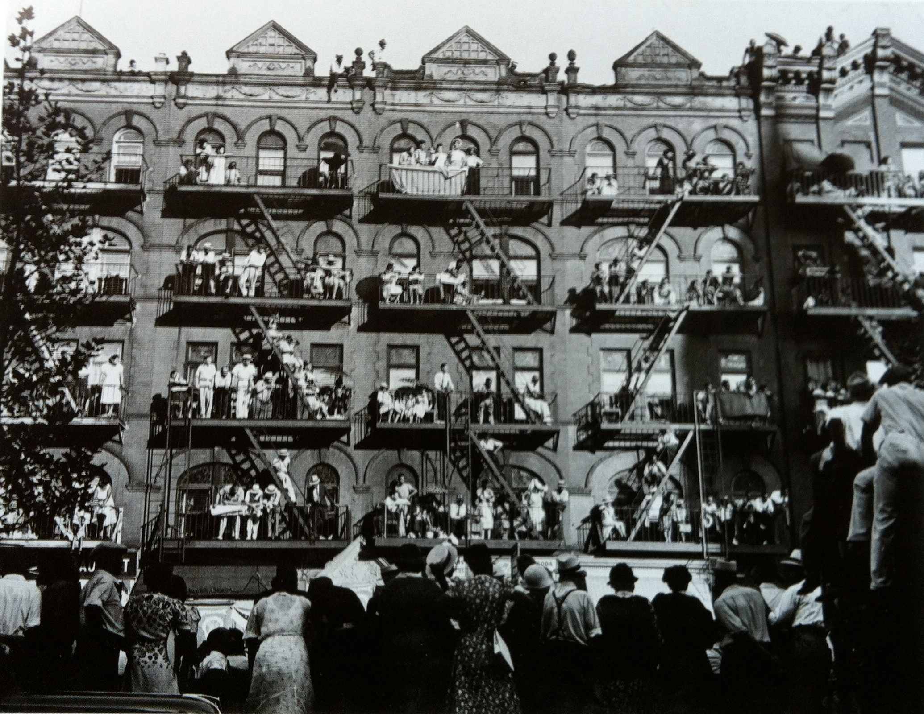

Slide 17
Let America be America again
Langston Hughes
I am the young man, full of strength and hope,
Tangled in that ancient endless chain
Of profit, power, gain, of grab the land!
Of grab the gold! Of grab the ways of satisfying need!
Of work the men! Of take the pay!
Of owning everything for one's own greed!
I am the farmer, bondsman to the soil.
I am the worker sold to the machine.
I am the Negro, servant to you all.
I am the people, humble, hungry, mean--
Hungry yet today despite the dream.
Beaten yet today--O, Pioneers!
I am the man who never got ahead,
The poorest worker bartered through the years.

Slide 18
Musicians
No aspect of the Harlem Renaissance shaped America and the entire world as much as jazz. Jazz flouted many musical conventions with its syncopated rhythms and improvised instrumental solos. Thousands of city dwellers flocked night after night to see the same performers. Improvisation meant that no two performances would ever be the same.

Slide 19
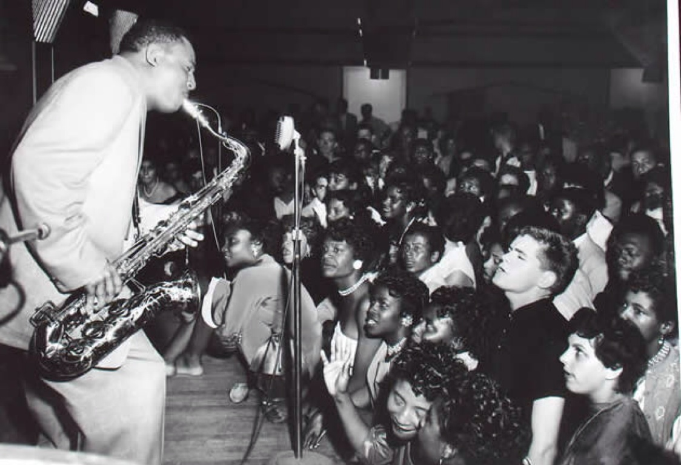

Slide 20
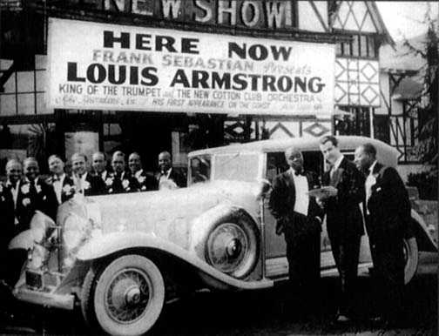
Harlem's Cotton Club boasted the talents of Duke Ellington. Singers such as Bessie Smith and Billie Holiday popularized blues and jazz vocals. Jelly Roll Morton and Louis Armstrong drew huge audiences as white Americans as well as African Americans caught jazz fever.

Slide 21
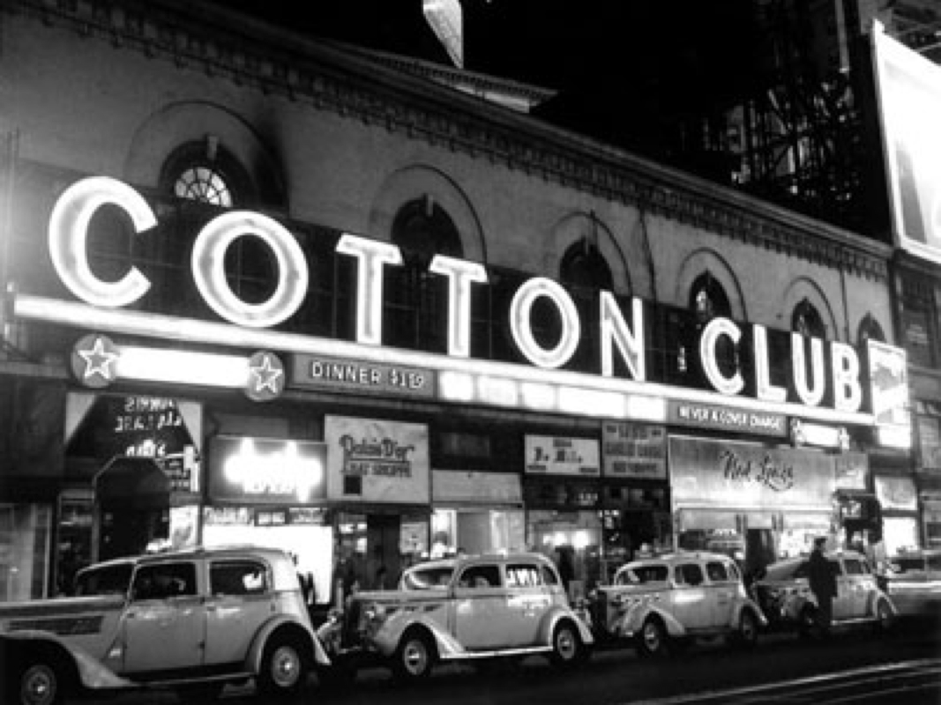

Slide 22
Writers and Actors
Langston Hughes was the most prolific writer of the Harlem Renaissance. He cast off the influences of white poets and wrote with the rhythmic meter of blues and jazz.
Claude McKay urged African Americans to stand up for their rights in his powerful verses.

Slide 23
Jean Toomer wrote plays and short stories, as well as poems, to capture the spirit of his times.
Zora Neale Hurston was noticed quickly with her moving novel, Their Eyes Were Watching God.
Actor Paul Robeson electrified audiences with his memorable stage performances.

Slide 24
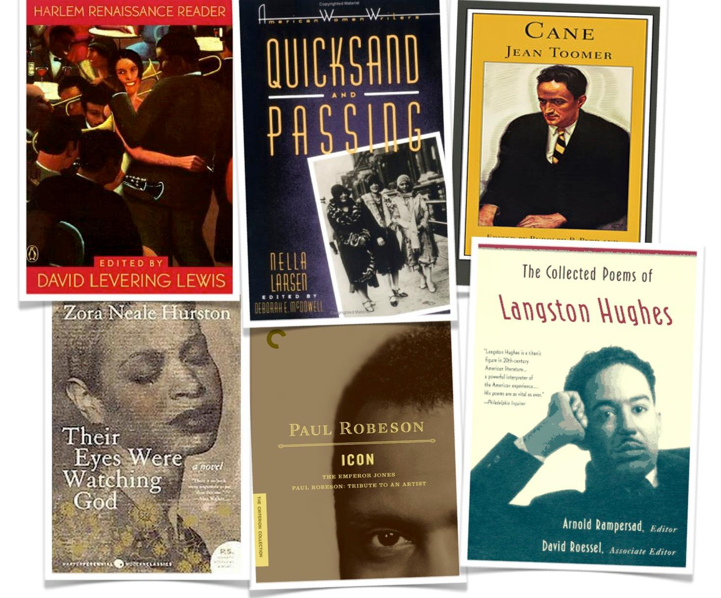

Slide 25
Many scholars think of the Harlem Renaissance as the moment African American literature first came into its own: a rebirth of literature as an African American space. Which was a pretty major deal, especially when you consider that the 1920s weren't so long after slavery was abolished. A whole group of people went from enslaved and illiterate to free and literary over the short span of fifty years.

Slide 26
This shows that the movement led to new styles of literature and new philosophical ideas regarding the issues that African Americans faced in the early twentieth century America. This important change in African American mindsets has survived throughout the centuries and persists even to this day.

Slide 27
The Crisis Magazine, an official magazine of the National Association for the Advancement of Colored People (NAACP) that was mainly subscribed to by blacks; and Negro World, the newspaper of Marcus Garvey’s helped immensely in publishing the African American writing. Harlem Renaissance help give African American visibility and opportunity for publications.

Slide 28
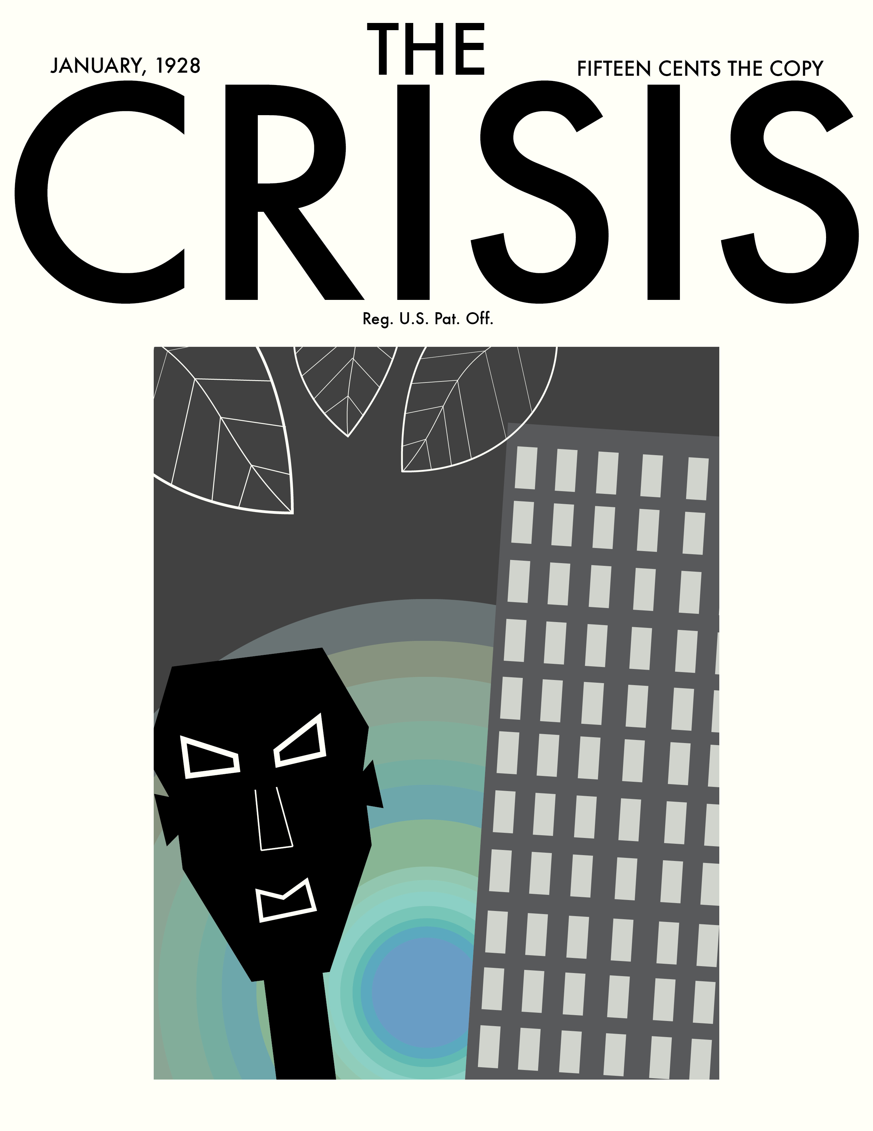
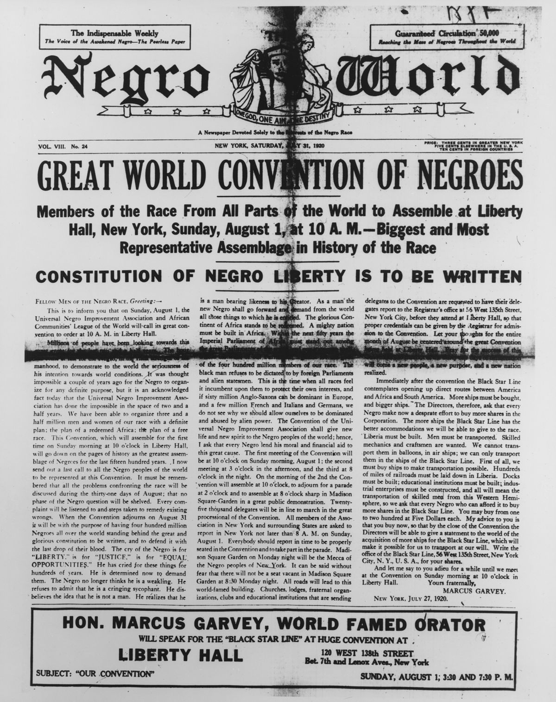

Slide 29
These publications published poetry, short stories, and essays sent in by black writers, and it encouraged them to do more, such as write, and make all forms of art, because expression was one way to freedom.

Slide 30
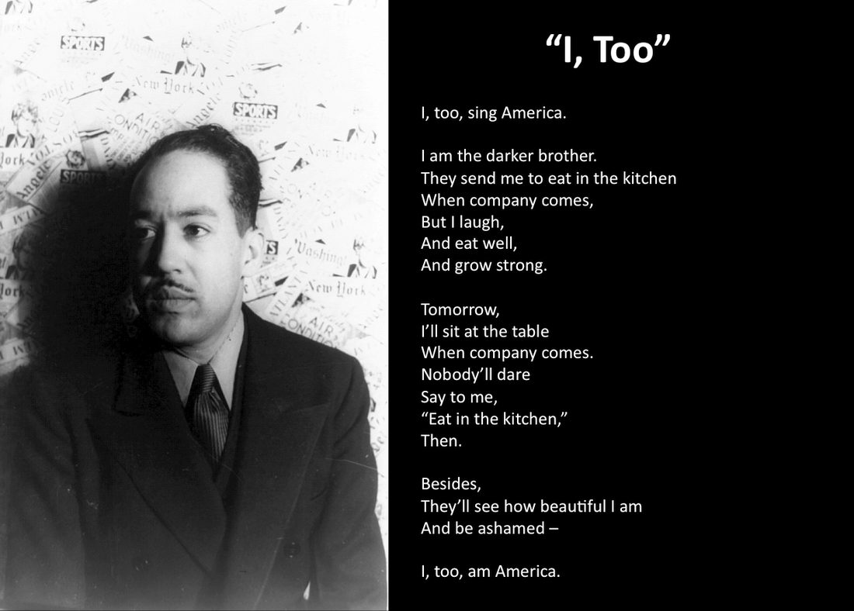

Slide 31
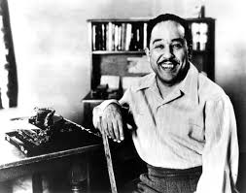
Langston Hughes was one of the leading black writers in that time period, and wrote many different types of literature. He wrote, and created a new literary art form called jazz poetry. His poem "The Negro Speaks of Rivers," provides solid unity for the African American history.

Slide 32
Harlem brought notice to great works that might otherwise have been lost or never produced. The results were phenomenal. The artists of the Harlem Renaissance undoubtedly transformed African American culture. But the impact on all American culture was equally strong. For the first time, white America could not look away.

Slide 33
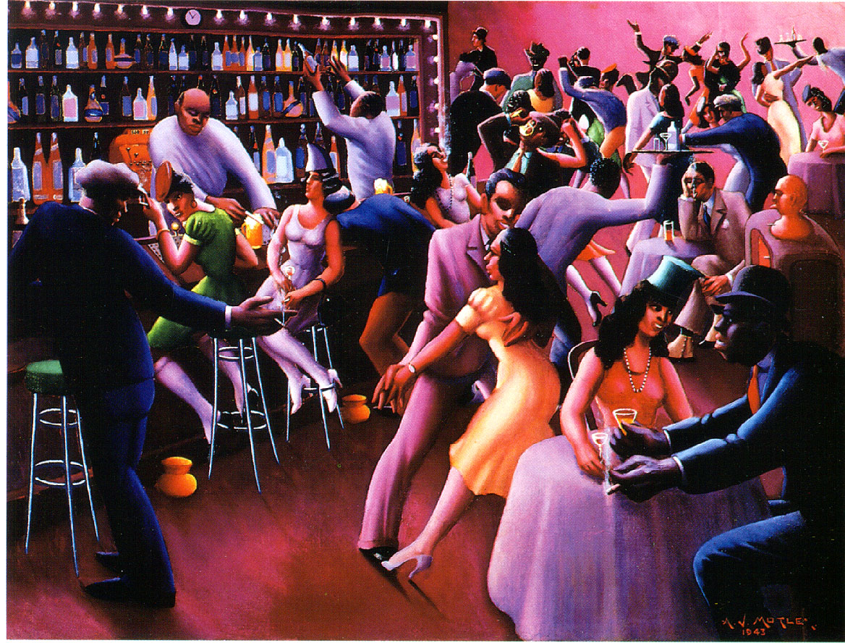

Slide 34
References
46e. The Harlem Renaissance (s/f) en U.S. History Pre-Columbian to the New Millenium disponible en: http://www.ushistory.org/us/46e.asp
https://bcc-cuny.digication.com/anuoluwapo_bolarinwa/Music
Armstrong, Louis, “Dinah” (video): https://www.youtube.com/watch?v=BhVdLd43bDI
Hughes, Langston, “Let America Be America Again”: https://www.poemhunter.com/poem/let-america-be-america-again/
Cotton Club-Harlem
Renaissance: https://www.youtube.com/watch?v=fdDsBg_p1v8

