Slide 1
Literary analysis
(Drama)
Professor: Celene García Ávila

Slide 2
Créditos Institucionales
UNIVERSIDAD AUTÓNOMA DEL ESTADO DE MÉXICO
FACULTAD DE LENGUAS
Licenciatura en Lenguas
Análisis Literario en Inglés
“Performance Analysis”
SEMESTRE 2017 A
TOLUCA, MÉXICO, OCTUBRE 2016
Nota: Si se activa la función “comentarios”, podrá verse la guía para usar estas diapositivas.

Slide 3
Performance analysis: space, time, action
Patrice Davis, en Gestos. Teoría y Práctica del Teatro Hispánico, núm 22, 1996, pp 11-32

Slide 4
Space, action, and time interact with each other:
TIME: manifests itself in space in visible manner
ACTION: becomes concrete in a given place and moment.
SPACE: is situated where the action takes place and unfolds for a certain duration of time.
These three points must be taken together, so they produce theatre.

Slide 5
CHRONOTOPE
Following Bakhtin, the alliance between space and action is a chronotope, in the case of the novel.
Space-time is a concrete unit (theatre space and time of the performance)
Space-time is also an abstract unit (fictional place an imaginary temporality).
The body functions as an outline of the representation, as a mediator between time-space.

Slide 6
Chronotope and the freudian model
“‘In the unconscious, time is transformed into space and space into corporeal unity. Throughout this transformation, the body , which functions as an outline of the representation, acts as a mediator between time and space’”.
The spectator’s experience of space and time is based on his reception of the chronotopes.

Slide 7
Corporeal unity
Time CORPOREAL UNITY
Space

Slide 8
The spatial experience: two antithetical options
1. Space is considered as an empty space which must be filled just like a container. The mode of description is objective, exterior.
2. Space is considered as invisible, limitless, and as an extension of the user; space is a substance not to be filled but expanded. The mode of description is gestural space.

Slide 9
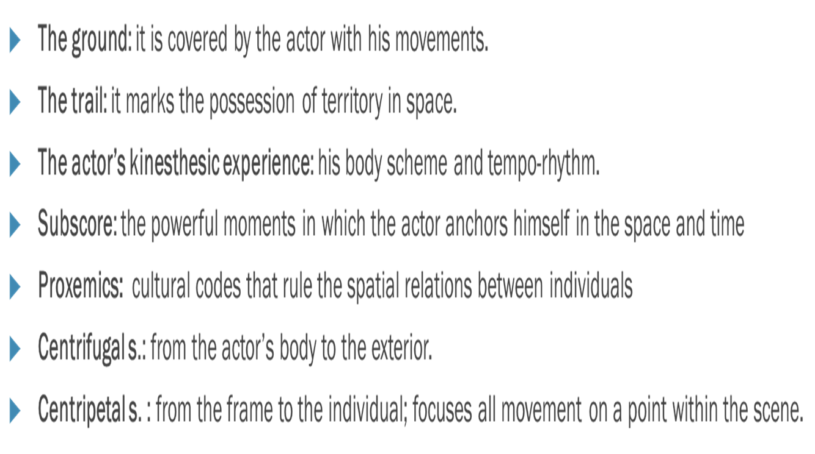
The spatial experience
Objective, exterior space: it clarifies the perspective of the description

Slide 10
Spatial Experience
Gestureal Space: it is emitted and traced by the actor, inferred by his corporeality
“Although the space mentioned in the text does not concern performance analysis and does not belong to the objective or gestural space, it must nevertheless be mentioned as this dramatic space includes information about the imaginary place, the characters and the narrative, and thus necessarily interferes with the stage space” (p. 15).

Slide 11
DRAMATIC SPACE, STAGE SPACE
“Although the space mentioned in the text does not concern performance analysis and does not belong to the objective or gestural space, it must nevertheless be mentioned, as this dramatic space includes information about the imaginary place, the characters and the narrative, and thus necessarily interferes with the stage space” (p. 15).

Slide 12
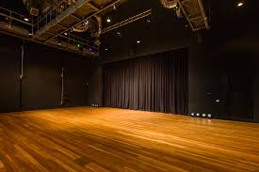
DRAMATIC SPACE, STAGE SPACE
There is an interference between: the iconicity of the concrete space and the symbolism of language.

Slide 13
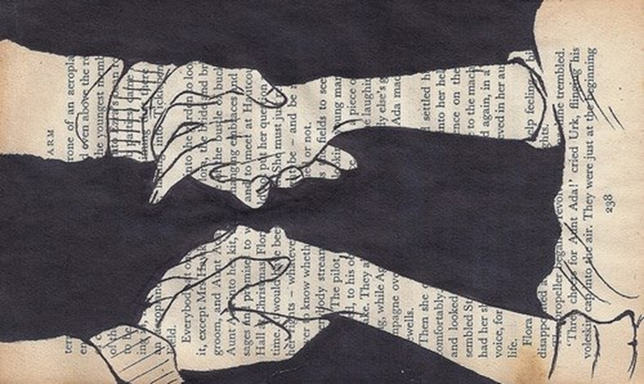
Other ways of approaching space
Textual space (not to be confused with the dramatic space): it is the way in which the text talks about space.

Slide 14
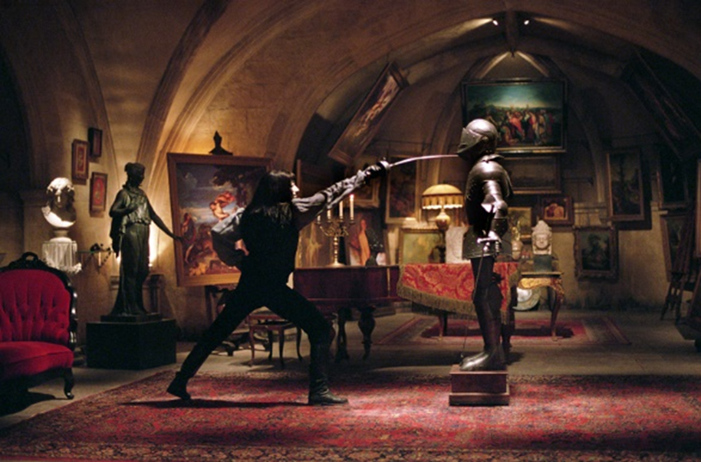
Other ways of approaching space
Internal space: it is the representation of fantasy or dreams evoked in the mise en scène.

Slide 15
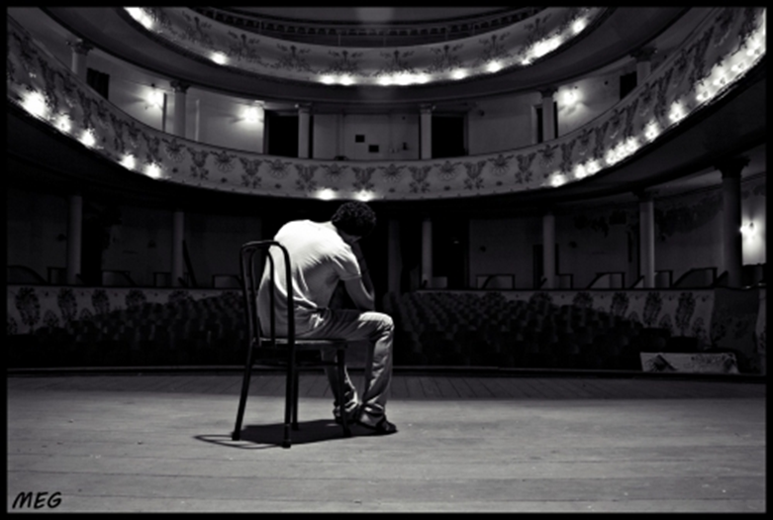
Other ways of approaching space
Ergonomic space of the actor: his work and life environment consists of:
  A proxemic dimension (relations between people)
  A haptic dimension (his way of touching others and himself)
  A kinesic dimension (the movement of his own body)

Slide 16
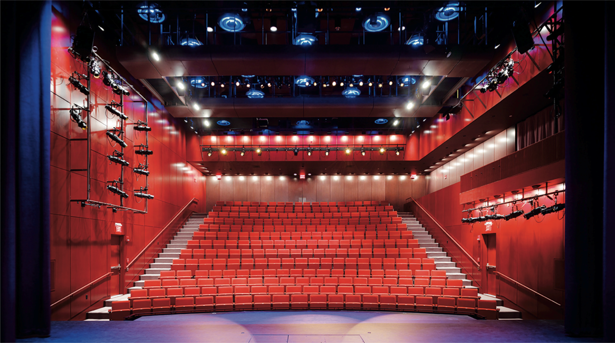
Other ways of approaching space
Installation space: sometimes, theatre is set up or installed in a space or building; it is different from the architectural space. Space works differently in each case.

Slide 17
The temporal experience
There are two types of temporal experience:
  a) An objective quantifiable, external experience.
  B) A subjective, qualitative and internal experience.

Slide 18
EXTERNAL, OBJECTIVE TIME
It is the duration of the performance
It is also the time of the dramaturgial framework with its obligatory transitions (exposition, build-up in the action, climax, curtain).

Slide 19
EXTERNAL, OBJECTIVE TIME
“This objective managment of time, this measurable spatiality imposed as if from the outside by the composer, director or actor, this highlighting of the prosody of the text, its textual space and its “eurythmic gesture characterize the rhythm” (p. 18).

Slide 20
Internal, subjective time
This time belongs to each individual, but this impression of durations is also cultural and linked to the habits and expectations of the audience.
It is experienced in different variations; it is the tempo, and the actor imbues his text and role with his own time and internal tempo.

Slide 21
Internal, subjective time
Temporality is not only a matter of rhythm and tempo and is not simply limited to the flow of time. It is made of particular moments (privileged moments), which time seems to stop: Lessing called it fertile instant; Brecht, gestus; Barthes’, the third sense or the punctum; the Kabuki theater, ma (mystical moment); the Korean Tao, the to; Daniel Mesguich, the right moment.

Slide 22
Dramatic time, stage time
Stage time: the time of the performance. The stage temporality is commun to both the actor and the spectator. Temporality is used and produced by the stage actions.
Dramatic time: the represented time of the reported events.

Slide 23
Borrowing the notion of chronotope, by Mikhaïl Bakhtin
The artistic chronotope, according to Bakhtin, allows for a spatial metaphorization and a temporal experience. In theatre, chronotopes link time, space and action.

Slide 24
To prepare chronotopes: contrast properties of space and time
SPACE | TIME
open | infinite
closed | limited
large | long
small | short
global | uninterrupted
fragmentary | interrupted
etc. | etc.

Slide 25
TO PREPARE CHRONOTOPES: COMBINE AT LEAST TWO PROPERTIES OF SPACE AND TIME
Chronotopes may exist in our experience and categorization of the world. (Note: Pavis cites Michael Chekhov, L’imagination créatrice de l’acteur, Paris, Pygmalion, 1995).
THE PRIMARY COLORS OF PERFORMANCE
MEGALOMANIA: Large space, fast tempo | THE WORLD IN SLOW MOTION: Large space, slow tempo
NERVOSITY: Small space, fast tempo | MINIMALISM: Small space, slow tempo

Slide 26
The plot and the chronotopes
“The plot is not […] a disjointed series of episodes and motives; it consists of a coherent pattern of chronotopes and corporealities” (p. 26).

Slide 27
The plot and the chronotopes
Each sequence is a process, which clarifies, directs and vectorizes the whole scene. For example, there are:
accumulators (of information), connectors (clues that come together to identify the place and the situation), revelations (to uncover appearances), shifters (clues which allow to move from one lever to another), secateurs (to end a sequence ant move on to a completely different sequence.

Slide 28
VECTORIZATION
THERE IS A GRAPHIC METHOD
OF NOTATING THE MOVEMENTS
OF ACTORS IN A SPACE

Slide 29

THE VECTOR
The outlined vectors indicate the form and pattern of the movement, its duration, its timing, its speed and the changes in intensity, the actors place in the stage space, the amount of force and energy used.

Slide 30
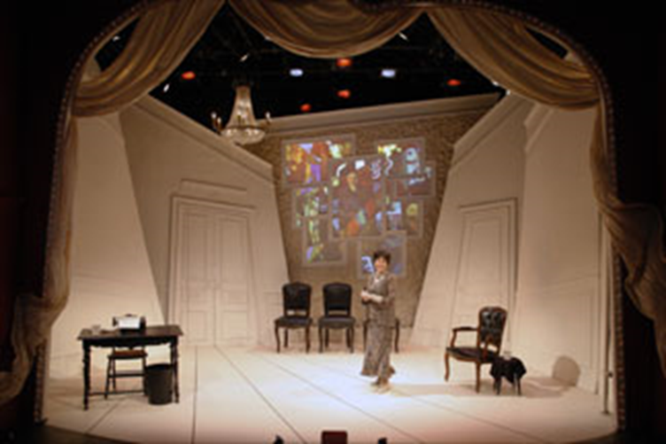
THE VECTOR
“The vector does not distinguish between space and time. Thus, time is vectorized, transformed into space, folded and unfolded, concentrated and extended in that space” (27).

Slide 31
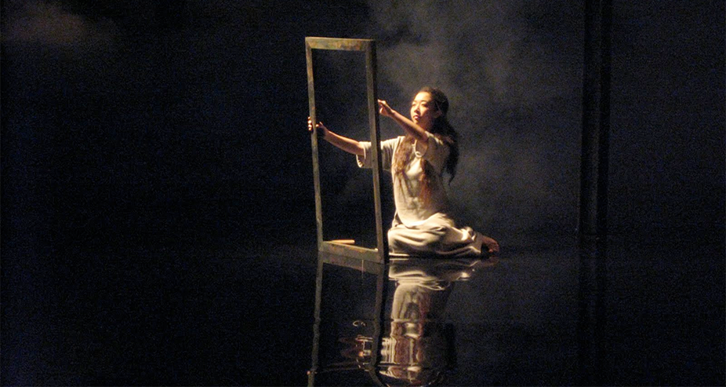
THE VECTOR
Actions are not described in psycological terms, but as ergonomy : as a physical task to be accomplished, an effort to be made, an object to be moved.

