Slide 1
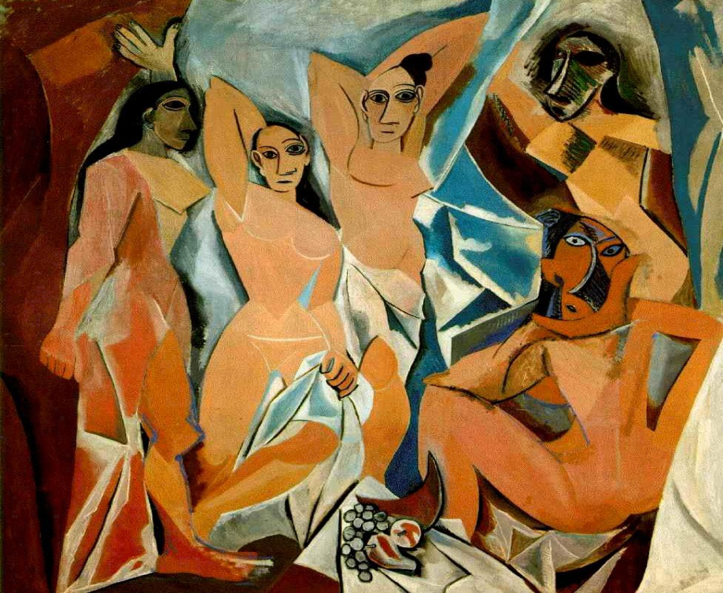
Modernist literature

Slide 2
Créditos Institucionales
UNIVERSIDAD AUTÓNOMA DEL ESTADO DE MÉXICO
FACULTAD DE LENGUAS
Licenciatura en lenguas
Literatura moderna en inglés
“contexto histórico y características de la literatura moderna en lengua inglesa”
SEMESTRE 2017 B
TOLUCA, MÉXICO, OCTUBRE 2017
Nota: Si se activa la función “comentarios”, podrá verse la guía para usar estas diapositivas.

Slide 3
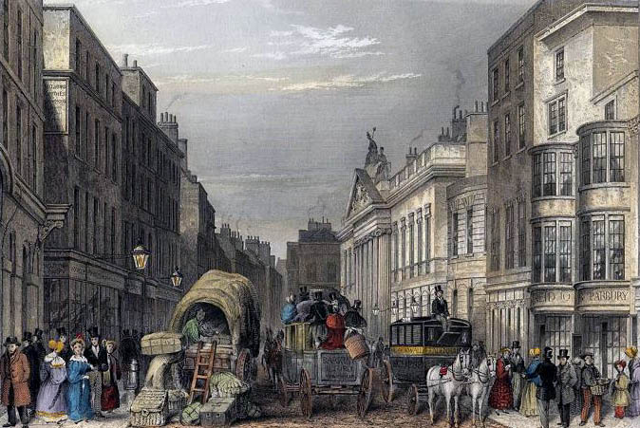
Leadenhall Street – J Hopkins

Slide 4
Background
By the beginning of the XX Century, there was a visceral reaction against Victorian aesthetic principles, which had prevailed for most of the nineteenth century.
Strong reaction traditions and conventions.

Slide 5
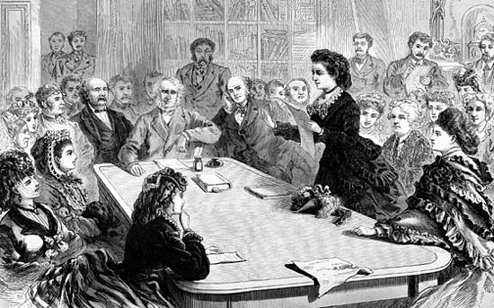
American woman suffrage advocates speak before the U.S. House Judiciary Committee in 1871

Slide 6
Gender and race
The nineteenth century was a time of privilege for wealthy Caucasian males.
Victorian women, minorities, and the poor were marginalized to the point of utter silence and inconsequence.
Even though Victorian writers denounced those inequities, citizen of the new Century protested and conquered some civil rights, such as the vote for women, and the defense of ethnic minorities.

Slide 7
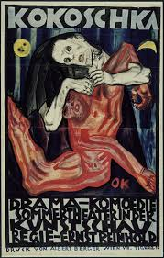

New Aesthetics
https://vimeo.com/58610065
“Helen in Egypt”
Hilda Doolittle

Slide 8
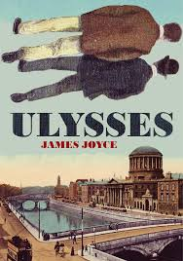

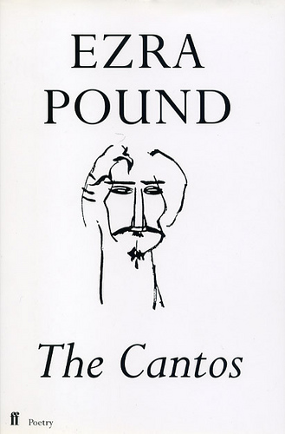
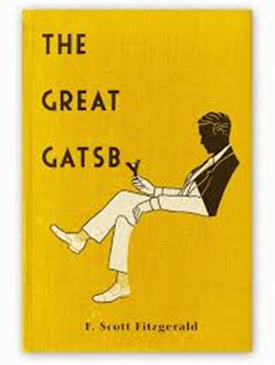
Experimentation, individualism, fragmentarism, and criticism against the system were some of the new artistic styles
.

Slide 9
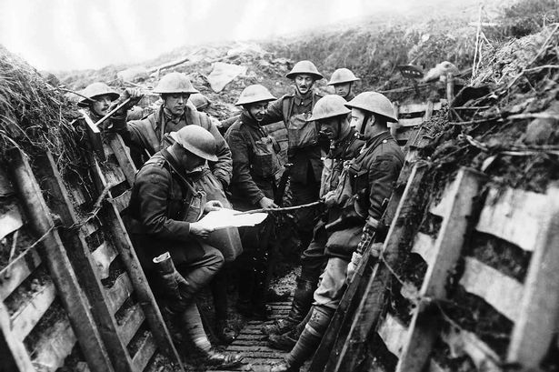
The Great War

Slide 10
Historical context
Cultural shocks :
World War One (1914-1918)
The Great War was supposed to “end all Wars”.
People were horrified by these circumstances.
Social crisis as a consequence of the two World Wars.

Slide 11
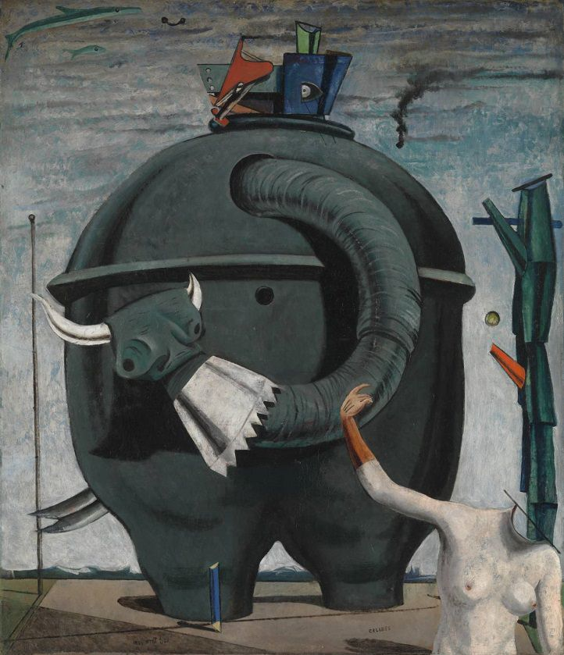
The Elephant Celebes – Max Ernst

Slide 12
Characteristics
Inner self and consciousness are the main concerns of Modernism.
Modernists care rather little for Nature, Being, or the overarching structures of history.
Instead of progress and growth, the Modernist sees decay and a growing alienation of the individual.

Slide 13
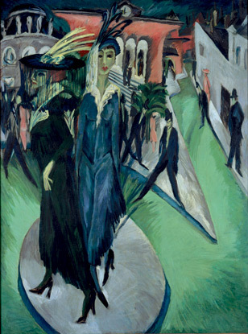
Potsdamer Platz –
Ernst Ludwig Kirchner

Slide 14
The machinery of modern society is perceived as impersonal, capitalist, and antagonistic to the artistic impulse.
War most certainly had a great deal of influence on such ways of approaching the world.
Enhancing personal and original artistic expressions.

Slide 15
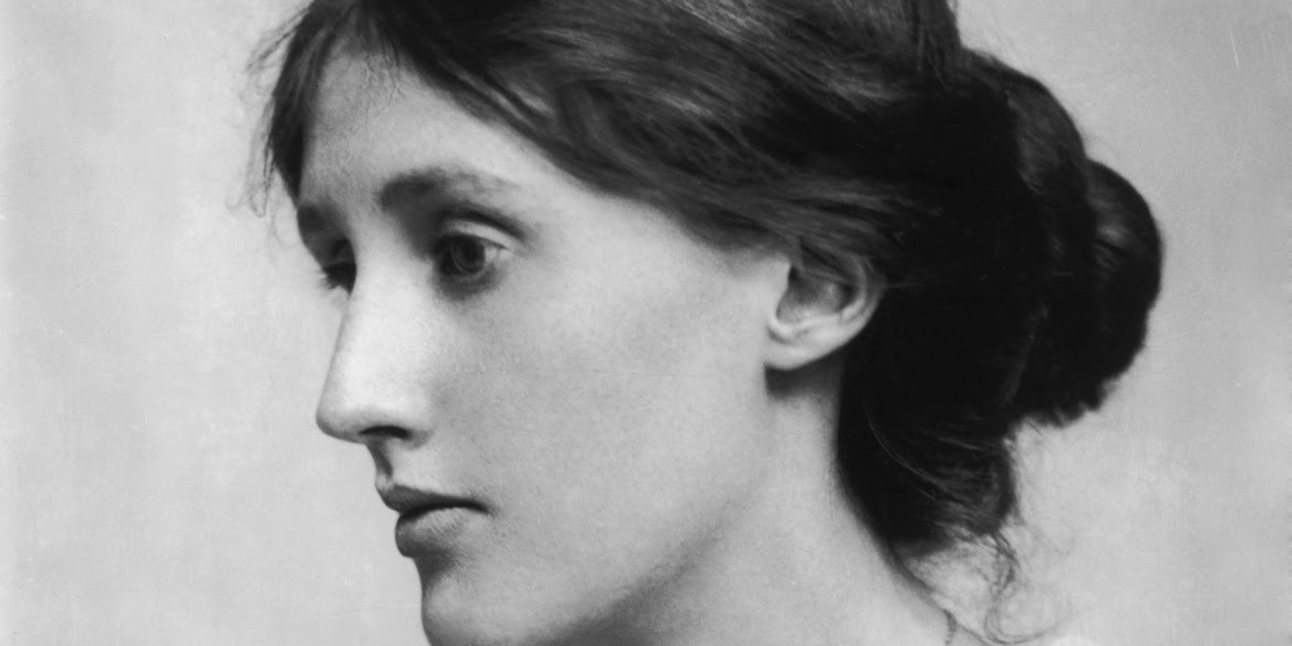
Virginia Woolf , and her vision of female writers

Slide 16
Even though sexism and racism had not been completely left behind, a new paradigm was emerging, first between the sexes, and later between different cultural groups.
A Room Of Ones’ Own is a milestone text to think over the situation of women. Rather than exposing her arguments following the typical structure of an essay, Virginia Woolf decided to create a story and play with the genres. Woolf claimed access of women to culture.

Slide 17
More on Virginia Woolf
Woolf wrote extensively on the problem of women’s access to the learned professions, such as academia, the church, the law, and medicine, a problem that was exacerbated by women’s exclusion from Oxford and Cambridge.
Woolf herself never went to university, and she resented the fact that her brothers and male friends had had an opportunity that was denied to her. Even in the realm of literature, Woolf found, women in literary families like her own were expected to write memoirs of their fathers or to edit their correspondence.
Woolf did in fact write a memoir of her father, Leslie Stephen, after his death, but she later wrote that if he had not died when she was relatively young (22), she never would have become a writer.

Slide 18
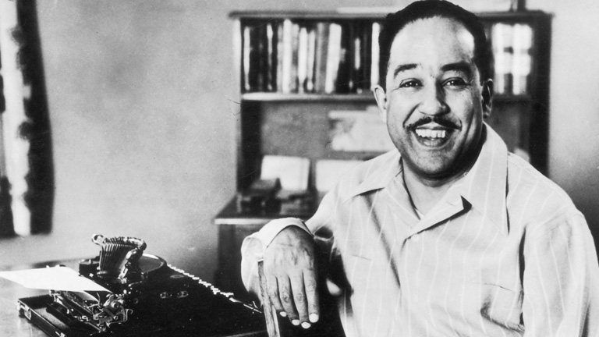
Langston Hughes
African-Americans took part in the Harlem Renaissance. Langston Hughes at the forefront of a vibrant new idiom in American poetry.

Slide 19
Imagist poetry
Imagist poetry was dominating the scene, and sweeping previous aesthetic points of view under the rug. The Imagists, among them Ezra Pound, sought to boil language down to its absolute essence.
Poetry was supposed to concentrate entirely upon “the thing itself,” in the words of in the words of critic-poet T. E. Hulme.
Hilda Doolittle and Amy Lowell became leaders of the Imagist movement.

Slide 20
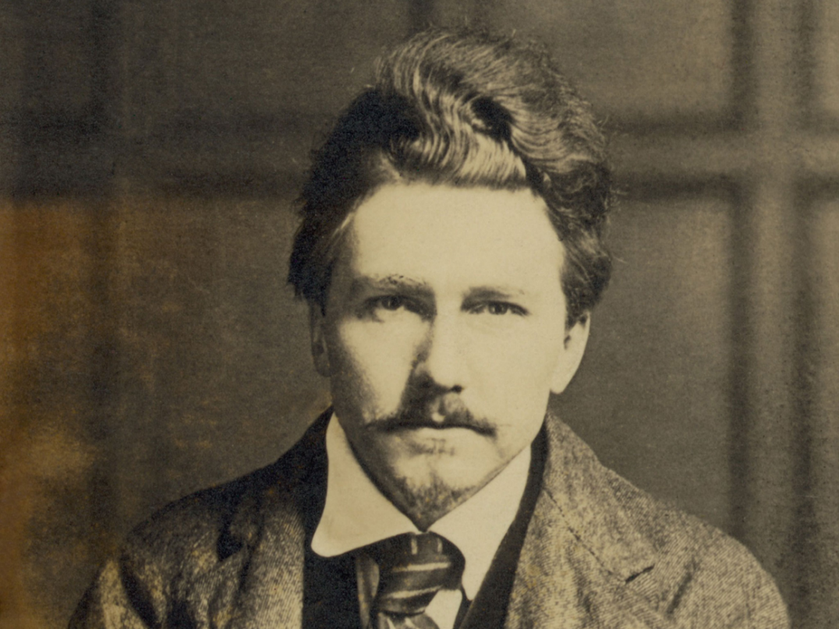
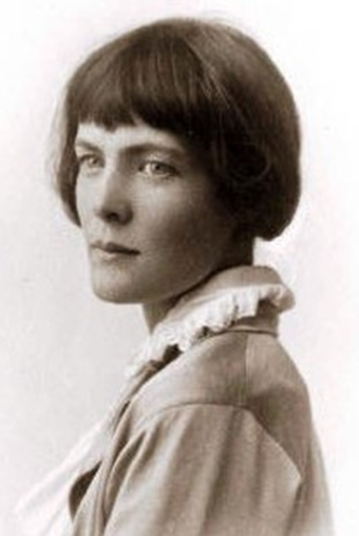
Ezra Pound and H.D (Hilda Doolittle)

Slide 21
Imagist poetry. Characteristics
Minimalist language, a lessening of structural rules and a kind of directness that Victorian and Romantic poetry seriously lacked.
Dreaminess or Pastoral poetry were utterly abandoned in favor of this new, cold, some might say mechanized poetics.
Experiments with intertextual, fragmentary, and polyphonyc texts.

Slide 22
Imagist poetry was almost always short, unrhymed, and noticeably sparse in terms of adjectives and adverbs.
At some points, the line between poetry and natural language became blurred.

Slide 23
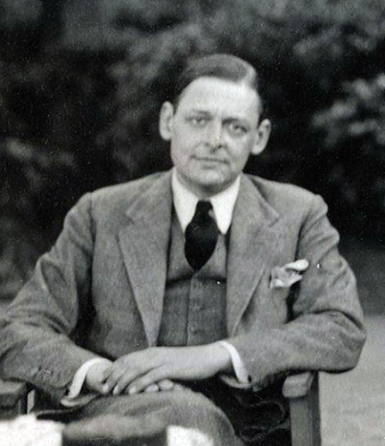
T. S. Eliot

Slide 24
Thomas Stearns Eliot
Eliot picked up where the Imagists left off, adding some of his own aesthetics. His principal contribution was a return to intellectual, allusive poetry. He looked backwards for inspiration, but was not nostalgic or romantic.
One of the distinguishing characteristics of Eliot’s work is the manner in which he moves from very high, formal verse into a more conversational and easy style. Yet even when his poetic voice sounds very colloquial, it is filled with secondary meanings.
It is this layering of meanings and contrasting of styles that mark Modernist poetry. Eliot was the pioneer of the ironic mode; that is, deceptive appearances hiding difficult truths.

Slide 25
The Waste Land
Perhaps the most representative example of experimentalism is T. S. Eliot’s poem The Waste Land. In it, one is confronted by biblical-sounding verse forms, quasi-conversational interludes, dense and frequent references and sections that resemble prose more than poetry.
Eliot displays the Modernist conventions: occupation with self and inwardness, the loss of traditional structures to buttress the ego against shocking realities, and a fluid nature to truth and knowledge.

Slide 26
Lost Generation
In the wake of the First World War, several American artists chose to live abroad as they pursued their creative impulses.
These included:
  Gertrude Stein,
  the novelists Ernest Hemingway,
  and F. Scott Fitzgerald, among others.

Slide 27
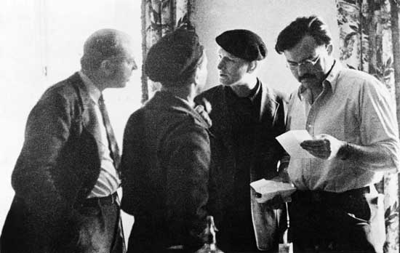
The Lost Generation

Slide 28
The term itself refers to the spiritual and existential hangover left by four years of unimaginably destructive warfare.
The artists of the Lost Generation struggled to find some meaning in the world in the wake of chaos, turning the mind’s eye inward and attempting to record the workings of consciousness.
For Hemingway, this meant the abandonment of all ornamental language. His novels are famous for their extremely spare, blunt, simple sentences and emotions that play out right on the surface of things.
All truth became relative, conditional, and in flux.
Source: Modernism, en The Literature Network:
http://www.online-literature.com/periods/modernism.php

Slide 29
Joyce and the
“Stream of consciousness”
The “unreliable” narrator supplanted the omniscient narrator, and readers had to question even the most basic assumptions.
James Joyce’s Ulysses is the prime example of a novel whose events are really the happenings of the mind, which translate the strange pathways of human consciousness.
Thanks to “Stream of consciousness”, novelists of the early twentieth century surveyed the inner space of the human mind. At the same time, the psychoanalytic theories of Sigmund Freud had come into mainstream acceptance. These two forces worked together to alter people’s basic understanding of what constituted truth and reality.

Slide 30
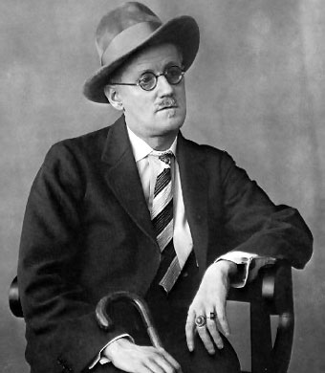
Ulysses quote
“I was a Flower of the mountain yes when I put the rose in my hair like the Andalusian girls used or shall I wear a red yes and how he kissed me under the Moorish wall and I thought well as well him as another and then I asked him with my eyes to ask again yes and then he asked me would I yes to say yes my mountain flower and first I put my arms around him yes and drew him down to me so he could feel my breasts all perfume yes and his heart was going like mad and yes I said yes I will Yes.”
― James Joyce, Ulysses

Slide 31
Conclusions
The cynicism and alienation of the first flowering of Modernist literature could not persist. By the Second World War, there was already a strong reaction against the Moderns.
Newer generation pursued a more pluralistic mode for poetry and the novel. There was optimism for the first time in a long time. Commercialism, publicity, and the popular audience were finally embraced.
Nevertheless, the Modern poet-critics changed the way people think about artists and creativity. The Modern novelists changed the way many people perceive truth and reality.

Slide 32
References
Gay, P. (2010). Modernism: The Lure of Heresy. New York: W. W. Norton & Company.
H.D. (s.f) “Helen in Egypt”, Eidolon, Book III: 4. Poets.org. Disponible en: https://www.poets.org/poetsorg/poem/helen-egypt-eidolon-book-iii-4. Fecha de consulta: 30 de septiembre de 2016.
Lewis, Pericles (2010). Virginia Wolf, in The Modernism Lab, Yale University. Disponible en: https://modernism.research.yale.edu/wiki/index.php/Virginia_Woolf. Fecha de consulta: 30 de septiembre de 2016.
Paunovic, Marko, Slow Walking. Vimeo. Disponible en: https://vimeo.com/58610065. fecha de consulta: 30 de septiembre de 2016.
Rahn, Josh (2011). Modernism, in The Literature Network, Jalic Inc. Disponible en: http://www.online-literature.com/periods/modernism.php. Fecha de consulta: 30 de septiembre de 2016.
White, Craig (s.f). Literature , Human Sciences, and Humanities. Courses. Universidad de Houston-Clear Lake. Disponible en: http://coursesite.uhcl.edu/HSH/Whitec/terms/M/modernism.htm. Fecha de consulta: 30 de septiembre de 2016.

