Slide 1


UNIVERSIDAD AUTÓNOMA DEL ESTADO DE MÉXICO
LICENCIATURA EN LENGUAS
Taller de micro enseñanza del inglés
Giving feedback
M. EN C. Y T.E. ALMA DELIA GARCIA ENSÁSTEGUI
Semestre 2017-B

Slide 2
Objective
The aim of this power point presentation is to identify the concept of feedback as well as the positive and negative feedback.

Slide 3
Index
Feedback definition | 5
Formative feedback | 11
Summative feedback | 14

Slide 4

Exercise
Think about how your language teachers have provided feedback.
Recall some phrases or words they have said.
Identify at what stage they provide feedback.

Slide 5

Feedback definition
It is information a teacher or another speaker, including another learner, gives to learners on how well they are doing, either to help the learner improve specific points, or to help plan their learning.

Slide 6
Aims:
To evaluate their
succes and/or progress
To bring self-awareness and improvement

Slide 7
Teacher’s role
To inform
To prompt
To assess
To encourage
To guide

Slide 8
What you shouldn’t do!
It is not to spoon-feed them.
Not to “make them do things”, but to make their learning possible (Ramsden, 1992).

Slide 9
Giving praise
Giving encouragement
Correcting
Having discussion as a group
Giving individual tutorial
forms

Slide 10
The type, extend and timing of feedback:
The stage of the lesson
Individual students
Different students respond to different types of feedback
Pre: aim
While: aim
Post: aim
Controlled-semi-free activity
Unconfident students may need more coaxing and encouragement
Type of skill: reading
Writing
Confident sts: appreciate more direct correction from the teacher
Aim of subskill
Advanced sts: don´t get enough corrections

Slide 11



Formative feedback
It is used to improve learning (and teaching).

Slide 12
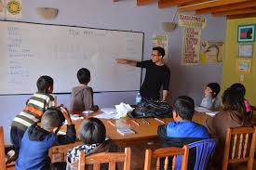
Formative feedback
It occurs during learning so students are able to act on it and is not punitive.

Slide 13

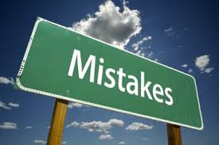
Formative feedback
Students advance their understanding through making mistakes and then learning to correct or avoid them.

Slide 14


Summative feedback
It is the final judgment on student achievement.
It is an end-of-semester exam or essay.

Slide 15
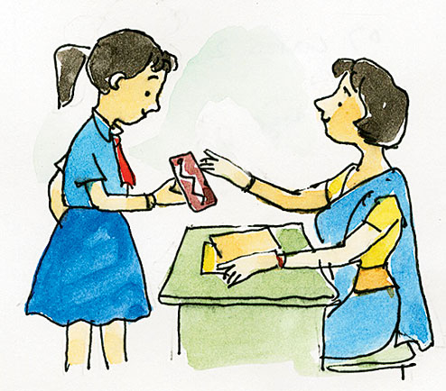
Summative feedback
It is a judgment and used to check learning at the end of a teaching episode.

Slide 16
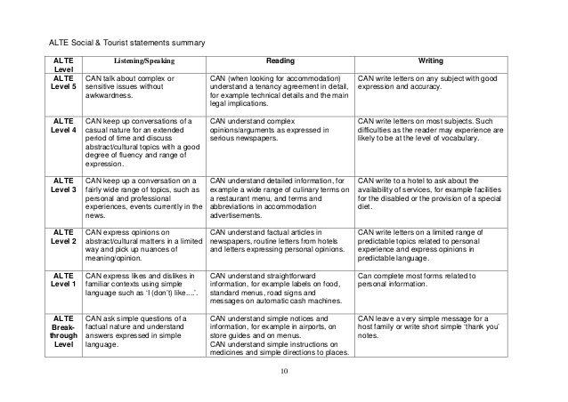
Summative feedback
It is used to grade, accredit or rank students and is usually expressed as a mark or grade.

Slide 17

Giving positive feedback
Be constructive
Be relevant
Be meaningful
Point ways of improving

Slide 18
Giving positive feedback
Always be on the lookout for positive points
successful communication
accurate use of grammar
good pronunciation
language style
handwriting: spelling, punctuation

Slide 19
Giving positive feedback: comment upon
Sucessful communication
Accuracy
Vocabulary
Where students have expressed themselves clearly and being understood by others.
Accurate use of grammar points or pronunciation seen recently.
Use of adequate vocabulary and appropriate expressions.

Slide 20
Giving positive feedback: comment upon
Fluency
Handwriting
Language
Good use of fluency in strategies in conversation.
Good spelling, mechanics in written language.
Use of language in the appropriate style; good use of colloquial expressions.

Slide 21
Use paralinguistic expressions
tone of voice
body
language
facial
expression
intonation

Slide 22
Unhelpful feedback
You’re totally wrong!
What’ve you been doing for the last 30 minutes?
Sheesh! Next person!

Slide 23

Unhelpful feedback
Comments that ‘pass the buck’:
• “You need help with your English.”
• “See an academic skills advisor.”

Slide 24
Avoid “need”
E.g.“Jane, you need to get your reports turned in on time, and you need to check them.”
Avoid “need to” phrases, which send implied messages that something that didn’t go well.
This message is not really performance feedback. It implies that Jane did not do something well with her reports, but it doesn’t report exactly what happened.
Providing clarity on what occurred is another aim of feedback.

Slide 25
Self-feedback
How have I been doing it?
What do I think of what I have been doing?
What have I been doing?
How could I improve my approach?

Slide 26

Peer-feedback
After performing a task talk about:
Two things to watch out for during this task…
Problems I encountered during this task and what I did to overcome them were …

Slide 27

Peer-feedback
After performing a task:
Mistakes that I wish I had avoided …
Two things that are worth doing before the task are …
Safe and acceptable shortcuts are …

Slide 28
Peer-feedback
It improves students’ learning outcomes, so may be in their best interests despite their perceptions.

Slide 29
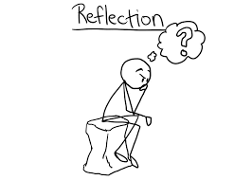
Sandwich approach
Where you give students a comment that identifies an area where they can improve ‘sandwiched’ between two positive comments that pick out where they have done well.

Slide 30

Effective feedback
It includes student elaboration.
Have students use their own language to describe the more effective strategy you are advocating.

Slide 31

Effective feedback
It focuses on increasing effort to use the more effective strategy.

Slide 32
Bibliography
Gower R. et al. ( 1998), Teaching Practice Handbook, London: Heinemann
Ramsden, P. (1992). Learning to teach in higher education. London: Routledge.
http://www.eflteachertraining.com/blog/giving-negative-feedback-to-students

