Slide 1

TÍTULO: “A TRIP TO THE PAST(business)”
Facultad de Contaduría y Administración
Facultad de Contaduría y Administración
Unidad de Aprendizaje: Inglés C1
Licenciatura en Administración
(Modalidad Presencial y a distancia)
SOLO VISIÓN PROYECTABLE
AUTORA:ROSA LILIANA CORDERO NAVA
Notes:
PORTADA 2

Slide 2


Unit of Competence D: Talking about important objects and people from the past
Talking about important objets from the past that revolutionized the history of the students’specific field of study using a wide range of different types of clues.
Speaking:
Interactions and production.
Expressing opinions and preference about the importance of objects or famous people from the past.
Notes:
INTERIORES

Slide 3
Guión explicativo: Objetivo
El presente material educativo (Sólo visión proyectable) está diseñado para el desarrollo de los objetivos de Expresión Oral de la Unidad de Competencia D del Nivel de Inglés C1 de la Dirección de Aprendizaje de Lenguas.
Talking about important objets from the past that revolutionized the history of the students’specific field of study using a wide range of different types of clues.
Expressing opinions and preference about the importance of objects or famous people from the past.

Slide 4
Guión explicativo: Escenario
El presente material educativo se puede utilizar en
Aula de clase: conversaciones en parejas o equipos.
Centro de Autoacceso: Asesorías individuales y prácticas de expresión oral.
Inglés C1 a distancia: Para asesorías a distancia, ya sea de grabación en voz o chat en vivo.

Slide 5
Guión explicativo: Contenido
El presente material se divide en cuatro secciones
USE OF PAST SIMPLE
HISTORY OF FAMOUS COMPANIES
HISTORY OF FAMOUS BUSINESS PEOPLE
OPINIONS

Slide 6

Use of the past simple

Slide 7
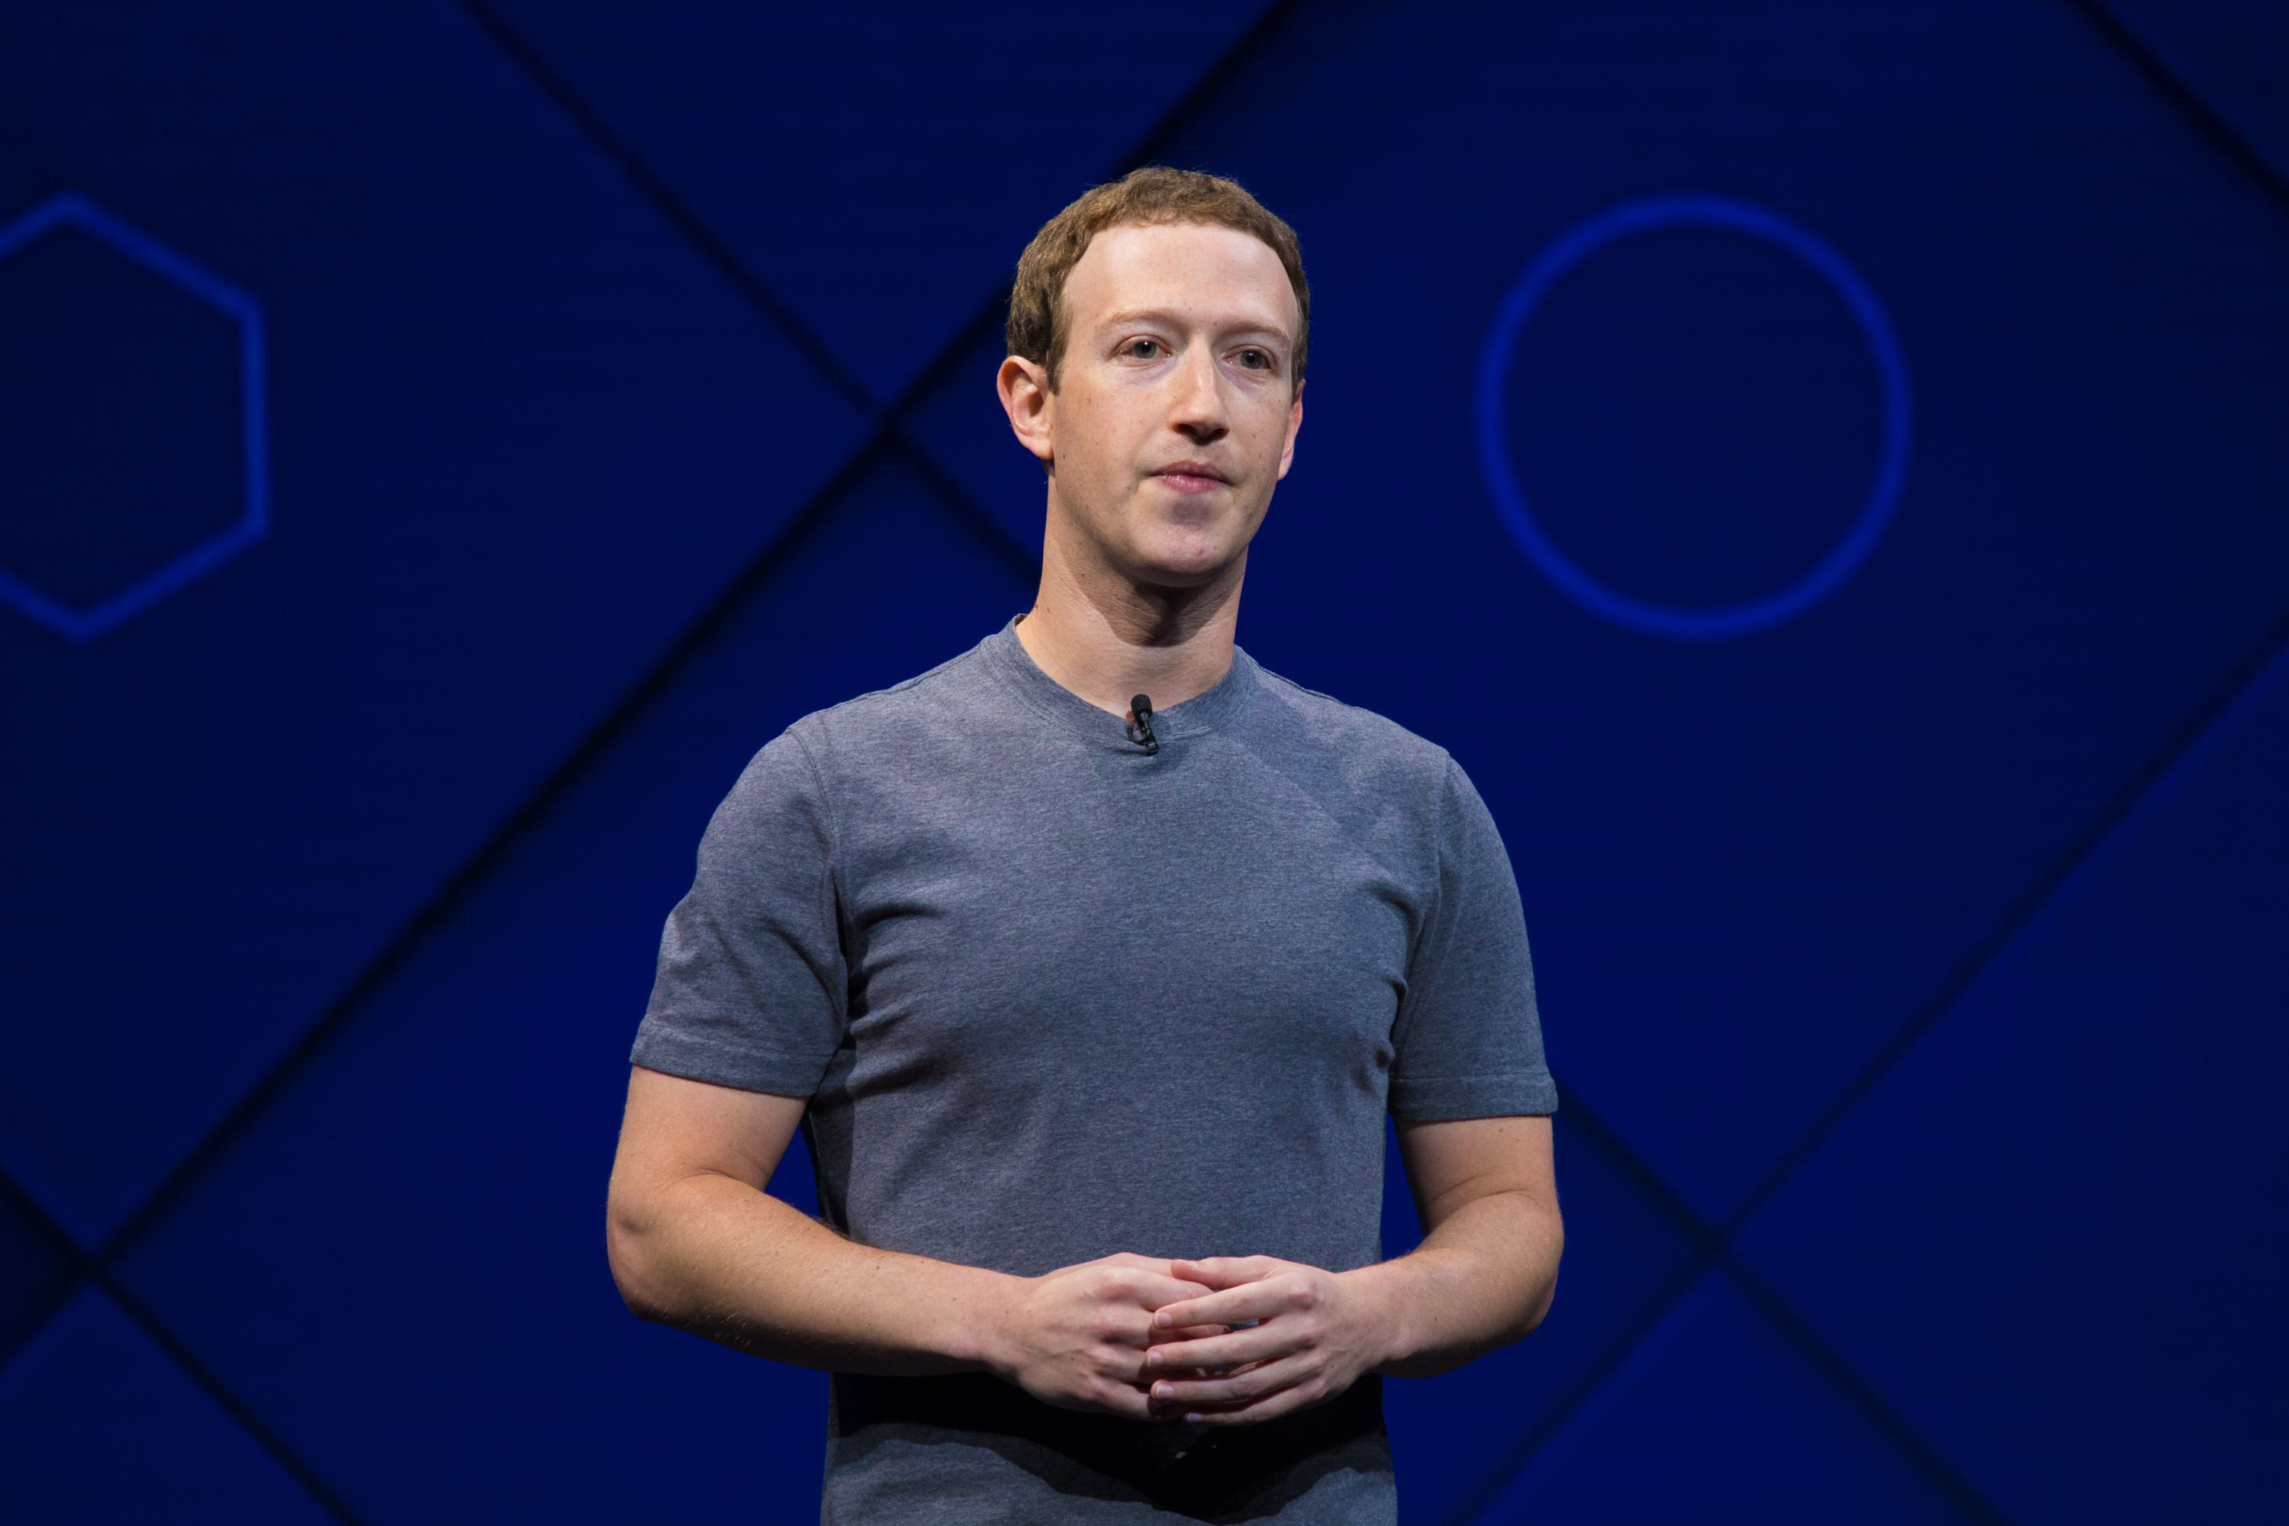
When do we use the past simple?
We use the past simple tense to talk about finished actions in the past.
When did he they create Facebook? He created Facebook in December 2004. I started the using Facebook last year.
Notes:
INTERIORES

Slide 8
past simple Structure
Affirmative
I installed a computer yesterday. She went to the Google office last year. He connected the networks on Friday. We attended to the training on Network cabling. You had a meeting about social networks .
Notes:
INTERIORES

Slide 9
past simple Structure
Negative
I didn’t install a computer yesterday. She didn’t go to the Google office last year. He didn’t connect he networks on Friday. We didn’t attend to the training on Network cabling You didn’t have a meeting about social networks .
Notes:
INTERIORES

Slide 10
past simple Structure
Time expressions
I look at that yesterday. I had broadband connected three days/ a month / two years ago. I used that system last week / year month. I started that user group on Monday / in June in 2001
Notes:
INTERIORES

Slide 11
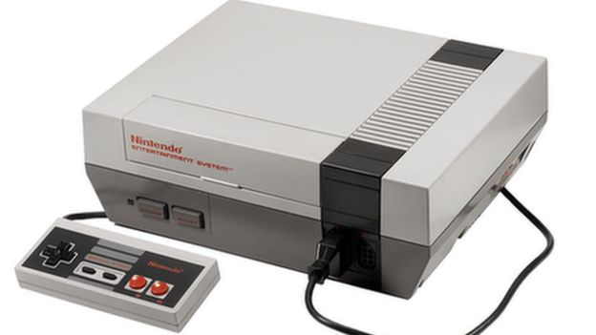
History of famous companies

Slide 12

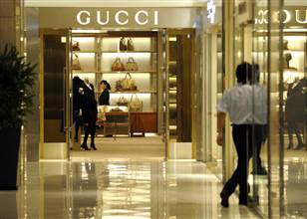

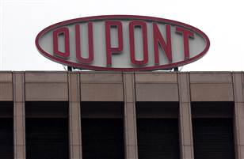
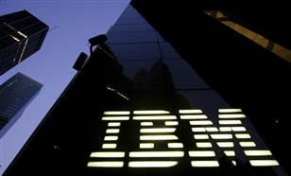
How much do you know about the history of these companies?
In the following slides you will see a
brief history of each company ➔
Notes:
INTERIORES

Slide 13
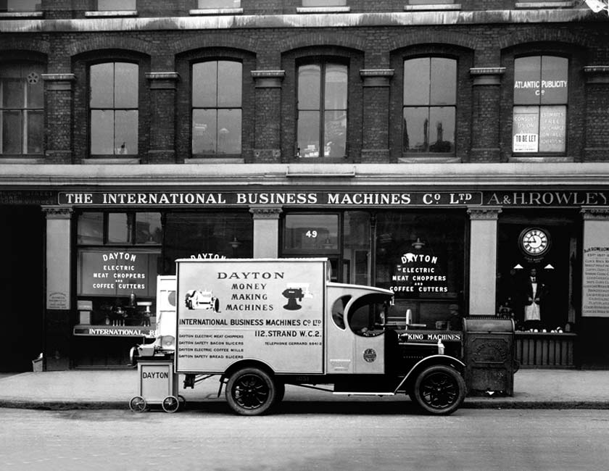
Answers: IBM
In 1911, Charles F. Flint started Computing- Tabulating- Recording Company (C-T-R) that manufactured and sold machinery ranging from commercial scales and industrial time recorders to meat and cheese slicers, along with tabulators and punched cards.

Slide 14
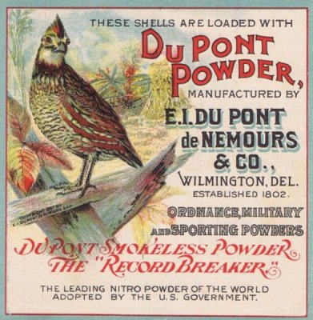
Answers: DUPONT
The company was founded in 1802, it had one focus: explosives. E.I. du Pont opened his first gunpowder mill on the Brandywine River in Wilmington, Delaware. By the mid-19th century, it was the largest supplier of gunpowder to the U.S. military.

Slide 15
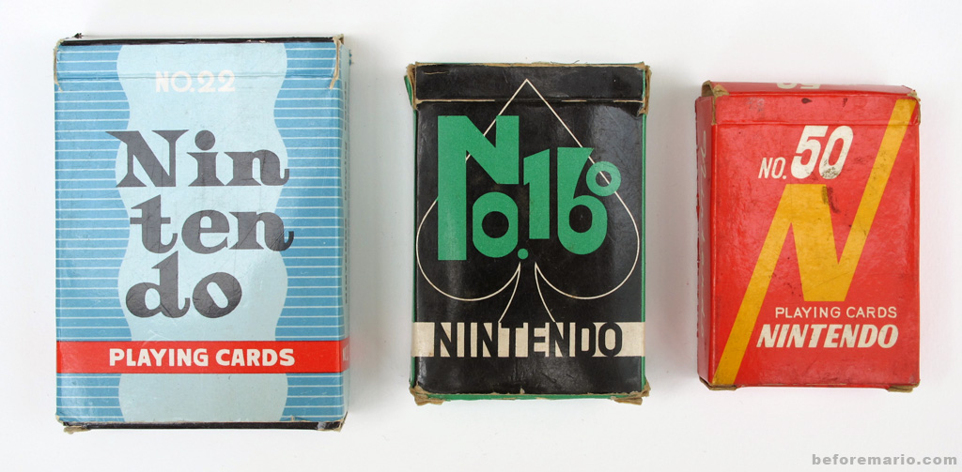
Answers: NINTENDO
This multinational company, based in Japan, started with simple playing cards. Nintendo Koppai was founded in 1889 to produce decks of cards made from the bark of mulberry trees. Its success in gaming systems started in the 1980s.

Slide 16
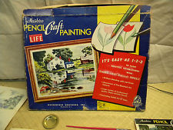
Answers: HASBRO
In 1926, brothers Henry, Hilal and Herman Hassenfeld began making pencil-box covers that were very popular at the time. In 1935, it began manufacturing the pencils as well. Toys didn't come until the end of the 1930s and were an extension of the company's line of school supplies.

Slide 17
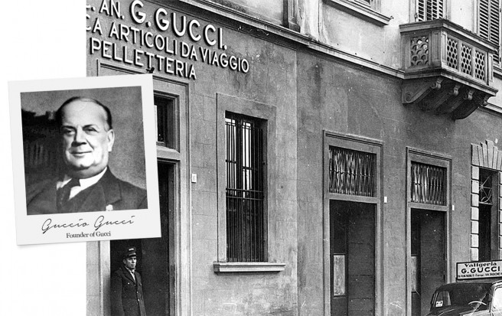
Answers: GUCCI
In 1921Gucci in began as a small, family-owned saddlery shop in Florence, Italy. Its focus was on leather goods for the fine horsemen: saddles, boots, gloves and saddle bags.

Slide 18
Prepare a short presentation about the history of a company.
Try to use the following verbs in simple past.
Achieve
Begin
Develop
Establish
Expand
Found
Increase
Launch
Manufacture
Produce
Reach
Want

Slide 19
Verbs in past simple
Achieve (achieved)
Begin (began)
Develop (developed)
Establish (established)
Expand (expanded)
Found (founded)
Increase (increased)
Launch (launched)
Manufacture (manufactured)
Produce (produced)
Reach (reached)
Want (wanted)

Slide 20
See the example below:
NINTENDO
In 1889 Fusajiro Yamauchi founded a small company to manufacture playing cards.
In1963 the company changed its name to Nintendo Co. Ltd. And started to manufacture games as well as playing cards.
1983 it developed the first console for use at home.
1989 Nintendo launched the Gameboy (the first console you can carry in your pocket)
In 2004 it released a new handheld console
In 2006 it achieved higher level of sales with the Wii (a console that allows players to physically move)

Slide 21
Ask and answer questions about
When was the company founded?
How long ago did…
When was the last time…
Who founded the company /invented?

Slide 22
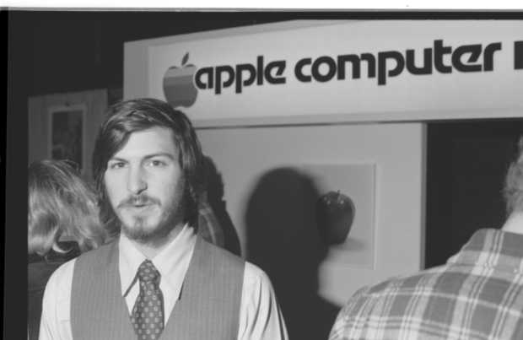
History of famous business people

Slide 23
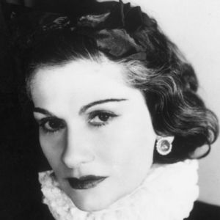
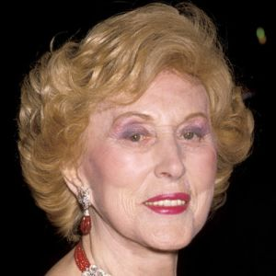
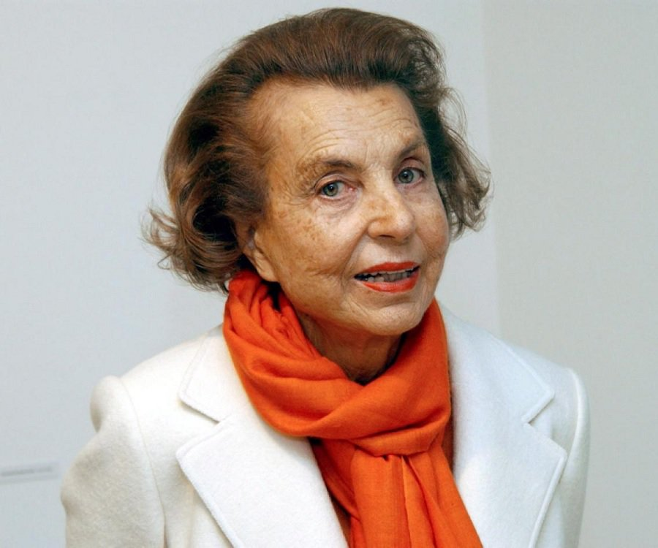
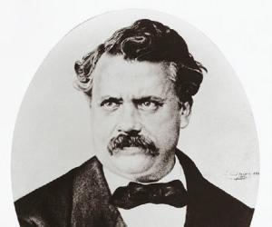
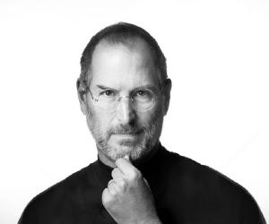
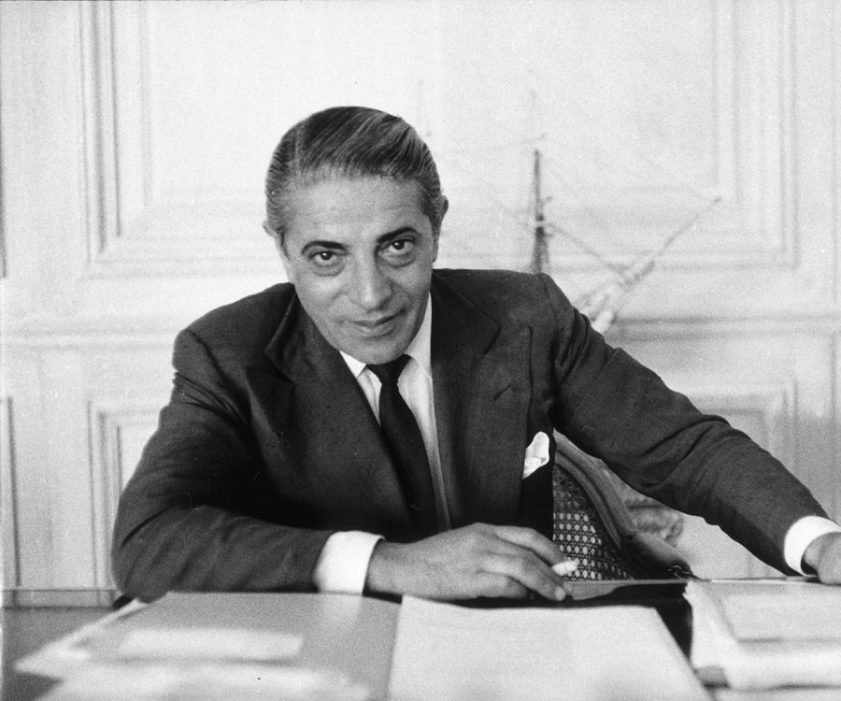
How much do you know about the history of these business people?
In the following slides you will see a
brief history of each business person ➔
Notes:
INTERIORES

Slide 24
Coco Chanel
1883-1971
Chanel was raised in an orphanage and taught to sew. She had a brief career as a singer before opening her first clothes shop in 1910. In the 1920s, she launched her first perfume and eventually introduced the Chanel suit and the little black dress, with an emphasis on making clothes that were more comfortable for women.

Slide 25
Estée Lauder
1908-2004
She came from a family of Jewish immigrants—her mother was Hungarian and her father was Czech.
Lauder showed her interest in beauty at an early age. She loved to brush her mother's long hair and apply creams to her face. Through her uncle, a chemist, Lauder later learned how to make her own beauty creams. She was only a teenager when she started selling her products at local hair salons.

Slide 26
Liliane Bettencourt
1922-2017
Liliane Bettencourt was one of the principal shareholders of L'Oréal
She was born as Liliane Henriette Charlotte Schueller on 21 October 1922 in Paris, France. She was the only child of Louise Madeleine Berthe and Eugène Schueller. Her father was a chemist while her mother was a pianist. Her mother died when Liliane was just five years old and she formed a very close bond with her father.

Slide 27
Steve Jobs
1955-2011
Born on February 24, 1955, Steve Jobs was the adopted son of Paul Reinhold and Clara Jobs. His biological parents were Abdulfattah ‘John’ Jandali and Joanne Carole Schieble, who could not raise Steve as their parents objected to their relationship.
Since a young age, Jobs was exposed to the world of mechanics. He spent long hours with his father, dismantling and rebuilding electronic devices in the family garage.

Slide 28
Louis Vuitton
1821-1892
Louis Vuitton was a French entrepreneur and designer who founded the iconic fashion house that carries his name.
Born to working class parents in rural 19th century France, he was expected to make a living as a carpenter, joiner, or a farmer but he became an apprentice in the workshop of a successful box-maker.

Slide 29
Aristotle Onassis
1906-1975
Aristotle Onassis was born in Smyrna, Greece and moved to Argentina.
Onassis started as an employee in the telephone exchange.
He then started a business empire, manufacturing cigarettes which not just made him a millionaire but a business tycoon.
He propelled further, diversifying his business interests, by obtaining a shipping business. No sooner he became a Geek Argentine shipping magnate.

Slide 30
Prepare a short presentation about the history of a businessperson.
Try to use the following verbs in simple past.
Is / are
have
Begin
become
Establish
Found
Increase
Launch
start
Produce
Reach
learn

Slide 31
Verbs in past simple
Is/are (was/were)
have (had)
Begin (begun)
Become (became)
Establish (established)
Found (founded)
Increase (increased)
Launch (launched)
Start (started)
Produce (produced)
Reach (reached)
learn (learned)

Slide 32

Opinions

Slide 33
Opinion
Answer the question using the phrases
suggested and the vocabulary below:
Do you think Internet has changed the way people do business?
I think… I believe…
communication
virtual
marketing
Places
Information
Notes:
INTERIORES

Slide 34
Opinion
Answer the question using the phrases
suggested and the vocabulary below:
Would you rather recommend starting a business in Mexico or in another country?
I would rather…
Constructions permits
Credit
Investors
Taxes
trading
Notes:
INTERIORES

Slide 35
Opinion
Answer the question using the phrases
suggested and the vocabulary below:
Would you prefer working in the public or private sector?
I would prefer…
Government
Television
Bank
School
companies
Notes:
INTERIORES

Slide 36
Opinion
Answer the question using the phrases
suggested and the vocabulary below:
It has been recently announced that there is a possibility that NAFTA collapses, as a result there would be a reduction of exports to the United states?
Would you support or oppose to this?
Products
Cheap
Expensive
Imports
exports
Notes:
INTERIORES

Slide 37
Opinion
Answer the question using the phrases
suggested and the vocabulary below:
If you could change one important thing about doing business in Mexico, What would you change?
I would change…
Working conditions
Taxation
Investment
Salaries
Holidays
bonus
Notes:
INTERIORES

Slide 38

References
12 famous companies’ surprising starts, Consulted in September 2017 from: http://www.nbcnews.com/id/39980719/ns/business-us_business/t/famous-companies-surprising-starts/
Best 20 companies, Consulted in September 2017 from: http://fortune.com/2013/05/06/20-companies-that-made-the-most/
Biography, Consulted in September 2017 from: https://www.biography.com/people/
Clarke, S. (2014). In company: pre intermediate students book. Macmillan. Thailand.
Hatten, T. (2016). Small Business Management. Cengage Learning. USA.
Murphy, R. (2015). Essential grammar in Use with answers. OUP. China.
Some images were taken from google images (used for academic purposes only) from https://images.google.com/
The famous people, Consulted in September 2017 from:https://www.thefamouspeople.com/
Notes:
CONTRAPORTADA

