Slide 1
Material Didáctico Audiovisual
Sólo Visión Proyectables Diapositivas
Inglés 2 - Módulo I
Bachillerato Universitario 2015
Ocasiones Especiales: ¿Qué está pasando? y ¿Qué hacen las personas que están a mí alrededor
Elaborado por: LLI. Cesar Martínez Acevedo
Plantel “Dr. Ángel Ma. Garibay Kintana”
de la Escuela Preparatoria

Slide 2
Inglés 2
PROPÓSITO GENERAL
Emplea el idioma inglés para satisfacer sus necesidades inmediatas de interacción, supervivencia y de relación con su entorno inmediato, de forma simple, por medio de expresiones cotidianas, frases comunes, familiares y aprendidas; y representaciones lingüísticas asociadas al contexto cultural y social.
Continuar

Slide 3
Módulo I
Nombre del Módulo
Ocasiones especiales: ¿Qué está pasando? y ¿Qué hacen las personas que están a mí alrededor?
Propósitos del Módulo
Describe su entorno social inmediato mencionando lo que está pasando a su alrededor y lo que hacen las personas a su alrededor.
Continuar

Slide 4
Competencia Disciplinar
Comunicación Básica
10 Identifica e interpreta la idea general y posible desarrollo de un mensaje oral o escrito en una segunda lengua, recurriendo a conocimientos previos, elementos no verbales y contexto cultural.
11. Se comunica en una lengua extranjera mediante un discurso lógico, oral o escrito, congruente con la situación comunicativa.
Extendida
9. Trasmite mensajes en una segunda lengua o lengua extranjera atendiéndolas características de contextos socioculturales diferentes.
Continuar

Slide 5
Competencia Genérica
4 Escucha, interpreta y emite mensajes pertinentes en distintos contextos mediante la utilización de medios, códigos y herramientas apropiados.
4.4 Se comunica en una segunda lengua en situaciones cotidianas.
7. Aprende por iniciativa e interés propio a lo largo de la vida.
7.1 Define metas y da seguimiento a sus procesos de construcción de conocimiento.
10. Mantiene una actitud respetuosa hacia la interculturalidad y la diversidad de creencias, valores, ideas y prácticas sociales.
10.2 Dialoga y aprende de personas con distintos puntos de vista y tradiciones culturales mediante la ubicación de sus propias circunstancias en un contexto más amplio.
Continuar

Slide 6
TEMAS
Simple Present vs. Present Continuous 1
Simple Present vs. Present Continuous 2
Simple Present Review
Present Continuous Review

Slide 7

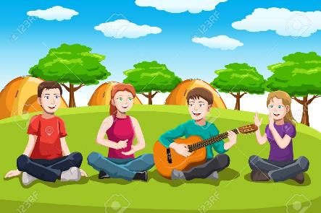

Simple Present Vs. Present Continuous 1
Hábitos, rutinas y descripción de acciones
que ocurren en el momento durante ocasiones especiales.

Slide 8
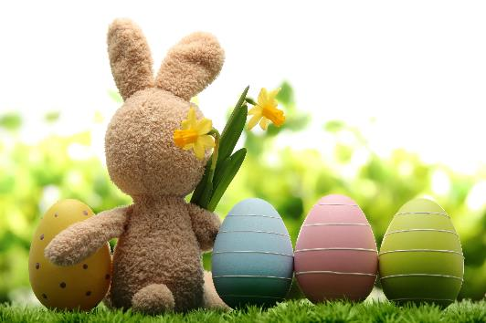
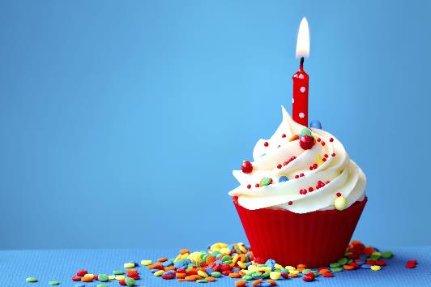
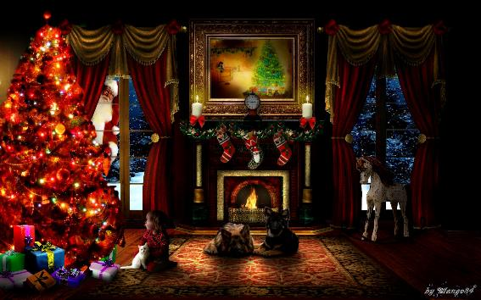
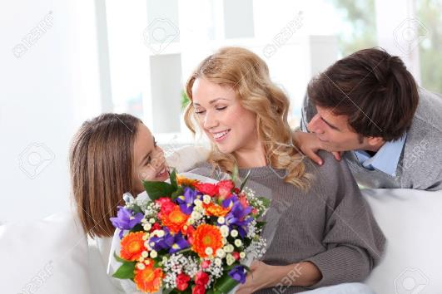

Special Occasions
Speaking
Look at the pictures and describe the occasions.
Easter
Birthday
Christmas Eve
Mother’s Day

Slide 9
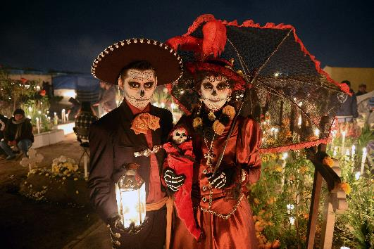

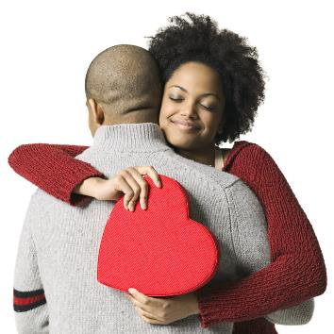

Special Occasions
Speaking
Look at the pictures and describe the occasions.
Day of the dead
New Year’s Eve
Valentine’s Day
Wedding Day

Slide 10
Describe the activities that you usually do in these occasions.
Writing
What do you usually do in…?
Occasion | Activities
Easter
Birthday
Christmas Eve
Mother’s Day
Day of the dead
New Year’s Eve
Valentine’s Day
Wedding Day

Slide 11
Speaking Activity
Work with a partner. Draw a chart in your notebook and complete the chart with his/her information.
Speaking
What do you usually do in…?
Occasion | Friend’s Activities
Easter
Birthday
Christmas Eve
Mother’s Day
Day of the dead
New Year’s Eve
Valentine’s Day
Wedding Day

Slide 12
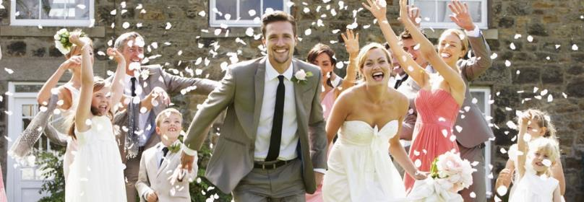
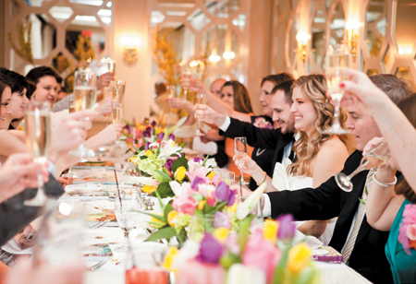
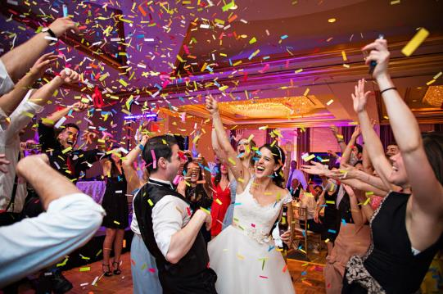
Look at the pictures and describe the activities that the people is doing now.
Writing
They are…
__________________________________.
__________________________________.
__________________________________.
__________________________________.
__________________________________.
__________________________________.

Slide 13
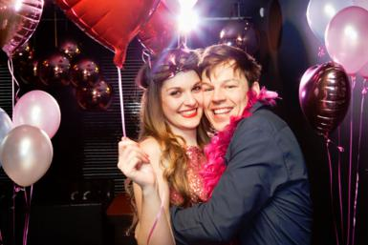
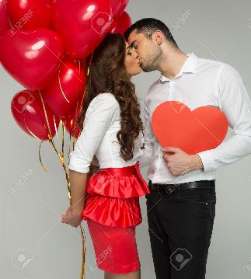
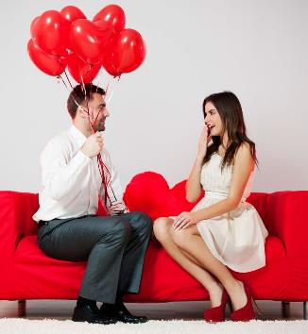
Look at the pictures and describe the activities that the people is doing now.
Writing
They are…
__________________________________.
__________________________________.
__________________________________.
__________________________________.
__________________________________.
__________________________________.

Slide 14
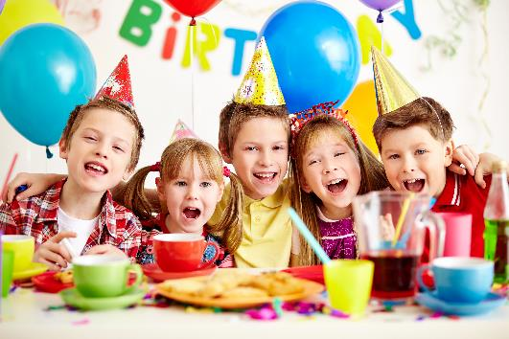
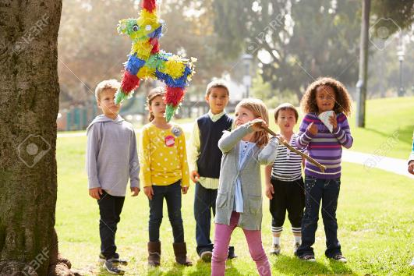
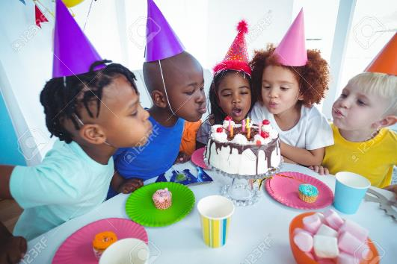
Look at the pictures and describe the activities that the people is doing now.
Writing
They are…
__________________________________.
__________________________________.
__________________________________.
__________________________________.
__________________________________.
__________________________________.

Slide 15
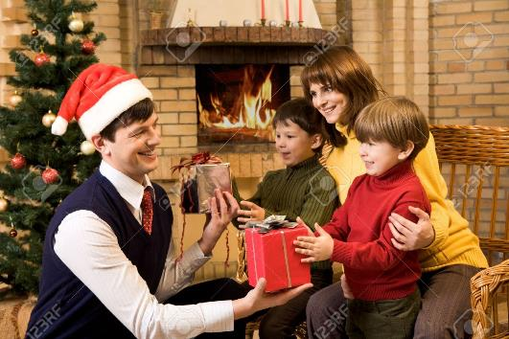
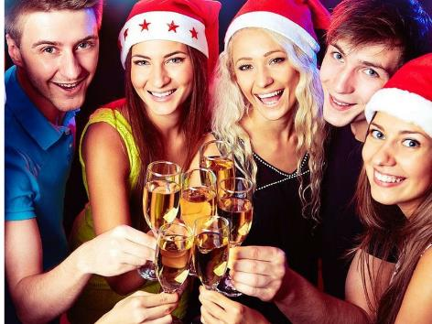
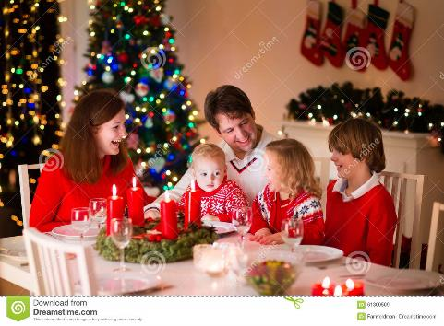
Look at the pictures and describe the activities that the people is doing now.
Writing
They are…
__________________________________.
__________________________________.
__________________________________.
__________________________________.
__________________________________.
__________________________________.

Slide 16
Simple Present Vs. Present Continuous 2
What’s the difference?

Slide 17
Competencias
Genéricas
4. Escucha, interpreta y emite mensajes pertinentes en distintos contextos mediante la utilización de medios, códigos y herramientas apropiados.
4.4 Se comunica en una segunda lengua en situaciones cotidianas.
Disciplinares
4 Produce textos con base en el uso normativo de la lengua, considerando la intención y situación comunicativa.
11 Se comunica en una lengua extranjera mediante un discurso lógico, oral o escrito, congruente con la situación comunicativa.

Slide 18
Simple Present
EXPLANATION
PAST
PRESENT
FUTURE
Use the PRESENT SIMPLE to express regular routines and habits.
The PRESENT SIMPLE is used to talk about actions and situations that are generally or permanently true.
The PRESENT SIMPLE is often used with adverbs of frequency.
Remember: Verb + “s” or “es”

Slide 19
Present Continuous
EXPLANATION
We use PRESENT CONTINUOUS to show that an action is happening at the moment.
Action in progress
PAST
PRESENT
FUTURE
dancing
sleeping
doing
crying
watching
eating
etc.
AM
IS
ARE

Slide 20
Simple Present vs Present Cotinuous
EXPLANATION
Every day, I watch TV at night.
In the evenings, my sister does her homework.
My father always cooks dinner.
Every weekend, my mother cleans the kitchen.
Right now, I’m watching my favorite TV series.
At the moment, my sister is doing her homework.
Now, my father is having dinner.
Look! My mother is cleaning the kitchen.

Slide 21
Expressions
EXPLANATION
SIMPLE PRESENT |  | PRESENT CONTINUOUS
Adverbs of frequency (always, usually, often, frequently, sometimes, seldom, rarely, hardly ever, never) Ever day, every week, every month, every year, etc. Once, twice, three times, four times… etc. a day/week/month/year |  | Now Right Now At the moment Today Listen! Look! Wait!

Slide 22
Look at the picture and choose the correct answer
PRACTICE
1. Peter drives / is driving a taxi in London.
2. He works / is working 12 hours a day.
3. He isn’t working / doesn’t work now.
4. He is reading / reads a newspaper.

Slide 23
Look at the picture and choose the correct answer
PRACTICE
5. Kate is a teacher. She teaches / is teaching physics.
6. She isn’t teaching / doesn’t teach now.
7. She has / is having a coffee.
8. She learns / is learning Greek because ...
9. …she is going / goes to Greece every summer.

Slide 24
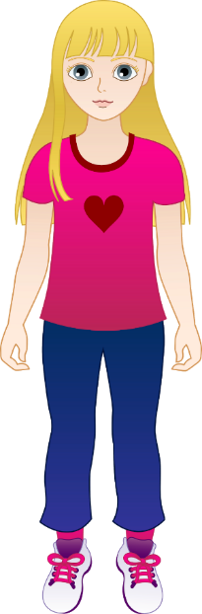

Fill in the blanks with the present continuous or the simple present of the verb in brackets.
GRAMMAR
I ______________ (go) to town right now. I ______________ (want) some groceries.
He ______________ (write) a letter to his family now. He ____________ (never) forgets to write.
He ______________ (not think) it is a good idea. He ______________ (want) to do something else.
She ______________ (talk) to her friend at the moment. She ______________ (not listen) to the teacher.
I ______________ (read) an interesting book now. I ____________ (enjoy) it very much.

Slide 25
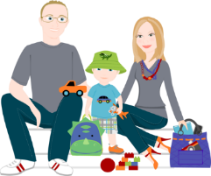
Fill in the blanks with the present continuous or the simple present of the verb in brackets.
GRAMMAR
We ______________ (watch) the news on television every morning.
He ______________ (teach) his friend how to play chess now. His friend ______________ (not know) how to play.
I ____________ (believe) you. You ______________ (not need) to explain.
The film ______________ (begin) right now. Please be quiet.
The sun is shining. It ______________ (not rain).

Slide 26

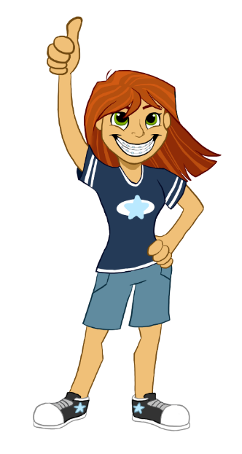

Simple Present or Present Continuous
GRAMMAR
He _____________________ to work everyday. (go)
Anne _____________________ to the music at the moment. (listen)
They _____________________ right now. (talk)
I _____________________ every morning. (jog)
He _____________________ friend this week. (help)
Mike _____________________ in the meeting. (sit)
We always _____________________ you. (help)
You _____________________ for your test. (learn)
Sometimes Mike _____________________ pizza. (eat)
He _____________________ in New york this year. (live)

Slide 27

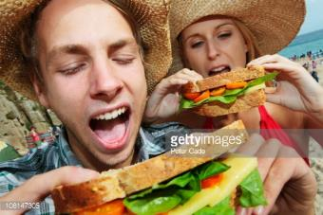
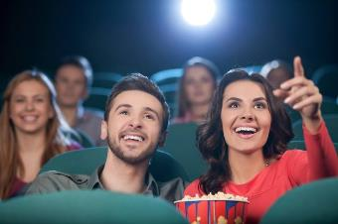
Simple Present Review
Describing averyday activities

Slide 28
Competencias
Genéricas
4. Escucha, interpreta y emite mensajes pertinentes en distintos contextos mediante la utilización de medios, códigos y herramientas apropiados.
4.4 Se comunica en una segunda lengua en situaciones cotidianas.
Disciplinares
4 Produce textos con base en el uso normativo de la lengua, considerando la intención y situación comunicativa.
11 Se comunica en una lengua extranjera mediante un discurso lógico, oral o escrito, congruente con la situación comunicativa.

Slide 29
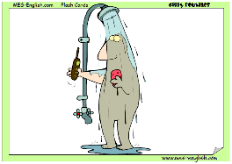
Instructions
Look at the pictures and describe the activity they do everyday.

Slide 30
What does he do?
SPEAKING

Slide 31
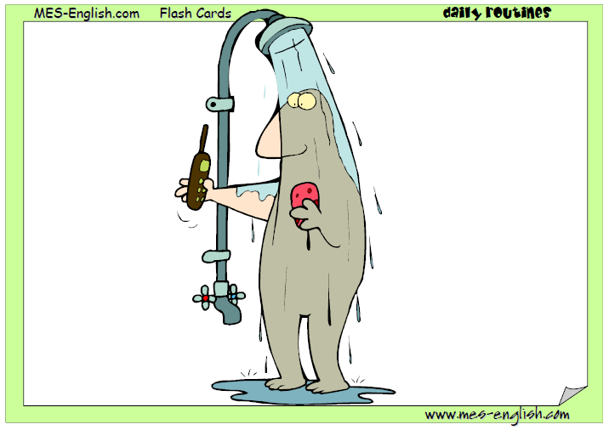
What does he do?
SPEAKING

Slide 32
What does she do?
SPEAKING

Slide 33
What does he do?
SPEAKING

Slide 34
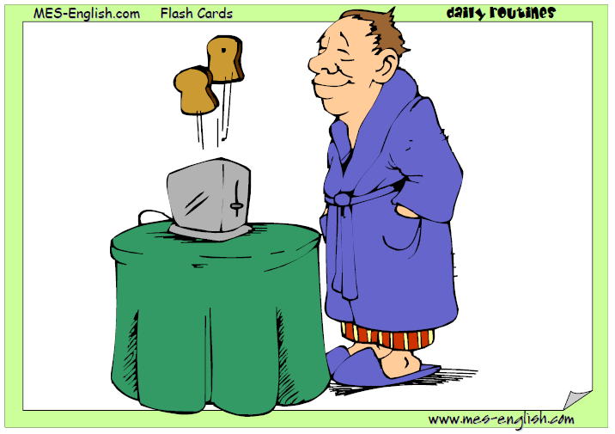
What does he do?
SPEAKING

Slide 35
What does he do?
SPEAKING

Slide 36
What does she do?
SPEAKING

Slide 37
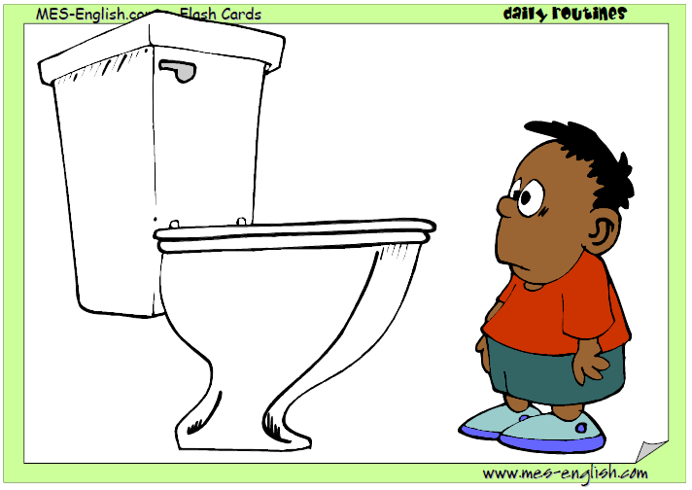
What does he do?
SPEAKING

Slide 38
What does he do?
SPEAKING

Slide 39
What does he do?
SPEAKING

Slide 40
What does he do?
SPEAKING

Slide 41
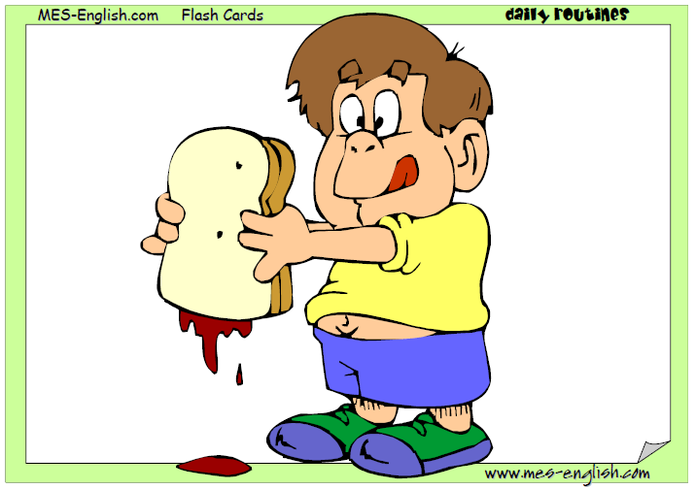
What does he do?
SPEAKING

Slide 42
What does he do?
SPEAKING

Slide 43
What does he do?
SPEAKING

Slide 44
What does he do?
SPEAKING

Slide 45
What does he do?
SPEAKING

Slide 46
What does he do?
SPEAKING

Slide 47
What does he do?
SPEAKING

Slide 48
What does she do?
SPEAKING

Slide 49
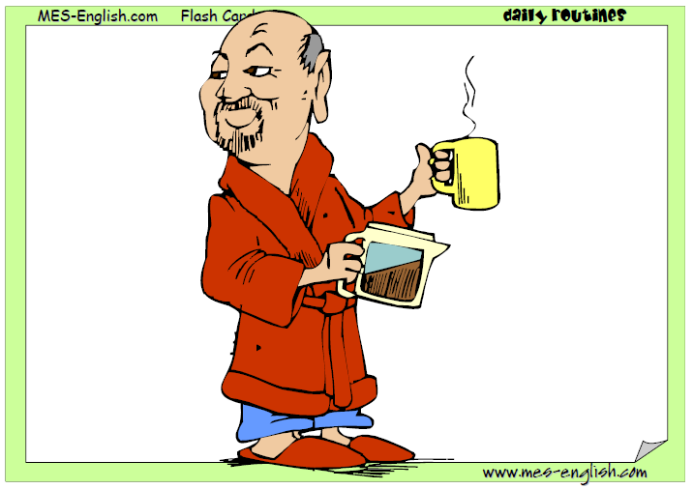
What does he do?
SPEAKING

Slide 50
What does he do?
SPEAKING

Slide 51
What does she do?
SPEAKING

Slide 52
What does she do?
SPEAKING

Slide 53
What does he do?
SPEAKING

Slide 54
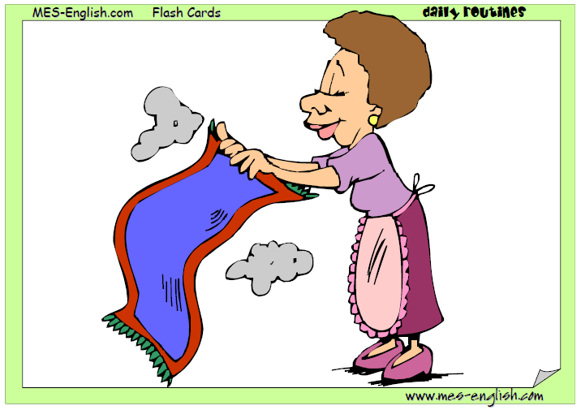
What does she do?
SPEAKING

Slide 55
What does he do?
SPEAKING

Slide 56
What does he do?
SPEAKING

Slide 57
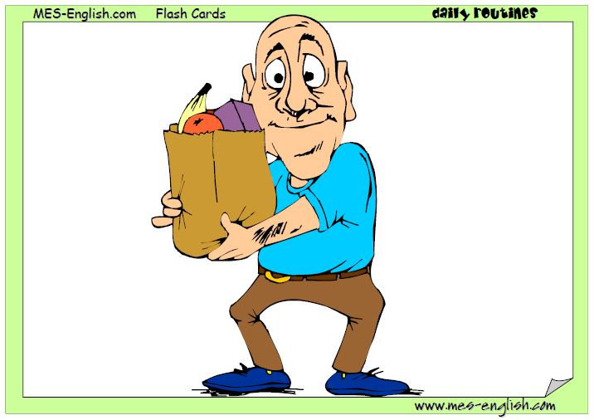
What does he do?
SPEAKING

Slide 58
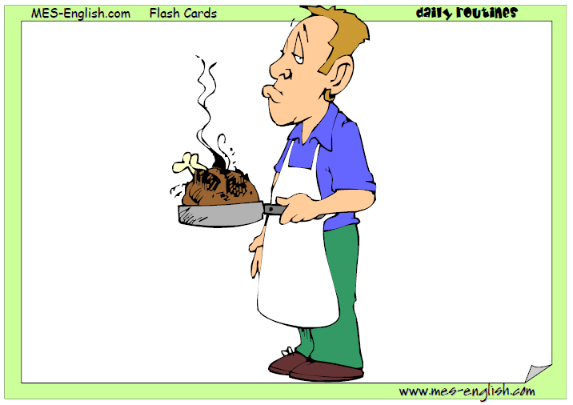
What does he do?
SPEAKING

Slide 59
What does she do?
SPEAKING

Slide 60
What does he do?
SPEAKING

Slide 61
Exercise
Complete the chart with your everyday activities.
GRAMMAR
Write two things you do…
In the morning | I get up early | I have breakfast
At night
At noon
On Mondays
At the weekends
After breakfast
Every day
Before bed

Slide 62
Use of English (Grammar)
SPEAKING
Put these words in the correct order to form sentences:
1. get/I/at/7/up/o'clock __________________________________
2. I/a/at/shower/have/o'clock/8 __________________________________
3. breakfast/at/he/has/half/past/8 __________________________________
4. goes/school/to/she/at/o'clock/9 __________________________________
5. has/she/lunch/at/o'clock/12 __________________________________
6. past/half/3/home/I/go/at __________________________________
7. dinner/have/I/o'clock/5/at __________________________________
8. bed/I/to/at/go/o'clock/9 __________________________________

Slide 63
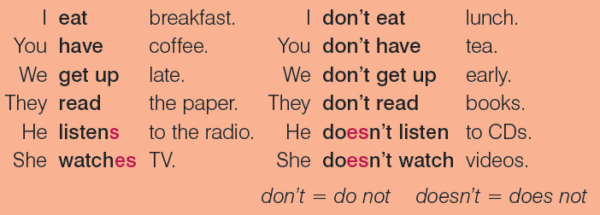
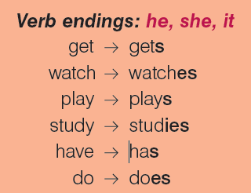
Simple Present Statements
EXPLANATION

Slide 64
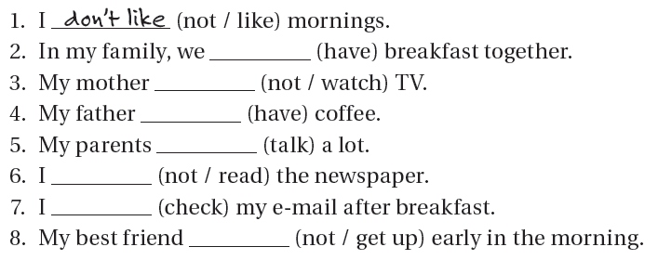
Exercise
Complete the sentences with the correct verb form.
GRAMMAR

Slide 65
Exercise
Answer the questions about you.
WRITING
1 What time do you get up? _______________________________________
2 Do you usually have a shower in the morning? ____________________________
3 How do you go to work or college? __________________________________
4 What time do you start work or college? _______________________________
5 Where do you usually have lunch? __________________________________
6 What do you have for lunch? _______________________________________
7 What time do you have dinner? _______________________________________
8 Who do you have dinner with? _______________________________________
9 What do you do in the evening? _______________________________________
10 What time do you go to bed? _______________________________________

Slide 66
Exercise: Ask two classmates the questions and complete the chart.
SPEAKING
Questions | Classmate 1 | Classmate 2
1 What time do you get up?
2 Do you usually have a shower in the morning?
3 How do you go to work or college?
4 What time do you start work or college?
5 Where do you usually have lunch?
6 What do you have for lunch?
7 What time do you have dinner?
8 Who do you have dinner with?
9 What do you do in the evening?
10 What time do you go to bed?

Slide 67
Adverbs of frequency
EXPLANATION
Adverbs of frequency are words that we use to say how often we do an activity.
EXAMPLES
I always study at night.
We usually play soccer in the park.
She often goes to the movies.
They sometime copy in the exams.
My cousin occasionally sends an email.
I seldom do exercise.
You rarely check your Facebook account.
I never help my friend with her homework.
ALWAYS
USUALLY
OFTEN
SOMETIMES
OCASSIONALLY
RARELY
HARLY EVER
NEVER
100%
0%

Slide 68
Adverbs of frequency
SPEAKING
HOW OFTEN DO YOU…?
… go to the movies?
ALWAYS
USUALLY
OFTEN
SOMETIMES
OCASSIONALLY
SELDOM
RARELY
NEVER
… cook at home?
… do exercise?
… clean your room?
… check your Facebook account?
… visit your grandparents?

Slide 69
Adverbs of frequency
WRITING
Rewrite the sentence putting the Adverb of Frequency in the correct place.
1. Karla listens to the pop music. (sometimes)
2. Joseph reads a book. (always)
3. My mother gets angry. (never)
4. Jessica is very friendly. (occasionally)
5. I take sugar in my coffee. (never)
6. Fabiola is hungry. (often)
7. My father goes for a walk in the morning. (always)
8. Walter helps his father in the kitchen. (usually)
9. Maria and Steve watch TV at night. (hardly ever)
10. Michael smokes after dinner. (seldom)

Slide 70
How often do you…?
WRITING
Think about the activities you do and describe some of them using Adverbs of frequency.
I usually do exercise in the morning.
I sometimes watch series on TV.
_____________________________________________.
_____________________________________________.
_____________________________________________.
_____________________________________________.
_____________________________________________.

Slide 71

Making Questions
SPEAKING
Instructions
Work in pairs in order to find out about your classmate’s activities?
What do you?
Do you play soccer? Yes, I do.
Do you study English? No, I don’t
Do you listen to music? Yes, I listen to pop.
How often do you play soccer? I never play soccer.
How often do you study English? I always study English.
How often do you listen to music? I sometimes listen to music.

Slide 72

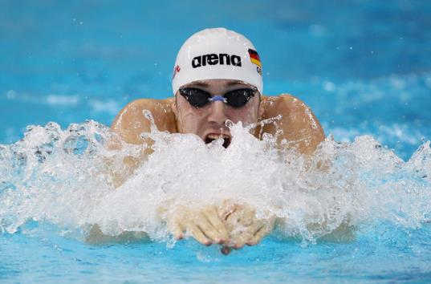

Present Continuous Review
Describing activities in the moment of speaking

Slide 73
Competencias
Genéricas
4. Escucha, interpreta y emite mensajes pertinentes en distintos contextos mediante la utilización de medios, códigos y herramientas apropiados.
4.4 Se comunica en una segunda lengua en situaciones cotidianas.
Disciplinares
4 Produce textos con base en el uso normativo de la lengua, considerando la intención y situación comunicativa.
11 Se comunica en una lengua extranjera mediante un discurso lógico, oral o escrito, congruente con la situación comunicativa.

Slide 74
SPEAKING ACTIVITY
Look at the following pictures and describe what’s happening.
Use Present Continuous

Slide 75
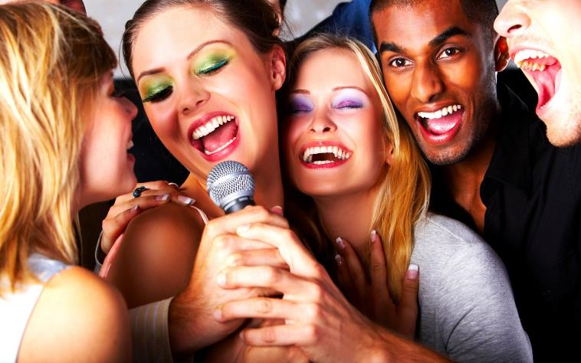
What is happening in the picture?
SPEAKING

Slide 76
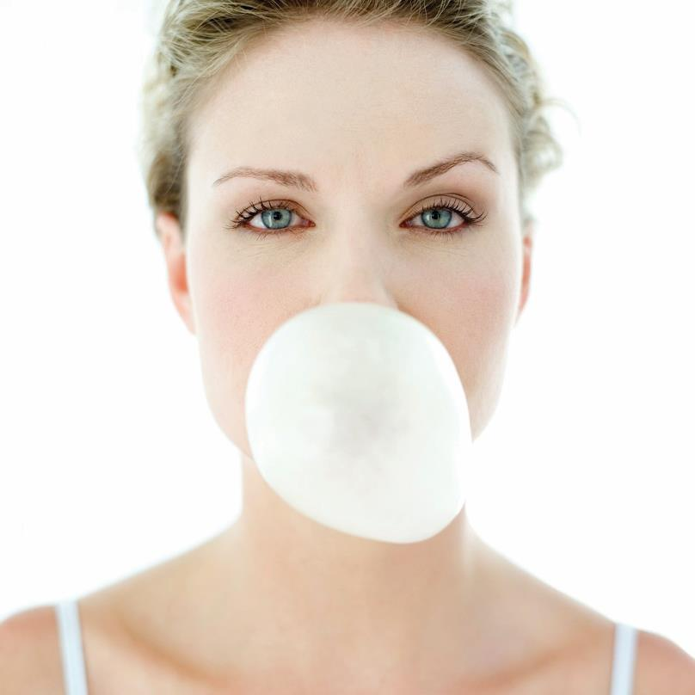
What is happening in the picture?
SPEAKING

Slide 77
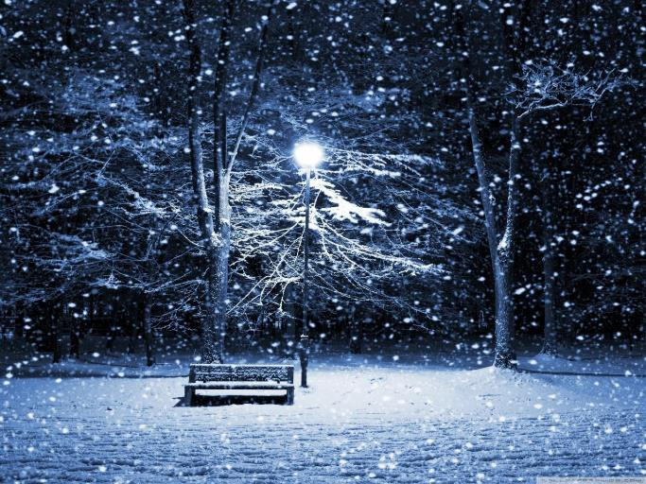
What is happening in the picture
SPEAKING

Slide 78
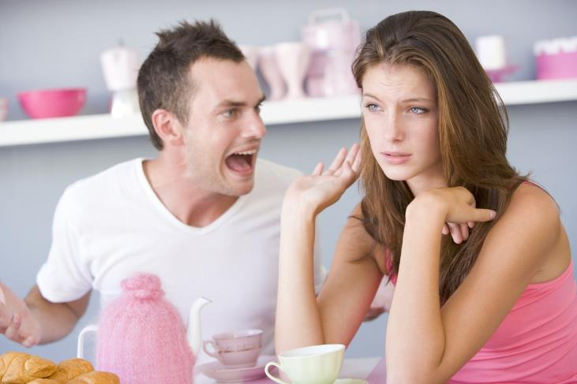
What is happening in the picture?
SPEAKIN
SPEAKING

Slide 79
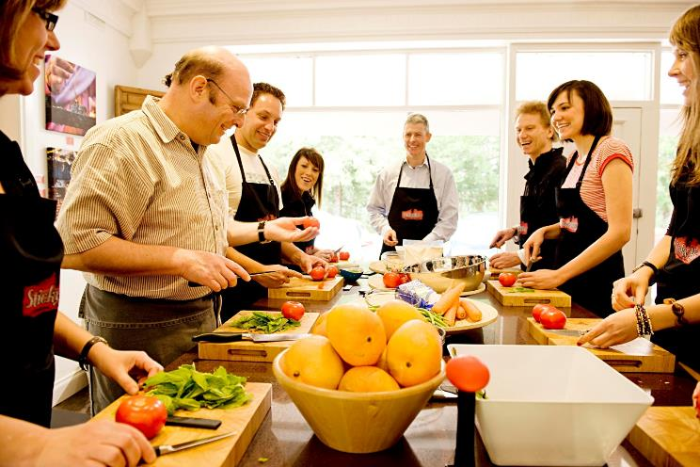
What is happening in the picture?
SPEAKING

Slide 80
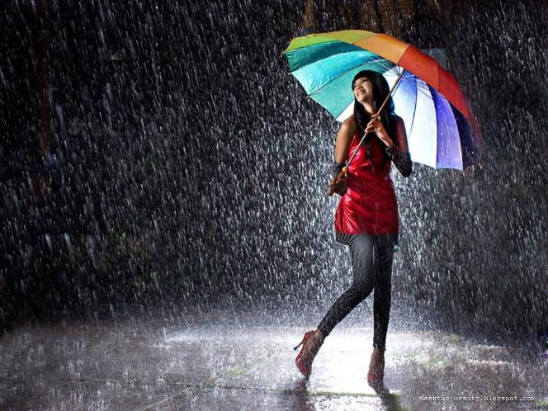
What is happening in the picture?
SPEAKING

Slide 81

What is happening in the picture?
SPEAKING

Slide 82
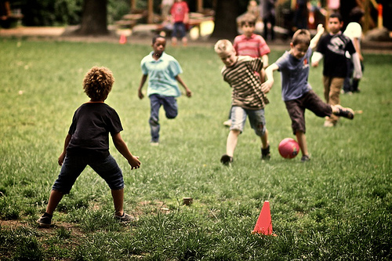
What is happening in the picture?
SPEAKING

Slide 83
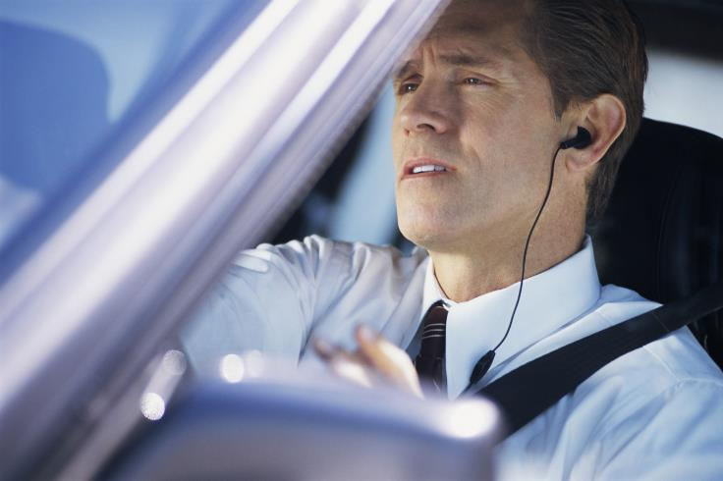
What is happening in the picture?
SPEAKING

Slide 84

What is happening in the picture?
SPEAKING

Slide 85
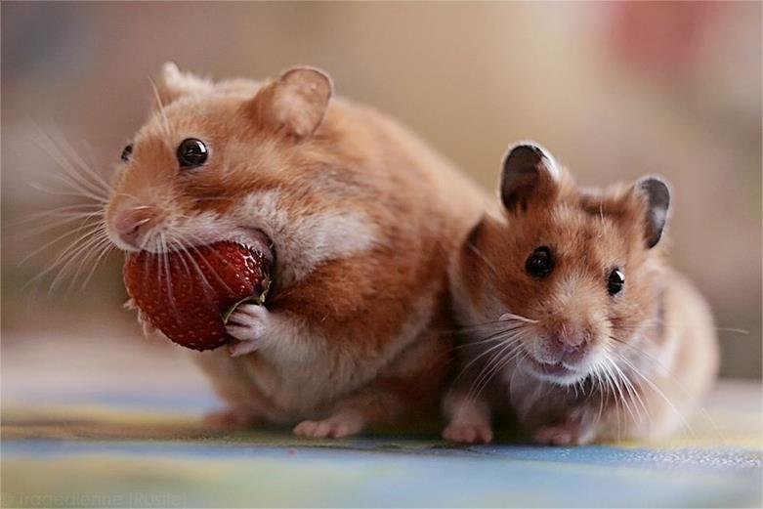
What is happening in the picture?
SPEAKING

Slide 86
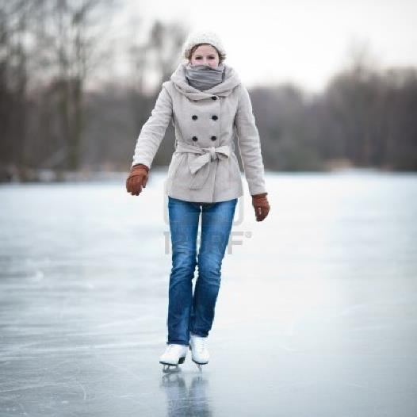
What is happening in the picture?
SPEAKING

Slide 87

What is happening in the picture?
SPEAKING

Slide 88
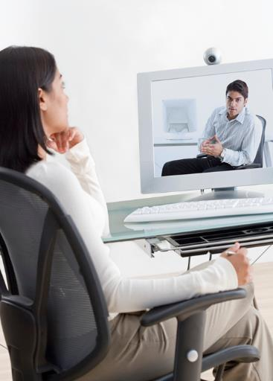
What is happening in the picture?
SPEAKING

Slide 89
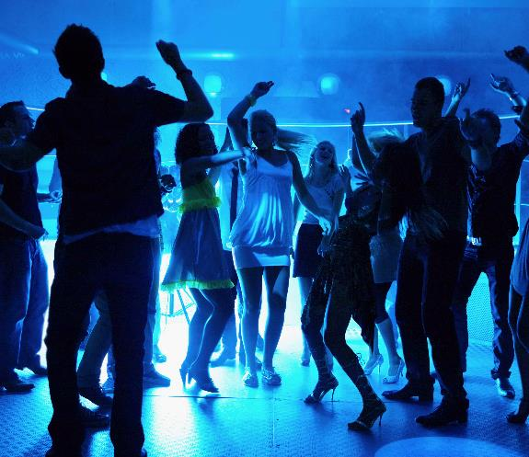
What is happening in the picture?
SPEAKING

Slide 90
There some expressions that we use in Present Continuous
NOW
Listen!
AT THE MOMENT
RIGHTNOW
Look!

Slide 91
And you…
WRITING
WRITING ACTIVITY
Describe three different activities that you
are doing at this moment.
What are you doing?
Right now,
I’m talking on the phone.
Now,
I’m writing a letter to my friend.
At the moment
I’m listening to pop music.
Examples

Slide 92
Don’t forget…
am
is
are
+
playing
singing
dancing
etc.

Slide 93
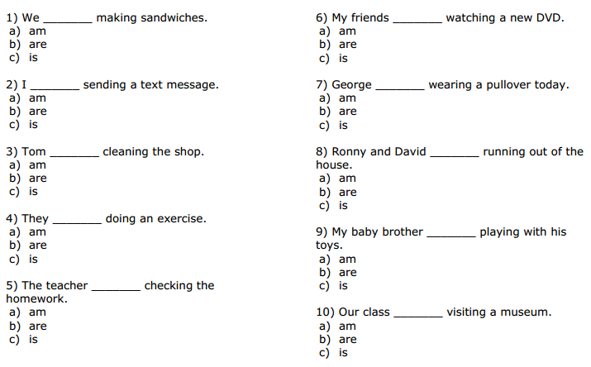
Exercise: Choose the correct verb to complete the sentence.
GRAMMAR

Slide 94
Exercise: Fill in the blanks with the verbs in brackets.
GRAMMAR
Example: He is writing a letter now.
1) I _______________ to the pet shop. (to go)
2) Look! The robber _______________ a bag. (to steal)
3) Listen! Pete and Joe _______________ . (to scream)
4) Look! They _______________ hands. (to shake)
5) Listen! Angela _______________ home. (to come)
6) I _______________ a bath right now. (to have)
7) Timmy _______________ the picnic basket. (to pack)
8) Dennis _______________ comics with Peter at the moment. (to swap)
9) We _______________ Stan from school. (to collect)
10) The cat _______________ through the window. (to climb)

Slide 95


Slide 96
Referencias
Mesografía
Presente Simple vs Presente Continuo 1 & 2
http://www.geocities.ws/hurtadopons/presents.pdf
Repaso Presente Simple
http://www.mes-english.com/flashcards/files/ppt/dailyroutines1.ppt
http://www.mes-english.com/flashcards/files/ppt/dailyroutines2.ppt
http://www.englishexercises.org/makeagame/viewgame.asp?id=80
http://www.esl.net/samples/touchstone/TE1U4.pdf
http://www.cambridge.org/us/esl/touchstone/images/pdf/SB1U4.pdf
http://www.language-worksheets.com/support-files/elementaryadverbsoffrequencyexercises.pdf
Repaso Presente Continuo
http://www.englisch-hilfen.de/en/download/test_present_progressive_en.pdf
https://www.englisch-hilfen.de/en/download/test_present_progressive_en_answers.pdf

Slide 97
Referencias Imágenes
Diapositiva 7
https://0.s3.envato.com/files/77681659/AS39.jpg
https://pbs.twimg.com/profile_images/2862008363/c704001153f6e191506c4341a611cb38_400x400.jpeg
Diapositiva 8 y 9
http://az616578.vo.msecnd.net/files/2016/03/25/635944802275079654398253038_Happy-Easter-Desktop-Wallpaper-HD-31.jpg
http://cdn.wallpapersafari.com/37/65/eoNVnk.jpg
http://www.justwhitedental.com/wp-content/uploads/2014/12/wedding.jpg?03e8d1
http://previews.123rf.com/images/goodluz/goodluz1202/goodluz120200361/12556993-Mother-s-day-celebration-in-family-Stock-Photo.jpg
http://r.hswstatic.com/w_907/gif/holidays-valentines-day.jpg
http://ar.cdn01.mundotkm.com/2015/10/halloween1.jpg
http://cdn.skim.gs/images/v1/msi/ipyl0gic7kwcu2karbxe/every-school-needs-to-adopt-the-birthday-cake-ban
http://ballyliffinhotel.com/static/uploads/media/new_year_christmas_glasses_champagne_clock_foretaste_mood_35854_2600x2280.jpg
https://heavyeditorial.files.wordpress.com/2015/11/gettyimages-186641559.jpg?quality=65&strip=all&strip=all
Diapositiva 12
http://homewoodsuites3.hilton.com/resources/media/hw/en_US/img/shared/carousel/main/HG_weddinghooray_970x336_FitToBox_Center.jpg
https://www.thecelebrationsociety.com/wp-content/uploads/2015/11/Wedding-Party-at-Recpetion-with-Confetti.jpg
https://40winksaday.files.wordpress.com/2013/03/wedding-reception.jpg
Diapositiva 13
http://previews.123rf.com/images/kiuikson/kiuikson1401/kiuikson140100066/25067456-Valentines-photo-of-kissing-couple-Stock-Photo.jpg
http://www.femmes-en-revue.com/wp-content/uploads/2015/01/saint-valentin-couple-amoureux.jpg
http://f.tqn.com/y/drawsketch/1/W/b/j/Valentines-Day.jpg

Slide 98
Referencias Imágenes
Diapositiva 14
http://previews.123rf.com/images/wavebreakmediamicro/wavebreakmediamicro1511/wavebreakmediamicro151103696/47714770-Excited-kid-enjoying-a-birthday-party-blowing-out-the-candles-Stock-Photo.jpg
http://ymcachgo.3cdn.net/48dd4dcb2cf25a487e_bnm62apkw.jpg
http://previews.123rf.com/images/stockbroker/stockbroker1507/stockbroker150706021/42307775-Children-Hitting-Pinata-At-Birthday-Party-Stock-Photo.jpg
Diapositiva 15
https://thumbs.dreamstime.com/z/family-christmas-dinner-home-big-three-children-celebrating-festive-fireplace-xmas-tree-parent-kids-eating-61300509.jpg
http://previews.123rf.com/images/pressmaster/pressmaster0812/pressmaster081200001/3968206-Photo-of-happy-father-giving-Christmas-gifts-to-surprised-sons-on-holiday-eve-Stock-Photo.jpg
https://assets.atdw-online.com.au/images/Original__10008377_AY69_Untitled_design_1_o4fqv8z.jpg?rect=0,0,2048,1536&w=800&h=600
Diapositiva 16
https://0.s3.envato.com/files/77681659/AS39.jpg
https://pbs.twimg.com/profile_images/2862008363/c704001153f6e191506c4341a611cb38_400x400.jpeg
Diapositiva 24
http://2.bp.blogspot.com/-n5l8uBv9IwA/UbQk3MNJlKI/AAAAAAAAAMA/_pTJSSb_sQY/s1600/Kartun+Cewek.png
http://img04.deviantart.net/fcc6/i/2015/136/e/9/olly_benito_cartoon_vector_by_tekrovergara-d8tjrta.png
Diapositiva 25
http://cliparts.co/cliparts/5iR/rab/5iRrabE6T.png
Diapositiva 26
http://pre10.deviantart.net/2c6c/th/pre/i/2015/091/e/4/cartoon_selfie_by_fire_topaz-d8o2cdj.png
http://www.1designshop.com/wp-content/uploads/2016/01/1dsp-20160105-business-011.png

Slide 99
Referencias Imágenes
Diapositiva 27
http://www.hobbiesforcouples.com/wp-content/uploads/2014/01/shutterstock_148169357.jpg
http://media.gettyimages.com/photos/couple-eating-large-sandwiches-on-beach-picture-id108147305?s=170667a
http://1.bp.blogspot.com/-_c6RrbNZ0xE/UlavsZIOpPI/AAAAAAAABys/Y1yIRWLdQcU/s320/adoles.png
Diapositiva 29-60
http://www.mes-english.com/flashcards/files/ppt/dailyroutines1.ppt
http://www.mes-english.com/flashcards/files/ppt/dailyroutines2.ppt
Diapositiva 71
http://ambito-financiero.com/wp-content/uploads/2013/05/preguntas-antes-de-invertir.jpg
Diapositiva 72
https://www.beastmodeprospecting.com/hs-fs/hubfs/student-taking-test2-667950-edited.jpg?t=1467044144558&width=3480&name=student-taking-test2-667950-edited.jpg
http://www3.pictures.zimbio.com/gi/10th+FINA+World+Swimming+Championships+25m+1QL2ixi_9yJx.jpg
http://www.retailwiseusa.com/wp-content/uploads/2014/04/Using-Music-To-Influence-Buying-Behavior.jpg

Slide 100
Referencias Imágenes
Diapositiva 75-89
http://image5.tuku.cn/wallpaper/Person%20Wallpapers/6525_1920x1200.jpg
http://www.implantomed.com.br/blog/wp-content/uploads/2013/01/Chicletes-Saudaveis-Odontoquality-Dentistas-dentes-Sc.png
http://lh3.googleusercontent.com/-vARv5cMODtY/Vmu3ylZkKHI/AAAAAAAAEdw/jR-vjCmP8is/s1600/156416.jpg
http://www.zirveart.com/uploads/posts/2016-06/1465931600_umenie-ssoritsya-slogaemoe-schastlivoy-semi-1.jpg
http://stickyricecookingschool.com.au/funstuff/wp-content/uploads/2009/01/sticky-rice-10.jpg
http://ullasamfm.com/wp-content/uploads/2016/08/page-img2.png
http://www.moderndent.com/wp-content/uploads/2015/09/modern-dental-healthy-college-students.jpg
http://nebula.wsimg.com/8dafa4cb9adf66bf95911a9ae7a96b14?AccessKeyId=063A7EAC25E985906F04&disposition=0&alloworigin=1
http://www.smartsuburbansurvival.com/wp-content/uploads/2016/07/distracted-person.jpg
https://i.ytimg.com/vi/GkbduqV86ck/maxresdefault.jpg
http://dailyhdwallpaper.com/wp-content/uploads/Hamster-Hd-Wallpaper-1680x1174.jpg
http://vignette1.wikia.nocookie.net/whatever-you-want/images/9/99/12405849-junge-frau-eislaufen-im-freien-auf-einem-teich-an-einer-eiskalten-wintertag.jpg/revision/latest?cb=20140112163511
https://www.beastmodeprospecting.com/hs-fs/hubfs/student-taking-test2-667950-edited.jpg?t=1467044144558&width=3480&name=student-taking-test2-667950-edited.jpg
http://psihoterapeutbeograd.com/images/on-line_psihoterapija.jpg
http://fashionmauritius.com/wp-content/uploads/hm_bbpui/4505/t6ghuyxj7pfyp7cxlzucixc8rao92klm.jpg
Diapositiva 95
http://www.references.net/root/app_common/img/top_logo_ref.png

