Slide 1
Material Didáctico Audiovisual
Sólo Visión Proyectables Diapositivas
Inglés 3 - Módulo I
Bachillerato Universitario 2015
El mundo del trabajo
Elaborado por: LLI. Cesar Martínez Acevedo
Plantel “Dr. Ángel Ma. Garibay Kintana” de la Escuela Preparatoria

Slide 2
Propósito General
Inglés 3
Interactúa en el idioma inglés de forma oral y escrita, en situaciones sociales o académicas relacionadas con áreas de experiencia que
le son especialmente familiares, para proporcionar información sobre sí mismo u obtener información de las personas que le rodean,
pasatiempos, describir intereses, actividades rutinarias, actividades en progreso, aspectos de su pasado personal y del lugar en donde
vive, eventos recientes, experiencias de vida; así como extraer información de distintas fuentes: visuales, auditivas y audiovisuales.

Slide 3
Módulo I
Nombre del Módulo
El mundo del trabajo
Propósitos del Módulo
Asocia elementos lingüístico – comunicativos para que de manera oral o escrita exprese sus planes en el futuro y haga predicciones basadas en una situación familiar que le sea familiar.

Slide 4
Competencia Disciplinar
Comunicación
Básica
10. Identifica e interpreta la idea general y posible desarrollo de un mensaje oral o escrito en una segunda lengua, recurriendo a conocimientos previos, elementos no verbales y contexto cultural.
11. Se comunica en una lengua extranjera mediante un discurso lógico, oral o escrito, congruente con la situación comunicativa.
Extendida
9. Trasmite mensajes en una segunda lengua o lengua extranjera atendiéndolas características de contextos socioculturales diferentes.

Slide 5
Competencia Genérica
4. Escucha, interpreta y emite mensajes pertinentes en distintos contextos mediante la utilización de medios, códigos y herramientas apropiados.
4.4 Se comunica en una segunda lengua en situaciones cotidianas.
7. Aprende por iniciativa e interés propio a lo largo de la vida.
7.1 Define metas y da seguimiento a sus procesos de construcción de conocimiento.
10. Mantiene una actitud respetuosa hacia la interculturalidad y la diversidad de creencias, valores, ideas y prácticas sociales.
10.2 Dialoga y aprende de personas con distintos puntos de vista y tradiciones culturales mediante la ubicación de sus propias circunstancias en un contexto más amplio.

Slide 6
TEMAS
Planes para
el futuro
Predicciones
hacia el
futuro

Slide 7


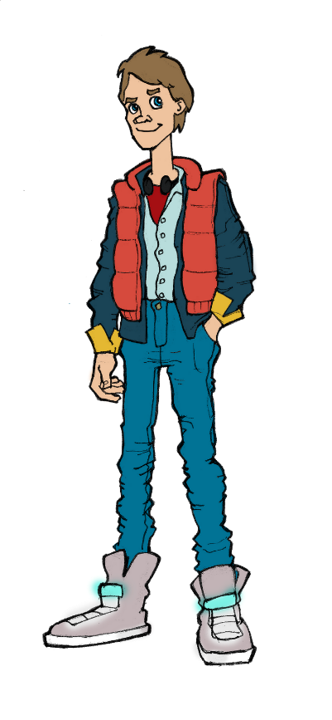



Jobs & Work
Occupations & Careers

Slide 8
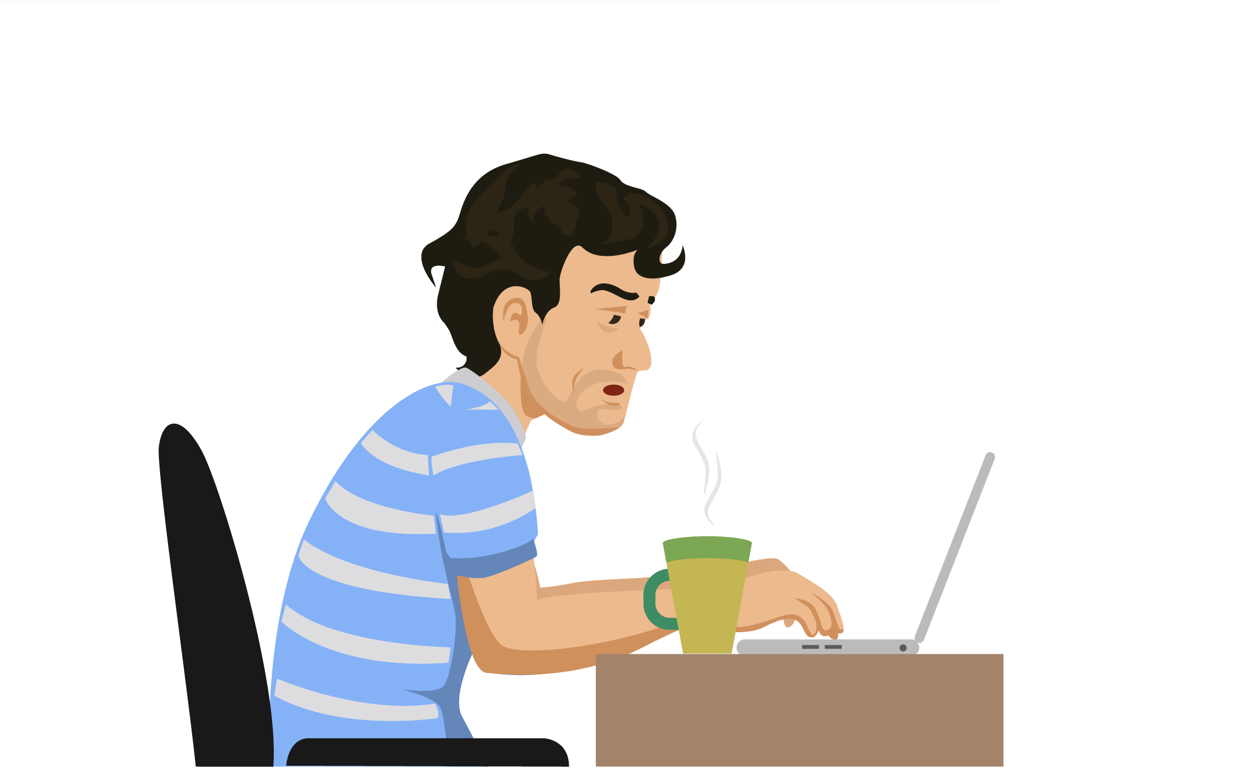
Occupations & Careers
Different people have different kinds of careers. There are many different kinds of careers and jobs to choose from. People have a wide choice of occupations they can do. Different careers require different kinds of responsibilities and duties. Different careers require different kinds of skills and abilities. They have different educational requirements and qualifications. Not everyone is suitable for every kind of career.

Slide 9

Brainstorm: Jobs & Occupations
Speaking

Slide 10

Occupations & Careers
Speaking
Think about 3 different careers.
In pairs, discuss the following questions:
What kinds of skills and abilities are required?
What educational requirements are required?
What kinds of responsibilities and duties are required?

Slide 11

Occupations & Careers
Speaking
Example: WAITER
What kinds of skills and abilities are required?
Good memory & balance, be polite, exceptional verbal and written communication skills, stress tolerance, etc.
What educational requirements are required?
High school is required for being a waiter.
What kinds of responsibilities and duties are required? Serve food or drinks to people, take orders, make food recommendations, collect payments from customers, remove dishes and glasses from tables, etc.

Slide 12
Occupations & Careers
Writing
Jobs/Careers | Skills & Abilities | Educational Requirements | Responsibilities & Duties

Slide 13
Occupations & Careers
Writing
Jobs | Skills & Abilities | Educational Requirements | Responsibilities & Duties
Waiter | Good memory & balance, be polite, exceptional verbal and written communication skills, stress tolerance, etc. | High school | Serve food or drinks to people, take orders, make food recommendations, collect payments from customers, remove dishes and glasses from tables, etc.

Slide 14
BE GOING TO
Future Plans

Slide 15
USES
Explanation
PLANS: Be going to is used to express plans made before the moment of speaking.
INTENTIONS: Be going to is used to describe things we expect to happen soon.
PREDICTIONS: Be going to is used to make predictions about the future based on physical (usually visual) evidence.

Slide 16
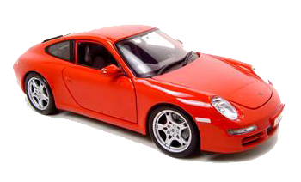
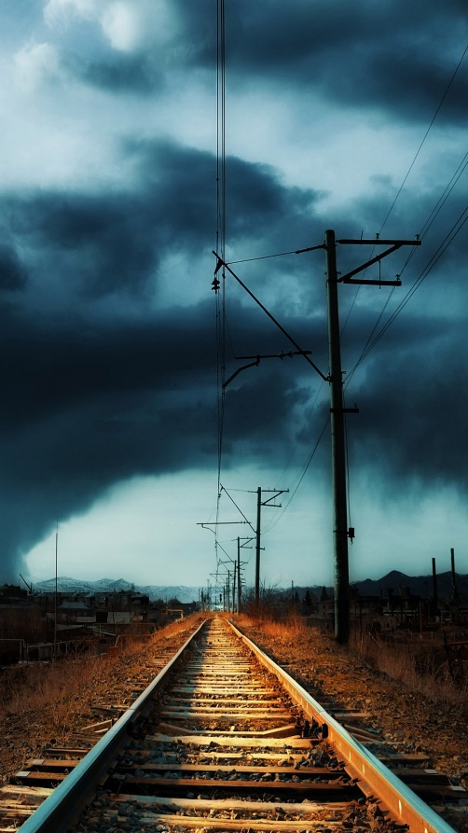

EXAMPLES
Explanation
John has won the lottery.
He says he’s going to buy a Porsche.
This semester is difficult.
I’m going to study very hard.
Look at the clouds!!
It’s going to rain in a few minutes.

Slide 17
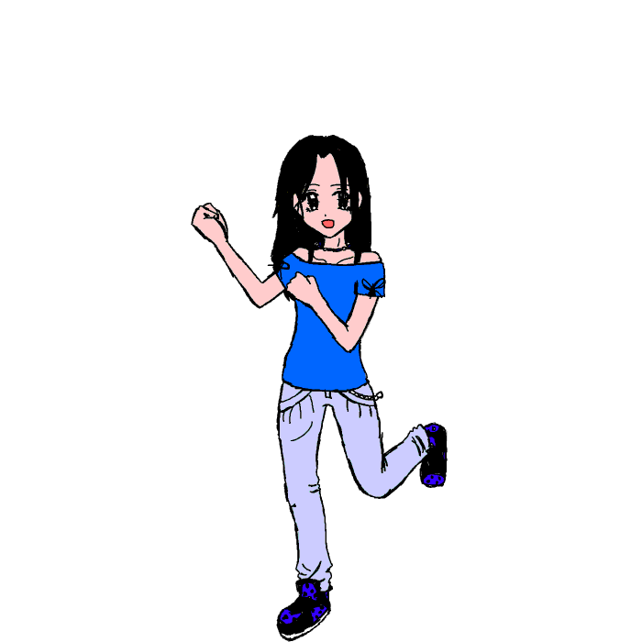
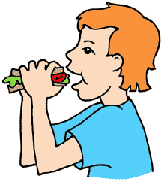
Explanation
POSITIVE
I | am | going to | work
You | are | going to | eat
He | is | going to | dance
She | is | going to | swim
It | is | going to | rain
We | are | going to | study
They | are | going to | sleep

Slide 18

Example:
Explanation
My friend is going to read a book.

Slide 19
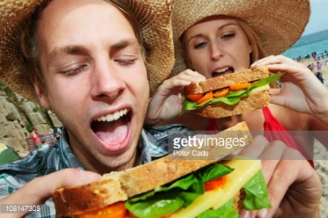
Example:
Explanation
They are going to eat a sandwich.

Slide 20
TIME EXPRESSIONS
Explanation
TOMORROW
NEXT WEEK
NEXT MONTH
NEXT YEAR
SOON
IN A MONTH

Slide 21
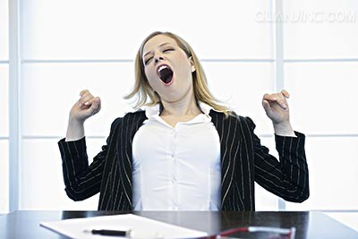
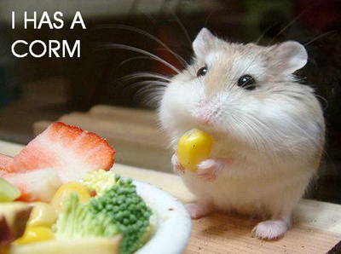
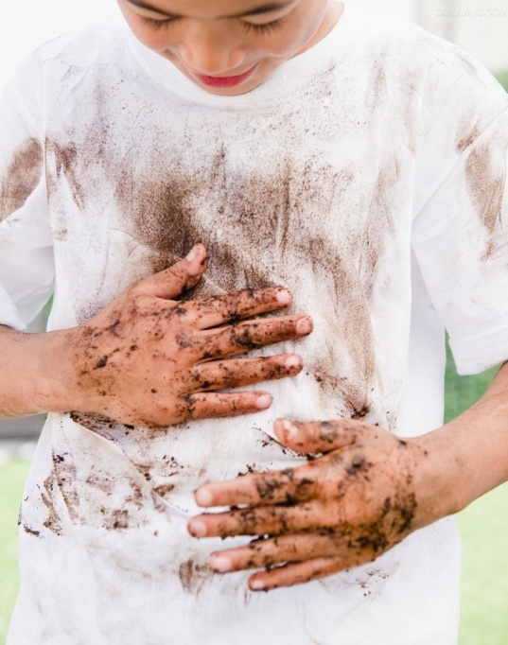
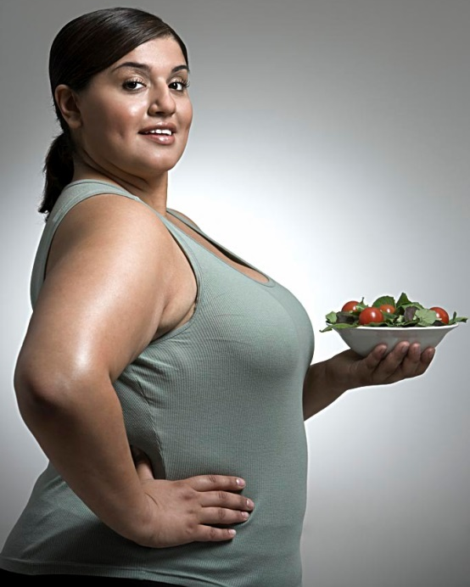
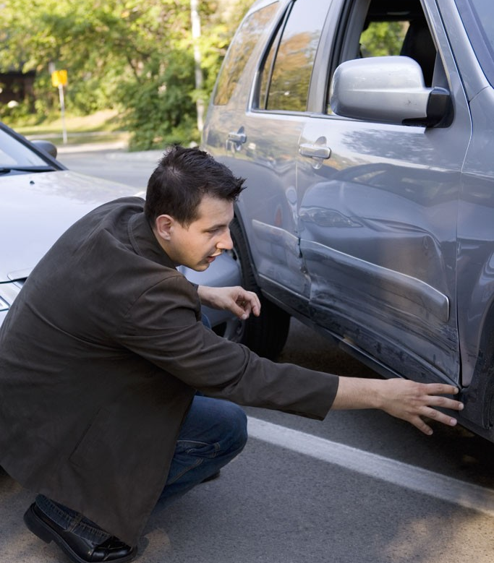
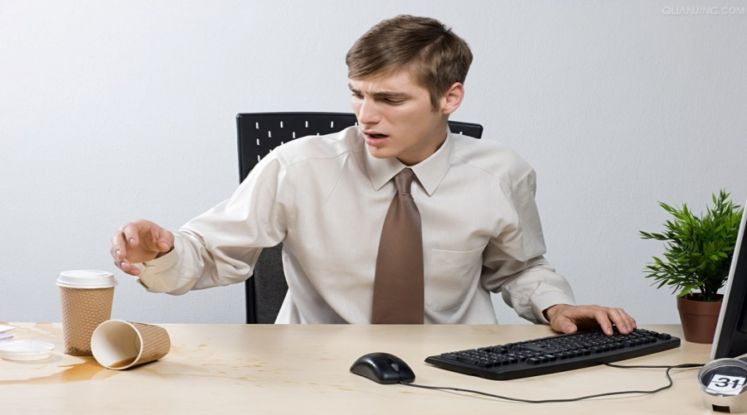
Speaking
Talk about the pictures by using BE GOING TO.
A
B
C
D
F
E

Slide 22
PLANS

Slide 23
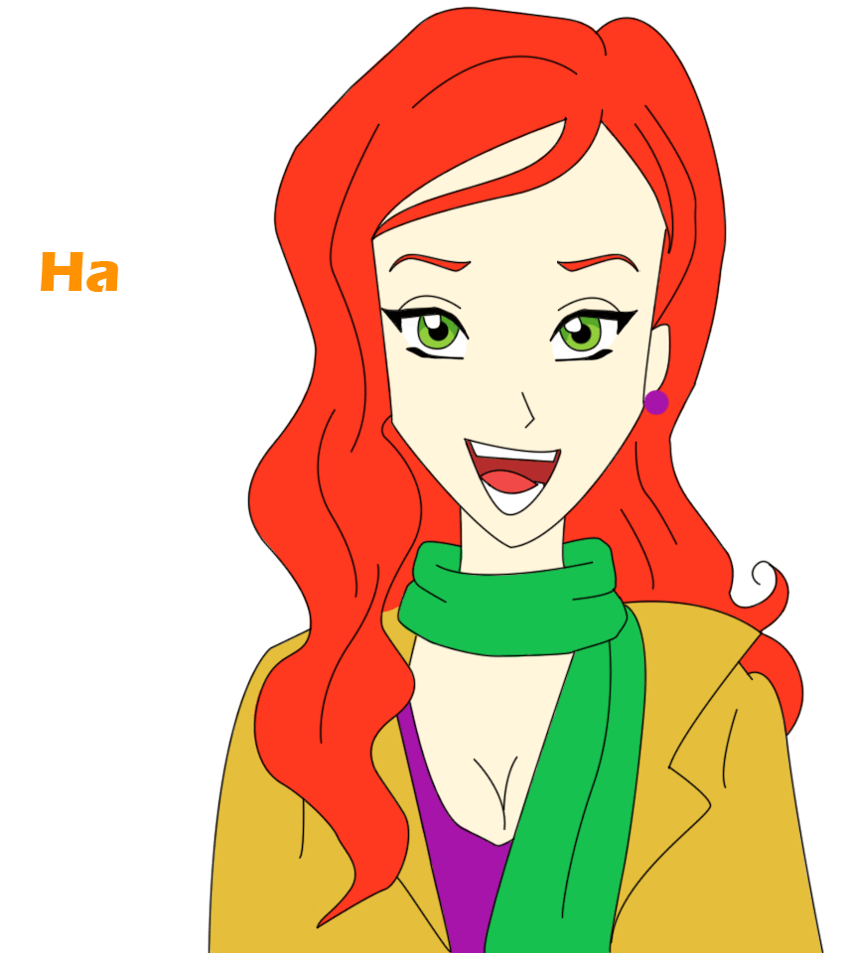
Activity: complete the chart with your own information.
Writing
What are you going to ….?
Activity | Me
DRINK
BUY
EAT
DO
STUDY

Slide 24
Activity: complete the chart with your own information.
Writing
What are you going to ….?
Activity | Me
DRINK | I’m going to drink juice.
BUY | I’m going to buy a cellphone.
EAT | I’m going to eat chilaquiles.
DO | I’m going to do yoga.
STUDY | I’m going to study Italian.

Slide 25
Activity: Make questions to know about your calssmates’ activities.
Speaking
What are you going to ….?
Activity | Student 1 | Student 2
DRINK | Ana is going to … | Ian is going to …
BUY
EAT
DO
STUDY

Slide 26
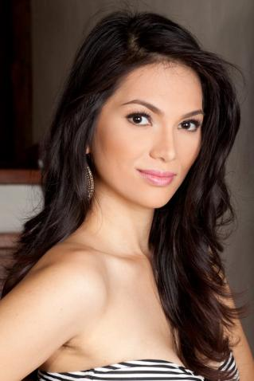
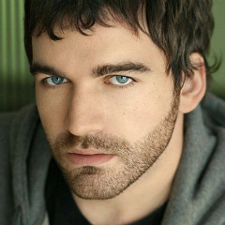
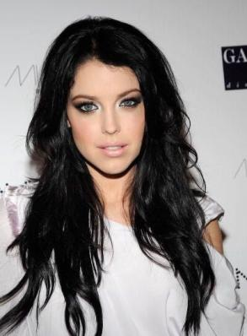
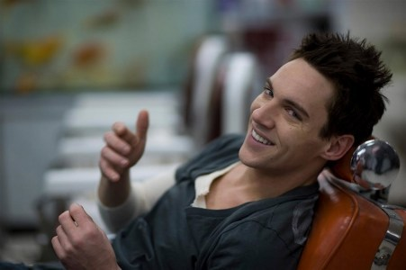
What are they going to do next month?

Slide 27
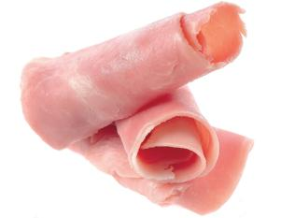
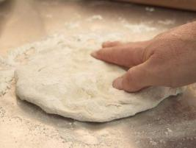
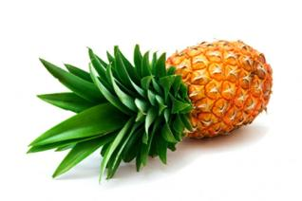
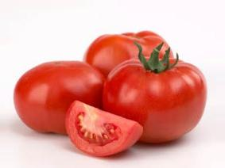
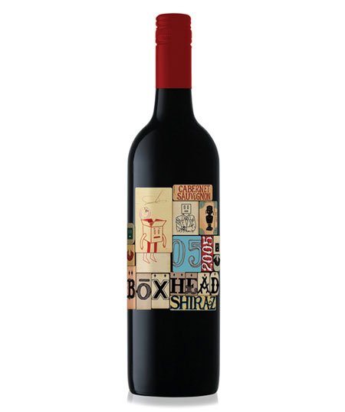
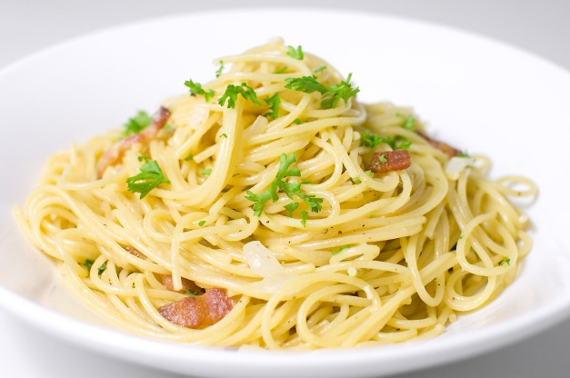

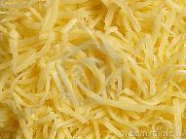
Kiera
Speaking
Kiera is going to…

Slide 28

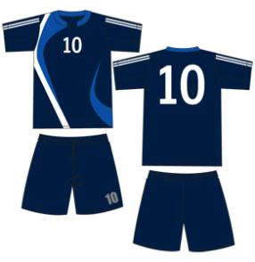
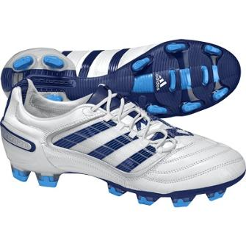
Steve
Speaking
Steve is going to…

Slide 29
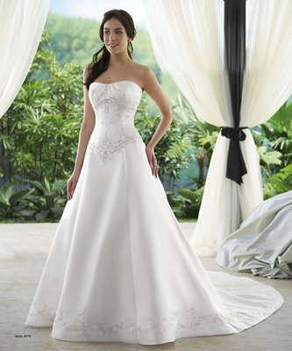



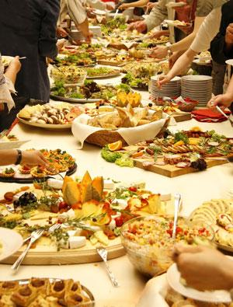
Camilla
Speaking
Camilla is going to…

Slide 30
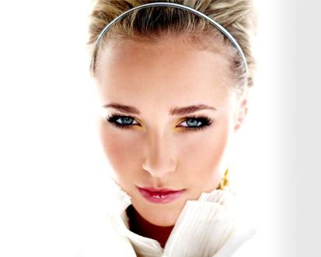
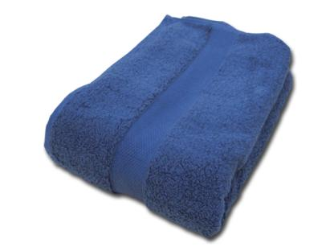
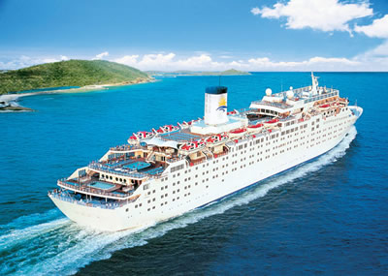
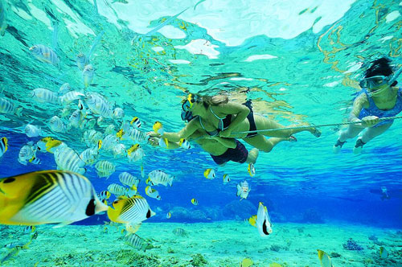
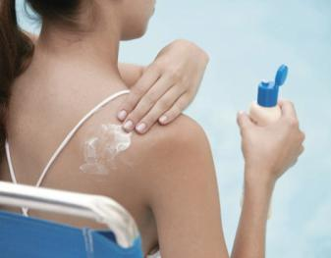
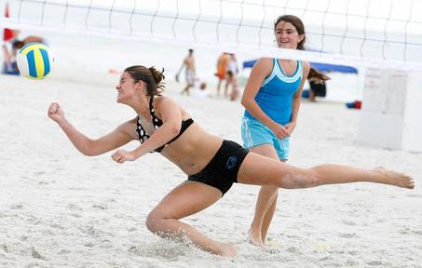
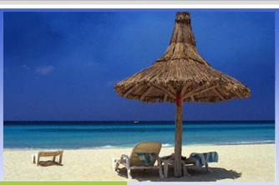
Hayden
Speaking
Hayden is going to…

Slide 31
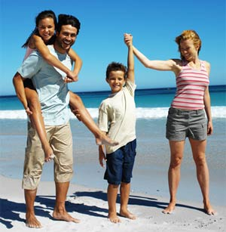
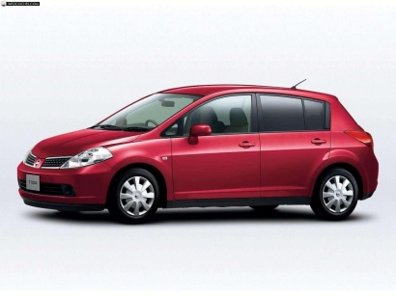
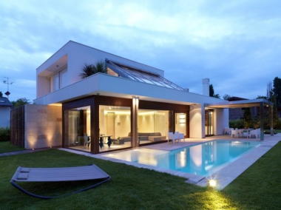
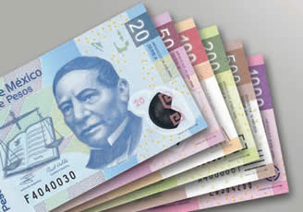
Jonathan
Speaking
Jonathan is going to…

Slide 32
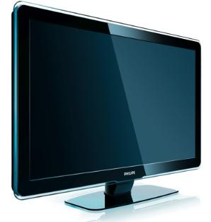


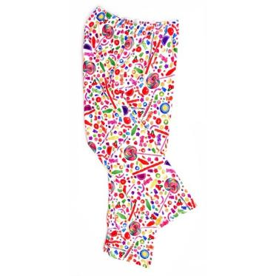
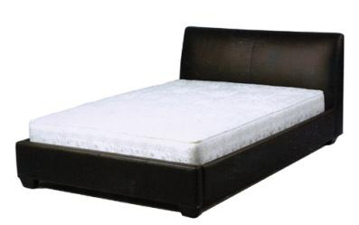
Maria
Speaking
Maria is going to…

Slide 33
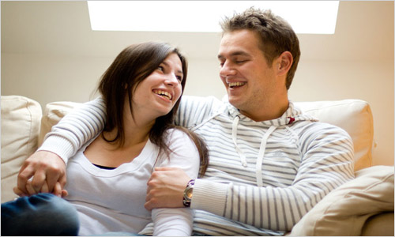

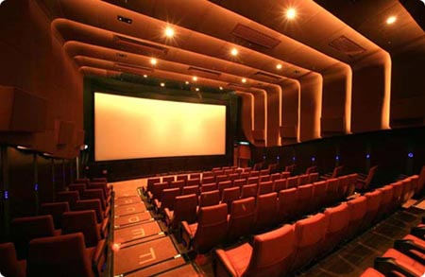
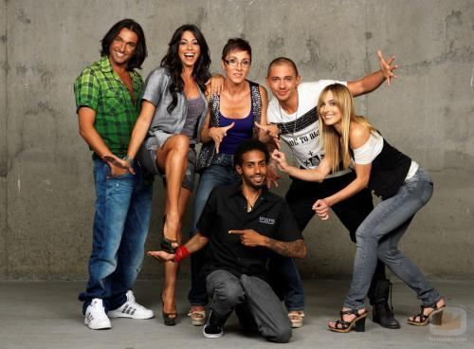

Monica &David
Speaking
Monica &David are going to…

Slide 34
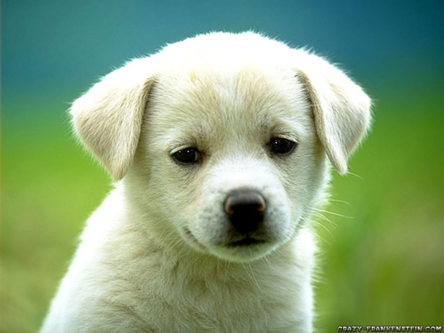
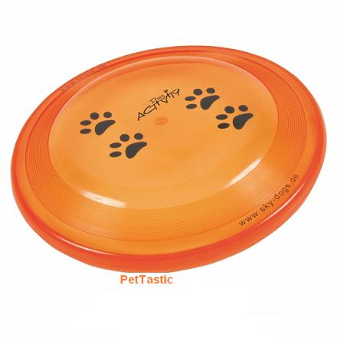


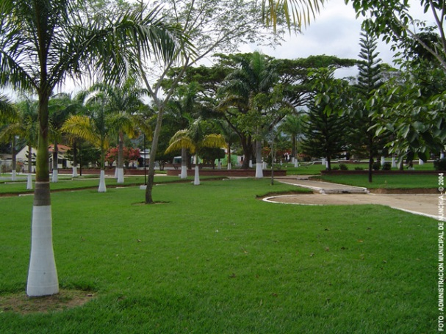

Snowball
Speaking
Snowball is going to…

Slide 35

What are you going to do next month?
Writing
I’m going to …
____________________________________
____________________________________
____________________________________
____________________________________
____________________________________
____________________________________

Slide 36
Explanation
NEGATIVE
I | am not | going to | work
You | aren’t | going to | eat
He | isn’t | going to | dance
She | isn’t | going to | swim
It | isn’t | going to | rain
We | aren’t | going to | study
They | aren’t | going to | sleep

Slide 37
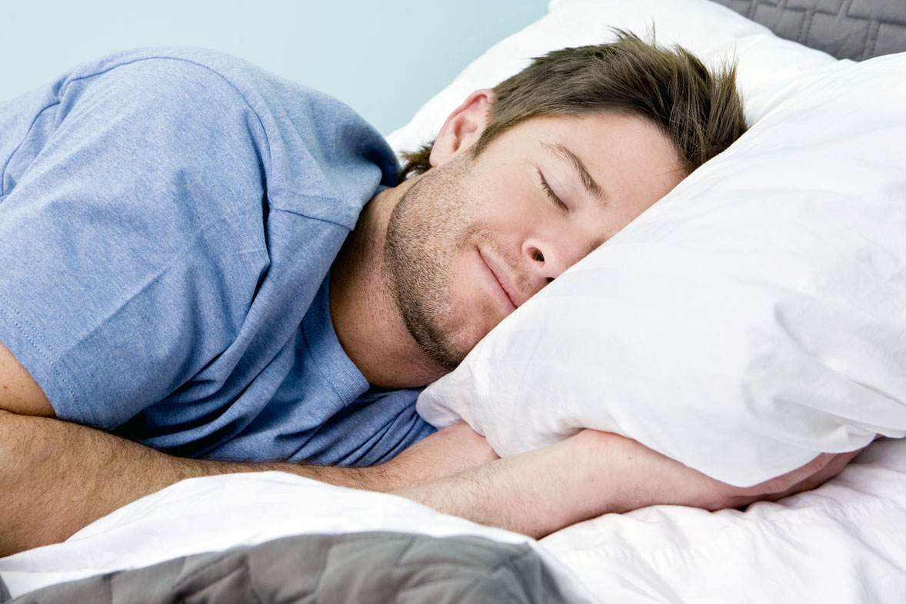
Example:
Explanation
He isn’t going to work.

Slide 38

Example:
Explanation
They aren’t going to swim.

Slide 39
Writing
Complete the sentences with BE GOING TO and the verbs in brackets:
Example: We are going to cook (cook) dinner this evening.
Next summer, I ________________________(travel) to England.
My sister Maria ________________________(live) in Madrid.
They ________________________(play) tennis this afternoon.
My father ________________________(buy) a new car.
Susan and David ________________________(see) the film tonight.
I ________________________(visit) the dentist tomorrow.
Now rewrite the sentences in a negative way.
Example: We aren’t going to cook dinner this evening.

Slide 40
Use of English
Use BE GOING TO in each question or sentence.
1. _____________________________________ ? (you/a car/buy)
2. _____________________________________ ? (he/married/get)
3. _____________________________________ ? (late/I)
4. _____________________________________ ? (today/rain/it)
5. _____________________________________ . (relax/We/today)
6. _____________________________________ . (She/marry/you/not)
7. _____________________________________ . (take/not/the train/I)
8. _____________________________________ . (my/room/clean/I)
9. _____________________________________ . (not/We/golf/play/with you)
10. _____________________________________ ? (Is/team/our/win)

Slide 41

PREDICTIONS

Slide 42
Look at the following pictures and describe what it is going to happen.
Make predictions based on evidence

Slide 43

Exercise / Work out
Speaking

Slide 44

Kiss
Speaking

Slide 45

Ask her to be his girlfriend
Speaking

Slide 46

Win
Speaking

Slide 47

Have an accident
Speaking

Slide 48

Steal
Speaking

Slide 49

Buy / Pay
Speaking

Slide 50

Run over
Speaking

Slide 51

Go on vacation
Speaking

Slide 52

Sink
Speaking

Slide 53

Argue / Fight
Speaking

Slide 54

Turn
Speaking

Slide 55

Study
Speaking

Slide 56

Fall into
Speaking

Slide 57

Score
Speaking

Slide 58

Rain
Speaking

Slide 59

Catch
Speaking

Slide 60

Fight
Speaking

Slide 61

Make a call
Speaking

Slide 62



Future Simple
WILL / WON’T

Slide 63



We use WILL to talk about preditions in the future.
Explanation
Examples
Tomorrow, I will have a good time with my friends.
Next week, my parents will visit Rome and Paris.
Probably, I won’t go to the Planet Electric Festival because I don’t have money.

Slide 64



We use WILL to talk about spontaneous decisions.
Explanation
Examples
I think I will do my homework today.
Wait! I’ll will help you with this.
You know what! I will study medicine next year.

Slide 65
Time Expressions
Explanation
In Future we use different time expressions such as:
Tomorrow,
Later,
In the future,
Next week,
Next month,
Next year,
In two days,
The day after tomorrow,
Tonight,
Soon,
In a few weeks,

Slide 66

Expressions
Explanation
We we use WILL we usually use some expressions to indicate the future tense.
I think …
I guess …
I’m sure…
Probably…
I expect…

Slide 67
Future Simple Structure
Explanation
To form the Future we use:
WIIL or WON’T + a verb in infinitive (go,
play, dance, work, etc)
Contractions:
I will → I'll | We will → we'll
You will → you'll | You will → you'll
He, she → he'll, she'll | They will → they'll

Slide 68


Look at the pictures and predict what will happen next

Slide 69

Make a prediction
Speaking
I think they…

Slide 70

Make a prediction
Speaking
I think Pepe…

Slide 71

Make a prediction
Speaking
Probably, he…

Slide 72

Make a prediction
Speaking
I guess Jessica…

Slide 73

Make a prediction
Speaking
I think John…

Slide 74

Make a prediction
Speaking
Probably, they…

Slide 75

Make a prediction
Speaking
I think he…

Slide 76

Make a prediction
Speaking
I think he…

Slide 77
Speaking
In pairs, read the following questions and answer them using WILL.
When will you graduate?
How will you use English in the future?
Will humans ever meet aliens? What will the meeting be like?
What will happen if we keep polluting the environment?
Will science find a solution to the environmental problems we have? What kind of solution will it be?
What will you do this weekend?
What will life be like when you are 40?
When will humans live on another planet?
What will you do after this class?
What will you do before you get married?
Use
I think I will…
I’m sure I will…
I expect I will
Probably I will…

Slide 78
Change these sentences from Present Simple into Future Simple (WILL)
Writing
a) We usually go shopping on Sundays.
___________________________________ (next Sunday)
b) Every weekend my sister and I play tennis.
___________________________________ (on the weekend)
c)We often go to the library after school.
___________________________________ (after school)
d) Sometimes I like to help my mother about the house.
___________________________________ (this evening)
e) When I finish my homework, I usually play computer games.
When I finish my homework ___________________________________ .

Slide 79
What will you do in the following days?
Write 5 different activities.
Use time expressions.
Writing
____________________________________________________.
____________________________________________________.
____________________________________________________.
____________________________________________________.
____________________________________________________.

Slide 80
Put the verbs in brackets into correct form (Future Simple – WILL or WON’T)
Use of English
a) I ___________ (not / see) him tomorrow. I ___________ (be) busy all day in the library.
b) Where you ___________ (to go) next summer? – I ____________ (go) to Greece.
c) Let’s go to this exhibition. We ____________ (meet) lots of interesting people.
d) I think my son ___________ (be) a great football player. He plays football so well!
e) I don't think she ____________ (pass) the exam, she isn't very good at History.
f) He _____________ (run) in the morning in the park every day next week.
g) I'm feeling so tired. I think I _____________ (go) to bed. Good night.
h) We ___________ (answer) the letter at seven o'clock.
i) They _______________ (not / take) care of our garden next summer.
j) I _____________ (send) him a telegram, if I do not receive an answer to my letter.
k) If the weather is fine tomorrow, we ________________ (go) to the seaside.

Slide 81


Slide 82
Referencias
Mesografía
https://www.eslconversationquestions.com/will/
https://myslide.es/documents/future-simple-560eda3c5cb18.html
https://sigugi-english-corner.wikispaces.com/file/view/future-simple.pdf

Slide 83
Referencias Imágenes
Diapositiva 7
http://static2.bigstockphoto.com/thumbs/7/2/1/large1500/12776741.jpg
http://1.bp.blogspot.com/-c0HlT9T_B48/UDy6BrVEMHI/AAAAAAAAAMI/m6CSTgkYGZs/s1600/marty+copy.png
https://i.pinimg.com/236x/b9/80/69/b98069293bb893b90c01c9c470594691.jpg
https://userscontent2.emaze.com/images/202c87c0-3bf9-4df6-a6cf-d968ff70f398/8a8b11dbb5aea22514de2b02d72d2515.png
https://res.cloudinary.com/emazecom/image/fetch/c_limit,a_ignore,w_200,h_200/https%3A%2F%2Fuserscontent2.emaze.com%2Fimages%2F5c71d02d-71df-4c8d-8797-7e7d3a29735d%2F26ddb773429567b2fe69c9d15256faea.png
Diapositiva 8
http://rogelioorts.com/images/how/55671b8286c89_6-01.png
Diapositiva 10
https://image.slidesharecdn.com/losopuestos-150619132104-lva1-app6892/95/los-opuestos-5-638.jpg?cb=1434720114
Diapositiva 11
https://pixabay.com/p-150452/?no_redirect
Diapositiva 16
http://3.bp.blogspot.com/-iUSqYXq2V9o/VEhnsrMZa7I/AAAAAAAAACI/9ZiUplDCdoA/s320/aprendizaje%2Bautonomo.jpg
http://img3.wikia.nocookie.net/__cb20100914172810/hotwheels/images/3/3d/1999-1113a.jpg
https://i.pinimg.com/originals/14/f1/41/14f1415a3e20cde91e5739f0d6734ff4.jpg
Diapositiva 17
http://rogelioorts.com/images/how/55671b8286c89_6-01.png
http://4.bp.blogspot.com/-U20jcPJ0Vn0/UVq7Q_0FlsI/AAAAAAAAMsU/eJGZf2qXSwM/s1600/dp+buat+bbm+Cewek+Keren+Menari.gif
http://studentweb.cortland.edu/Kelly.Rambo/Project2/sandwich_14.gif

Slide 84
Referencias Imágenes
Diapositiva 18
https://i.pinimg.com/originals/be/88/67/be8867dde5571f84fbcd7b231eff1f95.gif
Diapositiva 19
http://img0.utuku.china.com/212x0/toutiao/20170627/7817bf07-8a10-40a5-a1a7-e61b5d0798ab.jpg
Diapositiva 21
https://mombaby.tw/img/timthumb.php?src=https://mombaby.tw/wp-content/uploads/2012/09/c853.jpg&h=550&w=850&zc=1
https://www.pinterest.cl/explore/alimentos-para-h%C3%A1mster/
https://i.pinimg.com/originals/53/4b/0e/534b0e64d7218fc83d23fd6e3b4c1442.jpg
https://www.womenhealthzone.com/wp-content/uploads/2009/09/obese-woman.jpg
https://image1.masterfile.com/getImage/NzAwLTAwODY0NzkwZW4uMDAwMDAwMDA=AK-PV9/700-00864790en_Masterfile.jpg
http://l7.alamy.com/zooms/a35a2b44fbb54287b5c314672db137d6/office-worker-spilling-coffee-bhg4pb.jpg
Diapositiva 23 & 24
https://pre00.deviantart.net/6ca8/th/pre/i/2011/177/9/a/the_girl_with_the_green_scarf_by_johngrec-d3k1gfp.jpg
Diapositiva 26
http://sphotos.ak.fbcdn.net/hphotos-ak-snc6/hs060.snc6/169041_479999748989_770663989_5880832_4849026_n.jpg
http://cdn2.actitudfem.com/media/files/imagecache/content-images/images/beards-for-men-3.jpg
https://img.discogs.com/nhBu9EfmZbuHUhS1f7Sr4J2EG7g=/401x544/smart/filters:strip_icc():format(jpeg):mode_rgb():quality(90)/discogs-images/A-2040976-1495497736-7132.jpeg.jpg
http://bellezaslatinas.com/files/bellezaslatinas/jonathan-rhys-meyers.jpg

Slide 85
Referencias Imágenes
Diapositivas 27-31
https://soyunperro.com/wp-content/uploads/york.jpg
https://cdn.kiwilimon.com/recetaimagen/13530/6020.jpg
https://static1.squarespace.com/static/570ea986a3360c29db3c44ec/t/5727c6d18259b51be5f6c2ce/1462224737116/olpineapple
https://grist.files.wordpress.com/2009/09/tomato.jpg
https://cdn.kiwilimon.com/recetaimagen/20773/thumb400x300-9528.jpg
https://static.vinepair.com/wp-content/uploads/2016/12/avigonesi-1.jpg
https://www.irenteverything.com/wp-content/uploads/2015/05/71dFIorXoSL._SL1500_.jpg
https://sc01.alicdn.com/kf/HTB1o7sOJFXXXXaBXXXXq6xXFXXXN/Fresh-Frozen-Shredded-Mozzarella-Cheese.jpg_350x350.jpg
https://www.ecured.cu/images/thumb/4/4e/Copa_Actual.JPG/250px-Copa_Actual.JPG
https://sc02.alicdn.com/kf/HTB1qNpLgzihSKJjy0Feq6zJtpXa6/2017-New-design-hot-sale-short-sleeve.jpg
http://bigfootshoes.co.uk/media/catalog/product/cache/1/small_image/300x/9df78eab33525d08d6e5fb8d27136e95/a/d/adidas_11nova_trx_football_thumbnail_15001500x1500.jpg
https://modelosdevestidosdenoche.com/wp-content/uploads/2016/09/6-vestidos-de-novia-para-el-dia-1232-4-1.jpg
http://3.bp.blogspot.com/-UyS9239L23k/TkbVr-ktc5I/AAAAAAAAAC8/VHYn5cJ4ItY/s1600/iglesia-santa-lucia.jpg
http://img.chicade15.com/wp-content/uploads/2009/04/buffet-variado2.jpg
http://www.boda10.es/fotos/chaque_boda_10_alquiler_trajes_madrid(1).jpg
http://blog.webboda.es/wp-content/thumbgen_cache/51692/83a870d7f3b23fb716e7216856070562.jpg
https://pmcvarietylatino.files.wordpress.com/2016/05/screen-shot-2016-05-13-at-11-35-10-am.png?w=640
http://asset4.zankyou.com/images/mag-post/e26/917f/685//-/mx/wp-content/uploads/2010/10/cruceros-300x213.jpg
https://miviajecostarica.files.wordpress.com/2014/01/snorkeling-costa-rica.jpg
https://st-listas.20minutos.es/images/2010-12/265198/list_640px.jpg?1292438149
http://www.encontactomagazine.com/wp-content/uploads/2014/06/foto-cominucado-387.jpg
https://lh3.googleusercontent.com/1hHnaUYx_-_WdyZZkB-oBmj295pXcrCREASnG28z2xe5bA7t9mlqiRG3uQaUiXRnqM5S=s133

Slide 86
Referencias Imágenes
Diapositiva 32 – 35
https://img.discogs.com/nhBu9EfmZbuHUhS1f7Sr4J2EG7g=/401x544/smart/filters:strip_icc():format(jpeg):mode_rgb():quality(90)/discogs-images/A-2040976-1495497736-7132.jpeg.jpg
http://www.benitezrafa.es/wp-content/uploads/2012/05/facebook03.jpeg
https://s3.amazonaws.com/s3.timetoast.com/public/uploads/photos/8916359/tv.jpg?1475346844
http://fotos.imagenesdeposito.com/imagenes/c/cama_palmero-16881.jpg
http://www.clipartbay.com/cliparts/girls-pajama-pants-wfpfxkt.jpg
https://cdn.line.do/uploads/545d78d361a936ad016f500b_1415487253764_480.jpg
https://4.bp.blogspot.com/-cy1Ju8tB5MQ/VvV8fur7cII/AAAAAAAAAa4/iKkxjys9KOcZ8yC37EEOgug33h03PIYGw/s1600/hablando_en_pareja.jpg
http://cdn.elimpulso.com/media/bebidas.jpg
http://www.bfacemag.es/wp-content/uploads/2015/07/fama_jurado.jpg
http://ismaelmartin.com/wp-content/uploads/2016/05/Salas-de-proyeccion.jpg
https://www.creativosonline.org/blog/wp-content/uploads/2017/07/siluetas-de-gente-bailando.jpg
http://1.bp.blogspot.com/_iSqbtieR1bk/TH4xk4NRJVI/AAAAAAAAACc/QJWAbtqble4/s1600/perro-cahorro.jpg
http://laoblogger.com/images/cat-and-dog-grooming-clipart-6.jpg
http://www.extertronic.com/imagen/mascotas/juegos-lanzamientos-perro/disco-lanzar-juegos.jpg
https://http2.mlstatic.com/D_Q_NP_402505-MLM25023951162_082016-Q.jpg
https://comps.canstockphoto.es/can-stock-photo_csp1049939.jpg
http://prensalibrecasanare.com/uploads/posts/2016-04/1461926120_nunchia-parque11.jpg
http://www.principiamarsupia.com/wp-content/uploads/2012/06/you.jpg
Diapositiva 36 – 38
http://rogelioorts.com/images/how/55671b8286c89_6-01.png
http://4.bp.blogspot.com/-U20jcPJ0Vn0/UVq7Q_0FlsI/AAAAAAAAMsU/eJGZf2qXSwM/s1600/dp+buat+bbm+Cewek+Keren+Menari.gif
http://studentweb.cortland.edu/Kelly.Rambo/Project2/sandwich_14.gif
https://apotheka.com.mx/wp-content/uploads/2015/08/sleeping.jpg
https://estaticos.muyinteresante.es/media/cache/1000x460_thumb/uploads/images/pyr/55520750c0ea197b3fd50e4e/helado.jpg

Slide 87
Referencias Imágenes
Diapositiva 41 - 61
http://streamlyn.com/blog/wp-content/uploads/2017/03/crystal-ball1.png
https://iq-body.ru/uploads/ra/870x480/articles/original/novichok-v-sportzale.jpg
http://cdn.womanitely.com/wp-content/uploads/2015/05/Ways-to-Know-If-He-Wants-to-Kiss-You.jpg
https://d2z8zvwx6itreb.cloudfront.net/proyectop_article_62d665a2e2f2f61eada744e97d5e3c28_jpg_690x450_100_8344.jpg
https://previews.123rf.com/images/wavebreakmediamicro/wavebreakmediamicro1302/wavebreakmediamicro130200211/18095426-Mujer-atleta-celebra-victoria-en-l-nea-de-meta-en-campo-de-atletismo-Foto-de-archivo.jpg
https://previews.123rf.com/images/ximagination/ximagination1506/ximagination150600147/41196160-Hombre-de-negocios-joven-que-conduce-un-coche-y-se-ve-cansado-durmiendo-en-el-coche-mientras-llevaba-Foto-de-archivo.jpg
http://p2.so.qhimgs1.com/t01273e0889cc8fe442.jpg
https://st.depositphotos.com/1182166/2059/v/950/depositphotos_20591691-stock-illustration-funny-hungry-fat-man-waiting.jpg
http://st2.depositphotos.com/4769585/11755/v/950/depositphotos_117558496-stock-illustration-young-man-crossing-street-sending.jpg
https://www.illustrationsof.com/royalty-free-transportation-clipart-illustration-76357.jpg
https://faktor.ba/bundles/websitenews/gallery/news/246531/thumbs/1000_1493622688automobil_tone-ilustracija.jpg
https://www.der-weinmakler.de/blog/wp-content/uploads/2015/03/fleisch-streiten.jpg
http://www.beevoz.com/wp-content/uploads/2016/02/girar.jpg
http://georgetownpl.org/wp-content/uploads/2015/11/teen-reading-e1448055084752.png
https://lh3.googleusercontent.com/uzm3mVYcTRNaDwy4BQwYrhCSAOctU4ZJRNZQTy2F0Oyj3_xR9i0z--FcnGjk-wKTKn94itw=s85
http://2.bp.blogspot.com/_MSA3FN1oito/SRw0_Kofd8I/AAAAAAAAC4M/sickeajxStc/s400/freekick.jpg
https://www.drawshop.com/graphics/1243/watermarks/boy-pointing-forefinger-up-vector-illustration-Roy-274052-10.jpg
https://userscontent2.emaze.com/images/321af082-804a-44a8-88d8-afeb3f407f23/9d385190b12ef5785b878d64db37bb00.png
https://i.pinimg.com/236x/1c/02/81/1c02811f98db647d743c9132fedad689.jpg
http://www.leiaja.com/sites/default/files/styles/large/public/field/image/tecnologia/2013/08/543868_703108713038823_89065839_n.jpg?itok=3fNELPh-

Slide 88
Referencias Imágenes
Diapositiva 62 – 64
http://static7.depositphotos.com/1053932/747/i/950/depositphotos_7471186-stock-photo-bride-just-married-couple-in.jpg
https://i.pinimg.com/736x/3d/99/4d/3d994d2a86b470fd3f413a4937c57a91--weight-control-weight-gain.jpg
https://static.vix.com/es/sites/default/files/styles/large/public/imj/imujer/c/como-lidiar-con-el-trabajo-y-los-ni%C3%B1os-cuando-trabajamos%20desde-casa%203.jpg?itok=wGQarHZ7
https://stephstewartmusic.files.wordpress.com/2014/11/steph_boyfriends-161.jpg
http://redtravel.com.uy/wp-content/uploads/2017/03/Roma-Parismchp.jpg
http://www.orbitamagazine.com/wp-content/uploads/2016/01/luka-karo-.jpg
http://www.blognutricioncenter.com/wp-content/uploads/2017/09/iStock_000020614872XLarge.jpg
http://unistorage.com.my/ocart/image/data/Storage/Student%20share%20a%20room%2010sqft.jpg
https://www.helios-gesundheit.de/fileadmin/UWS_Kliniken/Klinikum_Niederberg/Unser_Angebot/Karriere/170829_Ausbildung_drubig-photo.jpg
Diapositiva 66 - 76
https://i.pinimg.com/736x/1f/73/1c/1f731ca3ff14eb8c7462b15913aefed3--wish-list-sur.jpg
https://www.zetizen.com/uploads/post/2017/08/30/Fable_Feed.jpg
http://deswebfulp2.fulp.ulpgc.es/sites/default/files/pie_de_foto_2_1.jpg
http://1.bp.blogspot.com/-5D9oA7_uzo0/Uq8R_KJRwgI/AAAAAAADNuE/NdvjEvv8IhE/s1600/2358526.png
http://www.santiagoturismo.com/files/full/20101026125129_verImagen10.jpg
https://www.wikihow.com/images/thumb/7/78/Get-an-A-Step-20.jpg/aid3928003-v4-728px-Get-an-A-Step-20.jpg
https://www.wikihow.com/images/thumb/6/6f/Get-an-A-Step-12.jpg/aid3928003-v4-728px-Get-an-A-Step-12.jpg
https://www.tuseguro.com/images/images/Blog/Contenido_Epico/5_malos_h%C3%A1bitos_al_conducir_que_debes_evitar_a_toda_costa/malos_h%C3%A1bitos_al_conducir.jpg
http://hybread.mk/wp-content/uploads/2016/02/surfing-couple.jpg
https://www.wikihow.com/images_en/thumb/b/b0/Get-an-A-Step-18.jpg/v4-728px-Get-an-A-Step-18.jpg
http://www.gibbons.de/main3/03cartoons/1999-08-take_home.jpg
Diapositiva 81
http://www.references.net/root/app_common/img/top_logo_ref.png

