Slide 1
UNIVERSIDAD AUTÓNOMA DEL ESTADO DE MÉXICO
SECRETARIA DE DOCENCIA
DIRECCIÓN DE ESTUDIOS DE NIVEL MEDIO SUPERIOR
PLANTEL «LIC. ADOLFO LÓPEZ MATEOS» DE LA ESCUELA PREPARATORIA
Programa de la Asignatura de Inglés 4 de quinto Semestre
FIRST CONDITIONAL practice 1 agosto 2017
Elaborado por: L.L.I. Mitzi Belinda Dávila González
Total de créditos: 7 horas prácticas:3 horas teóricas: 2

Slide 2
Objetivos:
-Describe acciones y consecuencias
-Utiliza el presente simple y el futuro con will para formar - oraciones de la primera condicional en el idioma inglés.
-Expresa como reaccionaría antes posibles situaciones.
-Identifica los posibles errores cometidos en las respuestas y se autoevalua.
MODULE II
My future: Possibilities and consequences
TEMA 3: Supersticiones

Slide 3
Descripción de la actividad:
Los alumnos participan en turnos o por numero de lista.
Se les indica a los alumnos que la presentación contiene láminas en las que se presenta un enunciado el cual deben de completar con la forma correcta del verbo en paréntesis para formar el primer condicional. La estructura puede ser :
If + present simple, will verb in base form.
Will verb in base form if + present simple.
El alumno debe responder el enunciado.
Posteriormente podrá ver la respuesta en la siguiente lámina.
Si es correcta obtendrá un punto.
Los alumnos toman turnos para ir contestando los enunciados en las láminas.
El profesor va anotando el número de aciertos por cada alumno.
El alumno que acumule más enunciados correctos será en ganador

Slide 4
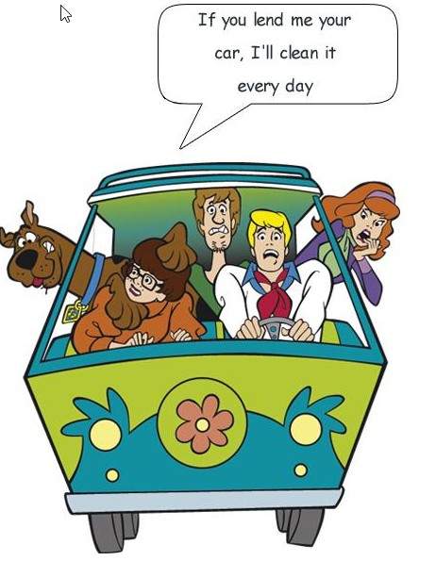

First conditional:

Slide 5
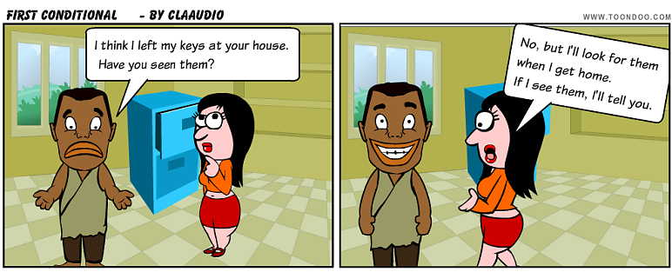
The First Conditional:
The first conditional has the present simple after 'if', then the future simple in the other clause:
if + present simple, ... will + infinitive
It's used to talk about things which might happen in the future. Of course, we can't know what will happen in the future, but this describes possible things, which could easily come true.

Slide 6
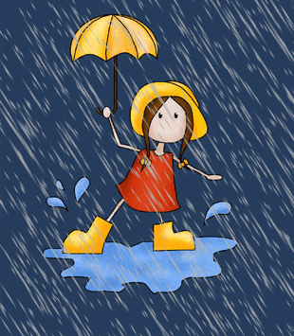
EXERCISE:
Complete the sentences with the correct form of each verb.
1) If it______ (rain), I____ (not go) to the park.

Slide 7
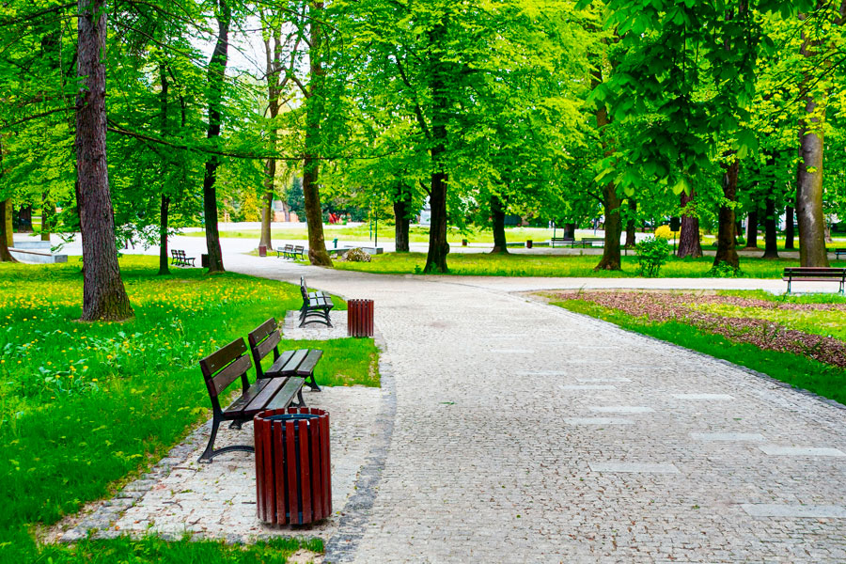
ANSWER:
1) If it rains, I won’t go to the park.

Slide 8
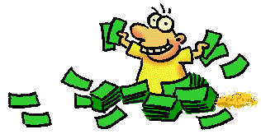
2) If I _____(have) enough money, I _____(buy) some new clothes

Slide 9
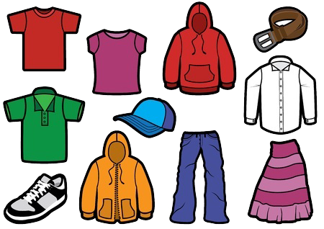
Answer:
2) If I have enough money, I’ll buy some new clothes

Slide 10
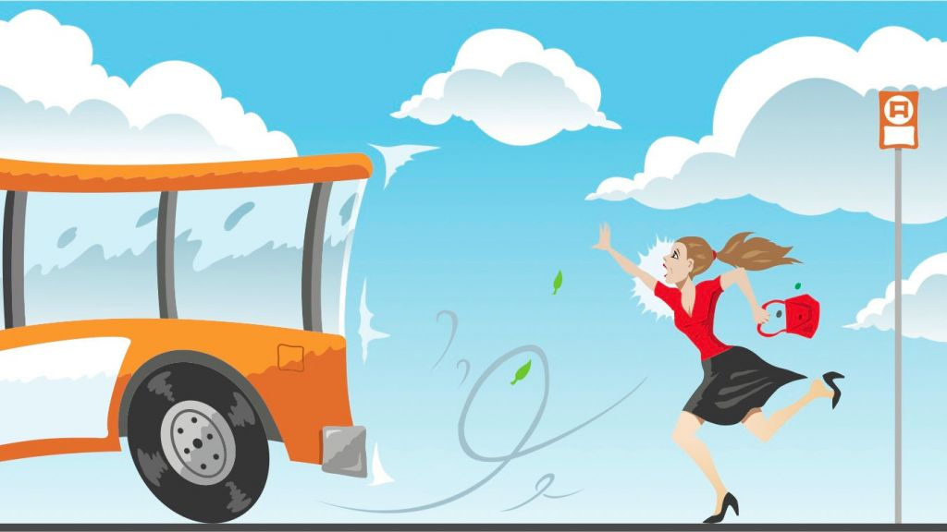
3) She ____ (miss) the bus if she _____ (not leave) soon.

Slide 11
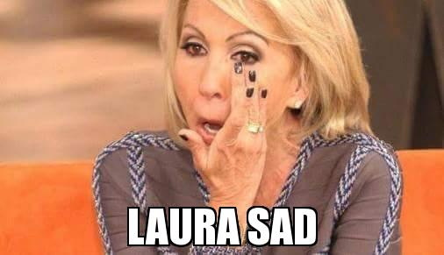
Answer:
3) She’ll miss the bus if she doesn’t leave soon.

Slide 12
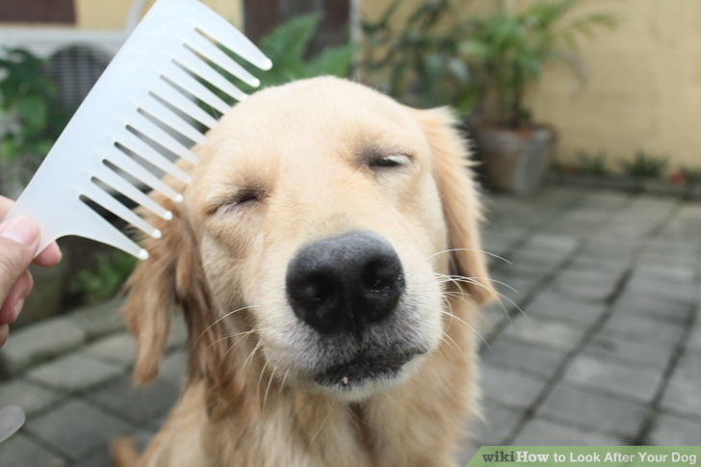
4) I ___ (look after) her dog if she___ (help) me with chemistry

Slide 13
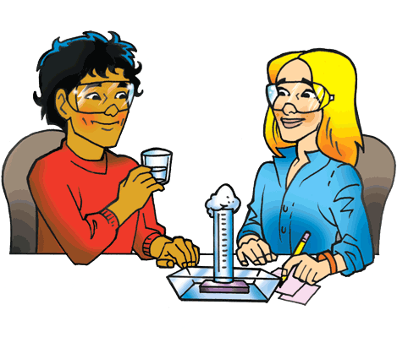
Answer:
4) I’ll look after her dog if she helps me with chemistry

Slide 14
5) If he ____ (buy) a new car, he _____ (not need) to use the public transport anymore.

Slide 15
5) If he buys a new car, he won’t need to use the public transport anymore
ANSWER:

Slide 16
6) If you_____ (give) me some money, ______ (pay) you back tomorrow.

Slide 17
ANSWER:
6)If you give me some money, I'll pay you back tomorrow.

Slide 18
7) If Mary_____(come), she_____ (want) to drive.

Slide 19
ANSWER:
7) If Mary comes, she'll want to drive.

Slide 20
8) If we _______ (not get) the contract, we_______ (waste) a lot of time and money..

Slide 21
ANSWER:
If we don't get the contract, we'll waste a lot of time and money.

Slide 22

9)If you _____(get) back late, I _____(be) angry.

Slide 23

ANSWER:
9) If you get back late, I ´ll be angry.

Slide 24
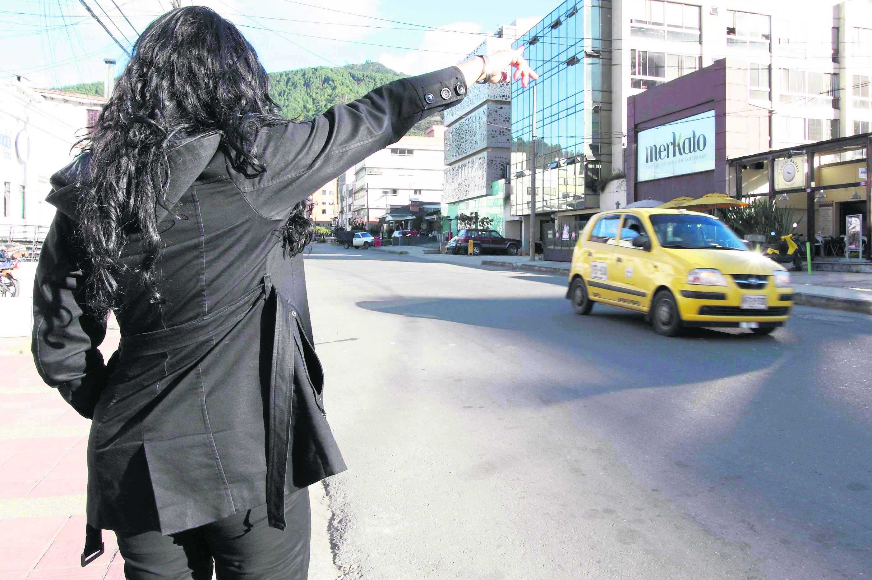
10) She_____(take) a taxi, if it_____(rain).

Slide 25
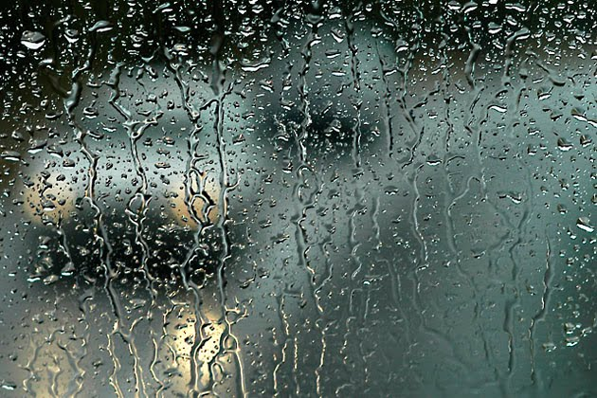
ANSWER:
10) She ´ll take a taxi, if it rains.

Slide 26
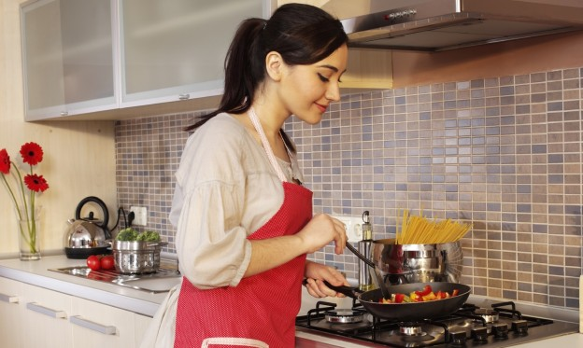
11) She_____(not/cook) dinner, if you_____(not/go) to the supermarket.

Slide 27
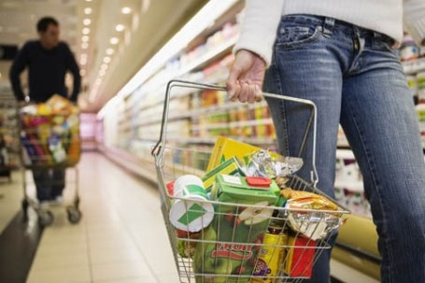
ANSWER:
11) She wont’ cook dinner, if don’t you go to the supermarket.

Slide 28
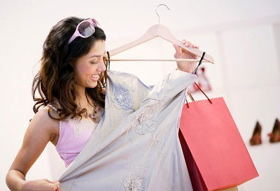
12) I_____(buy) a new dress if I_____(have) enough money.

Slide 29
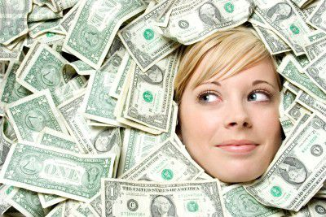
ANSWER:
12) I ´ll buy a new dress, if I have enough money.

Slide 30
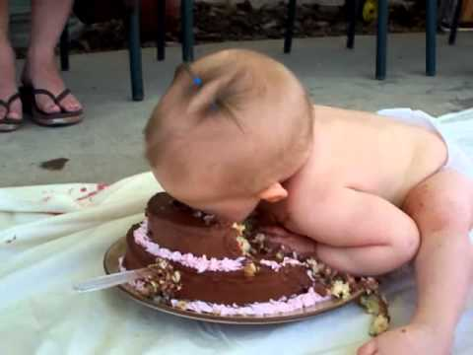
13) If he_____(eat) all this cake, he ______(feel) sick.

Slide 31
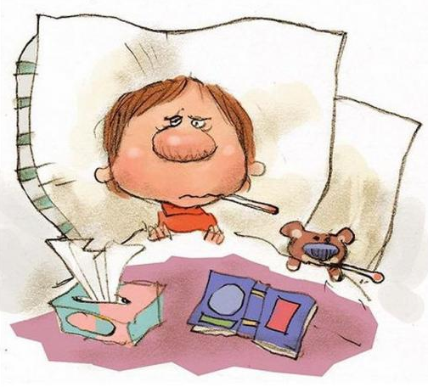
ANSWER:
13) If he eats all this cake, he ´ll feel sick.

Slide 32
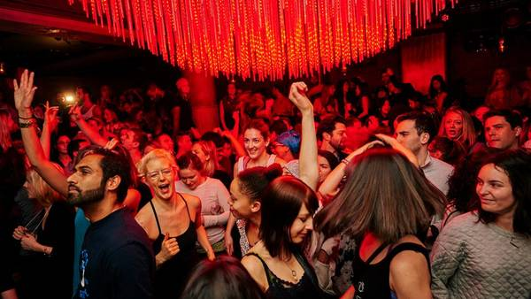
14) If Sue _____ (not/go) to the party, her mom ___ (scold) her.

Slide 33
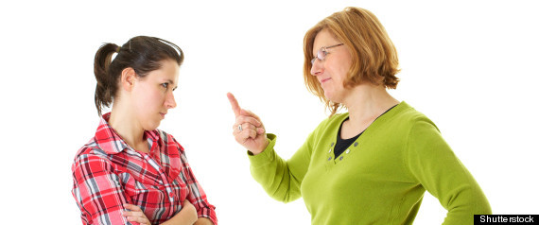
ANSWER:
14) If Sue doesn’t go to the party, her mom will scold her.

Slide 34
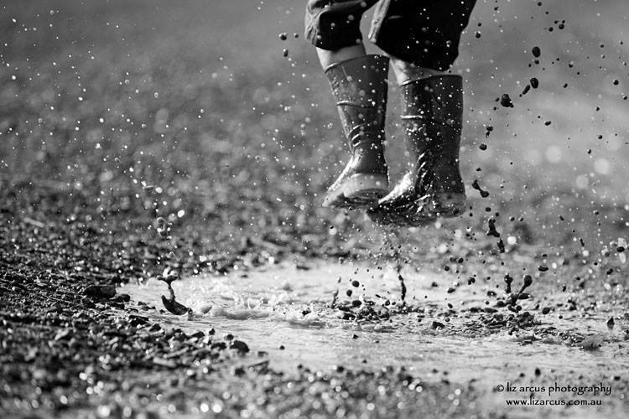
15) ______ (you/get)sick if you _____ (play) in the rain?

Slide 35
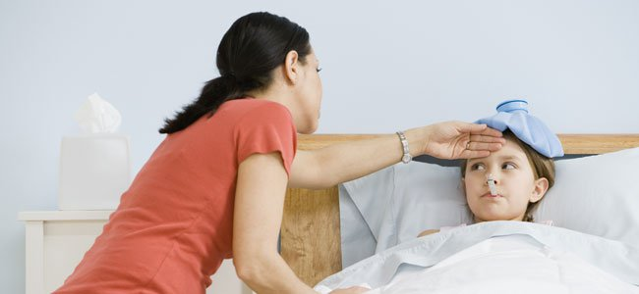
ANSWER:
15) Will you get sick if you play in the rain?

Slide 36
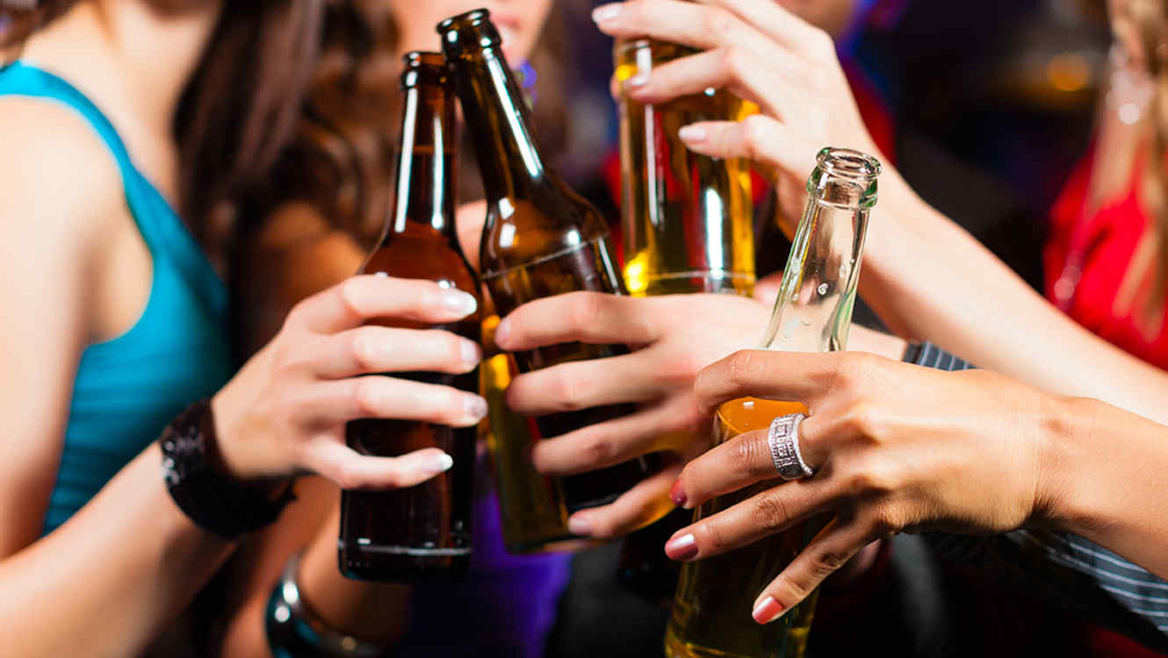
16) If I ____ drunk, I will ____ an accident.

Slide 37
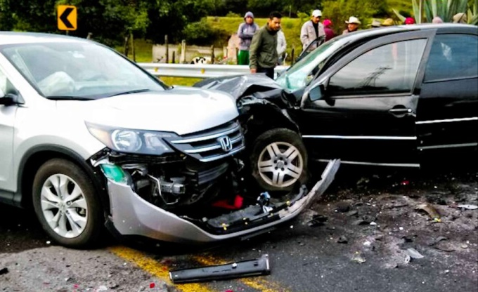
ANSWER:
16) If I drive drunk, I will cause an accident.

Slide 38
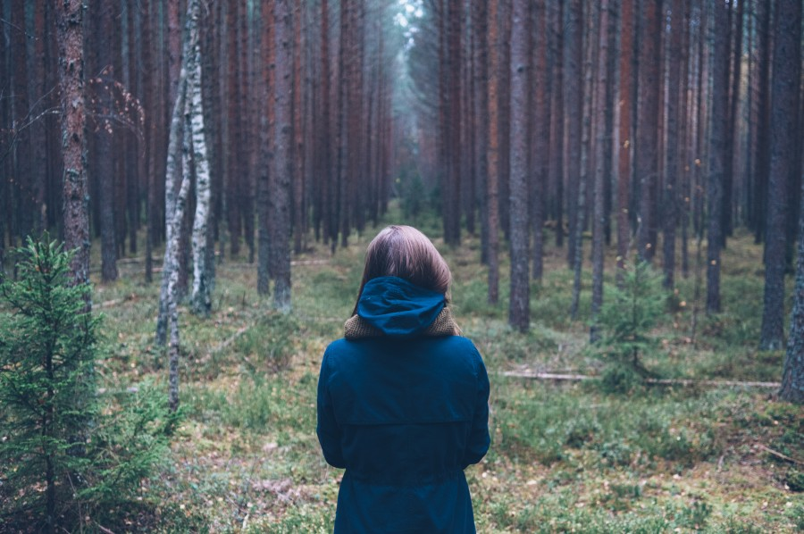
17) If she ____ (goes) to the forest she ___ (get) lost.

Slide 39
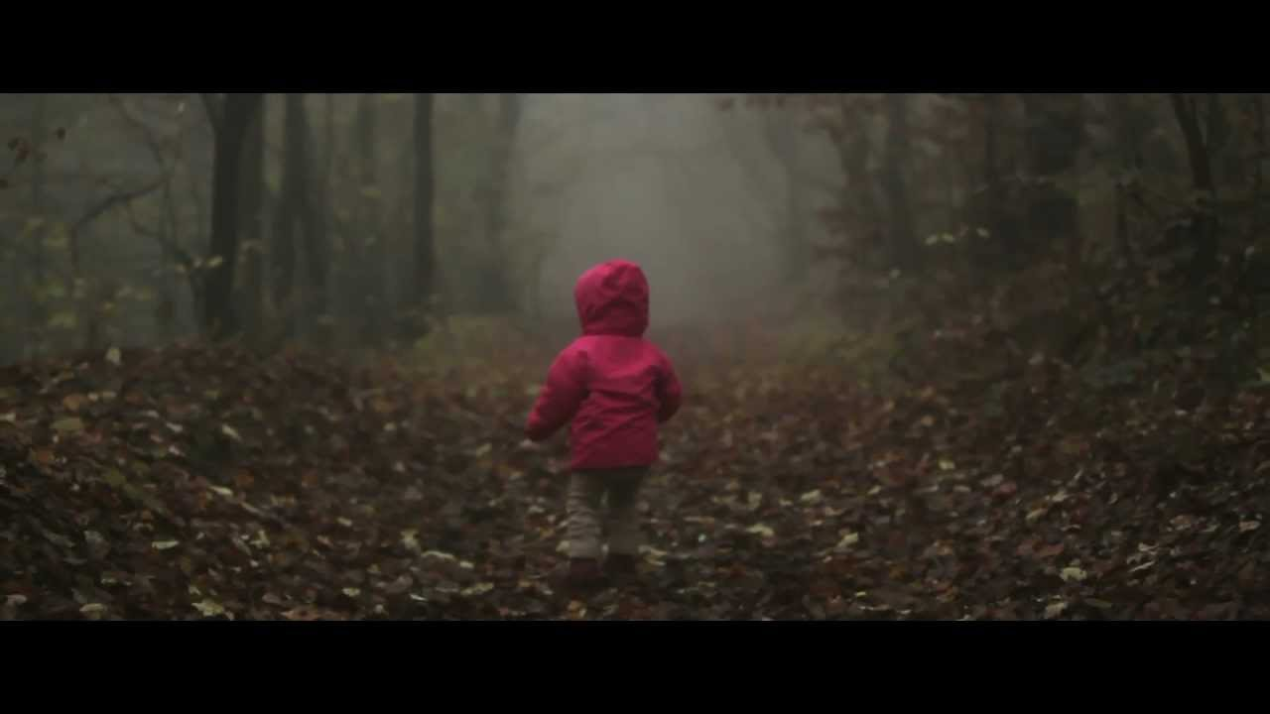
ANSWER:
17) If she goes to the forest she will get lost.

Slide 40

18) If I ____ (not/have) to much homework, I ____ (go out) with my friends.

Slide 41
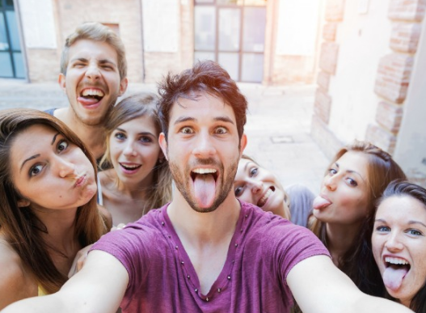
ANSWER:
18) If I don´t have to much homework, I wil go out with my friends.

Slide 42

19) If you hard, I _____ your exams.

Slide 43
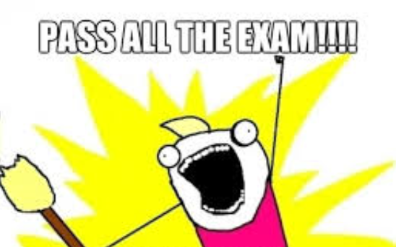
ANSWER:
19) If you study hard, I will pass your exams.

Slide 44

20) If I time, I ________you.

Slide 45
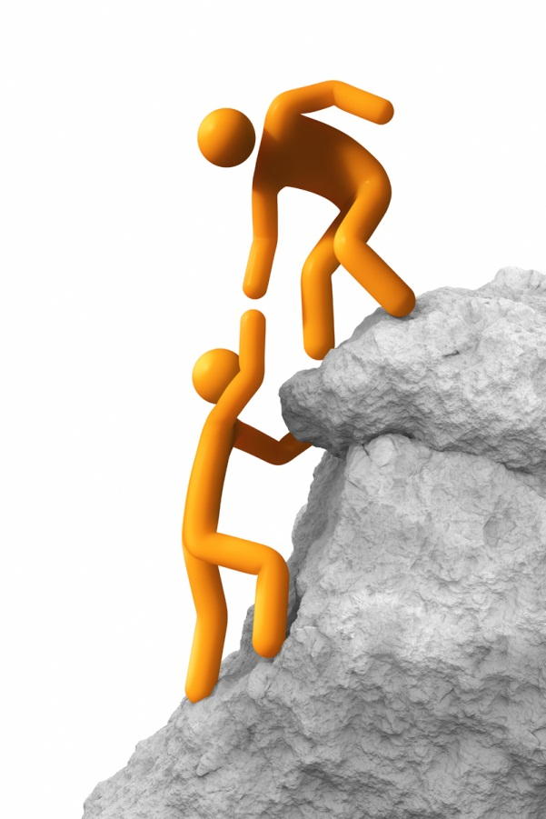
ANSWER:
20) If I have time, I will help you.

Slide 46
BIBLIOGRAFÍA
Falla, Davis, Paul A Davies. Solutions Pre-Intermediate Student's book. Oxford. 2012. 2° Ed.
Google images.
Univerisidad Autónoma del Estado de México. Programa de la Asignatura de Inglés 4 . Dirección de Estudios de Nivel Medio Superior. Bachillerato 2015.
www.perfect-english-grammar.com/first-conditional-exercise-1.ht...
https://www.ego4u.com/en/cram-up/.../conditional...1/exercises
https://www.learnenglishfeelgood.com/grammar-firstconditional1.

