Slide 1


Universidad Autónoma del estado de México
Plantel “LIC. Adolfo López mateos” de la escuela preparatoria
TÍTULO: Modulo I “Ocasiones especiales: ¿Qué está pasando? y ¿Qué hacen las personas que están a mí alrededor?”
PROGRAMA EDUCATIVO: INGLÉS 2
NIVEL EDUCATIVO DONDE SE IMPARTE: Medio Superior de la UAEMÉx.
SEMESTRE: tERCER Semestre
CBU: 2015
Responsable de elaboración:
m. EN p. E. ALMA ROSA LARA CONTRERAS
PROFESOR DE ASIGNBATURA DE INGLÉS

Slide 2
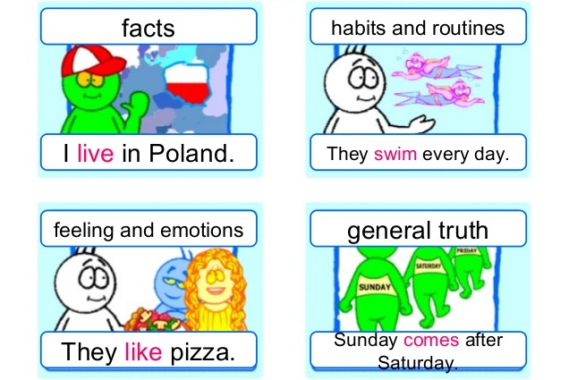
PRESENT SIMPLE
What is it for?

Slide 3
What is it? Exercise 1
I love holidays because there are no classes _____
The Earth goes around the Moon _____
I usually walk my dog in the afternoon _____
A lot of Mexicans eat tacos every day _____
We don’t like exams, they are too difficult _____
You get orange when you mix red and yelow _____
Choose beetween:
  Routines-habits
  Facts
  General truth
  or
  Feeling and emotions?

Slide 4
Answers 1
I love holidays because there are no classes FEELINGS OR EMOTIONS
The earth goes around the moon GENERAL TRUTH
I usually walk my dog in the afternoon HABITS OR ROUTINES
A lot of Mexicans eat tacos every day FACT
We don’t like exams, they are too difficult FEELINGS OR EMOTIONS
You get orange when you mix red and yelow GENERAL TRUTH

Slide 5
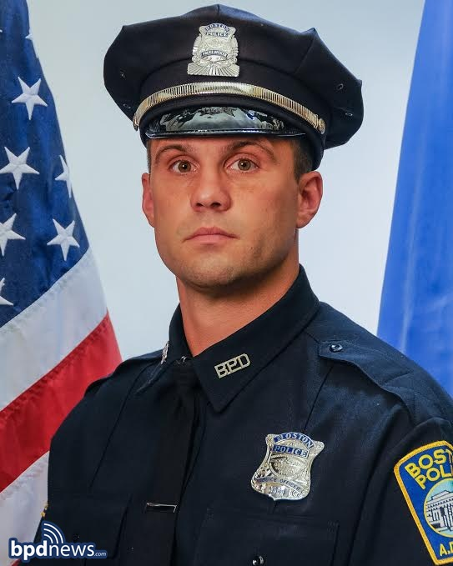
IDENTIFY PRESENT SIMPLE EXERCISE 2
Robert Hughes lives in Boston. He lives with his wife, Patricia. They live with their two children, Sam and Lana. Robert loves his family.
Robert works as a police officer in Boston. Boston has a high level of crime rate so he has a lot to do.. Robert usually patrol street at night but sometimes he works morning shift.
Robert protects the citizens of Boston. He solves crimes and catches criminals. He keeps the citizens safe.
Sometimes he visits the schools. He talks to students and the students always want to chat with Robert about chasings. Officer Robert Hughes is a hero in Boston. Thiefs, robbers and pick-pockters don’t like him at all.
What do you want to be when you grow up?
Underline present simple sentences

Slide 6
Answers 2
Robert Hughes lives in Boston. He lives with his wife, Patricia. They live with their two children, Sam and Lana. Robert loves his family.
Robert works as a police officer in Boston. Boston has a high level of crime rate so he has a lot to do. Robert usually patrol street at night but sometimes he works morning shift.
Robert protects the citizens of Boston. He solves crimes and catches criminals. He keeps the citizens safe.
Sometimes he visits the schools. He talks to students and the students always want to chat with Robert about chasings. Officer Robert Hughes is a hero in Boston. Thiefs, robbers and pick-pockters don’t like him at all.
What do you want to be when you grow up?

Slide 7
Classify sentences exercise 3
Robert Hughes lives in Boston. Robert usually patrol street at night
He lives with his wife, Patricia. Sometimes he works morning shift.
Robert works as a police officer in Boston. Sometimes he visits the schools.
Boston has a high level of crime rate The students always want to chat with Robert
Officer Robert Hughes is a hero in Boston. Thiefs, robbers and pick-pockters don’t like him at all.
Put the sentences of previous exercise into the corrrect column according to their use
Habbit / routine | Fact | General Truth | Feelings / Emotions

Slide 8
answers 3
Put the sentences of previous exercise into the corrrect column according to their use
Habbit / routine | Fact | General Truth | Feelings / Emotions
Robert usually patrol street at night | Robert Hughes lives in Boston. | Boston has a high level of crime rate | Robert loves his family.
sometimes he works morning shift | He lives with his wife |  | Thiefs, robbers and pick-pockters don’t like him at all
Sometimes he visits the schools | Robert works as a police officer
the students always want to chat with Robert | he has a lot to do
 | Robert protects the citizens

Slide 9
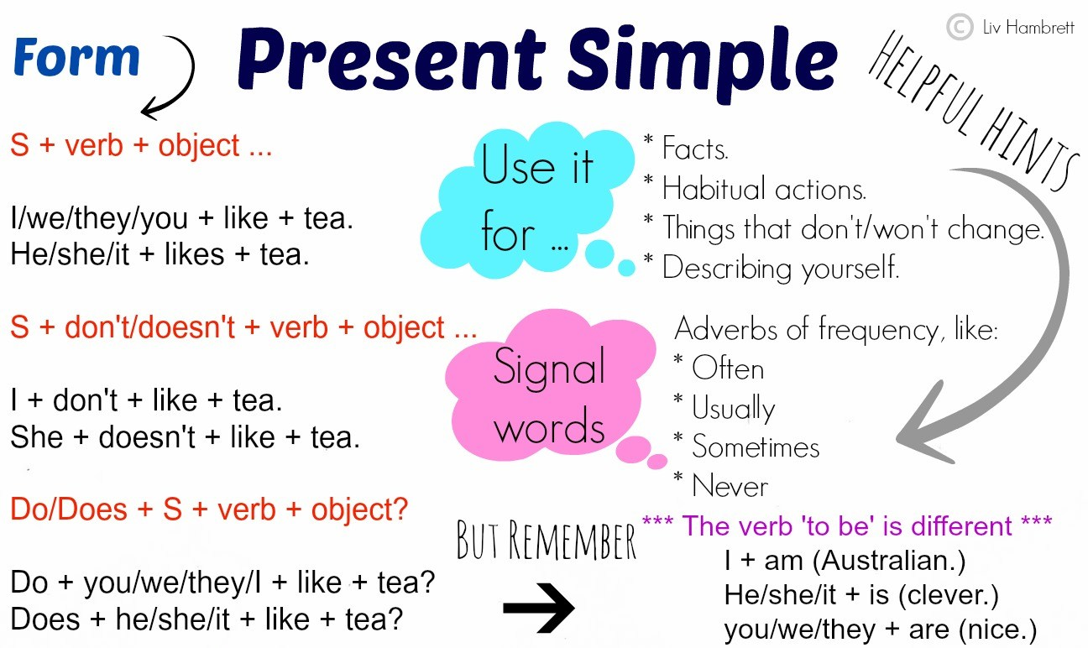
structure

Slide 10
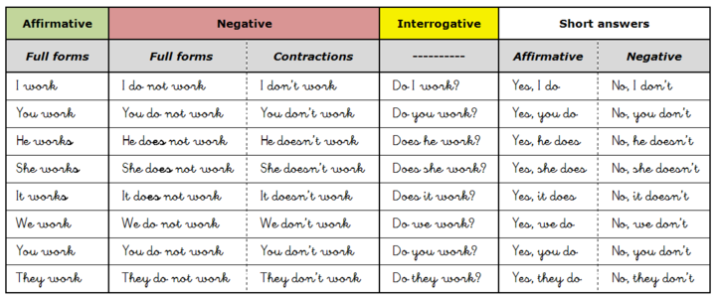
Structure

Slide 11
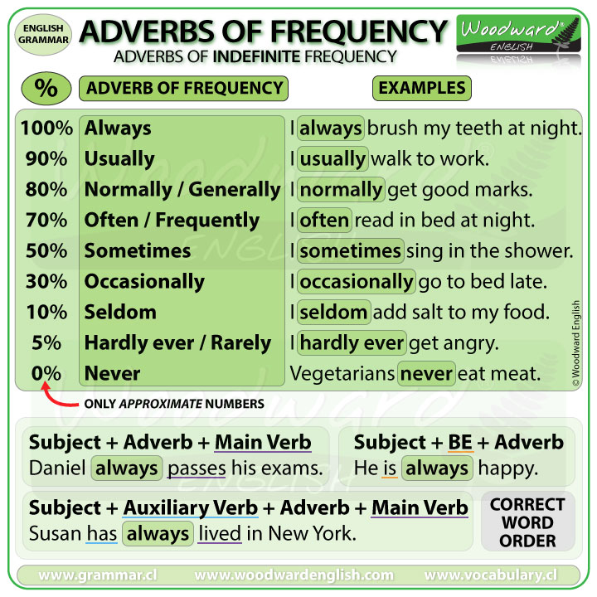
Time expressions
These words tell you what tense you have to use. For the Simple Present these are adverbs of frequency:
always
often
usually
sometimes
seldom
never
Other phrases of time can occur, like:
every day
every week
every year
on Mondays
after school

Slide 12
Exercises 4
Negative Sentences
Make negative sentences.
My father makes breakfast. → _______________________
They are eleven. → _______________________________
She writes a letter. → _____________________________
I speak Italian. → _________________________________
Danny phones his father on Sundays. → _________________
Form of Affirmative Sentences
Put the verbs into the correct form.
I (to like) ________ lemonade very much.
The girls always (to listen) ________ to pop music.
Janet never (to wear) ________ jeans.
Mr Smith (to teach) ________ Spanish and French.
You (to do) ________ your homework after school.

Slide 13
Answers 4
Form of Affirmative Sentences
Put the verbs into the correct form.
I like lemonade very much.
The girls always listen to pop music.
Janet never wears jeans.
Mr Smith teaches Spanish and French.
You do your homework after school.
Negative Sentences
Make negative sentences.
My father makes breakfast. → My father doesn't make breakfast.
They are eleven. → They aren't eleven.
She writes a letter. → She doesn't write a letter.
I speak Italian. → I don't speak Italian.
Danny phones his father on Sundays. → Danny doesn't phone his father on Sundays.

Slide 14
Exercise 5
Questions
Make questions.
you / to speak / English → _______________________
when / he / to go / home → ______________________
they / to clean / the bathroom → __________________
where / she / to ride / her bike → __________________
Billy / to work / in the supermarket → ______________
Signal Words
Find the signal words for simple present.
Which is a signal word for simple present?
now last Monday often
Which is a signal word for simple present?
sometimes at the moment yesterday
Which is a signal word for simple present?
last Friday every Friday next Friday
Which is not a signal word for simple present?
never already usually
Which is not a signal word for simple present?
Listen! first ... then ... seldom

Slide 15
Answers 5
Questions
Make questions.
you / to speak / English → Do you speak English?
when / he / to go / home → When does he go home?
they / to clean / the bathroom → Do they clean the bathroom?
where / she / to ride / her bike → Where does she ride her bike?
Billy / to work / in the supermarket → Does Billy work in the supermarket?
Signal Words
Find the signal words for simple present.
Which is a signal word for simple present?
now last Monday often
Which is a signal word for simple present?
sometimes at the moment yesterday
Which is a signal word for simple present?
last Friday every Friday next Friday
Which is not a signal word for simple present?
never already usually
Which is not a signal word for simple present?
Listen! first ... then ... seldom

Slide 16
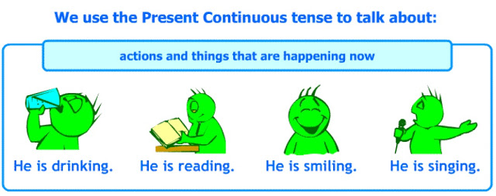
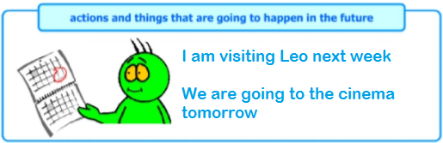
Past continuous or progressive
What is it for?

Slide 17
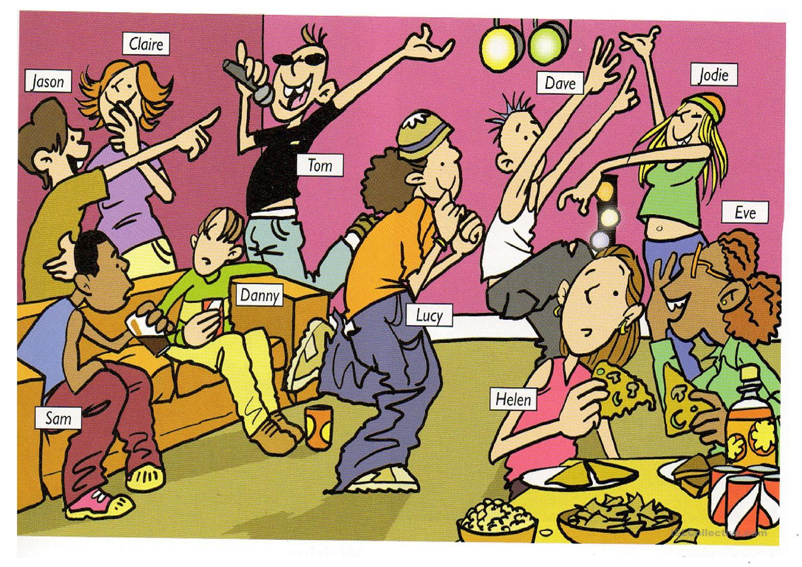
Match the actions exersice 6
Write the manes of the people with the actions they are doing NOW
________ is telling a secret to Helen
________ is singing aloud
________ and ________ are laughing at Tom
________ is enjoying a fizzy drink
________, ________ and ________ are dancing happily
________ is listening to what Eve is saying

Slide 18
Answers 6
Eve is telling a secret to Helen
Tom is singing aloud
Jason and Claire are laughing at Tom
Sam is enjoying a fizzy drink
Jodie, Dave and Lucy are dancing happily
Helen is listening to what Eve is saying

Slide 19
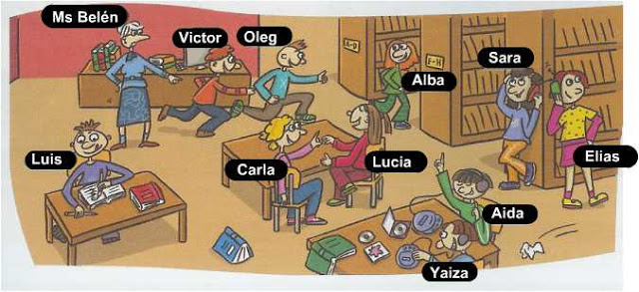
Describe the photo 7
Describe the actions that are happening now

Slide 20
Answers 7
Victor and Oleg are running
Clara and Lucia are chatting
Luis is answering an exercise
Aida is dancing
Elias and Sara are listening to music
Mr. Belen is telling off the students
Alba is walking to the corridor
Etc…

Slide 21
What are your plans for the weekend? 8
Travel - France - plane
Use the prompts to have create sentences
Meet Brat Pitt / Angelina Jolie
Have – enormous party - friends
Attend – concert – cancert hall
Work – grocery store - Saturday
This weekend
Study - exams - library
Go – swim - Italy
Go – cimena- exboyfriend / girlfriend
Play – soccer – 1 pm Sunday

Slide 22
Possible answers Answers 8
I’m meeting Brat Pitt on Saturday
I’m playing football at 1 pm on Sunday
I’m attenting a concert of Black Eye Peas at a concert hall
I’m studying for my exams of next week at the libary
I’m working at a grocery store on Saturday
I’m going to the cinema with my exboyfriend
I’m travelling to France to sightsee the Eifeel Tower

Slide 23
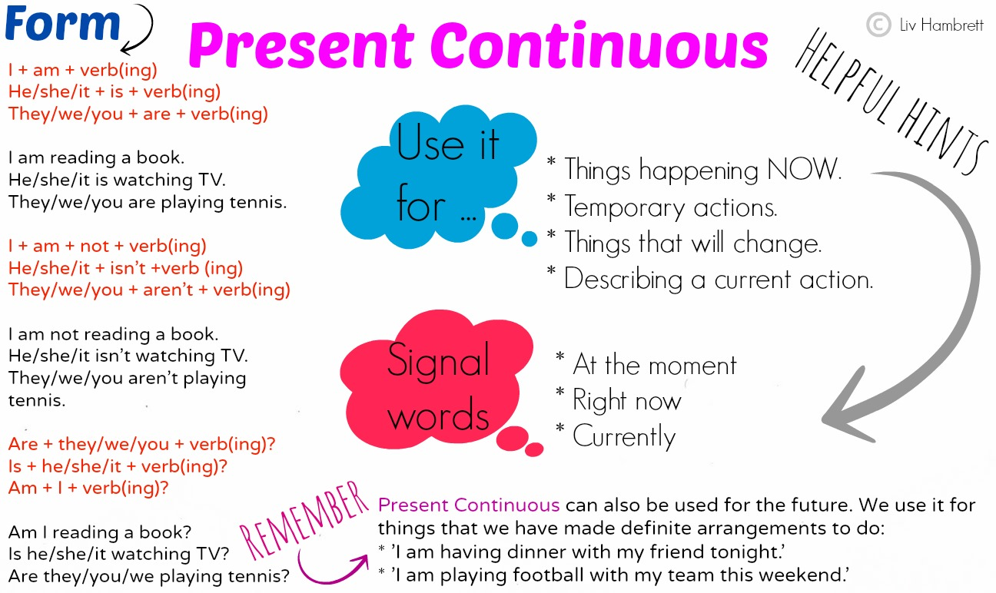
structure

Slide 24
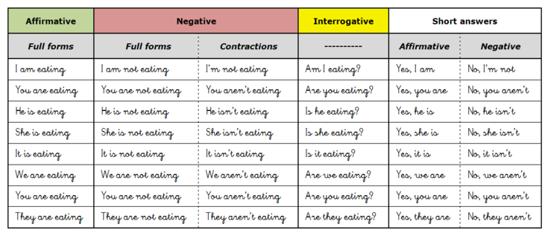
Structure

Slide 25
Time expressions
These words tell you what tense you have to use. For the Present Continuous:
  Now
  At the moment
  At present
  These days
  This month etc.
  Tomorrow
  Next week
  Tonight
  Tomorrow morning
Other phrases for the Present Continuous:
  Look!
  Listen!
  Watch out!
  Nowadays
  Currently
  Etc.
:

Slide 26
exercises
Positive Sentences
Put the verbs into present progressive.
My sister (to clean) ______ the bathroom.
Look! They (to go) ______ inside.
I (to wait) ______ in the car now.
Mrs Miller (to listen) ______ to CDs.
We (to speak) ______ English at the moment.
Negative Sentences
Rewrite the sentences using the negative forms.
We are playing a game. _______________________________
I'm drawing a picture. ________________________________
He is making pizza right now. __________________________
Susan and her brother are taking photos. _________________
Dad is working in the kitchen. _________________________

Slide 27
answers
Rewrite the sentences using the short forms (where long forms are given) or the long forms (where short forms are given).
We are reading a letter. We're reading a letter.
He is opening the window. He's opening the window.
I am playing computer games. I'm playing computer games.
She's dancing at the party. She is dancing at the party.
They're drinking a cup of tea. They are drinking a cup of tea.
Put the verbs into present progressive.
My sister is cleaning the bathroom.
Look! They are going inside.
I am waiting in the car now.
Mrs Miller is listening to CDs.
We are speaking English at the moment

Slide 28
exercises
Questions and Signal Words
Write questions in present progressive.
Robin / to ride / his bike - ______________________________________________
where / she / to go - __________________________________________________
what / your mother / to do / now - _______________________________________
what / you / to do / tomorrow - _________________________________________
where / he / to go / next week - _________________________________________
Which is a signal word for the present progressive?
often now sometimes
Which is not a signal word for the present progressive?
always Look! at the moment
Which is a signal word for the present progressive?
tomorrow often yesterday
Which is not a signal word for the present progressive?
never watch out! Listen!

Slide 29
answers
Questions and Signal Words
Write questions in present progressive.
Robin / to ride / his bike - Is Robin riding his bike?
where / she / to go - Where is she going?
what / your mother / to do / now - What is your mother doing now?
what / you girlfriend / to do / tomorrow - What is your mother doing tomorrow?
where / he / to go / next week – Where is he going next week?
Which is a signal word for the present progressive?
often now sometimes
Which is not a signal word for the present progressive?
always Look! at the moment
Which is a signal word for the present progressive?
tomorrow often yesterday
Which is not a signal word for the present progressive?
never watch out! Listen!

Slide 30
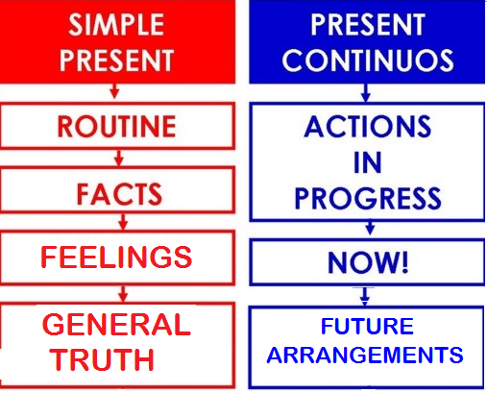
Present simple vs present continuous
She always has cereal, fruit and yogurt for breakfast.
I live in small house and I have a dog.
I don’t like P.E. I am a couch potato.
Water boils AT 100°C
Alex is living in a flat meanwhile he finds a house.
I’m learning the diference between present simple and continuous
We’re travelling to Cancun next holidays, I can’t wait!

Slide 31
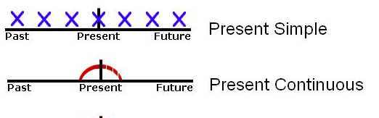
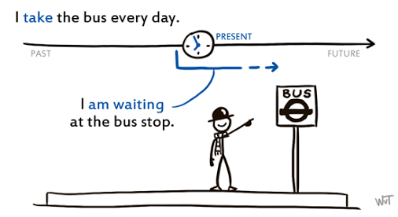
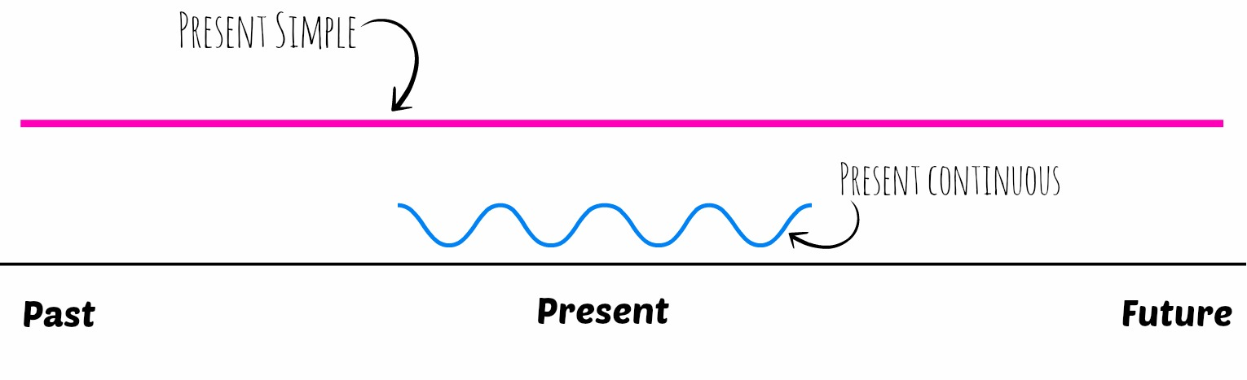
Still questions?

Slide 32
Present simple or continuous
Complete the sentences with the present simple or present continuous form of the verbs in brackets. Use contractions where possible
She(run) because she's late for her lesson. _______________________________
Our teacher always(give) us lots of homework. ___________________________
We(not want) to go to the concert. ___________________________________
What time(you / meet) Pete tomorrow? ________________________________
I(not work) today. I'm on holiday. ______________________________________
People(speak) English in Jamaica. ______________________________________
Archie(not use) his computer at the moment. ____________________________
(Tony / live) near the park? __________________________________________

Slide 33
answers
She IS RUNNING because she's late for her lesson.
Our teacher always GIVES us lots of homework.
We DON’T WANT to go to the concert.
What time ARE YOU MEETING Pete tomorrow?
I AM NOT WORKING today. I'm on holiday.
People SPEAK English in Jamaica.
Archie IS NOT USING his computer at the moment.
DOES TONY LIVE near the park?

Slide 34
EXERCISES
Present Progressive
Write the ing-form of the following verbs.
fly - _______________
book - _____________
hit - _______________
take - ______________
lie - _______________
Simple Present
Write the 3rd person singular of the following verbs (in Simple Present).
do - he _________________
worry - she ______________
play - she ________________
watch - he _______________
invite - she _______________
When to use which tense?
Which tense do you have to use with the following signal words: Look!, now? _______________________
Which tense do you have to use with the following signal words: often, seldom, never? ______________________
For actions happening at the moment of speaking, we use. ___________________________
For actions set by a timetable or schedule, we use. ___________________________
In a story, for present actions happening one after another, we use. ___________________________
For arrangements for the near future, we use. _______________________

Slide 35
ANSWERS
Write the ing-form of the following verbs.
fly - flying
book - booking
hit - hitting
take - taking
lie - lying
Write the 3rd person singular of the following verbs (in Simple Present).
do - he does
worry - she worries
play - she plays
watch - he watches
invite - she invites
When to use which tense?
Which tense do you have to use with the following signal words: Look!, now? Present Progressive-Continuous
Which tense do you have to use with the following signal words: often, seldom, never? Simple Present
For actions happening at the moment of speaking, we use Present Progressive-Continuous
For actions set by a timetable or schedule, we use Simple Present.
In a story, for present actions happening one after another, we use Simple Present.
For arrangements for the near future, we use Present Progressive-Continuous

Slide 36
EXERCISES
Positive sentences
Complete the sentences. Use Simple Present or Present Progressive.
We (help) ________ in the canteen this week.
Martin usually (drive) ________ to work.
But today, he (take) ________ the bus.
Listen! She (practise) ________ the piano.
My friend (play) ________ the guitar every evening.
Negative sentences
Complete the sentences. Use Simple Present or Present Progressive.
He (not / spend) ________ his holidays in Spain each year.
I (not / meet) ________ Francis tonight.
They (not / fly) ________ to London tomorrow.
We (not / work) ________ this week.
The film (not / begin) ________ at 7 o'clock.

Slide 37
ANSWERS
Complete the sentences. Use Simple Present or Present Progressive.
We are helping in the canteen this week.
Martin usually drives to work.
But today, he is taking the bus.
Listen! She is practising the piano.
My friend plays the guitar every evening.
Complete the sentences. Use Simple Present or Present Progressive.
He does not spend his holidays in Spain each year.
I am not meeting Francis tonight.
They are not flying to London tomorrow.
We are not working this week.
The film does not begin at 7 o'clock.
My friend plays the guitar every evening.

Slide 38
EXERCISES
Text
Complete the sentences. Use Simple Present or Present Progressive.
Maria (want) ______________ to improve her English.
Therefore, she (do) ______________ a language course in London at the moment.
She (stay) ______________ with a host family and(must) ______________ take the tube to get to her language school.
It (be) ______________ only a five-minute walk to the nearest tube station.
The tube (leave) ______________ at half past eight.
The first lesson (begin) ______________ at 9 o'clock.
In the afternoons, the school (offer) ______________ sightseeing tours in and around London.
Tomorrow, the students of the language school (go) ______________ to Windsor.
Question
Complete the sentences. Use Simple Present or Present Progressive.
(leave / you) ______________ the party now?
(have / you) ______________ any brothers or sisters?
(love / she) ______________ him?
Who (cook) ______________ dinner tonight?
(send / he) ______________ you an e-mail every day?

Slide 39
answers
Complete the sentences. Use Simple Present or Present Progressive.
Maria wants to improve her English.
Therefore, she is doing a language course in London at the moment.
She is staying with a host family and must take the tube to get to her language school.
It is only a five-minute walk to the nearest tube station.
The tube leaves at half past eight.
The first lesson begins at 9 o'clock.
In the afternoons, the school offers sightseeing tours in and around London.
Tomorrow, the students of the language school are going to Windsor.
Complete the sentences. Use Simple Present or Present Progressive.
Are you leaving the party now?
Have you got any brothers or sisters?
Does she love him?
Who is cooking dinner tonight?
Does he send you an e-mail every day?

Slide 40
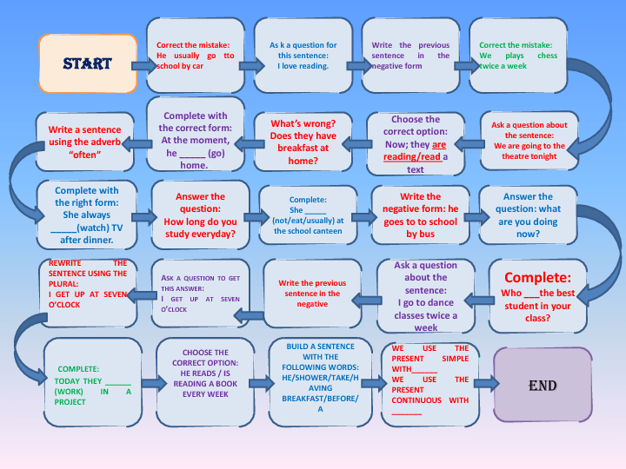
Let’s play

Slide 41
referencias
Falla, Tim, Solutions: Elementary Student’s book,.Oxford Press, Oxford, London. 2nd edition.
Falla, Tim, Solutions: Elementary Workbook,.Oxford Press, Oxford, London. 2nd edition.
https://www.ego4u.com/
http://www.perfect-english-grammar.com/

Slide 42
Guion explicativo para el empleo del material, con relación a los objetivos y contenidos del curso
La asignatura de inglés 2 correspondiente al campo disciplinar de la Comunicación ubicándose en el tercer semestre con el propósito general de Emplea el idioma inglés para satisfacer sus necesidades inmediatas de interacción, supervivencia y de relación con su entorno inmediato, de forma simple, por medio de expresiones cotidianas, frases comunes, familiares y representaciones lingüísticas asociadas al contexto cultural y social. (programa de inglés 2, 2016).
El curso se compone de 4 módulos:
El primer módulo hace un link con los temas del semestre anterior sin embargo ahora se contrastan en lugar de verse por separado. El módulo dos trata de comida y cantidades, de conseguir una vida saludable, el tercero busca narrar eventos del pasado y finalmente el modulo cuatro compara y contrasta situaciones y elementos del entorno del estudiante.

Slide 43
De forma más específica el módulo I “Ocasiones especiales: ¿Qué está pasando? y ¿Qué hacen las personas que están a mí alrededor?” tiene como propósito: Describe su entorno social inmediato mencionando lo que está pasando a su alrededor y lo que hacen las personas a su alrededor.
Por lo que las presentes diapositivas se centran en el desarrollo de la descripción de acciones que usualmente ocurren o que son verdades generales así como también eventos que están ocurriendo este momento y momentos arreglados en el futuro.

Slide 44
Competencias
Competencia de la dimensión (perfil de egreso)
COMPETENCIA DISCIPLINAR
Comunicación. Básica
10 Identifica e interpreta la idea general y posible desarrollo de un mensaje oral o escrito en una segunda lengua, recurriendo a conocimientos previos, elementos no verbales y contexto cultural.
11. Se comunica en una lengua extranjera mediante un discurso lógico, oral o escrito, congruente con la situación comunicativa.
Extendida
9. Trasmite mensajes en una segunda lengua o lengua extranjera atendiéndolas características de contextos socioculturales diferentes.
COMPETENCIA GENÉRICA
4 Escucha, interpreta y emite mensajes pertinentes en distintos contextos mediante la utilización de medios, códigos y herramientas apropiados.
4.4 Se comunica en una segunda lengua en situaciones cotidianas.
7. Aprende por iniciativa e interés propio a lo largo de la vida.
7.1 Define metas y da seguimiento a sus procesos de construcción de conocimiento.
10. Mantiene una actitud respetuosa hacia la interculturalidad y la diversidad de creencias, valores, ideas y prácticas sociales.
10.2 Dialoga y aprende de personas con distintos puntos de vista y tradiciones culturales mediante la ubicación de sus propias circunstancias en un contexto más amplio.

Slide 45
Módulo 1
TEMA 1 | Hábitos, rutinas y descripción de acciones que ocurren en el momento durante ocasiones especiales
Uso de la lengua | Present simple and present continuous
Vocabulario | Habits and routines Actions happening now Arrangements

